Slide 1
Case Study 112 Demyelinating Disorders
Swati Laroia, DO
PGY III

Slide 2
HPI
19 yr old right handed Caucasian female presents with acute painful vision loss x 3 days in her right eye. She was studying for her final exams in college and thought it may be due to fatigue and lack of sleep. When her vision did not get better, she presented to the ER.

Slide 3
History
PMHx: Anxiety, Migraines
Surgical Hx: None
Meds: None
Social Hx: (-) Tobacco/ (+) Occasional Alcohol/ (-) Drugs
Family Hx: Migraines
Allergies: None

Slide 4
Physical Exam
ROS: (-) SOB / (-) CP / (-) Numbness / (-) Parasthesias / (-)Urinary Problems / (-) Constipation / (+) Right Eye Pain upon EOM / (+) Right Eye Vision Loss
Clinical Exam:
General: well nourished, fully developed F
Cardiac: RRR
Resp: CTA B/L
GI: Soft, Non Tender, Non Distended
Integ: Soft, Dry, Intact
Neuro:
CN: +Afferent Pupillary Defect in Right Eye, Left Eye PERRL, EOMI B/L, VF intact Left Eye, VF Right Eye elicits central scotoma, Optic Disc Margin in Right Eye Blurred, Facial Expression Symmetrical, Facial Sensation V1-V3 Intact to Touch, Pinprick, Temperature, Tongue and Uvula Midline, Shoulder Shrug 5/5, Color Desaturation of Right Eye
MSK: 5/5 UE and LE b/l
Cerebellar: Finger to Nose Intact B/L, Heel to Shin Intact B/L, No Pronator Drift B/L
Sensory: Intact to Pain, Pinprick, Temperature, Proprioception B/L UE and LE
Reflexes: +2/4 UE and +2/4 LE B/L, Downgoing Toes B/L
Gait: Normal

Slide 5
Differential Diagnosis

Slide 6
Differential Diagnosis
Ischemic Optic Neuropathy
Arteritic and Non Arteritic
Infections
Meningitis
Syphilis
Lyme Disease
Toxoplasmosis, Bartonella
PML
Inflammatory
Sarcoidosis
Sjogrens
Lupus
Genetic
Leber’s hereditary optic neuropathy
Kjer type autosomal dominant optic neuropathy
Neoplasms
Optic Glioma
Meningioma
Metastasis
Lymphoma

Slide 7
Differential Diagnosis
Compression
Abscess
Carotid ophthalmic artery aneurysm
Thyroid ophthalmopathy
Orbital pseudotumor
Pseduotumor cerebri
Toxic/Metabolic
Drugs
Toxins
B12, B1, Folate Deficiency
Tobacco/Alcohol Amblyopia
Radiation
Demyelinating
NMO
MS

Slide 8
Work Up

Slide 9
Workup
CMP
CBC
MRI Brain w/ and w/o contrast
MRI C Spine
MRA
LP
RPR
Lyme Titer

Slide 10
Results
CMP : normal
CBC : normal
MRI Brain w/ and w/o contrast: enhancement of right optic nerve
MRI C Spine w and w/o contrast : normal
MRA : normal
LP : normal
RPR : negative
Lyme Titer : negative
Sjogrens Abs (La/Ro): negative

Slide 12
Treatment Choices

Slide 13
Treatment
1 Gram IV Solumedrol x 5 Days
Optic Neuritis Treatment Trial
IV Solumedrol accelerated recovery of visual function
IV Solumedrol reduced risk of conversion to MS when compared to oral prednisone or placebo

Slide 14
Clinically Isolated Syndrome

Slide 15
What if the patient had NMO?
What AB would come back (+) ?
What would be clinical findings?
What would the pathologic features be?
What are the radiographic findings?
Treatment?

Slide 16
NMO
NMO Ab: Aquaporin 4
Clinical Findings:
Vision Loss
Weakness
Sensory loss at a distinct level
sphincter disturbances
Pathologic Features:
Cavitary Lesions may contain sheet of macrophages and absence of axons.
Optic nerve may show cavitary lesions.

Slide 17
NMO
Radiographic Features
Enhancement of the spinal cord in 3 or more segments on MRI and Optic Nerve Enhancement on MRI
Treatment:
1 gram IVIG x 5 days
OR
Plasma Exchange (in severe cases)

Slide 18
The story continues…
The patient did well over the course of five weeks.
She regained her full vision and had serial optic exams yearly
Twenty three years later, she noticed she was having numbness and tingling of her left leg, increasing gait difficulty due to balance issues and bladder problems

Slide 19
Work Up

Slide 20
Work Up
MRI Brain W/ and W/O Contrast
MRI C, T, L Spine W/ and W/O contrast
LP: CSF (+) IgG Oligoclonal Bands

Slide 21
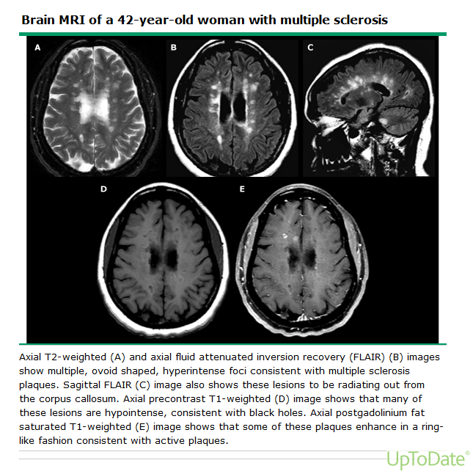
Results

Slide 22
Diagnosis

Slide 23
McDonald Criteria
Objective demonstration of dissemination of central nervous system lesions in both space and time, based upon either clinical findings alone or a combination of clinical and MRI findings
is demonstrated with MRI by one or more T2 lesions in at least two of four MS-typical regions of the central nervous system (periventricular, juxtacortical, infratentorial, or spinal cord) or by the development of a further clinical attack implicating a different central nervous system site.
is demonstrated with MRI by the simultaneous presence of asymptomatic gadolinium-enhancing and nonenhancing lesions at any time, or a new T2 and/or gadolinium-enhancing lesion(s) on follow-up MRI, irrespective of its timing with reference to a baseline scan, or by the development of a second clinical attack.

Slide 24
Clinical Features
Acquired, progressive chronic inflammatory disorder of the CNS that causes multiple demyelinating lesions “in space and time”
Incidence increases away from the Equator
Demyelination confined to CNS
W > M
¾ of patients present between the ages of 15-45 years

Slide 25
Clinical Features: Types
Relapsing/Remitting
85% of cases
Sporadic Attacks with new or worsened symptoms over a period of 2-10 days
Variable improvement over 1-6 months
Primary Progressive
15% of cases
Progressive disease without true relapses
Secondary Progressive
Conversion to progressive disease in approximately 50% of RR patients
Progressive Relapsing
Gradual deterioration from onset of symptoms but with superimposed relapses

Slide 26
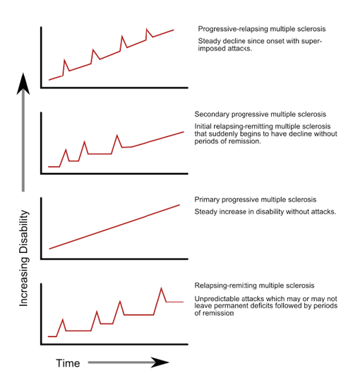
Clinical Features: Types

Slide 27
Radiologic Features
Periventricular and peripheral white matter T2-hyperintense lesions
Supratentorial ovoid-shaped lesions
Frequent cerebellar and brain stem surface lesions
T1-weighted images often show “black holes,” which represent focal areas of more severe injury
Atrophy may be apparent early, as indicated by enlarged sulci, thinning of the corpus callosum, and widening of the third ventricle

Slide 28
Pathologic Features: Gross Findings
Gross findings in patients with long-standing disease include mild to moderate cerebral atrophy and hydrocephalus ex vacuo
Optic Nerves and Chiasm may be grossly atrophic
Superficial plaques may be evident on the surface of the brainstem and corpus callosum or lining the walls of the lateral ventricles
Coronal Sections in typical relapsing-remitting MS reveal sharply outlined, gray-glistening patches of myelin loss, most of which range from 2 to 10mm in diameter
The cerebrum, cerebellum, brain stem, spinal cord, and optic nerve/chiasm are variably involved

Slide 29
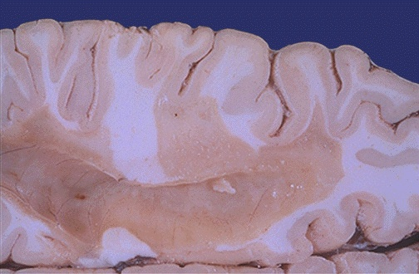
Gross Findings
Seen here in white matter is a large "plaques" of demyelination in
Gross Findings_1

Slide 30
Gross Findings
Gross Findings_2

Slide 31
Pathologic Features: Microscopic Findings
Plaques near the ventricles are immediately adjacent to the ependymal lining
Subpial plaques are often wedge shaped, with a broad base adjacent to the subarachnoid space
Plaques involving the gray matter are best seen with myelin stains
Plaques at autopsy are either chronic active or chronic inactive

Slide 32
Pathologic Features: Microscopic Findings
Activity is based on presence or absence of macrophages
Chronic Inactive Plaques:
Hypocellular
Loss of Oligodendrocytes
Astrocytosis
No Macrophages
Acute Demyelination
Macrophages with myelin debris stained with Luxol Fast Blue (LFB)
Subacute Demyelination
Macrophages containing PAS-stained material
Remyelinated Lesions
Shadow Plaques

Slide 33
H&E: Perivascular Lymphocytes
H&E

Slide 34
H&E: Demyelination
H&E2

Slide 35
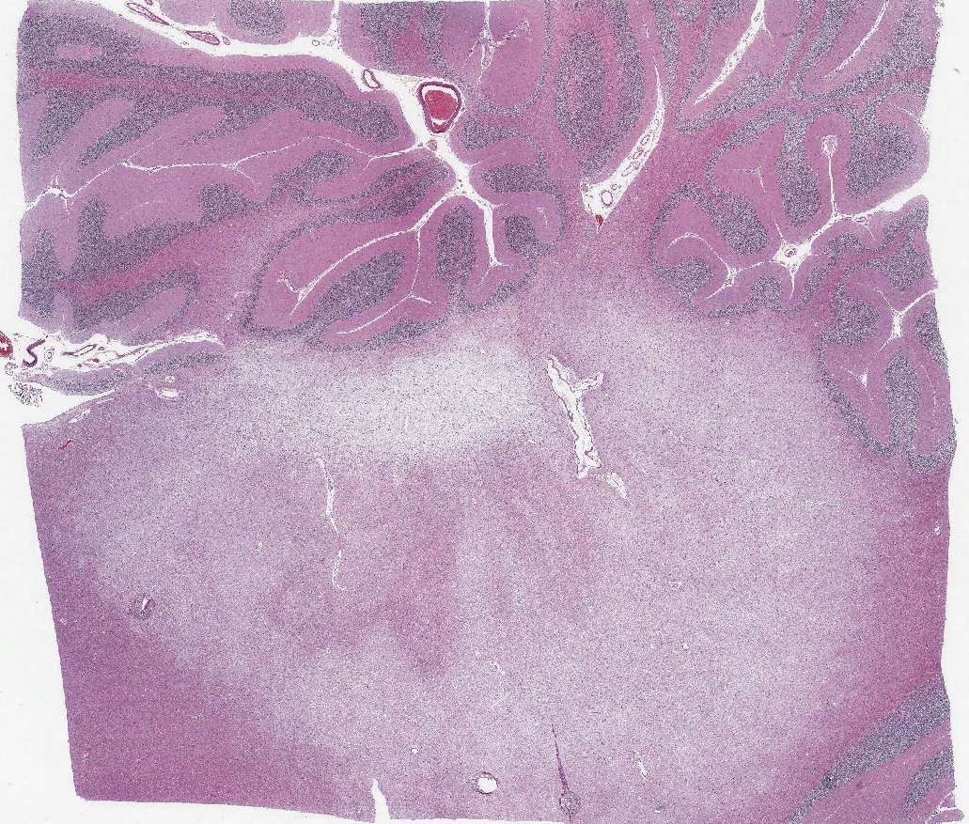
H&E: Demyelination
H&E3

Slide 36
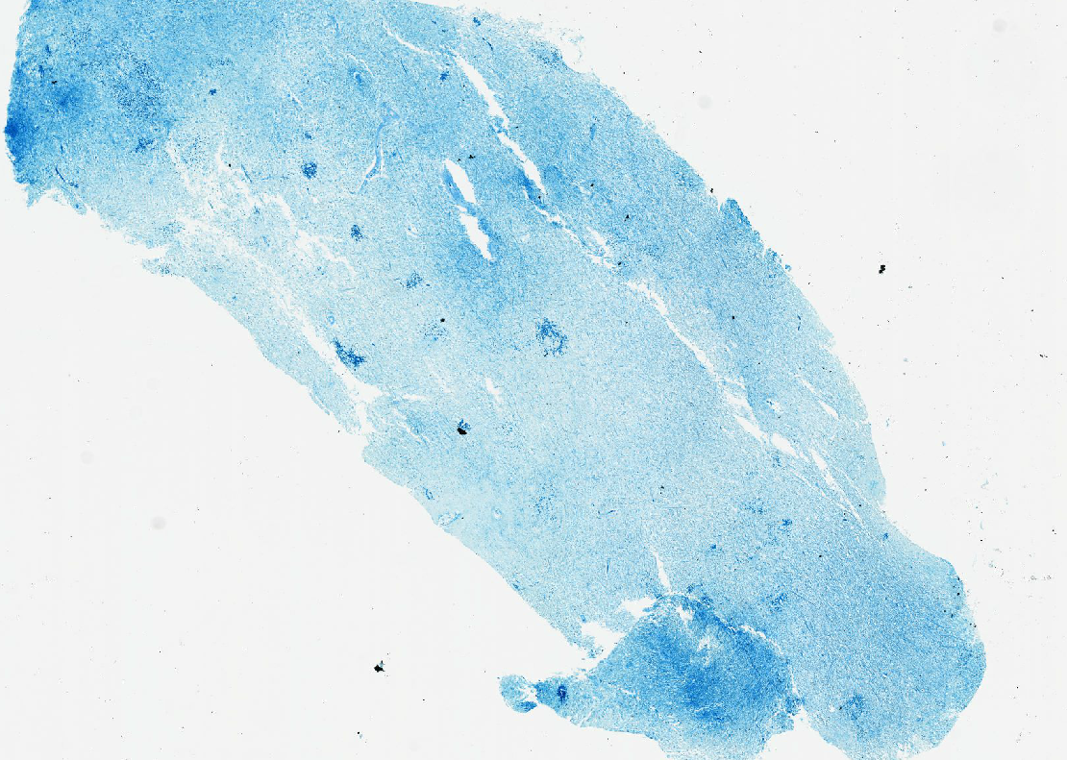
Luxol Fast Blue: Demyelination
Luxol Fast Blue

Slide 37
Neurofilament: Normal
Neurofilament

Slide 38
Treatment Options
“The choice of a specific agent should be individualized according to disease activity and patient values and preferences” UpToDate
Infusion Therapy: Effectiveness > Safety & Convenience
Oral Therapy: Convenience > Effectiveness & Safety
Injections Therapy: Safety > Effectiveness & Convenience

Slide 39
DMA: An Overview
Injectable Therapy: Interferon Betas (Betaseron)
Interferon Beta 1-b: cytokine that modulates immune responsiveness
Interferon Beta 1-a:
Side Effects: Flu Like Illness, Injection Site Necrosis, Liver Disease, Anemia, Thyroid
Injectable Therapy: Glatiramer Acetate
Glatiramer Acetate: Polymer of 4 Amino Acids. The mixture is antigenically similar to myelin basic protein, a component of the myelin sheath of nerves. In experimental models, the immunomodulatory mechanism of action for glatiramer involves binding to major histocompatibility complex molecules and consequent competition with various myelin antigens for their presentation to T cells. In addition, glatiramer is a potent inducer of specific T helper 2 type suppressor cells that migrate to the brain and lead to bystander suppression; these cells also express anti-inflammatory cytokines
Side Effects: Post site reaction, less commonly: flushing, dyspnea, anxiety, cp

Slide 40
DMA: An Overview
Infusion Therapies: Natalizumab (Tysabri)
Natalizumab is a monoclonal antibody against the alpha-4 subunit of integrin molecules. These molecules are important to adhesion and migration of cells from the vasculature into inflamed tissue. Natalizumab blocks integrin association with vascular receptors, limiting adhesion and transmigration of leukocytes.
Side Effects:
Black Box Warning for PML
Test for JC Virus Abs after first yr
Infusion Reaction: Flushing, Erythema, Nausea, Lightheaded
Infections (UTI/PNA)
Anxiety
Fatigue
Peripheral Edema

Slide 41
DMA: An Overview
Oral Therapy: Dimethyl Fumarate (Tecfidera)
DMF and its active metabolite, monomethyl fumarate (MMF), have been shown to activate the nuclear factor (erythroid-derived 2)-like 2 (Nrf2) pathway, which is involved in cellular response to oxidative stress. The mechanism by which dimethyl fumarate (DMF) exerts a therapeutic effect in MS is unknown, although it is believed to result from its anti-inflammatory and cytoprotective properties via activation of the Nrf2 pathway
Side Effects:
GI symptoms
Flushing
Oral Therapy: Teriflunomide (Aubagio)
active metabolite of leflunomide that inhibits pyrimidine biosynthesis and disrupts the interaction of T cells with antigen presenting cells
Side Effects:
GI Symptoms
Hair Thinning
Elevated ALT levels
Oral Therapy: Fingolimod (Gilenya)
sphingosine analogue that modulates the sphingosine-1-phosphate receptor and thereby alters lymphocyte migration, resulting in sequestration of lymphocytes in lymph nodes
Side Effects:
Cryptococcal Infections
PML
Varicella Zoster Infections

Slide 43
References
http://www.uptodate.com/contents/disease-modifying-treatment-of-relapsing-remitting-multiple-sclerosis-in-adults?source=preview&search=multiple+sclerosis+treatment&language=en-US&anchor=H3&selectedTitle=1~150#H21
http://library.med.utah.edu/WebPath/CNSHTML/CNS085.html
http://www.uptodate.com/contents/optic-neuritis-pathophysiology-clinical-features-and-diagnosis?source=search_result&search=Optic+Neuritis&selectedTitle=1%7E150
http://www.uptodate.com/contents/optic-neuritis-prognosis-and-treatment?source=preview&search=optic+neuritis+treatment&language=en-US&anchor=H7&selectedTitle=1~150#H7
http://patient.info/education/multiple-sclerosis
Prason, Richard. Neuropathology. 2012. Dysmyelinating and Demyelinating Disorders. P200-210

