Slide 1
72-year-old male with fever of unknown origin
Lananh Nguyen, M.D.
Division of Neuropathology
University of Pittsburgh Medical Center

Slide 2
Clinical history
Patient complains of fluctuating fevers for the last 3 weeks.
He has diplopia due to CN IV palsy but no surgical or family history.

Slide 3
What is the differential diagnosis for fever of unknown origin (FUO)?

Slide 4
What is the differential diagnosis for fever of unknown origin (FUO)?

Slide 5
Additional history and workup results
Patient has myalgias, joint pain, headache and jaw claudication.
Scalp was tender to palpation.
Imaging was negative for mass lesions.
Serologies and cultures were negative.
Prophylactic antibiotics were initiated without significant improvement.

Slide 6
What did the clinician do next and why?
A temporal artery biopsy was ordered with a suspicion for an inflammatory disorder.
The biopsy specimen was sent to pathology for evaluation.

Slide 7
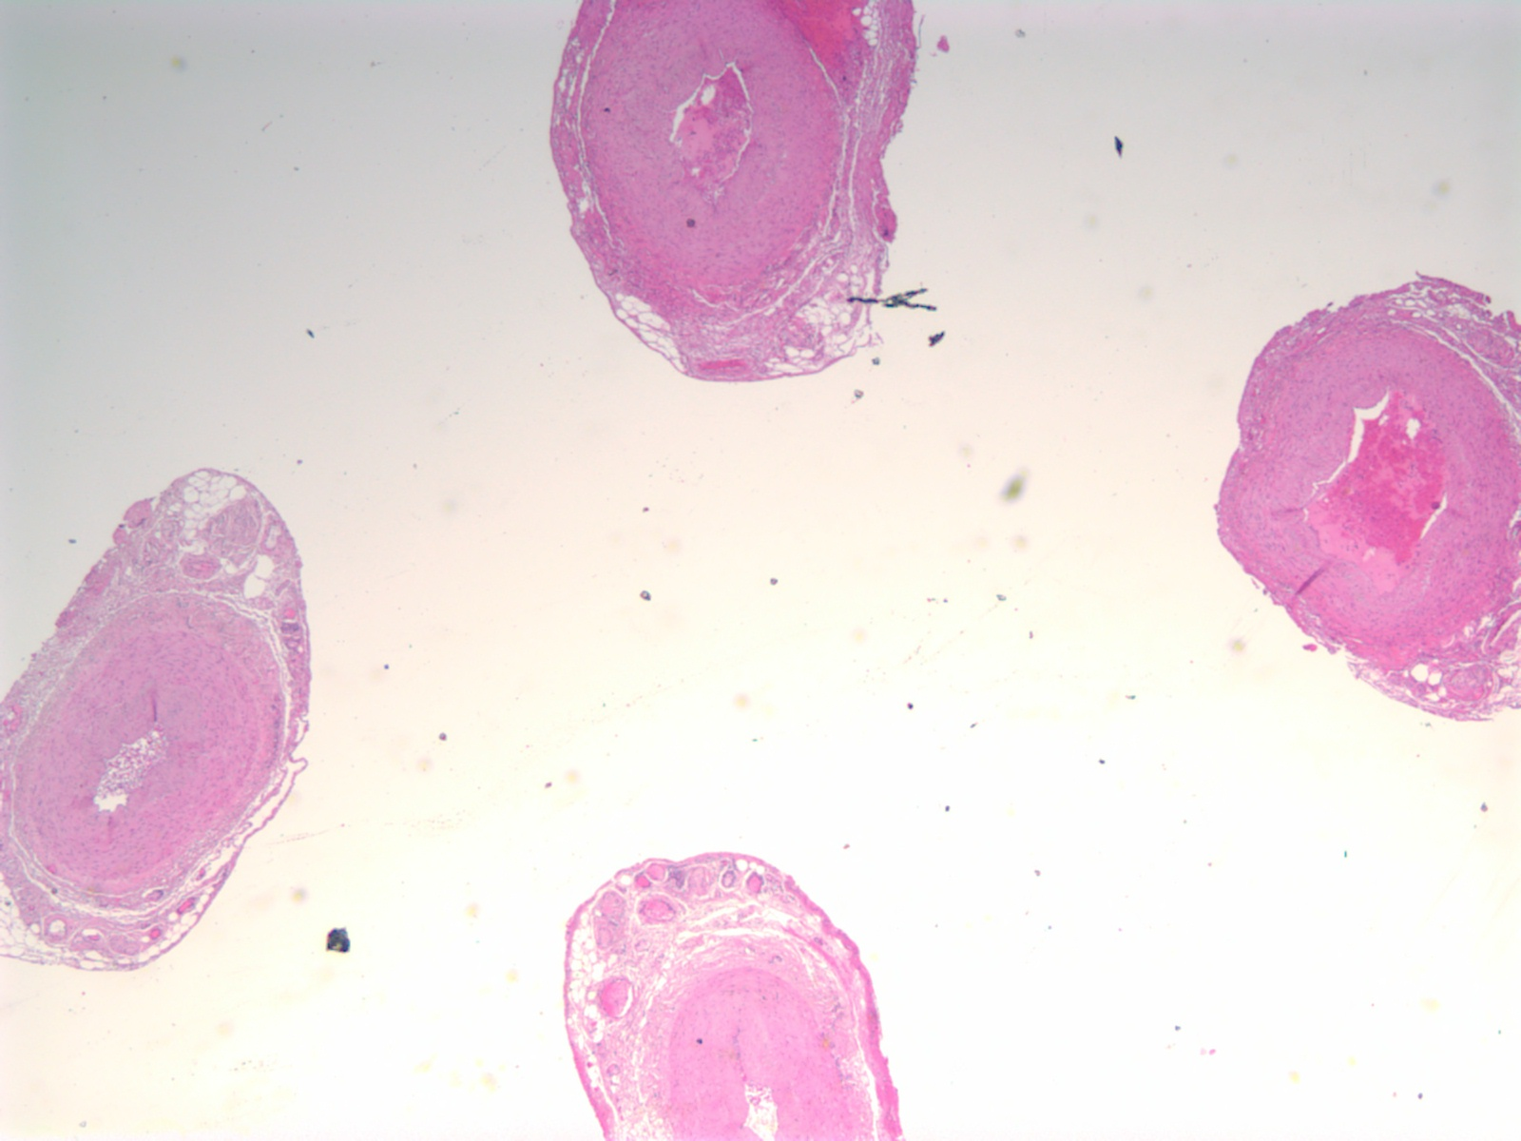
Gross description: 5 x 0.2 cm tissue labeled “left temporal artery”
Serial sections of the entire vessel

Slide 8
Why is it important to evaluate the entire length of the vessels?

Slide 9
Why is it important to evaluate the entire length of the vessels?
Inflammatory lesions show patchy distribution hence, you need to evaluate for skip lesions.
Skip lesions are just that, non contiguous lesions along the length of the vessels.

Slide 10
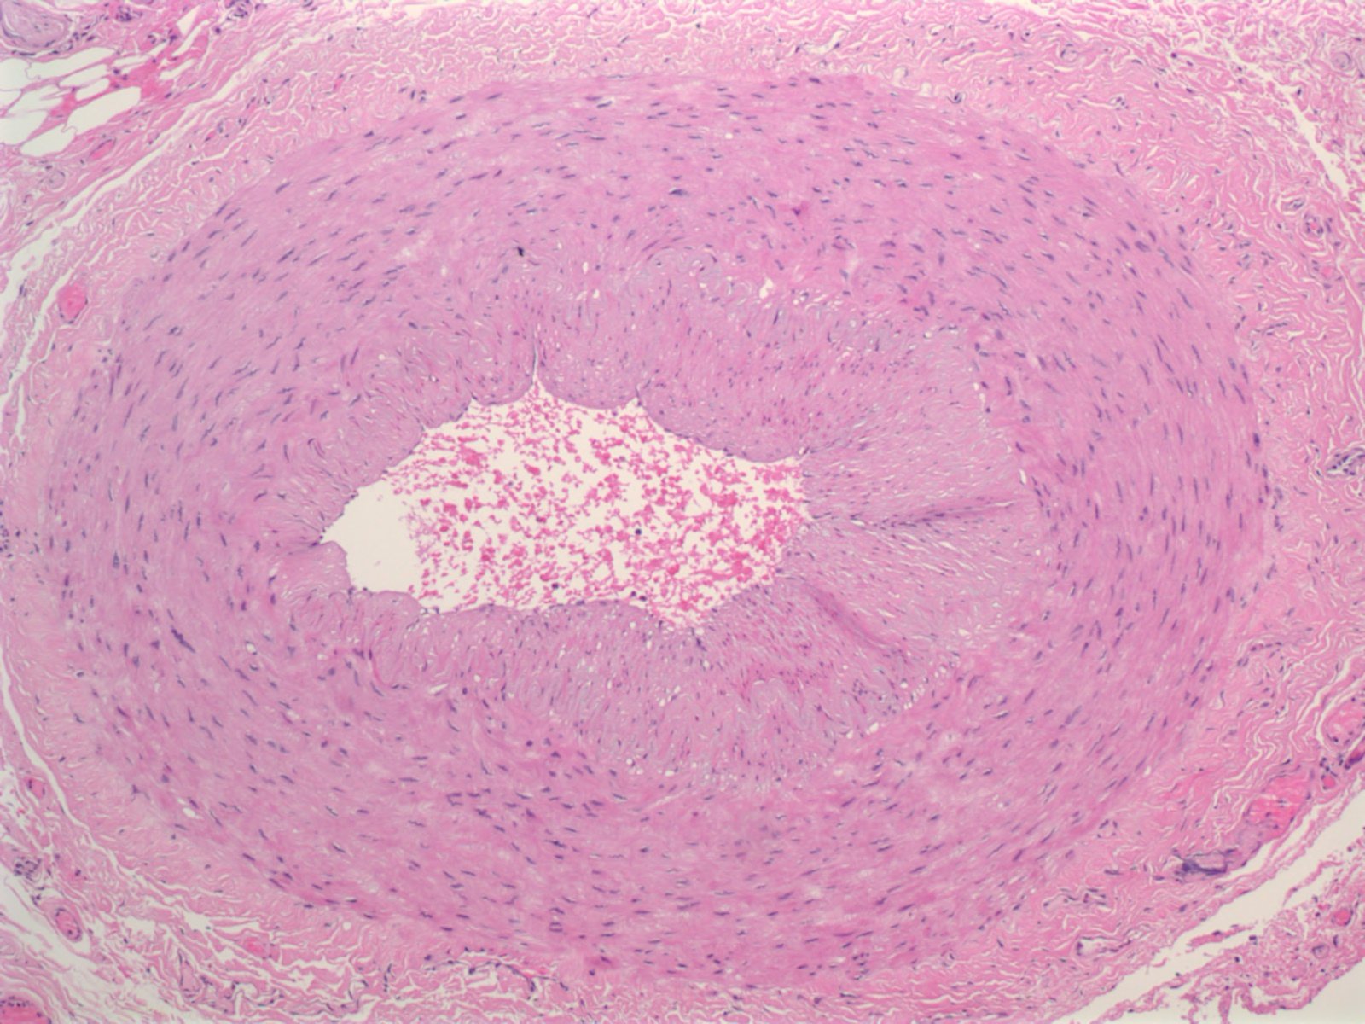
This is one section on the slide. Name the histologic layers indicated by ***. What is your interpretation?
***
***
***

Slide 11
This is a normal section. This is an artery as evident by the thick muscular wall.
Adventitia
Media - muscular wall
Intima

Slide 12
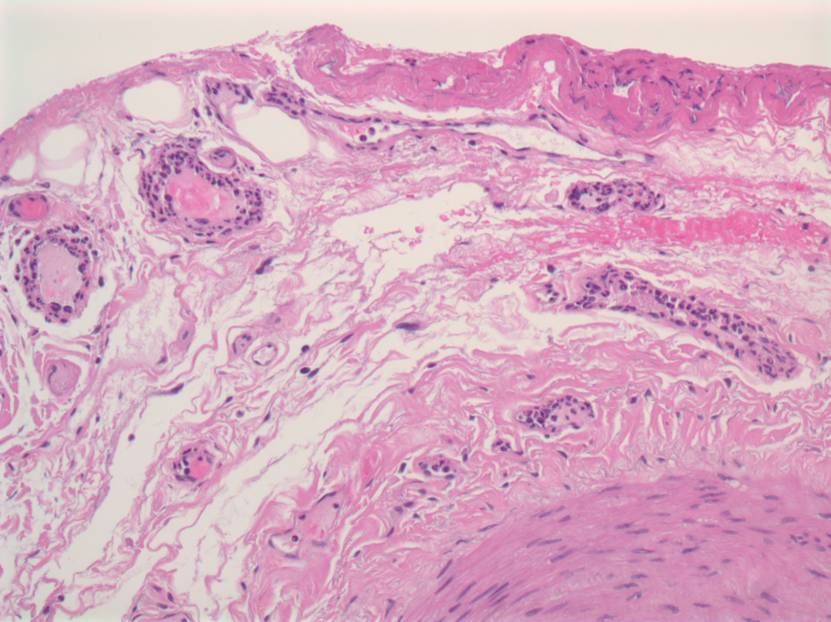
This is another section on the slide. What vessel layer are we in and what do you see?

Slide 13
There is inflammation in the vasa vasorum, branches of the temporal artery

Slide 14
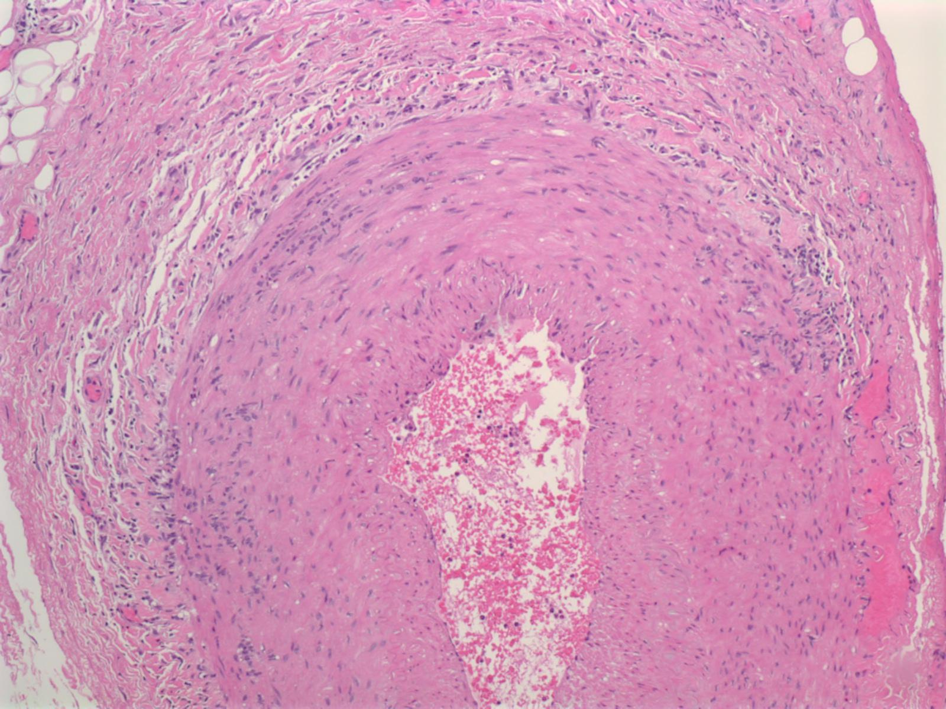
This is another section. What do you see?

Slide 15
This section shows significant inflammation around and infiltrating the vessel wall.

Slide 16
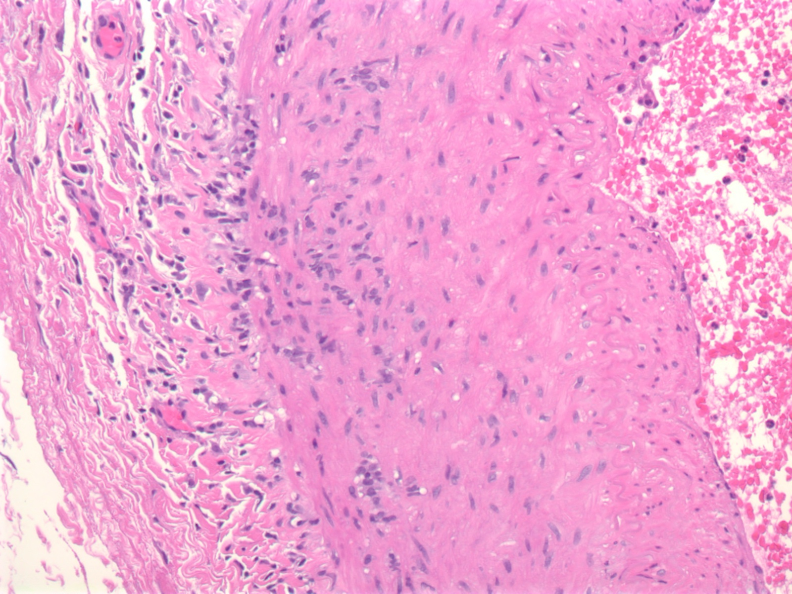
Higher magnification shows inflammatory cells in the adventitia and infiltrating the media.

Slide 17
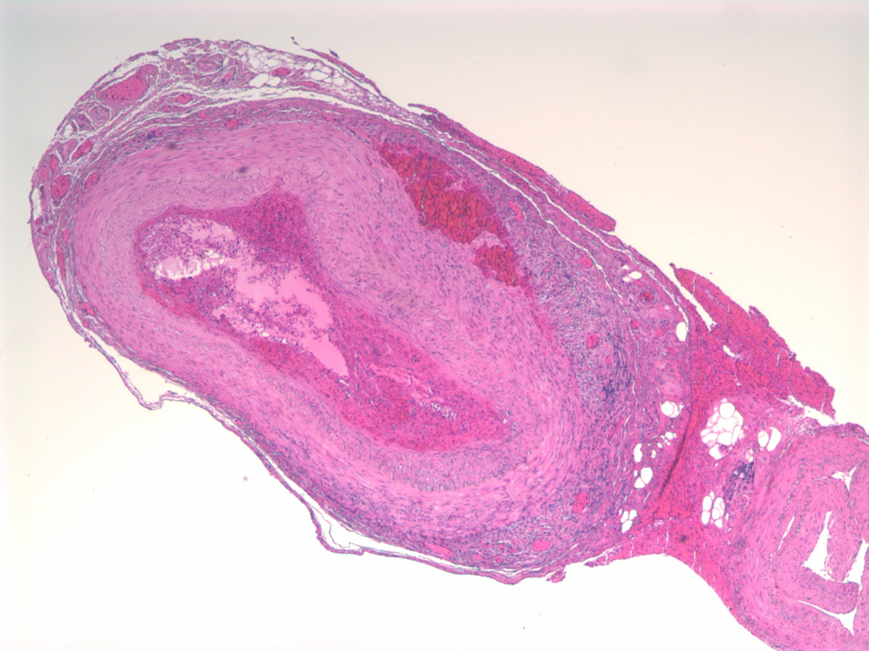
This is another section where severe inflammation can be appreciated even at low power.

Slide 18
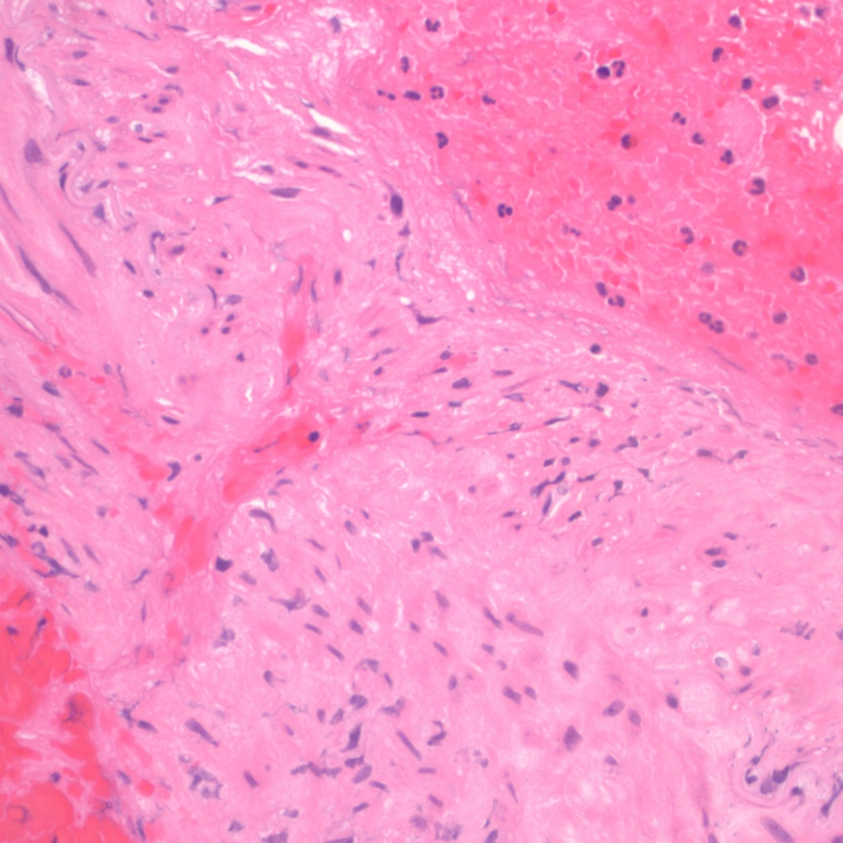
Higher magnification shows inflammatory cell infiltration with disruption of the internal elastic lamina, the structure which separates the intima from the media.
Internal elastic lamina, note the squiggly pink line

Slide 19
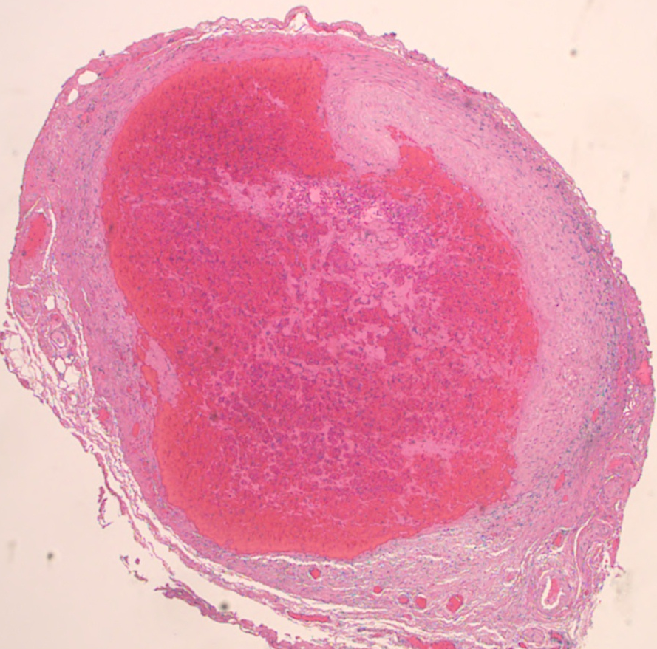
Another section shows loss of vessel integrity. No granulomas or giant cells were identified.

Slide 20
Final diagnosis
ARTERY, LEFT TEMPORAL, BIOPSY:
POSITIVE FOR ARTERITIS.

Slide 21
What is the treatment?

Slide 22
What is the treatment?
Glucocorticoids, even prior to confirmatory biopsy. This is key to preventing anterior ischemic optic neuropathy (otherwise known as permanent visual loss). Preferably, biopsy should be perform soon after administration.

Slide 23
Discussion – Take home points
Giant cell arteritis (GCA) is a large vessel vasculitis (aorta and primary branches with a predilection for extracranial arteries)
Pathologically, giant cells may not be present and skip lesions can occur. Therefore, evaluate multiple levels and evaluate the vasa vasorum (branches of the temporal artery) for evidence of inflammatory cells.
Mean age 70; female:male 2:1
SIGNS AND SYMPTOMS: new-onset headache, fever, visual symptoms (blindness, amaurosis fugax, diplopia), TA/scalp tenderness, jaw claudication, weight loss
LABS: elevated ESR/CRP but also anemia, hypoalbuminemia, transaminitis. SIADH Is associated with GCA
40% with GCA have polymyalgia rheumatica (PMR) but only 10% with PMR have GCA on temporal artery biopsy. It’s a spectrum.
American College of Rheumatology criteria for diagnosis: 3 out of the following 5
Age > 50
New headache
Temporal artery abnormality
ESR > 50
Abnormal temporal artery biopsy

