Slide 1
Case Study #105
Michael Reznik
PGY-4 Neurology Resident (2014)

Slide 2
Case Vignette
46 year old African-American man
6 months of progressive visual loss, becoming nearly completely blind.
Began having visual hallucinations
Progressively became more frightening prompting him to become violent and agitated at times.

Slide 3
What is on the differential diagnosis for optic neuropathy?

Slide 4
What is on the differential diagnosis for optic neuropathy?
Vascular: Non-arteritic ischemic optic neuropathy, arteritic ischemic optic neuropathy (including giant cell arteritis)
Infectious/parainfectious: Lyme, syphilis, multiple viruses, Toxoplasmosis, Bartonella, meningitis
Trauma; Toxins/drugs: toxic alcohols
Autoimmune/inflammatory: Multiple sclerosis, neuromyelitis optica, sarcoidosis, Sjogren’s, Behçet’s
Metabolic: Nutritional deficiency (thiamine, B12, folate)
Inherited/congenital: Leber’s hereditary optic neuropathy, Autosomal dominant optic neuropathy
Neoplastic/paraneoplastic: Optic glioma, lymphoma, meningioma
Compressive: Pseudotumor cerebri, orbital pseudotumor, thyroid ophthalmopathy, abscess, tumor, carotid-ophthalmic artery aneurysm

Slide 5
Case Vignette (cont’d)
Brain MRI showed enhancement of both optic nerves
Ophthalmologic testing showed bilateral optic nerve atrophy.
Trial course of IV steroids which appeared to bring about some improvement, and he was initially started on Imuran (azathioprine) for maintenance immunosuppression for an as-yet-undiagnosed cause of bilateral optic neuritis.
Over the following 2 months progressive worsening of his cognition with confusion and general forgetfulness along with personality changes including more frequent aggressive behavior.
Worsening bifrontal/temporal headaches.
Methotrexate added, but symptoms progressed.
Exam was notable for:
active visual hallucinations, agitation; poor attention with poor word recall; poorly reactive pupils bilaterally with only some light perception; difficulty with rightward gaze, including right-beating nystagmus; left > right intention tremor; and a wide-based and ataxic gait, with consistent falling to the left. There was no motor weakness, sensory loss, or pathologic reflexes.

Slide 6
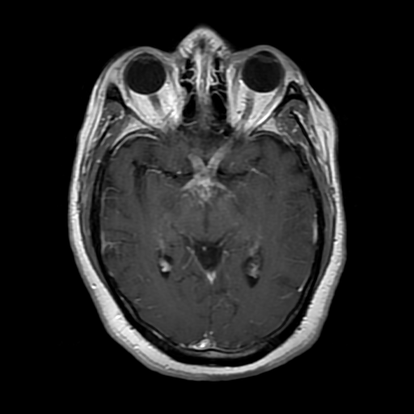
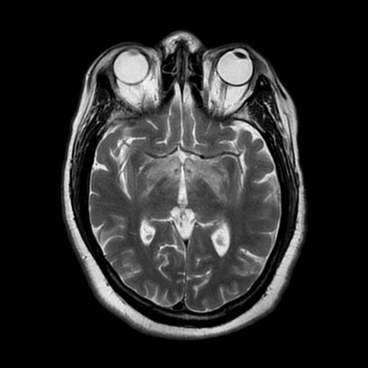
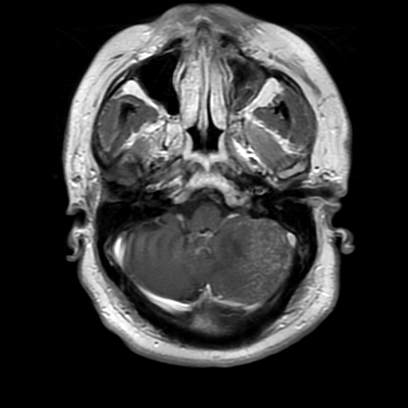
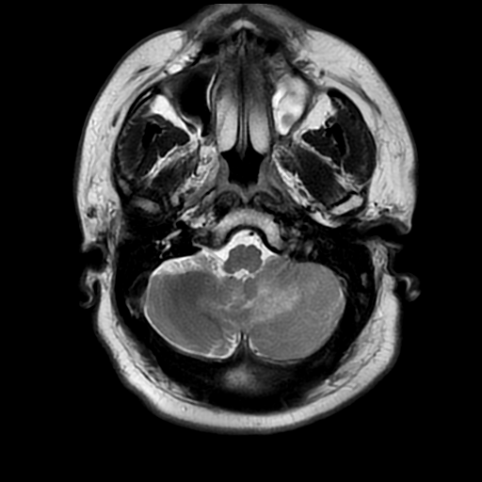
Brain MRI
Left: T1 w/ gadolinium
Right: T2
What are findings?

Slide 7
Brain MRI
Left: T1 w/ gadolinium
Right: T2
Enhancement of optic nerves including optic chiasm and tracts, as well as the pituitary, hypothalamus, anterior thalamus, and L cerebellum.

Slide 8
CSF Results
WBC 16 (Neutrophils 1%, Lymphocytes 92%, Monocytes 8%, Atypical Lymphs 1%).
RBC: 51
Glucose: 46
Protein: 130
VDRL: Non-reactive
CSF Culture: negative
Fungal Culture: negative
Viral Culture: negative
AFB: negative
Cryptococcal Antigen: negative
Enterovirus: negative
Viral PCR (CMV, HSV-1, HSV-2, VZV): negative
Meningoencephalitis panel: negative
Cytology: SATISFACTORY FOR INTERPRETATION. NEGATIVE FOR MALIGNANT CELLS. MONOCYTES, LYMPHOCYTES, RARE NEUTROPHILS AND RED BLOOD CELLS PRESENT.
PLEOCYTOSIS WITH PREDOMINANCE OF LYMPHOCYTES. CLINICAL CORRELATION IS ESSENTIAL.

Slide 9
What is the most likely diagnosis?

Slide 10
What is the most likely diagnosis?
Would these findings be consistent with an inflammatory process?

Slide 11
Hospital Course
Given the clinical scenario, neurosarcoidosis was high on the differential.
Chest CT:
Partially calcified enlarged mediastinal lymph nodes probably from old granulomatous disease compatible with but not specific for sarcoid.
No definite finding of sarcoid involvement in the lung parenchyma or its interstitium. 1 small inflammatory appearing nodule in the left lower lobe abutting the fissure could be granulomatous and there are 2 minor areas of interstitial nodularity involving the major fissure. None of these are amenable to biopsy.
Given lack of possible lung/mediastinal sites, a brain biopsy was done instead.
Endocrine testing also showed pituitary insufficiency and diabetes insipidus necessitating hormone replacement (levothyroxine, hydrocortisone, DDAVP)
An attempt was made at IV steroids but patient became more agitated and these had to be stopped after 2 days. After better management of his psychotic symptoms, this was switched to PO steroids which he was able to tolerate, and which appeared to provide some improvement.
As an outpatient, he also had his maintenance therapy changed to remicade (infliximab) and cellcept (mycophenolate)

Slide 12
What percentage of patients with sarcoidosis develop neurologic symptoms?

Slide 13
What percentage of patients with sarcoidosis develop neurologic symptoms?
5-10%; of these, half present with neurologic symptoms at the time their sarcoidosis is diagnosed.

Slide 14
What are common clinical features of neurosarcoidosis?

Slide 15
What are common clinical features of neurosarcoidosis?
Cranial neuropathies, especially of the optic, facial, and vestibular nerves
Neuroendocrine dysfunction (from hypothalamic and/or pituitary lesions)
Seizures, cognitive and behavioral problems (from perivascular granulomatous inflammation)
Myeloradiculopathy (if granulomatous inflammation affects the spinal cord)
Acute aseptic or chronic meningitis
Hydrocephalus, communicating or non-communicating
Peripheral neuropathies, either as mononeuropathy, mononeuritis multiplex, or generalized polyneuropathies (sensory, motor, autonomic, or any combination of these)
Acute or chronic proximal myopathy

Slide 16
What are the histologic features of sarcoidosis?

Slide 17
Base of brain biopsy
H&E Paraffin embedded section
Describe the findings

Slide 18
Base of Brain Biopsy
Multinucleated Giant Cells
Discrete whorls of epitheliod macrophages i.e. noncaseating granulomas

Slide 19
What are some other disease processes with possible granulomatous involvement in the nervous system?

Slide 20
What are some other disease processes with possible granulomatous involvement in the nervous system?
Vasculitides: Wegener’s, Churg-Strauss
Infections: Tuberculosis, aspergillosis, histoplasmosis, blastomycosis, candida, paracoccidioidomycosis, cryptococcosis, amebic encephalitis, schistosomiasis
Neoplasm: Lymphoma (lymphomatoid granulomatosis)

Slide 21
What histologic features of sarcoidosis distinguish it from other granulomatous diseases?

Slide 22
What histologic features of sarcoidosis distinguish it from other granulomatous diseases?
Tuberculosis: Caseating (as opposed to non-caseating) granulomas, featuring central necrosis
Fungal infections: Hyphal or yeast forms on GMS or PAS stain

