Slide 1
Leukodystrophies
Costello, D. J., A. F. Eichler, and F. S. Eichler. "Leukodystrophies: Classification, Diagnosis, and Treatment." Neurologist 15, no. 6 2009: 319-28.

Slide 2
Leukodystrophies
Under recognized and frequently misdiagnosed.
Many with unknown molecular and biochemical abnormalities
Not limited to childhood
MRI helps define new clinical patterns
MRS to detect abnormal metabolites
Together their incidence = that of MS
Treatment with enzyme replacement and cell therapy

Slide 3
Childhood onset
Normal early development followed by insidious progression
Subtle cognitive decline
Progressive motor loss
Some have other clinical signs
E.g. adrenal insufficiency
DX- Rule out infections and toxins
Family history
Pattern of white matter involvement on MRI

Slide 4
Adult-onset
Progressive neuropsychiatric disease
“subcortical dementia”
Particularly MLD
Progressive spastic paraparesis

Slide 5
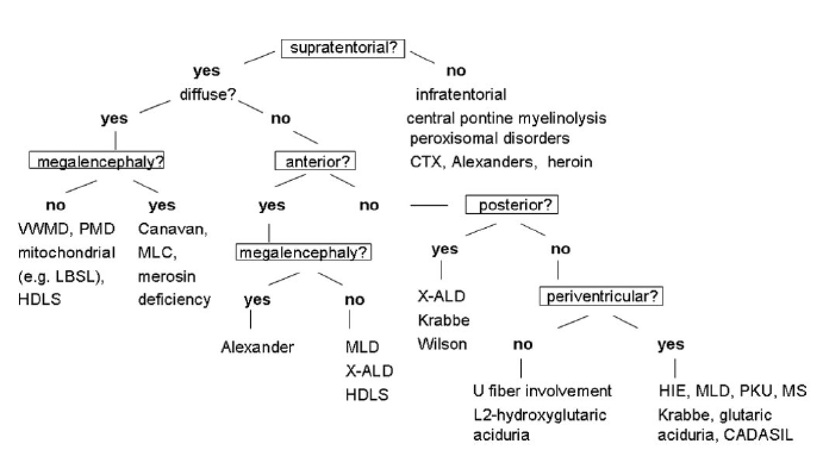
Characteristic Imaging
Confluent imaging abnormalities
Not multifocal or asymmetric
Enhancement only with X-linked adrenoleukodystrophy

Slide 6
Biochemistry
Numerous potential errors in membrane synthesis
Lipid synthesis
Very long chain fatty acids (X-linked ALD)
Protein synthesis
PLP (Pelizaeus-Merzbacher)
Gap junctions (PMLD)
DNA repair

Slide 7
X-linked ALD
Several phenotypes
Female carriers can have progressive myelopathy
Defect in ABCD1
Peroxisome membrane transporter
Acyl-CoA esters into peroxisome
Immune mediated destruction of myelin
Therapy
Exogenous steroids
Dietary restriction of VLCFA (+ Lorenzo’s oil)
Bone Marrow transplant (if early)

Slide 8
Metachromatic Leukodystrophy
Autosomal recessive
Lysosomal arylsulfatase A (ARSA) deficiency
Measured in leukocytes
High urinary sulfatides
Toxic accumulation and oligodendroglia death
3 clinical phenotypes
Late infantile, juvenile, adult
Therapy
Bone marrow transplant
Delays onset and progression

Slide 9
Globoid Cell Leukodystrophy (Krabbe Disease)
Cerebroside β-galactocerebrosidase deficiency
Lysosomal enzyme
Substrate accumulation
Galactosylceramide accumulates in macrophages
Therapy
M transplant and enzyme replacement
?effectiveness

Slide 10
Vanishing White Matter Disease
Occurs in first years of life
Short survival
Mutations in eIF2B
Eukaryotic initiation factor
Why just white matter and ovary damage?

Slide 11
Alexander disease
Mutation in GFAP gene
Induces stress response in astorcytes
Death within 10 years

Slide 12
Canavan Disease
Aspartoacylase (ASPA)
Elevation of NAA
ASPA cleaves NAA to acetate and aspartate
Aspartate necessary for myelin synthesis

Slide 13
Hereditary Diffuse Leukoencephalopathy with Spheroids
Adults
CSF receptor deficiency

Slide 14
Pelizaeus-Merzbacher Disease
X-linked mutation in PLP1
Failure to form myelin
Versus PM-like disease
Autosomal recessive
Mutation in gap junction protein α12 (GJA12)

Slide 15
Aicardi-Goutieres Syndrome
Genetically heterogeneous
5 subtypes
Autosomal recessive
Subtypes 1-4
Errors in nuclease genes
Subtype 5
TREX1 mutation
DNA repair

