Slide 1
Acute changes consistent with a common stroke syndrome
Case 109
Barb Merriman, Neurology PGY-3

Slide 2
HPI
70 yo female with history of previous CVA (date unknown), hypertension (HTN), hyperlipidemia (HPL), presents to ER with sudden onset aphasia, dysphagia, nystagmus, decreased level of consciousness, respiratory difficulty, and minimal movement of bilateral UE and LE. She is diagnosed with acute CVA secondary to atrial fibrillation, started on amiodarone, warfarin, and is discharged to a skilled nursing facility.

Slide 3
Neurologic Exam and workup
Key neuro exam findings:
General: Globally aphasic, apathetic, abulic, makes no eye-contact
Mental Status: Obtunded, non-interactive
Cranial Nerves: Vertical gaze palsy with downbeat nystagmus, left ptosis, anisocoria (R=4mm, L=3mm), muscles facial expression intact, cannot asses CN IX-XII due to lack of participation.
Motor and Sensory: tetraparesis, grimaces slightly to deep pain stimulus
Workup:
EKG: A fib with rapid ventricular response
Echocardiogram: Left atrial dilatation, left ventricular hypertrophy with diastolic dysfunction. EF=45%.
INR: 1.0
LDL: 125
HBA1C: 7.2
PEG Tube and Tracheostomy placed surgically prior to discharge due to dysphagia and inability to protect airway.

Slide 4
HPI
2 years later she returns to ER with refractory emesis, copious oral secretions, and diaphoretic. She meets SIRS criteria at admission, and blood, urine, and sputum cultures are collected.
Despite aggressive treatment, she dies from complications of infection from sacral decubitus ulcer and aspiration pneumonia.

Slide 5
Objective data
Vitals: T=37, P=110 with irregularly irregular rhythm, PO2=100%, BP=96/66
Labs: Blood glucose=504, WBC=16.9, Cr=2.4 (baseline=0.6), lactate=2.6 (normal <1).
General PE: Diaphoretic, oral secretions require suctioning, rales audible, pale, dry mucous membranes. Stage III sacral decubitus ulcer. PEG and Tracheostomy in place.
Neurologic Exam: Obtunded, globally aphasic, dysconjugate gaze, no gag reflex, dysphagia, slight grimace to deep pain stimulus in bilateral UE and LE. Because of level of consciousness and aphasia, exam is severely limited.
Imaging:
Chest xray: Bilateral infiltrate with consolidation.
CT brain (see next slide)

Slide 6
CT Brain – image 1

Slide 7
CT brain – image 2

Slide 8
Ct brain – image 3

Slide 9
Questions 1 - 4
What is the most striking abnormality on each CT brain?
Image 1 _________
Image 2 _________
Image 3 _________
Are there any acute processes present? ________

Slide 10
Answer 1: Chronic bilateral thalamic hypodensity suggestive of infarction

Slide 11
Answer 2: Chronic midbrain hypodensity suggestive of infarction

Slide 12
Answer 3: chronic bilateral cerebellar hypodensities suggestive of infarction

Slide 13
Answer 4
No new territorial infarction, hemorrhages, mass effect, or extra-axial collections present.

Slide 14
Summarize
Summarize your knowledge of this case thus far in one concise, summarizing statement.

Slide 15
Summary statement
70 yo AA female with history of atrial fibrillation, multiple CVAs, HTN, HPL, DM presenting with decubitus ulcer, pneumonia, and SIRS. Despite treatment, she dies during hospitalization from sepsis.

Slide 16
Question 5
Based on all information gathered thus far, was her previous stroke acute, sub-acute, or chronic? Explain.

Slide 17
Answer 5
CT head this visit reveals that previous strokes appear chronic (>1 month ago). Hypodense regions of the thalamus, midbrain, and bilateral superior cerebellar hemispheres are noted, indicating these ischemic events all occurred over one month ago. Her sacral decubitus ulcer secondary to inability to ambulate also supports this.
In general, passage of time since infarction onset can be approximated as follows:
Acute (0 - 8 hrs since infarct): blurred gray/white margin on CT, faint hypodensity may be detected in region of infarct.
Subacute (2 - 30 days since infarct): hypodensity visible, plus edema best demonstrated by diminished sulci, possible midline shift and/or ventricular effacement.
Chronic (months to years since infarct): Infarcted region becomes well-defined and will appear isodense with ventricles on CT. This is defined as encephalomalacia. Some cavitary regions may collapse/compress, causing surrounding tissue to appear hypertrophic.

Slide 18
Question 6
List 5 of this patient’s risk factors for CVA.

Slide 19
Answer 6
Her CVA risk factors include:
HTN
HPL
DM
History of previous stroke
Atrial Fibrillation

Slide 20
autopsy
On autopsy, brain mass was 1250 grams with the following gross images recorded:

Slide 21
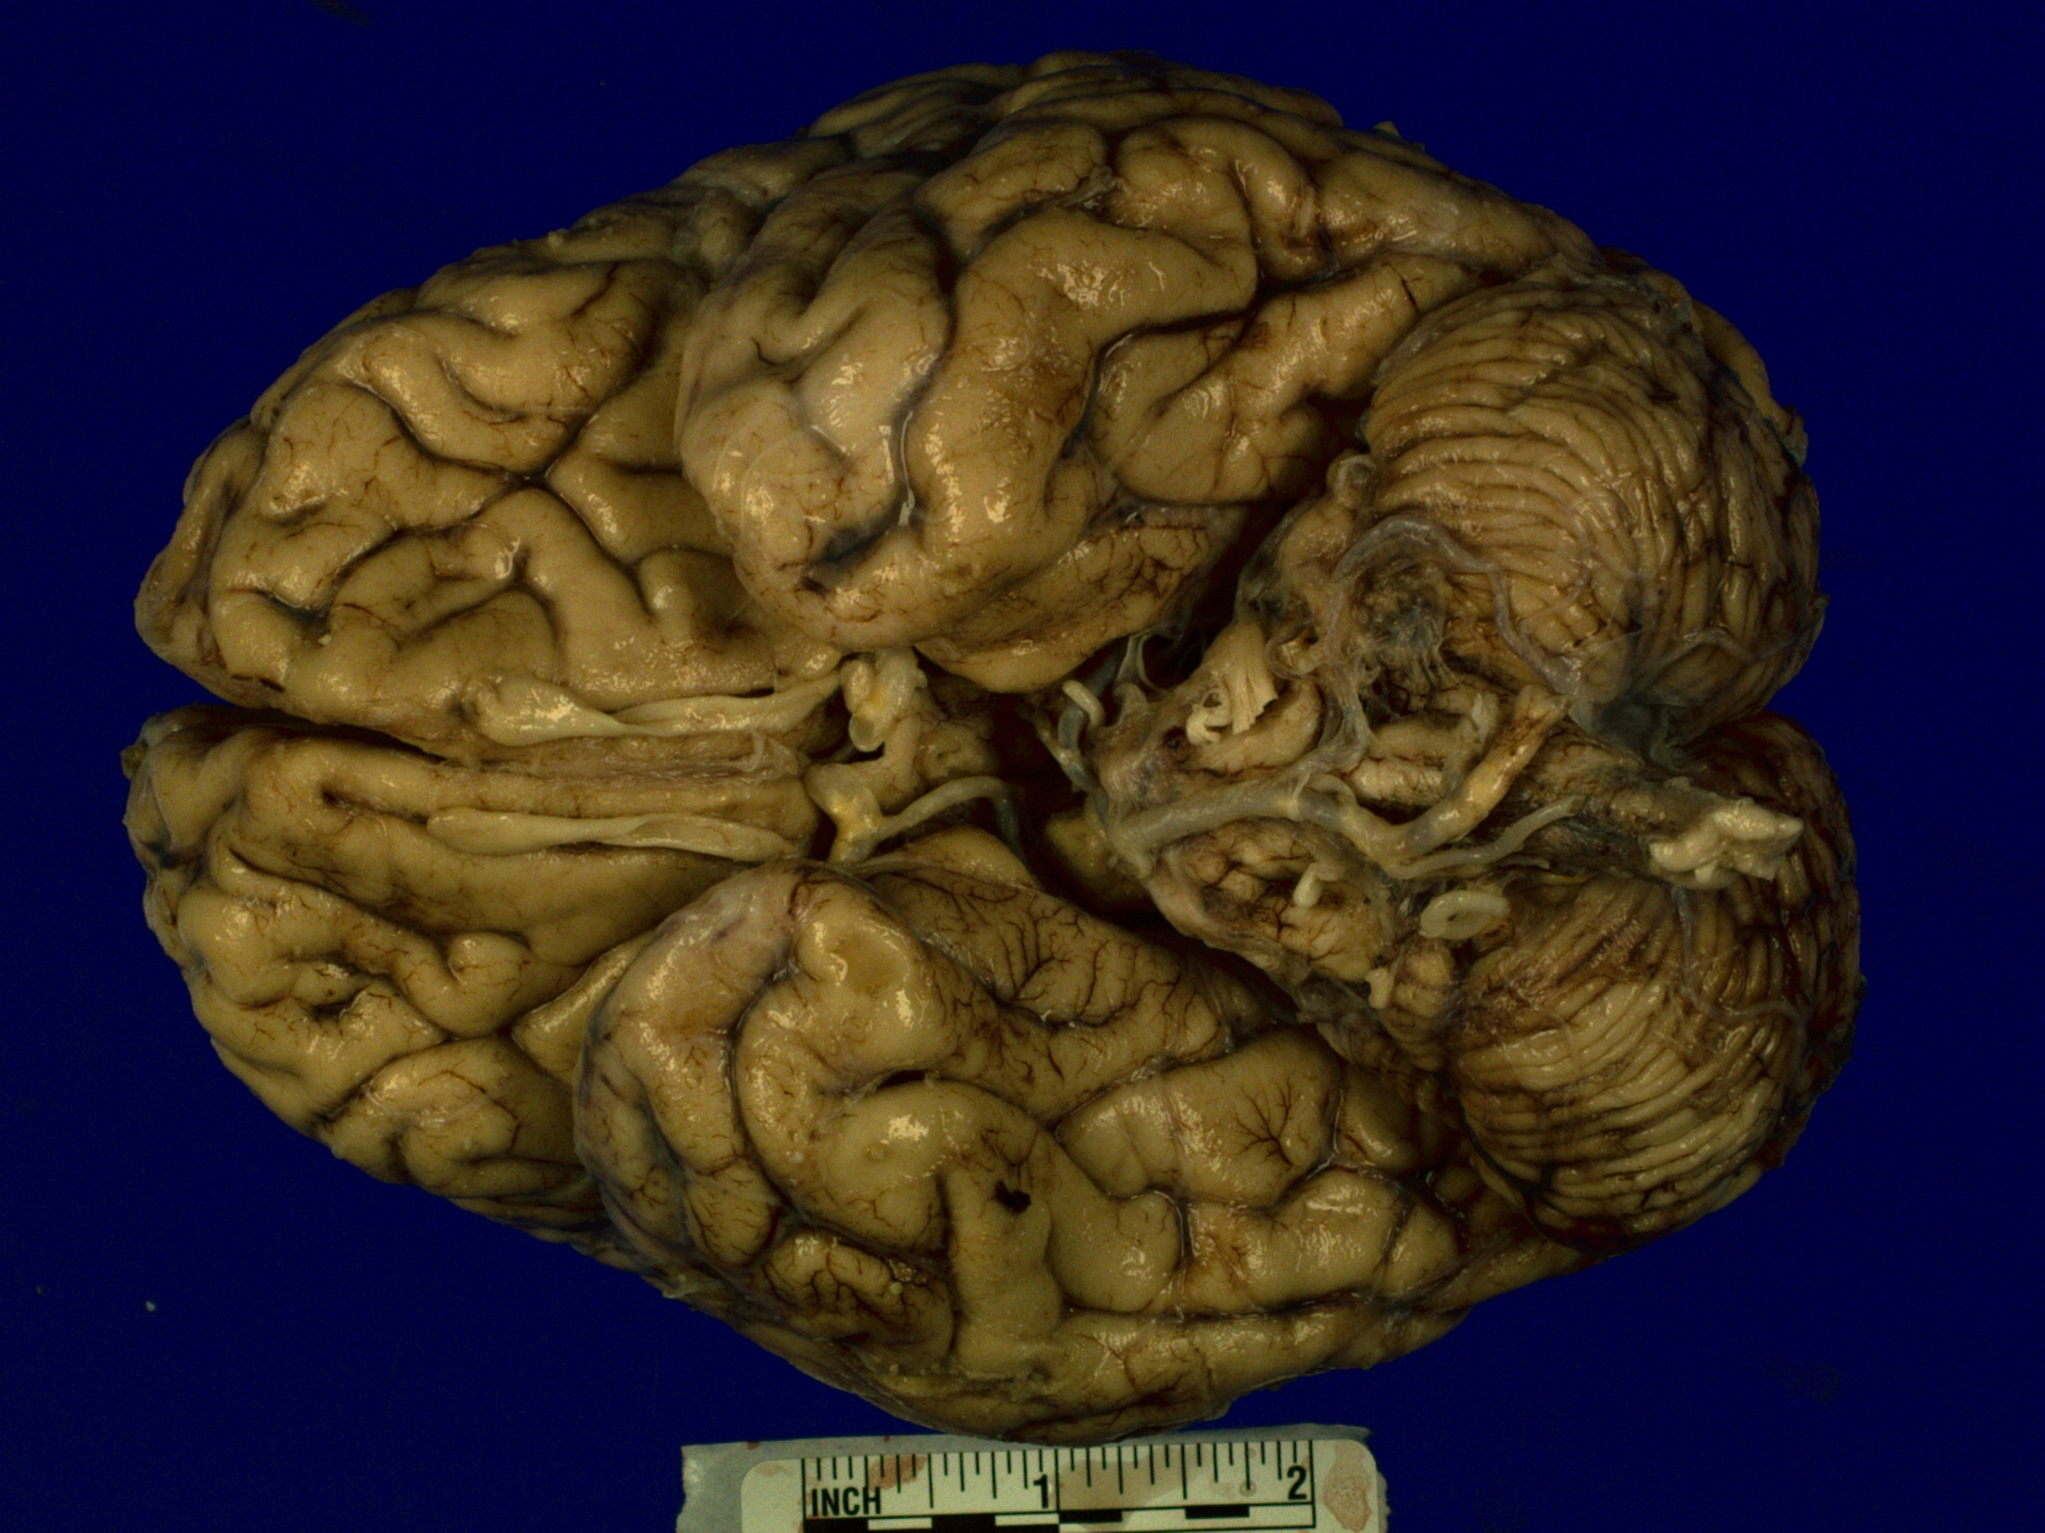
Image 4

Slide 22
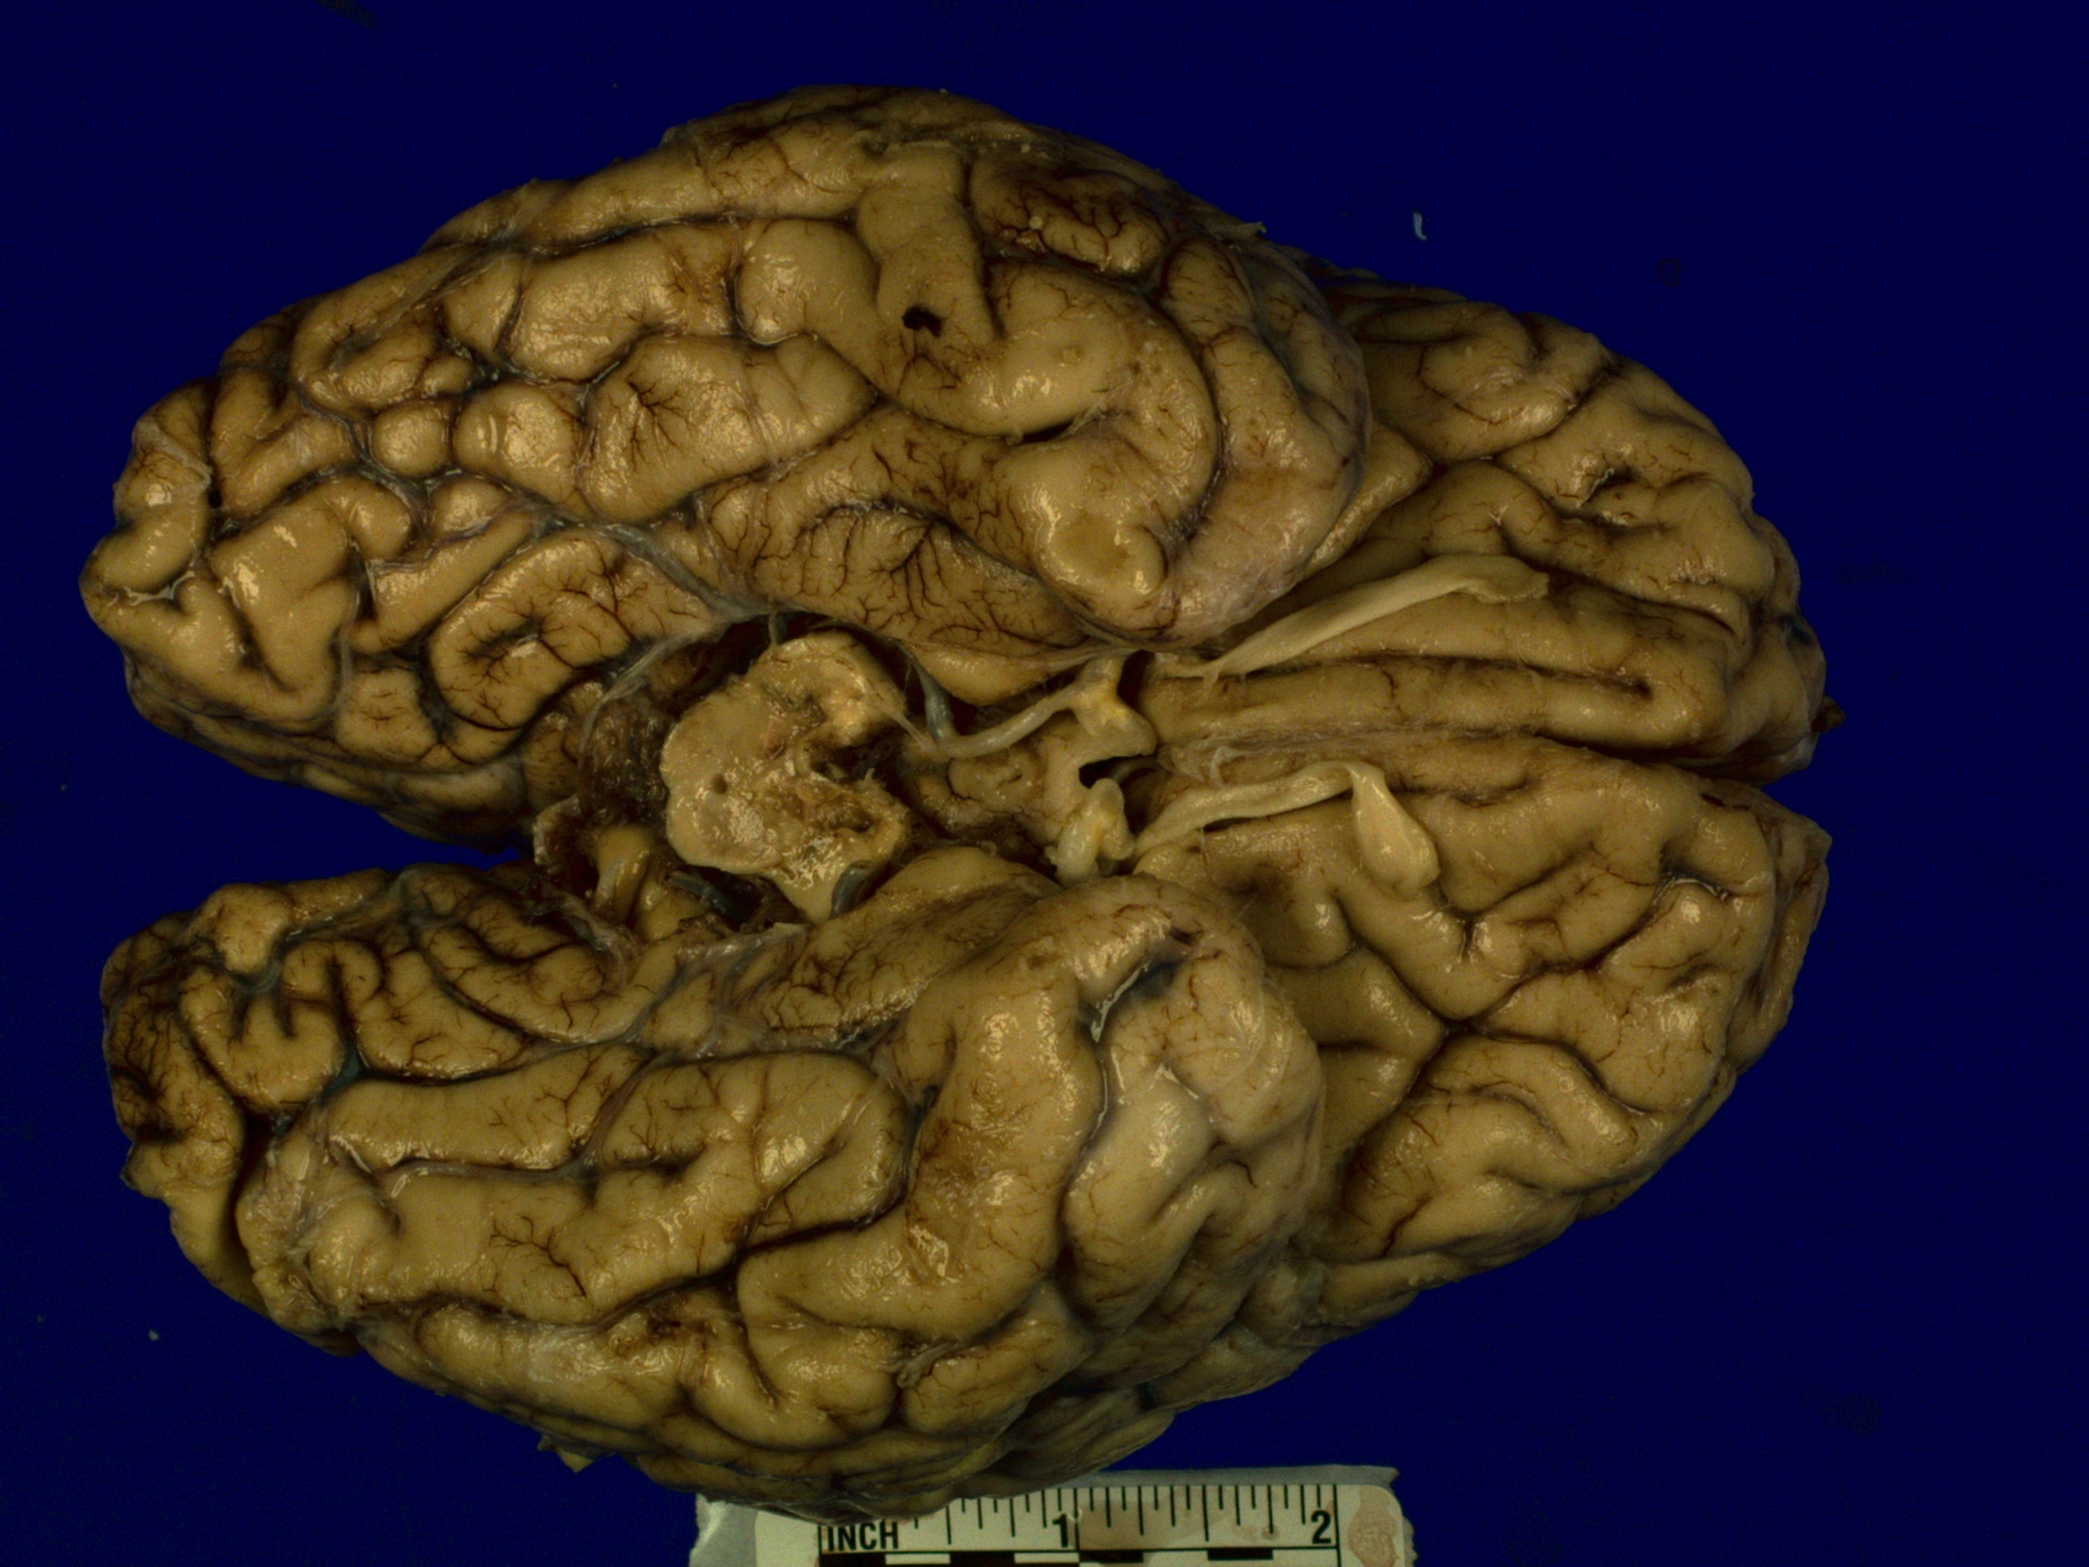
Image 1
Image 5

Slide 23
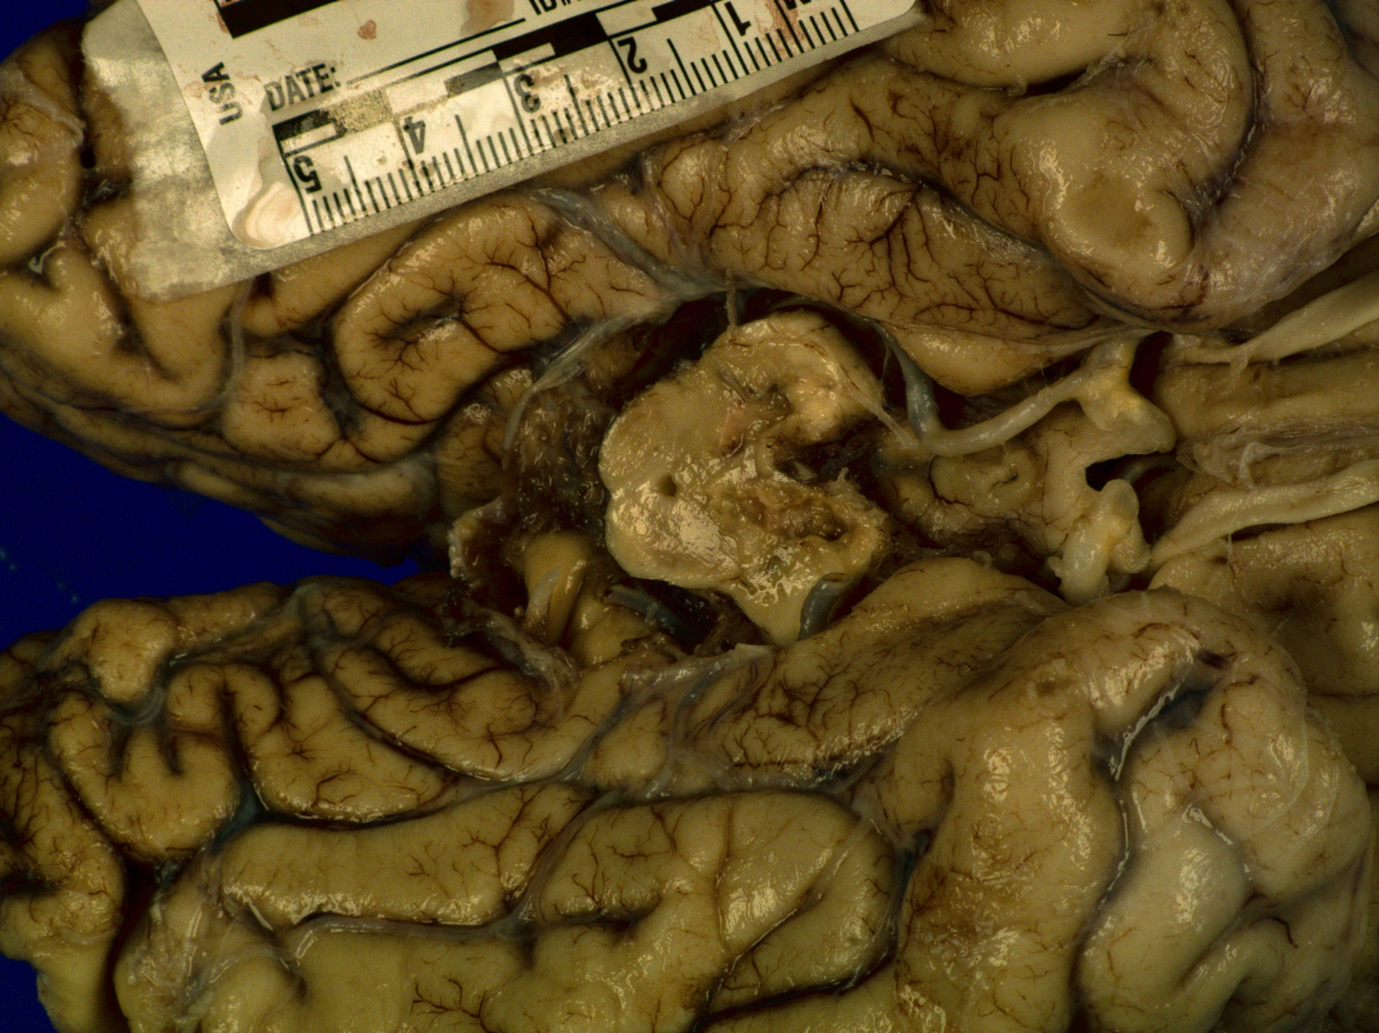
Image 6

Slide 24
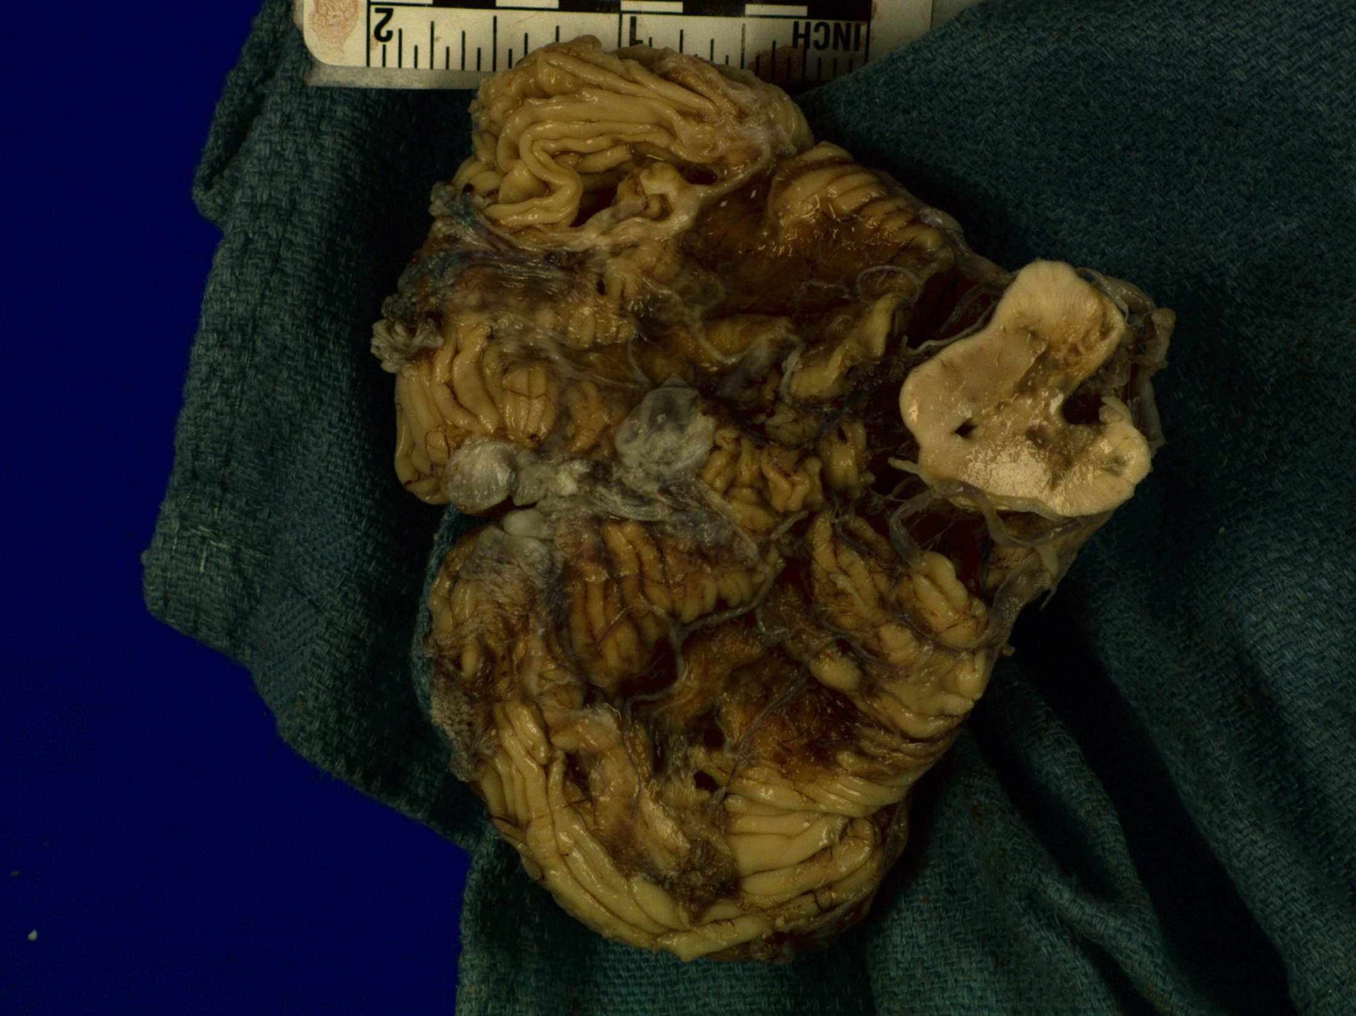
Image 7

Slide 25
Question 7
Reviewing these gross images, which region(s) appear abnormal?

Slide 26
Answer 7
Multiple areas of tissue atrophy, discoloration, irregular jagged edges, and destruction/loss of tissue.
These are areas in which the patient has had a stroke (infarction).
These infarctions have been circled in red on the following images:

Slide 27
Image 1
Image 5

Slide 28
Image 6

Slide 29
Image 7

Slide 30
Question 8
Which gross areas of the brain have been damaged by infarction?
Left cortical hemisphere
Bilateral medial frontal lobes
Right posterior limb of internal capsule
Cerebellum and brainstem

Slide 31
Answer 8
d. Gross inspection reveals lesions and tissue loss of the rostral anterior brainstem (midbrain), and cerebellar hemispheres. Other areas of infarction deep to the surface are not seen.

Slide 32
Question 9
Review the next two images. What gross findings are noted in the basal ganglia and centrum semiovale, and what part of her medical history predisposes her to this condition?

Slide 33
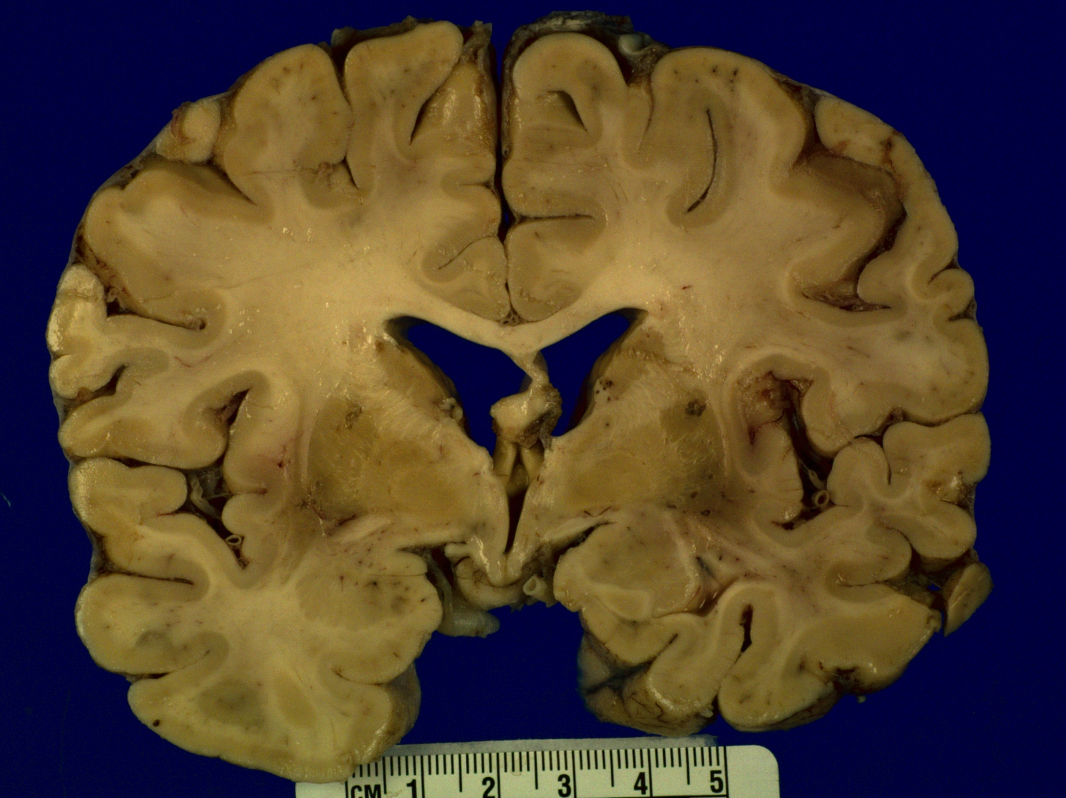
Image 8

Slide 34
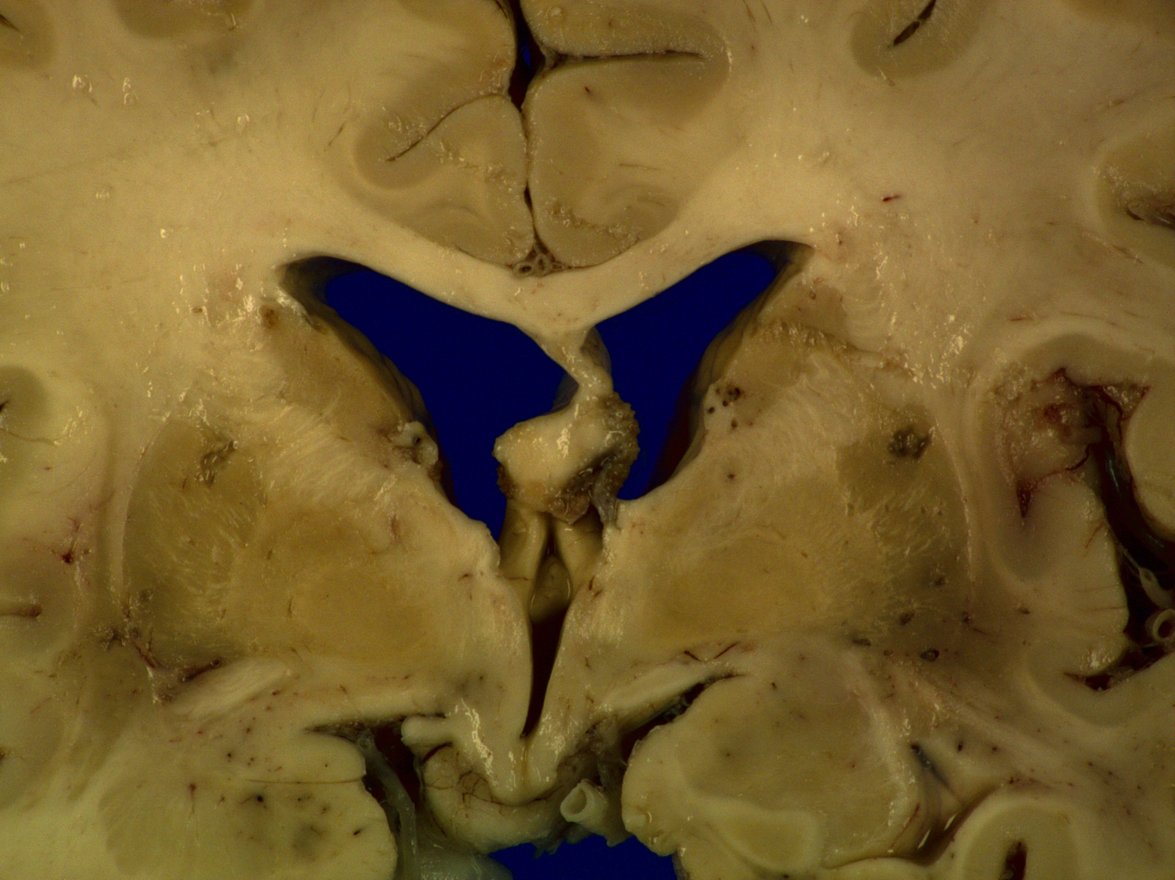
Image 9

Slide 35
Answer 9
Lacunar infarctions are noted grossly and microscopically. Consistent with this are microscopic vasculature changes and dilatation of the perivascular space as seen on images 8 and 9.
Lipohyalinosis is the term that that describes thickening of the arterial wall by hyaline material, within which are embedded variable numbers of lipid-bearing macrophages, causing narrowing/obliteration of vessel lumen. The most frequent cause of lipohyalinosis is HTN.

Slide 36
Image 8

Slide 37
Image 9

Slide 38
Microscopic findings
The following images show key findings of the cortex, cerebellum and midbrain.

Slide 39
Slide 1-Cortex
Cingulate cortex and caudate
H&E
Abeta amyloid
Infarcted cortex
H&E
GFAP
CD68

Slide 40
Slide 2-midbrain
Midbrain
H&E
Neurofilament
CD68
GFAP

Slide 41
Slide 3-cerebellum
Cerebellum
H&E

Slide 42
Question 10
Does review of histology slides confirm or disprove that the following vessels and territor(ies) were infarcted?
SCAs to Cerebellum
Paramedian perforating arteries to Midbrain
Distal PCAs to Occipital lobes
Thalamoperforating arteries to thalamus

Slide 43
Answer 10
SCAs to Cerebellum: Infarcted
Paramedian perforating arteries to Midbrain: Infarcted
Distal PCAs to Occipital lobes: Not infarcted
Thalamoperforating arteries to thalamus: Infarcted
The midbrain, thalamus, and cerebellum are supplied by the posterior circulation system, which includes:
Vertebral Arteries
Posterior Inferior Cerebellar Artery (PICA)
Basilar Artery
Anterior Inferior Cerebellar Artery (AICA)
Superior Cerebellar Arteries (SCA)
Posterior Cerebral Arteries (PCA)
Small Perforating arteries

Slide 44
Circle of willis

Slide 45
Circle of willis and Midbrain blood supply

Slide 46
Key Features of Brainstem and cerebellar Infarcts
Thalamus
Paresthesias
Acute hypersomnolence
Apathy
Abulia
Midbrain
Gaze Palsies, especially vertical
Ptosis
Motor and/or sensory loss
Locked-In syndrome
Cerebellum
Coma +/- tetraplegia
Ataxia
Nystagmus
Headache
Dizzyness
Emesis

Slide 47
Question 11
Why was patient’s vision unaffected despite large infarction of the bilateral PCAs?

Slide 48
Answer 11
The Circle of Willis bypasses flow obstruction in bilateral P1 segments, restoring PCA bloodflow:
Common Carotid→Internal Carotid→PCOM→P2 segment of PCA

Slide 49
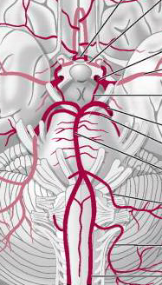
Blue=Top-Of-the-basilar thrombus Purple= Blood supply from Carotid→PCOM→PCA to Occipital Lobe

Slide 50
PCA by region (P1, P2, P3):
Blood no longer flows through basilar artery due to thrombus (shown in blue). Instead blood supply to P2 and P3 is “restored” by PoCA via anterior circulation (drawn in purple).

Slide 51
Top-of-the-basilar syndrome
Top-of-the-Basilar stroke:
Infarction to thalamus, midbrain, reticular activating system, and superior cerebellum
Symptoms of
Decreased level of consciousness, (infarction of RAS)
Paresis and paresthesias (cerebral peduncle, medial lemniscus infarction)
Ataxia, dysmetria, dysequilibrium, emesis (cerebellar infarct).
Most common etiology is cardioembolic

Slide 52
Conclusion
The patient’s presentation is likely due to a Top-of-the-Basilar CVA, which occurred some time prior to her recent hospitalization.
Possible stroke etiology is atrial fibrillation, for which amiodarone and coumadin were started

Slide 53
credits

