Slide 1
Case 107 Heart Transplant with complications
Barb Merriman, Neurology resident, PGY-3

Slide 2
HPI
27-yo female with medical history of congenital hypoplastic right heart admitted for worsening fatigue, SOB, and advanced hepatic fibrosis as a result of the right-sided heart failure. Already pre-approved for heart transplant, she was admitted and underwent successful cardiac transplant, and anti-rejection therapy was started . Other than acute cardiac decompensation and elevated AST and ALT, she was otherwise healthy at admission, normotensive, afebrile, no leukocytosis.

Slide 3
Hospital Course
Within 7 days of the transplant, mean arterial blood pressure had fallen to average of 52 mmHg, requiring epinephrine, and echocardiogram showed EF=20%. She required ECMO (extra-corporeal membranous oxygenation) and intubation for acute respiratory failure, and developed acute kidney injury requiring dialysis. WBC jumped to 23,000, blood and sternal wound cultures were collected, with negative results.

Slide 4
Question 1
What type of shock is this patient experiencing and why?
Cardiogenic
Septic
Neurogenic
Hypovolemic
Combination of above types

Slide 5
Answer 1
A. CARDIOGENIC
The patient’s post-transplant ejection fraction of 20% suggests primary graft dysfunction. Causes can be multiple, and include:
Pre-existing donor heart disease
Injury to the donor heart during donor brain death
Ischemia during organ recovery, preservation, and re-implantation
Reperfusion injury immediately after re-implantation

Slide 6
Hospital Course
Day 12: MAP stabilized at 65 mmHg, and repeat echo showed EF=50%. She was weaned from the ventilator, epi was stopped, however still required hemodialysis and was noted to have developed a sacral decubitus ulcer measuring 18x22 cm. WBC had reached 33,000, Infectious Disease was consulted and triple antibiotic therapy started.
Day 16: Epinephrine and midodrine required again for falling MAP. Sacral wound cultures noted fungal forms. Daily surgical debridements began, noting necrotic tissue, purulence and liquefied muscle tissue. Two antifungals had been started but despite this, WBC continued to rise, with fevers up to 104 degrees, worsening mental status and delirium. Pulmonary edema was noted on CXRay, and ascites in her abdomen. A biopsy was done that showed Grade I heart graft rejection.

Slide 7
Question 2
Which of the following clinical conditions best defines this patient’s status?
Sepsis
Septic Shock
Multiple Organ Dysfunction Syndrome (MODS)
Unable to be determined with information provided

Slide 8
Answer 2
C. Multiple Organ Dysfunction Syndrome (MODS)
Multiple organ dysfunction syndrome (MODS) refers to progressive multi-organ dysfunction in an acutely ill patient, such that homeostasis cannot be maintained without intervention. It is at the severe end of the severity of illness spectrum of both SIRS and sepsis.
There are no universally accepted criteria for individual organ dysfunction in MODS. However, progressive abnormalities of the following organ-specific parameters are commonly used to diagnose MODS and scoring systems are used to predict ICU mortality:
●PaO₂/FiO₂ ratio
●Serum creatinine (or urine output)
●Glasgow coma score
●Hypotension
●Platelet count
●Serum bilirubin
Notes:
I don’t know anything about this

Slide 9
Hospital Course
Daily wound debridements continued, with concern for disseminated infection. Antifungal therapy was changed to Posaconazole, Amphotericin B, and Caspofungin. Decubitus cultures were now negative for fungal forms, however, WBC reached 64,000, and she required maximum doses of epi, norepi, dopamine to sustain MAP >60 mmHg. Despite new transplant rejection, all immunosuppressive medications were stopped due to disseminated infection.
Patient slipped into coma, and died shortly thereafter from complications of the infection and multisystem organ failure.

Slide 10
Question 3
Which of the following conditions is least likely to predispose a patient to opportunistic fungal infection?
Chronic renal disease
Hepatic failure
Cardiovascular surgery
Organ transplant
Chronic pulmonary disease

Slide 11
Answer 3
A. Chronic renal disease
Anti-rejection therapy suppresses the immune system
Liver failure causes low albumin and compromised immune cell production.
Cardiogenic shock results in systemic hypoperfusion, reducing supply of oxygen, nutrients, and immune cells to tissue.
Although not applicable to this scenario, chronic pulmonary disease have increased secretions which harbor bacteria, chronic inflammation, and antimicrobial-resistant infections.

Slide 12
Autopsy
At autopsy, the gross brain weighed 1270 grams, and was examined before dissection. No surface abnormalities such as hemorrhages, necrosis, opaque leptomeninges, were noted.
The following two slides show autopsy images (Image 1) and MRI images (Image 2) taken one day prior to death*:
*Note that lesions on MRI vs. gross dissection appear to be on opposite side of head because normal MRI convention is to show images reversed (i.e., right side of brain is on left side of image).

Slide 13
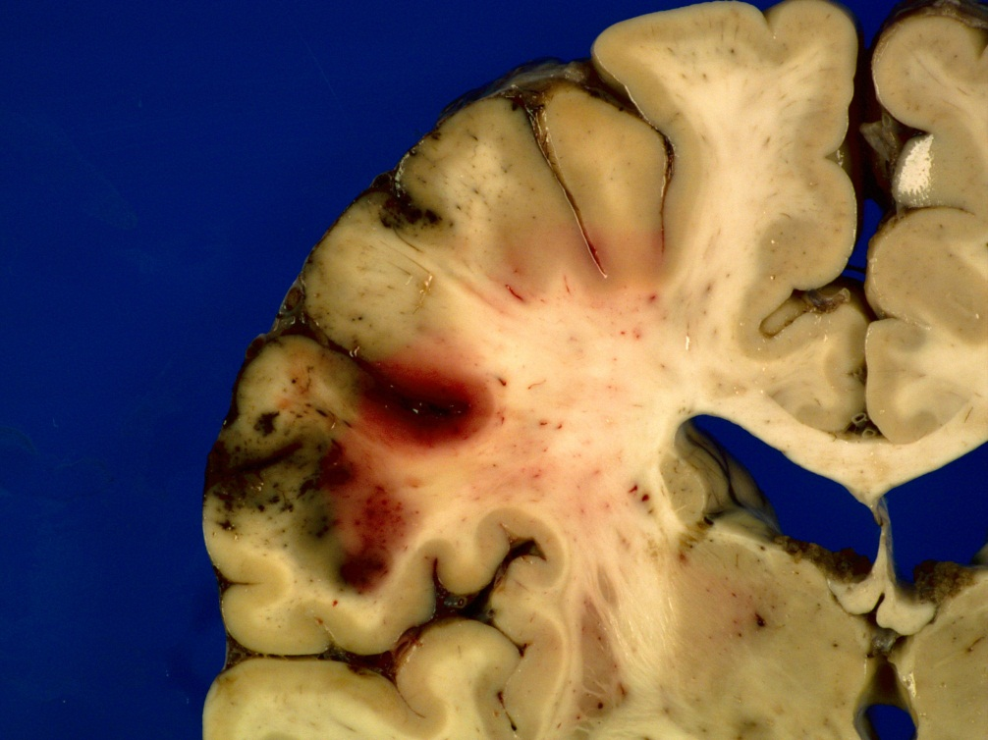
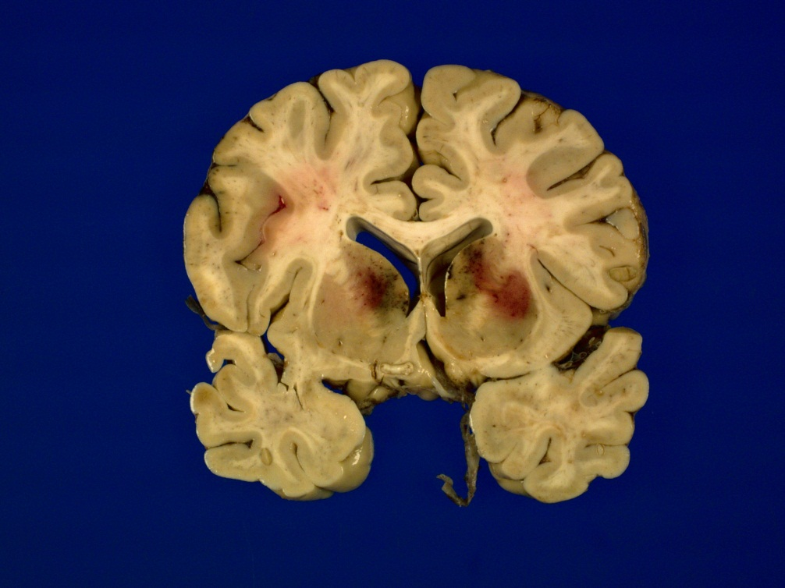
Image 1
Notes:
I assume this is from Ellison & Love or some Internet source.
Were gross autopsy photos taken on our case?
I replaced Ellison and Love with images from actual patient taken at autopsy - BJM
Are there any MRIs either of our patient or another?
See next slide

Slide 14
Image 2
Notes:
MRI images added - BJM

Slide 15
Question 4
What abnormalities are noted on Images 1 and 2?
Kernicterus from liver cirrhosis and failure
Cortical and deep nuclei hemorrhages
Basal forebrain hemorrhages
Arterio-venous malformations (congenital abnormalities)
None of the above

Slide 16
Answer 4
B. Cortical and Basal Ganglia hemorrhages
These abnormalities represent hemorrhages of the parietal lobe and deep gray nuclei, i.e., the basal ganglia. The arterial supply of these regions is the Middle Cerebral Artery and lenticulostriate branches.
Notes:
I deleted “micro” in microhemorrhages because if you see them grossly they aren’t micro

Slide 17
CNS Fungal Infections
The four most common fungal infections of the CNS include candidiasis, Cryptococcus, aspergillis, and mucormycosis. The resulting CNS infection partly reflects the form and size of the organism involved:
Yeast: small diameter, do not occlude capillaries, typically causing leptomeningitis.
Hyphal forms: Tend to obstruct medium and large-sized proximal CNS arteries such as MCA, Vertebrobasilar.
Pseudohyphae: occlude parenchymal vessels, producing small infarcts that rapidly evolve into microabscesses.

Slide 18
Question 5
Which of the following CSF profiles is most typical of fungal meningitis?
WBC<250/microliter with lymphocytic pleocytosis, glucose >50% of serum glucose, protein <150 mg/dL
WBC>1000/microliter, glucose <45 mg/dL, protein >250 mg/dL,
WBC<80/microliter with mononuclear predominance, glucose ~50% of serum glucose, protein<100 mg/dL

Slide 19
Answer 5
C.
Answer A is most suggestive of viral/aseptic meningitis
Answer B represents CSF profile most typical of bacterial meningitis.

Slide 20
Question 6
See images of fungi on the following slides (Images 3-7). Which of the following fungi and corresponding morphology are incorrect?
Aspergillis/branching hyphae
Candida/Pseudohyphae
Cryptococcus/round, symmetric
Mucormycosis/non-septate, branching hyphae
Histoplasma/branching hyphae
Notes:
I would suggest putting images of all the fungi on one slide
Perhaps H&E for one slide
PAS for another slides
GMS for a third slide

Slide 21
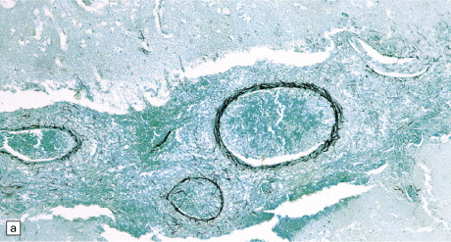
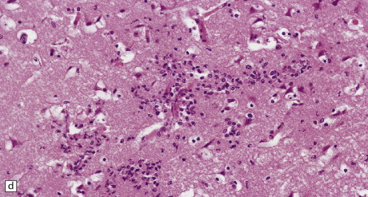
Image 3: Aspergillis
(a) Infiltration of the walls of leptomeningeal blood vessels by Aspergillus hyphae.
(b) Vascular invasion by Aspergillus admixed with thrombus in the lumen, infiltrating the vessel wall and extending into adjacent tissue.
(d) Spread of Aspergillus infection along parenchymal blood vessels.

Slide 22
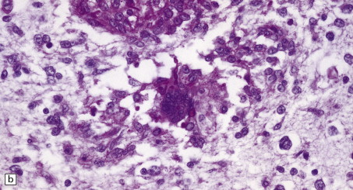
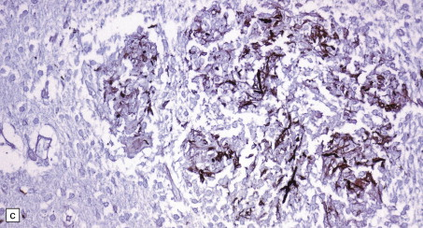
Image 4: Candida
(a) Basophilic Candida yeasts and pseudohyphae, with acute infarction of surrounding brain tissue.
(b) Candida PAS stain. Here it is surrounded by an infiltrate of lymphocytes and macrophages.
(c) Silver methenamine impregnation of Candida fungi within a focus of granulomatous inflammation.

Slide 23
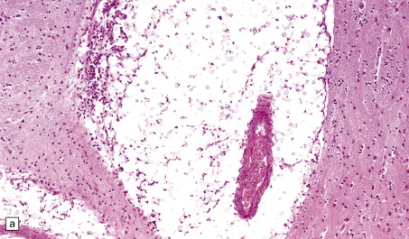
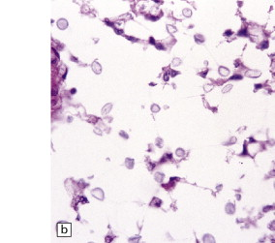
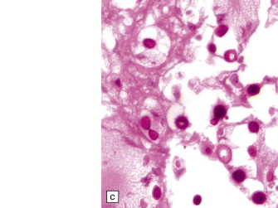
Image 5: Cryptococcus
(a) Enlarged perivascular space containing numerous cryptococci.
(b) H and E stain: Cryptococci appear as spherical basophilic bodies.
(c) Cryptococci are strongly PAS-positive.

Slide 24
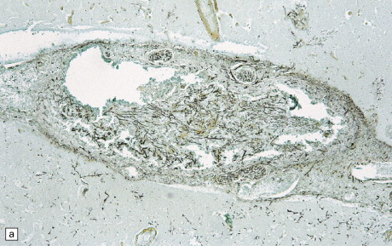
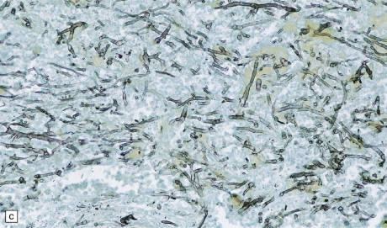
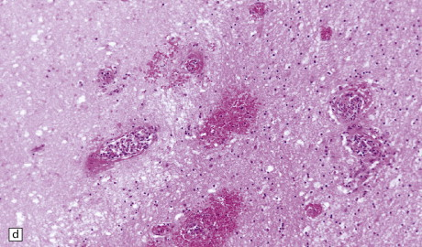
Image 6: Mucormycosis
(a) Thrombosed artery in which thrombus is admixed with Mucor hyphae. Hyphae are also present in the adjacent necrotic brain tissue.
(c) Methenamine silver impregnation shows the hyphae to be broad, non-septate and of varying caliber.
(d) Extensive cerebral infarctions. Also seen is a small foci of hemorrhage in the cerebral white matter.

Slide 25
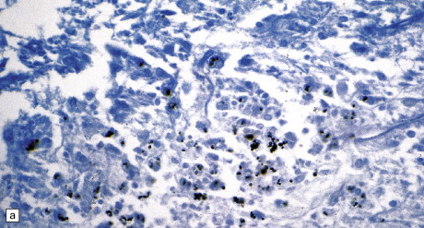
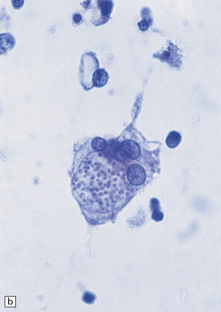
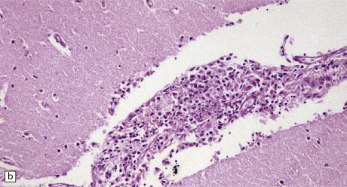
Image 7: Histoplasma
(a) Histoplasma yeasts in macrophages and lying extracellularly in the brain of a patient with AIDS.
(b) Inflammatory infiltrate in the meninges of a patient with CNS histoplasmosis.
(c) A smear of the meningeal exudate contains multinucleated cells within which are many small, round Histoplasma yeasts.

Slide 26
Answer 6
D. HISTOPLASMA
Aspergillis forms branching, septate hyphae
Candida, is round uni-diameter in non-pathologic states; pseudohyphal form during times of overgrowth.
Cryptococcus is round, uniform diameter
Mucor is noted for branching, non-septate hyphae
Histoplasma is characterized by round cocci of uniform diameter, NOT branching hyphae.
Notes:
Reorder so same as question

Slide 27
Question 7
Image 8 has 4 hyperlinks that illustrate microscopic brain tissue collected during autopsy. What is the most likely infectious agent?
Aspergillis
Candida
Cryptococcus
Mucormycosis
Histoplasma

Slide 28
Image 8
H&E stain: http://image.upmc.edu:8080/NeuroPathology/WileyViralandNonViral/WileyViralNonViral6/NV.39a.svs/view.apml?X=0.27127571717184&Y=-0.0384415838489637&zoom=100
PAS stain: http://image.upmc.edu:8080/NeuroPathology/WileyViralandNonViral/WileyViralNonViral6/NV.39b.svs/view.apml?X=0.294279720711814&Y=-0.124218859535119&zoom=100 )
PAS Light Green stain: http://image.upmc.edu:8080/NeuroPathology/WileyViralandNonViral/WileyViralNonViral6/NV.39c.svs/view.apml?X=0.131880002910407&Y=-0.15783731155022&zoom=64.4972544
Grocott stain:
http://image.upmc.edu:8080/NeuroPathology/WileyViralandNonViral/WileyViralNonViral6/NV.39d.svs/view.apml?X=0.15847283329941&Y=-0.124255727198803&zoom=100

Slide 29
Answer 7
D. Mucormycosis
Image 8 hyperlinks reveal non-septate hyphae in vessel walls and surrounding tissue, consistent with mucor infection.
H&E of involved blood vessel
PAS Light Green of involved blood vessel
Notes:
Dr. Hamilton said something about this basal ganglia pattern being “classic”

Slide 30
Question 8
What pathologic mechanism has occurred based on this specific type of fungal infection?
Cerebral abscess formation and subsequent hemorrhage
Hemorrhages from parenchymal granuloma formation
Hemorrhage and necrosis from spore inhalation
Hematogenous spread, vascular damage, and hemorrhage
Thrombosis of the cavernous sinus

Slide 31
Answer 8
D. Hematogenous spread, vascular damage, hemorrhage
Classically seen in IV drug users, HIV +, or immunocompromised patients with Mucor infection.
Infection source was sacral decubitus wound, with rapid systemic hematogenous spread.
Hyphae damage cerebral vessel walls, causing micro-thrombus which occlude vessel lumens, and extensive hemorrhagic infarctions.
Despite aggressive wound debridement and three antifungal agents, rapid Mucor dissemination ultimately led to MODS and subsequent death.
Notes:
Dr. Hamilton said something about this basal ganglia pattern being “classic”

