Slide 1
Neuropathology Case Studies 1 & 2
Katherine M. Anetakis, MD
June 2016

Slide 2
HPI
4 year old previously healthy little girl who presents for evaluation for blurry vision, headaches
One month ago when she began complaining of headaches.
Headaches worse in the morning
Able to complete her daily activities and go to preschool, but headache would return at night.
No photosensitivity or neck pain.
Lying down made the headaches worse, sitting up made them feel better.
Also complained of blurry vision intermittently, like “looking through raindrops.”

Slide 3
HPI
ROS:
Fatigue, looking tired with the headaches, and sometimes seeming "more out of it." She would sometimes stare off, but she was always distractible. No convulsive spells or freezing spells. She had one episode of vomiting in the past month, which occurred in the evening.
Past Medical History
Full term, twin gestation
Developmentally normal, will still write some letters backwards but otherwise doing well in preschool
Immunizations up to date.
Family History: Mother: HTN, Father: Healthy, Fraternal Twin: Healthy

Slide 4
Exam
MENTAL STATUS: Awake, alert, and developmentally appropriate. Cooperative with age-appropriate comprehension and fluent speech. Appears fatigued.
CRANIAL NERVES:
II: Full visual fields by confrontation. Fundi through the dilated pupil reveal bilateral pappilledema.
III, IV, VI: Full ocular motility without nystagmus. Pupils equal, round, reactive to light and accommodation. She does note double vision ("I see two Elmos") when pursuing the toy to the right. No clear disconjugate gaze noted.
V: Normal facial sensation bilaterally.
VII: No facial weakness or asymmetry. Normal expression.
VIII: Hearing grossly normal.
IX, X: Palate elevates symmetrically.
XI: Normal strength of trapezii and sternocleidomastoid muscles. No atrophy.
XII: Tongue protrudes in midline; no fasciculations or atrophy.
MOTOR: Normal muscle bulk, tone, and strength. No adventitious movements.
REFLEXES: Deep tendon reflexes 2+ and symmetric. Plantar responses flexor.
SENSORY: Intact to light touch, vibration, and temperature.
COORDINATION: No tremor or abnormal movement. Touches target without dysmetria. Normal gait with appropriate coordination. No ataxia.

Slide 5
Imaging

Slide 6
What does the imaging show?

Slide 7
What does the imaging show?
Diffuse expansion of the brainstem and cerebellum
Increased T2 signal of these structures with no pathological enhancement.
There is downward displacement of the cerebellar tonsils below the foramen magnum and occlusion of the bilateral foramen of Luschka.
Extensive periventricular edema in the setting of occlusive hydrocephalus.
On sagittal images, there is a pre-syrinx involving the visualized cervical cord. There is marked flattening of the posterior globes with accumulation of CSF around the optic nerves reflecting increased intracranial pressure.

Slide 8
What is the differential?

Slide 9
What is the differential?
Diffuse astrocytoma:
Typically non enhancing
May arise in brainstem or cerebellum
BUT: Incidence increases with advancing age.
Pilocytic astroytoma:
Common in children
May have brainstem location
BUT: No enhancing mural nodule
Medulloblastoma
Common in children
Rapid growing usually on surface
Dysembrioplastic Neuroeptihelial Tumor Less likely
Non-enhancing
More common in children
BUT: Rarely in brainstem
Oligodendroglioma/Mixed oligoastrocytoma: Less likely
Diffusely infiltrative
Most a rise in hemispheres, rare in brain stem
Rare in children
Metastatic carcinoma, CNS lymphoma, reactive gliosis (Highly unlikely in child)

Slide 10
Clinical Course
Hospital Day 1: Right ventriculostomy, EVD placed
Hospital Day 3: Suboccipital craniectomy with biopsy

Slide 11
Biopsy Results
H&E Intraop Smear
H&E Permanent
Ki67

Slide 12
Describe Results

Slide 13
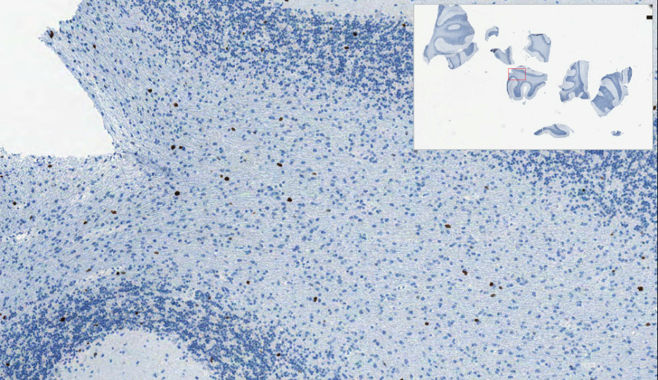
Describe Results
Hypercellularity with mixed neoplastic and non-neoplastic elements
Infiltrative with mineralization
Mild to moderate nuclear atypia
Ki67 5%+
Ki67

Slide 14
Diagnosis
Infiltrating Astrocytoma versus JPA
Absence of a margin and cystic nodule is more consistent with infiltrating astrocytoma
No pilocytic features, nor eosinophil granular bodies (EGBs) nor Rosenthal fibers
Next generation sequencing recommended to distinguish malignant midline glioma (e.g. histone mutation H3 K27M)

Slide 15
Clinical Course
She began receiving vinblastine weekly.
She was found to have hydrocephalus causing increase in mass effect from the tumor growth on MRI. She had a VP shunt placed and was switched over to carboplatin therapy.
She then underwent craniospinal radiation therapy.
She started her oral temozolomide therapy a month later. After one week of treatment, she was admitted to Children's Hospital due to fatigue, weakness and gait instability.

Slide 16
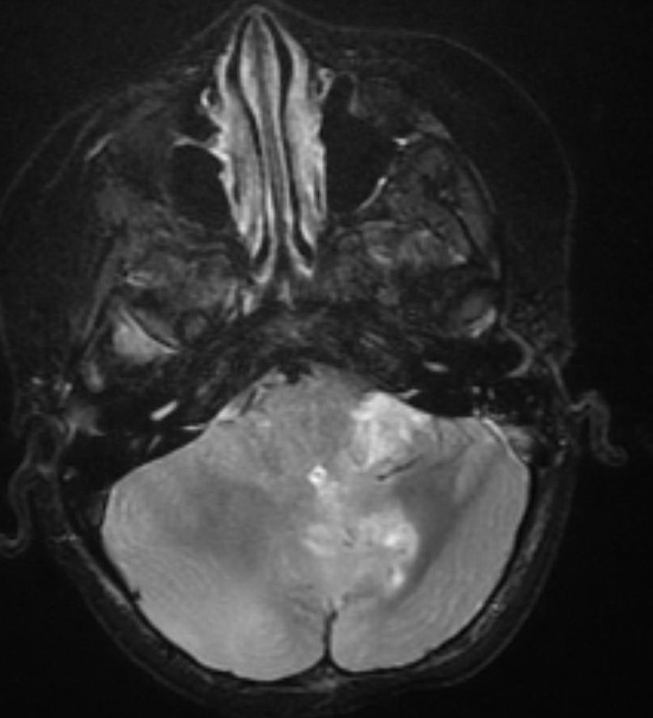
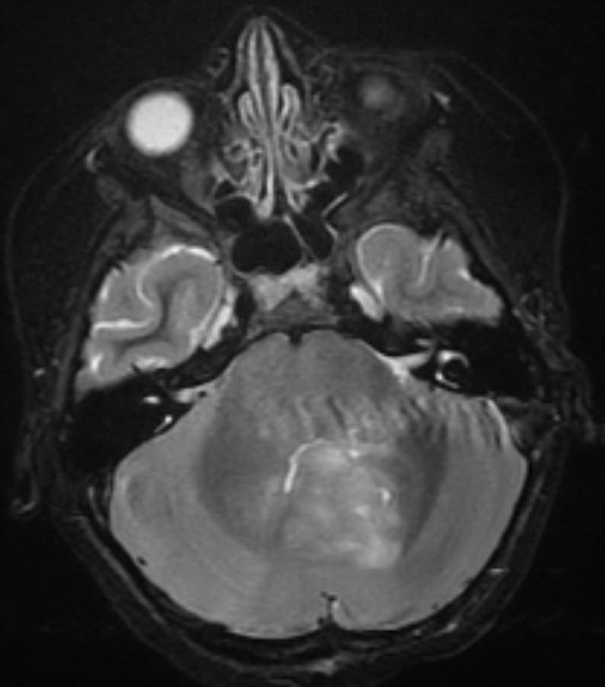
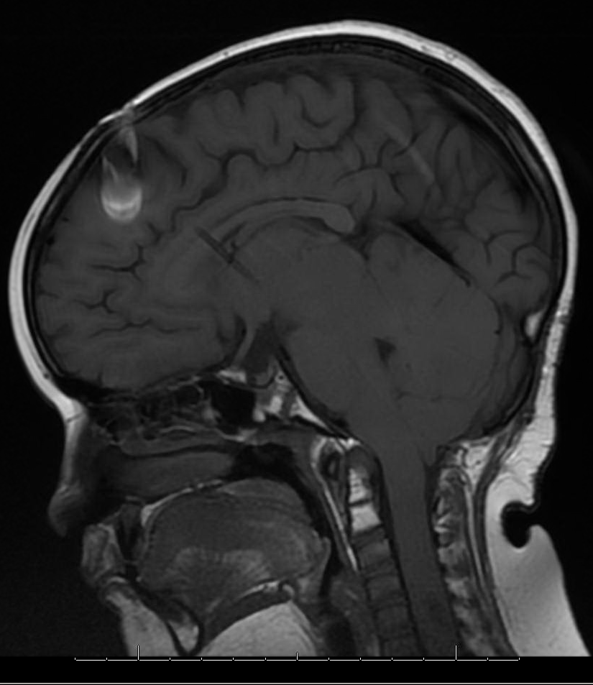
Imaging

Slide 17
What does the imaging show?

Slide 18
What does the imaging show?
Decrease in mass like parenchymal enhancement involving left greater than right cerebellar hemispheres.
New sites of heterogeneous parenchymal enhancement involving left middle cerebellar peduncle and greater leptomeningeal enhancement along left inferomedial margin of cerebellar folia extending superiorly along the vermis.
New region of heterogeneous parenchymal enhancement involving left middle cerebellar peduncle likely to be…

Slide 19
Biopsy

Slide 20
What does the biopsy show?

Slide 21
What does the biopsy show?
Demonstrates hyalinization of vessels with macrophage infiltrate.
In other cases, may show coagulative necrosis with dystrophic calcification or telangiectasias.

Slide 22
What is the differential?

Slide 23
What is the differential?
Residual tumor vs. Radiation necrosis

Slide 24
Diagnosis
Radiation Necrosis

Slide 25
Clinical Course (continued)
She was initially started on high-dose Decadron, which was weaned and started on Avastin therapy.

