Slide 1
Case Study 67
Chih King, Ph.D.

Slide 2
Question1
This is a 58 years old female initially presented with complaints of dizziness for the past 4 months, with progressing symptoms of nausea, impaired balance, weakness, and headache.
A MRI with and without contrast study is ordered, please describe the abnormalities present in the next slide:

Slide 3
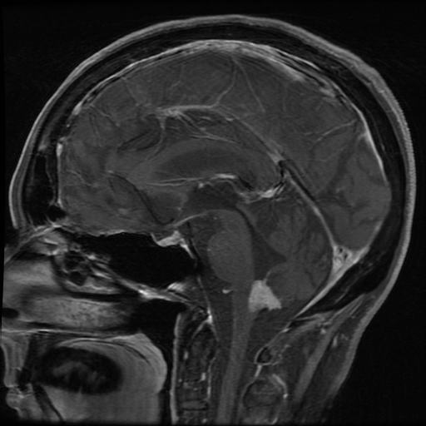
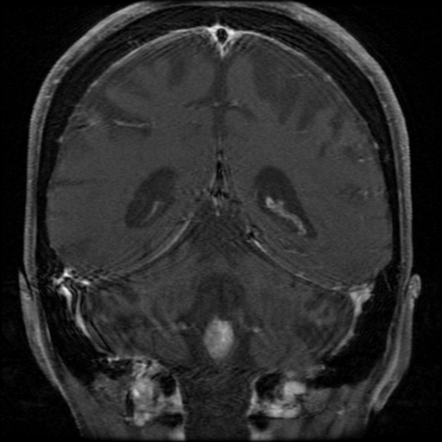
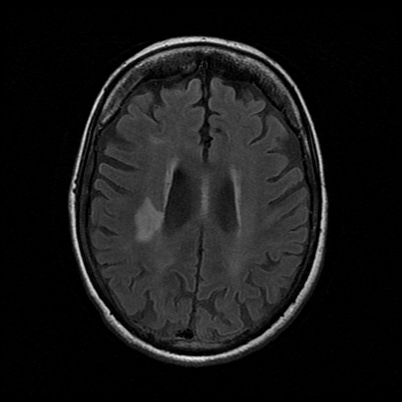
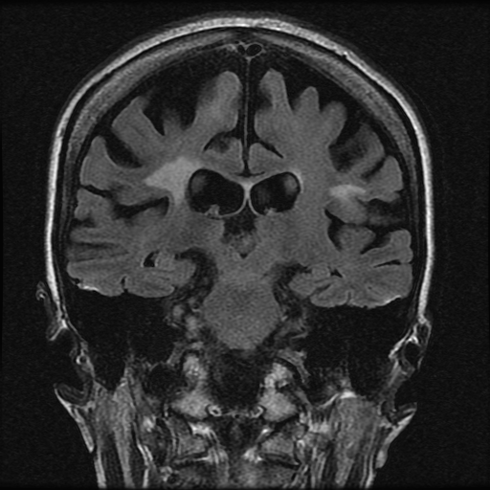
Sagittal T1
with contrast
Coronal T1
with contrast
Axial
T2 FLAIR
Coronal T2
FLAIR

Slide 4
Answer
The axial and coronal T1 with contrast series show a well-demarcated enhancing mass in the outlet of the 4th ventricle
The axial and coronal T2 FLAIR series show dilated lateral ventricles, as well as SUBEPENDYMAL TRANSUDATION AND a hyperintense lesion ADJACENT TO The RIGHT LATERAL VENTRICLE, POSSIBLY CONSISTENT WITH VASOGENIC EDEMA

Slide 5
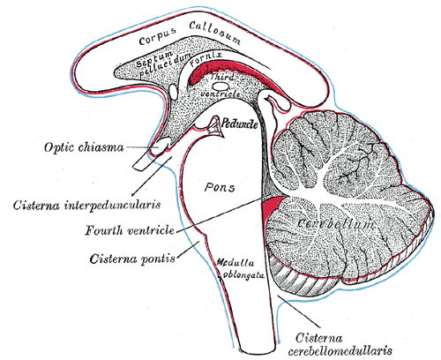
Question 2
What are the differential diagnosis of a tumor in the 4th ventricle for this patient’s age group (adult)?
What additional tumors SHOULD YOU consider for a lesion at this location if this is a younger/pediatric patient?
(1911) 20th U.S. edition of Gray's Anatomy of the Human Body.

Slide 6
Answer
Ependymoma
Subependymoma
Choroid plexus papilloma
Meningioma
Also consider for younger/pediatRic patients:
Medulloblastoma
Pilocytic Astrocytoma
The radiology diagnosis of this tumor is subependymoma. Which MRI feature shown in slide 3 may be inconsistent with this diagnosis?

Slide 7
Answer and Question 3
Subependymoma usually are non-enhancing post-contrast, while the tumor of this patient shows enhancement
An intraoperative neuropath consult is requested, and both a smear and frozen section of the resected tissue are processed, please describe the pertinent histologic features of the 2 slides.
Notes:
HAVE SLIDES SCANNED

Slide 8
Answer and Question 4
Smear shows increased cellularity, and cells with moderately dense nuclei and fine cytoplasmic processes
Frozen sections shows ciliated epithelium cells, as well as features suggestive of perivascular pseudorosettes
Notes:
PERHAPS PUT ARROWS ON SLIDE TO HIGHLIGHT FEATURES

Slide 9
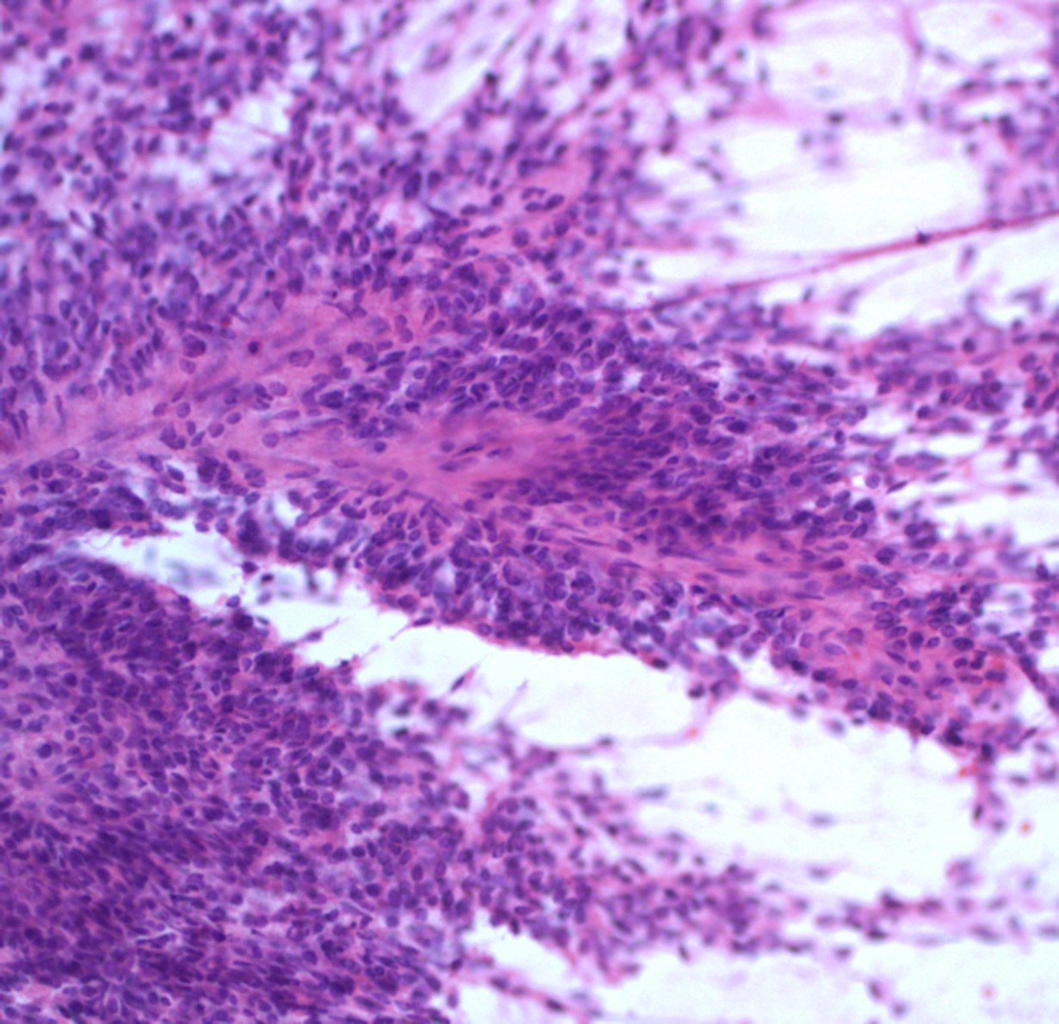
Smear
High cellularity with perivascular orientation

Slide 10
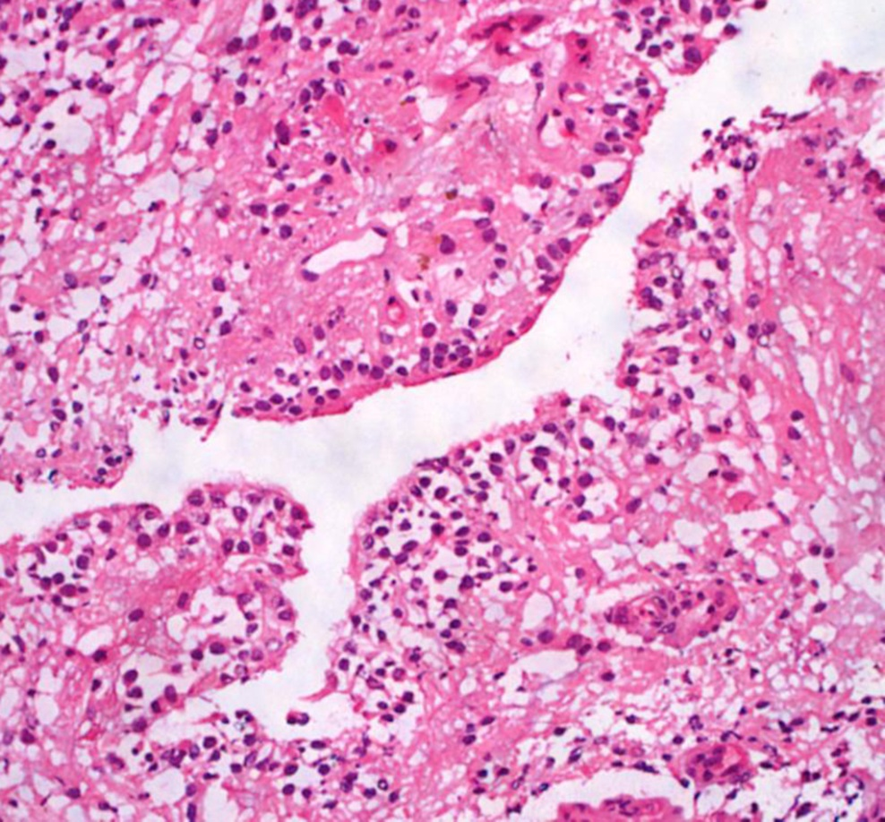
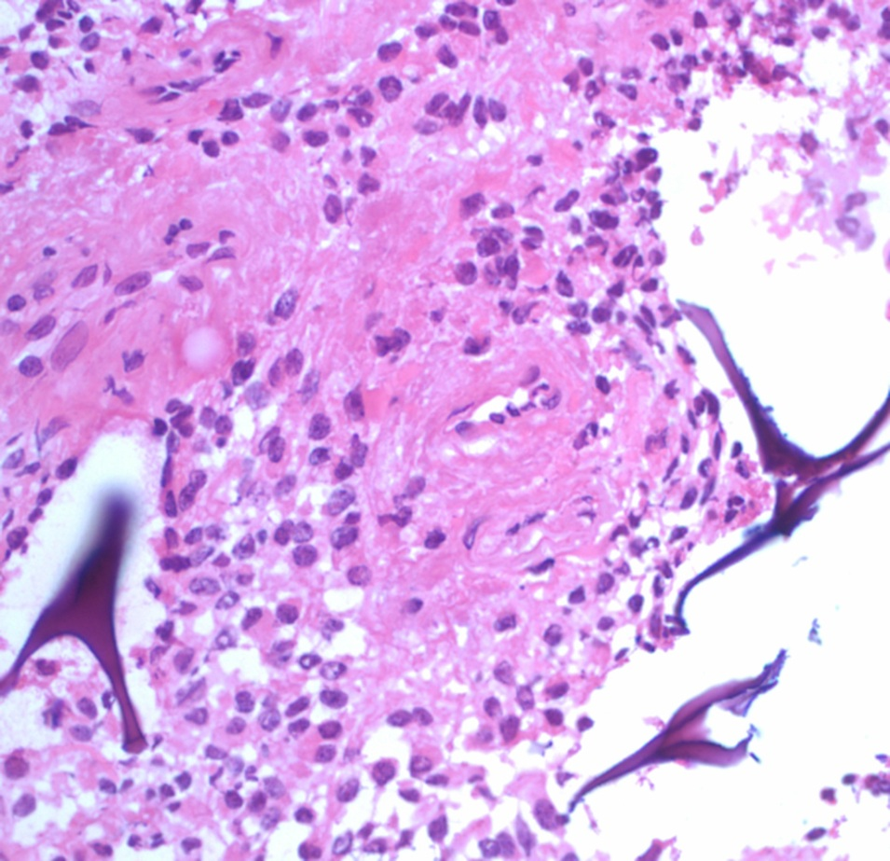
Frozen Sections
Ciliated epithelium
Perivascular pseudorosette

Slide 11
Answer and Question 4
After an intraop diagnosis was made, paraffin-embedded sections of the lesion are cut. Please describe the pathological features of the following H&E sections
Notes:
PERHAPS PUT ARROWS ON SLIDE TO HIGHLIGHT FEATURES

Slide 12
Answer and Question 5
The lesion contains ciliated epithelial cells, and there are multiple areas of eosinophilic fibrillar anuclear zone around blood vessels surrounded by delineated nuclear zone, characteristic of perivascular pseudorosette
Based on the features observed from the intraop and permanent sections, which stains would you consider ordering at this point?

Slide 13
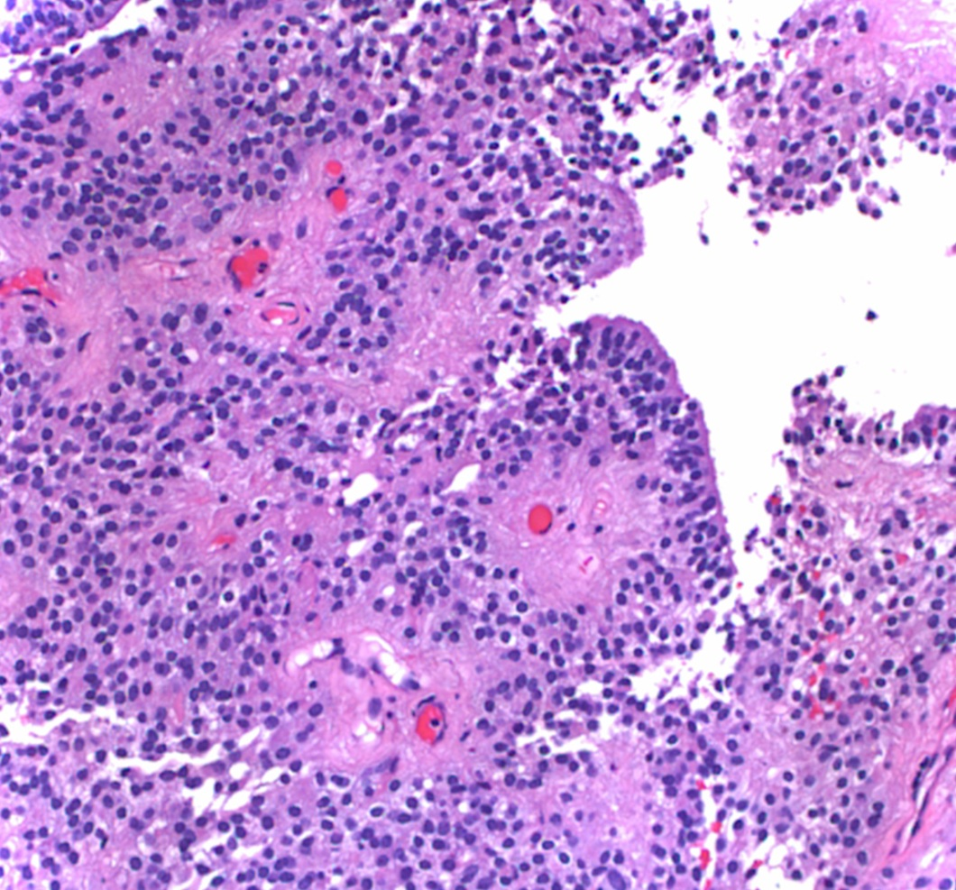
Permanent slides – H&E
Ciliated epithelium
Perivascular acellular areas

Slide 14
Answer
GFAP
EMA (epithelial membrane antigen)
Ki67 – to measure cell proliferation, usually elevated in anaplastic examples of this tumor
p53 – a tumor suppressor commonly mutated in neoplasm
May also want to consider neurofilament or synaptophysin staining to highlight axons if you want to confirm an infiltrative growth pattern

Slide 15
Question 6
The following slides show the 4 stains that are ordered with pertinent findings:

Slide 16
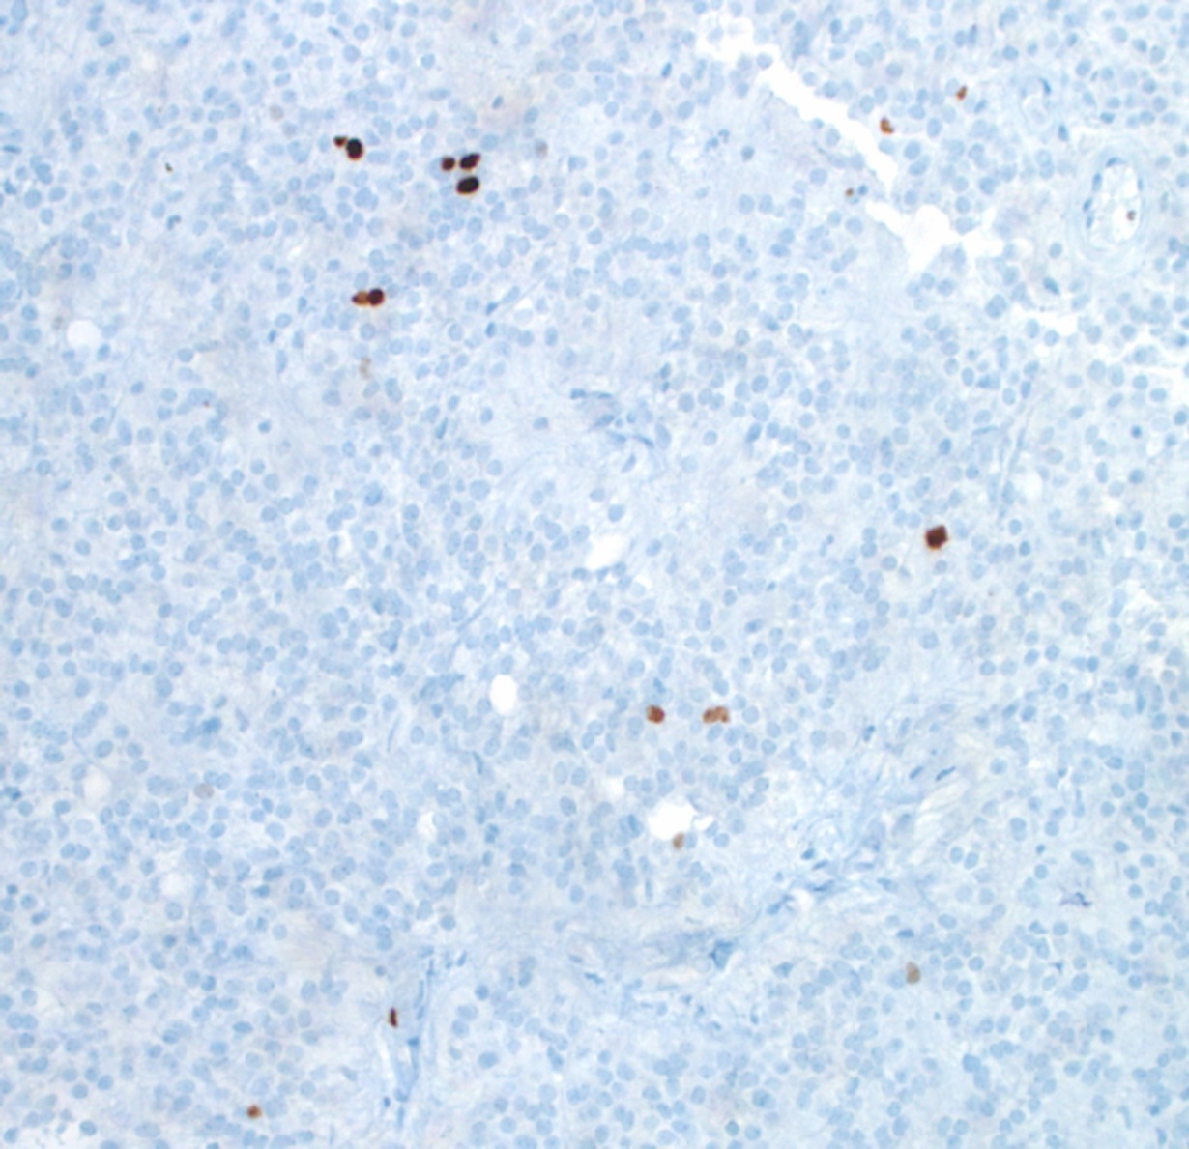
Ki67
Low Ki-67 proliferation index

Slide 17
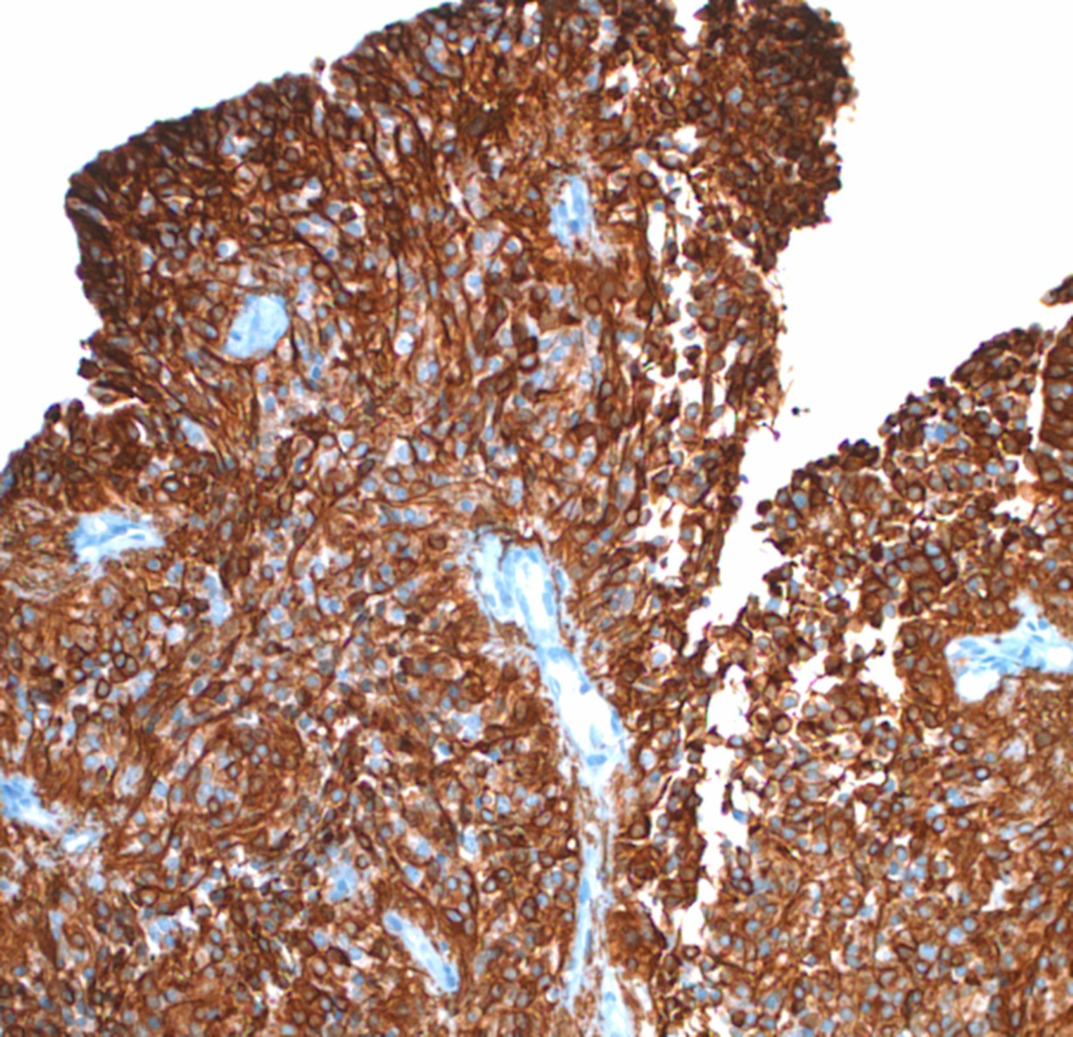
GFAP
Prominent GFAP positivity in cytoplasmic processes

Slide 18
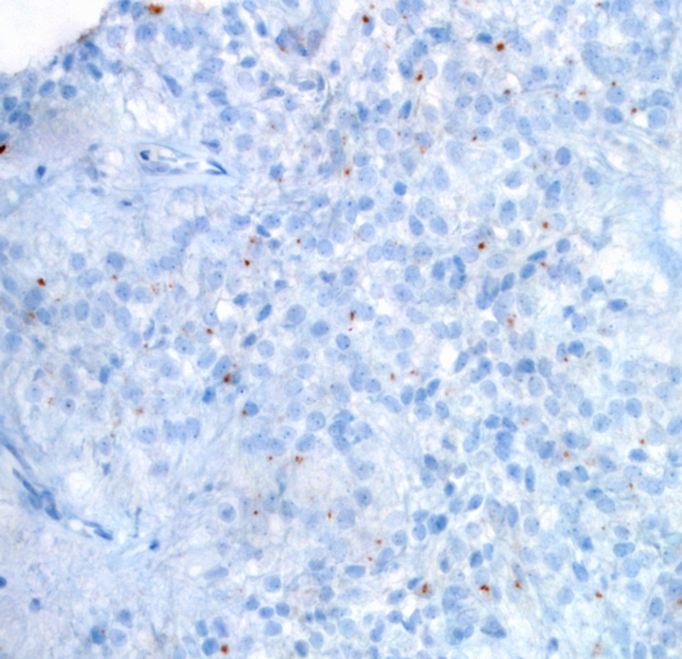
EMA
Dot-like perinuclear EMA positivity

Slide 19
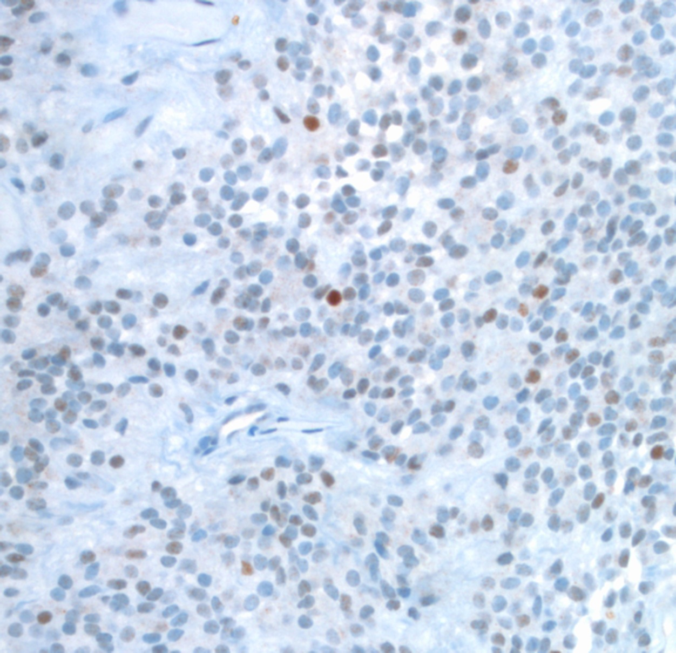
p53
Negative- i.e. <70% strong staining

Slide 20
Answer
Ki67 shows a low percentage of the cells (1-2%) being positive, indicating a low Ki-67 proliferative rate (<5%)
GFAP shows pericellular staining, as well as staining of the thin cytoplasmic processes
EMA shows positive intracytoplasmic punctate staining
p53 shows nuclear staining in only rare number of cells (less than the 70% level considered to be positive for p53 mutation)

Slide 21
Question 7
Based on all of the previous histological and immunohistochemical findings, what is your diagnosis of this lesion?

Slide 22
Answer
The most likely diagnosis of this lesion is ependymoma, based on the presence of perivascular pseudorosettes, rows of ciliated epithelial cells, and the positive GFAP and DOT-LIKE EMA staining
Because this lesion has a low Ki67-proliferative index and no apparent mitotic figures or hypercellularity, it is UN-likely to be anaplastic (WHO grade III)
In summary, this patient is diagnosed with ependymoma, WHO grade II

Slide 23
Discussion – Ependymoma Variants
Conventional ependymoma
Cellular ependymoma – same as conventional, but predominantly arranged in sheets
Papillary ependymoma – PseUdopapillae, but with gliovascular rather than fibrovascular core (like choroid plexus tumors)
Clear cell ependymoma – Mimics oligodendroglioma due to prominent perinuclear halos, but are more sharply demarcated, and EPENDYMOMA lacks 1p19q deletion

Slide 24
Discussion – Variants continued
Tanycytic ependymoma – Long thin processes similar to pilocytic astrocytoma or schwannoma, but with no EGB or Rosenthal fibers unlike a pilocytic astrocytoma, and with strong GFAP staining unlike a schwannoma
Myxopapillary ependymoma – Prominent vascular hyalinization with perivascular mucoid degeneration
Nearly always found WELL ENCAPSULATED in the spinal cord, with excellent prognosis (WHO grade I)

Slide 25
Discussion – Clinical Features
Ependymoma accounts for 3-9% of all CNS tumors
90% of tumors are in the brain, with a infratentorial location twice as likely as a supertentorial location
Infratentorial lesions often fill the 4th ventricle, with obstructive hydrocephalus a frequent complication
10% present in the spinal cord, most often in adults

Slide 26
Radiological and Pathological Features
Present radiologically as an enhancing, solid, well-demarcated lesion
Grossly usually well-circumscribed
FREQUENTLY CURED BY GROSS TOTAL RESECTION
Microscopically usually present with sharp demarcation from adjacent CNS parenchyma
The most characteristic feature is perivascular pseudorosettes, which are nuclear free zones around central blood vessels (although this feature can also be present in other CNS neoplasm)
Usually arranged in sheets of astrocyte-like, ciliated epithelioid, and/or signet ring-shaped cells

Slide 27
Discussion - Immunohistochemistry
GFAP – usually positive and highlights the tapering process in perivascular pseUdorosettes
S-100 – usually positive
Cytokeratin – usually negative, but focal positivity in rare cases
EMA – PERINUCELAR DOT- highlightING ULTRASTRUCTURAL intracytoplaSmic lumina
CD99 – highlights surface membranes
Ki67 (MIB-1) – typically elevated in anaplastic examples

Slide 28
Reference
Pages 497-503 from Prayson, Neuropathology 2nd Edition. Elsevier Saunders, Philadelphia, PA 2012
Pages 194-195 from Burger, Scheithaur, and Vogal, Surgical Pathology of the Nervous System and its Coverings 3rd Edition. Churchill Livingstone, New York, NY 1991
Pages 268-285 from Burger, Smears and Frozen Sections in Surgical Neuropathology. PB Medical Publishing, Baltimore, MD 2009

