Slide 1
Jason Chiang, MD, PhD & Clayton Wiley, MD, PhD
University of Pittsburgh Medical Center
Department of Pathology Division of Neuropathology

Slide 2
Case History
67 years old male with multiple sclerosis (MS) for 39 years
Treated with Tysabri (Natalizumab) during the past 5 years
What is MS?
What is Tysabri?

Slide 3
Case History
New onset of arm dysmetria, slurred speech and choking
Describe MRI findings

Slide 4
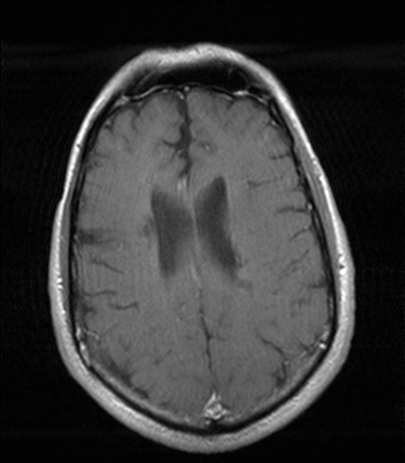
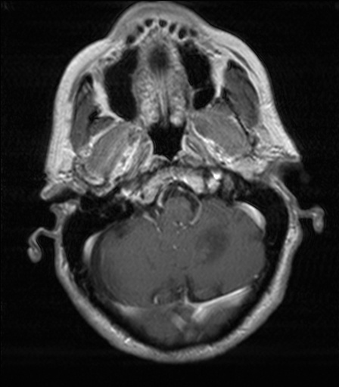
Radiologic Findings - MRI T1 + Contrast
R
R

Slide 5
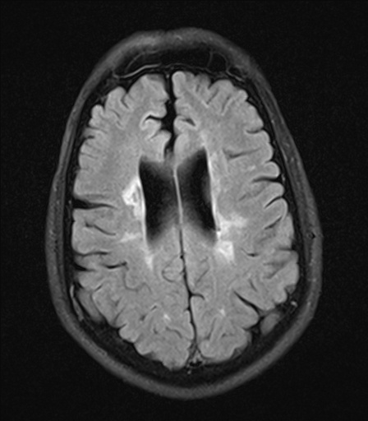
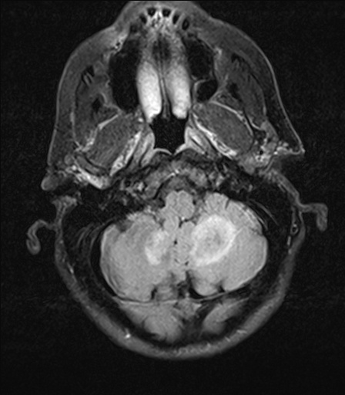
Radiologic Findings - MRI FLAIR/T2
R
R

Slide 6
Further Studies and Clinical Course
CSF analysis:
Normal differential count and glucose level
Elevated protein level, elevated IgG index and oligoclonal bands
Tysabri discontinued, plasmapheresis, IV dexamethasone
Why are they stopping the Tysabri?
Died 25 days after MRI

Slide 7
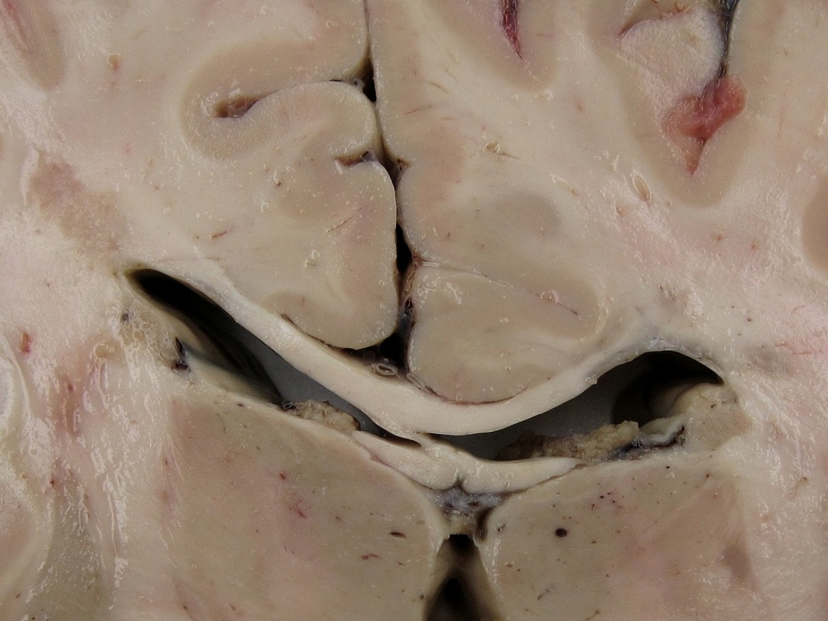
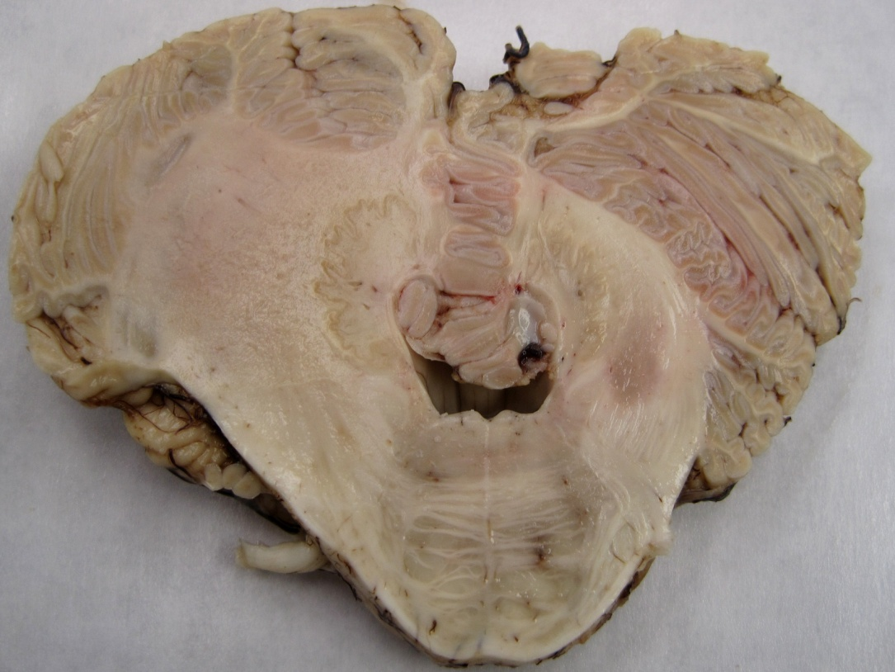
Gross Neuropathology Findings
R
R

Slide 8
Microscopic Findings
Peri-ventricular Area
Cerebellum
2x
20x
H&E

Slide 9
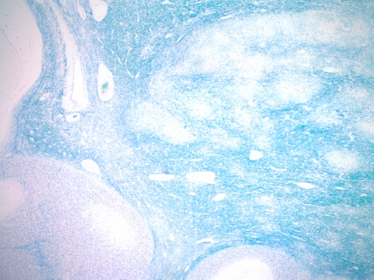
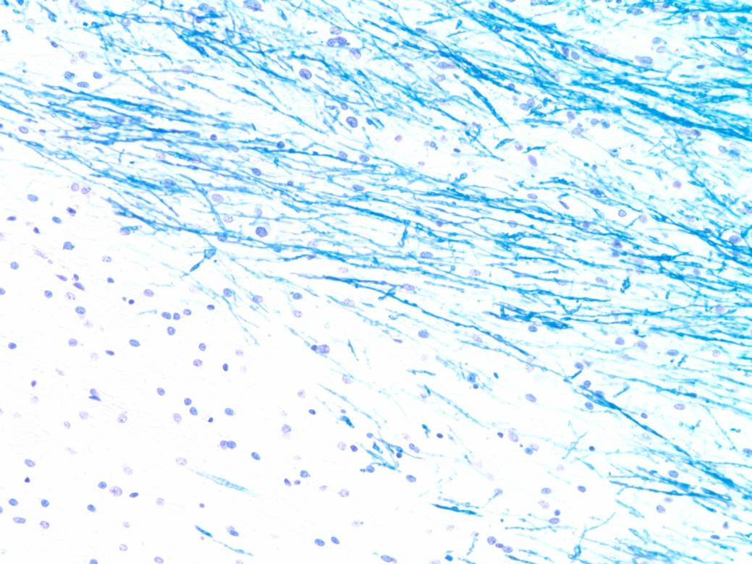
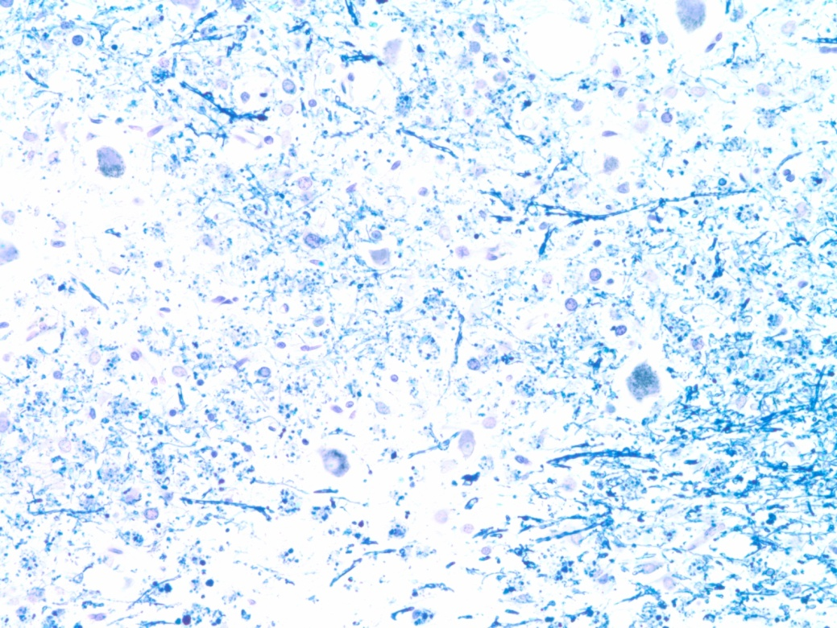
Microscopic Findings
Peri-ventricular Area
Cerebellum
2x
20x
LFB/CV

Slide 10
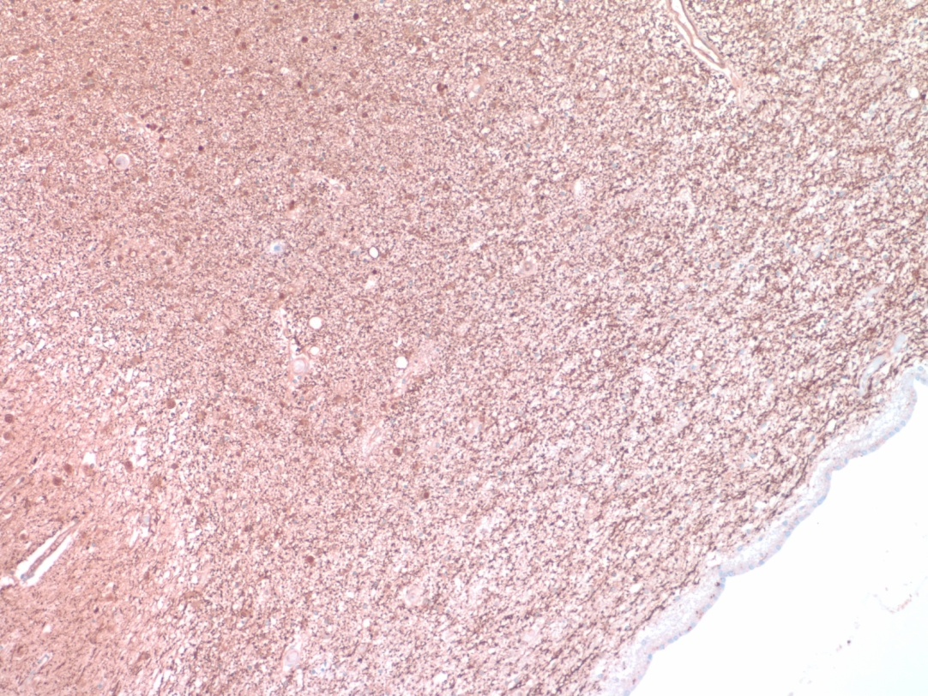
Neurofilament stain
Peri-ventricular Area
Cerebellum
20x

Slide 11
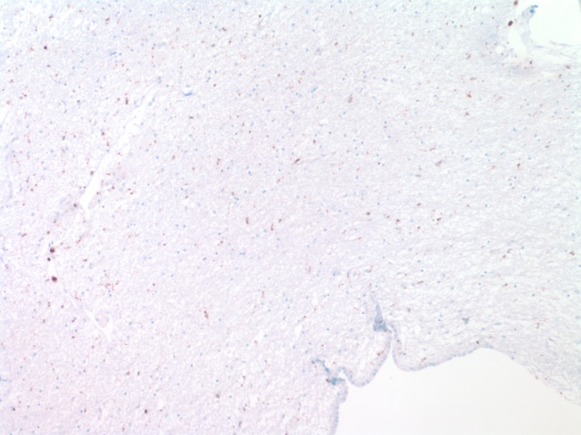
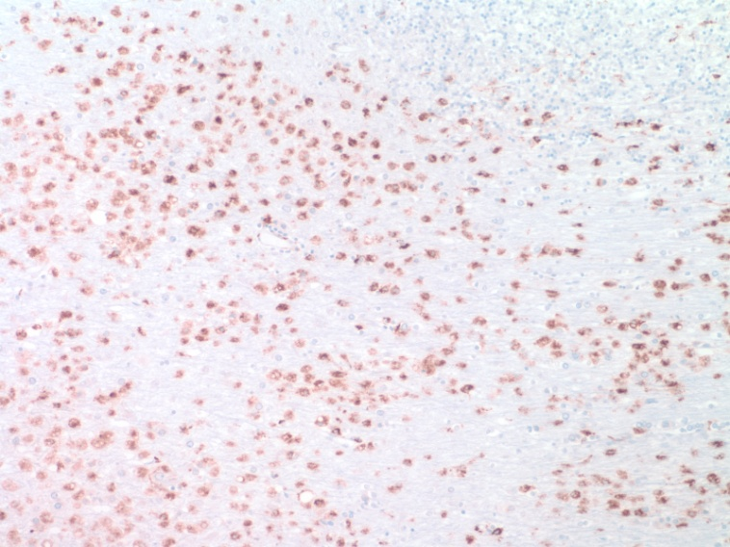
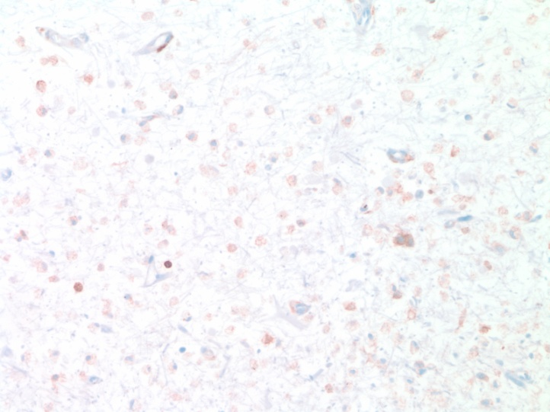
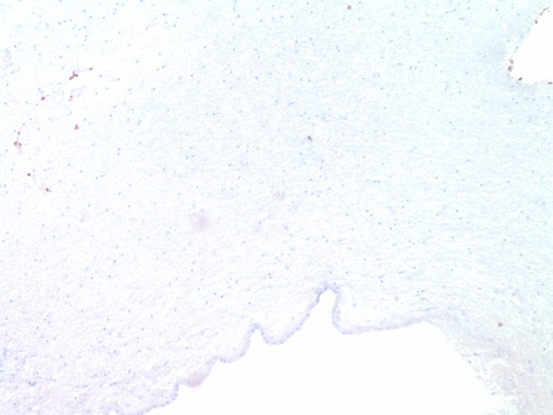
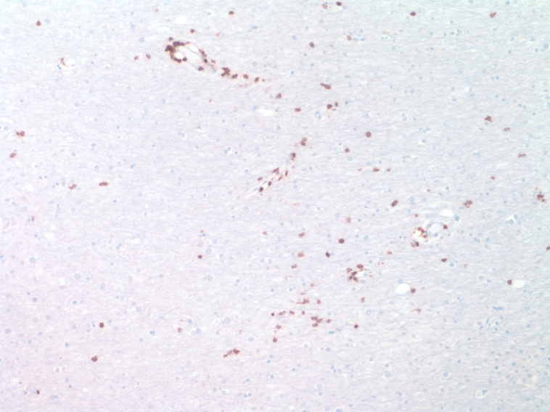
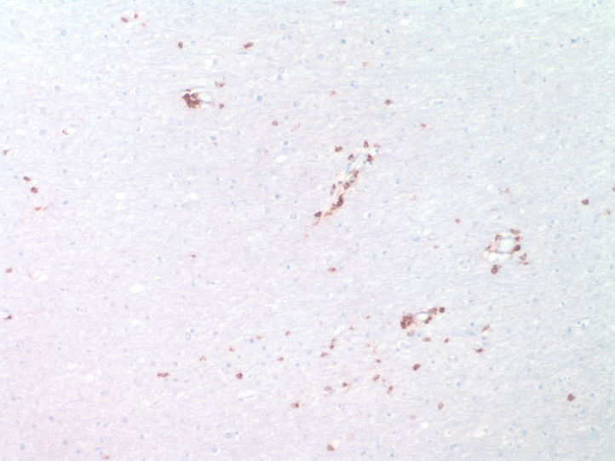
Further Studies
Peri-ventricular Area
Cerebellum
CD68
CD68
CD4
10x
CD3
CD3
CD8

Slide 12
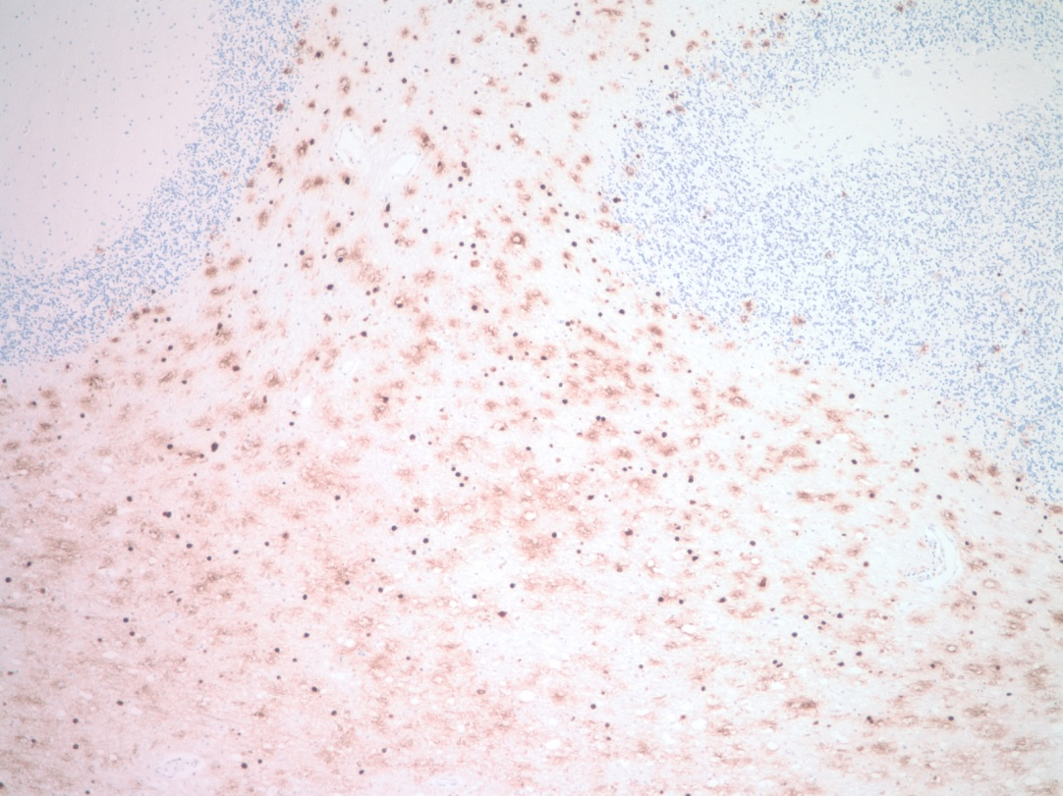
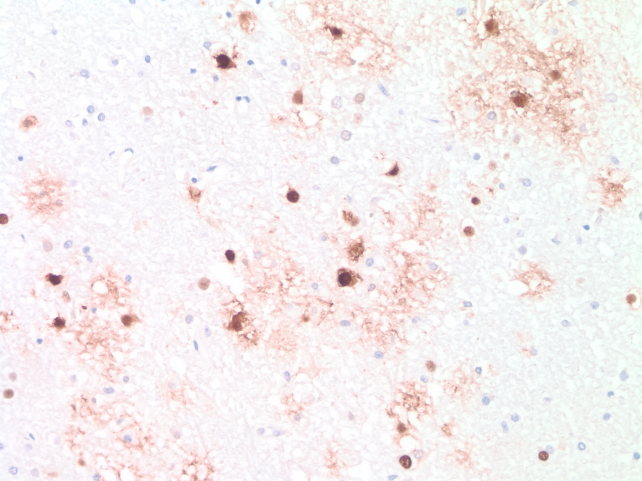
JC Virus in situ Hybridization
Cerebellum
4x
40x

Slide 13
Timeline
MRI
6/5/2012
MRI
9/10/2012
Death
10/5/2012
MS
39 years
Tysabri
Tysabri
Tysabri
Tysabri
Tysabri
Plasmaphereses
Steroid
MS
PML
Symptoms
IRIS

Slide 14
Final Diagnosis
Progressive multifocal leukoencephalopathy (PML)
Bilateral cerebellar white matter
Dentate nuclei
Middle cerebellar peduncles
Superimposed immune reconstitution inflammatory syndrome (IRIS)
Quiescent multiple sclerosis (MS) plaques
Multiple areas of cerebral peri-ventricular white matter
Gray and white matter of spinal cord

