Slide 1
Tinnitus in 44 y/o female
Richard Lukose

Slide 2
Presents to family doctor
A 44 y/o female
Tinnitus in right ear for 1 month, worsening
PMHx: obesity
Medications: none
Social Hx: occasional alcohol
SurgHx: c-section/tubal ligation
Family Hx: father-HTN, mother-DM2, sister-migraine HA’s
Allergies: none

Slide 3
Physical Exam
General: well-nourished female
General medical Exam: negative
Neurological Exam:
Mental status: A&O x 3
CN’s: decreased hearing R ear, tinnitus R ear, R facial droop including the forehead, face sensation intact
Motor: 5/5 throughout, normal
Reflexes: 2/4, toes downward
Sensation: intact throughout
Cerebellar: intact
Gait: intact

Slide 4
Give a one line summary of patient

Slide 5
One line summary
A 44 female with slowly progressive R tinnitus, diminished hearing on the R side and R facial droop including the forehead

Slide 6
Where’s the Lesion?

Slide 7
Where’s the Lesion?
A 44 female with slowly progressive R tinnitus, diminished hearing on the R side and R facial droop including the forehead
Cranial Nerves Involved:
R VII, R VIII
Likely a peripheral lesion (not in the brainstem, you would expect more cranial nerve dysfunction or “crossed” motor and/or sensory signs; and motor to forehead not preserved)
Likely localizes to R cerebellopontine angle

Slide 8
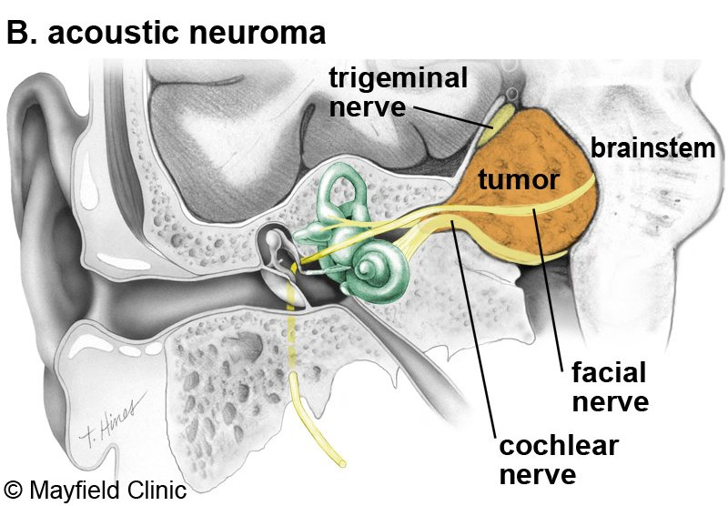
Cerebellopontine Angel Anatomy

Slide 9
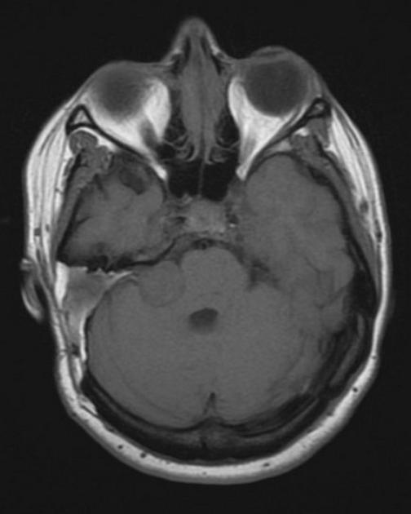
Describe imaging findings

Slide 10
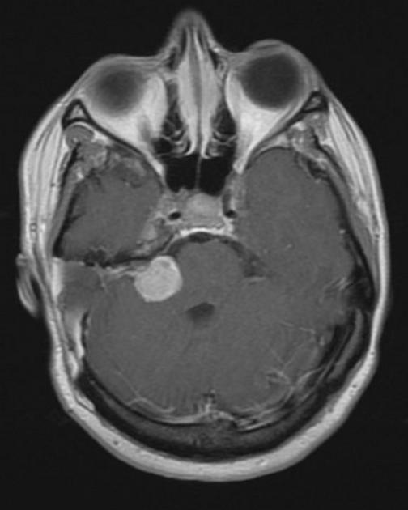
Describe imaging findings

Slide 11
Patient had an MRI brain with and without contrast
A well-circumscribed, heterogenously contrast enhancing mass at the right cerebellopontine angle with mass effect on the superior cerebellar peduncle.
T1 MRI
T1 MRI post contrast

Slide 12
Differential Diagnosis?

Slide 13
Differential Diagnosis
Cerebellopontine Angle mass
Schwannoma (80%)
Meningioma (10%)
Epidermoid Cyst (5%)
Pituitary adenoma
Ependymoma
Choroid plexus papiloma
Neurosarcoid

Slide 14
The process for a Neuropathologist
Intraoperative smear – H & E
Preliminary diagnosis
Frozen Section – H & E
Final diagnosis
Or, wait for results of ancillary testing
Ancillary testing – immunohistochemistry
Final diagnosis

Slide 15
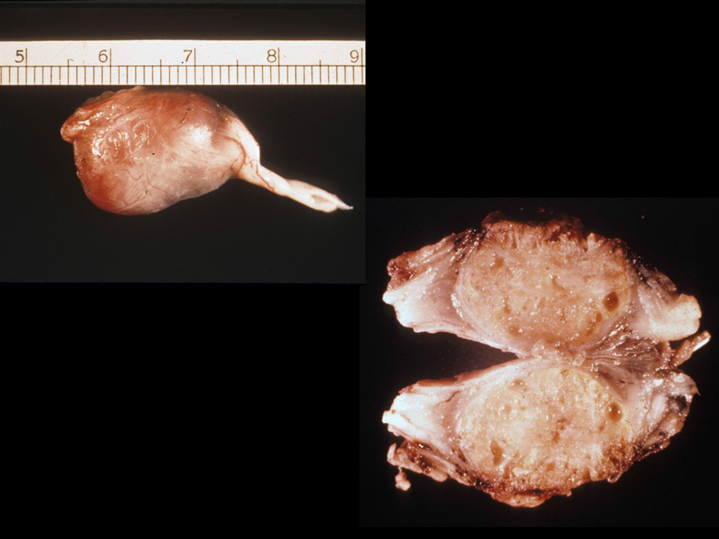
Gross specimen How would you describe this mass?

Slide 16
Gross specimen
Well circumscribed
Encapsulated
Globoid
Light tan in color
Appears to have a nerve origin
Vascularization along what appears to be nerve origin
Cystic pockets are present on section view

Slide 17
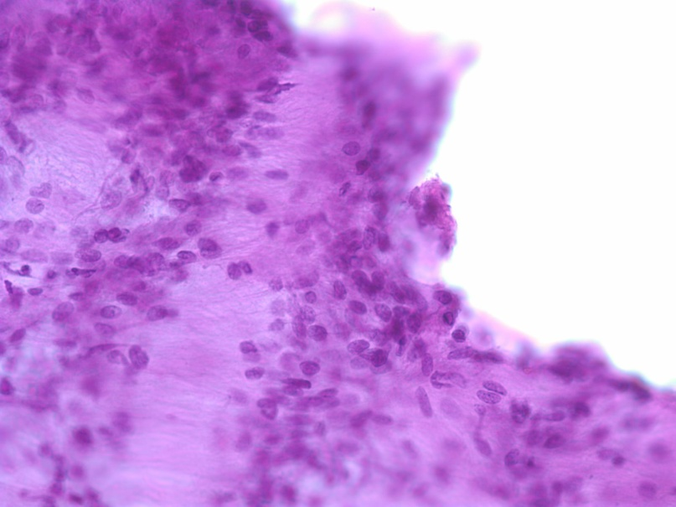
Microscopic findings intraoperative preparation
H & E low power (10x)
H & E low power (20x)
How would you describe these findings?
H & E low power (40x)

Slide 18
Microscopic findings intraoperative preparation
H & E low power (10x)
H & E low power (20x)
Cellular
Spindle shaped cells
Columns of cells
no atypia
Intraoperative dx?
H & E low power (40x)

Slide 19
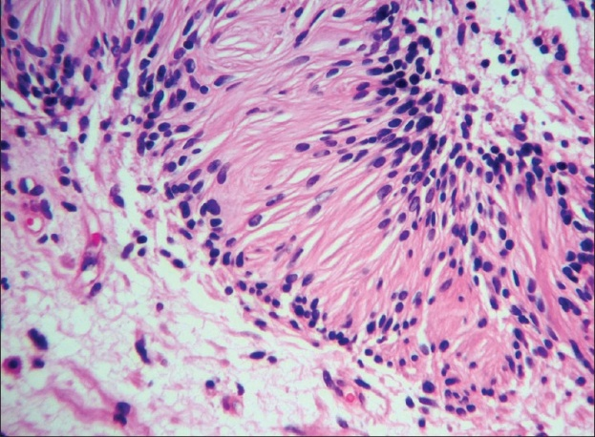
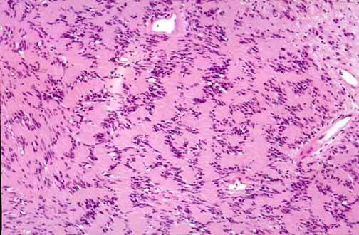
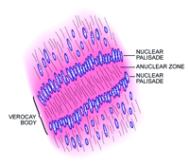
Microscopic findings permanent preparation
H & E low power (40x). Distinctive pattern seen
H & E low power (20x)
Verocay Body: alternating pattern of hypercellular columns with hypocellular area: pathognomonic for Schwannoma

Slide 20
Your Final Dx: Schwannoma Neurilemmoma
Schwannoma
8% of all intracranial tumors, 29% or spinal tumors
90% are sporadic, 4% associated with neurofibromatosis type 2
All ages affected, but pediatric cases rare
Peak incidence 4th to 6th decade of life
You are confident in your diagnosis because of the location of this lesion, clinical presentation and the histological characteristics

Slide 21
Additional evaluation?
immunohistochemistry stains were ordered as confirmatory tests
S-100 staining should be positive for Schwannoma
Ki -67 will help determine the proliferation rate; Ki-67 protein is found in all active cell cycle stages (G1, G2, S and mitosis) and absent during inactive cell cycle stages (G0)

Slide 22
Schwannoma links
Smear
Fz
H&E Permanent
S-100
Ki67
Neurofilament

Slide 23
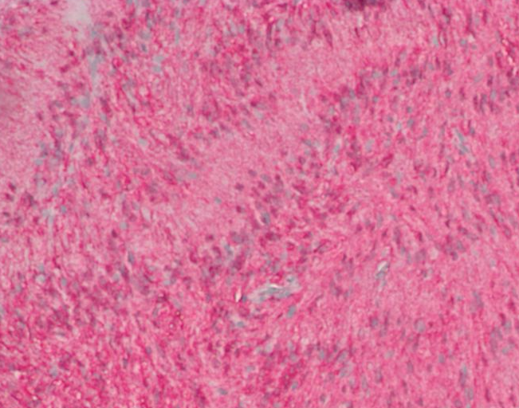
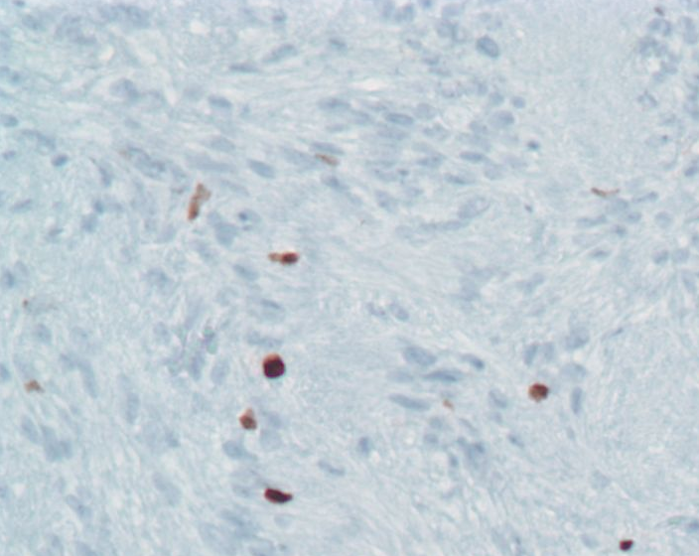
S 100 staining is diffusely positive
Ki-67 showed low staining
Final diagnosis: Schwannoma, WHO Grade 1: low proliferative
Surgical removal was successful without recurrence at 2 years.

Slide 24
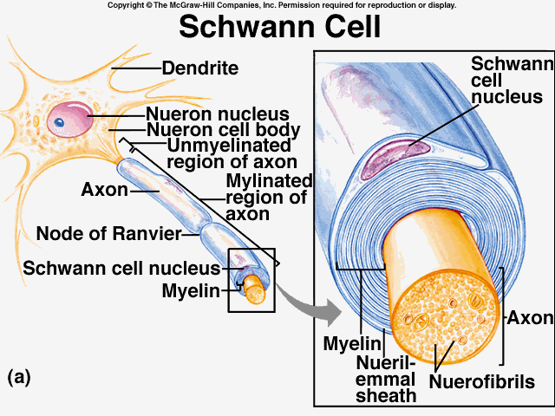
Schwann Cells:
Produce myelin for the peripheral nervous system
(analagous to oligodendrocytes in the central nervous system)

Slide 25
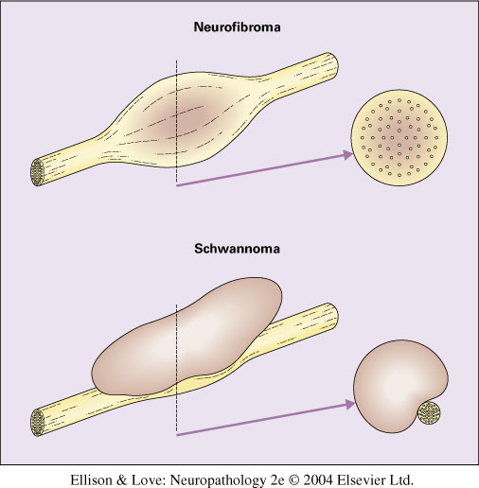
Schwannoma vs Neurofibroma

