Slide 1
Case Study
Nima Aghaebrahim, 2013
Notes:
Patterson, James 785546781
June 8, 2013

Slide 2
Presentation
73 year old man with history of atrial flutter, HTN and CAD s/p CABG presented with sudden onset left sided weakness and dysarthria
On exam he was found to have
Left facial droop
No movement of the left upper and lower limb (0/5)
Dysarthria
Extinction on the left

Slide 3
Question 1
Diagnosis?

Slide 4
Answer
Base on patient’s risk factors and the acute onset of his symptoms, this is most likely a stroke localized to the R frontoparietal lobe area
Head CT was done and was normal
Since he was on Coumadin with therapeutic INR, IV tPA could not have been given
He underwent cerebral angiography with mechanical embolectomy of an occluded right M2 division of the R MCA with successful recanalization (see next slide)

Slide 5
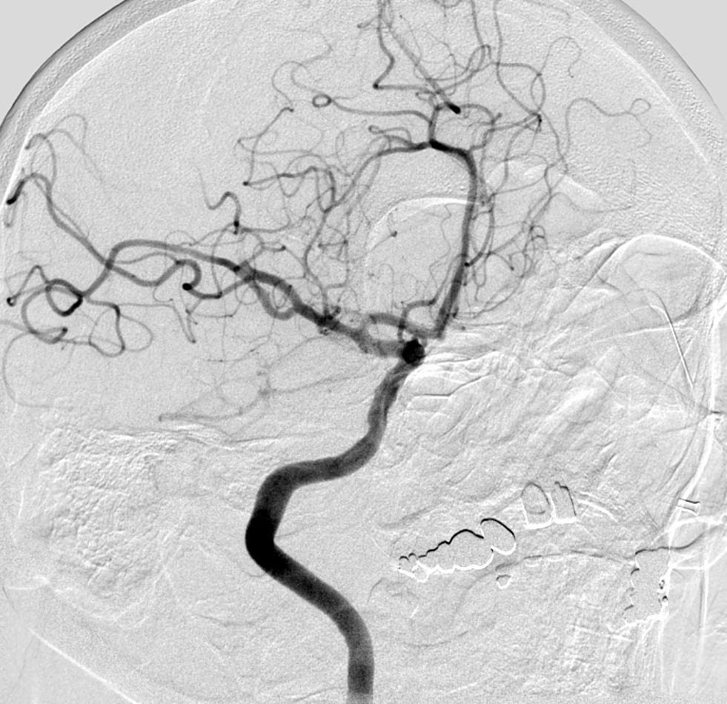
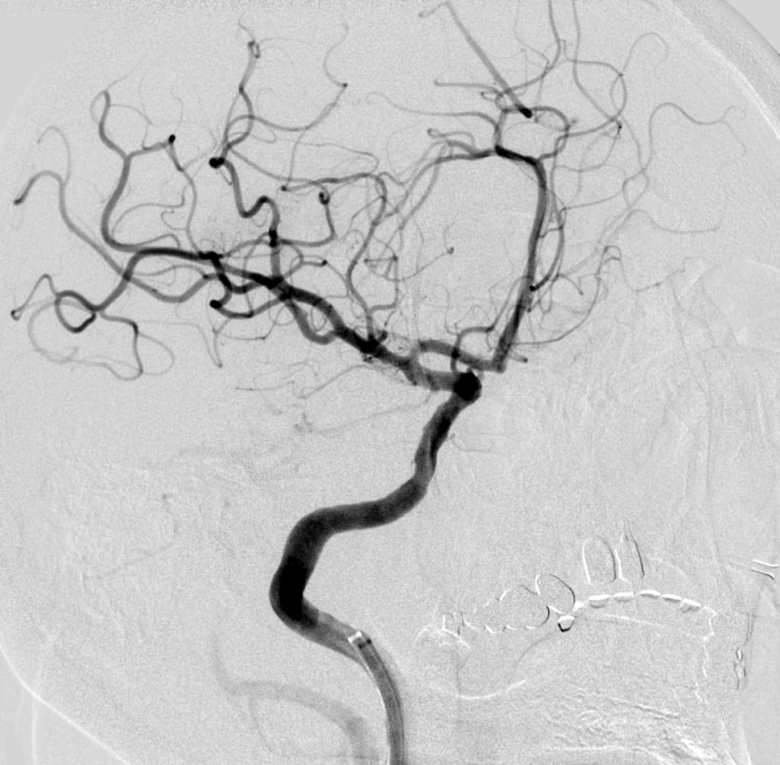
Cerebral angiography with mechanical embolectomy
Flow is restored in the vessel
post recanlization 5 hours after
symptoms onset
Occluded R M2 divison (arrow)
prior to recanlization

Slide 6
Imaging
About 2-3mm of clot was removed from the M2 division of the R MCA
MRI was done after recanalization
Describe the MRI findings:

Slide 7
DWI, axial view
Axial T2 FLAIR

Slide 8
Imaging
Axial DWI shows a very small area of restricted diffusion in the R insular region suggestive of an acute infarct
Axial FLAIR shows multiple other chronic areas of increased signal suggestive of older infarcts
A day after recanalization, his symptoms were significantly improved and he only had left facial palsy and a very mild left upper limb weakness

Slide 9
Embolectomy specimen
H&E
Anti-fibrinogen
Anti- CD31

Slide 10
Question 2
Describe the clot findings

Slide 11
Answer
Specimen consists of acutely clotted blood showing no significant organization
Emboli can consist of hyperacute coagulative processes initiate on a structural abnormality as in this case
or more organized tissue if the chronic thrombus breaks off

Slide 12
Question 3
What was the etiology of his stroke?

Slide 13
Answer
Most likely cardioembolic thrombi

Slide 14
Clot in the brain
Sudden occlusion of a brain artery by a blood clot can lead to ischemic stroke
Embolism is the most common cause of brain ischemia
Particles that can embolize distally
Emboli: calcific particles or thrombi
Red thrombi: erythrocyte-fibrin rich
White thrombi: platelet-fibrin rich
Other: air, fat, tumor cells and foreign objects
Source
Heart (often larger infarct/particles), aorta, cervicocranial arteries, paradoxical

Slide 15
Thrombi
Traditionally, a cardiac source with slow flow is thought to lead to development of “red” (erythrocyte-rich), clots whereas high flow in arteries due to damage endothelium (atherosclerotic vessels) are thought to form “white” (fibrin-rich) clots

Slide 16
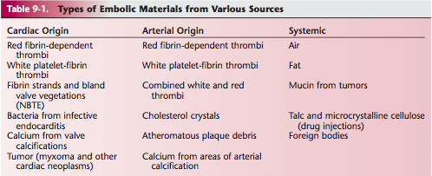

Slide 17
