Slide 1
24 year old male found unconscious
Lananh Nguyen, M.D.
Division of Neuropathology
University of Pittsburgh Medical Center

Slide 2
Clinical history
Patient is known drug abuser who was found down in his residence.
He was taken to the ED and imaging was done.

Slide 3
Name the modality of this MRI and describe what you see?

Slide 4
Name the modality of this MRI and describe what you see?
T2 MRI
Bilateral posterior limb internal capsule T2 intensity
White matter intensity in splenium of corpus callosum
Bilateral occipital white matter T2 intensity

Slide 5
Name the modality of this MRI and describe what you see?
Spongiform leukoencephalopathy exclusively seen in inhalation of heroin
Bilateral occipital white matter T2 intensity
Bilateral posterior limb internal capsule T2 intensity
White matter intensity in splenium of corpus callosum

Slide 6
Also known on MRI imaging as “Chasing the dragon”
Heroin Inhalation and Progressive Spongiform Leukoencephalopathy
N Engl J Med 1997; 336:589-590February 20, 1997

Slide 7
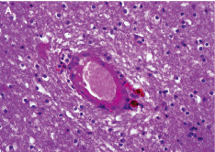
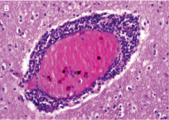
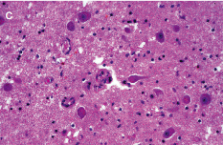
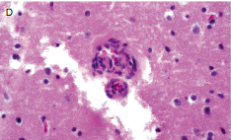
These are the histologic changes. Describe what you see?

Slide 8
These are the histologic changes. Describe what you see?
Concentric small vessel wall thickening pigment deposition
Perivascular inflammatory cell infiltrates
Low power
High power
Reactive endothelial cell proliferation
Büttner A. Review: The neuropathology of drug abuse. Neuropathol Appl Neurobiol. 2011 Feb;37(2):118-34.

Slide 9
Buttner, R. Review: The neuropathology of drug abuse, Neuropatholo Appl Neurobiol. 2011 Feb;37(2):118-34.

Slide 10
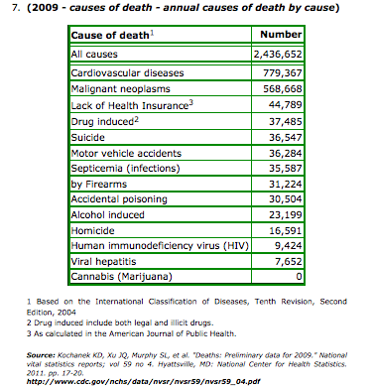
According to CDC, drug abuse is 4th leading cause of death in the US.

Slide 11
Take home points
Abusers with single illicit drug use can have characteristic pathologic findings
However, most abusers are polydrug users
Constellations of findings (neuronal changes, white matter changes, astrocytic changes, and vascular changes) that are nondiagnostic but can be corroborative if in the right clinical context

