Slide 1
65 year-old female with progressive neuromuscular disease
Lananh Nguyen, M.D.
Division of Neuropathology
University of Pittsburgh Medical Center

Slide 2
65 year old male presents with 1-2 years of intermittent muscle cramping and twitching. He has had unsteadiness on his feet and difficulty maintaining his posture at times due to weakness and states he trips over things occasionally as well. He has also noticed in the past year that his hands are not as strong as they used to be and he needs help at times opening jars and other previously menial tasks. 3 months ago he began to require the use of a cane and was sent to a neurologist by his PCP.

Slide 3
Physical Exam revealed
Cranial nerves appear intact
Mentation appropriate
Bilateral lower extremity atrophy greater than upper extremity with wasting of his gastrocnemius to be the most severe.
Upper extremity spasticity
Hyporeflexive in all 4 extremities
Tongue fasiculations

Slide 4
He was then sent for EMG testing
Normal sensory nerve action potentials (SNAP)
Very mildly reduced compound muscle action potentials (CMAP)
Normal F-wave latencies
Increased amplitude, duration and polyphasia of motor unit potentials with signs of decreased recruitment
Both fibrillations and fasciculations seen in upper and lower extremities
Tongue fasciculations on needle EMG present

Slide 5
MRI Brain
Age related white matter changes with no signs of atrophy or previous stroke
MRI Cervical Spine
Mild right lateral disc bulge C4-C5 with no intrusion of the nerve root or spinal canal
Lumbar Puncture revealed no significant abnormalities except increased glutamate levels
He developed PNA and sepsis and passed away 5 months later

Slide 6
An autopsy was performed and showed the following:
The thoracic, cervical, and lumbosacral anterior horns were atrophic
The lower extremity muscles showed severe atrophy and the upper extremity muscles showed moderate atrophy

Slide 7
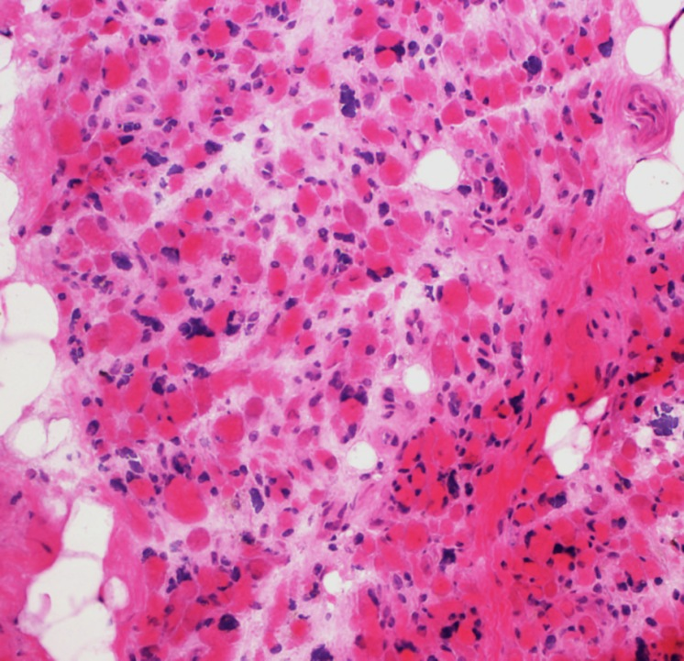
This is a frozen section of the muscle. Describe what you see.
Click here for a normal muscle

Slide 8
This is a frozen section of the lower extremity muscle. Describe what you see.
H&E of the quadriceps muscle showing end-stage muscle demonstrated by severe panfascicular atrophy, variation in myofiber sizes, grouped fiber atrophy and increased nuclear clumps.

Slide 9
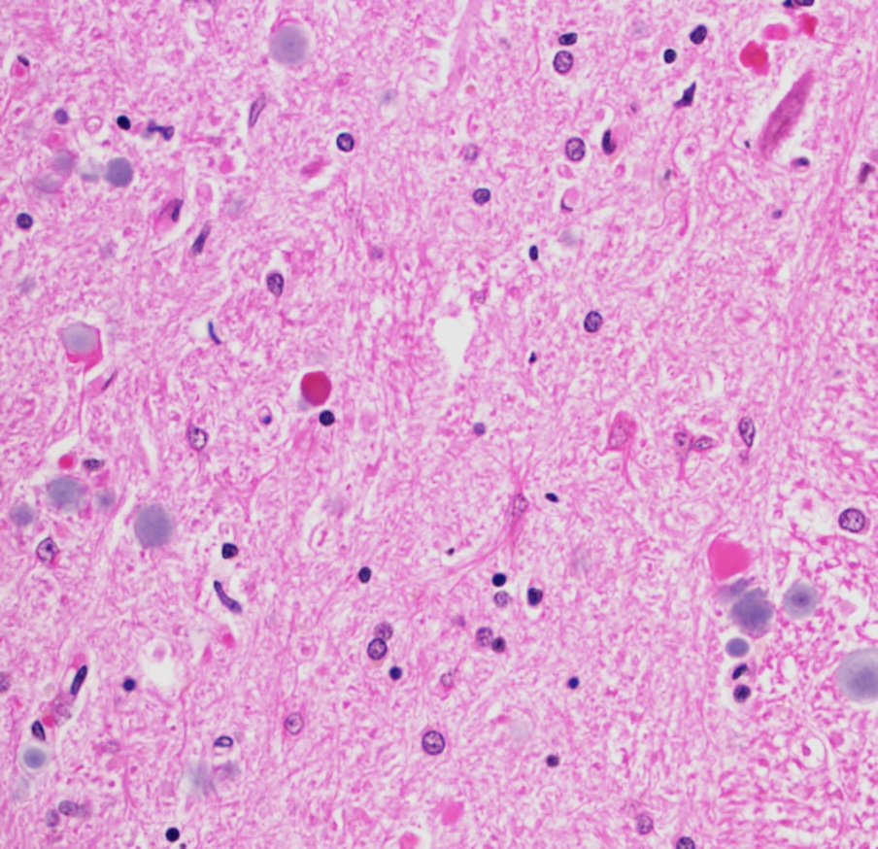
This is a section of the spinal cord anterior horn. What do you see?
This is normal

Slide 10
This is a section of the spinal cord anterior horn. What do you see?
H&E stain of the gray matter in the spinal cord shows a prominent loss of motor neurons in a background of reactive glial cells (arrows).

Slide 11
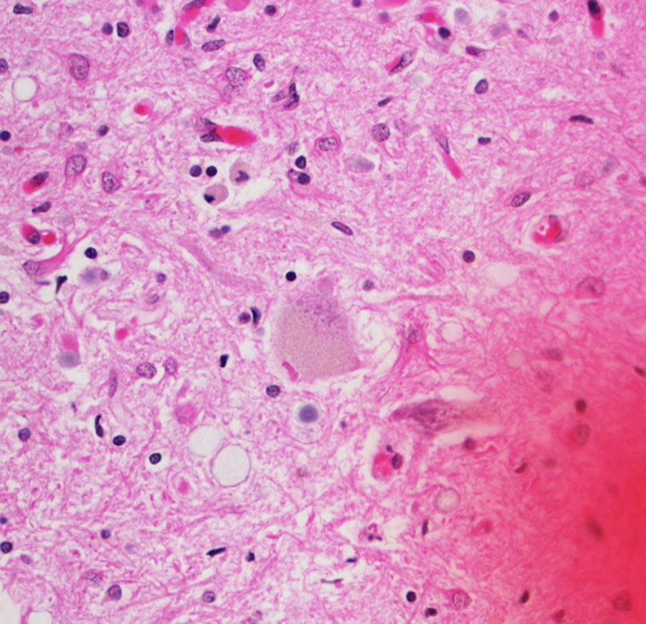
This is a section of the spinal cord anterior horn. What do you see?

Slide 12
This is a section to the spinal cord anterior horn. What do you see?
There are a few remaining motor neurons in the anterior horn. Present within the cytoplasm are eosinophilic inclusions called Bunina bodies (arrows).

Slide 13
What is the diagnosis?

Slide 14
What is the diagnosis?
Amyotrophic lateral sclerosis (ALS)
aka Lou-Gehrig’s disease

Slide 15
ALS
Sporadic- 80-90% of cases
Genetic testing has increased in recent years with various markers found (see next slides)
Many genetic markers correlate with both ALS and FTD- further research to investigate this link is underway
Survival average 3 years from diagnosis
Bulbar onset has worse prognosis
Treatment is supportive
Riluzole- prolongs survival by 6 months

Slide 16
Gene | Location | Inheritance | Percentage explained |  | Putative protein function
 |  |  | Familial ALS | Sporadic ALS
Values represent the percentage of ALS explained by each gene in populations of European ancestry. References are provided in the main text. AD, autosomal dominant; AR, autosomal recessive; XD, X-linked dominant; DENN, differentially expressed in normal and neoplasia.
TARDBP | 1p36 | AD | 4 | 1 | RNA metabolism
SQSTM1 | 5q35 | AD | 1 | <1 | Ubiquitination; autophagy
C9ORF72 | 9p21 | AD | 40 | 7 | DENN protein
VCP | 9p13 | AD | 1 | 1 | Proteasome; vesicle trafficking
OPTN | 10p13 | AR and AD | <1 | <1 | Vesicle trafficking
FUS | 16p11 | AD and AR | 4 | 1 | RNA metabolism
PFN1 | 17p13 | AD | <1 | <1 | Cytoskeletal dynamics
SOD1 | 21q22 | AD and AR | 12 | 1–2 | Superoxide metabolism
UBQLN2 | Xp11 | XD | <1 | <1 | Proteasome
Table 1: Genes known to carry ALS-causing mutations

Slide 17
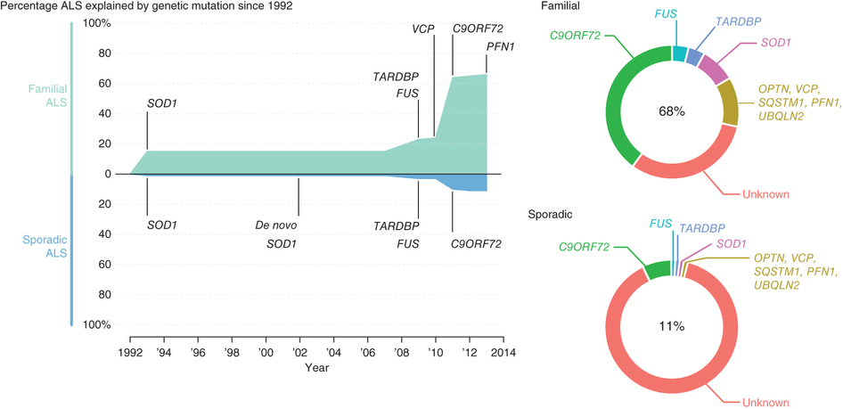

Slide 18
References
Alan E Renton, Adriano Chiò,Bryan J Traynor: State of play in amyotrophic lateral sclerosis genetics. Nature Neuroscience Volume: 17, Pages: 17–23. 26 December 2013.

