Slide 1
Clinical Pathology Case Chalazion
Angela Elam, MD

Slide 2
Clinical Course
61 yo woman with a raised, vascular-appearing upper lid lesion that had been present for a while
Increasing in size over time
Non-tender
No (madarosis) lash loss
Involving the lid margin

Slide 3
Clinical Course
Ophthalmologist’s clinical suspicion was for papilloma
Wedge resection was performed and specimen sent to Pathology for evaluation (PHS12-35718)

Slide 4
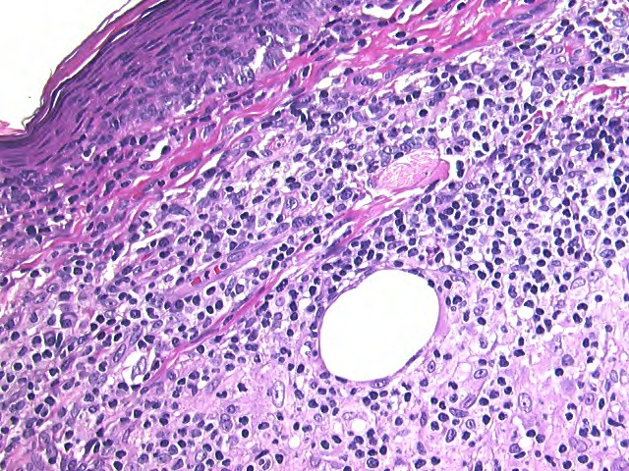
Chalazion
Granulomatous inflammation surrounding empty lipid vacuole
Empty lipid vacuole
PHS12-35718_4

Slide 5
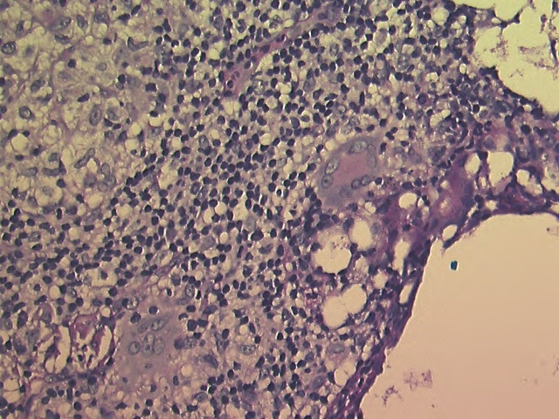
Chalazion
Multinucleated giant cells
PHS12-35718_6

Slide 6
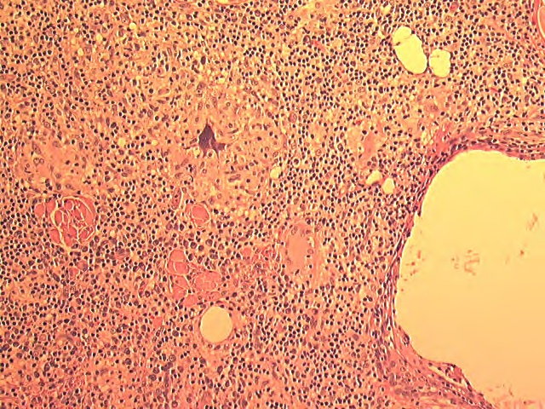
Chalazion
Generalized lipogranulomatous inflammation
Lipid vacuoles
Giant cell
Lipid vacuole
PHS12-35718_2

Slide 7
Pathophysiology
Meibomian glands are a sebaceous glands found in the eyelids
They secrete the oily component of tears
Chalazion formed when duct supplying a Meibomian gland is obstructed

Slide 8
Making the Diagnosis
Clinical and pathologic diagnoses correlate more than 90% of the time
When the diagnosis of chalazion is missed, sebaceous cell carcinoma is often the correct diagnosis, causing some to believe that all chalazion should be sent for pathologic evaluation
Accuracy of the clinical diagnosis of chalazion. Ozdal et al. Eye 18; 135-138, 2004

Slide 9
Common Treatment Course
Conservative = Warm compresses (many will resolve with conservative therapy)
Medical = Topical antibiotics or subcutaneous steroids
Surgical = Incision and removal

Slide 10
Differential Diagnoses
Papilloma
Molluscum contagiosum
Eyelid Tumors (Examples: sebaceous adenocarcinoma, basal cell carcinoma)
Preseptal cellulitis

Slide 11
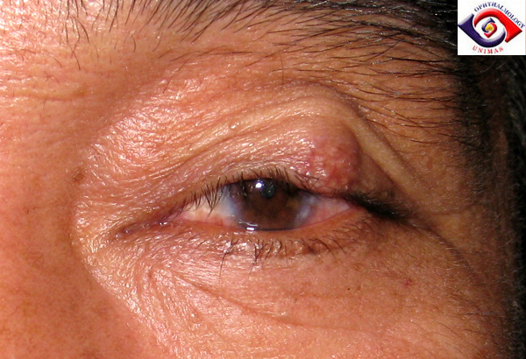
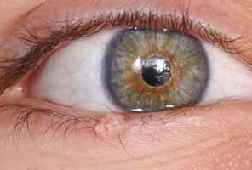
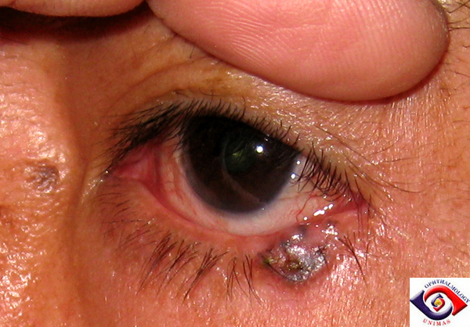
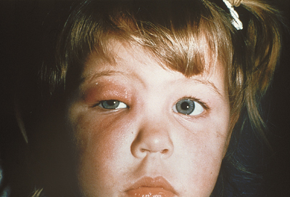
Chalazion
Sebaceous cell carcinoma
www.sarawakeyecare.com
en.wikipedia.org
Papilloma
www.oculist.net
Basal cell carcinoma
www.sarawakeyecare.com
Preseptal cellulitus
http://www.funscrape.com
Molluscum contagiosum
www.EyePlastics.com

Slide 12
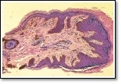
Papilloma
Most common benign eyelid lesion; Associated with HPV infection
Keratinized epidermal fronds covering a fibrovascular core
eyepathologist.com

Slide 13
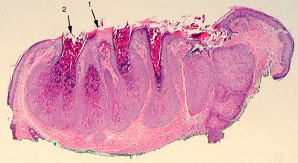
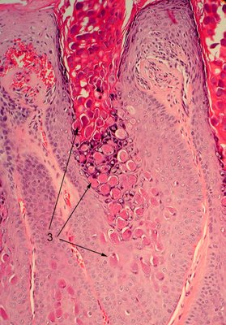
Molluscum Contagiosum
Lobular acanthosis, large basolophilic poxviral intracytoplasmic inclusions composed of poxvirus DNA
www.missionforvisionusa.org

Slide 14
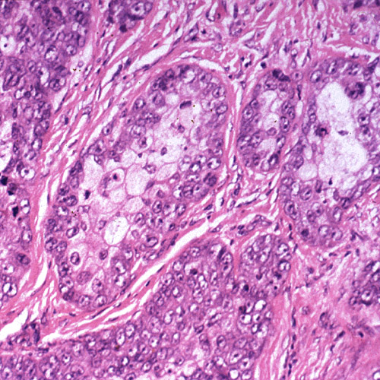
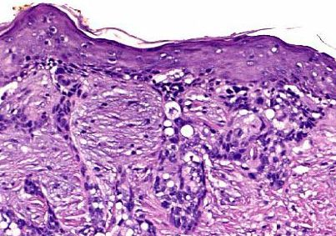
Sebaceous Adenocarcinoma
Second most common eyelid malignancy; Can be misdiagnosed as a recurrent chalazion
Lobules of anaplastic cells with foamy lipid-laden, vacuolated cytoplasm; large hyperchromic nuclei; skip areas
www.mrcophth.com

Slide 15
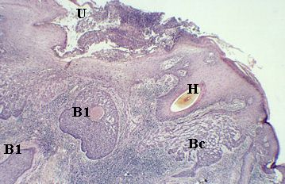
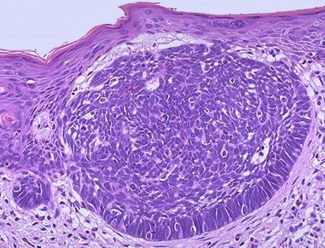
Basal Cell Carcinoma
Most common malignancy of the eyelid
Blue basaloid tumor cells arranged in nests and cords
www.mrcophth.com

Slide 16
References
Basic Clinical Science Course: Cornea and External Disease. American Academy of Ophthalmology 2009-2010
Eye Pathology: An Atlas and Text, Second edition. Ralph Eagle, 2011
Review of Ophthalmology. Friedman, Kaiser, Trattler. 2005

