Slide 1
Complicated
Department of Ophthalmology
Grand Rounds
August 31, 2018
Rikki Enzor, MD, PhD, PGY3
Alex Mammen, MD, Cornea
Notes:
Hi, my name is Rikki Enzor. Along with Dr. Mammen, I will be presenting Grand Rounds today.
Dr Nischal (our chief of pediatric ophthalmology) noticed the perivascular distribution of the sarcoid granulomas on the pathology slides and suggested that the patient may have Blau syndrome and should have genetic testing for a mutation in NOD2.

Slide 2
Ophthalmology Consult
6/2/2017
CC: blurred vision, pain, & redness OS
HPI:
40 yo F with hx chronic uveitis OU 2/2 sarcoidosis, glaucoma OU.
Itching, burning, & redness OS 6 days ago.
Progressively worsening blurred vision, pain, redness, light sensitivity, & discharge OS.
Thought it was allergies & tried Clear Eyes with no improvement
Seen by regular ophthalmologist at Allegheny Eye Associates
Transferred to Presby ED
Notes:
My GR starts just over a yr ago, with a patient who presented for blurred vision, pain, and redness in her left eye.

Slide 3
Histories
POHx: hx chronic anterior/posterior uveitis OU, inflammatory glaucoma OU, pseudophakia OU, legal blindness OU
Baseline exam in 3/2017: VA 20/300 OU, IOP 13 OD, 14 OS, BK OD>OS, PCIOL OU
PMHx: sarcoidosis (dx at age 2), RA, NIDDM2, hx hyperCa, hx renal stones
FOHx: unremarkable
FMHx: sarcoidosis in pgm & maternal cousin
SHx: lives alone, occasional etoh, has tattoos, on disability
All: NKDA
gtts: PF QID OS, Combigan BID OU, Refresh QID OU, Clear Eyes prn OU
Meds: prednisone 2 mg q other day
Notes:
Cataract surgery in 2013, uveitis flares were b/l with last one about 2 years ago, chronically poor vision due to sarcoid ant and post uveitis OU

Slide 4
Basic exam
 | Right Eye | Left Eye
Distance VA | 20/300 PH NI | HM
Pupils | 5-5 | 6-6
Tonometry | 21 mmHg | 17 mmHg
EOMs | full | full
External | normal | normal

Slide 5
Corneal drawing
5 x 2 mm epi defect with dense white infiltrate at 9 o'clock mid-periphery, 40% thinning along nasal limbus adjacent to the infiltrate, surrounding DM folds, band K, dense pigment on endothelium, no KPs

Slide 6
Slit lamp exam
 | Right Eye | Left Eye
Lids/Lashes | normal | edematous, matting
Conj/Sclera | white and quiet | 2+ injection, discharge
Cornea | band K, pigment on endothelium | 5 x 2 mm epi defect with dense white infiltrate at 9 o'clock mid-periphery, 40% thinning along nasal limbus adjacent to the infiltrate, surrounding DM folds, band K, dense pigment on endothelium, no KPs
Anterior Chamber | deep and quiet | 1 mm hypopyon
Iris | fixed and dilated, irregular | fixed and dilated, irregular, iris atrophy
Lens | PCIOL | PCIOL

Slide 7
DFE
 | Right Eye | Left Eye
Vitreous | clear | clear
Optic Nerve | pale, no cup | hazy view
Macula | normal | hazy view
Vessels | normal | hazy view
Periphery | attached | attached, multiple small yellow well-defined retinal spots (likely sequela of old posterior uveitis)

Slide 8
Impression
Impression:
1. Corneal ulcer with adjacent thinning OS
2. Hx Chronic anterior / posterior uveitis OU
Sequelae
Quiet for the past 2 years
3. Pseudophakia OU
Notes:
1) What is your differential for a mid peripheral ulcer with peripheral thinning in this patient?
Infectious vs Inflammatory. Bacterial, fungal, viral vs PUK or Mooren ulcer.

Slide 9
DDx for peripheral corneal ulcer
Infectious
Bacterial keratitis (staph, pseudomonas, strep, moraxella, serratia, haemophilus)
Fungal keratitis (candida, aspergillus, nocardia, fusarium)
Viral keratitis (HSV) with superinfection
Autoimmune
Peripheral ulcerative keratitis
Mooren ulcer
Notes:
Mention why I choose those bacteria. 2) What are a few features of infectious corneal ulcer? A= focal white infiltrate with overlying epithelial defect, possibly a hypopyon or corneal thinning. Pt may complain of things like decreased vision, redness, discharge, light sensitivity, tearing. It will most likely have acute onset.
3) Upper level- What are a few features of inflammatory corneal ulcer? A=PUK or Mooren have a crescent shaped peripheral ulcer with corneal thinning, inflammation involves the limbus, sclera is often involved in PUK but not in Mooren ulcer. PUK often has associated systemic autoimmune dz (RA is most common) but Mooren does not.

Slide 10
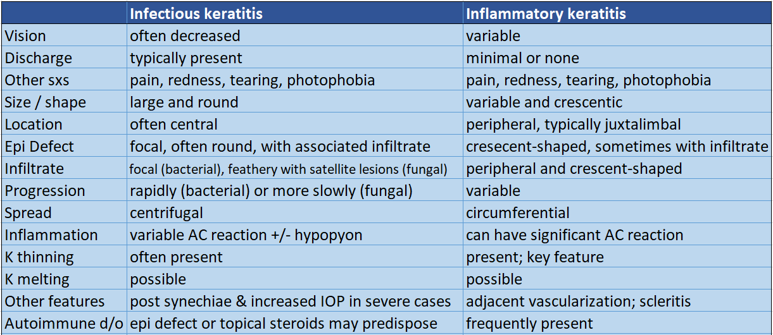
Notes:
How do we distinguish infectious vs inflammatory corneal ulcer? How do we use these distinguishing features to tell these apart? Acute onset, prominent discharge, and mid-peripheral location of the ulcer favor infection. Some overlapping features. Ultimately, tell them apart by getting smears and cultures and start empiric Abx.
4) How we tell for sure whether the ulcer is infectious vs inflammatory? A=we could culture the ulcer and see if something grows. we could also see if the ulcer responds to treatment.
F/U question -- which one would you want to treat empirically first--infection or inflammation? what treatment would you give? A=probably infection first, I would want to start fortified antibiotic drops

Slide 11
Recommendations
Corneal smears and cultures collected
Gtts:
Ancef q2h and tobramycin q2h OS, alternating, around the clock
Atropine daily OS
Stop PF OS
Continue Combigan BID OU
PO:
Vitamin C 1,000 mg BID
Doxycycline 100 mg BID
Continue systemic steroids
Rheumatology consult for systemic evaluation and steroid dosing
Notes:
5) Can another first year tell me what we usually give in addition to FF ABx gtts? A=cyclogyl, vitamin C, and doxycyline
Rheum consult was placed to evaluate for systemic e/o active sarcoidosis, recommend tx, and manage dosing of systemic steroids.

Slide 12
Pt seen in Cornea Clinic 6/5/17
S:
No improvement in her vision.
Pressure sensation and light sensitivity OS.
O:
Exam:
VA: CF OD, HM OS
IOP: 29 OS (iCare)
O (cont’d):
Exam | Left Eye
Conj/Sclera | Diffuse conj injection
Cornea | Epi defect 6 mm V x 4 mm H Crescent infiltrate 3 V X 2.2 H Nasal 40% thinning Steamy with DM folds
Anterior Chamber | Trace 0.5 mm hypopyon with diffuse AC inflammation (4+ flare)
Iris | Hazy view of iris
B-scan | Acoustically clear vitreous cavity. Retina attached. No choroidals.

Slide 13
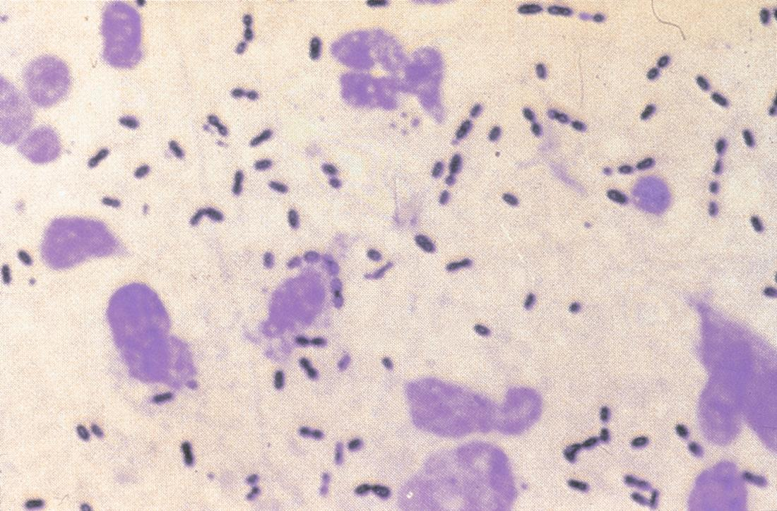
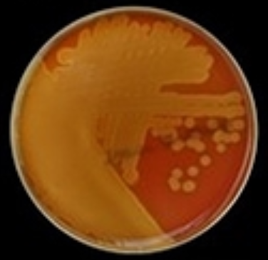
Corneal cultures
Smears: Gram positive diplococci
Cultures: Heavy α-hemolytic Strep
Image credit: Courtesy of James Chodosh, MD
https://www.aao.org/image/grampositive-cocci
Image credit: https://microbiologyinfo.com/ haemolysis-of-streptococci-and-its-types-with-examples/
Notes:
GPC in pairs = Pneumo
Alpha hemolytic Strep = Pneumo or Viridans

Slide 14
What kind of Strep is this?
α-hemolytic Strep β-hemolytic Strep γ-hemolytic Strep
Image credit: https://microbiologyinfo.com/ haemolysis-of-streptococci-and-its-types-with-examples/

Slide 15
What kind of Strep is this?
GPC in pairs GPC in chains
Photo credit: http://anythingfordoctors.blogspot.com/2012/06/129.html

Slide 16
Risk factors for bacterial keratitis
Risk factors
CL wear
SCL
Overuse
Poor lens hygiene
Trauma
Agricultural injury (fungal)
Atypical mycobacteria with LASIK
Ocular surface disease
Others
Immunosuppression
Diabetes mellitus
Vitamin A deficiency
Our patient
?Conjunctivitis
?Peripheral inflammatory ulcer
Immunosuppresion
Sarcoidosis
Diabetes
Chronic topical steroids
Surface disease
Band keratopathy
Dry eyes
Notes:
6) Can someone tell me some risk factors for infectious keratitis/corneal ulcer? A=contact lenses are a big one, esp if patients don't take them out overnight or wash them in tap water. Or trauma to the eye, like if they have a corneal FB or abrasion.
F/U Q=what bacterial infection is often associated with CLs? what type of infection is assoc with getting vegetative material in the eye? A=Pseudomonas. Fungus.
Upper level- 7) What do you think about why our patient specifically developed a corneal ulcer? A=she was on pred forte in that eye, beyond that anything causing a defect in the corneal epithelium could do it
Our pt could have had conjunctivitis preceding the ulcer and -> ocular surface breakdown? Or a peripheral inflammatory ulcer -> corneal epi defect and thinning? But we don’t know for sure.

Slide 17
Etiologies of bacterial keratitis
Compromised ocular defenses
Pseudomonas aeruginosa
GNR
60% of CL-related keratitis
Staphylococcus aureus
GPC
Focal well-defined infiltrate
Streptococcus pyogenes or pneumoniae
GPC
Aggressive, duotherapy preferred
Some bacteria can penetrate the corneal epithelium in setting of conjunctivitis
Neisseria species
Corynebacterium diphtheria
Haemophilus influenzae
Notes:
Usu develops w compromised ocular defenses

Slide 18
Corneal cultures and sensitivities
Smears: Gram positive diplococci
Cultures: Heavy α-hemolytic Strep
ALPHA HEMOLYTIC STREPTOCOCCI
Susceptibilities
Bacitracin……………….. Sensitive
Cefazolin…………………. Sensitive
Ciprofloxacin…………… Intermediate
Gatifloxacin…………….. Sensitive
Gentamicin……………… Resistant
Moxifloxacin……………. Sensitive
Ofloxacin…………………. Sensitive
Polymyxin B.……………. Resistant
Sulfa………………………… Sensitive
Tobramycin……………... Resistant
Vancomycin…………….. Sensitive
Strep pneumo
Notes:
What we have been giving the pt

Slide 19
Corneal cultures and sensitivities
Smears: Gram positive diplococci
Cultures: Heavy α-hemolytic Strep
ALPHA HEMOLYTIC STREPTOCOCCI
Susceptibilities
Bacitracin……………….. Sensitive
Cefazolin…………………. Sensitive
Ciprofloxacin…………… Intermediate
Gatifloxacin…………….. Sensitive
Gentamicin……………… Resistant
Moxifloxacin……………. Sensitive
Ofloxacin…………………. Sensitive
Polymyxin B.……………. Resistant
Sulfa………………………… Sensitive
Tobramycin……………... Resistant
Vancomycin…………….. Sensitive
Strep pneumo
Notes:
What we are going to switch to

Slide 20
Pt seen in Cornea Clinic 6/5/17
A/P:
Impression:
Corneal ulcer OS with adjacent thinning
Strep pneumo
Stable
Significant AC inflammation
Resistant to tobramycin
Notes:
Generally, we do not change ophthalmic Abx based on resistance that shows up on susceptibilies, rather on clinical response.
Reid Kowalski does not believe in resistance to ophthalmic Abx.

Slide 21
Recommendations
Gtts:
Stop tobramycin
Start serum tears q2h OS
Continue
Ancef q2h and Vigamox q2h OS, alternating around the clock
Atropine daily OS
Combigan BID OU & dorzolamide BID OS
PO:
Vitamin C 1,000 mg BID PO
Doxycycline 100 mg BID PO
Increase PO steroids to 20 mg, given worsening AC inflammation (discussed with Rheumatology fellow)
Restart topical steroids, after complete healing of epi defect.
Notes:
8) Why did we start the pt on serum tears? On vit C and doxy? A=serum tears because the GFs in the pt's own serum can help the corneal epithelium to heal. vit C promotes collagen synthesis, while doxy stops breakdown of collagen, so they can also help the epithelium to heal
F/U question for upper level -- why in this patient is it so important to promote corneal healing? A=because of the significant corneal thinning, we need to help the epithelium to heal to prevent corneal melt, descemetocele formation, and perforation
Was pt started on serum tears? If so when? In eye with concern for progression of corneal melt (hx inflammatory dz), benefit of serum tears = getting epi to heal.
Why do we use vit C and doxy?
Vit C promotes collagen synthesis
Doxy inhibits MMPs (which degrade collagen and other extracellular matrix proteins)

Slide 22
Prevention of corneal melt
Medical (first)
Treat underlying cause
Abx gtts (for infectious)
Systemic steroids +/- immunosuppressants (for inflammatory)
PPx Abx gtts (for epi defect)
PFATs, punctal plugs, serum tears
PO vitamin C 1 g daily and doxycycline 50-100 mg BID daily
Avoid topical steroids or NSAIDs
Surgical (second)
BCL
Glue
Conjunctival recession or excision +/- keratoepithelioplasty (for inflammatory)
Notes:
How do we get the epithelium to heal?
Avoid topical steroids because they may worsen corneal thinning.
Keratoepithelioplasty (suturing of a donor corneal lenticule onto the scleral bed) to produce a physical barrier against conjunctival regrowth and further thinning/melting.
Glue = Cyanoacrylate adhesive

Slide 23
Steroids and corneal ulcers
Pros: decreased inflammation, improved comfort, and minimized scarring
Cons: increased replication of microorganisms, decreased immune response
Steroids for Corneal Ulcers Trial (SCUT)
No benefit in most cases
Benefit in severe cases (CF vision or large central ulcers)
Study design
All pts were culture-positive
Steroids were started after moxifloxacin x 48 hrs
General recommendations
Wait 1-2 d after antibiotic gtts
Make sure pt is improving first
Avoid steroids with significant thinning or delayed healing
Source credits: Corticosteroids for bacterial keratitis: the Steroids for Corneal Ulcers Trial (SCUT), <https://www.ncbi.nlm.nih.gov/pubmed/21987582>. Bowling, Brad. “Chapter 6, Cornea.” Kanski’s Clinical Ophthalmology, 8th edition, 2016.
Notes:
Did we do the right thing by stopping the patient’s topical steroids? Maybe we did, but is there something else we should have done instead?
increased replication of microorganisms, esp fungi, acanthamoeba, HSV, and mycobacteria
decreased immune response to bacteria
General recommendations when steroids are used:
Be careful of rebound inflammation with early discontinuance
Avoid steroids in setting of significant thinning or delayed epithelial healing, to prevent corneal melt

Slide 24
Rheumatology Recommendations 6/6/17
Continue prednisone 20 mg daily
Once ulceration is healed
Restart topical steroid drops
Possibly start steroid-sparing agent
Cellcept
Adalimumab
Avoid MTX, due to hepatomegaly
Taper PO steroids

Slide 25
Discharge summary 6/8/17
40F hx sarcoidosis & RA on chronic prednisone p/w L eye pain & discharge.
Problems:
Bacterial keratitis OS
K culture: α-hemolytic Strep
J culture: α-hemolytic Strep & Staph aureus
Extensive corneal thinning adjacent to ulcer OS
?Hx RA, neg RF and CCP
Sarcoidosis
Discrete yellow retinal lesions OS
Hepatomegaly with calcified granuloma on U/S liver
Mildly elevated ACE
Hypercalcemia

Slide 26
Simplified problem list
1. Corneal ulcer OS
- With adjacent nasal thinning
Strep pneumo
Significant AC inflammation
2. Hx Chronic ant / post uveitis OU
Sequelae
?Recurrence
Notes:
Does corneal infection predispose to recurrent uveitis?

Slide 27
Recurrent uveitis and corneal ulcers
Loosely related articles:
Recurrent non-infectious scleritis in pt with u/l intra-ocular lepromatous leprosy, despite systemic cure
Poon A¹, MacLean H, McKelvie P. Recurrent scleritis in lepromatous leprosy. Aust N Z J Ophthalmol. 1998 Feb;26(1):51-5. Cont Lens Anterior Eye. 2013 Dec;36(6):313-7. doi: 10.1016/j.clae.2013.07.013. Epub 2013 Aug 28.
PUK in patients with sarcoidosis
Siracuse-Lee D¹, Saffra N. Peripheral ulcerative keratitis in sarcoidosis: a case report. Cornea. 2006 Jun;25(5):618-20.
Harthan JS¹, Reeder RE. Peripheral ulcerative keratitis in association with sarcoidosis. Cont Lens Anterior Eye. 2013 Dec;36(6):313-7. doi: 10.1016/j.clae.2013.07.013. Epub 2013 Aug 28.
Notes:
Does corneal infection predispose to recurrent uveitis?

Slide 28
More of our patient’s story…
6/2017: F/U with local ophthalmologist
Trace cell, then no AC cell
No DFEs
Severe pain & photophobia OS -> referral to Dr. Waxman
1/2018: More sequelae
OD: punched out chorioretinal lesions
OS: 4+ flare, dense cyclitic membrane, RD
Recs: cycloplegics and tinted lenses
Notes:
Trace cell at first local f/u (a few weeks after the ulcer started), then no AC cell a month after that.
But no DFE is recorded for the next 6 months…
By the time she presents to Dr Waxman’s clinic in January, she has lots more sequelae…
Does pt have active posterior uveitis that has gone unnoticed and inadequately managed?
Her ocular sarcoidosis is end-stage by now and she develops severe pain & light sensitivity

Slide 29
Sarcoidosis
Chronic non-caseating granulomatous inflammation
Lungs and LNs
Any organ system
Unknown etiology
Epidemiology
Black:White 10:1
More common in colder climates
One of the most common systemic associations of uveitis

Slide 30
Clinical findings
Symptoms
Respiratory (cough, DOE) in 50%
Constitutional (malaise, arthralgia) in 50%
Signs
Lungs: mild infiltration to severe fibrosis
LNs: enlarged hilar/superficial nodes
Skin:
Erythema nodosum
Lupus pernio
Neuro (rare): meningitis, CN palsies, pituitary involv -> hormonal abnl
Cardiac (5%): arrhythmia, sudden death
Ocular (25-70%, depending on ethnicity)
Notes:
Erythema nodosum (tender erythematous plaques on shins)
Lupus pernio (indurated violaceous lesions of nose, cheeks, fingers, ears)

Slide 31
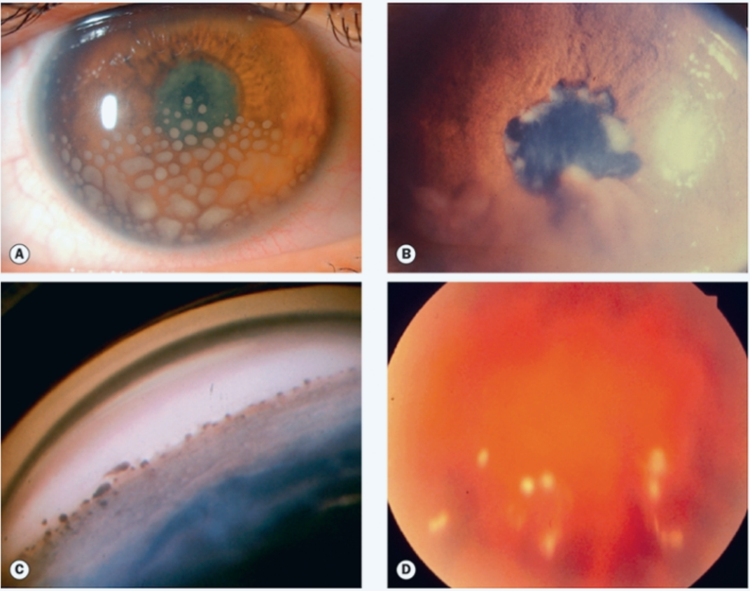
Ocular features in sarcoidosis
MC = granulomatous ant uveitis
AAU (acute-onset sarcoid)
CAU (older pts with chronic pulm dz)
Complications:
Cataract
Glaucoma
PS/PAS
Band K
VH
Maculopathy (CME/ERM/CNV)
RD
Phthisis
Prognosis = Blindness, if poorly treated
(A) Very large granulomatous ‘mutton fat’ KPs. (B) large iris nodules. (C) nodular involvement of TM. (D) snowballs.

Slide 32
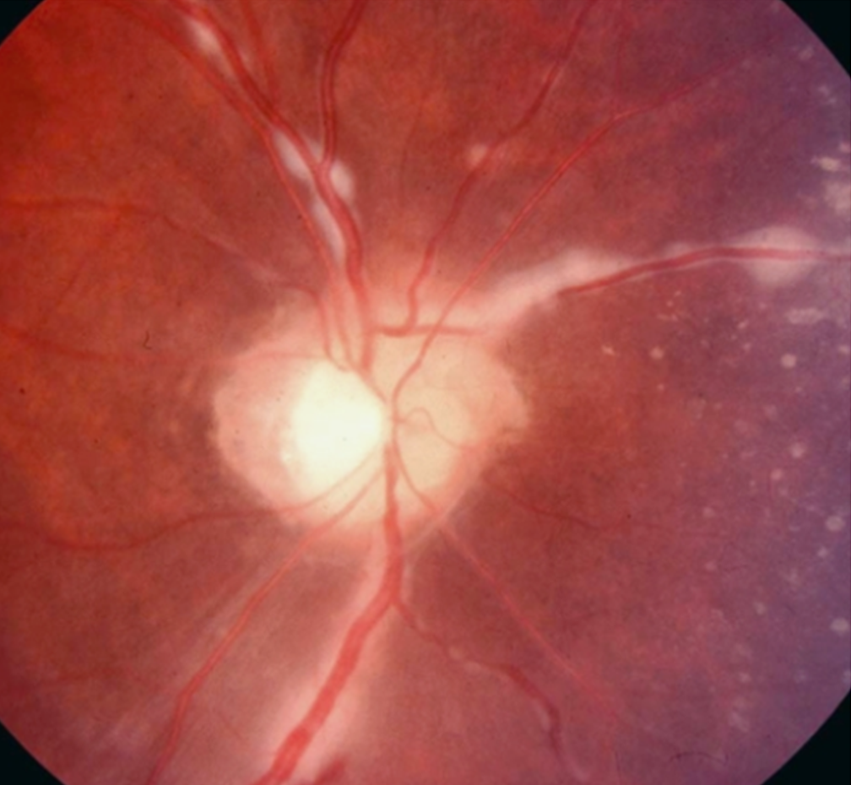
7 key signs of sarcoidosis (per IWOS 2009)
Granulomatous or iris nodules
TM nodules or tent-shaped PAS
Vitreous opacities (snowballs/“strings of pearls”)
Multiple peripheral chorioretinal lesions
Small pale-yellow infiltrates
Large confluent infiltrates
Multifocal choroiditis
Retinal granulomas
Vascular inflammation
Segmental periphlebitis +/- “candle wax drippings”
Retinal macroaneurysms
Optic disc involvement
Solitary choroidal nodule/granuloma
Persistent disc edema
Bilaterality

Slide 33
Dx and Tx of sarcoidosis
Diagnosis
Biopsy
superficial lesion (skin, LN)
bronchoscopy or FNA of hilar LN
ocular site = conj, lacrimal gland, or vitreous
Neg TB skin test
Incr serum ACE +/- serum lysozyme
CXR with b/l hilar LN (90%) -> chest CT (if neg CXR)
Abnl LFTs
CD4/CD8 ratio in vitreous or BAL fluid
Treatment
Posterior uveitis: Systemic steroids +/- IS (MTX, AZA, cyclosporine, anti-TNFs)
Anterior uveitis: Topical steroids & cycloplegics
Retinal NV: Scatter photocoagulation

Slide 34
5/2018: Pt sees Dr Mammen
CC: Severe pain and photophobia OS
HPI: “Pt currently cannot really leave her house due to photophobia and feels it is interfering with her quality of life.”
Exam: 20/200 OD, HM OS, early band K OU, cyclitic membrane OS
B scan OS: RD with PVR? And heme?
A/P:
Chronic uveitis 2/2 sarcoidosis
Seeing rheum & discussed starting steroid-sparing agent
Currently only on prednisolone gtts BID & PO pred 2 mg QOD
Severe light sensitivity OS>>OD
Atropine helps a little
Tinted lenses don’t help
Discussed enucleation

Slide 35
7/11/18: Enucleation OS
Left eye is enucleated by Dr Stefko & Dr Mancini
Then sectioned and examined by Dr Chu & myself

Slide 36
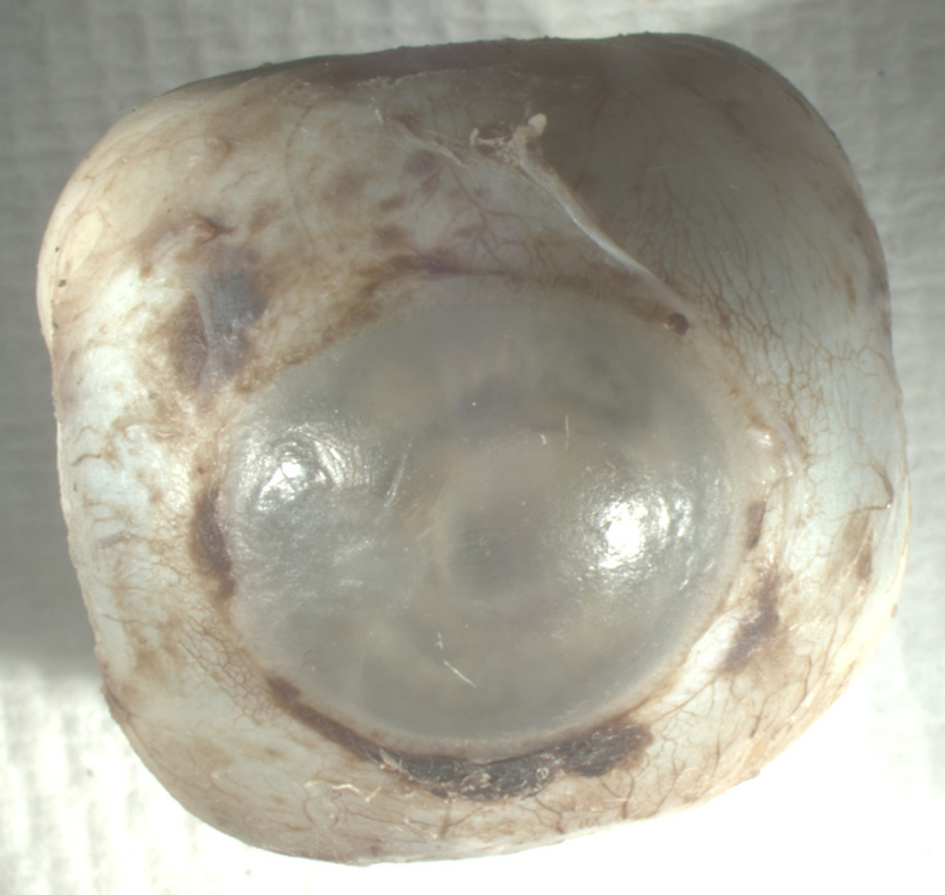
Our patient’s eyeball

Slide 38
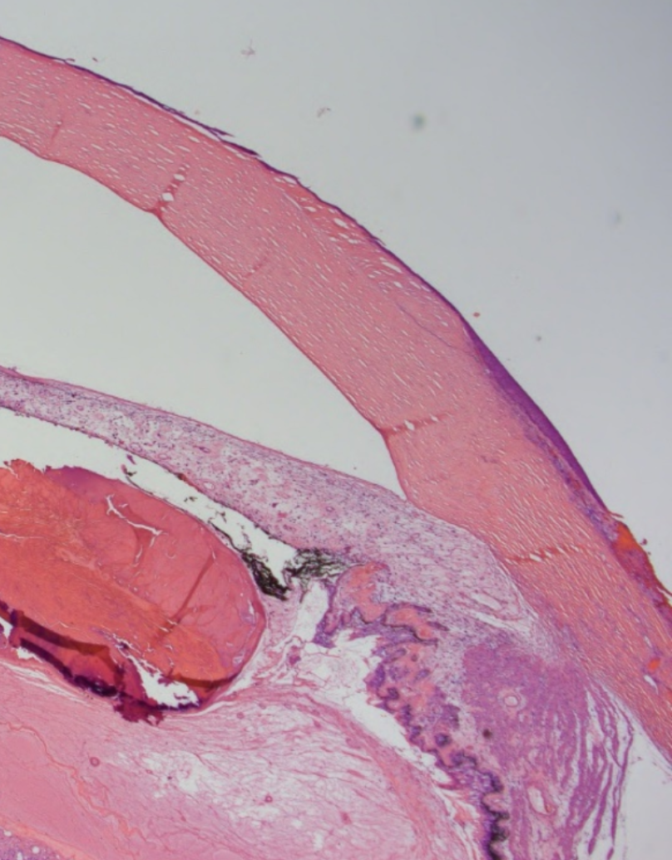
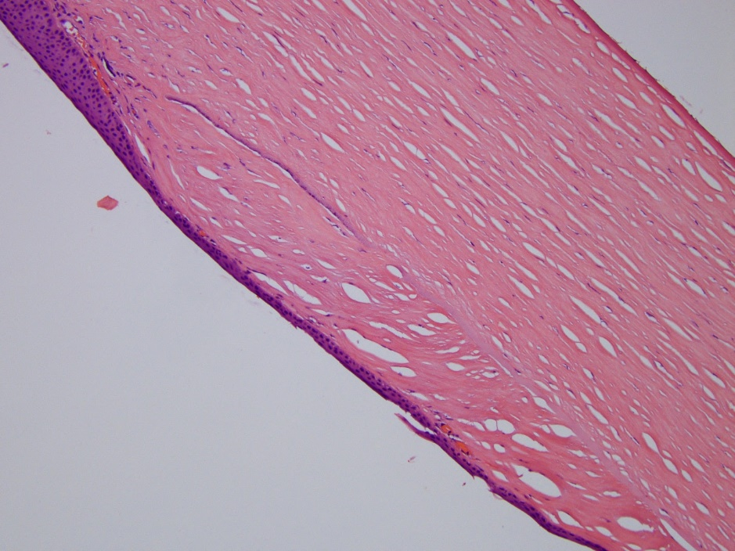

Slide 39
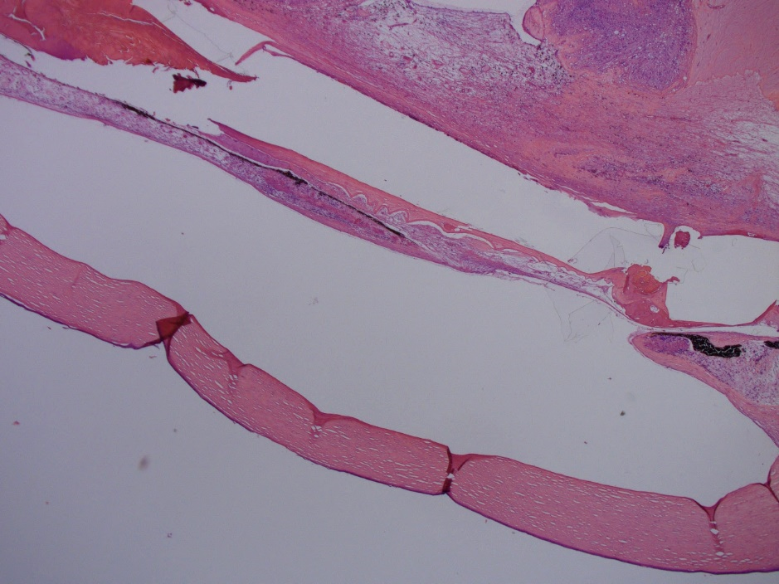

Slide 40
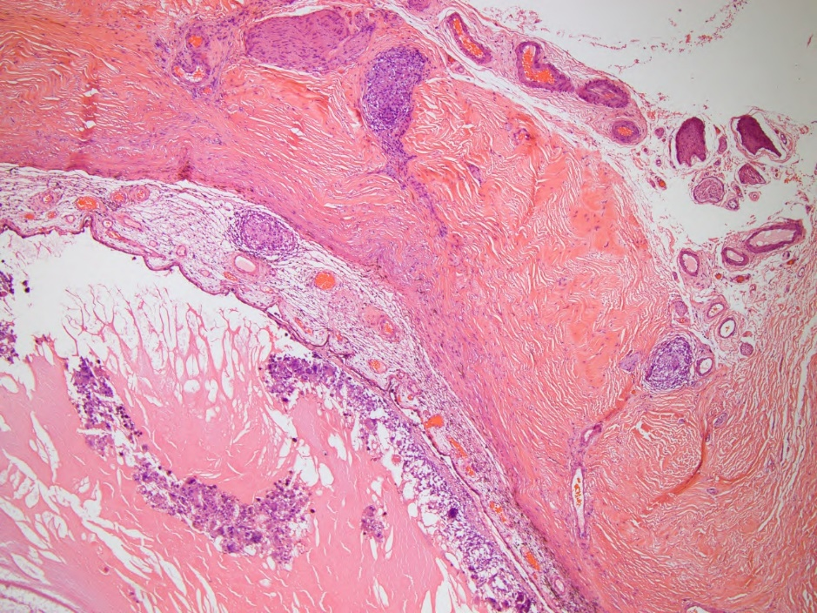

Slide 41
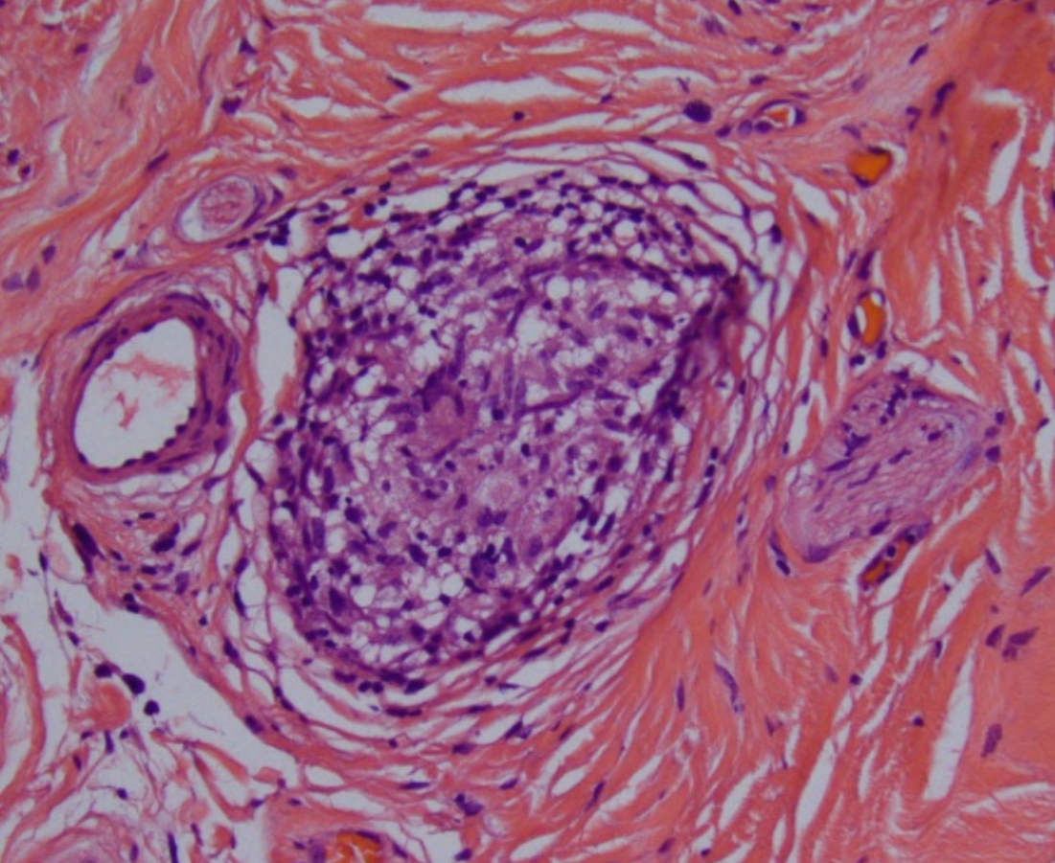
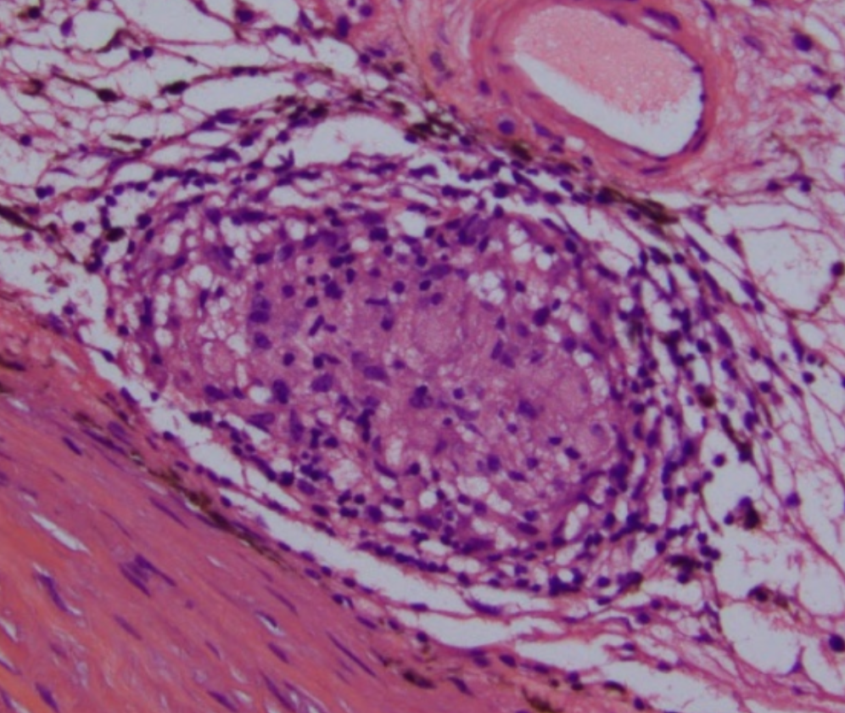
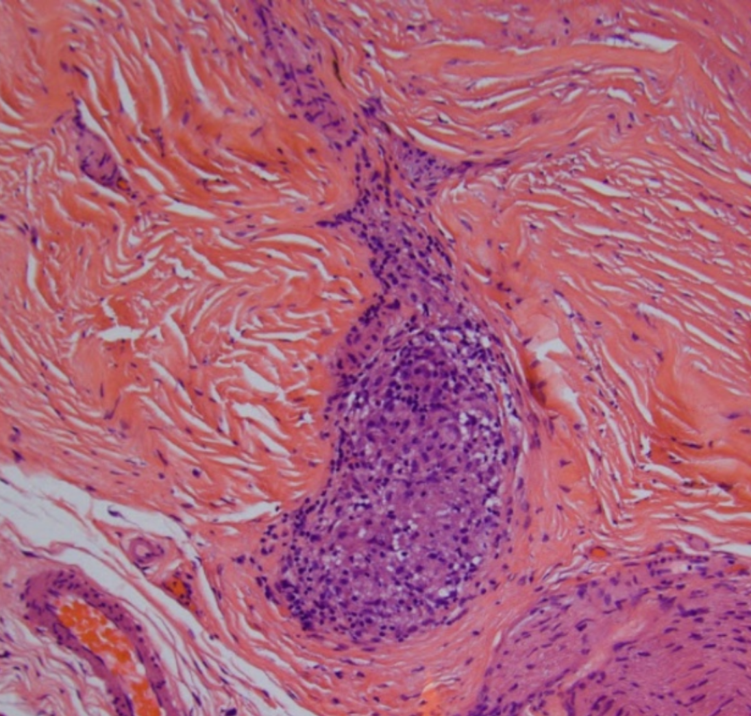

Slide 44
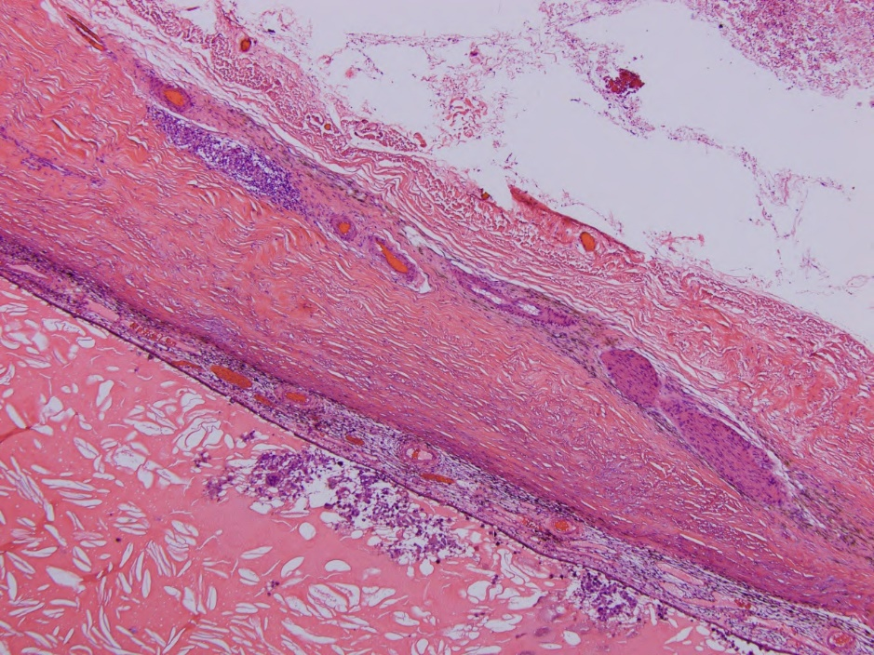

Slide 45
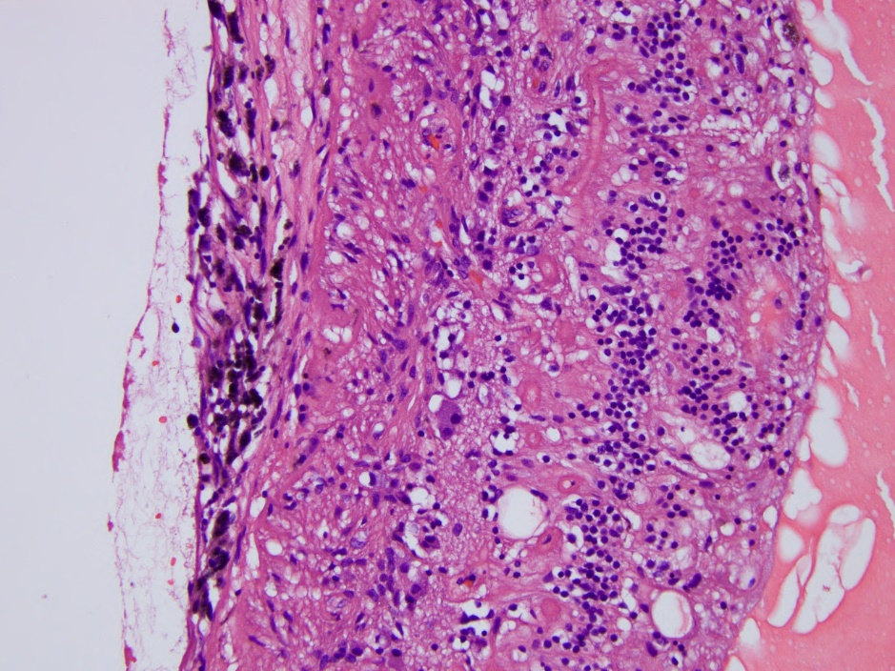
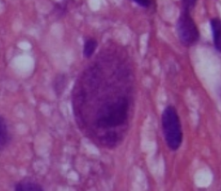

Slide 46
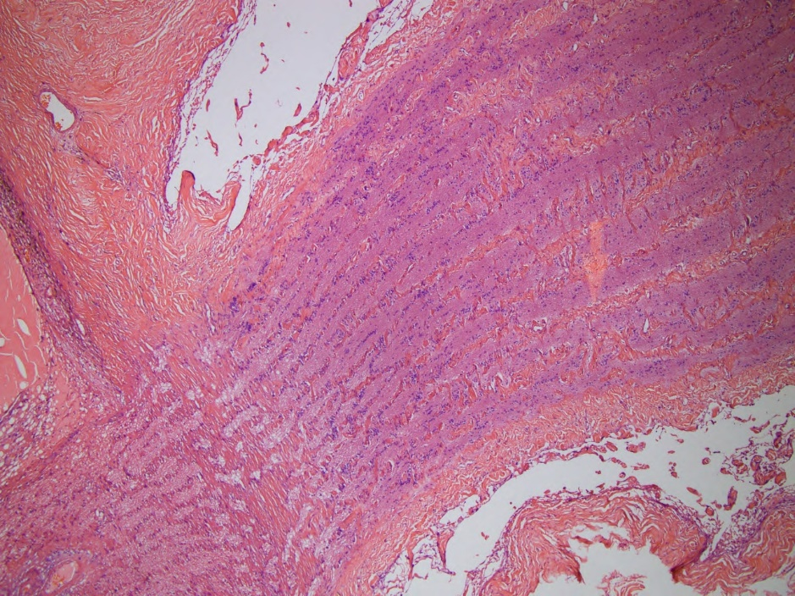

Slide 48
Summary of Case
Pt starts off with poor vision in both eyes, due to sarcoidosis diagnosed at a very young age.
She develops an infectious corneal ulcer, in the setting of underlying corneal pathology
dry eyes
band keratopathy
She has recurrent inflammation, after being quiet for about 2 yrs.
The AC quiets down, but OS develops more sequelae and becomes unbearably painful and light sensitive.
Ultimately, about a yr later, she has the left eye enucleated.

Slide 49
What can we learn from this Case?
The difficulty of treating 2 conditions with competing treatment requirements.
- No steroids due to infection vs. steroids for chronic uveitis
Was the inflammation part of the infection, rebound inflammation, or recurrent sarcoid uveitis? What about the additional sequelae?
Could more steroids or starting a steroid-sparing agent have been helpful?
What could we have done differently to prevent this outcome?
How can we protect the other eye?

Slide 50
Acknowledgements
Alex Mammen, MD (cornea)
Jake Waxman, MD, PhD (comprehensive)
Charleen Chu, MD, PhD (ophthalmic pathology)
Tonya Stefko, MD (oculoplastics)
Alexis Mancini, MD (oculoplastics)
Everyone else that helped to care for these 2 patients, thank you!

Slide 51
Questions/Further Discussion

Slide 52
References
Infectious and inflammatory keratitis:
Bowling, Brad. “Chapter 6, Cornea.” Kanski’s Clinical Ophthalmology, 8th edition, 2016.
Bagheri and Wajda (editors). “Chapter 4, Cornea.” The Wills Eye Manual, 7th edition, 2017.
http://eyewiki.aao.org/Peripheral_Ulcerative_Keratitis
https://www.ncbi.nlm.nih.gov/pmc/articles/PMC4216880/
Strep cultures:
https://microbiologyinfo.com/haemolysis-of-streptococci-and-its-types-with-examples/
DDx slide:
Bagheri and Wajda (editors). “Chapter 4, Cornea.” The Wills Eye Manual, 7th edition, 2017.
https://www.medicinenet.com/keratitis/article.htm# what_are_the_different_types_of_keratitis
Sarcoidosis:
Bowling, Brad. “Chapter 11, Uveitis.” Kanski’s Clinical Ophthalmology, 8th edition, 2016.
Bagheri and Wajda (editors). “Chapter 4, Cornea.” The Wills Eye Manual, 7th edition, 2017.
https://www.ncbi.nlm.nih.gov/pubmed/29593377
https://www.ncbi.nlm.nih.gov/pubmed/29023165
https://onlinelibrary.wiley.com/doi/abs/10.1111/j.1755-3768.2012.02483.x
https://www.ncbi.nlm.nih.gov/pubmed/28145942
https://www.ncbi.nlm.nih.gov/pmc/articles/PMC4060497/

Slide 53
Infectious keratitis epidemiology
Different incidence in developed vs. developing world
US: 11 per 100,000 persons⁵
Madurai District in S. India: 113 per 100,000 persons¹⁰
Nepal: 799 per 100,000 persons⁶
MC isolates in different parts of the world
MC isolates in N. America (per Ormerod et al.):
Staphylococcal species
Pseudomonas aeruginosa
Streptococcus pneumoniae
MC isolates in Sweden (per Neuman and Sjostrand):
Staphylococcus aureus and Staphylococcus epidermidis
Pseudomonas aeruginosa
Developing world has more fungal infections
In Madurai District of S. India, bacterial = fungal infections
MC bacteria = Streptococcus pneumoniae, followed by Pseudomonas spp
MC fungi = Fusarium spp, followed by Aspergillus spp
Bacterial keratitis epidemiology:
https://www.ncbi.nlm.nih.gov/pmc/articles/PMC3074777/
https://bjo.bmj.com/content/81/8/622

Slide 54
Peripheral ulcerative keratitis
Associated with systemic autoimmune disease
May begin before or after systemic features
Mechanism:
immune complex deposition in peripheral cornea
episcleral and conjunctival capillary occlusion -> cytokine release and WBC recruitment
upregulation of collagenases and reduced activity of inhibitors
Systemic associations
MC = RA
Wegener granulomatosis
Others (PAN, relapsing polychondritis, lupus)

Slide 55
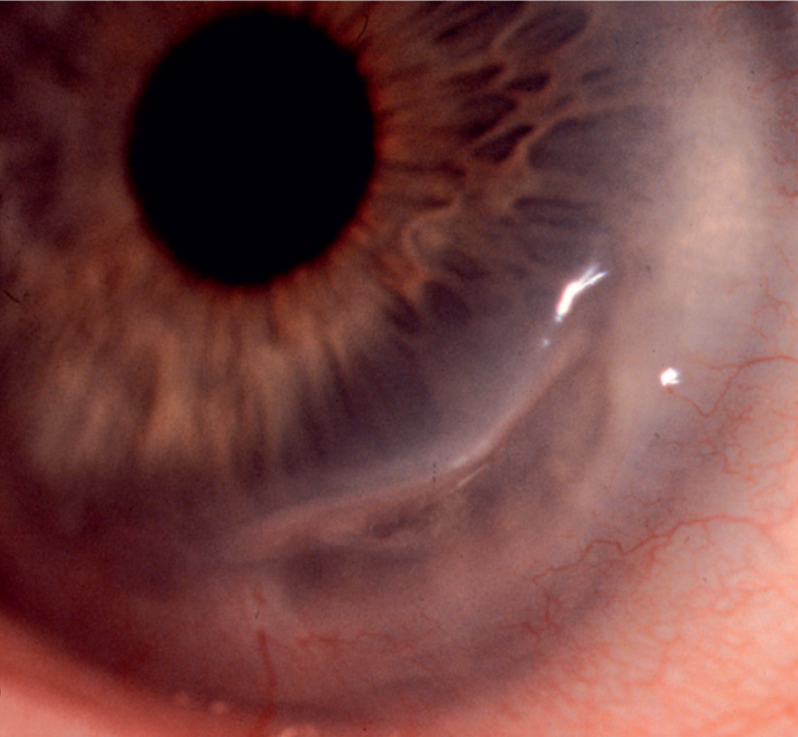
Clinical features of PUK
Crescent ulcer with epi defect and thinning
Spreads circumferentially
Sometimes spreads centrally
Involves limbus with no intervening space
May extend into the sclera
May extend full-circle (“contact-lens cornea”)
Perforation can occur
Rheumatoid paracentral ulcerative keratitis (PCUK) is unique
More central, appears punched-out, has little infiltrate or injection
Cornea may perforate quickly
Tx with topical cyclosporine + BCL/glue is usu effective
Photo credit:
Bowling, Brad. “Chapter 6, Cornea.” Kanski’s Clinical Ophthalmology, 8th edition, 2016

Slide 56
Treatment of corneal melt
Medical (first)
Treat underlying cause
Abx for infectious
Systemic steroids +/- immunosuppressants for inflammatory
Avoid topical steroids or NSAIDs
PPx Abx gtts (for epi defect)
PFATs, punctal plugs
PO doxycycline 50-100 mg BID daily and vit C 1 g daily
Surgical (second)
BCL
Glue
Conjunctival recession or excision (for inflammatory)
Notes:
Avoid topical steroids because they may worsen corneal thinning.
Keratoepithelioplasty (suturing of a donor corneal lenticule onto the scleral bed) to produce a physical barrier against conjunctival regrowth and further melting.
Glue = Cyanoacrylate adhesive

