Slide 1
Infectious Conjunctival Granuloma following a Penetrating Ocular Injury by a Thorn
Ann Barker-Griffith, MD, FRCRC
Professor Emeritus of Ophthalmology and Pathology
SUNY Upstate Medical University, Syracuse, NY
The Eastern Ophthalmic Pathology Society, 2018

Slide 2
Clinical Presentation
History of present illness
47 yo male presented with chief complaint “I was clearing brush when a branch hit my left eye” 4 days ago.
Local urgent care facility did not find a foreign body immediately following injury
Past Ophthalmic History
A thorn, one centimeter long, was removed from the left lower lid at Upstate emergency room, 4 days after injury
Patient still had red eye and floaters
Eye exam next day
Vision 20/40, conjunctival mass inferior temporally, shallow anterior chamber, pressure 9, retinal tear and hemorrhage extending into vitreous at site of injury
B Scan
Choroidal thickening
Surgery
Remove mass and repair ruptured globe
Pars plana victrectomy, endolaser of retinal tear, injection of Amphoterican B, Vancomycin and Ceftazidine
Post operative vision 20/70, improving to 20/30 with rare floaters
All cultures negative at one month
Lost to follow up.

Slide 4
Histopathology
Conjunctival mass thick, firm, 5x4.5x3mm, ulcerated surface 1.5mm across
Conjunctivae surfaced by ulcerated non keratinizing ss epithelium
Subepithelial large granuloma showing central necrosis, histiocytes, multinucleated giant cells, birefringent foreign material and brown-bronze colored spores, 3-6 micra across in clusters or chains. No hyphae. Sclerotic bodies or “copper pennies” positive with GMS, PAS, and PASF.
Vitreous Cytology: rare monocytes and superficial epithelial cells, one lymphocyte and basal epithelial cell. No organisms.

Slide 5
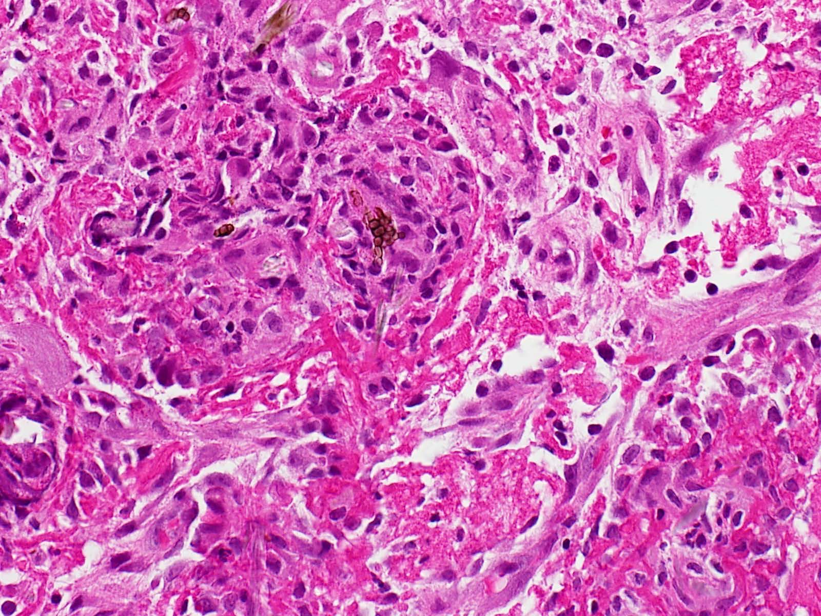
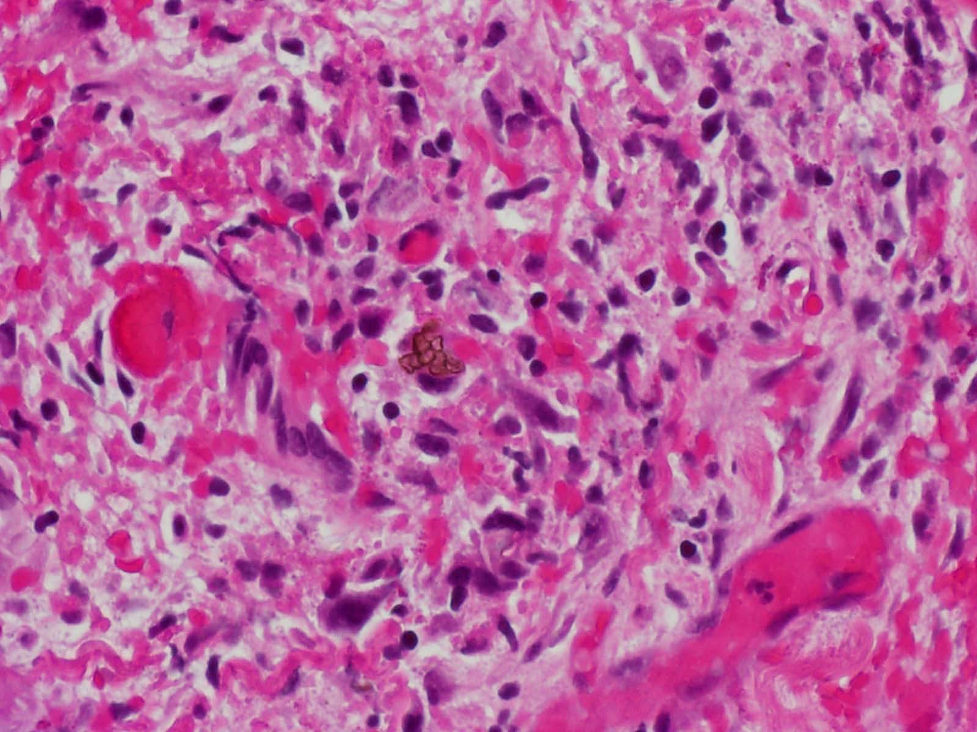
Histopathology

Slide 6
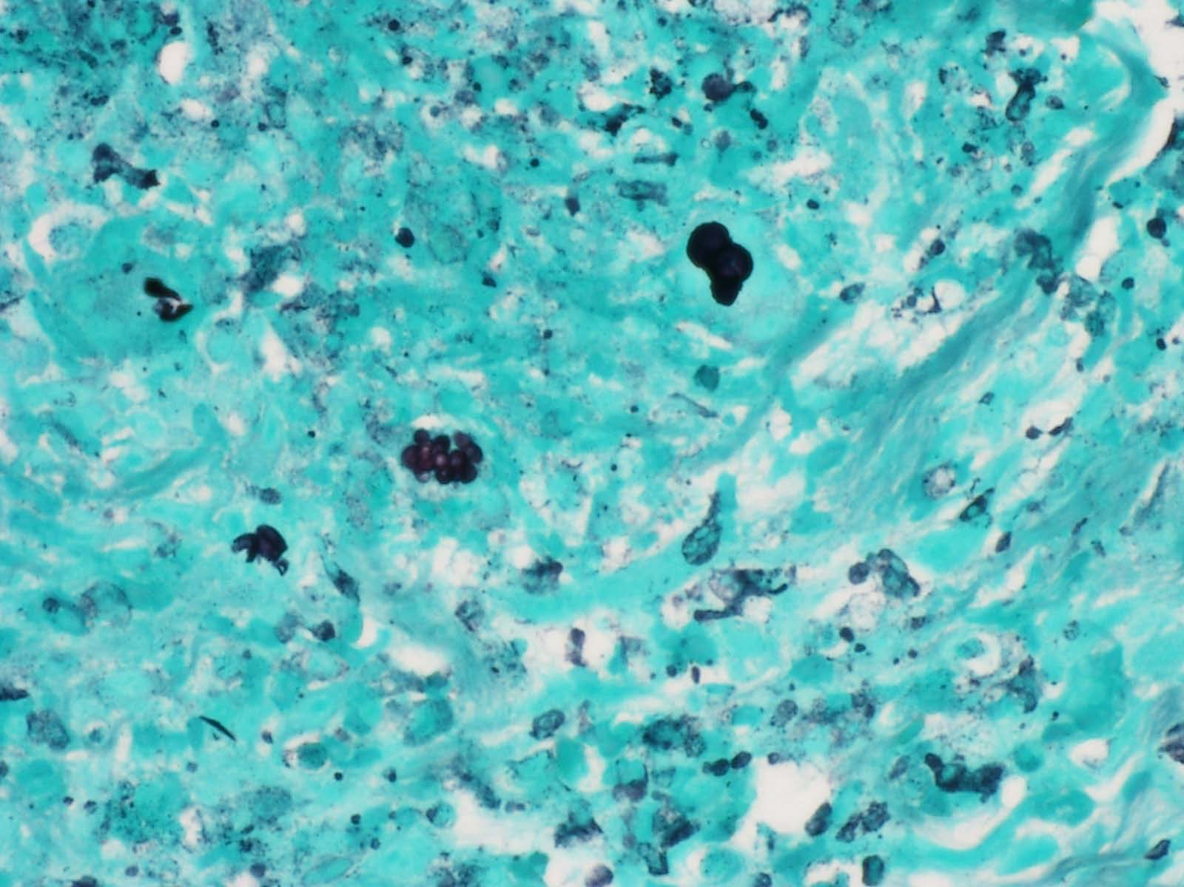
GMS

Slide 7
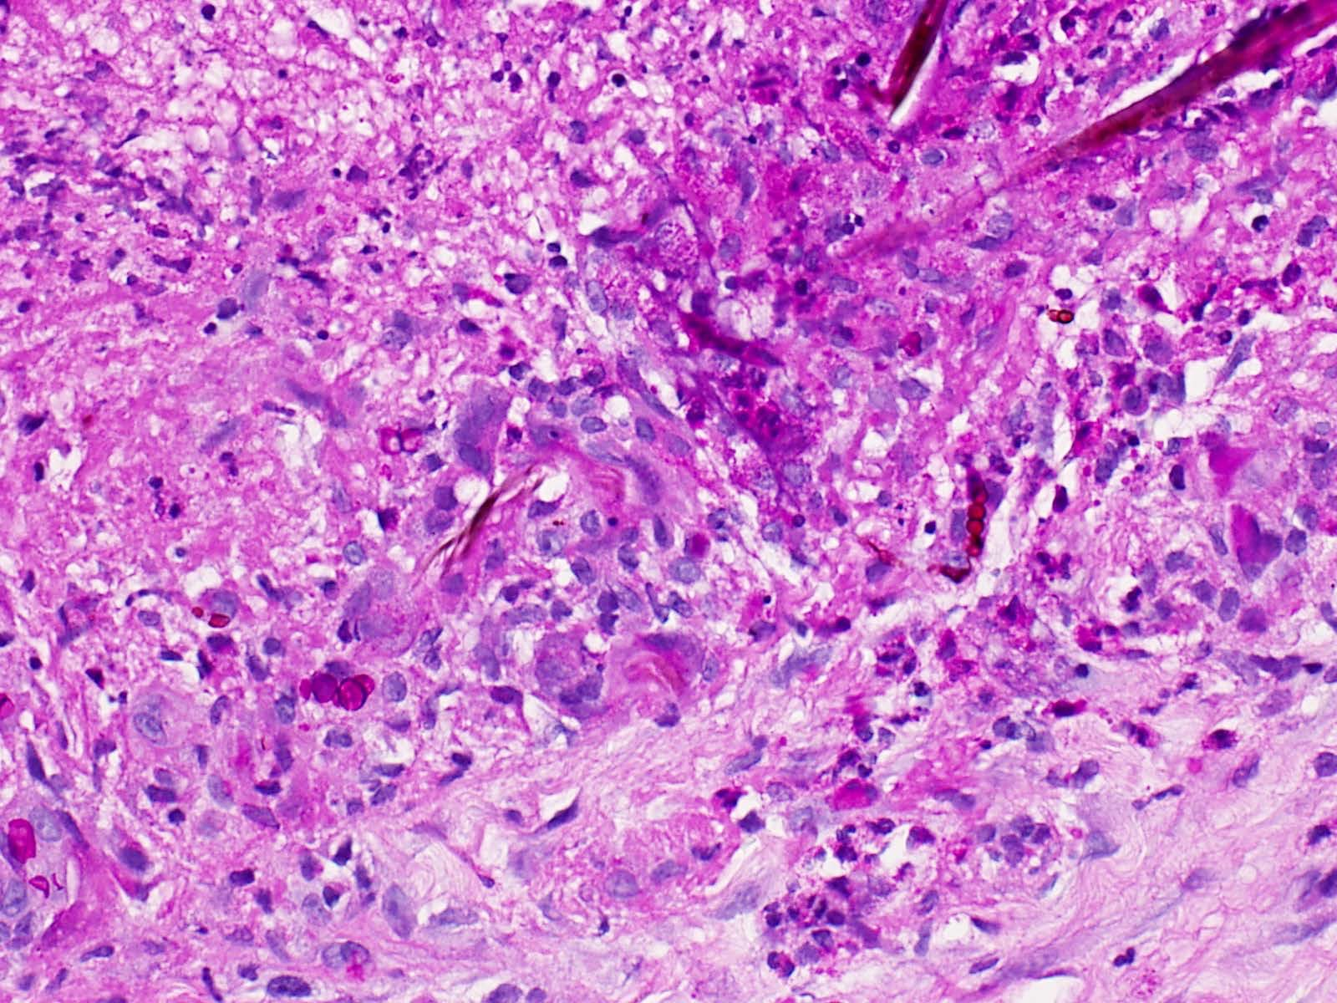
PAS

Slide 8
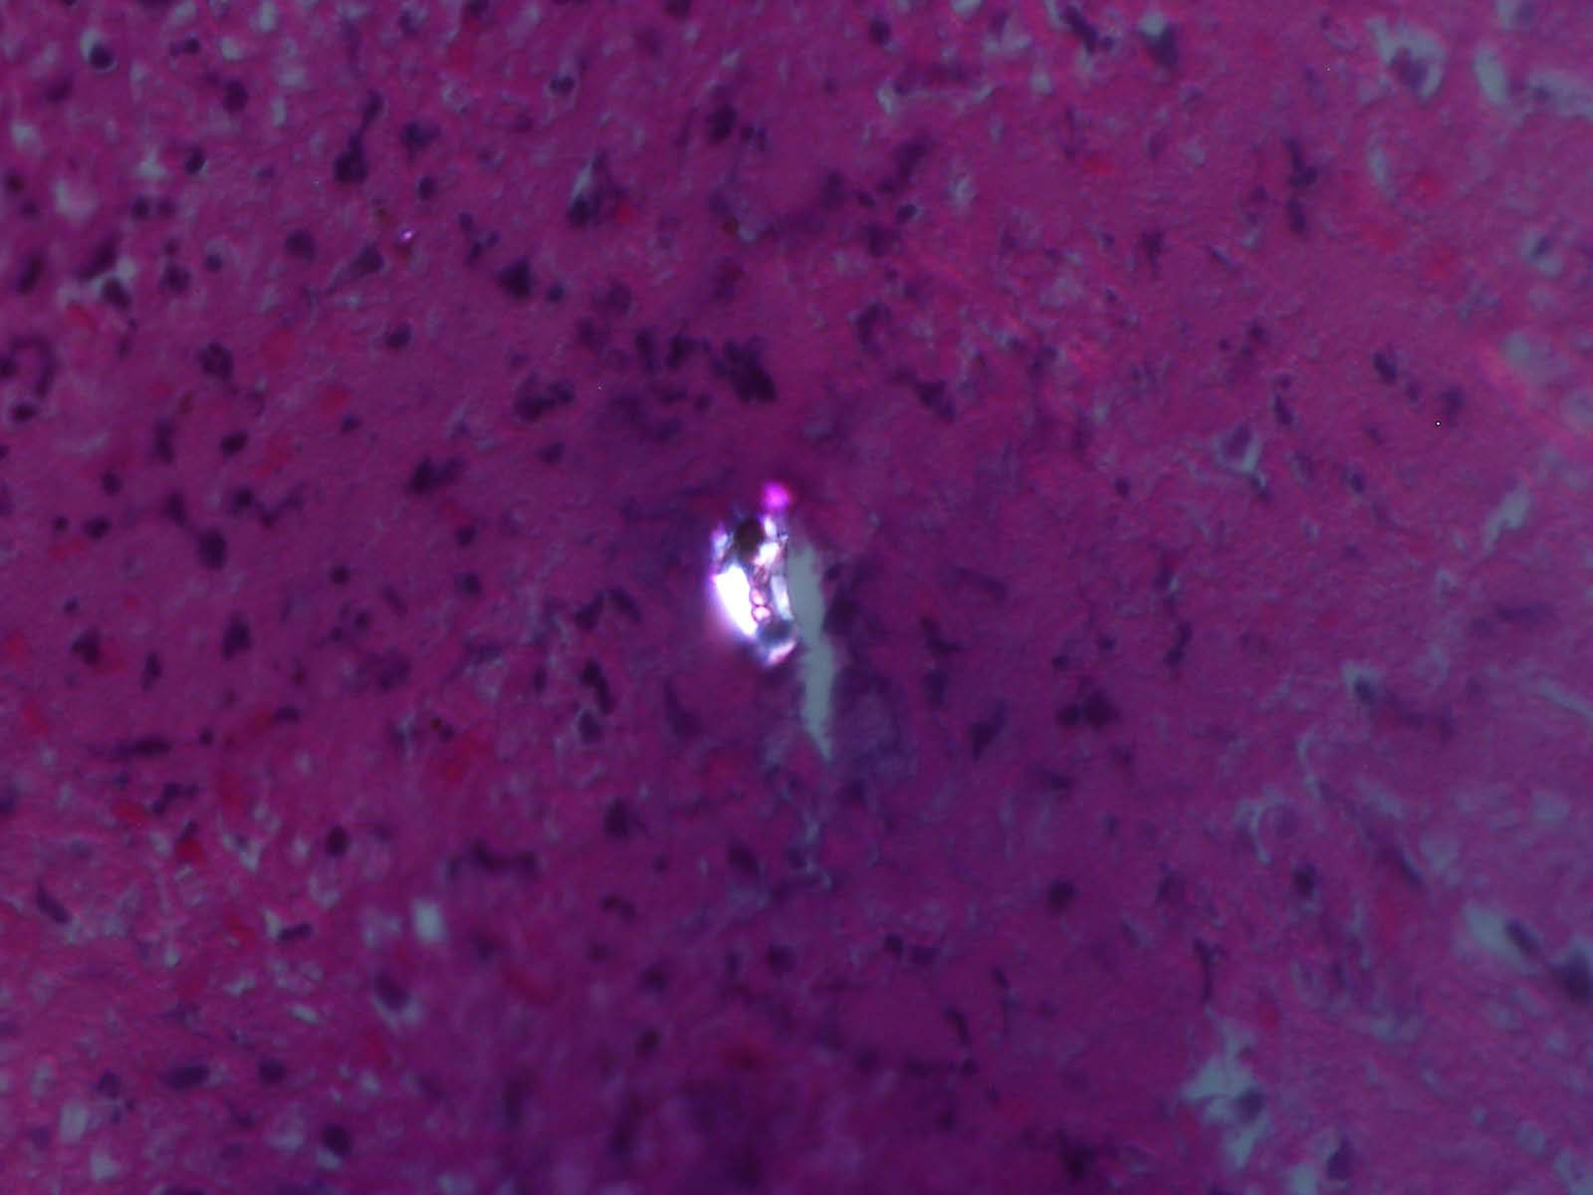
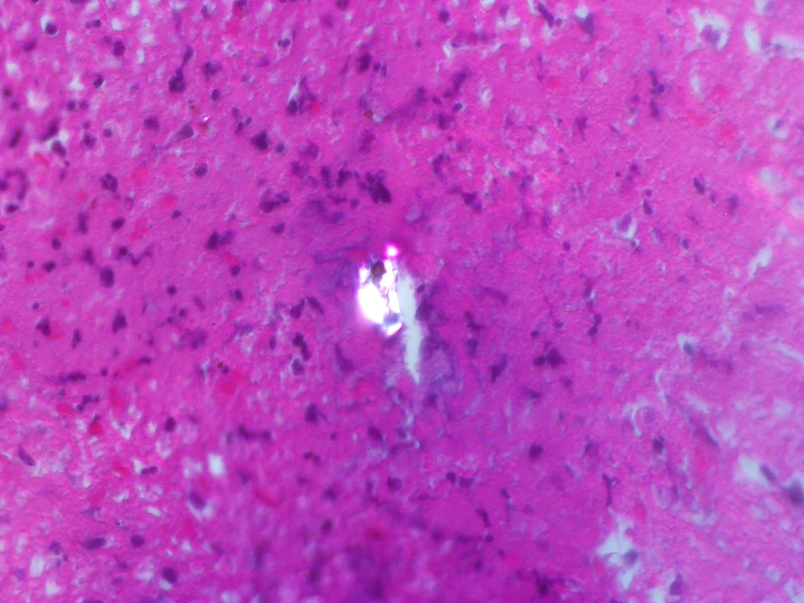
Birefringence: Chain of “copper pennies” inside a cellulose particle

Slide 9
Diagnoses
Conjunctival Granulomatous inflammation associated with Chromoblastomycosis
Vitreous consistent with traumatic vitritis
No evidence of fungal endophthalmitis

Slide 10
Discussion:
Dermatiaceous fungi have dark melanized hyphe
Found in soil and plants
Many different species cause skin infections
Phaeohyphomycosis is a group of diseases caused by saprophytic pigmented fungi that are dark brown in culture.
Hyalohyphomycosis group have colorless, transparent
(hyaline) hyphae in culture
Species can be identified by mycology reference laboratories by nucleic acid sequencing

Slide 11
Chromoblastomycosis
Chronic cutaneous or subcutaneous fungal infection from implantation of certain dematiaceous fungi
First studied by Alexandre Pedroso in Sao Paulo, Brasil in 1911 and often called Pedroso’s Disease or Fonseca’s Disease occuring in barefoot rural workers in humid tropical and subtropical climates
International Society for Human and Animal Mycology (ISHAM) in 1992 decided that Chromoblastomycosis is the proper name
It occurs worldwide with lesions found in the cornea, neck, face, and ears but only becomes disseminated in immunocompromised patients

Slide 12
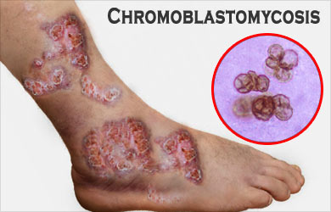
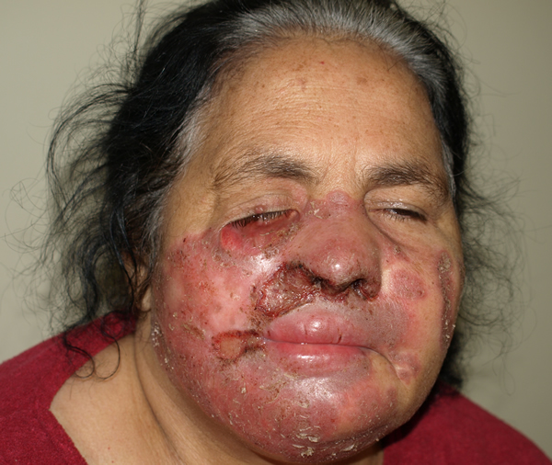
Various Cutaneous Lesions in CBM
https://www.medindia.net/patients/patientinfo/chromoblastomycosis.htm
(Courtesy of Dr Flavio, Brazil) http://www.life-worldwide.org/fungal-diseases/chromoblastomycosis/

Slide 13
Key Fungal Structures Observed in Microscopic Examinations of Clinical Specimens
Predominant Morphology | Mycoses
Yeasts—single or multiple buds | Blastomycosis, Histoplasmosis, Paracoccidioidomycosis, Penicilliosis, Sporotrichosis
Yeasts with capsules | Cryptococcosis
Hyphae—septate | Hyalohyphomycosis—species of Aspergillus, Fusarium, Geotrichum, Trichosporon, et al.)
Hyphae—septate in skin or nail specimens | Dermatophytosis
Hyphae—nonseptate | Mucormycosis—species of Rhizopus, Lichtheimia, Cunninghamella, et al.
Hyphae—septate; brownish cell walls | Phaeohyphomycosis—species of Bipolaris, Cladosporium, Curvularia, Exserohilum, et al.
Yeasts and Pseudohyphae | Candidiasis—species of Candida
Yeasts and Hyphae in skin scrapings | Pityriasis versicolor
Spherules | Coccidioidomycosis
Sclerotic cells—brownish cell walls | Chromoblastomycosis
Sulfur granules | Mycetoma
Arthroconidia in hair | Dermatophytosis
Conidia in pulmonary cavity | Hyalohyphomycosis—species of Aspergillus, Fusarium, et al.
Cysts (asci) in pulmonary specimens | Pneumocystis
Jawetz, Melnick, & Adelberg’s Medical Microbiology, 27e > Medical Mycology Karen C. Carroll, Jeffery A. Hobden, Steve Miller, Stephen A. Morse, Timothy A. Mietzner, Barbara Detrick, Thomas G. Mitchell, James H. McKerrow, Judy A. Sakanari+

Slide 14
Diagnosis of CBM
Biopsy showing tuberculoid type granuloma with sclerotic bodies
4-12 micra in diameter & also called Medlar bodies
Clusters of 4-8 cells look like copper pennies
Divide by transverse septation, never by budding
Sclerotic bodies are diagnostic of CBM regardless of etiologic agent
Slow growing is culture forming black colonies
Molecular diagnostics by PCR for species identification when appropriate

Slide 15
Treatment
Surgical resection for small lesions is curative as in our case
Large lesions of chronic cases are difficult and recurrence is usual
Antifungals and adjuvant (heat, cryo, laser) therapy for chronic cases
Persistence of infection may be due to:
dormant sclerotic bodies or
melanin in cell walls may protect against free radicals or
there may be genetic factors

Slide 16
Summary
Although the exact causative organism in our case is unknown, the likely pathogen is from the group of Chromoblastomycosis
The sclerotic bodies are diagnostic of the CBM group
If our patient had developed endophthalmitis or had not been lost to follow up, then species identification by a mycology reference laboratory might have been appropriate

Slide 17
Acknowlegments
Robert Swan, MD, Assistant Professor of Ophthalmology Director of Uveitis Clinic, Upstate Medical University
Soma Sanyal, MD, Assistant Professor of Pathology, Assistant Director of Clinical Microbiology Upstate Medical University
William Mueller, Medical Photographer, Upstate Medical University

