Slide 1
An old man has decrease in vision
Presented by: Khalid Bedaiwi, MD R1
Supervised by: Abdullah Alfawaz, MD, FRCS
Anterior segment and uveitis consultant, King Saud University

Slide 2
History
71 year old Saudi gentle man.
K/C of RHD, HTN and CKD.
Admitted for workup of anemia and weight loss.
On 3/18/2018.
Referred from internal medicine to ophthalmology clinic.
Gradual painless decrease in vision OU for 3-4 months.

Slide 3
History Cont.
No ocular pain, redness or epiphora.
No photophobia, floaters, or scotoma.
No Hx of trauma to the eyes.
No Hx of ocular surgeries or diseases.

Slide 4
Examination
VA: OD: 6/200 OS: 20/200 PH 20/100. IOP: 13 OD 15 OS. Pupils are both reactive to light, No APD.
SLE | OD | OS
Lids | WNL | WNL
Conjunctiva | WNL | Very minimal redness.
Cornea | Multiple corneal scars. | Mild Corneal edema, Multiple corneal scars.
AC | Deep and quit. | 3mm of hemorrhagic hypopyon.
Lens | Grade 3-4 nuclear cataract with anterior cortical cataract. | Visually significant nuclear cataract with anterior cortical cataract, Iris pigments on the surface of the lens.
Pupils | WNL | Irregular pupil with posterior synechiae.
Fundus | Normal optic disc, normal macula and myopic fundus. | Normal optic disc and macula, myopic fundus with poor view to the fundus

Slide 5
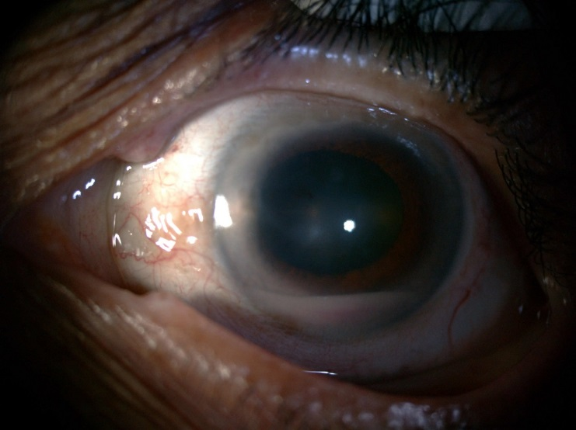
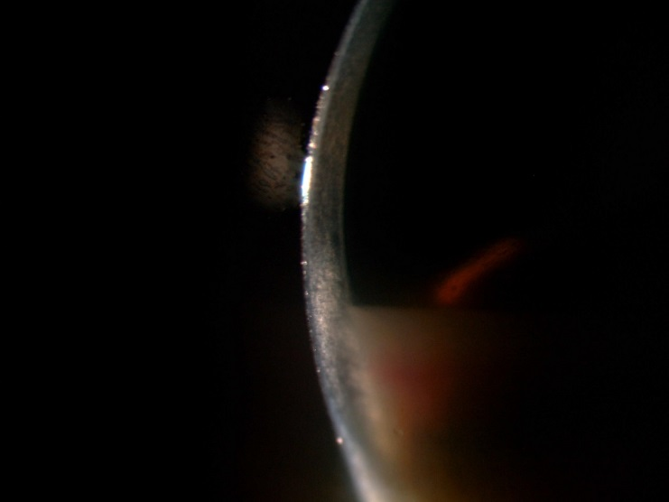
Cont.
Left eye hypopyon.

Slide 6
Additional history
No shortness of breath or cough.
No skin changes.
No oral or genital ulcers.
No abdominal pain.
No symptoms of urethritis.
No back pain.
No flank pain.
No night sweat.
Positive history of ingestion of raw milk.

Slide 7
Differential diagnosis
Hypopyon to rule out Endogenous endopthalmitis.
Infectious
VS
non infectious uveitis.
Pseudohypopyon to rule out Masquerade syndrome.

Slide 8
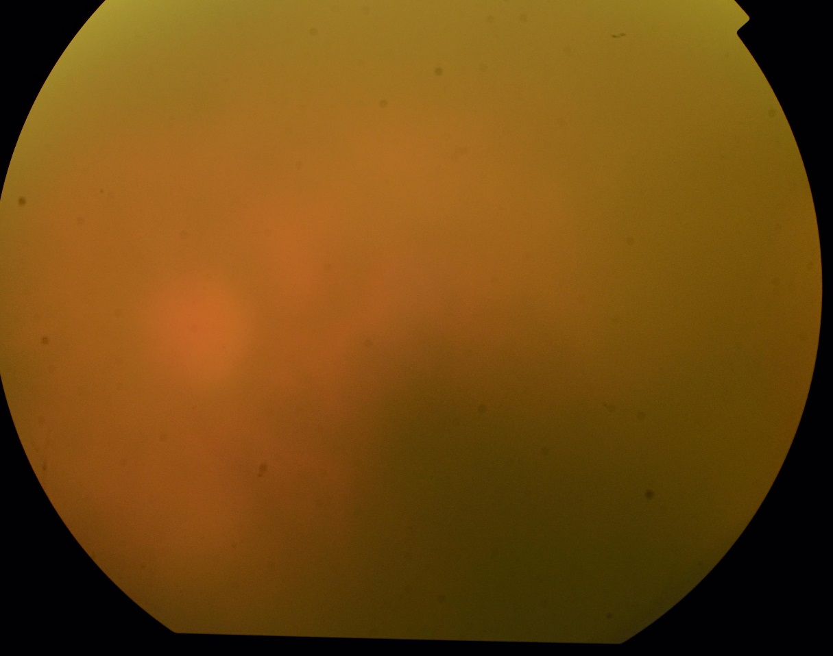
Fundus photo of left eye 3/18/2018
Very poor view to fundus

Slide 9
FFA of left eye 3/18/2018
Very poor view to fundus

Slide 10
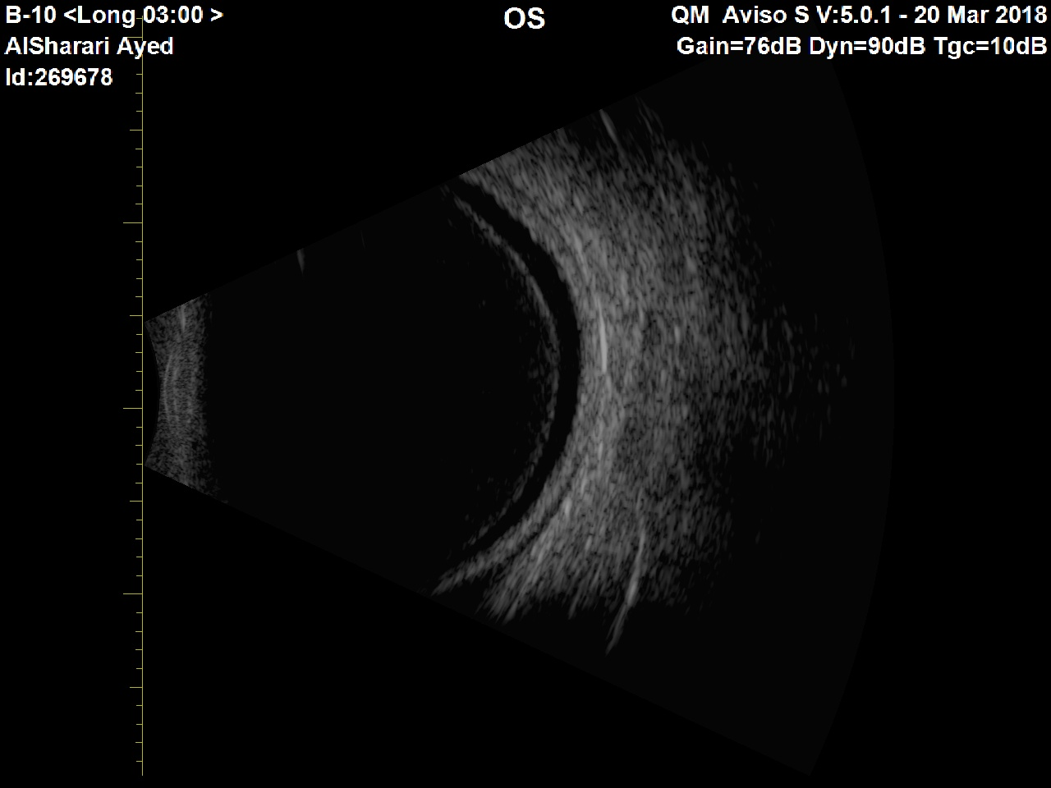
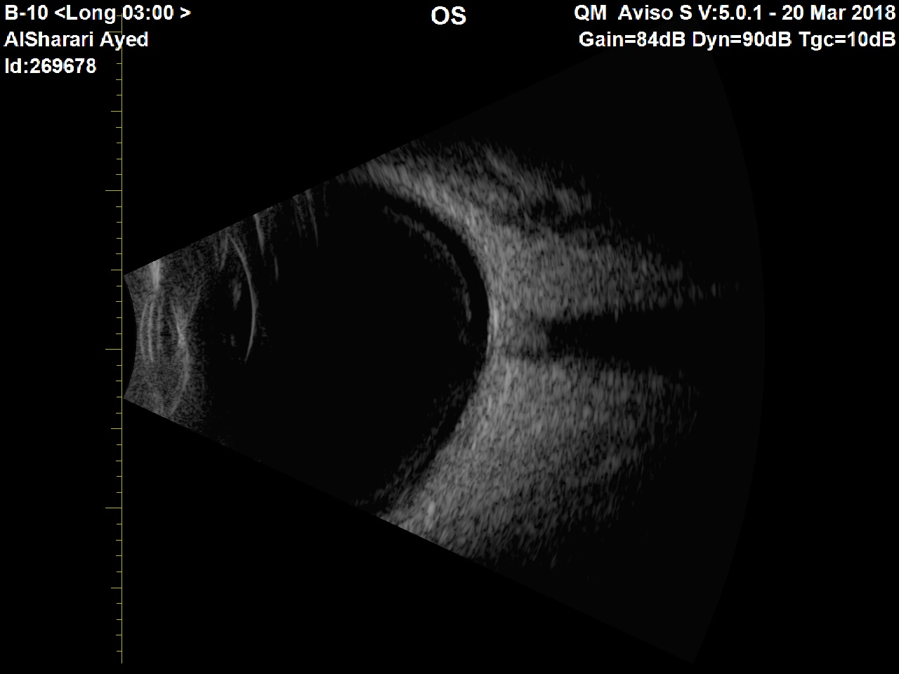
US of left eye 3/18/2018
Flat retina, No evidence of Vitritis

Slide 11
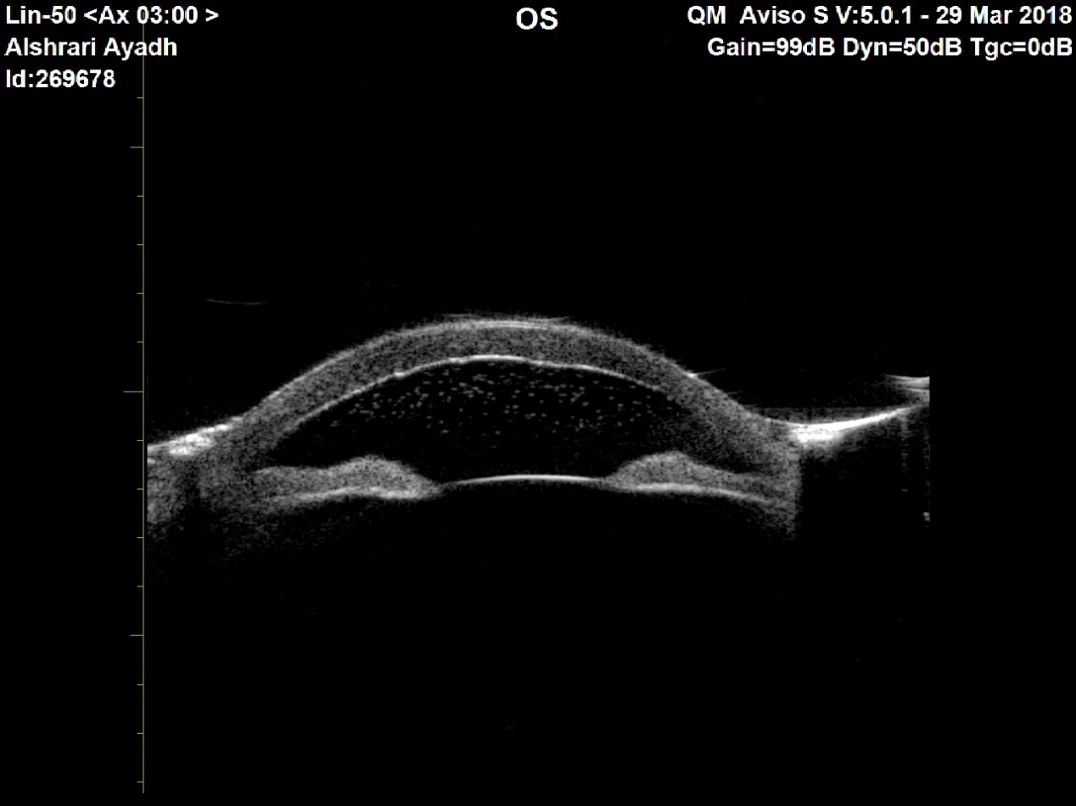
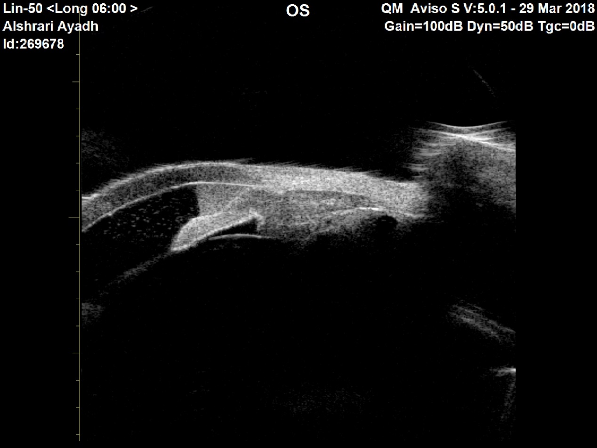
UBM of left eye 3/18/2018
Hypopyon , floating cells in the AC

Slide 12
Laboratory
We have contacted his primary team for further investigation.
Extensive investigations were done:
3 sets of Blood, sputum and urine culture were all negative.
3 sets of AFP culture were negative.
Brucella titer was negative for brucellosis infection.

Slide 13
Radiology
Chest x ray: signs of pulmonary edema otherwise unremarkable for TB or sarcoidosis.
Liver US: heterogeneous liver with no definite mass lesion noted.
CT CAP shows:
Large heterogeneous left adrenal mass, with finding that is suspicious for invasion consistent with malignancy.

Slide 14
Management
US guided biopsy was taken from the adrenal mass and waiting for pathology report:
Prednisolone Acetate drops QID
Cyclopentolate drops TID

Slide 15
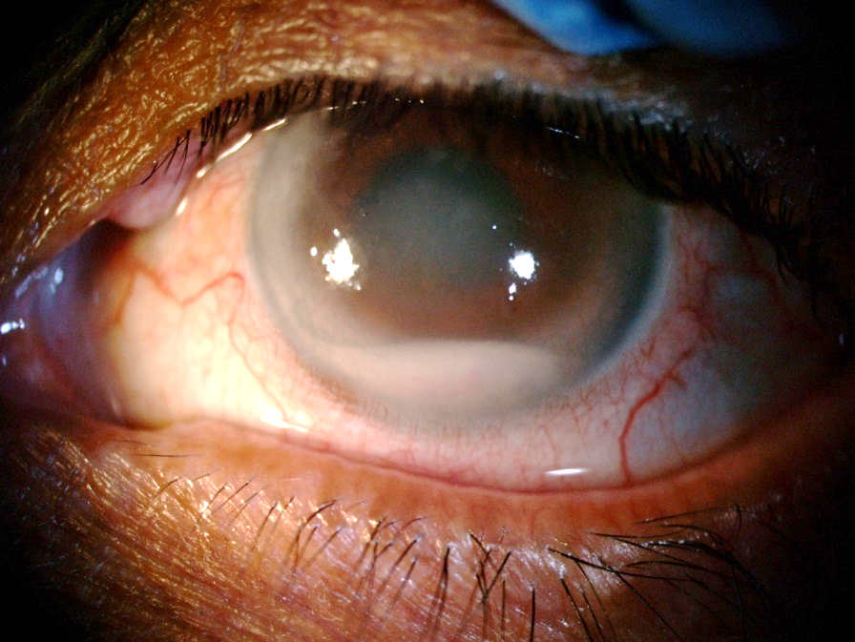
Management cont’d
Follow on 3/27/2018.

Slide 16
Management cont’d
On 15th of April 2018, The patient was managed with cataract surgery of the left eye.
Intraoperative diagnostic paracentesis was done.

Slide 17
Management cont’d
Patient was given follow up next day and he was stable, AC was deep, IOL in place, good red reflex and poor view to fundus.
Started on perforate tapering and vigamox.

Slide 18
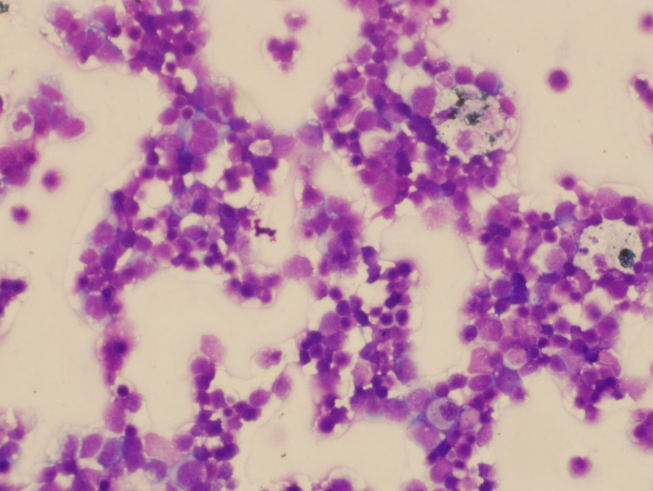
Management cont’d
Microscopic examination showed atypical lymphocytes in a necrotic background.
Flowcytometry analysis of the left aqueous fluid showed :
Atypical lymphoid cells with blastoid morphology consistent with T cell lymphoma.

Slide 19
ADRENAL BIOBSY

Slide 20
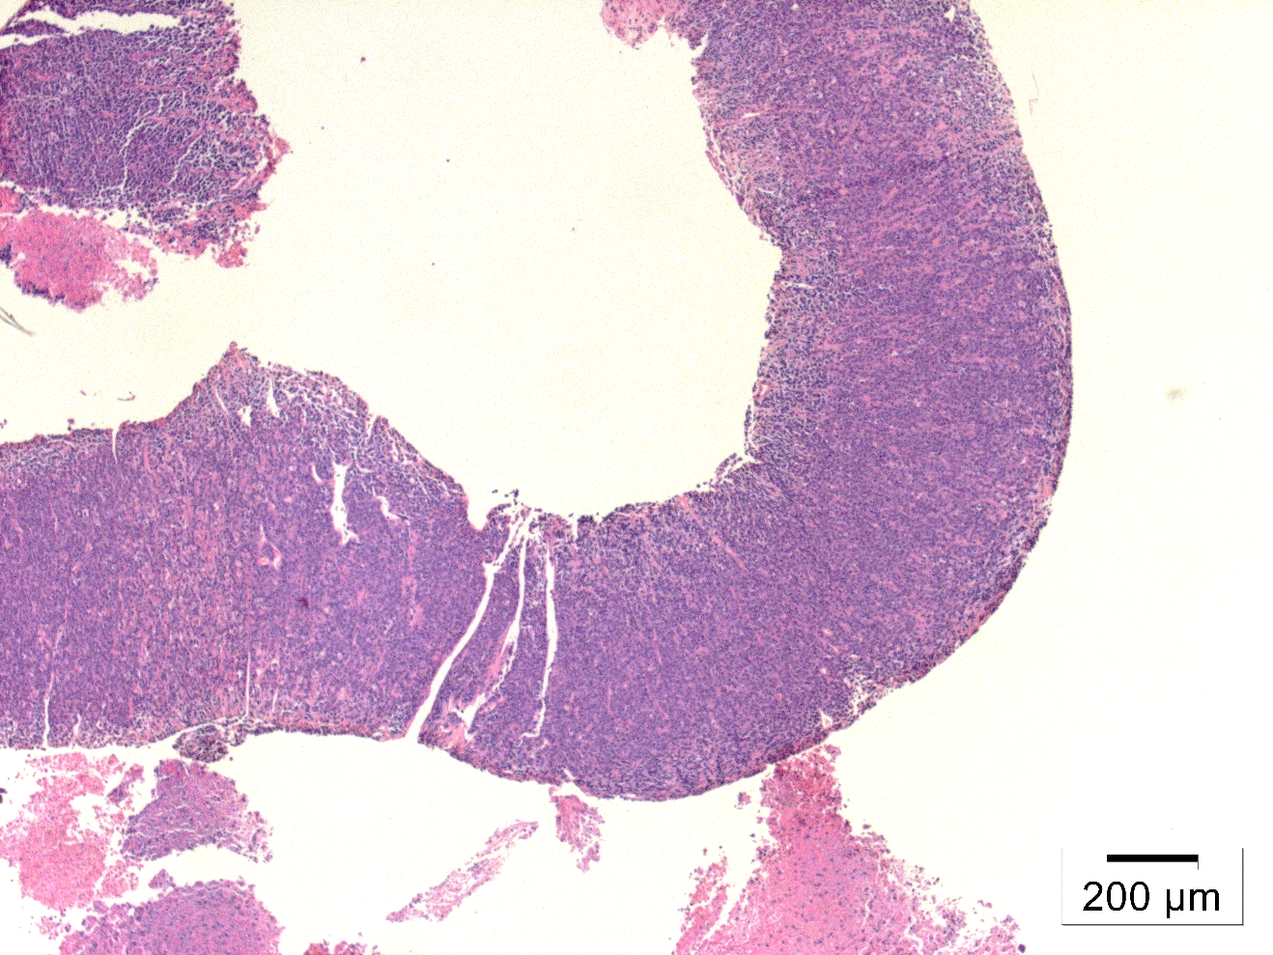
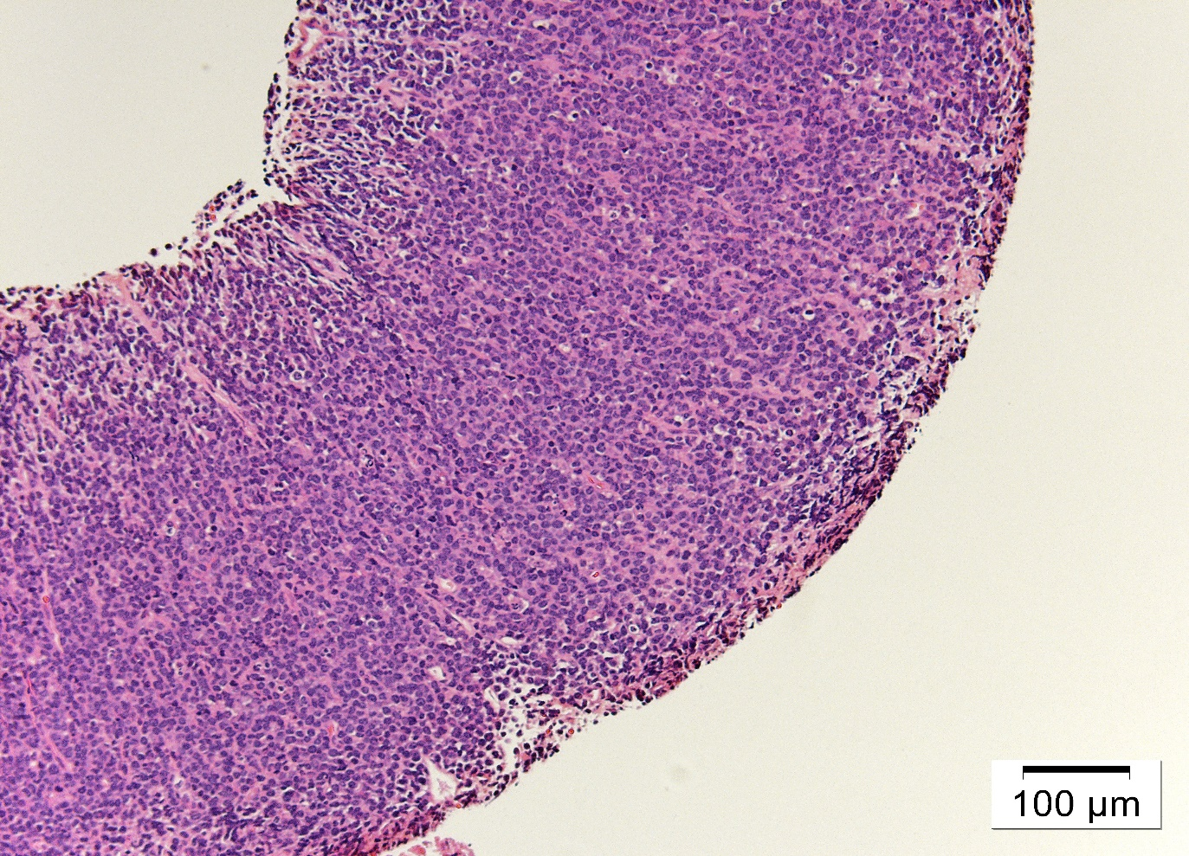
Biopsy from from adrenal gland showed adrenal tissue infiltrated with atypical small to medium lymphoid cells with blastoid features.
H&E
H&E

Slide 21
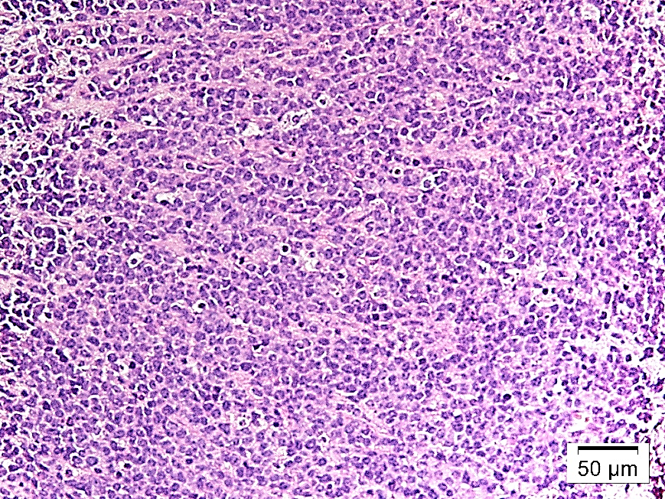
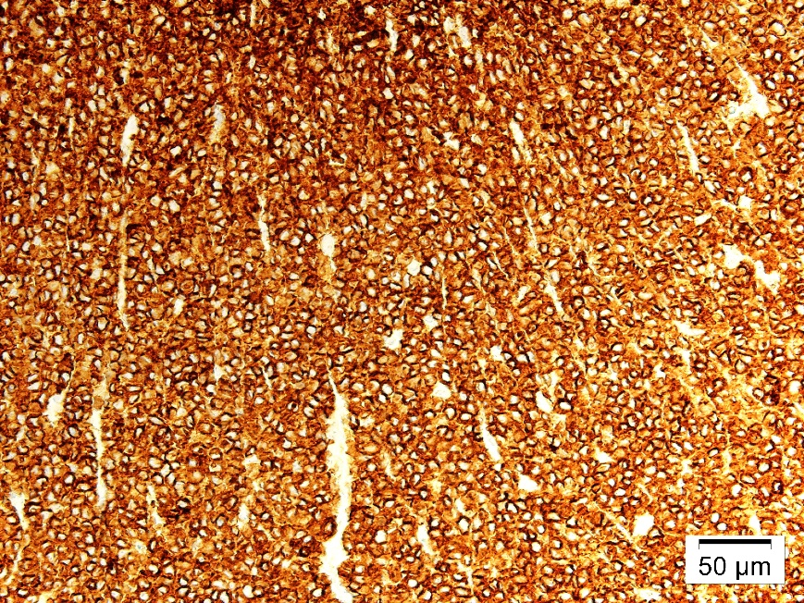
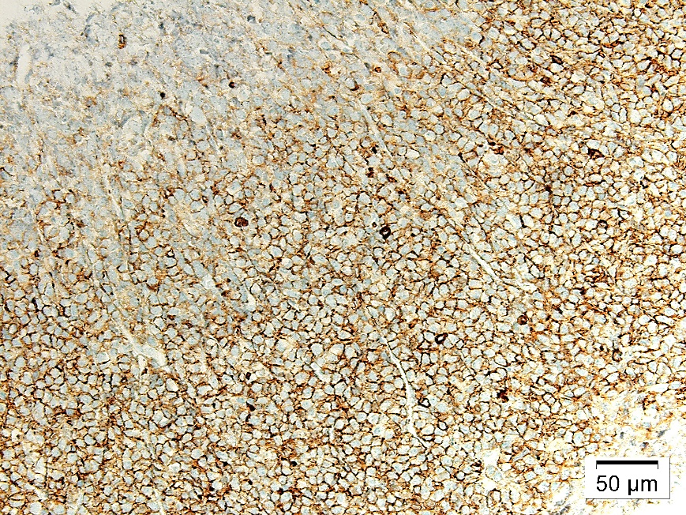
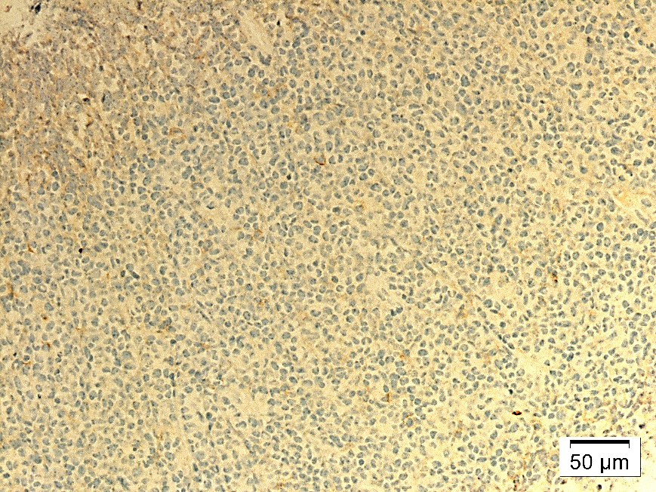
T cell lymphoma confirmed by extensive battery of immunohistochemical stains.
Tumor cells were positive to CD 3,CD 34 and negative to CD 20.
H&E
CD3
CD34
CD20

Slide 22
Management cont’d
PET scan done and showed high uptake in scrotum and testicles.
US of scrotum and testicles showed picture of testicular lymphoma.
Bone marrow biopsy showed no evidence of metastasis.

Slide 23
Management cont’d
On follow up:
BCV: CF OU at 3 feet.
IOP : WNL.
Anterior segment:
OD: Quite, dense NS cataract.
OS: corneal epithelial edema, pink hypopyon 3mm, IOL is in place.
Fundus exam:
OD: hazy view due to cataract, mild vitritis ?
OS: hazy view, whitish retinal infiltrate in multiple areas.
Notes:
BCV Best corrected vision

Slide 24
Management cont’d
Hemato-oncology team were consulted to start treatment. They recommend to do lumber puncture and PET scan of the brain to rule out CNS involvement since there is intraocular infiltrates.
PET scan of the brain showed increase uptake in right nasal and eithmoid sinus, most likely lymphoma related.
LP was done. CSF was negative.
CVP protocol started.
Intrathecal treatment was given with cytarabine and hydrocortisone.
Local radiation treatment was given to orbits and testicles.

Slide 25
Management cont’d
Unfortunately patient condition was deteriorating, he had rapid venticular response and atrial fibrillation.
Patient was stabilized and transferred to ICU.

Slide 26
Management cont’d
Because the patient were in MICU, ophthalmic bedside follow up were continued.
The patient suddenly collapsed, unresponsive and unpalpable pulse.
CPR and ATLS protocol started.
Patient intubated, deeply comatosed, GCS 6/15.
Developed sepsis.
Because of his clinical condition, chemotherapy and radiation were on hold.

Slide 27
Management cont’d
Patient continue to deteriorate, GCS 3/15.
Put on full DNAR.
Unfortunately on 1st of july patient died in the hospital.

Slide 28
Final diagnosis
Most likely
MASQUERADE SYNDROME
Due To
Adrenal T cell Lymphoma

Slide 29
Masquerade Syndrome[1].
It is group of disorders that can mimic immune-mediated uveitis.
Difficult to diagnose.
Neoplastic VS Non-neoplastic.
5% of uveitis patients.

Slide 30
Masquerade Syndrome[1].
Neoplastic :
It accounts up to 2-3% of all uveitis patients in tertiary hospital.
Primary central nervous system lymphoma (PCNSL) – Most common.
Systemic lymphoma.
Leukemia.
Uveal lymphoid proliferation.
Retinoblastoma.
Juvenile xanthogranuloma.
Metastatic tumors.
Non-neoplastic :
Retinitis Pigmentosa.
Ocular Ischemic Syndrome.
Chronic Peripheral Rhegmatogenous Retinal Detachment.
Intraocular Foreign Body.
Pigment Dispersion Syndrome.

Slide 31
Primary central nervous system lymphoma[1]. (including primary intraocular lymphoma)
Most common neoplastic masquerade syndrome.
98% is non Hodgkin B cell and 2% is T cell.
Sixth to seventh decade.
1 every 100,000 immunocompetent patient.
25% of PCNSL have an ocular involvement.
Two-third of patients with primary intraocular lymphoma will develop CNS disease.
Presentation:
Mostly vitreoretinal involvement.
Decreased vision and Floaters - Most common.
Vitritis, creamy yellowish sub-retinal infiltrate overlying RPE detachments and AC cells.

Slide 32
Systemic lymphoma[1].
Rare.
Hematogenous spread:
Mostly uveal involvement.
choroid, sub-retinal space, vitreous and AC.
Presentation:
Pseudohypopyon, vitritis, creamy sub-retinal infiltrate.
Retinal vasculitis, necrotizing retinitis, diffuse choroditis or uveal masses.

Slide 33
Systemic lymphoma
Ocular involvement is much less prevalent in lymphoma arising outside CNS [2].
Only few reports of patients in whom psudohypopon was among the presenting signs of systemic lymphoma [3, 4].
Pseudohypopyon has been reported as a relapse among patients with systemic lymphoma in remission state but it is rare[4-5].

Slide 34
Systemic lymphoma
Majority of metastatic intraocular lymphomas are of B-cell origin [8].
Metastatic intraocular T-cell lymphomas are very rare and often secondary to cutaneous or adult T-cell lymphoma [8].
Primary adrenal lymphoma (PAL) is rare and aggressive [6, 7].
60-75% of cases are bilateral [6, 7].
80% of PAL are large B-cell, where is 7% are peripheral T cell [7, 8].
Intraocular metastasis secondary to PAL is extremely rare [9].
Up to our knowledge, literature reports only 5 cases of PAL. Two of them had eye metastasis: one with AC involvement and the other with rectus sheath involvement OU.

Slide 35
 | Karthik Bommannan | Sampath et al . [8] | Pimentel et al . [10] | May et al . [11] | Sfaxi et al . [12]
Age and gender | 26 YO male | 33 YO male | 42 YO male | 59 YO male | 70 YO male
Side | Bilateral | Bilateral | Bilateral | Right adrenal | Bilateral
Symptoms | Weight loss, blurred vision | Weight loss, fever, abdominal pain | Weight loss, fever, vomiting | Asymptomatic | Weight loss, fever
Metastasis | Anterior chamber and bone marrow infiltration | No distant metastasis | CNS (CSF positive) and rectus sheath of both eyes | No distant metastasis | No distant metastasis
Treatment | Conservative | CHOP | CHOP with intrathecal methotrexate | Surgery and radiation | Surgery and chemotherapy
Outcome | Expired | Treated and was asymptomatic | Expired | Remission for 8 years | Expired

Slide 36
Home messages
High level of suspicion should accompany any patient who is presented with anterior uveitis and hypopyon mixed with blood.
Risk factors include: old age, Hx of malignancy, immunocompromised patients.
Possibility of endogenous endopthalmitis should be ruled out.
Close ophthalmic and hematological observation is mandatory as systemic relapse can occur following ocular relapse.

Slide 37
Acknowledgment
Many and special thanks to:
Dr. Azza Maktabi.
Dr. hind alKhtan.
Dr. Shamayel Mohammed.

Slide 38
References
American Academy of Ophthalmology.
Chan CC, Buggage RR, Nussenblatt RB. Intraocular lymphoma. Curr Opin Ophthalmol 2002;13:411–8.
Goldey SH, Stern GA, Oblon DJ, et al. Immunophenotypic characterization of an unusual T-cell lymphoma presenting as anterior uveitis. A clinicopathologic case report. Arch Ophthalmol 1989;107:1349–53.
Gu ¨ndu ¨z E,Korkmaz C, Kasifoglu T, et al. Unusual presentation of non-Hodgkin lymphoma: polyarthritis and uveitis mimicking a rheumatologic disease. Rheumatol Int 2008;28:613–24.
Verity DH, Graham EM, Carr R, et al. Hypopyon uveitis and iris nodules in non-Hodgkin’s lymphoma: ocular relapse during systemic remission. Clin Oncol 2000;12: 292–4.
Tsukahara T, Takasawa A, Murata M, et al. NK/T-cell lymphoma of bilateral adrenal glands in a patient with pyothorax. Diagn Pathol 2012;7:114.
Rashidi A, Fisher SI. Primary adrenal lymphoma: a systematic review. Ann Hematol 2013;92:1583-93.
Santhosh S, Mittal BR, Shankar P, et al. (18)F-FDG PET/CT in bi- lateral primary adrenal T-cell lymphoma. Hell J Nucl Med 2011;14:166-7.
Levy-Clarke GA, Greenman D, Sieving PC, et al. Ophthalmic manifestations, cytology, immunohistochemistry, and molec- ular analysis of intraocular metastatic T-cell lymphoma: report of a case and review of the literature. Surv Ophthalmol 2008;53:285-95.
Pimentel M, Johnston JB, Allan DR, Greenberg H, Bernstein CN. Primary adrenal lymphoma associated with adrenal in- sufficiency: a distinct clinical entity. Leuk Lymphoma 1997; 24:363-7.
May F, Bachor R, Hack M, Gottfried HW, Hautmann RE. Primary adrenal nonHodgkin's lymphoma: long-term survival. J Urol 1998;160:487.
Sfaxi M, Bouzouita A, Bouasker I, et al. Primary bilateral adrenal T-cell lymphoma. A case report rarer than B-cell lymphoma. Ann Endocrinol (Paris) 2008;69:249-53.

