Slide 1
Eastern Ophthalmic Pathology Society
Washington DC
September 13-15, 2018
A SLAM diagnosis
Paula L. Blanco, MD MSc
Assistant professor, University of Ottawa
Staff pathologist, The Ottawa Hospital

Slide 2
Disclosure
I do not have any affiliation (financial or otherwise) with a commercial organization that may have a direct or indirect connection to the content of my presentation.

Slide 3
Case presentation
67 y.o. male
PMH
- Myocardial infarction 2007
- Hypertension
- Osteoarthritis with left knee replacement
No POH

Slide 4
Case presentation
HPI
- 2 month history of suspected stye in left lower eyelid,
not resolving
O/E
- 3mm pearlescent, ulcerated lesion
Clinical dx
? Keratoacanthoma ?BCC
Biopsy

Slide 5
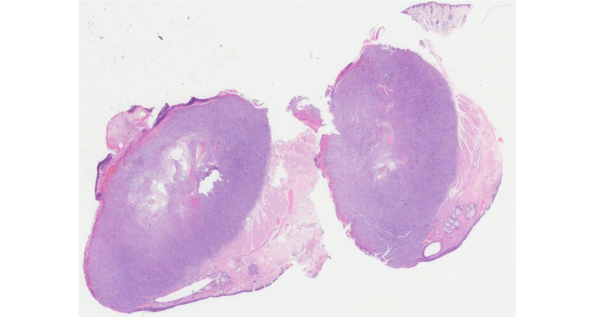

Slide 6
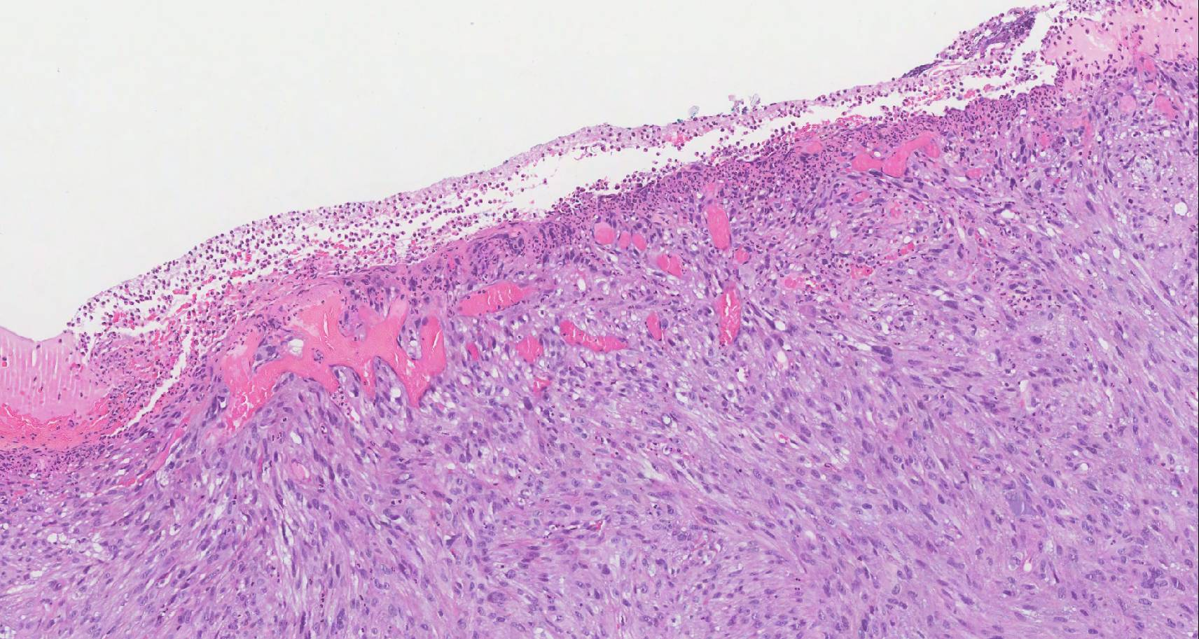

Slide 7
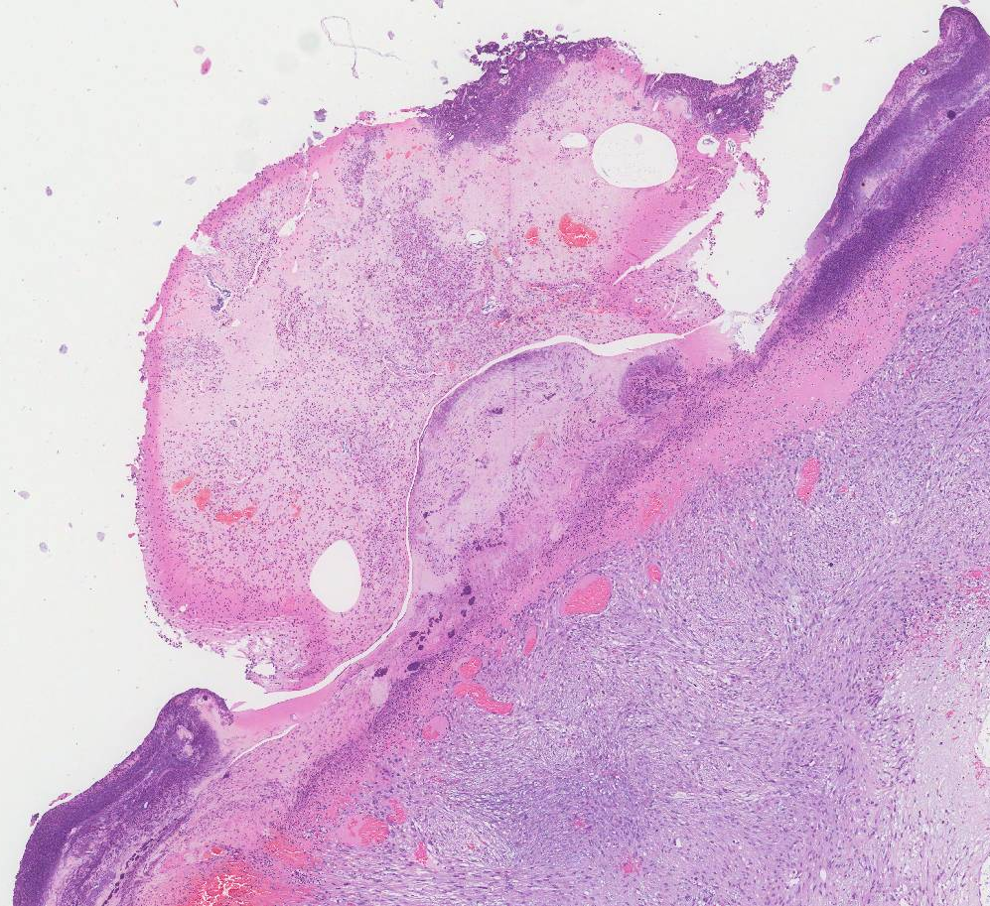

Slide 8
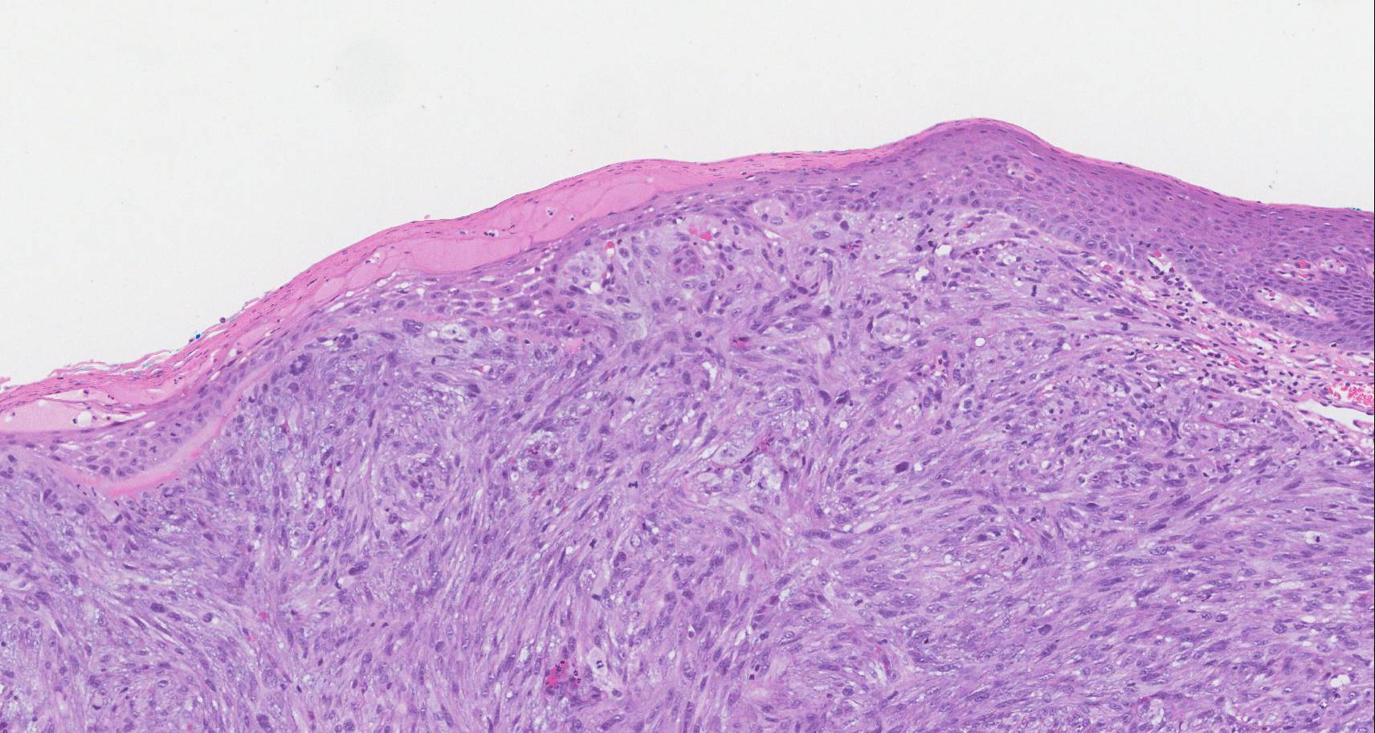

Slide 9
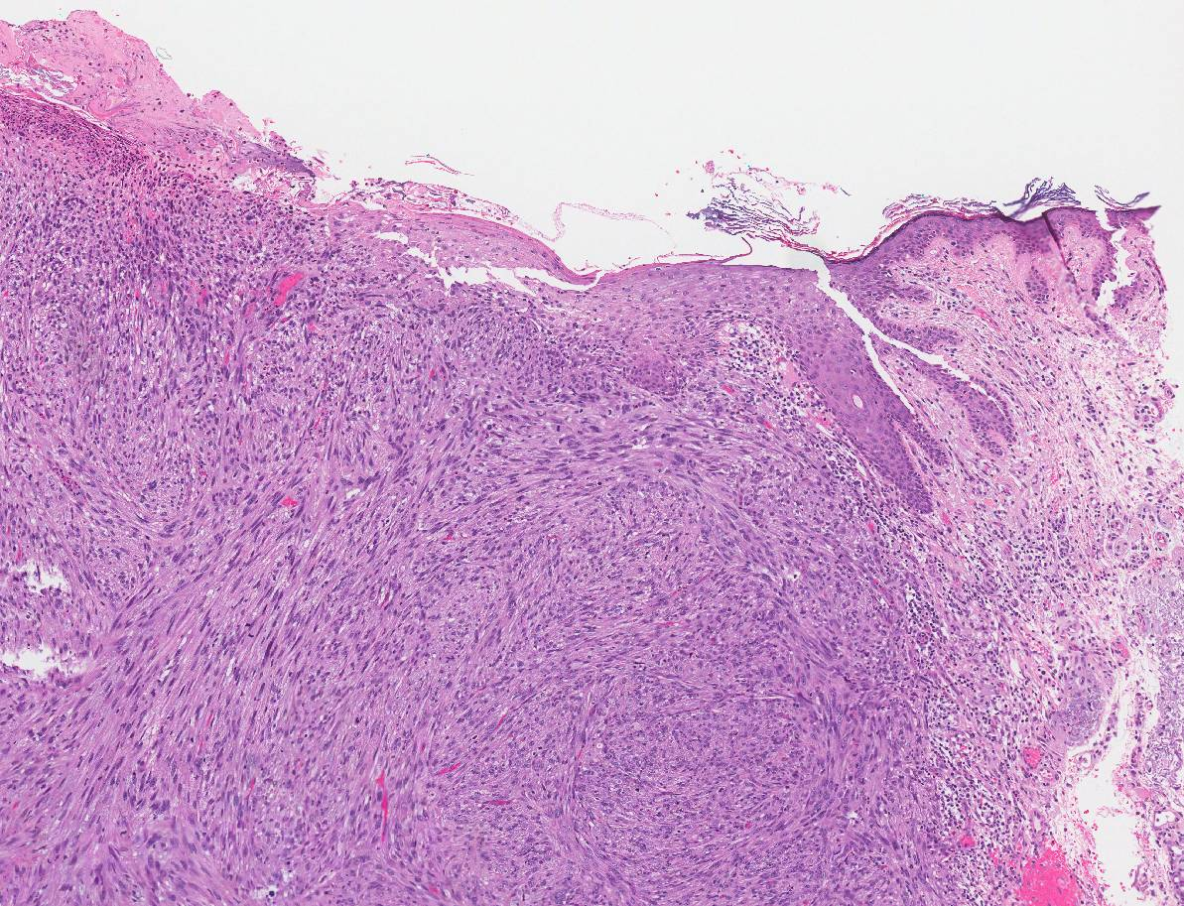

Slide 10
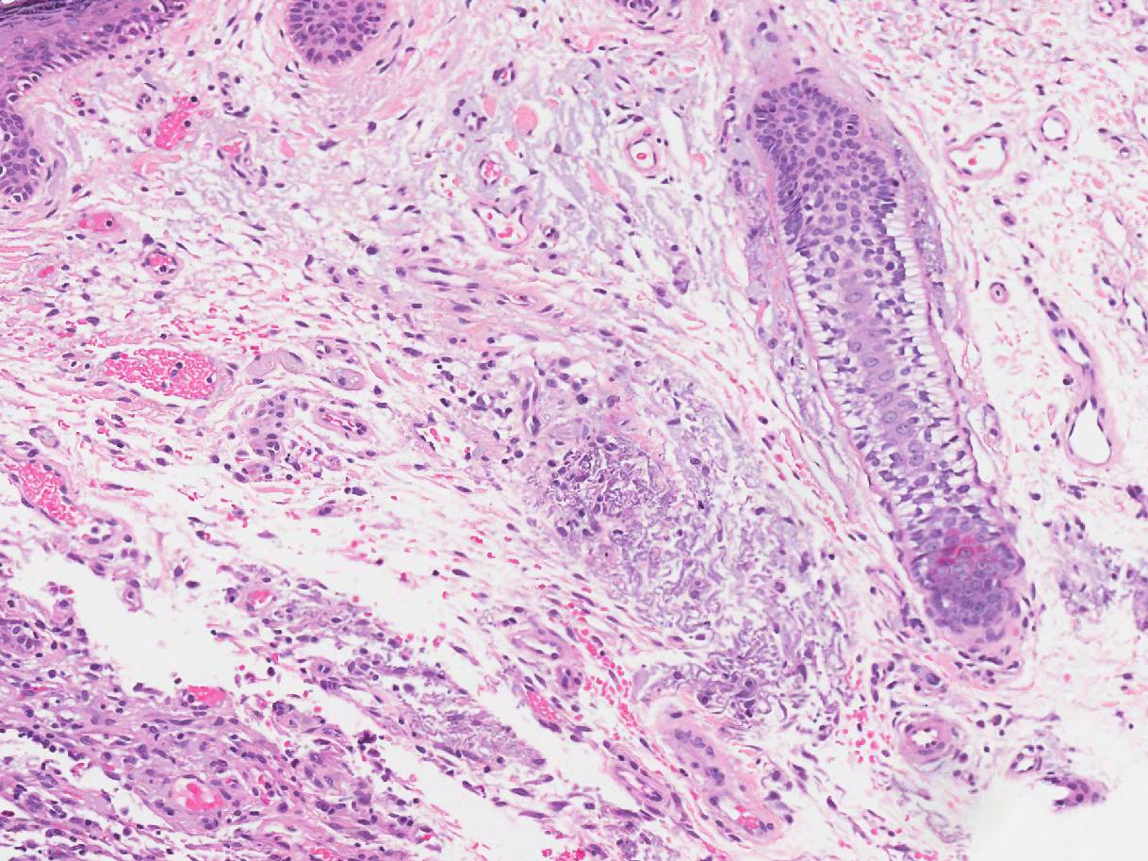

Slide 11
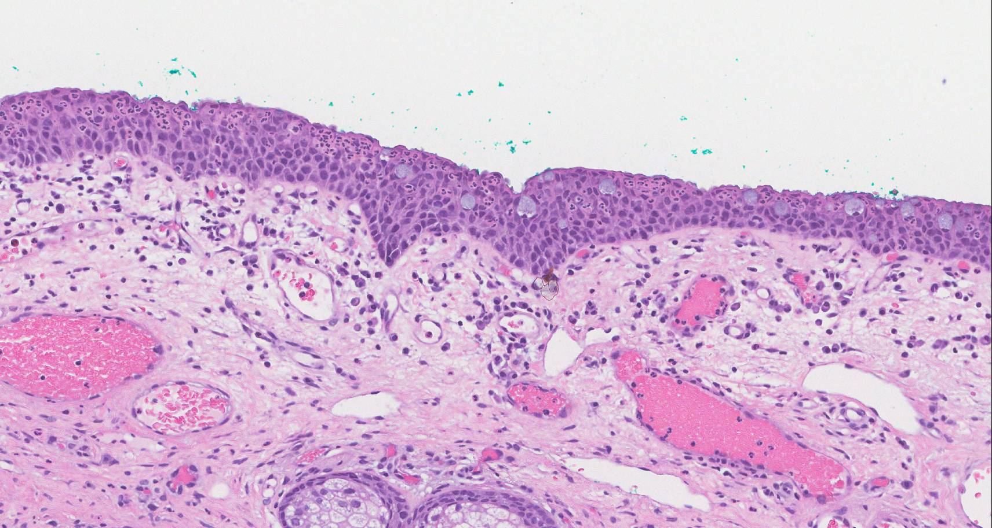

Slide 13
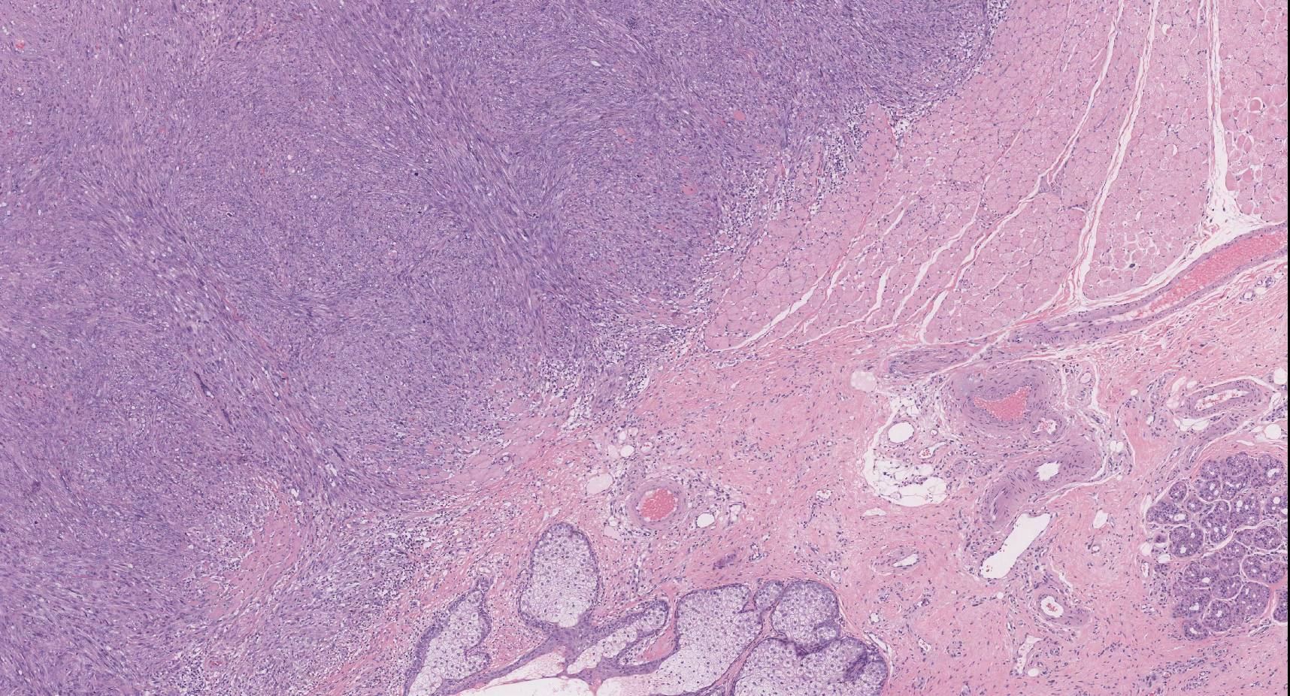

Slide 14
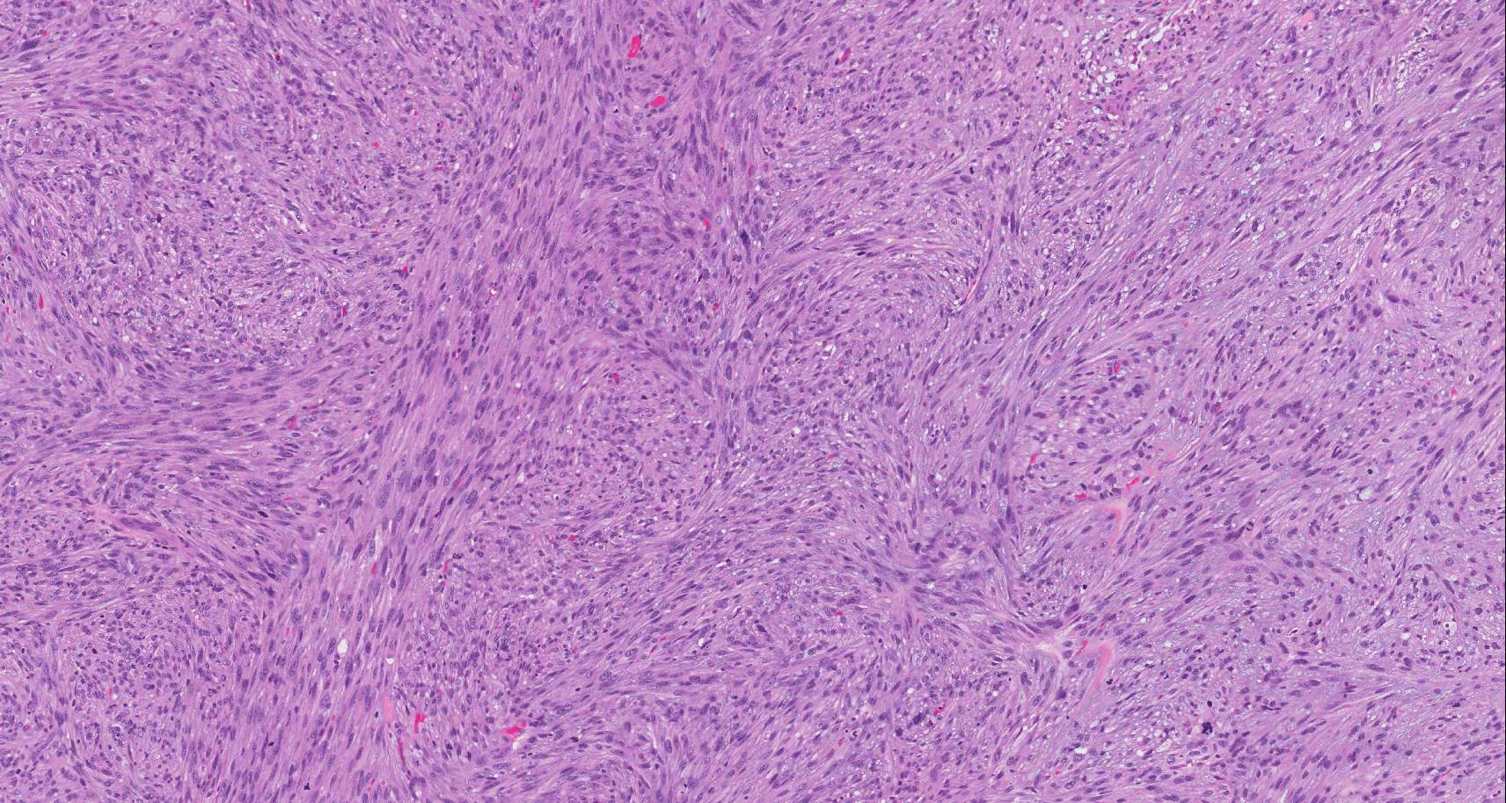

Slide 15
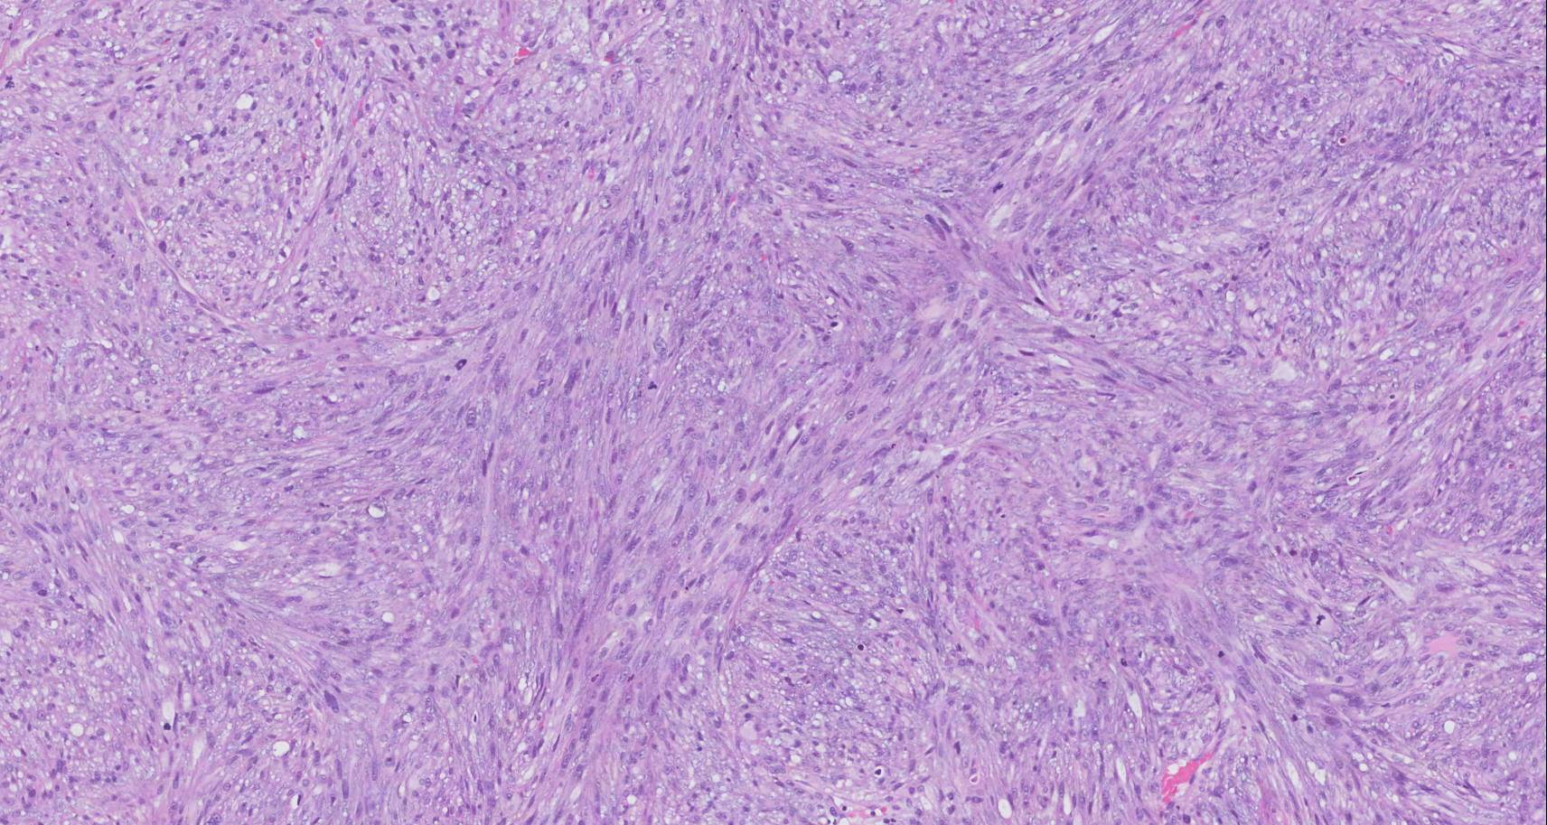

Slide 16
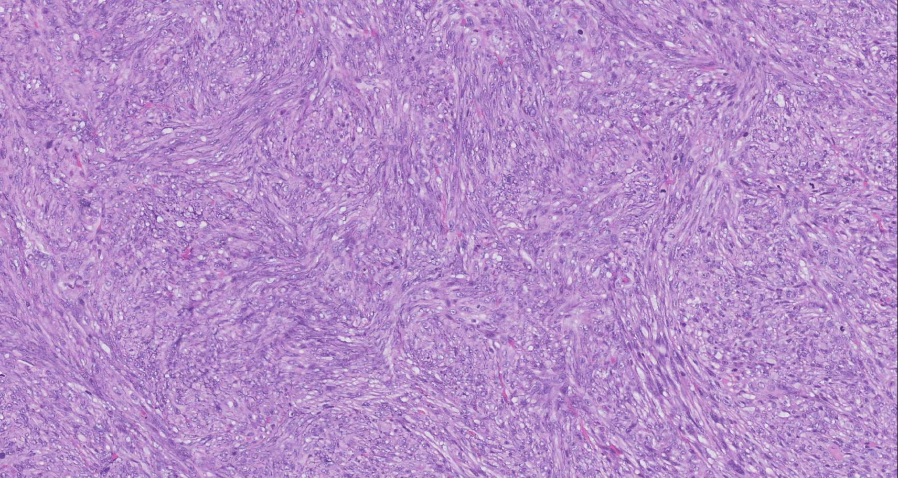
Areas of whorled growth

Slide 17
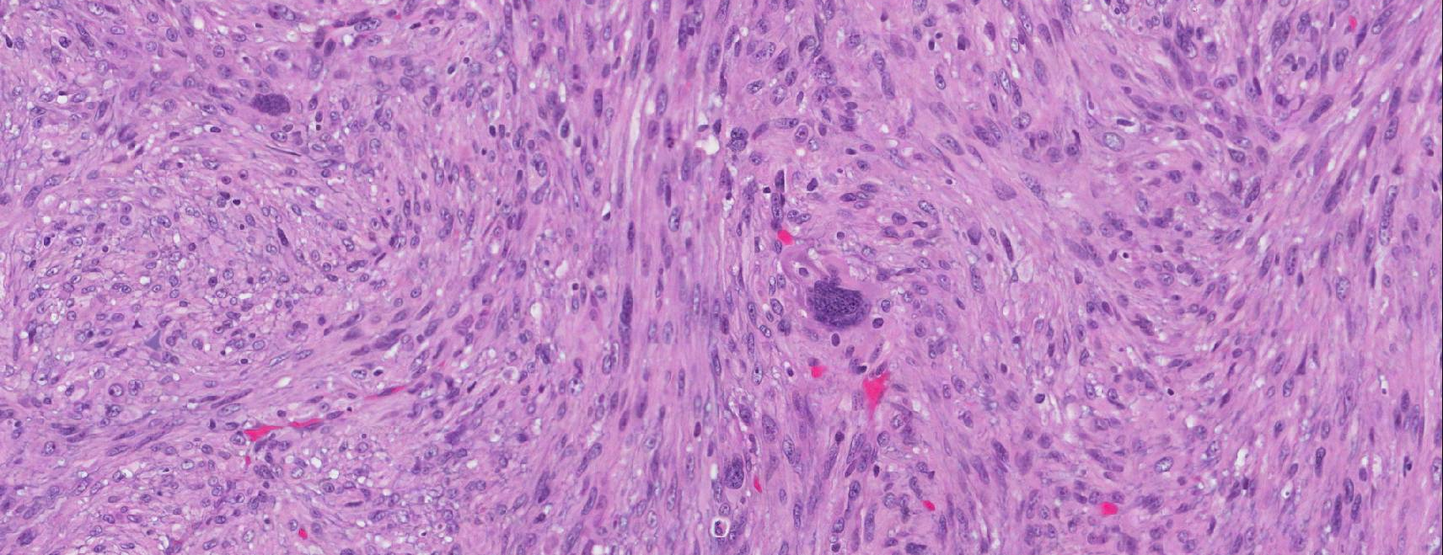

Slide 18
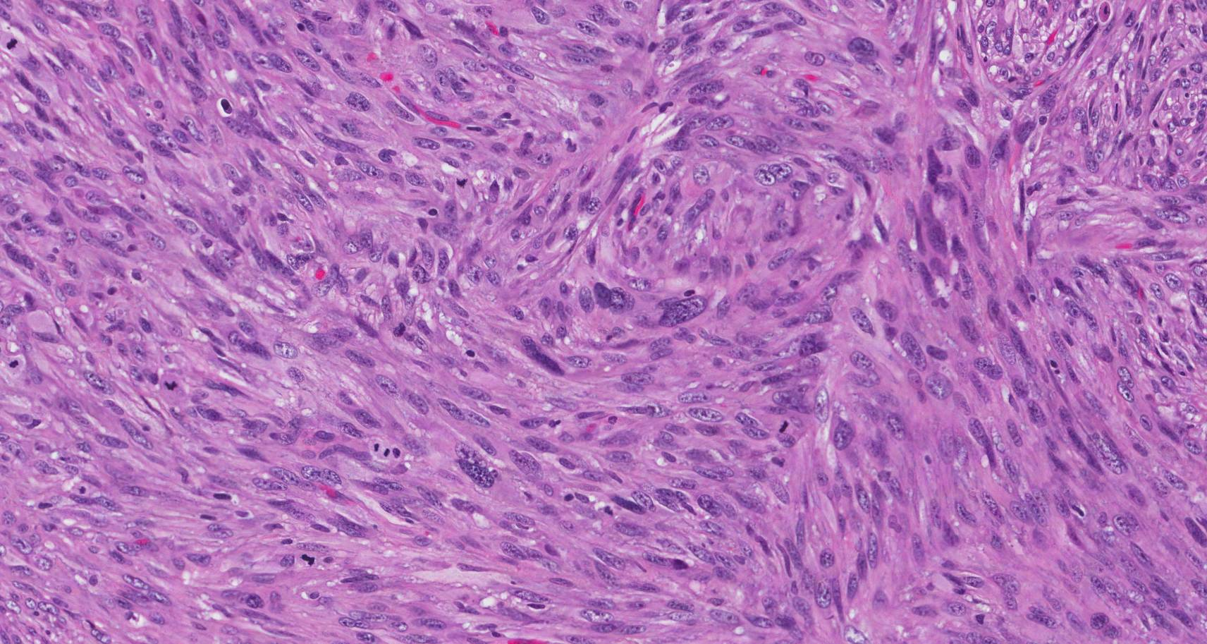

Slide 19
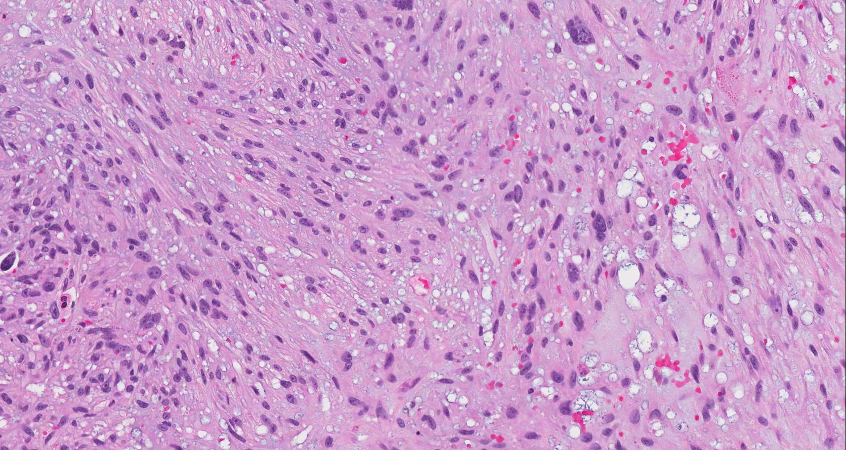

Slide 22
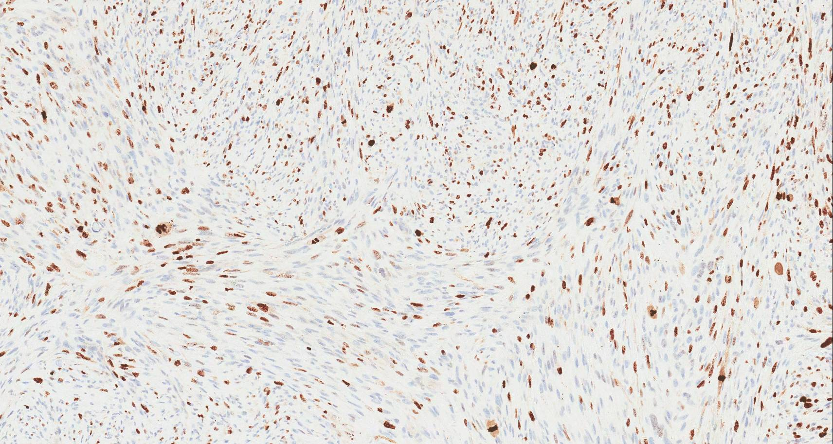
Ki67

Slide 23
Differential diagnosis
“Atypical spindle cell neoplasm that abuts the epidermis”
S pindled squamous cell carcinoma
L eiomyosarcoma
A typical fibroxanthoma
M elanoma

Slide 24
Differential diagnosis
S pindled squamous cell carcinoma
L eiomyosarcoma
A typical fibroxanthoma
M elanoma

Slide 25
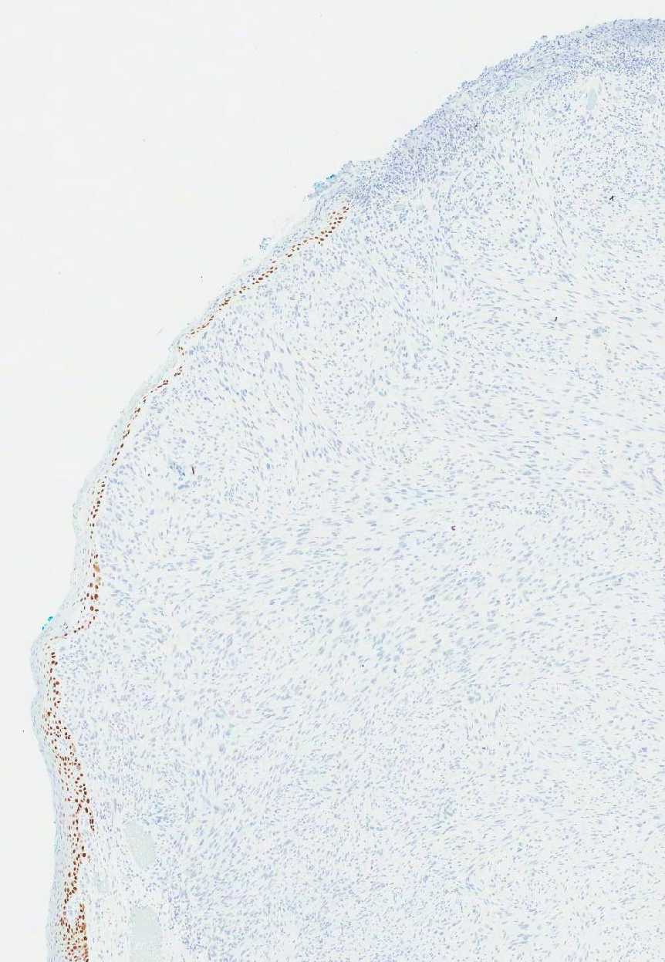
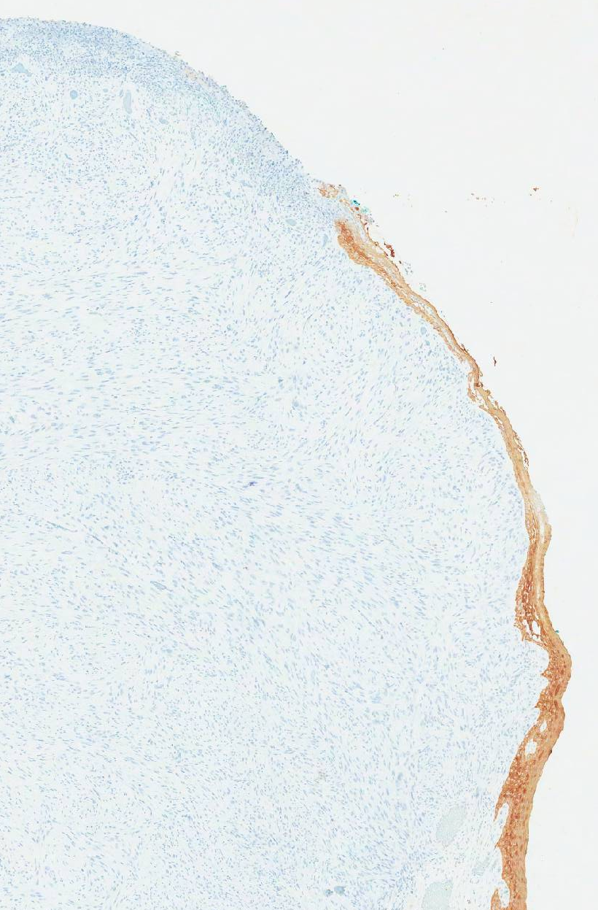
Our case
p40
CK Pan

Slide 26
Differential diagnosis
S pindled squamous cell carcinoma
L eiomyosarcoma
A typical fibroxanthoma
M elanoma

Slide 27
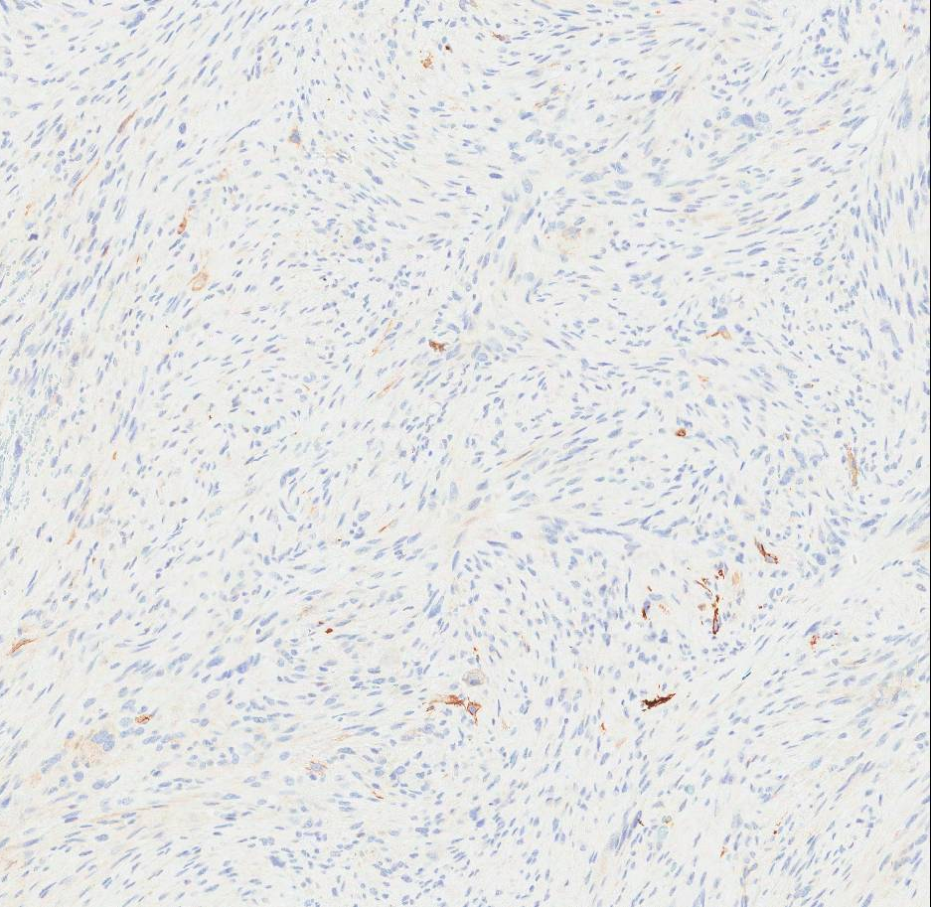
Our case
Caldesmon and desmin negative
Sun damaged skin
Elderly
Caldesmon

Slide 28
Differential diagnosis
S pindled squamous cell carcinoma
L eiomyosarcoma
A typical fibroxanthoma
M elanoma

Slide 29
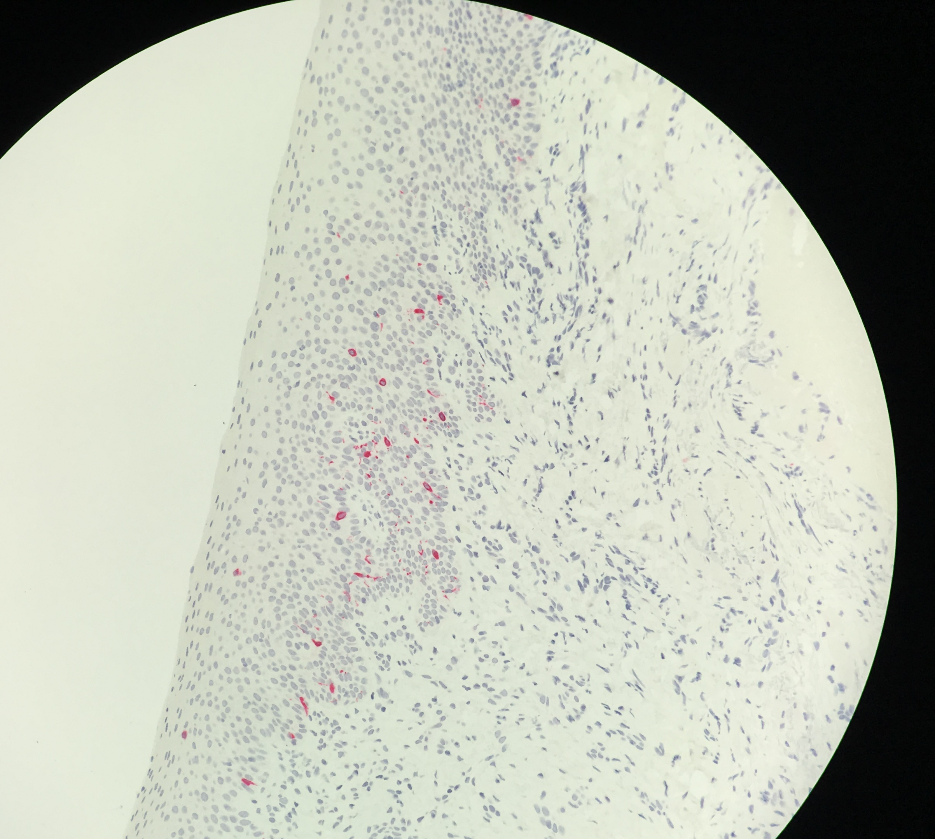
Our case
S100, Melan A, HMB 45 and Sox 10 negative
Lack of atypical intradermal melanocytic proliferation
S100
Melan A

Slide 30
Differential diagnosis
S pindled squamous cell carcinoma
L eiomyosarcoma
A typical fibroxanthoma
M elanoma
Spindle cell angiosarcoma

Slide 31
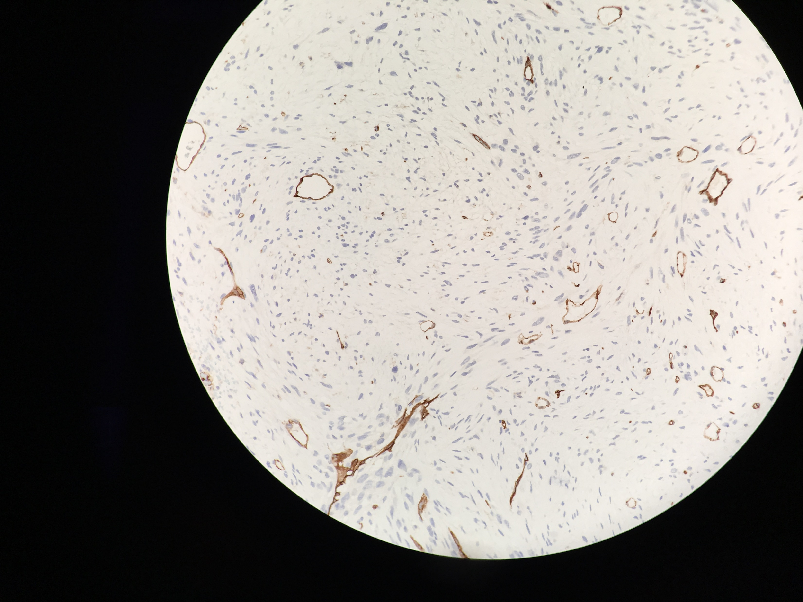
Our case
Lack of prominent blood filled spaces, significant intratumoral hemorrhage and hemosiderin deposition
CD31, CD34 negative
Clinical appearance
Atypical fibroxanthoma with pseudoangiomatous features (10%)
CD31

Slide 32
Differential diagnosis
Spindled squamous cell carcinoma
Leiomyosarcoma
Atypical fibroxanthoma
Melanoma
Spindle cell angiosarcoma
Dermatofibrosarcoma protuberans

Slide 33
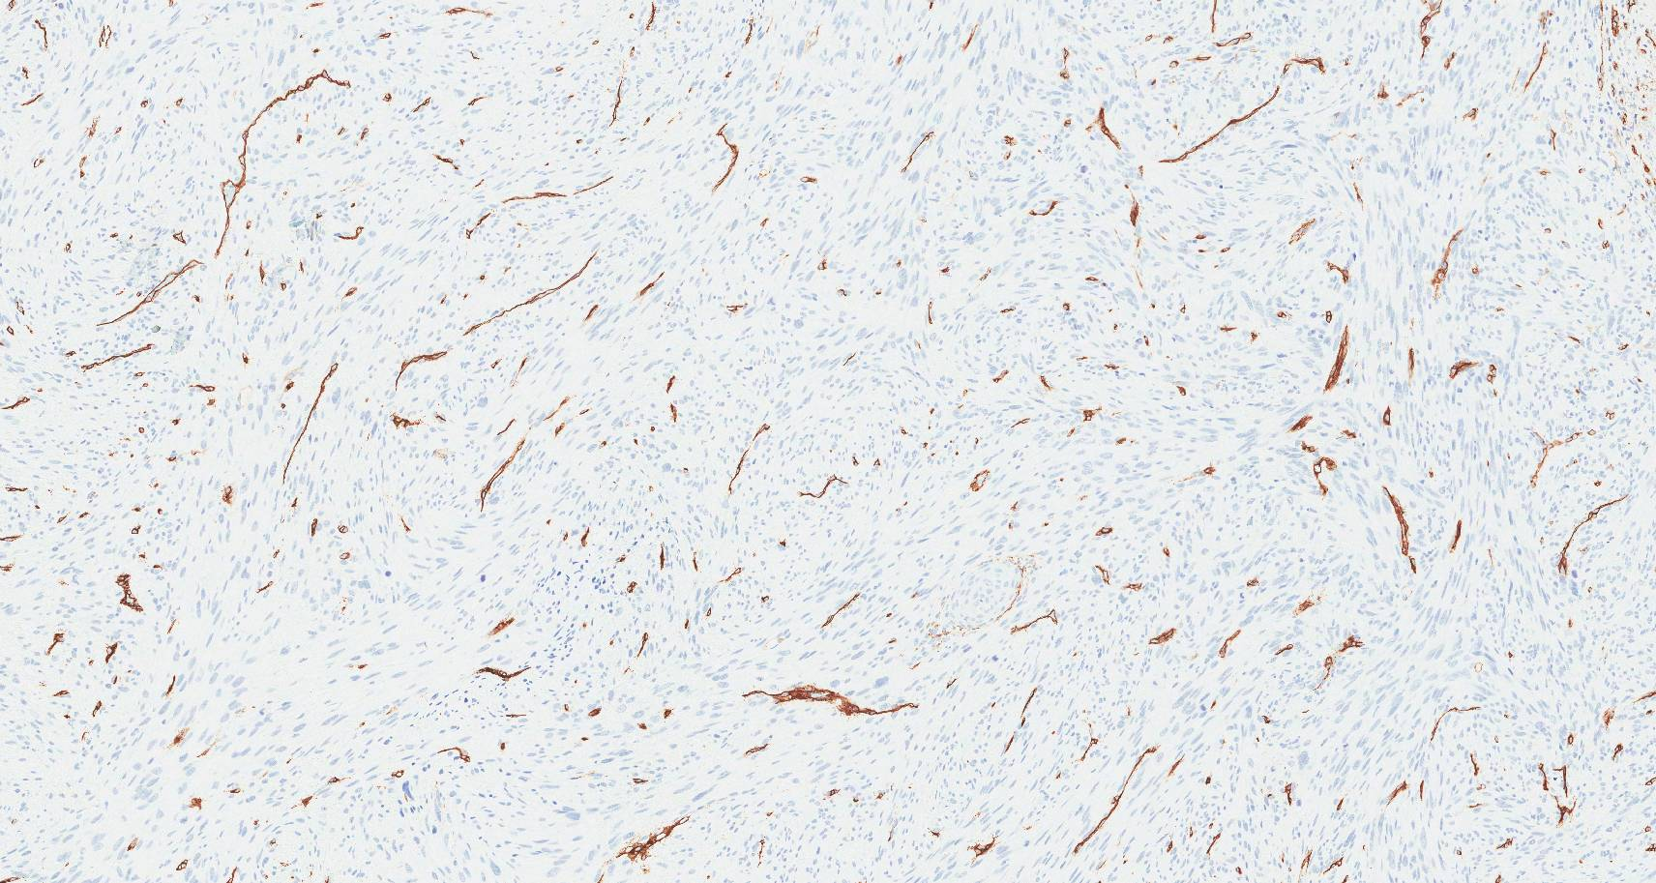
Our case
CD34

Slide 34
“The positives”
CD10
CD99

Slide 35
“The focally positives”
CD68
SMA

Slide 36
Diagnosis
Left lower eyelid, wedge biopsy:
- Atypical fibroxanthoma.
- Medial margin positive for tumor.

Slide 37
Atypical fibroxanthoma (AFX)
Lund and Kraus in 1962
Benign cutaneous neoplasm
Uncertain lineage
“Superficial malignant fibrous histiocytoma” – avoid

Slide 38
Atypical fibroxanthoma
Epidemiology
Elderly
Caucasian
Men > woman
Genetic analysis: mutations in p53
Incidence highest in areas of high UV radiation
Risk factors
- Xeroderma pigmentosum: younger age
- Radiotherapy / immunosuppression (transplantation)

Slide 39
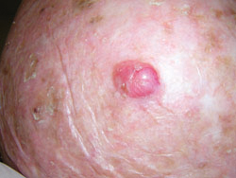
Atypical fibroxanthoma
Clinical presentation
Solitary
Nodular dome-shaped, pink/red/brown
Ulceration, bleeding/crusting
<2cm diameter
Short duration / rapid growth
Actinically-damaged skin
Head and neck
- Ocular, rare
Eyelid (6), medial canthus (1), conjunctiva (5)
newportbeachskincancer.com

Slide 40
Histopathology
Well circumscribed dermal tumor that abuts the epidermis (grenz zone may be seen)
Only focal extension into superficial subcutaneous tissue
Nodular or polypoid configuration, non-capsulated
Exophytic, often ulcerated
Collarette formation of lateral epidermis
Adjacent solar elastosis
Pushing growth pattern
Sheets, fascicles or haphazard arrangement of large spindle-shaped, epithelioid, anaplastic and multinucleated giant cells in different proportions
Admixed chronic inflammatory infiltrate

Slide 41
Histopathology
Cytology
Bizarre cells with marked nuclear pleomorphism
(hyperchromatic or vesicular chromatic and large often
multiple nucleoli)
Abundant eosinophilic / foamy cytoplasm
Brisk and atypical mitotic activity
Variants
Clear cell, angiomatoid, chondroid, granular cell, keloidal, myxoid, osteoclastic, osteoid, and pigmented

Slide 42
Histopathology
Absence of
Necrosis
Invasion into deep subcutis and underlying skeletal muscle
Lymphovascular / perineural invasion
Pleomorphic dermal sarcoma
15% metastatic potential / higher recurrence rate
Caution when diagnosing AFX on superficial biopsies!

Slide 43
Immunohistochemistry
“Diagnosis of exclusion”
Positives
CD10
CD99
CD68
Vimentin
SMA (30%)
Calponin (30%)
CD31 (5%, focal)
Negatives
S100
Cytokeratins
CD34
ERG
HMB-45, Melan A
SOX-10
Desmin
Caldesmon (majority)
p40/p63

Slide 44
Atypical Fibroxanthoma
Prognosis and treatment
Low local recurrence rate (less than 10%)
No metastasis has been described
Complete surgical excision with clear margins

Slide 45
Back to our case…

Slide 46
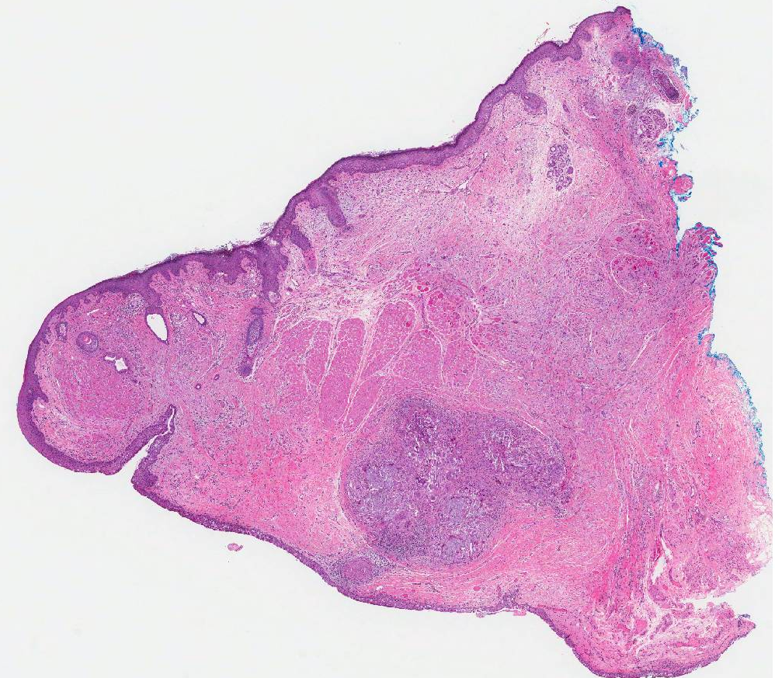

Slide 47
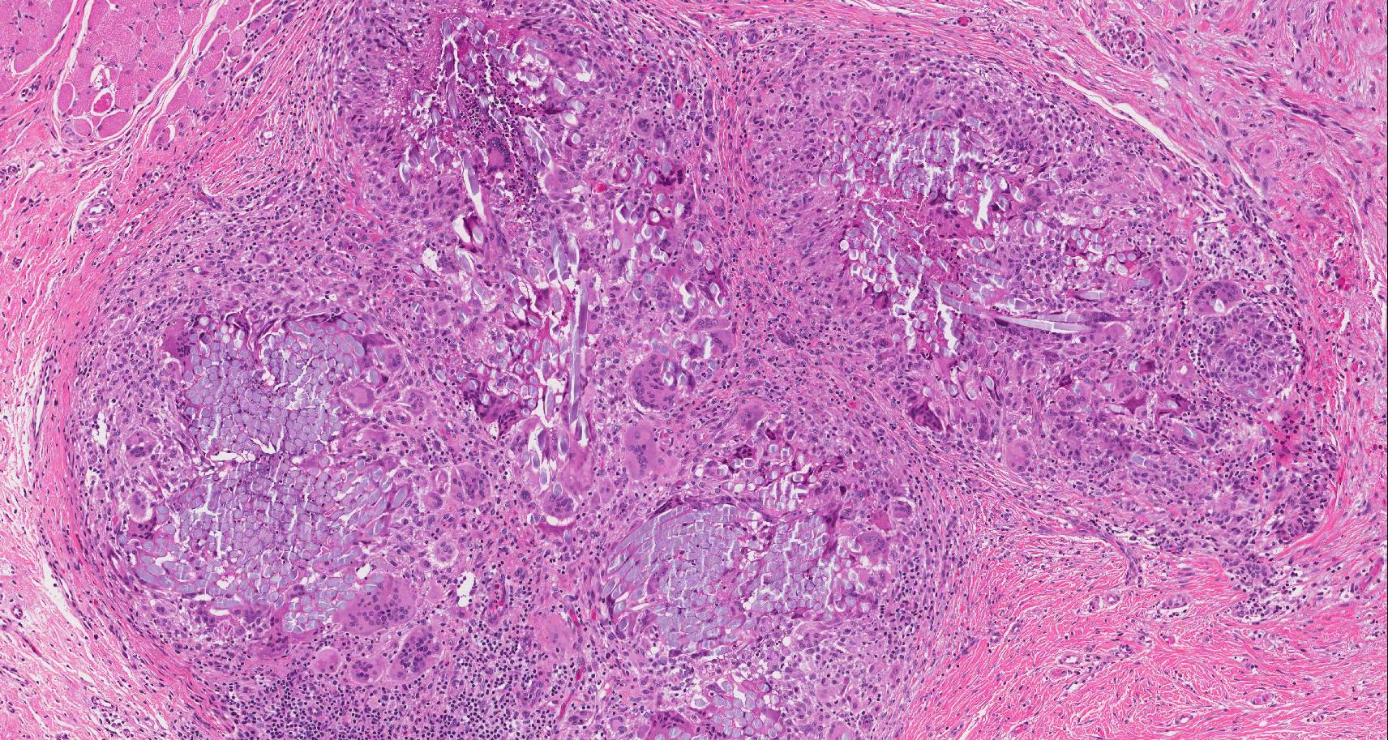

Slide 48
Follow up
Left lower eyelid, wide wedge resection:
- Scar tissue
- Focal foreign body granulomatous
inflammatory reaction consistent with
prior surgery
- Negative for residual tumor

Slide 49
Thank you for your attention

