Slide 1



Persistent, Contact Lens-related Acanthameba Keratitis:
Role of Molecular Testing
Charleen T. Chu, MD, PhD
A. Julio Martinez Chair in Neuropathology
Director, Ophthalmic Pathology
University of Pittsburgh
http://path.upmc.edu/personnel/Faculty/Chu.htm
Notes:
10 min

Slide 2
Clinical History
43 year old man – abraded left cornea while removing contact lens in late Aug
  H/o swimming and sleeping with contacts in
Developed ulcer over following month, treated with Abx for bacteria and prednisolone
  Bacterial and fungal cultures neg
Sx worsened. Added PHMB/chlorhexidine & valacyclovir on 10/8
  Cultures for acanthamoeba and HSV neg
Presented to ED on 10/16 “unmanageable pain,” orbital pressure, left headache

Slide 3
Exam
Visual acuity: 20/50 OD; motion only OS
Pressures: 13 mmHg OD; 28 mmHg OS
Lid crusting, 4+ injection with limbal flush
5 x 5 mm corneal epithelial defect with a 7 x 6 mm ring infiltrate
4+ hypopyon

Slide 4
Laboratory studies
Eyewash sent for molecular testing
Primer and Probe set from Qvarnstrom et al. (2006)
  Detects down to 0.7 cysts/10 microliters and 2.3 trophozoites/10 microliters (Thompson et al., 2008)
Target 18S rRNA gene
  Minimal variation in sequence (T1-T15)
  Primers are to region conserved across 40 spp.
Qvarnstrom et al. Journal of Clinical Microbiology, 2006.
Thompson et al. Journal of Clinical Microbiology ,2008.
Notes:
Talk about genotype outcomes

Slide 5
PCR assay designs
http://www.sigmaaldrich.com/life-science/molecular-biology/pcr/learning-center/probed-based-qpcr-animation.html

Slide 6
PCR assay design
R
Q
R
Q
Notes:
http://www.sigmaaldrich.com/life-science/molecular-biology/pcr/learning-center/probed-based-qpcr-animation.html

Slide 7
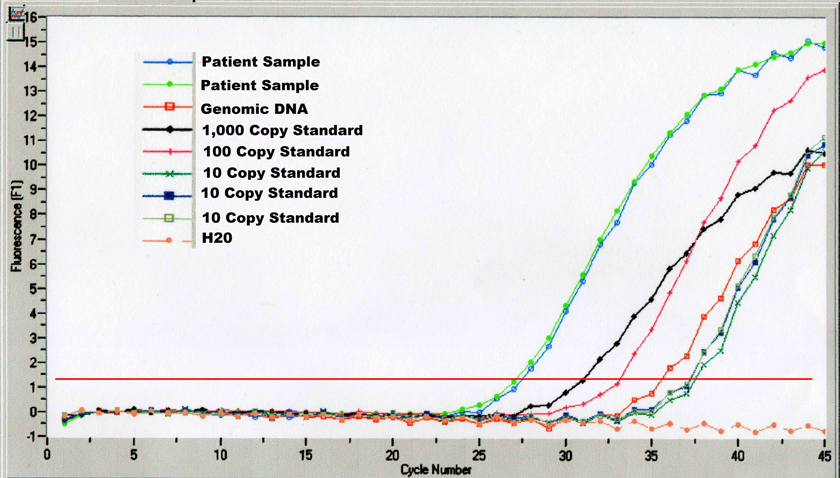
Laboratory studies
2⁴ = 16x the 1000
copy standard
Cycle 31
Positive Control
Cycle 27
Negative control
Chu, Anani, Oury, unpublished data

Slide 8
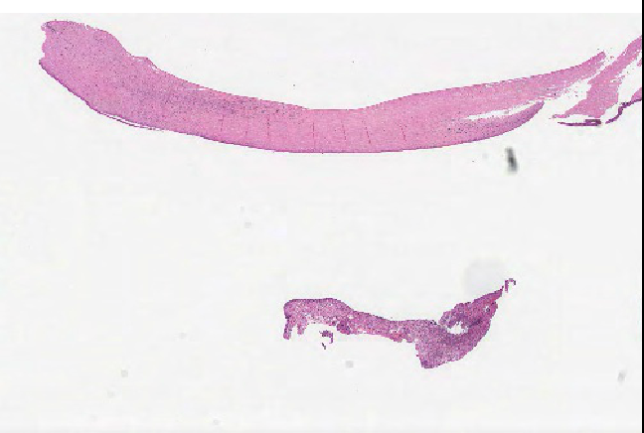
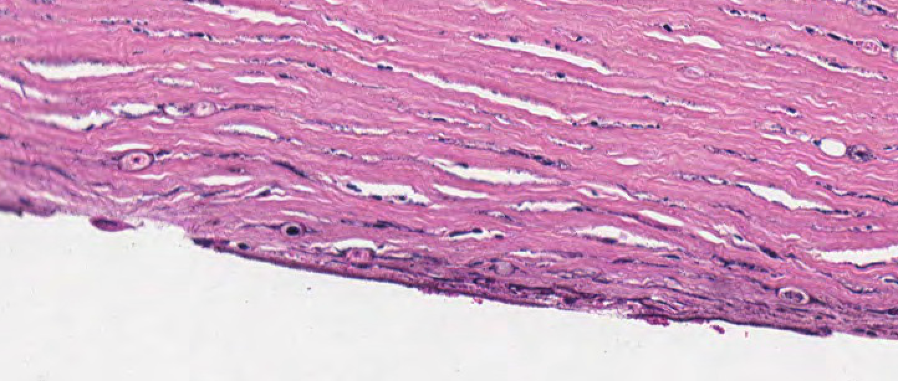
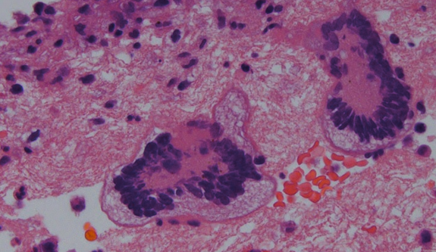
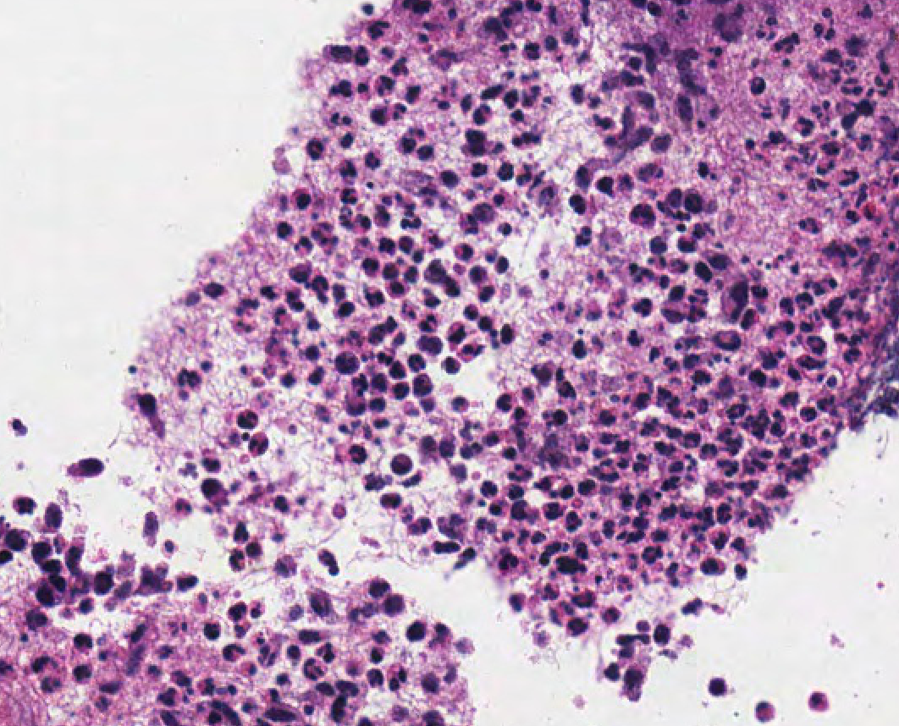
Corneal transplant 11/4
8 x 5 mm corneal button (cultures sent)
http://image.upmc.edu:8080/NeuroPathology/Eye/Eye5/EP5.28.svs/view.apml?
Chu, Anani, Oury, unpublished data

Slide 9
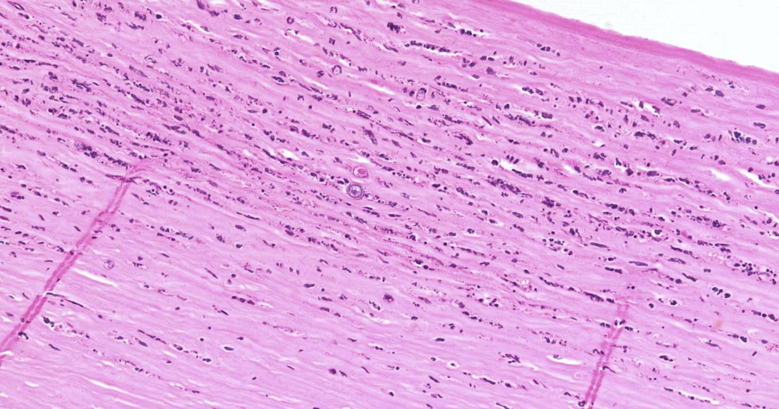
Chu, Anani, Oury, unpublished data

Slide 10
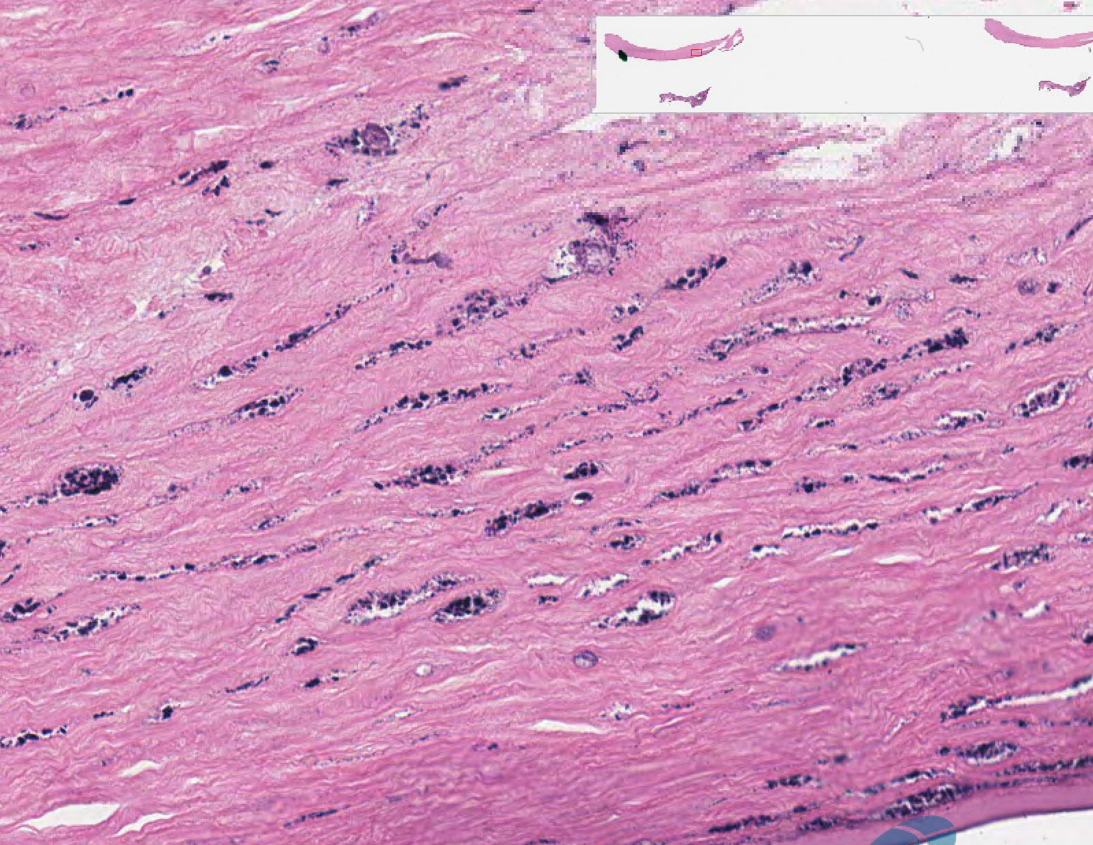
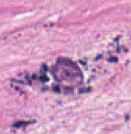
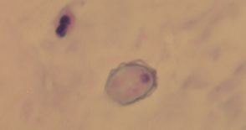
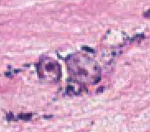

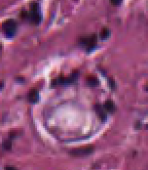
Other cases:
Mostly devitalized or empty cysts
Chu, Anani, Oury, unpublished data

Slide 11
General
Free-living protozoan
Found ubiquitously in nature
  In lakes, swimming pools, tap water, heating and air conditioning,
Acanthamoeba keratitis associated with
  Poor contact lens hygiene
  Corneal trauma
Infects immunocompetent individuals

Slide 12
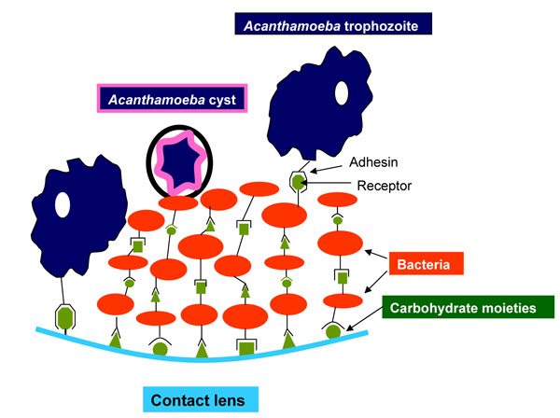
Interaction of Acanthameba with bacterial prey and mannose on contact lens

Slide 13
Immune evasion by acanthameba
2007 outbreak – Advanced Medical Optics Complete MoisturePlus
  Designed for one-step, no-rub, moisture-retaining properties
  Propylene glycol – promotes encystation, and thus resistance to disinfection Eye Contact Lens 34:133–139, 2008.
Neutrophils and macrophages predominate
  Not effective in killing cysts
  No NK or T cell response even in a case where immune privilege was breached (Knickelbein…Chu 2013, Hum Pathol 44: 918)
Corticosteroids promote encystation
T4 is the most common; non-T4 strains may resist Rx

Slide 14
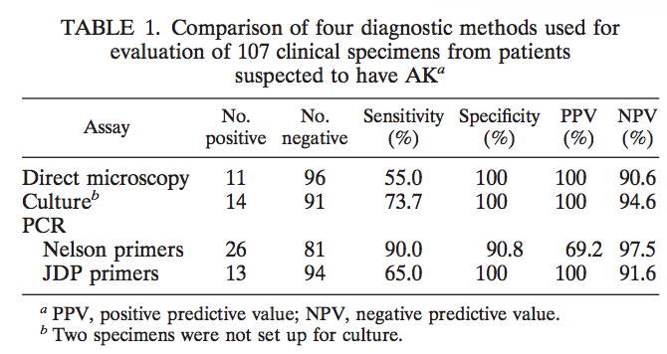
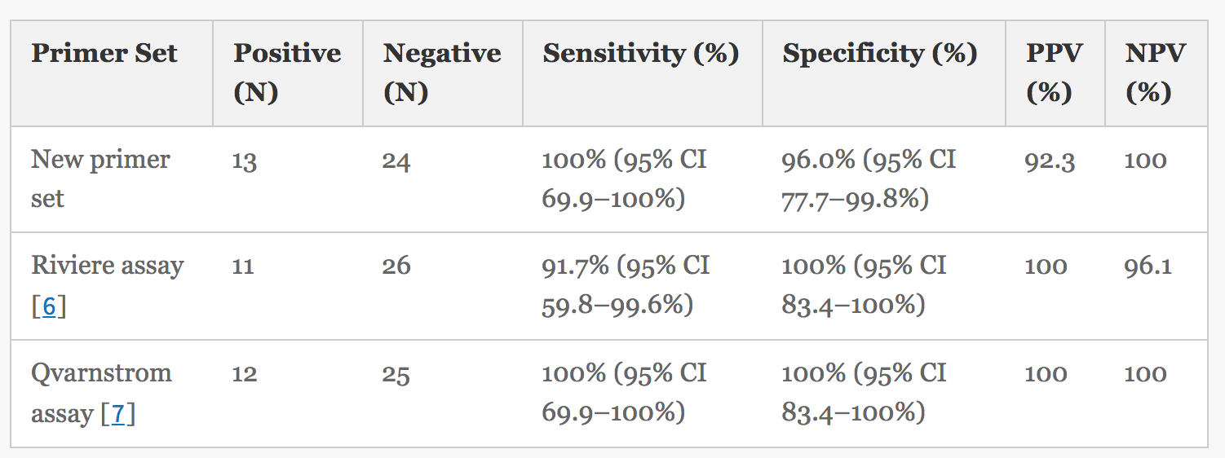
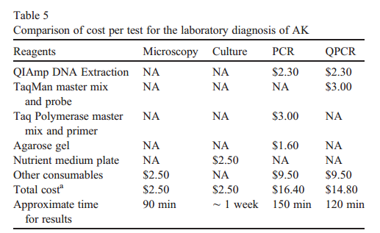
Sensitivity, Specificity, Cost, Time
Boggild et al 2009, J Clin Microbiol 47: 1314
Karsenti 2017, BMC Research Notes 10:355
Khairnar et al. Diagnostic Microbiology and Infectious Disease 2011.

Slide 15
UPMC (Sep 2015-Aug 2018)
214 PCR tests
  6 were positive (0.28%) - all unique patients
  One was culture negative
268 cultures, sometimes repeated cultures on the same individual
  10 were positive, from 5 unique patients

Slide 16
Interesting Points About Case
In our experience, high concentrations of Acanthamoeba are rare
  Assay performing properly?
  Specimen/positive control mix-up?
  False positive amplification?
Pathology & culture sent from OR were positive
  Many viable trophozoites and cysts
  Suggest a treatment-resistant strain
Followup – Graft clear at 4 yrs, dry eye

