Slide 1
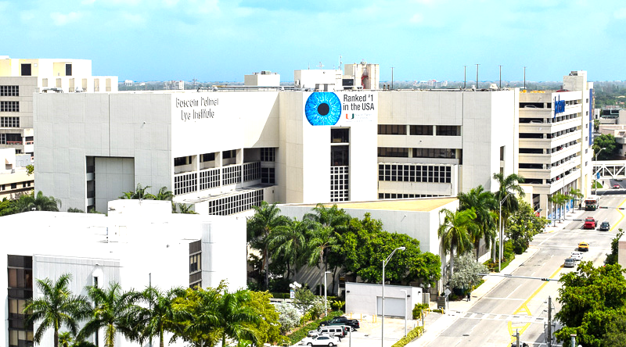
Unknown Vitreous Biopsy Eastern Ophthalmic Pathology Society Washington, DC; September 13 – 15, 2018
Sander R. Dubovy, MD
Professor of Ophthalmology and Pathology
Victor T. Curtin Chair in Ophthalmology
Florida Lions Ocular Pathology Laboratory
Bascom Palmer Eye Institute
University of Miami Miller School of Medicine

Slide 2
Financial Disclosures
No financial disclosures

Slide 3
History
CC: 77-year-old male
Decreased vision OS x 2 months
Associated floaters OS
No flashes, no distortion of vision OU
No pain
POH: None
PMH
Hypertension
Pre diabetic
Heart disease
Motor neuron disorder – mixed upper and lower motor neuron deficit
*Additional history withheld*
FH: Non-contributory
PSH
Knee surgery
Coronary artery bypass
Spine surgery
Appendectomy
Medications
Enalapril, zolpidem, baclofen, citalopram, metoprolol
Allergies
Shellfish

Slide 4
Presenting Eye Exam
20/30-1 PH NI
VA CC
20/50 PH NI
3 mm
no RAPD
full
Pupils
CVF
3 mm
no RAPD
full
17 mm Hg
full
T_{tono}
EOM
20mm Hg
full
Notes:
VA CC

Slide 5
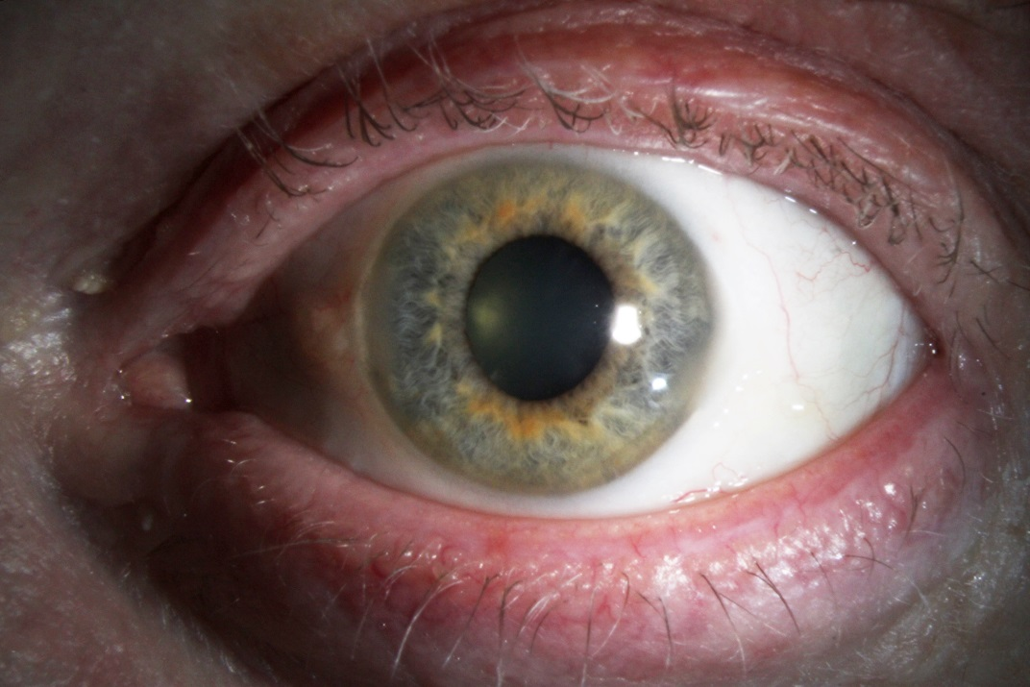
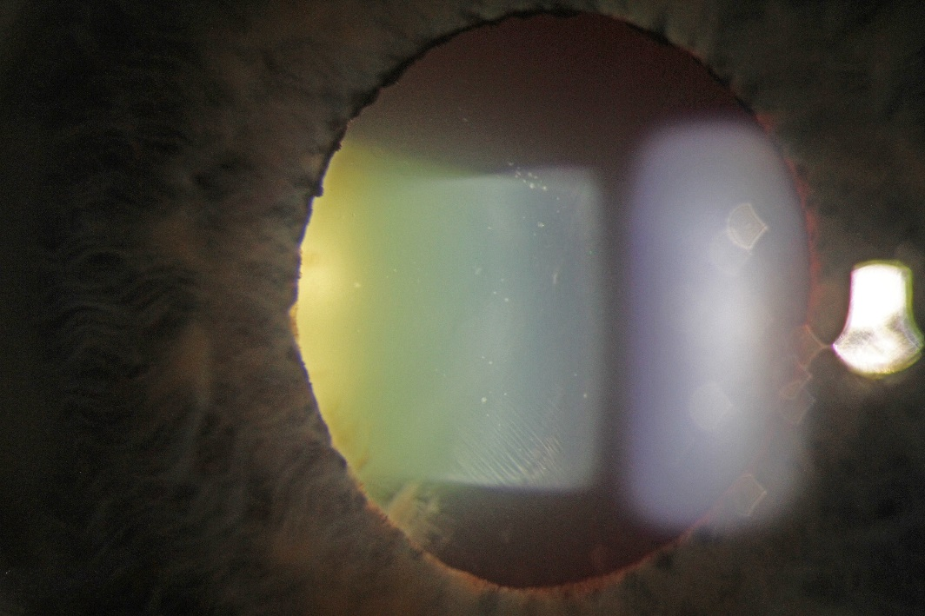
Slit Lamp Exam OS
Notes:
External unremarkable; Vitreous cells

Slide 6
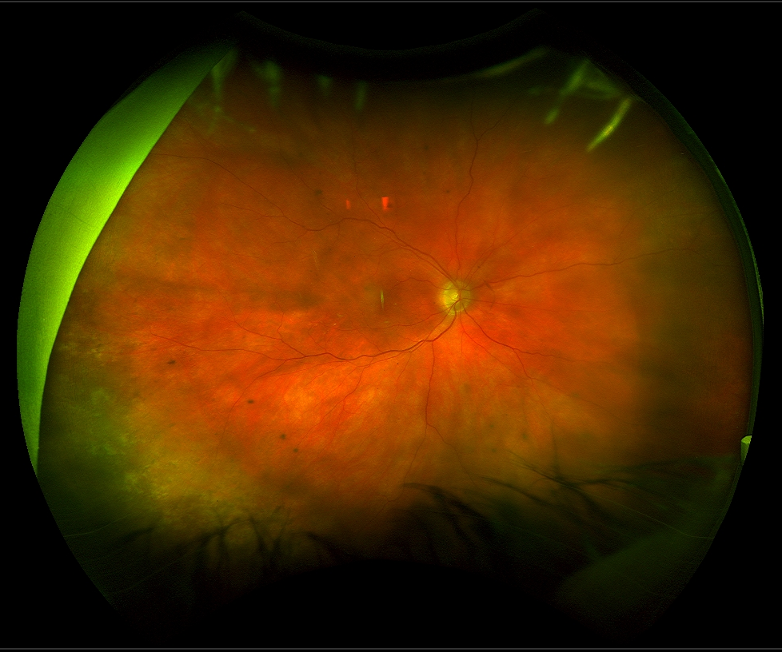
Fundus Photo OD
Notes:
OD: Hyperpigmented areas (RPE changes); otherwise unremarkable

Slide 7
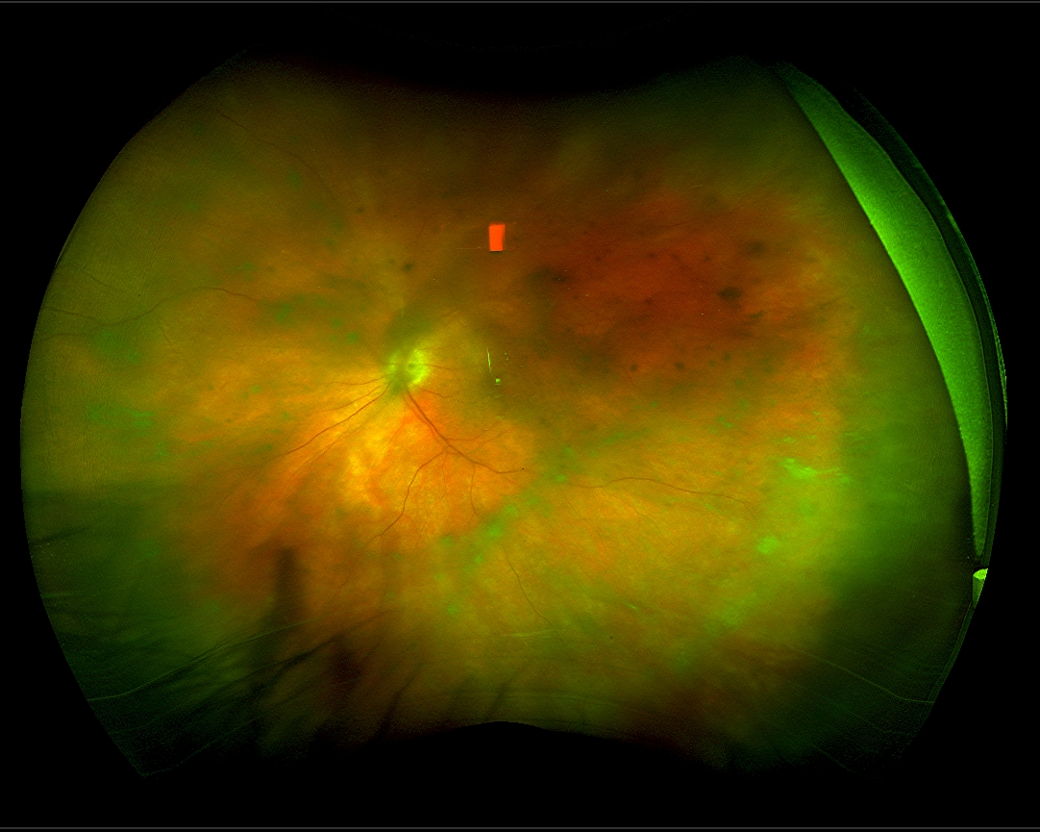
Fundus Photo OS
Notes:
OS: hazy, hyperpigmented areas – RPE changes; no subretinal lesions; vitreous haze
Optos – may see more of the fundus than exam – worse clinically than optos
Pigmentary changes in pereiphery; vitreous change; no Sub RPE or subretinal lesion

Slide 8
Fluorescein Angiogram
1 min
4 min
Notes:
OD: normal AV transit, no hyperfluorescence consistent with CME, CNV. NVD or NVE. Normal FAZ.
Pigmentary changes – similar to leopard spots
No CME,

Slide 9
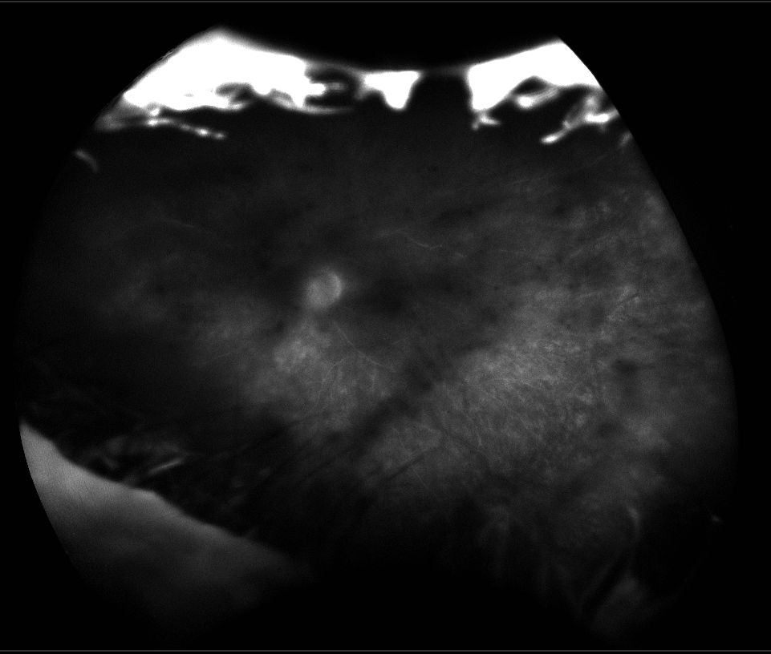
Fluorescein Angiogram
3 min
5 min
Notes:
OS: Normal AV transit. No hyperfluorescence consistent with CME; mostly peripheral RPE changes, in somewhat of a leopard-spot pattern. No CNV. No hyperfluorescence consistent with NVD or NVE, but slight leakage from ONH. FAZ not clearly visualized.
*No vascular leakage** no clear vasculitis*

Slide 10
Differential
Infectious
Bacterial (Tb, syphilis)
Fungal
Protozoan
Parasitic
Viral
Non-infectious
Sarcoidosis
VKH
Sympathetic ophthalmia
Behcets
Masquerade syndromes
Primary intraocular lymphoma
Secondary intraocular lymphoma
CNS lymphoma
Other tumors (melanoma)
Metastasis from breast, lung or renal carcinomas
Paraneoplastic syndromes
Idiopathic

Slide 11
Vitreous Biopsy, OS
Notes:
40x; 60x – shows two populations of cells – large cells and small cells
There are many small cells but there are also some larger cells – likely represent large cell transformation of the skin lymphoma

Slide 12
CD3
CD19
Notes:
Most cells are CD3+, CD7+, CD2+; many are CD19+, CD8 > CD4 consistent with T-cell lymphoma with large cell transformation
CD3+ and 2+ 7+
CD8>CD4;
Immunophenotype slightly different from original – immunotypic shift or a subset of the clone in vitreous; but has been reported esp
May represent progression of disease or subclonal

Slide 13
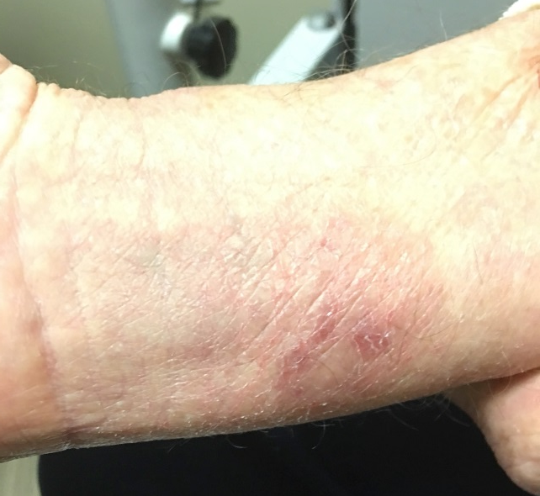
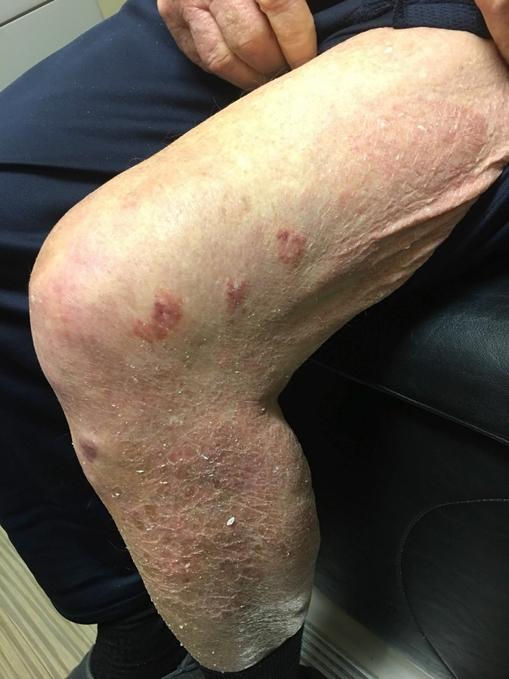
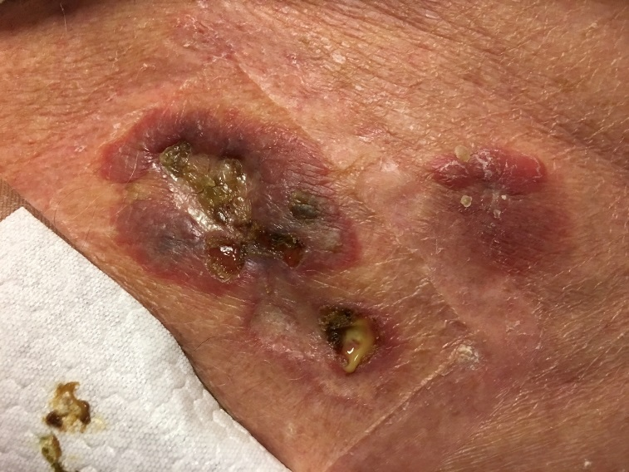
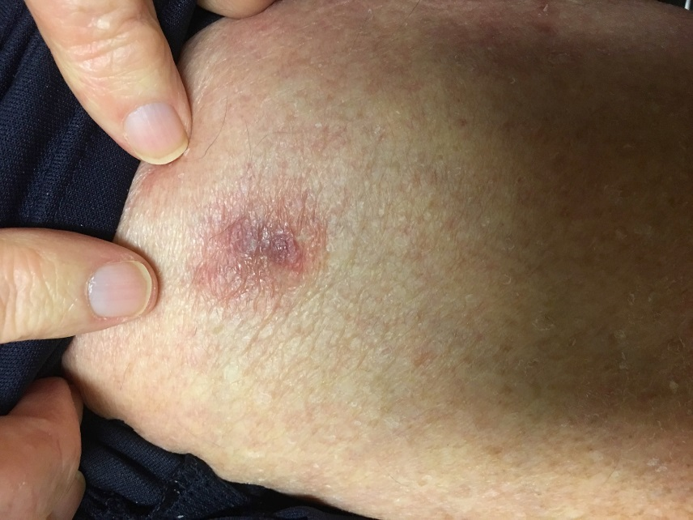
Skin Findings
Notes:
Show one lesion – center – looks infected – show first
Then show the other; diagnosed 1.5 years ago

Slide 14
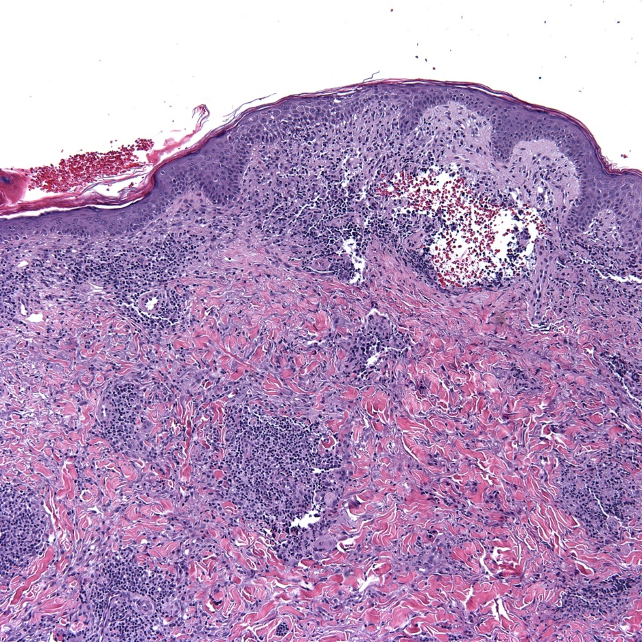
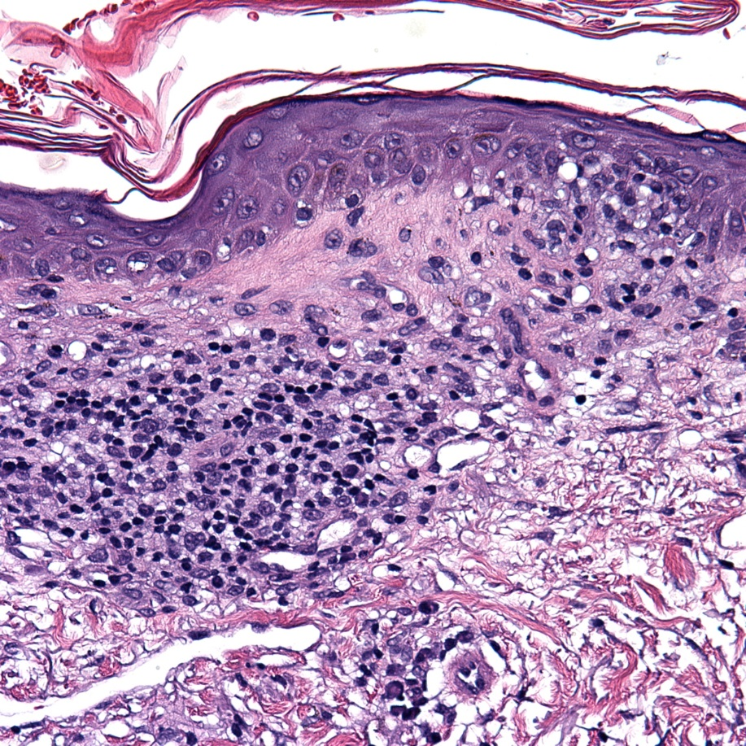
Skin Biopsy
Notes:
Skin biopsy reveals superficial and deep perivascular lymphoid infiltrate composed of a pleomorphic population of lymphocytes, histiocytes and plasma cells.

Slide 15
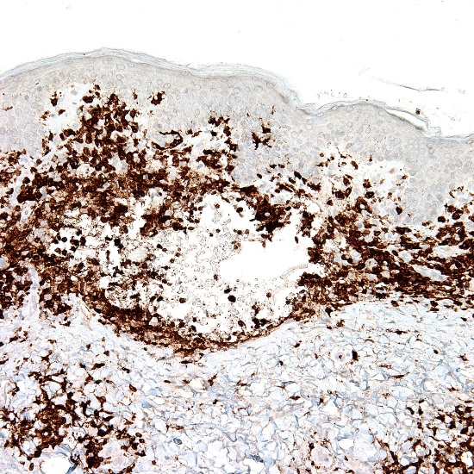
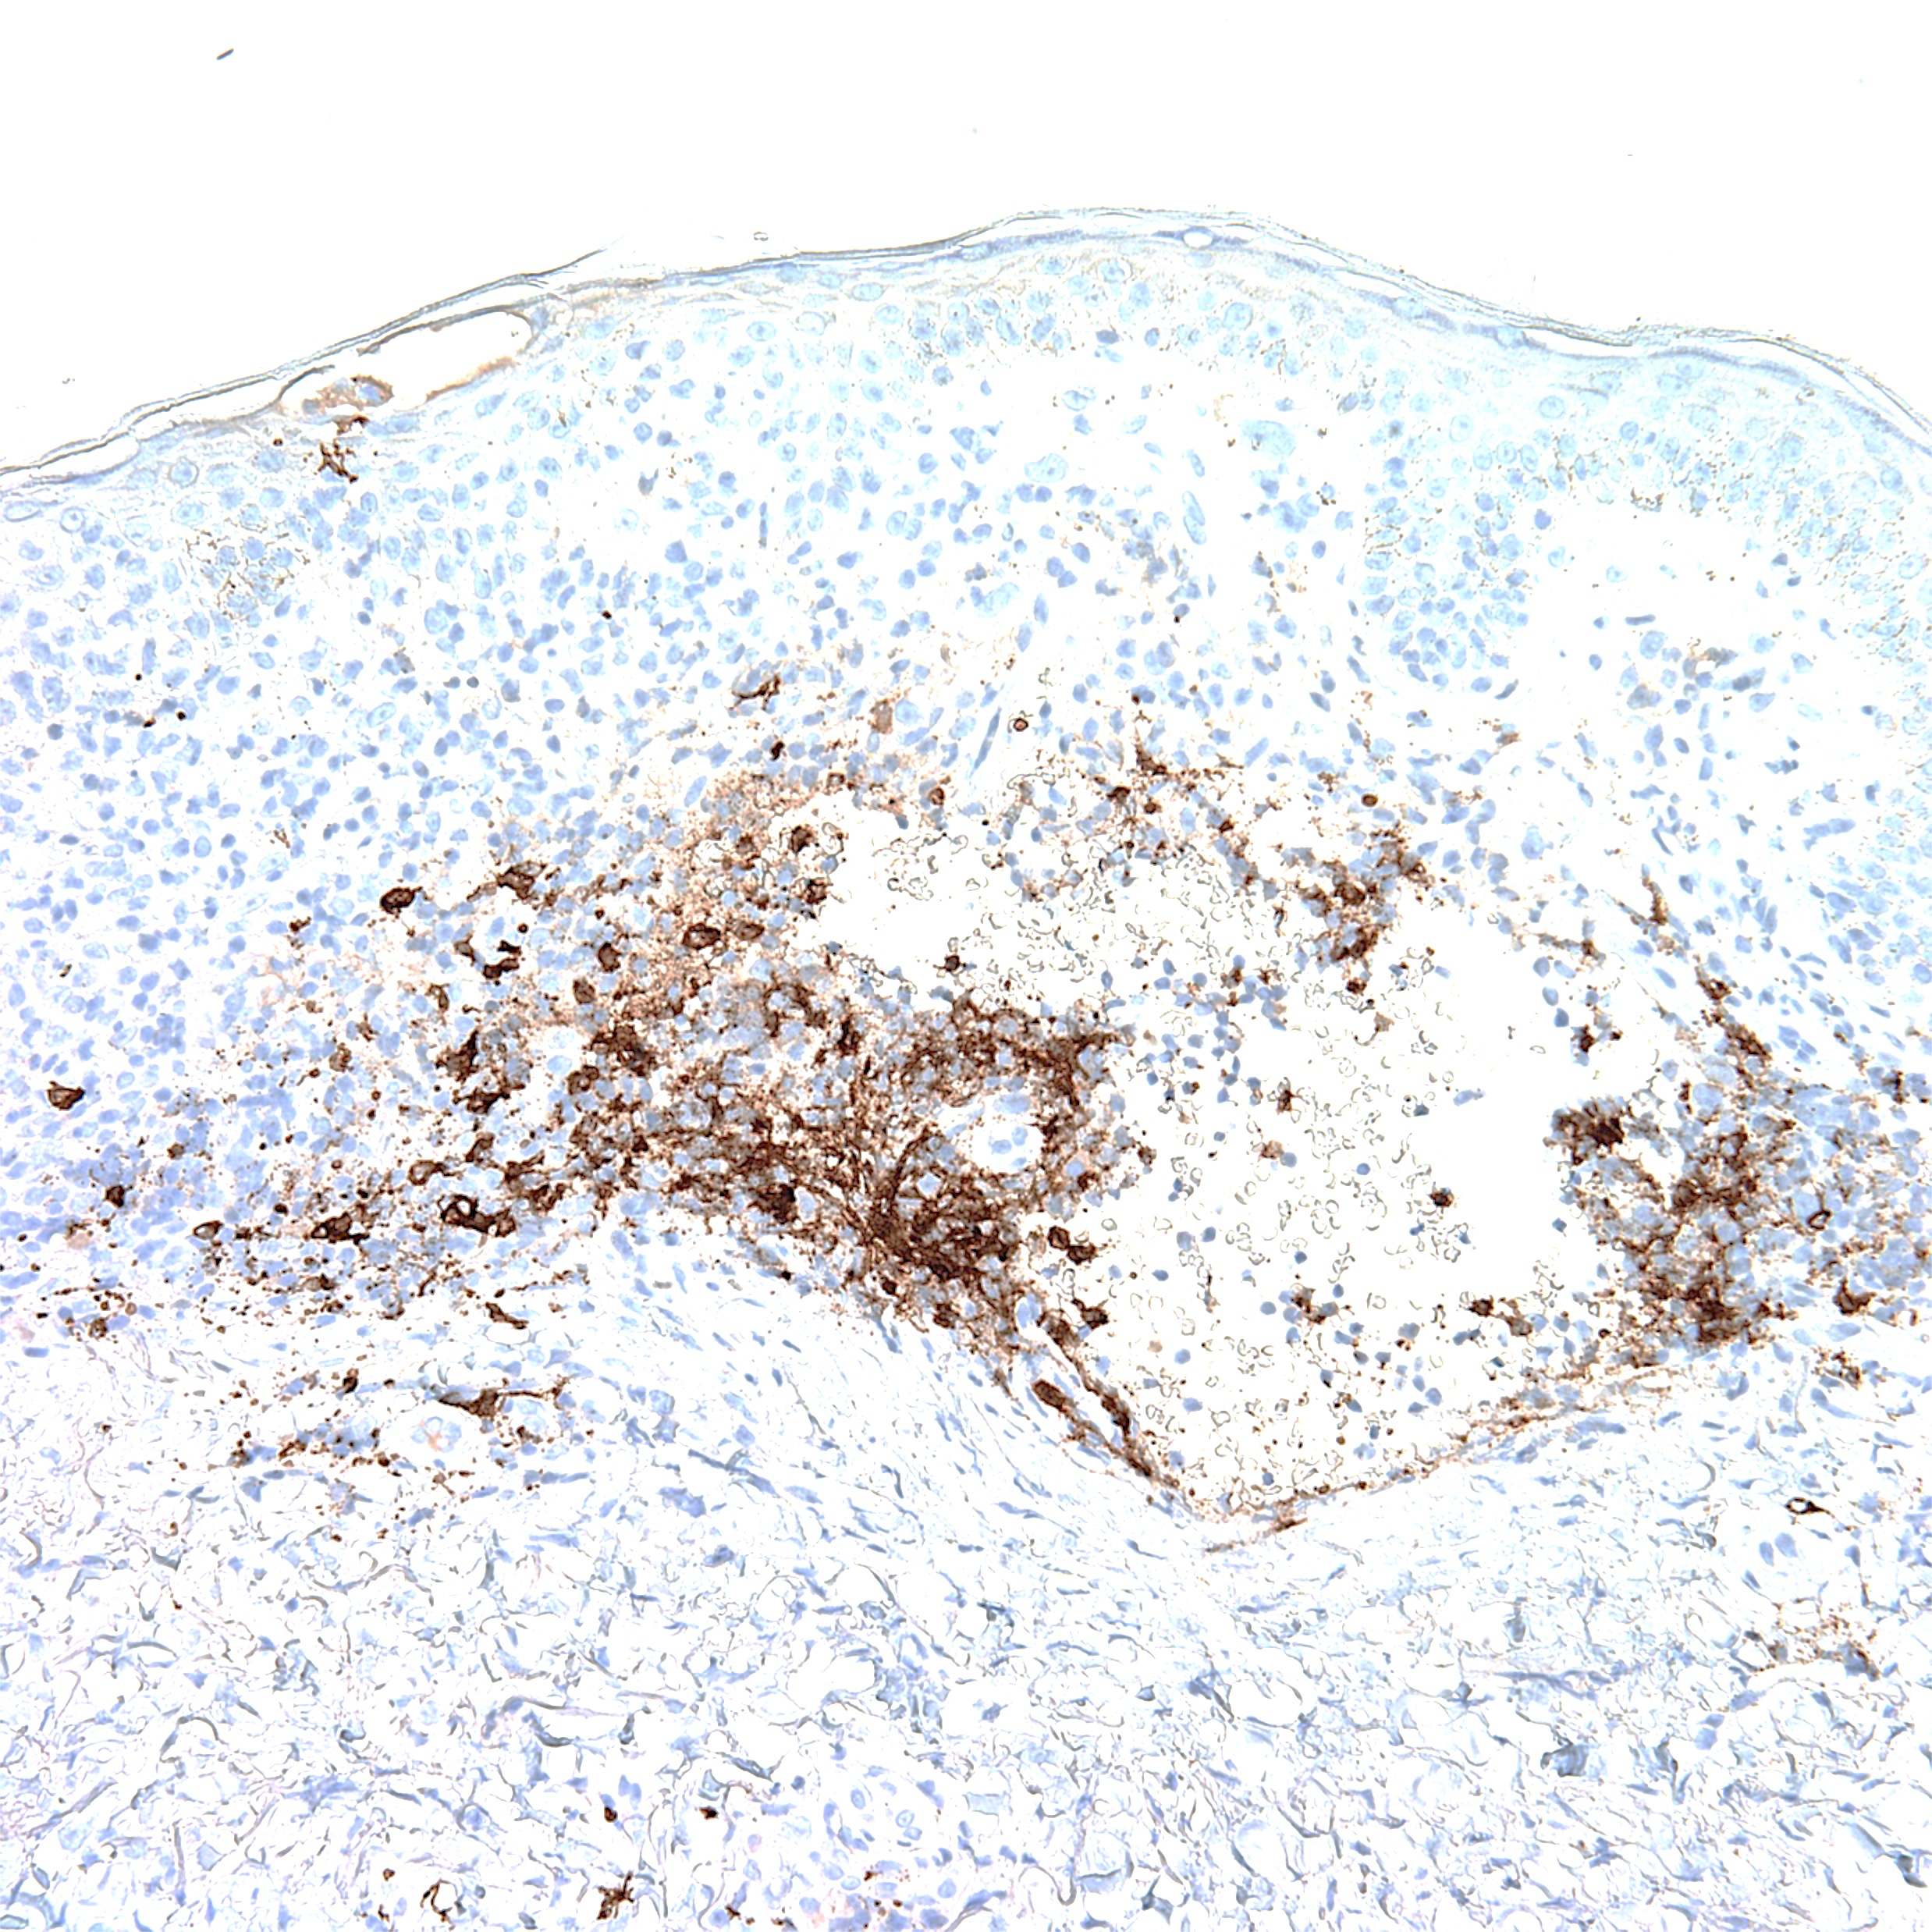
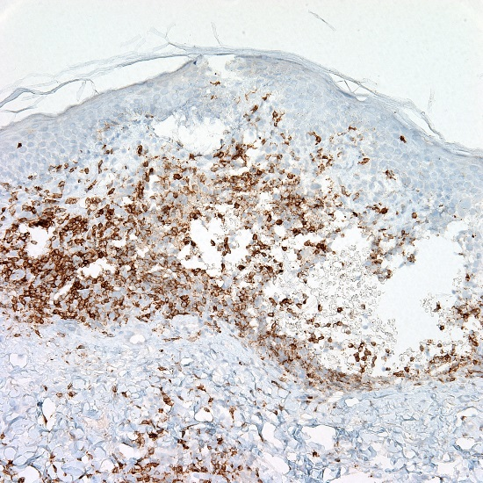
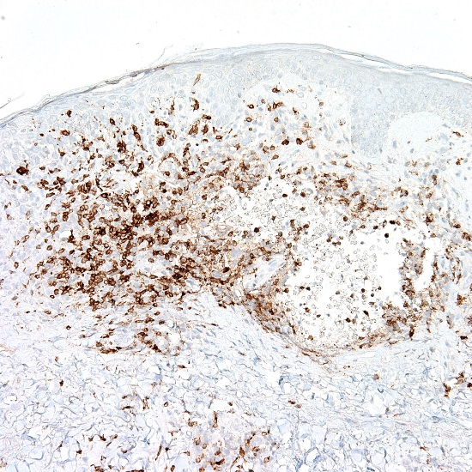
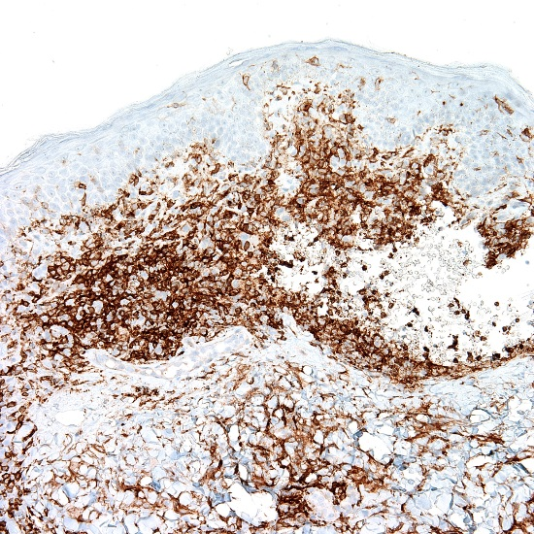
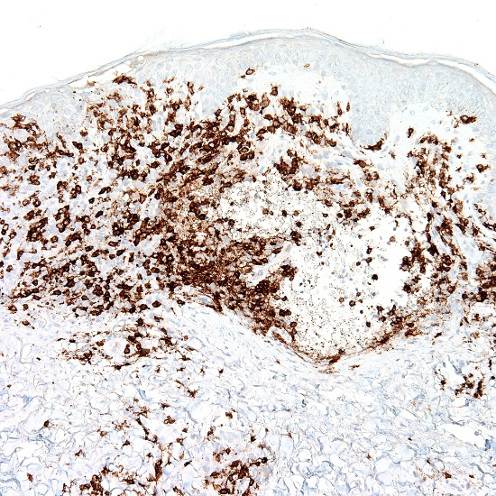
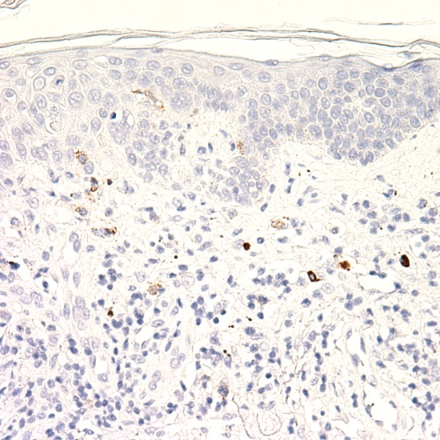
CD3
CD20
CD5
CD7
CD4
CD8
CD30
Notes:
These findings are consistent with cutaneous T-cell lymphoma
TCR positive
CD3 20 5 7 on top
CD4 and 8 and CD30 lower
T cells both 4 and 8 positive with normal ratio; CD7 lost expression in subset; TCR psotive in subest
Infiltrate is composed of mostly CD3+ T cells with a small subset of B cells
These T cells are preserved CD5 and 7
Appear positive for both CD4 and CD8; CD30 is negative
T cell gene rearrangement by PCR showed a clonal T cell population
The overall picture is consistent with mycosis fungoides
overall

Slide 16
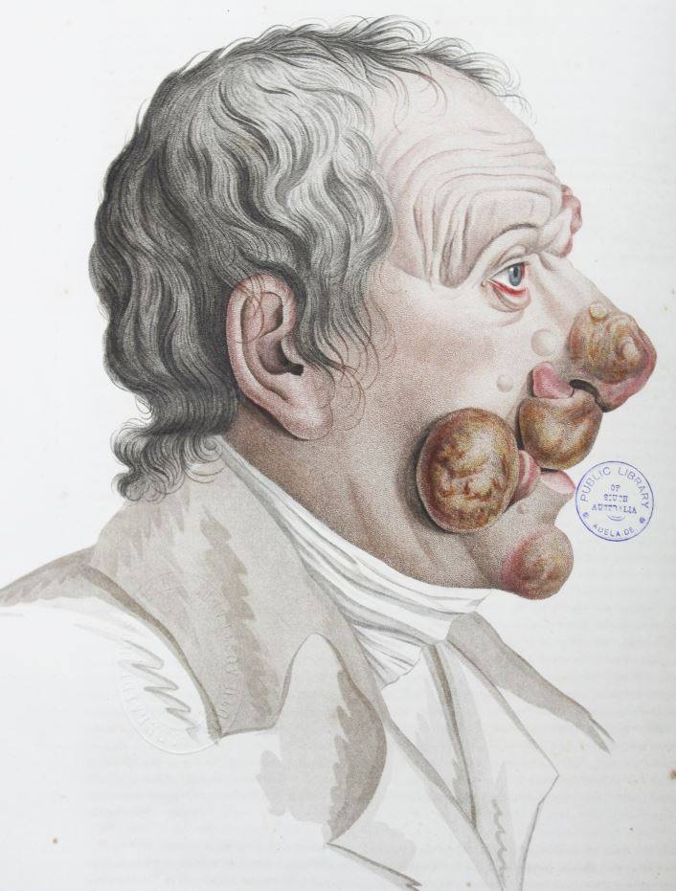
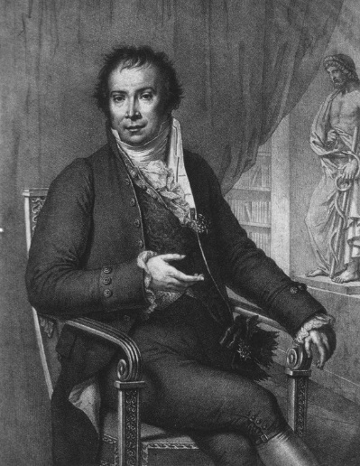
Mycosis Fungoides Disease Background
Mycosis Fungoides (MF) – “mushroom-like fungal disease”
Alibert: 1806
Primary cutaneous T-cell lymphoma characterized by
Epidermotropic T helper lymphocytes
Slow progression over years or decades with clinical course showing stepwise evolution of patches, plaques, and tumors in areas not exposed to the sun
Epidemiology
6/1,000,000 people per year
50% of all primary cutaneous lymphoma
Adults 5th-6th decades
Male:Female 2:1
Jean Louis Marc Alibert
Reference: Lorenzo Cerroni, Kevin Gatter, Kerl Helmut. Skin Lymphoma: The Illustrated Guide, 4th Edition; Wiley-Blackwell 2014
Notes:
** ADD citation;
Male predominance
It is estimated that over 90% of patients with early mycosis fungoides neither progress to tumor stage nor show extracutaneous manifestations of the disease
Incidence 6/million; represents 50% of all

Slide 17
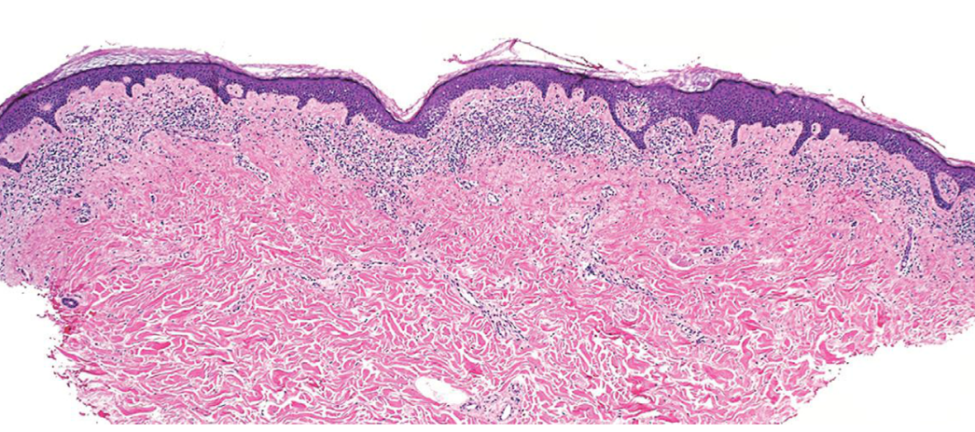
Mycosis Fungoides
Histopathologic Features
Epidermotropism
Notes:
Although other phenotypes are seen – as in our case
Cite: skin lymphoma book

Slide 18
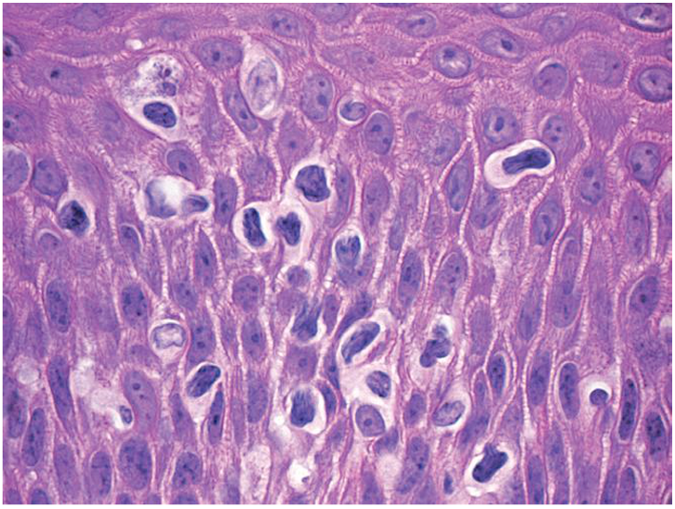
Mycosis Fungoides
Histopathologic Features
Epidermotropism
Small to medium sized lymphocytes (unless large cell transformation)
Cerebriform nuclear contours and hyperchromatic nuclei
Notes:
Although other phenotypes are seen – as in our case
Cite: skin lymphoma book

Slide 19
Mycosis Fungoides
Histopathologic Features
Epidermotropism
Small to medium sized lymphocytes (unless large cell transformation)
Cerebriform nuclear contours and hyperchromatic nuclei
Immunophenotype
CD3(+)
CD4(+), CD8 (– )
CD7(– )
CD2(+), CD5 (+/-)
Notes:
Although other phenotypes are seen – as in our case
Cite: skin lymphoma book

Slide 20
Cutaneous T Cell Lymphoma
Indolent Behavior
Mycosis fungoides
Mycosis fungoides variants and subtypes (folliculotropic mycosis fungoides, pagetoid reticulosis, granulomatous slack skin)
Primary cutaneous CD 30+ lymphoproliferative disorder (Primary cutaneous anaplastic large cell lymphoma, lymphomatoid papulosis)
Subcutaneous panniculitis-like T-cell lymphoma (provisional)
Primary cutaneous CD4+ small/medium sized pleomorphic T-cell lymphoma (provisional)

Slide 21
Cutaneous T Cell Lymphoma
Aggressive Behavior
Sezary Syndrome
Adult T-cell leukemia/lymphoma
Extranodal NK/T-cell lymphoma, nasal type
Primary Cutaneous peripheral T-cell lymphoma unspecified
Primary cutaneous aggressive epidermotropic CD 8+ T-cell lymphoma (provisional)
Cutaneous gamma/delta positive T-cell lymphoma (provisional)

Slide 22
Mycosis Fungoides
Three stages
Patch (atrophic or non atrophic): Nonspecific dermatitis, patches on lower trunk and buttocks; minimal/absent pruritis
Plaque: intensely pruritic plaques, lymphadenopathy
Tumor: prone to ulceration

Slide 23
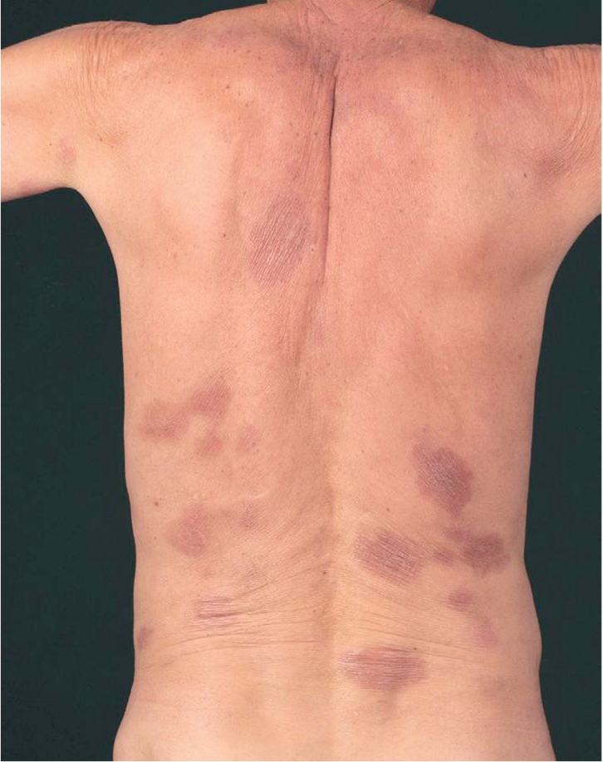
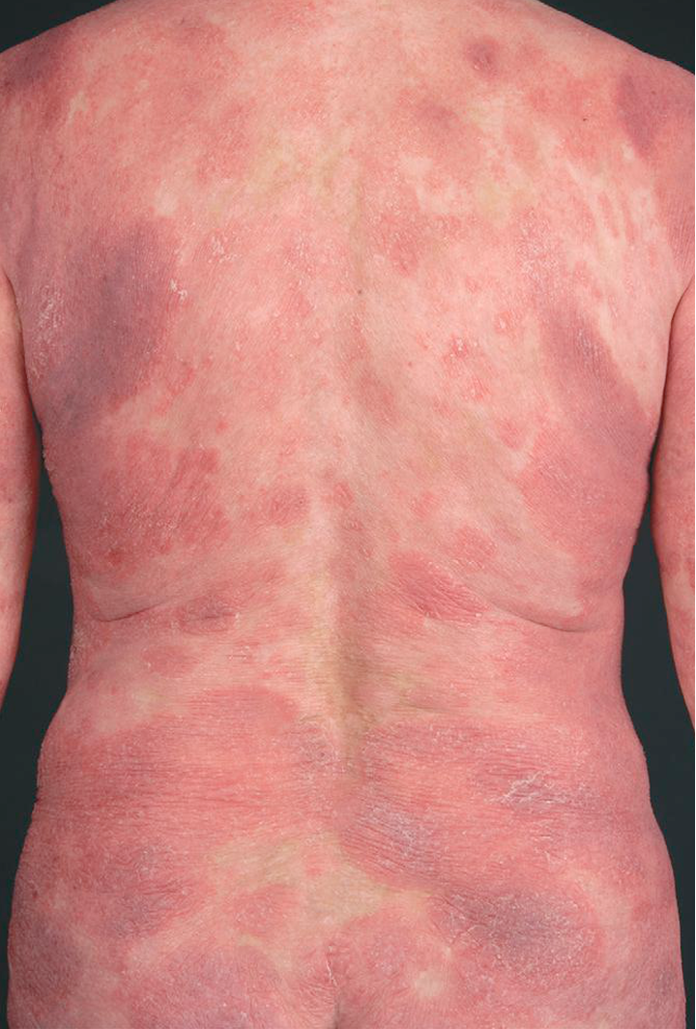
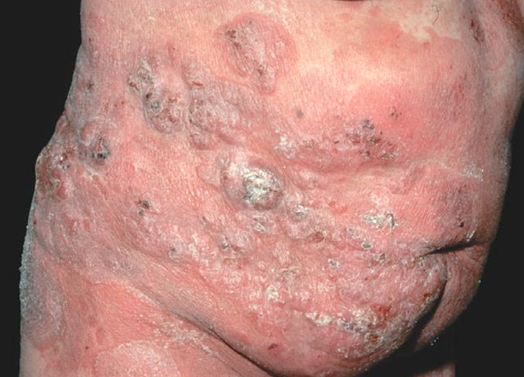
Tumor
Plaque
Patch
Reference: Lorenzo Cerroni, Kevin Gatter, Kerl Helmut. Skin Lymphoma: The Illustrated Guide, 4th Edition; Wiley-Blackwell 2014
Notes:
Patch – variably large, erythematous, finely scaling lesions – typical wrinkled apperance ‘parchment-like’; predilection for sun-protected areas
Plaque – infiltrated variably scaling, reddish-brown lesions
Tumors – solitary or more often localized or generalized; ulceration is common

Slide 24
Sezary Syndrome
Defined by erythroderma and leukemia. Signs and symptoms include:
Edematous skin
Lymphadenopathy
Palmar and/or plantar hyperkeratosis
Alopecia
Nail dystrophy
Ectropion
Hepatosplenomegaly may be present

Slide 25
Staging
Stage 1A: patchy or plaquelike skin disease involving < 10 % of skin surface area (T1 skin disease)
Stage 1B: Patch/plaquelike skin disease involving > or = 10% of the skin surface (T2 skin disease)
Stage IIB disease: Tumors are present (T3 skin lesions)
Stage III disease: generalized erythroderma is present
Stage IVA1 disease: erythroderma and significant blood involvement occur
Stage IVA2 disease: Lymph node biopsy result shows total effacement by atypical cells (LN4 node)
Stage IVB disease: Visceral involvement (eg liver, lung bone marrow occurs)

Slide 26
CD3
CD19
CD2
CD7
CD4
CD8
Notes:
Most cells are CD3+, CD7+, CD2+; many are CD19+, CD8 > CD4 consistent with T-cell lymphoma with large cell transformation
CD3+ and 2+ 7+
CD8>CD4;
Immunophenotype slightly different from original – immunotypic shift or a subset of the clone in vitreous; but has been reported esp
May represent progression of disease or subclonal

Slide 27
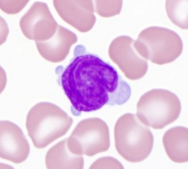
Flow cytometry
T-cell lymphoma expressing CD3, CD56, CD7 (bright), CD2, CD8 (subset) and negative for CD5 and CD4
The neoplasm seems to coexpress CD19 and kappa light chain and contains large lymphoid cells
T-cell PCR results: Positive for monoclonal T cell population
B-cell PCR results: Negative for B cell clonality; A polyclonal background of B cells is not detected indicating lack of B cells in the sample
Positive | Negative
CD2 CD3 CD7 CD8 CD19 Kappa light chain | CD4 CD5
Notes:
Flow cytometry TCR+
3 19 T and B together; 2 and 7 and then 4 and 8

Slide 28
CD3
CD19
CD2
CD7
Typical Immunophenotype | Patient Skin Biopsy 6/2016 | Patient Skin Biopsy 10/2017 | Patient Vitreous
CD3 (+) CD4 (+) CD8 (-) CD7 (-) CD2 (+) | CD3 (+) CD4:CD8 8:1 CD7 (+) CD2 (+) CD19 (-) | CD3 (+) CD4:CD8 2:1 CD7 (+) CD2 (+) | CD3 (+) CD4 (-) CD8 (+) CD7 (+) CD2 (+) CD19 (+)
CD4
CD8
Notes:
MF typically an infiltrate of T-helper lymphocytes; minority are T-cytotoxic
Most cells are CD3+, CD7+, CD2+; many are CD19+, CD8 > CD4 consistent with T-cell lymphoma with large cell transformation
CD3+ and 2+ 7+
CD8>CD4;
Immunophenotype slightly different from original – immunotypic shift or a subset of the clone in vitreous; but has been reported esp
May represent progression of disease or subclonal

Slide 29
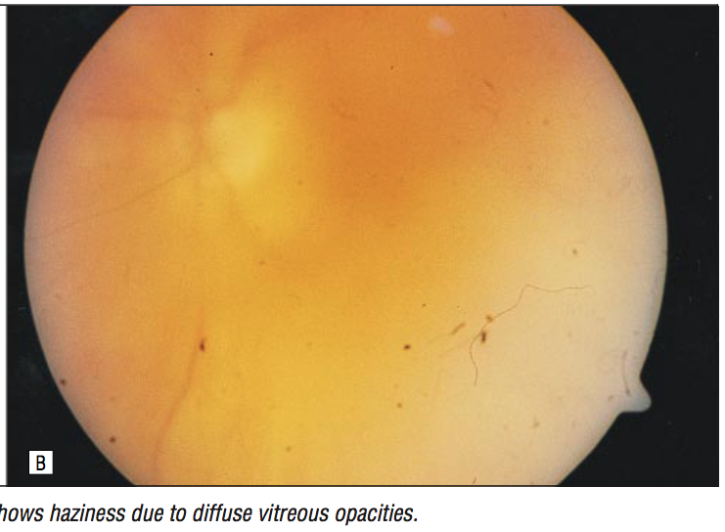
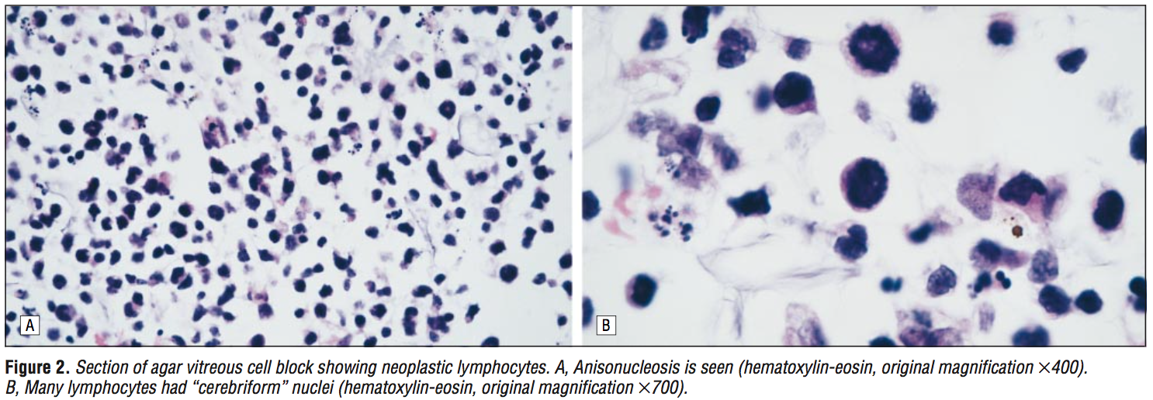
82-year-old male with 7 year history of MF
Decreased vision OS with dense vitreous opacities
Vitreous biopsy: CD3+ cells with CD4/CD8 ratio 1:4 (original skin biopsy was 5:1)
External beam radiotherapy scheduled but patient died soon after
CD8 positivity and immunophenotypic shift in skin biopsies appears to be associated with more aggressive disease
Notes:
1977

Slide 30
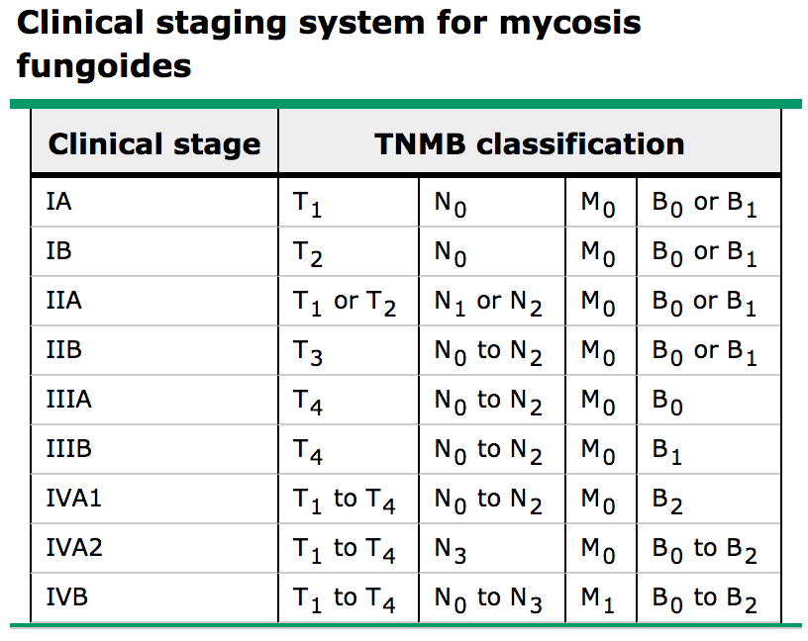
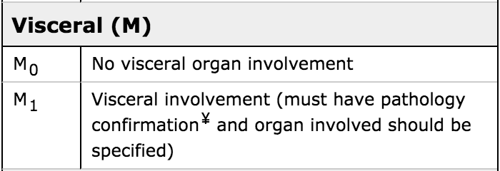
Diagnosis
Cutaneous T-cell lymphoma (mycosis fungoides) with intraocular involvement by T-cell lymphoma
Stage IVB
Based on extracutaneous disease involving visceral organ

Slide 31
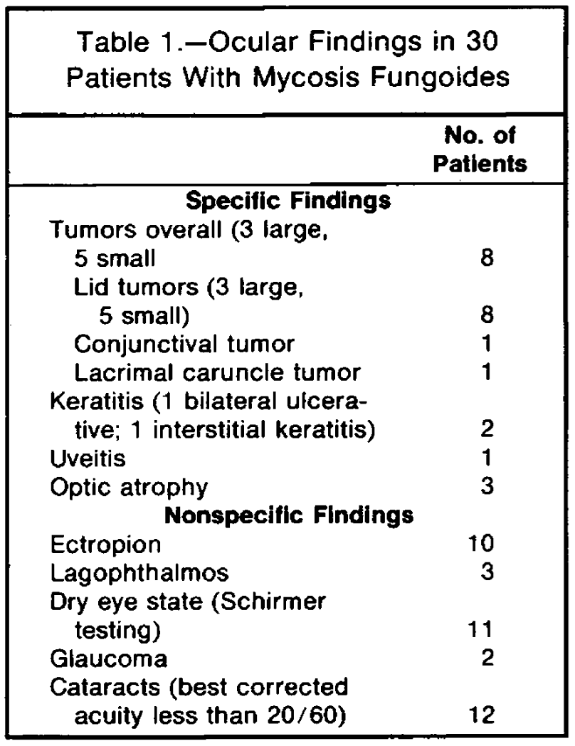
Largest series of patients with MF reported in ophthalmic literature
11 of 30 consecutive patients with MF had ocular findings related to MF
Notes:
**Add photo of first patient

Slide 32
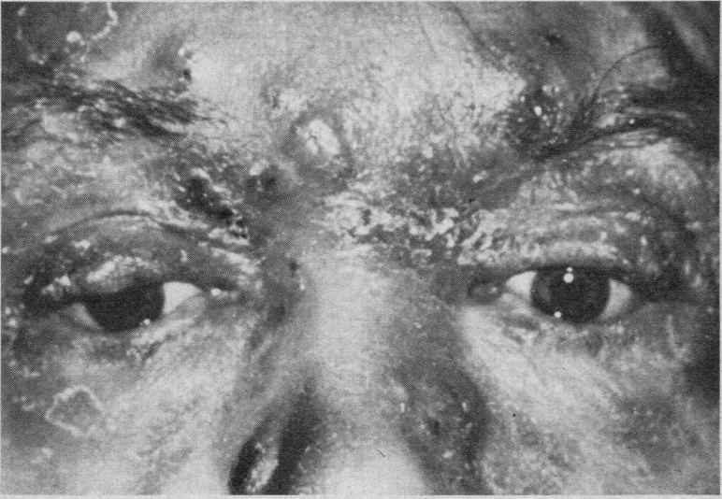
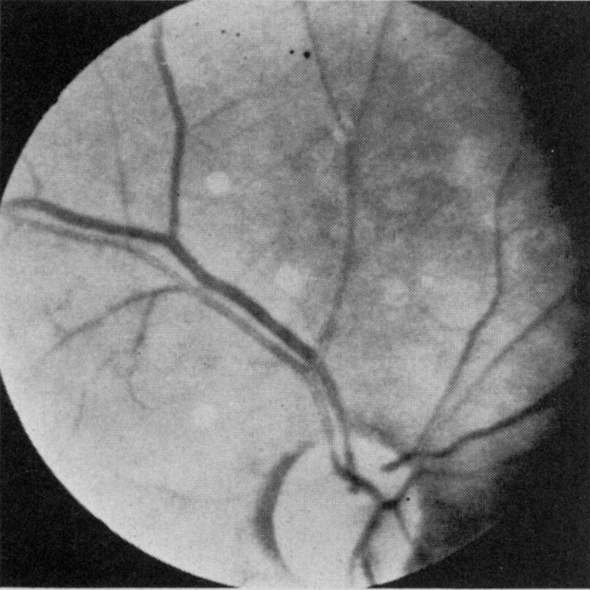
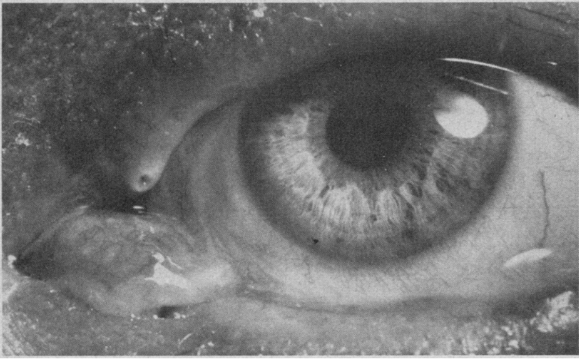
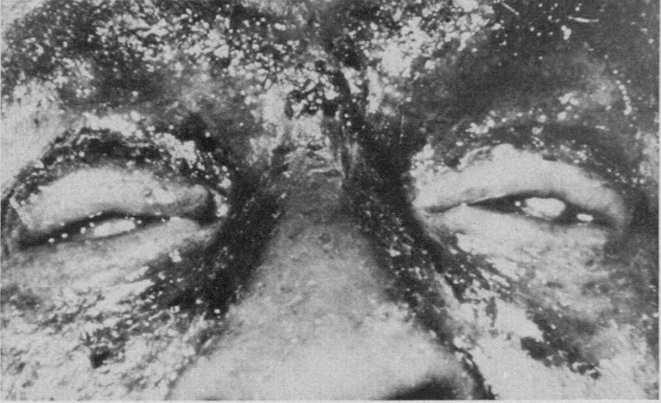
Notes:
**Add photo of first patient

Slide 33
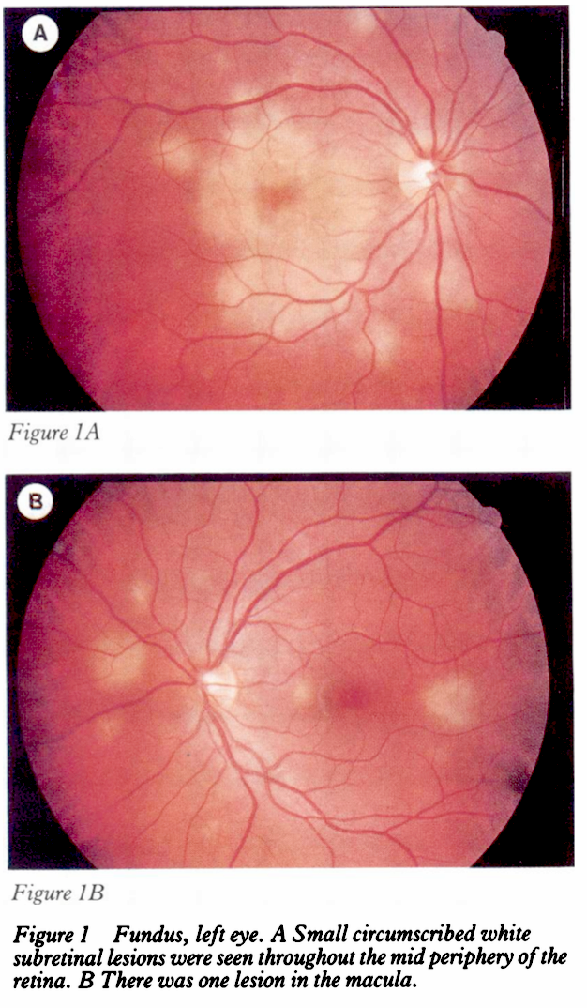
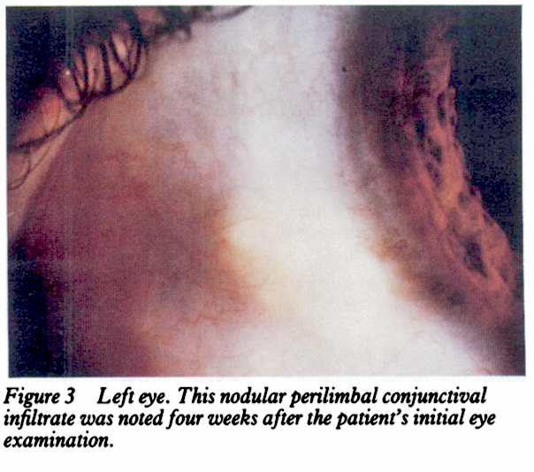
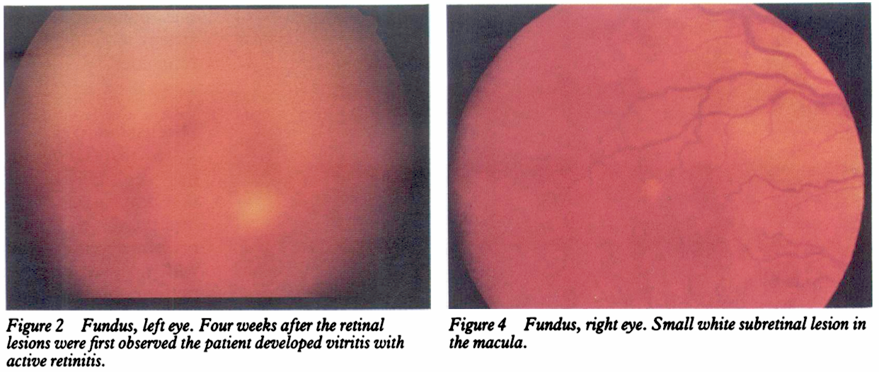
48-year-old male with mycosis fungoides x30 years presenting with blurry vision OS
Bilateral disc swelling (resolved), white subretinal lesions and vitritis
Perilimbal nodule
Histopathology – malignant T cell infiltrates consistent with MF in retina, vitreous and between RPE and Bruch’s membrane
Patient died 2 months after presentation from widespread lymphoma
Notes:
1977 - Erny et al. reported on the clinical and histopathologic findings in a 48-year-old man with vitritis and subretinal lesions that proved to be malignant T-cell infiltrates in the retina and the vitreous and between the RPE and Bruch's membrane.

Slide 34
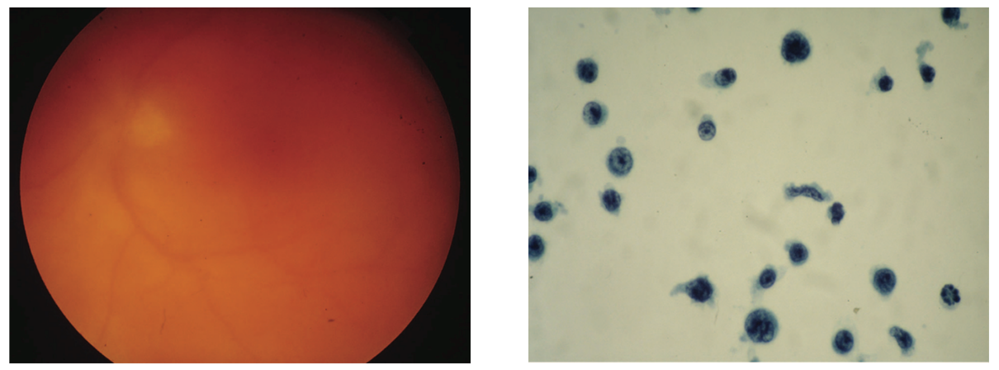
52-year-old male with 1.5 year history of MF – treated
Progressive loss of vision OS with floaters and flashes
Bilateral keratic precipitates OS>OD
Dense vitreous haze OS, mild vitritis OD
Treated with radiation to eye → CNS metastasis – died 5 months after ocular findings
Notes:
Recurrent MF can present

Slide 35
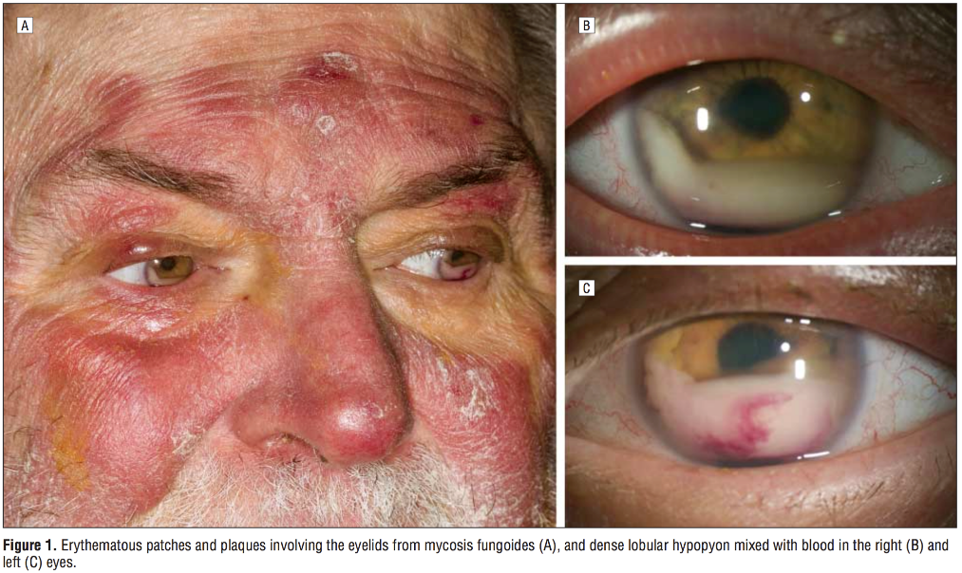
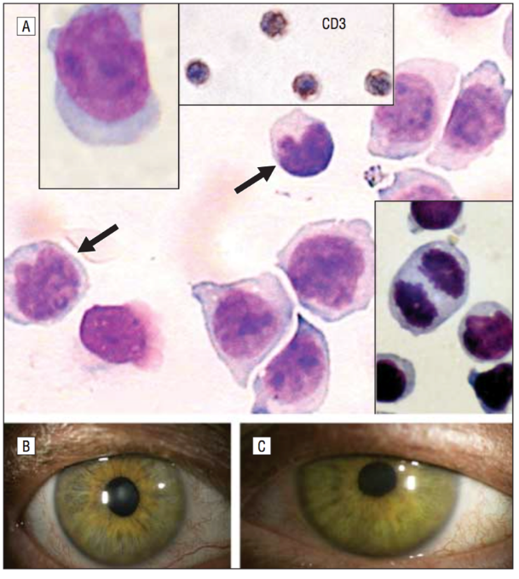
68-year-old with worsening vision
Dense, bilateral, lobular-appearing hypopyon with admixure of blood was present in each eye
Treated with external beam irradiation with complete resolution of hypopyon on day 10 of therapy

Slide 36
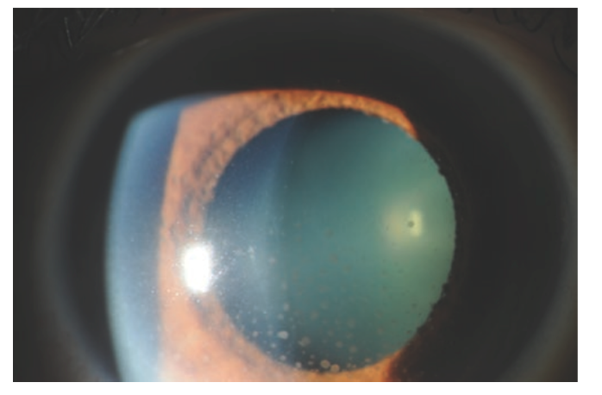
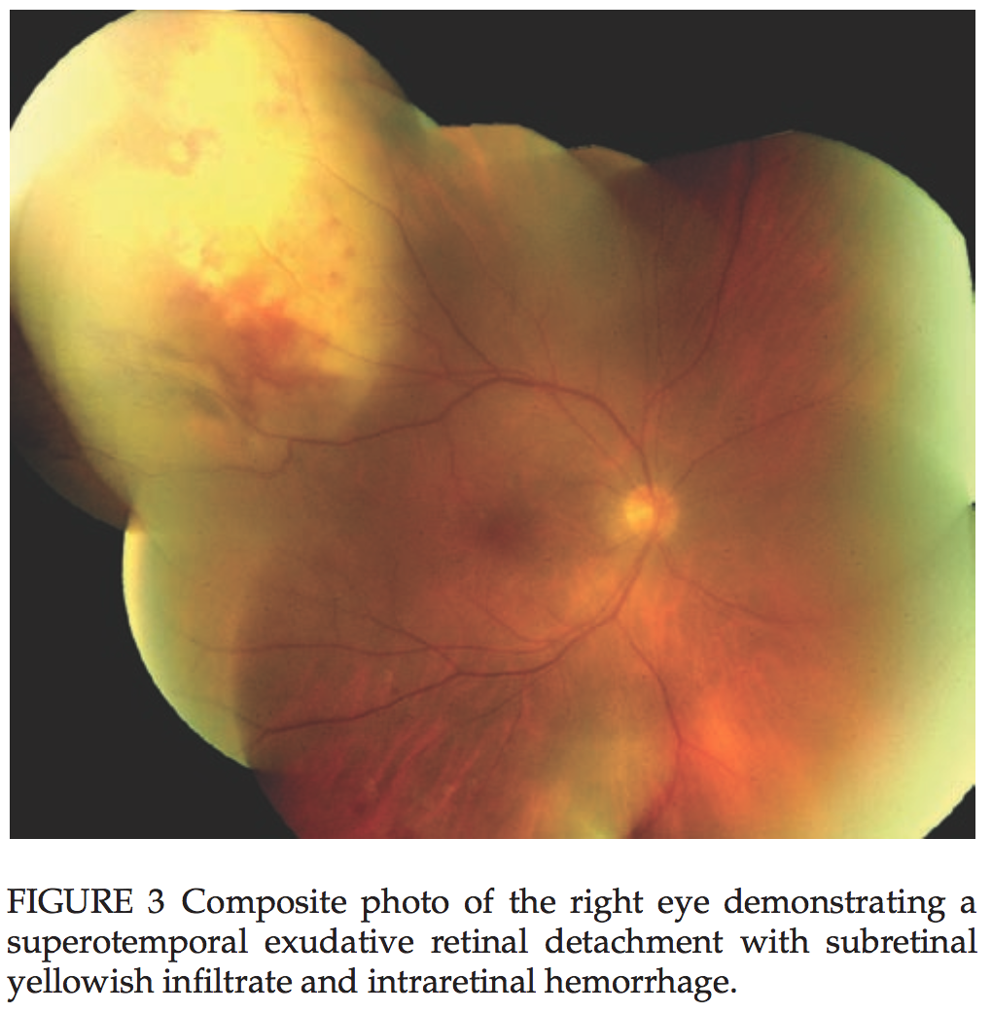
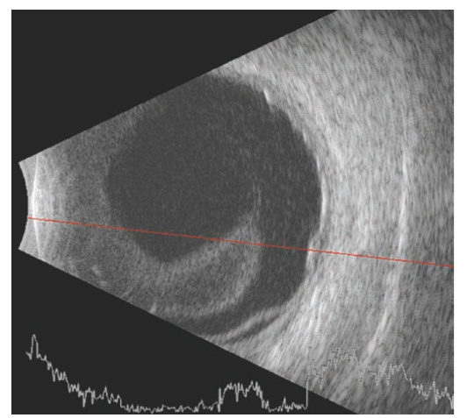
58-year-old female with decreased vision and anterior uveitis OD
5 year history of MF
CD3+, CD7+, CD8+, CD19+
Anterior uveitis, eventually developing a subretinal infiltrate
Notes:
2011 – Add citation

Slide 37
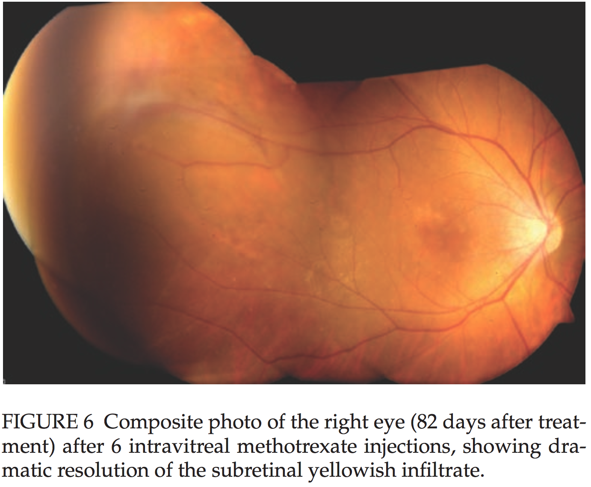
Notes:
Intravitreal MTX (400 up/0.1ml) administered weekly x1 month, and then every 2 weeks, and monthly to prevent reucrrence.

Slide 38
Treatment
Intravitreal chemotherapy
Methotrexate 400mcg/0.1mL
External beam radiotheraphy (EBRT)
Bilateral cases
Systemic Chemotherapy
Systemic disease, CNS involvement
Notes:
See Coupland paper how we dx and treat

Slide 39
Clinical Course
Five weeks after initial presentation: progressive physical weakness, difficulty with balance, swallowing and memory
Lumbar puncture showed CSF positive for atypical lymphoid cells c/w T cell lymphoma
Brain MRI: three lesions in the left frontal and lleft superior temporal lobe were noted
Patient underwent external beam radiation to bilateral orbits of 30 Gy in 10 fractions
Intrathecal methotrexate and cytarabine, systemic methotrexate and procarbamazine (DeAngelis protocol)
Patient died three months after initial presentation of symptoms

Slide 40
Summary
Mycosis fungoides with vitreous involvement is rare
Variable clinical presentation including vitritis, panuveitis, chorioretinal lesions, optic nerve infiltration and anterior chamber involvement
Patients respond well to radiation or intravitreal methotrexate
Prognosis is poor after intraocular involvement
Large cell transformation with immunophenotype shift

Slide 41
Acknowledgements
Dr. Xiao Zhou
Dr. Eduardo Uchiyama
Dr. J. William Harbour
Dr. James Lin
Dr. Pedro Monsalve
Notes:
Show clinical and histological findings; not common

Slide 44
References
Coupland SE, Bechrakis NE, Anastassiou G, Foerster AM, Heiligenhaus A, Pleyer U, Hummel M, Stein H. Evaluation of vitrectomy specimens and chorioretinalbiopsies in the diagnosis of primary intraocular lymphoma in patients withMasquerade syndrome. Graefes Arch Clin Exp Ophthalmol. 2003 Oct;241(10):860-70. 1.
Sagoo MS, Mehta H, Swampillai AJ, Cohen VM, Amin SZ, Plowman PN, Lightman S. Primary intraocular lymphoma. Surv Ophthalmol. 2014 Sep-Oct;59(5):503-16.
Sen HN, Bodaghi B, Le Hoang P, Nussenblatt R. Primary Intraocular Lymphoma: Diagnosis and Differential Diagnosis. Ocular immunology and inflammation. 2009;17(3):133-141.
Coupland SE, Damato B. Understanding intraocular lymphomas. Clin Exp Ophthalmol. 2008 Aug;36(6):564-78.
Karamanou, Marianna et al, ‘Baron Jean-Louis Alibert (1768-1837) and the first description of mycosis fungoides’, JBOUN, vol. 19, no. 2, 2014, accessed online https://www.jbuon.com/pdfs/585-588.pdf
Levy-Clarke GA, Greenman D, Sieving PC, Byrnes G, Shen D, Nussenblatt R, Chan CC. Ophthalmic manifestations, cytology, immunohistochemistry, and molecular analysis of intraocular metastatic T-cell lymphoma: report of a case and review of the literature. Surv Ophthalmol.
Aronow ME, Portell CA, Sweetenham JW, Singh AD. Uveal lymphoma: clinical features, diagnostic studies, treatment selection, and outcomes. Ophthalmology. 2014 Jan;121(1):334-41.
Lorenzo Cerroni, Kevin Gatter, Kerl Helmut. Skin Lymphoma: The Illustrated Guide, 4th Edition; Wiley-Blackwell 2014.
Stenson S, Ramsay DL. Ocular findings in mycosis fungoides. Arch Ophthalmol.1981 Feb;99(2):272-7.
FOERSTER HC. Mycosis fungoides with intraocular involvement. Trans Am AcadOphthalmol Otolaryngol. 1960 May-Jun;64:308-13.
Keltner JL, Fritsch E, Cykiert RC, Albert DM. Mycosis fungoides. Intraocularand central nervous system involvement. Arch Ophthalmol. 1977 Apr;95(4):645-50.
Erny BC, Egbert PR, Peat IM, Shorrock K, Rosenthal AR. Intraocular involvementwith subretinal pigment epithelium infiltrates by mycosis fungoides. Br JOphthalmol. 1991 Nov;75(11):698-701.
Leitch RJ, Rennie IG, Parsons MA. Ocular involvement in mycosis fungoides. Br J Ophthalmol. 1993 Feb;77(2):126-7.
Lois N, Hiscott PS, Nash J, Wong D. Immunophenotypic shift in a case ofmycosis fungoides with vitreous invasion. Arch Ophthalmol. 2000Dec;118(12):1692-4.
Ralli M, Goldman JW, Lee E, Pinter-Brown LC, Glasgow BJ, Sarraf D. Intraocularinvolvement of mycosis fungoides. Arch Ophthalmol. 2009 Mar;127(3):343-5.
Wan MJ, Sheidow TG, Jones GW, Heathcote JG. Vitritis as the initialmanifestation of recurrent mycosis fungoides. Retin Cases Brief Rep. 2009Summer;3(3):240-2.
Reddy R, Kim SJ. Intraocular T-cell lymphoma due to mycosis fungoides andresponse to intravitreal methotrexate. Ocul Immunol Inflamm. 2011Aug;19(4):234-6.
Jusufbegovic D, Char DH. Clinical variability of ocular involvement in mycosisfungoides. JAMA Ophthalmol. 2015 Mar;133(3):341-3.
Braue JA, Daniels AB, Zwerner JP, Kim SJ, Zic JA. Intraocular involvement ofmycosis fungoides associated with immunophenotypic switch from CD4+ to CD8.Blood. 2018 Jan 3.

