Slide 1
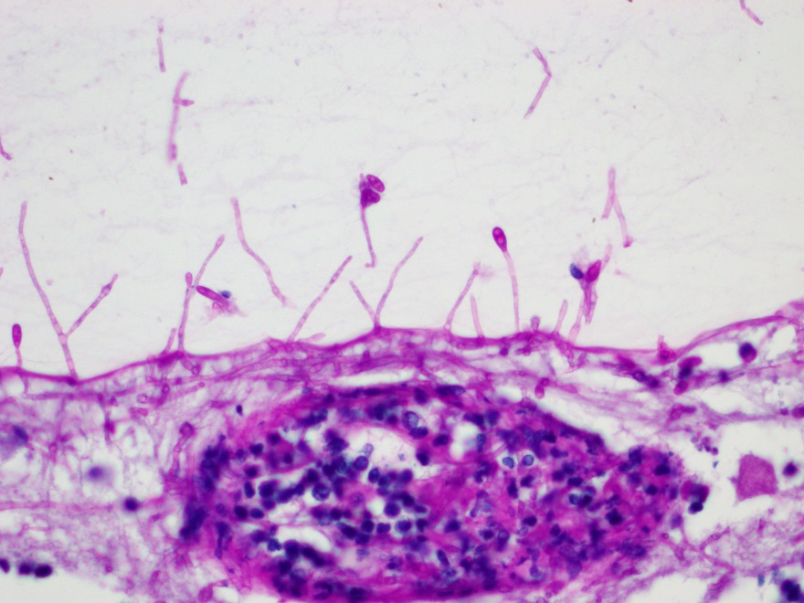
Fungus Attacks!
EOPS 2018, Washington DC
Charles G. Eberhart M.D., Ph.D.
Johns Hopkins University

Slide 2
Clinical History
The patient was a 43 year-old female with a past medical history significant for monocytic acute myeloid leukemia (AML) with FLT3 ITD mutation.
She was first diagnosed with AML in July 2017, and subsequently had refractory disease despite multiple treatment protocols.
An ophthalmic exam performed in February 2018 was normal aside from some vitreous floaters.

Slide 3
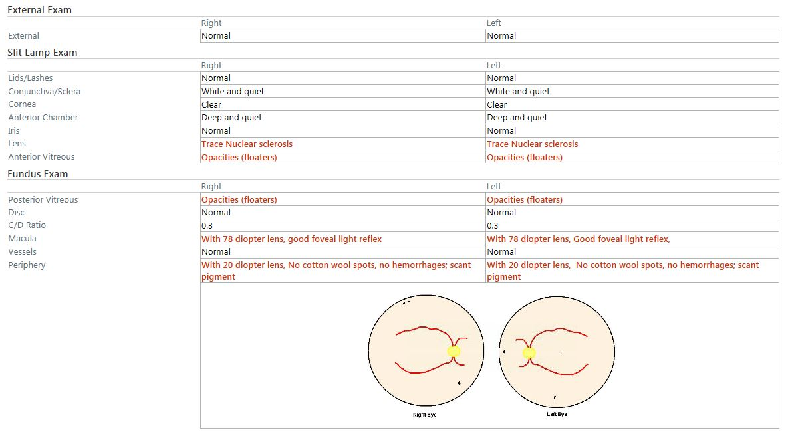

Slide 4
Pathology Report
BONE MARROW (BIOPSY AND ASPIRATE): PERSISTENT ACUTE MYELOID LEUKEMIA
MICROSCOPIC DESCRIPTION: The marrow is hypercellular (70-80%). The myeloid:erythroid ratio is markedly increased. The myeloid lineage demonstrates a pronounced left shift with sheets of immature cells and
rare maturing granulocytes. The erythroid lineage is markedly hypoplastic with few scattered erythroid lineage cells. Megakaryocytes are decreased in number, and are small with hypolobated and hyperchromatic nuclei.

Slide 5
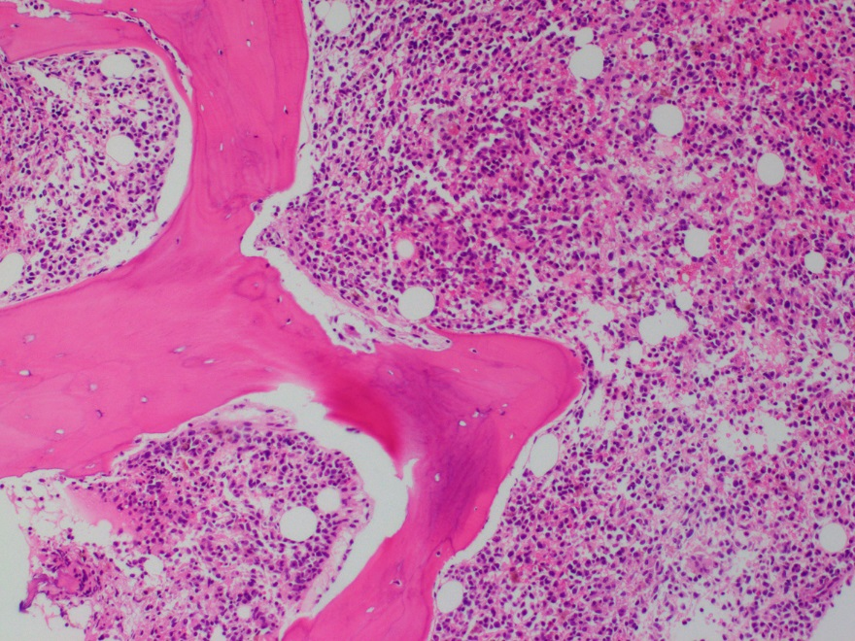

Slide 6
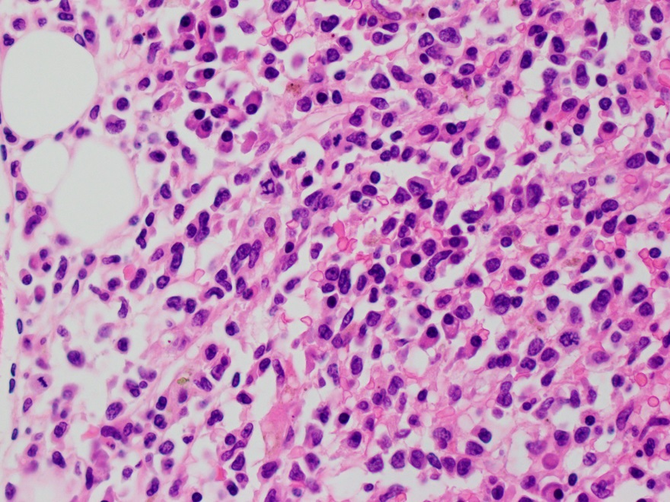

Slide 7
Clinical History
In early May 2018, she was found to have a right frontal lobe brain mass and CNS involvement of her leukemia.
She was treated with multiple courses of intrathecal chemotherapy, antibiotics, and antifungal therapy.
Her brain mass progressed, despite treatment, and was concerning for an invasive fungal infection.
Blood cultures grew out Scedosporium prolificans (formerly known as Lomentospora prolificans).
She was transitioned to comfort care and died in late May 2018.

Slide 8
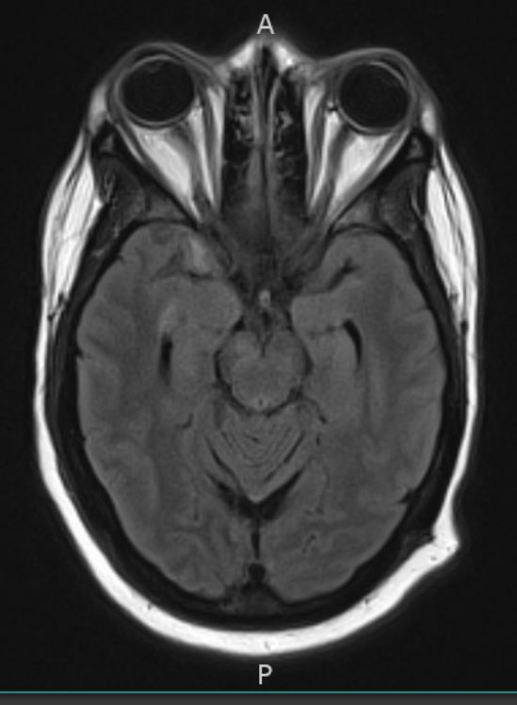
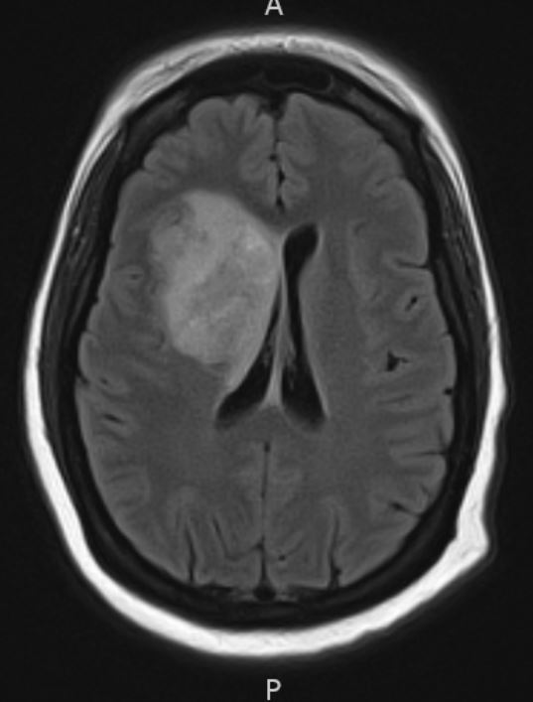
Imaging
T2 Flair

Slide 9
Autopsy Findings
Autopsy demonstrated systemic invasive fungal infection, involving the brain, heart, stomach, thyroid, and kidney.
The fungal hyphae were septate, with acute angle branching, and on a morphological basis were consistent with the ante mortem culture of Scedosporium
Multiple hemorrhages and infarctions were noted in the cerebral hemispheres, cerebellum, and brainstem secondary to invasive fungal infection.
The patient's acute myeloid leukemia was identified in the brain, eye, breast, kidney, and possibly spleen, with persistent disease present in the bone marrow.

Slide 10
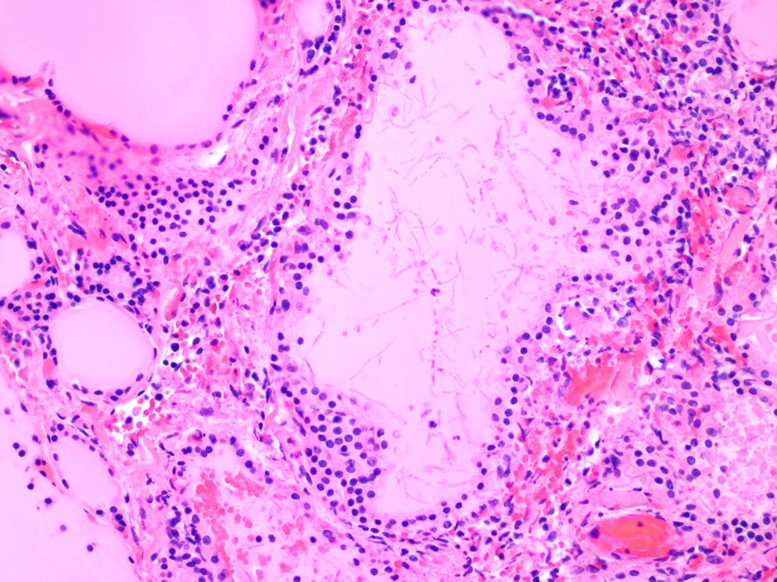
Thyroid

Slide 11
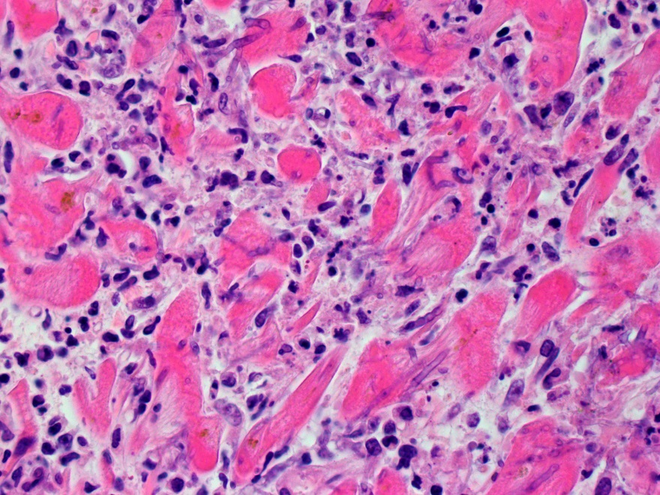
Heart

Slide 12
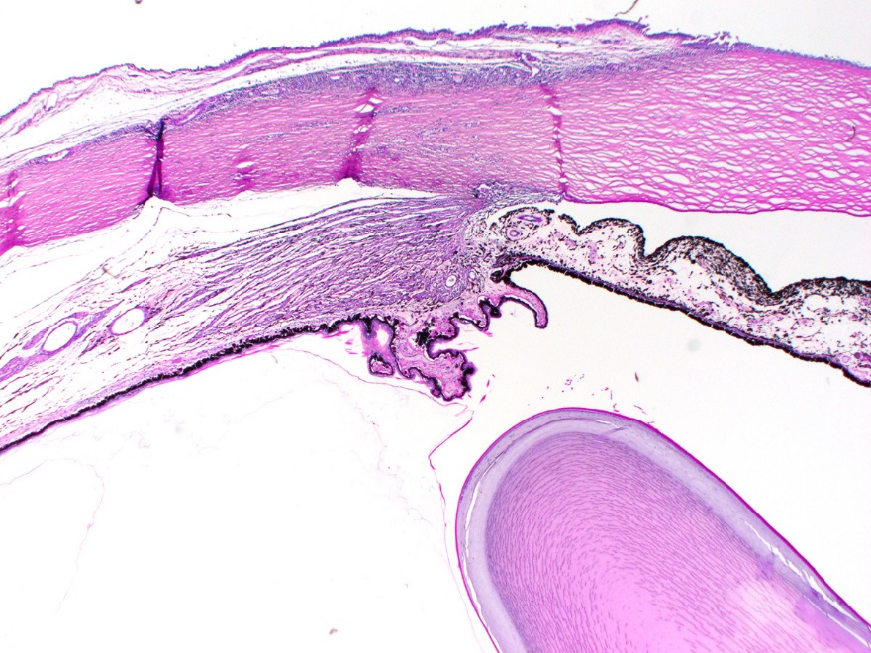

Slide 14
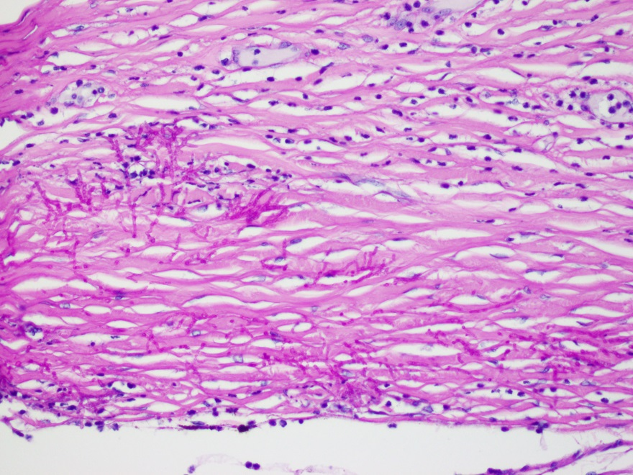

Slide 15
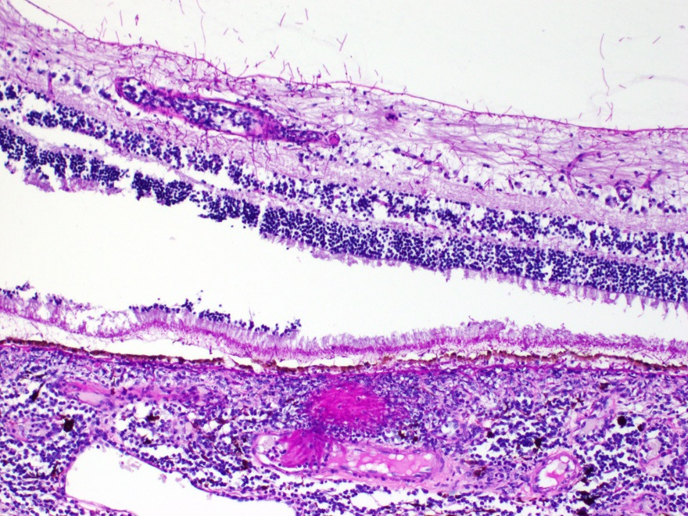

Slide 16
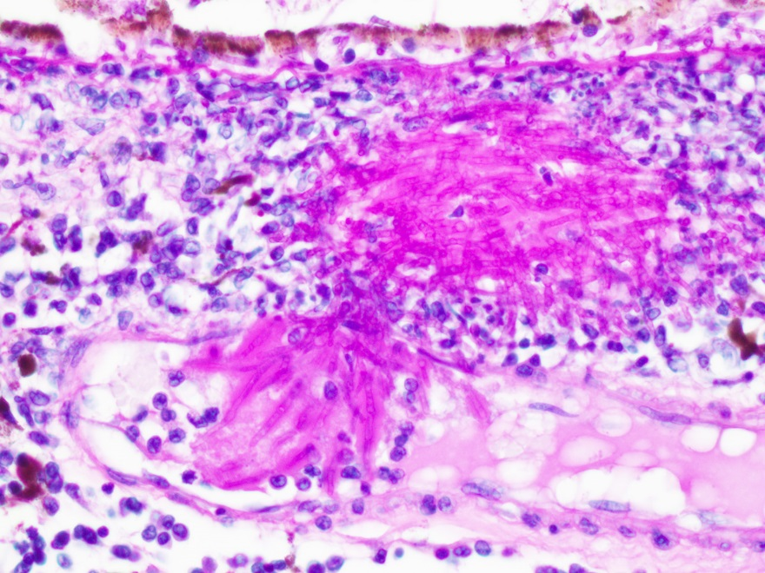

Slide 17
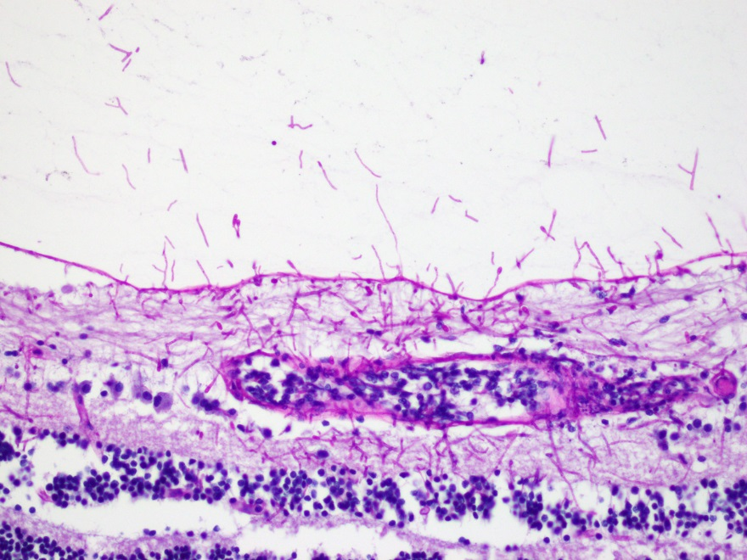

Slide 19
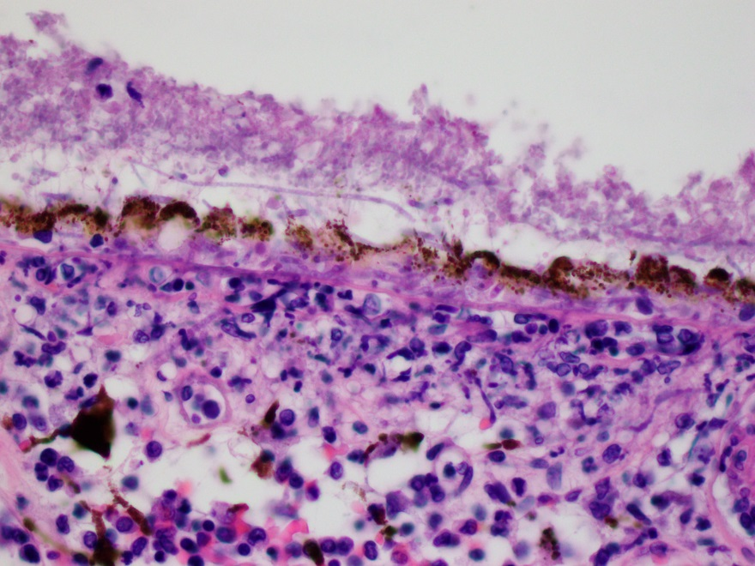

Slide 20
Scedosporium
Ubiquitous filamentous fungi present in soil, sewage, and polluted waters
The genus Scedosporium contains two medically important species:
  S. apiospermum (and its sexual state Pseudallescheria boydii)
  S. prolificans
Can colonize soft tissues, damaged lungs or disseminate hematogenously

Slide 21
Scedosporium prolificans
Scedosporium prolificans was originally named Lomentospora prolificans in 1974. It was transferred to the genus Scedosporium in 1991.
Subcutaneous infections occur following traumatic implantation.
Immune impairment is associated with systemic infection.
It is resistant to most antifungal drugs and infections are often fatal.

Slide 22
Conidiophore
Conidia

Slide 25
Day 8
6 Years

Slide 30
Of 1,792 culture proven keratitis cases, 10 (0.6%) were Scedosporium.
Trauma history in 8/10 cases
Topical natamycin treatment was often successful when started early

Slide 31
Scedosporum apiospermum

Slide 32
Thank You

