Slide 1
Eastern Ophthalmic Pathology Society: Ciliary-choroidal Mass in 52 yo Female
Washington, DC September 2018
Susan G Elner, MD
Victor M Elner, MD, PhD
Hakan Demirci, MD

Slide 2
History of Present Illness
52 year old woman referred for uveitis OD
Initial symptoms: Blurred VA/partial scotoma in superior field OD 6 mo prior
Diagnosed by outside ophthalmologist with anterior uveitis OD
Treated with topical steroids w/o improvement in symptoms
Subsequent intravitreal kenalog OD – improved VA temporarily
Past medical history
Psoriasis – affecting ear canals
Per patient, prior labs and CXR negative
Negative ROS
Family history - uterine and breast cancer (paternal grandmother), lung cancer (paternal grandfather), GI cancer (maternal grandfather)
Past ocular history
Cataracts OU
H/o radial keratotomy OU

Slide 3
Examination on Presentation
 | OD | OS
VAcc | 20/40 | 20/25
IOP | 17 mmHg | 14 mmHg
 | OD | OS
L/L | WNL | WNL
C/S | Faint injection | White and quiet
K | RK scars, no KP | RK scars, no KP
A/C | Deep, very rare cell, mild flare | Deep and quiet
Iris | Pharmacologically dilated | Pharmacologically dilated
Lens | Trace NS | Trace NS

Slide 5
Notes:
ERM with surface wrinkling of retina. Submacular fluid with extension inferiorly and temporally. Nodularity of choroid with loss of choroidal vascular pattern.

Slide 6
00:21
01:29
02:19
Notes:
Normal transit phase. Normal retinal vasculature without leakage. Multiple areas of dilated vessels in far inferotemporal periphery with late fluorescein leakage. No leakage within macula.

Slide 7
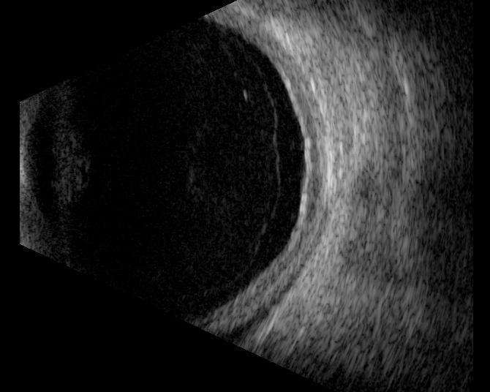
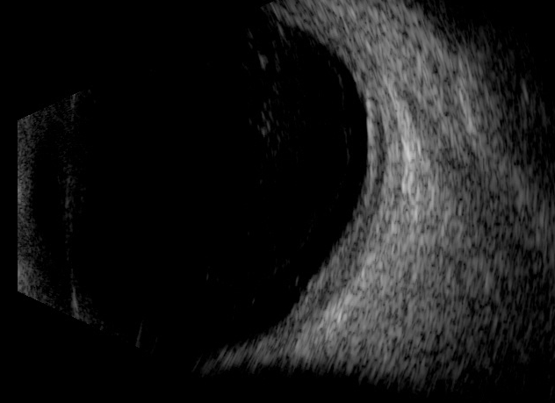
9EP
L8
Notes:
Moderately dense vitreous opacities. 2. Total posterior vitreous detachment with subhyaloid opacities. 3. Low reflective choroidal thickening extending form 6:00 to 11:00, from posterior pole to the mid-periphery, and maximal fundus thickness measures 2.3mm, at 8:00, posterior pole. 4. No Tenon's infiltration or orbital lesion detected.

Slide 8
Work-up
Labs ordered:
Quantiferon TB-gold, FTA-ABS, ACE, lysozyme, c-ANCA, CBC
CXR
Ocular Oncology consultation same day:
CT chest, abdomen, pelvis ordered
Discussed observation versus fine needle aspiration biopsy
Patient elected for FNAB, to be scheduled
Lab work-up: negative
CXR: negative
CT chest, abdomen, pelvis negative

Slide 9
Urgent Clinic Visit
One wk prior to scheduled FNAB OD pt presented with c/o further decreased VA OD
 | OD | OS
VAcc | CF at 6 inches | 20/25
IOP | 24 mmHg | 25 mmHg
 | OD | OS
L/L | Mild erythema and edema of periocular area | WNL
C/S | Diffusely hyperemic | White and quiet
K | RK scars, 30% inferior KP | RK scars, no KP
A/C | Deep, 2+ cell and flare | Deep and quiet
Iris | Pharmacologically dilated | Pharmacologically dilated
Lens | Trace NS | Trace NS

Slide 11
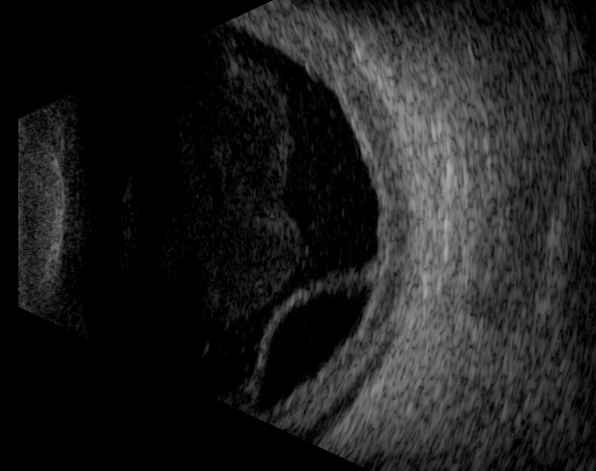
9PE

Slide 12
Ciliary-Choroidal Biopsy
Discussed ciliary-choroidal biopsy rather than FNAB
Partial thickness scleral flap created that extended 5 mm circumferentially from the limbus from 7-9:00
Vannas scissors used to incise scleral bed to expose choroid
Ciliary body/choroid specimen excised (0.6 x 0.1 x 0.1 cm) and sent to pathology
Scleral flap closed with 8-0 vicryl

Slide 13
Histopathology

Slide 14
Histopathology

Slide 15
Immunohistochemistry
CD68

Slide 16
Immunohistochemistry
CD 163

Slide 17
Immunohistochemistry
CD 163

Slide 18
Immunohistochemistry
CD3
CD20

Slide 19
Diagnosis
Sarcoidosis: based upon non-caseating granulomas

Slide 20
Clinical Follow-up
Rheumatology evaluation for extraocular sarcoidosis negative
Prednisone 60 mg daily started and tapered off after Cellcept 1000mg po BID established
Subretinal fluid, ciliary-choroidal thickening, vitreous debris rapidly improve
VA improved to 20/30, 4 mo post-biopsy

Slide 21
Sarcoidosis
Chronic, granulomatous multisystem autoimmune disease
Ocular involvement in 25-60% of patients
Uveitis or Conjunctival nodules – most frequent manifestation
Chest radiograph/Chest CT are the best screening test, 90% of sarcoid patients have pulmonary involvement (hilar lymphadenopathy or infiltrates)
Serum ACE is 73%, serum lysozyme is 60% sensitive for sarcoid
Definitive diagnosis requires a biopsy

Slide 22
Sarcoidosis: Pathology
Non-Caseating granulomas are pathognomonic for sarcoidosis
Granulomas consist of multinucleated giant cells and epithelioid cells
CD4/CD8 positive T-lymphocytes
B-lymphocytes typically located in the periphery of the granuloma

Slide 23
discussion
Ocular involvement may be initial manifestation of sarcoid in 21% of patients, which our case demonstrates
When it is the first manifestation of sarcoid it most commonly presents as anterior, intermediate or posterior uveitis
Ciliary body or choroidal mass/thickening is unusual manifestation of sarcoid, particularly as an early presentation without evidence of systemic disease

Slide 24
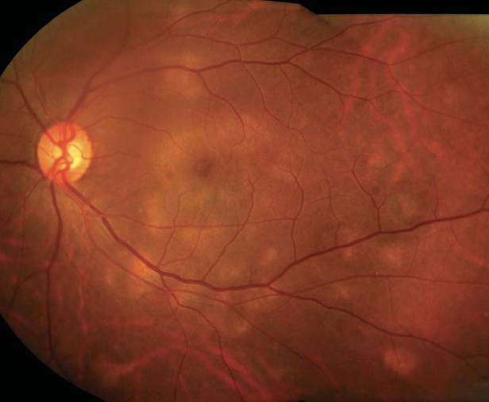
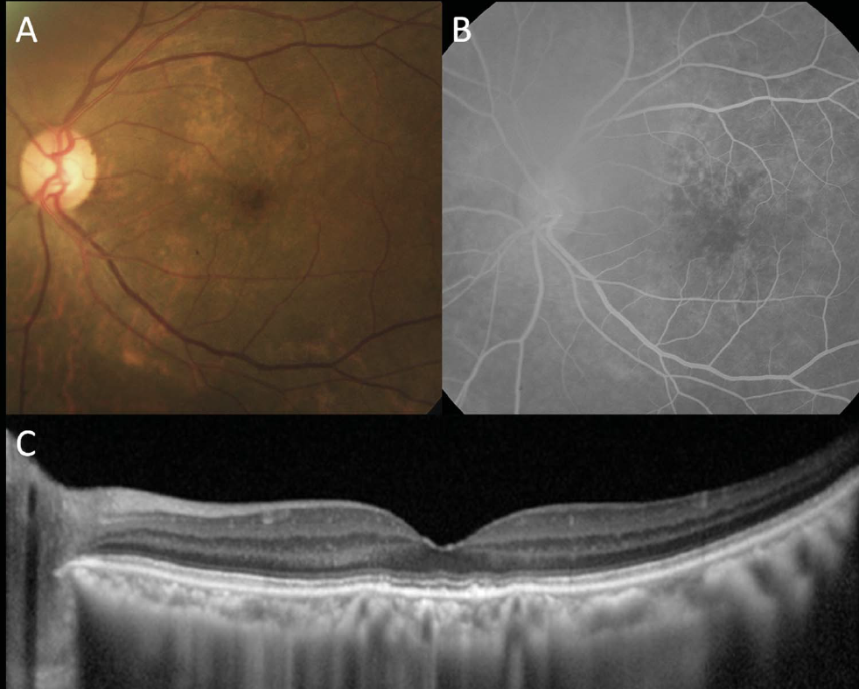
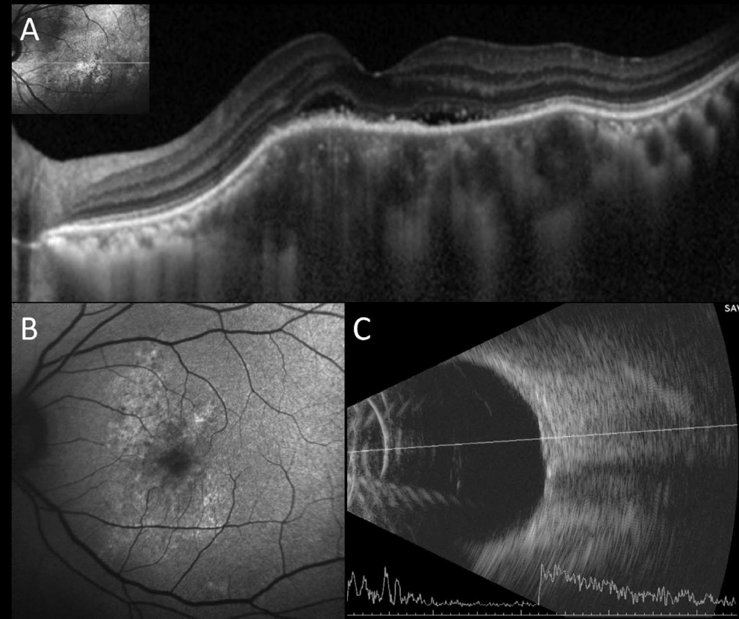
ACE, lysozyme, CXR negative
After treatment with PO steroids
Notes:
Paratrachael lymph nodes – biopsied by pulmonologist

Slide 25
discussion
Ocular involvement may be initial manifestation of sarcoid in 21% of patients
Ciliary body or choroidal thickening/mass is unusual early manifestation of sarcoid
Our case had no evidence of extraocular disease (radiographically, clinically or on laboratory testing)
Lesson 1: SARCOID remains in the differential
Lesson 2: If no other sites exist to safely biopsy and significant ciliary or choroidal thickening is present it may be possible to safely biopsy these sites :
To rule out lymphoproliferative or infectious disease
May be sole site to obtain pathologic confirmation of sarcoidosis

