Slide 1
Anterior Orbital Roof Lesion in a 76 year-old Woman
Victor M. Elner, MD, PhD
Ravitz Foundation Professor of Ophthalmology
Professor of Pathology
and
Hakan Demirci, MD
Richard N and Marilyn K Witham Professor of Ophthalmology
Associate Professor of Ophthalmology
University of Michigan
Eastern Ophthalmic Pathology Society
Washington, DC
September 2018
Notes:
.

Slide 2
Case Presentation: History
Chief Complaint:
A 76 year-old woman developed symptoms of sinusitis 3 months before consultation at the University of Michigan
History of Present Illness:
Cough & nasal congestion began 4 mo before consultation
A CT scan including the sinuses, performed 2 mo prior to consultation, revealed a 1.6 cm left anterolateral orbital bone lytic lesion with cortical breakthrough into the superolateral orbit, but no sinusitis. The left lacrimal gland appeared mildly enlarged.
An orbital MRI, performed 1.5 mo prior to consultation, revealed a 1.6 x 1.3 enhancing anterolateral orbital mass hyperintense on T2 and hypointense in T1 imaging.
A bone scan, performed 1 mo prior to consultation, was unremarkable.
At consultation the patient denied any ophthalmic symptoms
She denied periocular edema, pain, redness, proptosis, alterations in vision, or restriction in eye movement.

Slide 3
Case Presentation: History
Past Ocular History
Early age-related cataracts
Dry eye syndrome
Corneal ectasia
Ocular Medications
Over-the-counter artificial tears
Past Medical History
Coronary artery disease
Transient ischemic attack 11 yr prior
Hypertension
Hyperlipidemia
Hypothyroidism
Erosive osteoarthritis
Stage 2 breast cancer, treated 17 yr prior by partial mastectomy, lymphadenectomy, chemotherapy (6 mo), radiotherapy (38 sessions)
Chronic kidney disease, stage III
Allergic rhinitis
Gastroesophageal reflux

Slide 4
Case Presentation: History
Systemic Medications
Hydroxychloroquine sulfate
Levothyroxine
Atorvastatin
Losartan
Metoprolol
Triamterene-hydrochlorothiazide
Aspirin
Allergies
None
Family Medical History
Mother: coronary artery disease
Father: bladder cancer, rheumatoid arthritis
Brother: coronary artery disease
Social History
Widowed
Non-smoker
No alcohol use

Slide 5
Case Presentation: Physical Examination
Visual acuity (cc): 20/20 OU
Color vision: 14/14 Ishihara plates OU
Visual fields: full OU
Intraocular pressure: 17 mm Hg OU
Pupils: no deficit OU
Extraocular motility:
Versions full, bilaterally
External examination:
No increased resistance to retropulsion OU
Exophthalmometry: 16 mm OD; 16 mm OS (base 90 mm)
Margin-reflex distance: 3.5 mm OD; 3.0 mm OS
Biomicroscopic & funduscopic examinations:
Mild nuclear sclerotic cataract OU
Posterior vitreous detachment OU

Slide 6
Case Presentation: Physical Examination
Echographic Examination:
Scattered vitreous opacities; no ocular or orbital lesion detected
CT (2 mo prior to consultation):
1.6 cm lytic lesion, with of anterior/lateral left orbital roof with central intermediate density, cortical breakthrough, and communication with orbital soft tissue; adjacent lacrimal gland mildly enlarged
Metastatic disease or extension of lacrimal gland neoplasm cannot be excluded; MRI recommended
MRI (1.5 mo prior to consultation):
1.6H x 1.3V cm lesion, with increased T2 signal intensity, decreased T1 signal intensity, and mild contrast enhancement; extension into the superolateral left orbit contacting lacrimal gland
Concerning for metastatic disease or multiple myeloma with hemangioma or hemangioendothelioma also considered

Slide 7
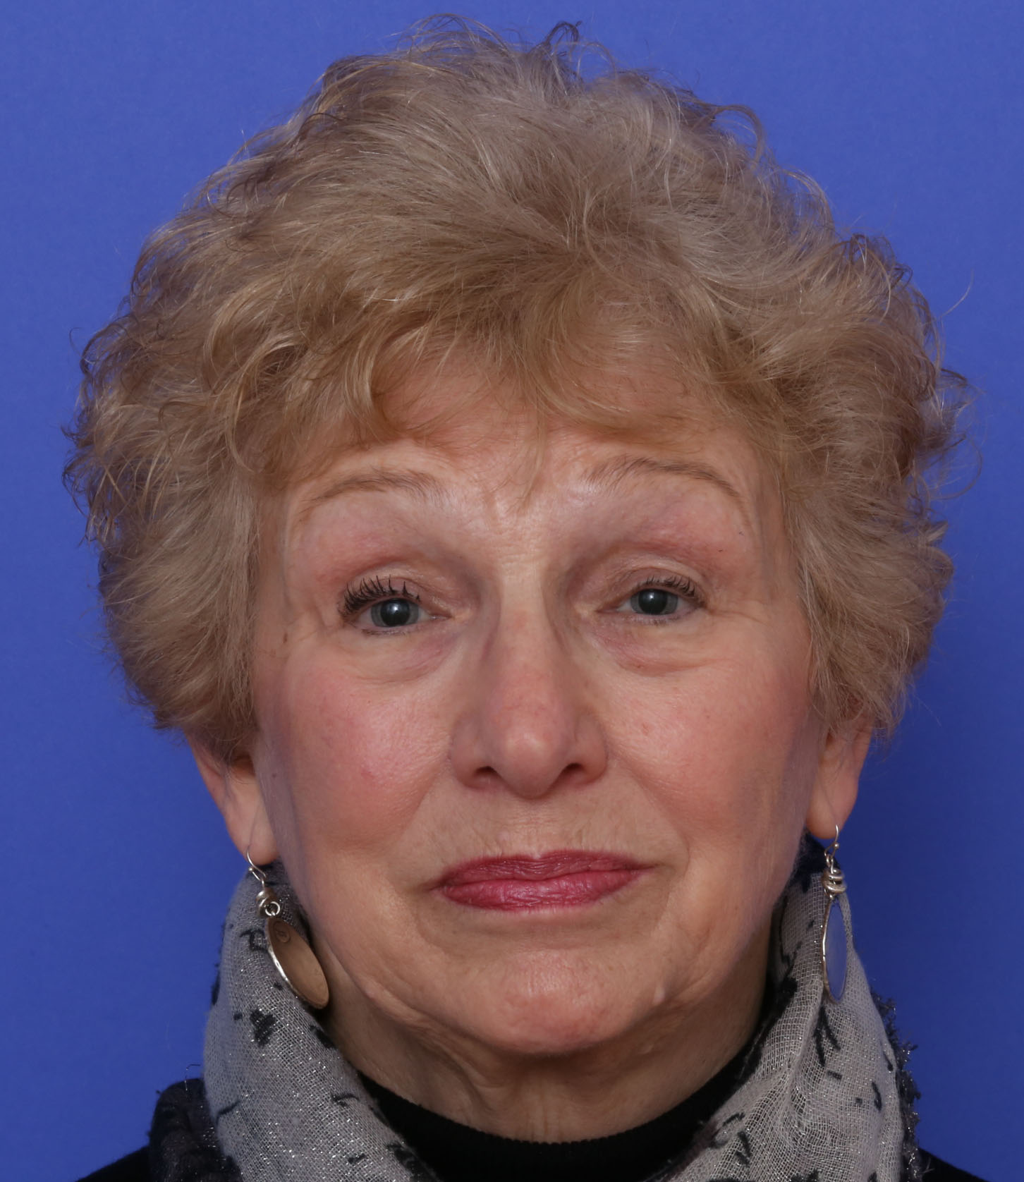
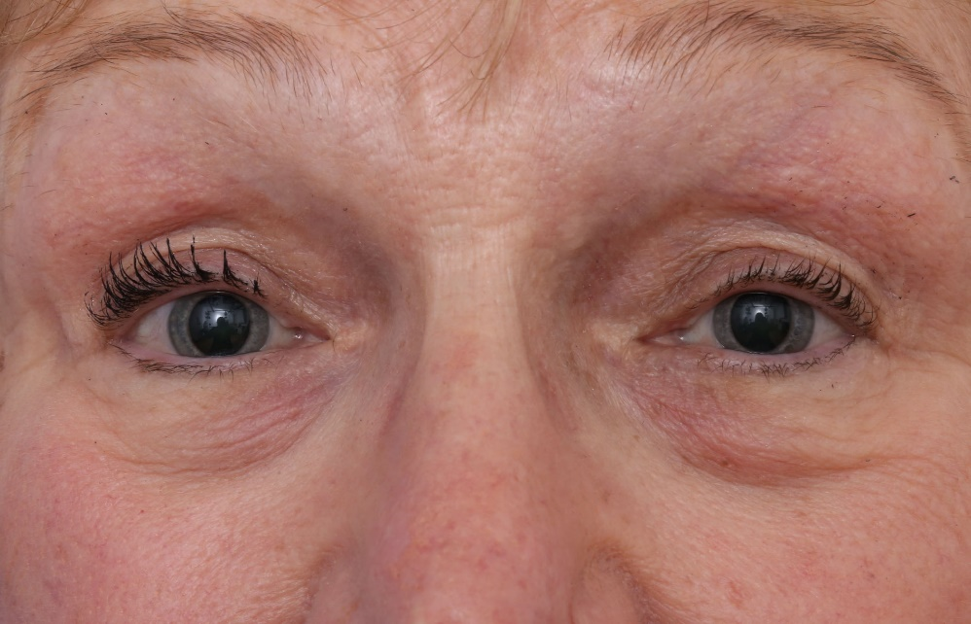
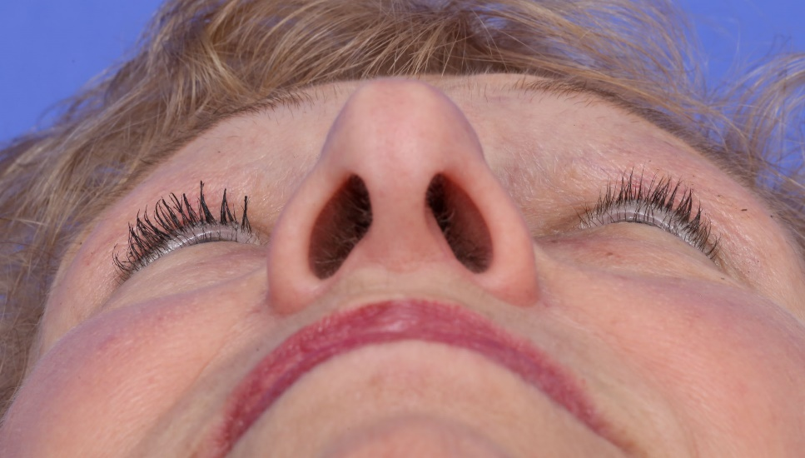
Case Presentation: Left Orbital Roof/ Lateral Wall Lesion Before Biopsy

Slide 8
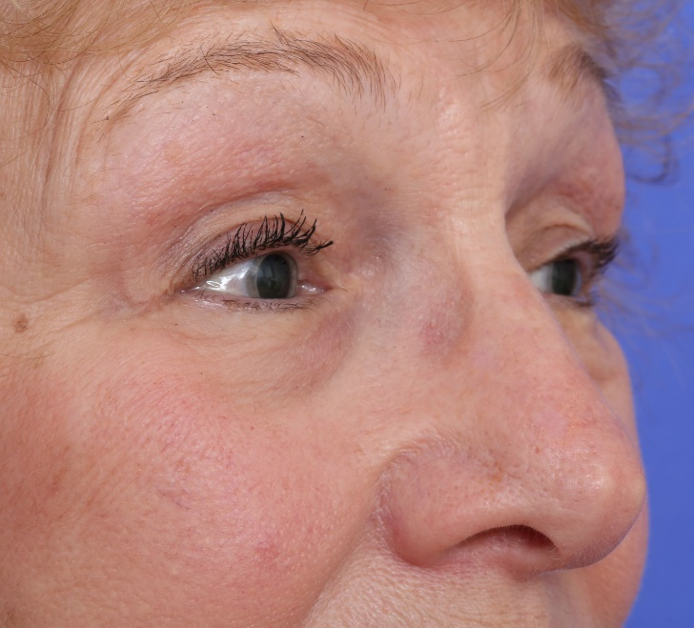
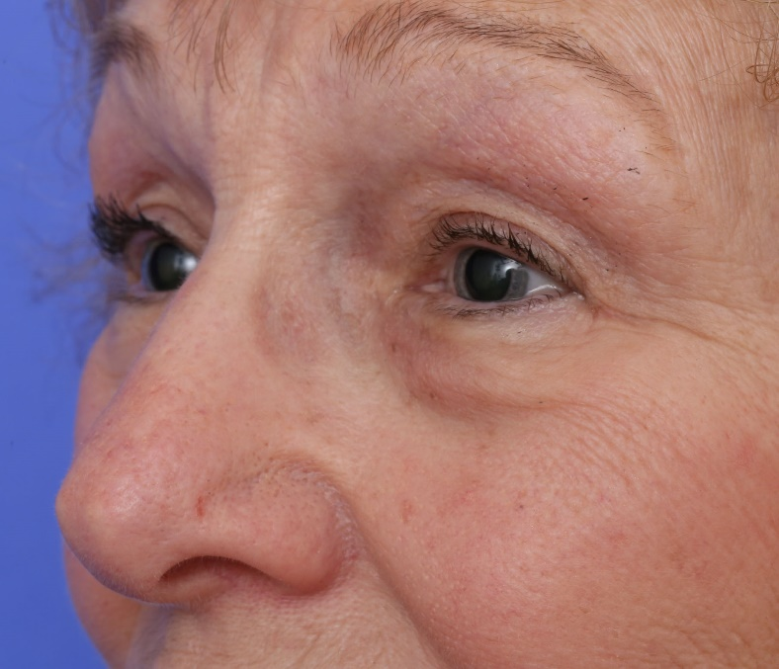
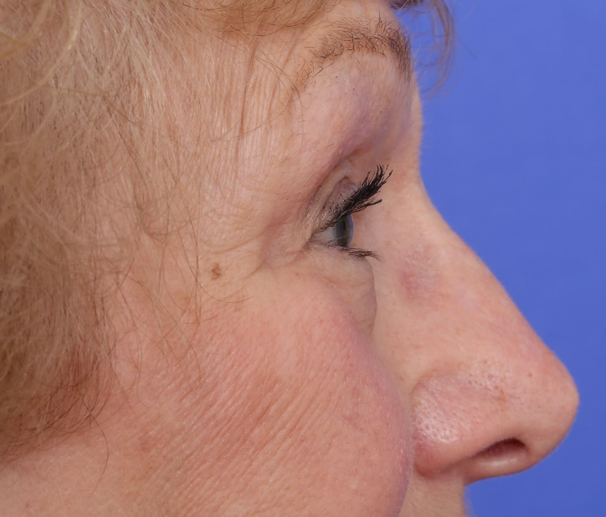
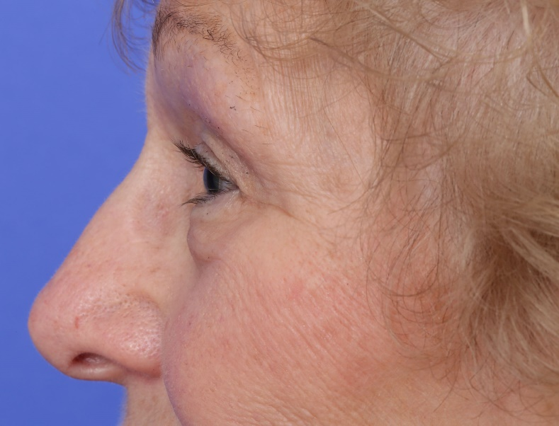
Case Presentation: Left Orbital Roof/ Lateral Wall Lesion Before Biopsy

Slide 9
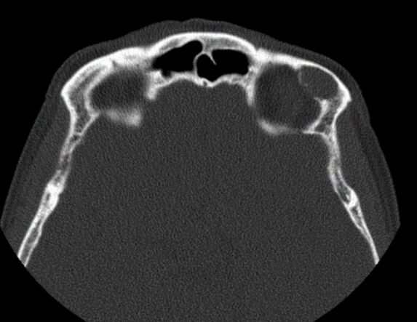
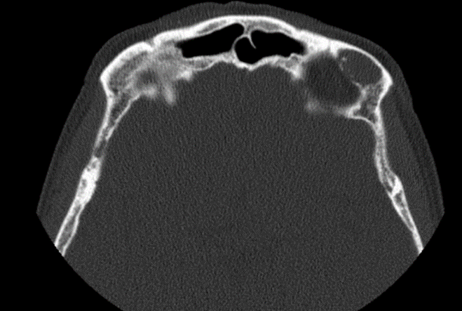
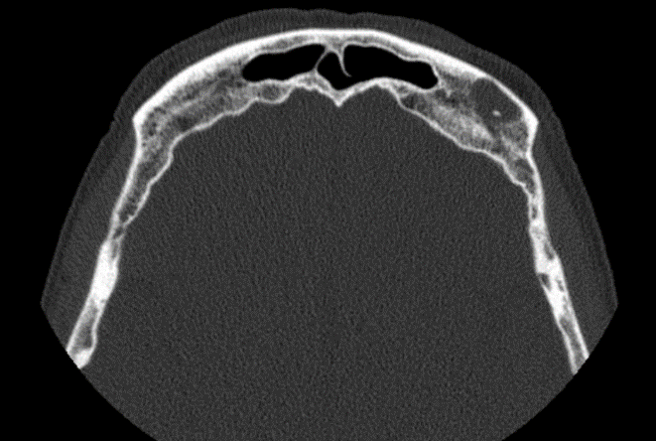
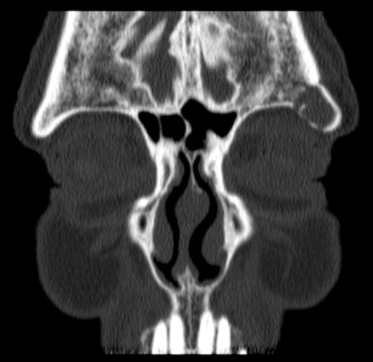
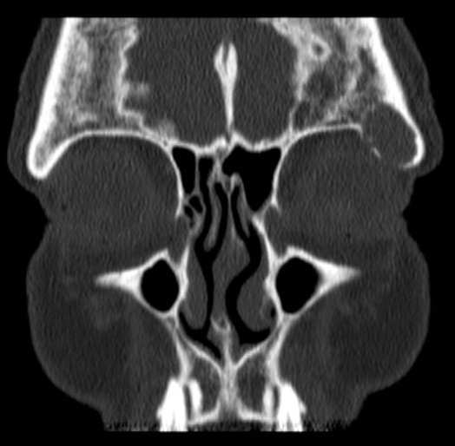
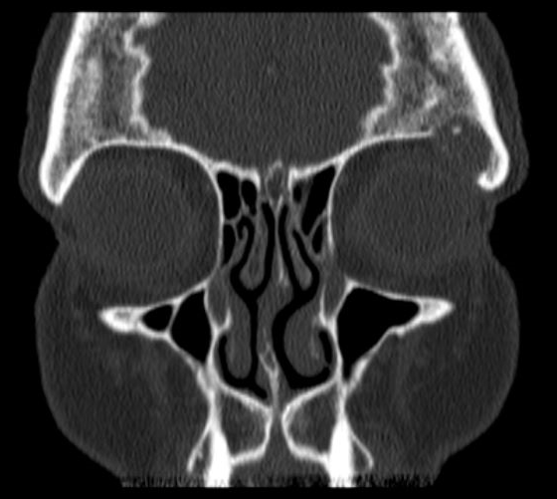
Case Presentation: CT
1.6 cm lytic lesion, with of anterior/lateral left orbital roof with central intermediate density, cortical breakthrough, and communication with orbital soft tissue; adjacent lacrimal gland mildly enlarged
Notes:
A mass with attenuation suggesting soft tissue posterolateral to the right globe which does not appear to extend beyond the orbit and exerts mass effect uopn the globe, deviating it toward the left

Slide 10
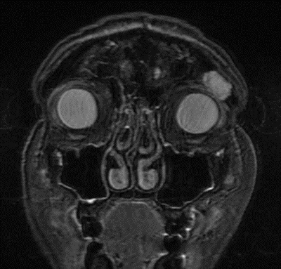
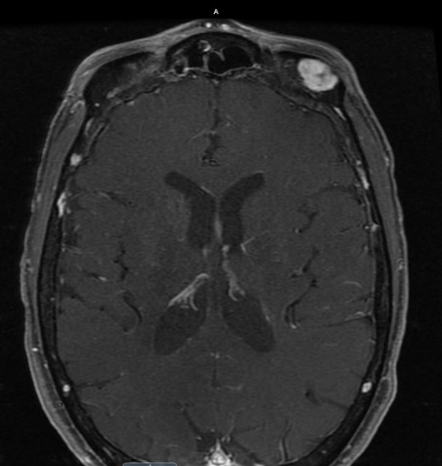
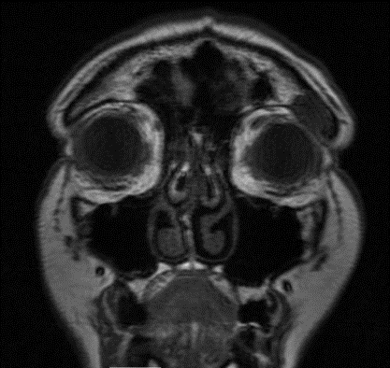
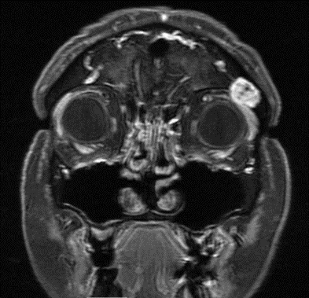
Case Presentation: MRI
1.6H x 1.3V cm lesion, with increased T2 signal intensity, decreased T1 signal intensity, and mild contrast enhancement; extension into the superolateral left orbit contacting lacrimal gland
Notes:
A mass with attenuation suggesting soft tissue posterolateral to the right globe which does not appear to extend beyond the orbit and exerts mass effect uopn the globe, deviating it toward the left

Slide 11
Clinical Course
Biopsy performed
Use of Stryker navigation system
Lateral left upper lid crease orbitotomy incision
White-yellow gummy and mildly friable tissue removed from eroded frontal bone
Mass extended into frontal sinus
Gross pathology
1.8 x 1.3 x 0.5 cm aggregate of gray-brown rubbery tissue
0.7 x 0.5 x 0.05 cm gray-brown bone fragment

Slide 12
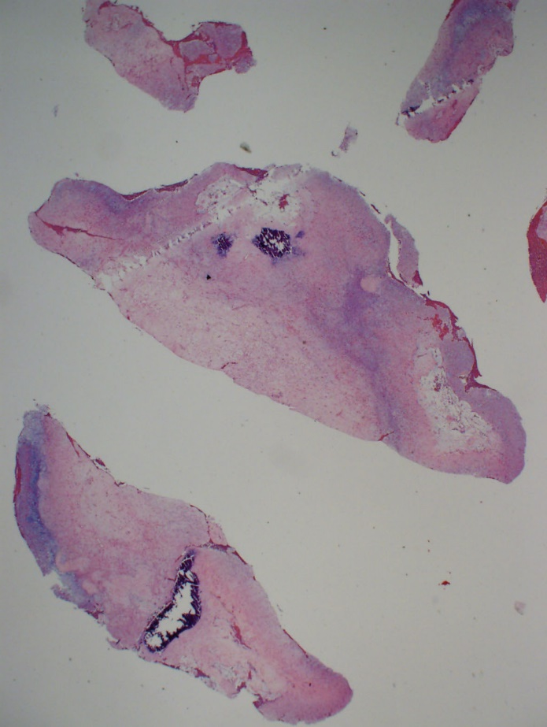
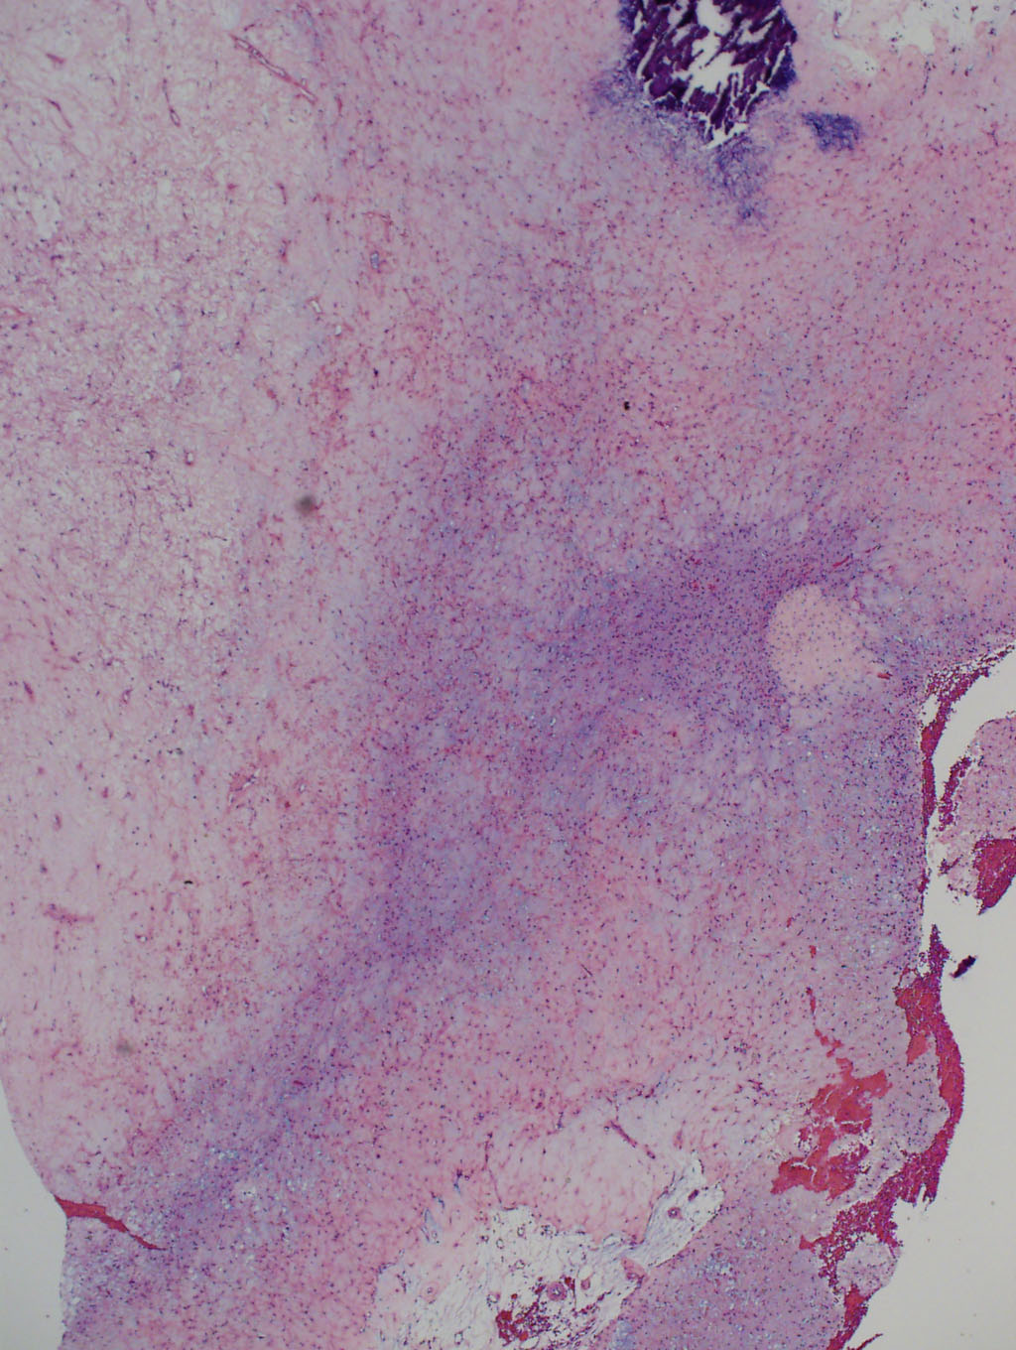
Anterior Orbital Roof Lesion: Histopathology
H&E x 12.5
H&E x 40
Lesion and bone fragments, the former consisting of a loose matrix containing stellate, fusiform, and rounded cells with occaisional blood vessels

Slide 13
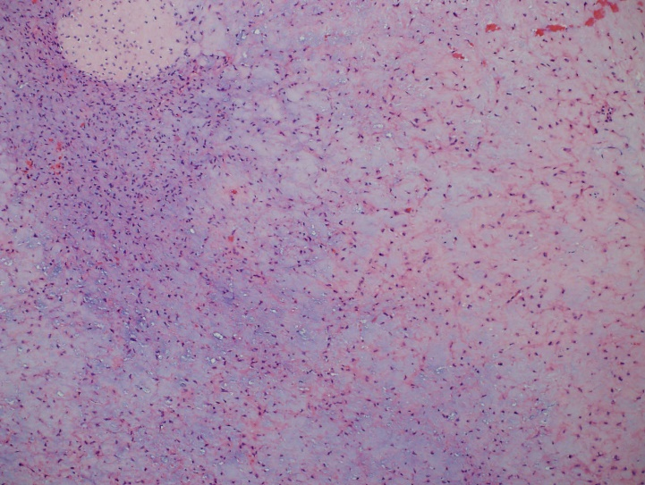
Anterior Orbital Roof Lesion : Histopathology
H&E x 100
Lesion and bone fragments, the former consisting of a loose matrix containing stellate, fusiform, and rounded cells with occasional blood vessels

Slide 14
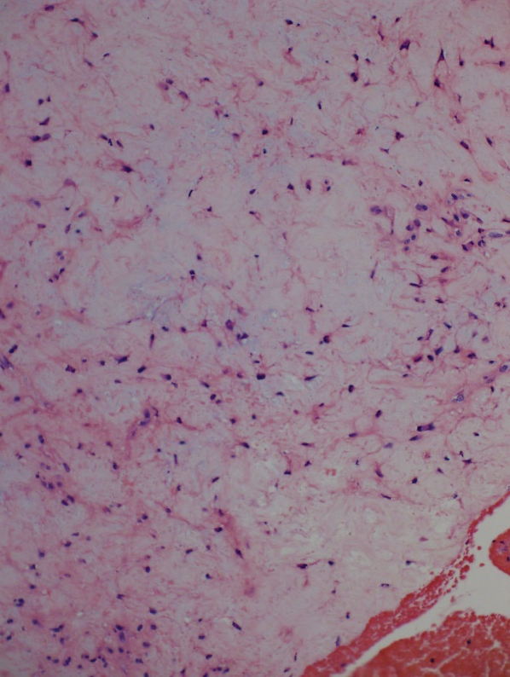
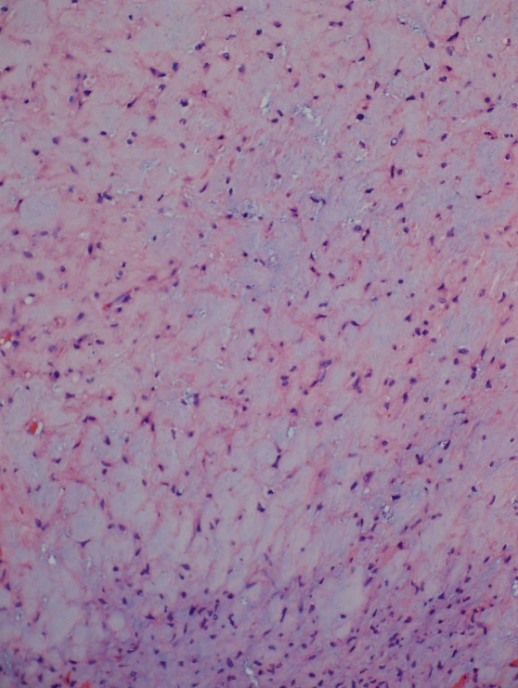
Anterior Orbital Roof Lesion : Histopathology
H&E x 200
Lesion and bone fragments, the former consisting of a loose matrix containing stellate, fusiform, and rounded cells with occasional blood vessels

Slide 15
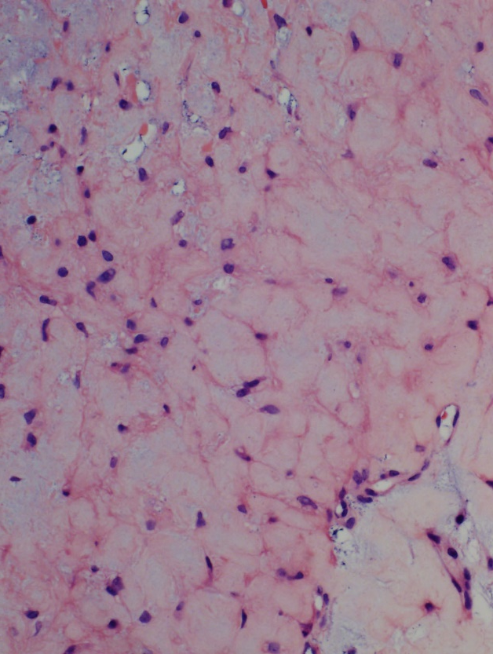
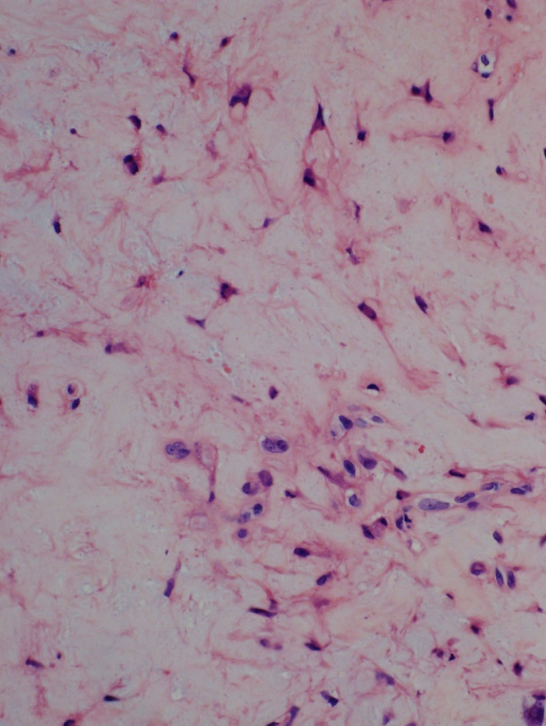
Anterior Orbital Roof Lesion: Histopathology
H&E x 400
Lesion and bone fragments, the former consisting of a loose matrix containing stellate, fusiform, and rounded cells with occasional blood vessels

Slide 16
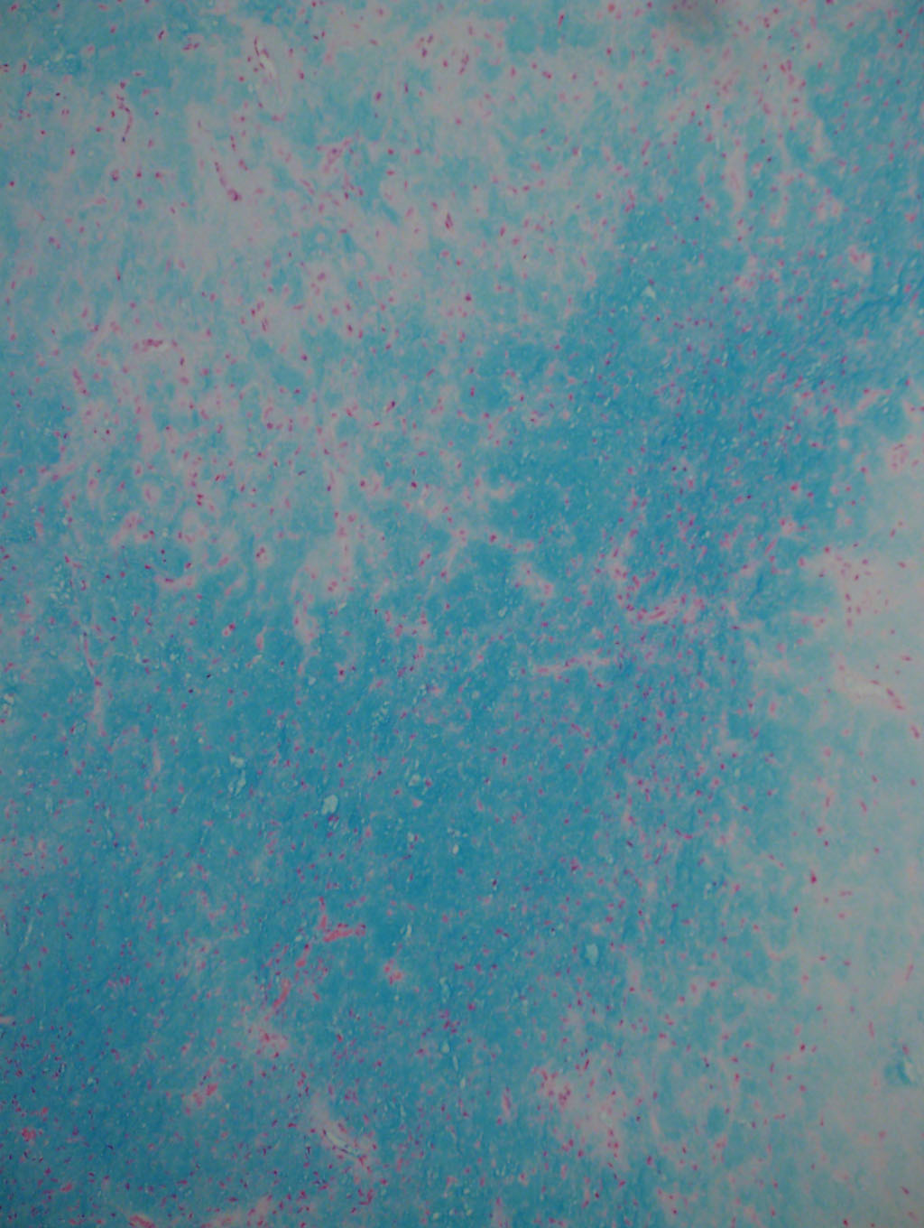
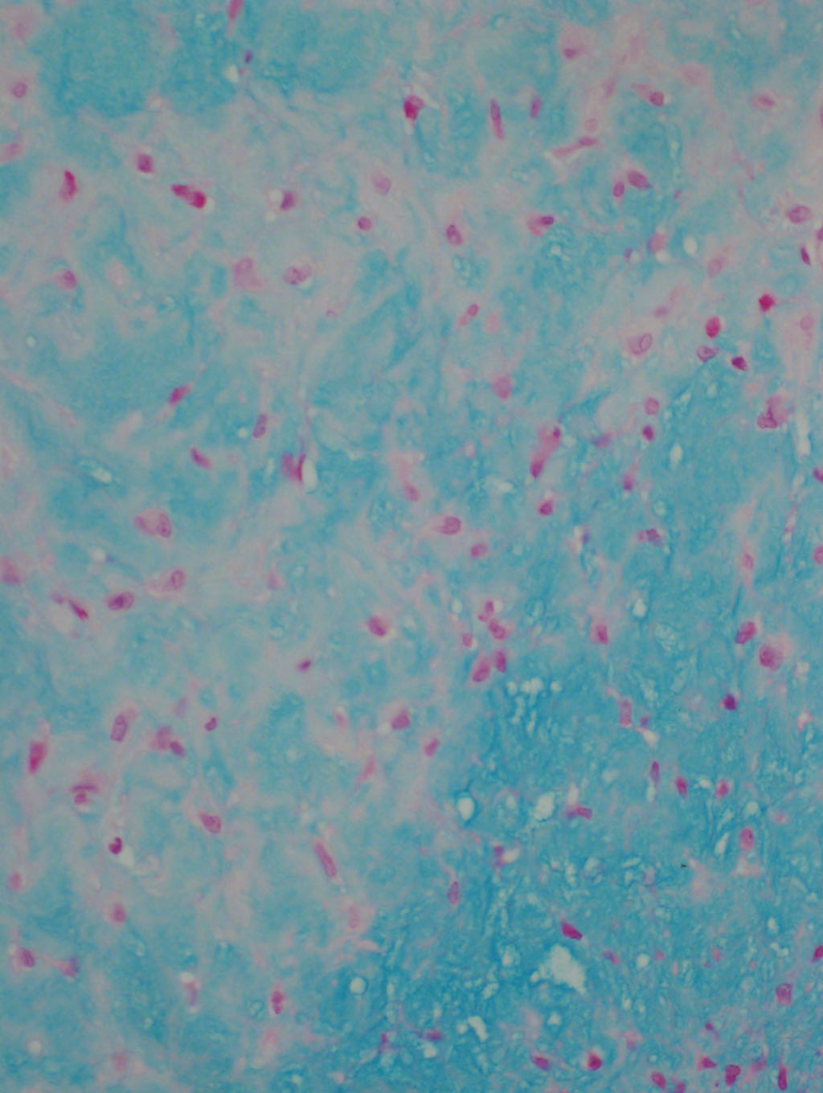
Anterior Orbital Roof Lesion: Histochemistry
Alcian blue x 100 (left) & x 400 (right)
Intense, diffuse Alcian blue positivity, for acid (non-sulfated) mucopolysaccharides, of non-dense matrix

Slide 17
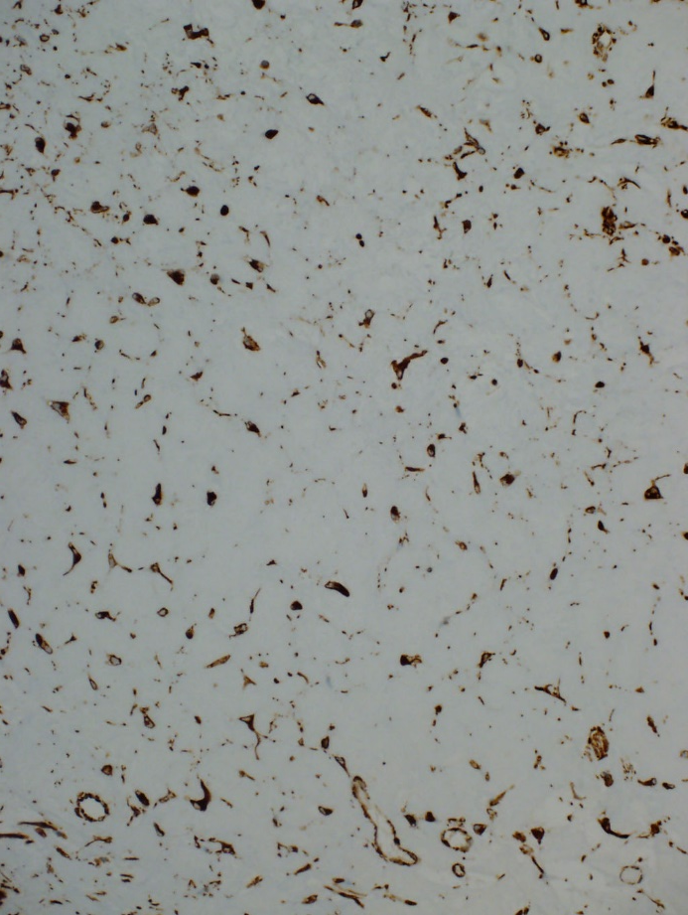
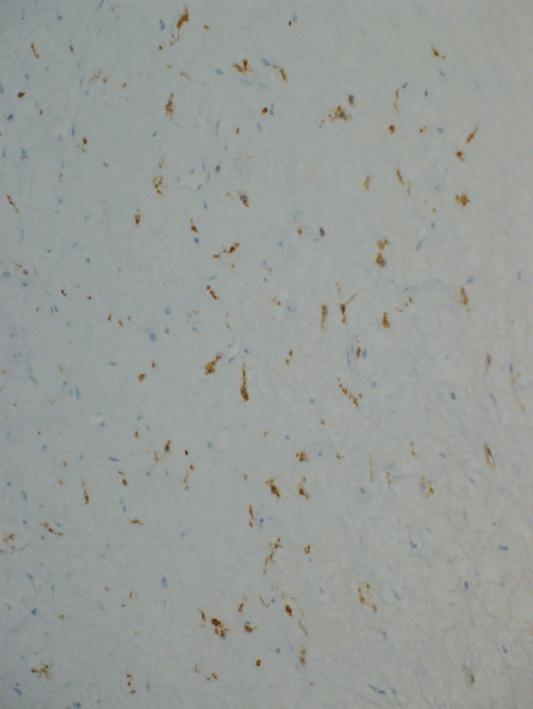
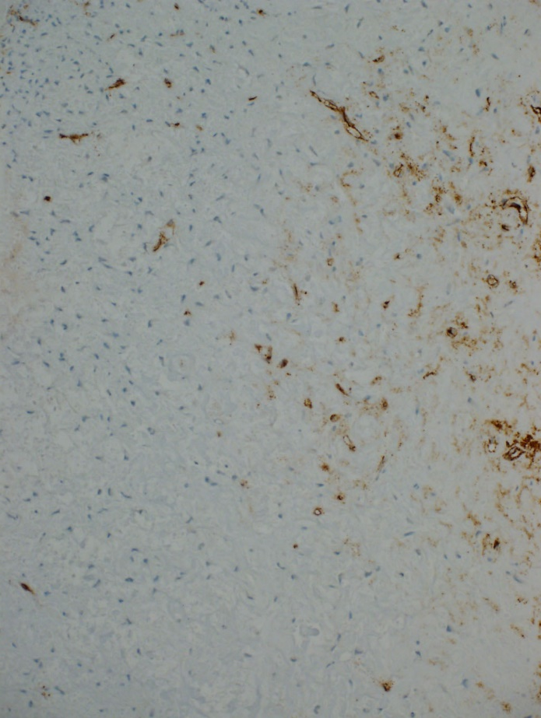
Anterior Orbital Roof Lesion: Immunohistochemistry
Vimentin (left), Factor XIIIa (center), & CD34 (right), all x 200
Intense vimentin, patchy moderately intense Factor XIIIa, & multifocal CD34 immunopositivity of cells; CD34 also marks blood vessels

Slide 18
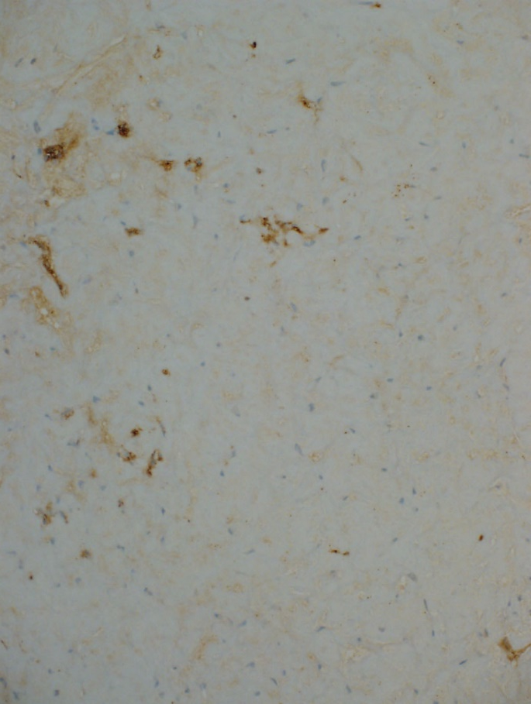
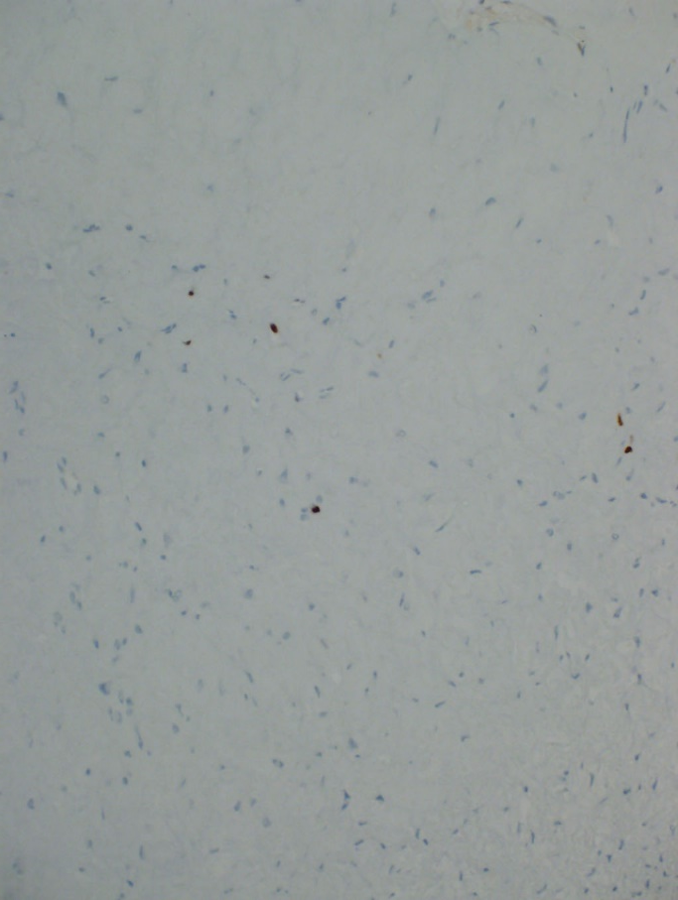
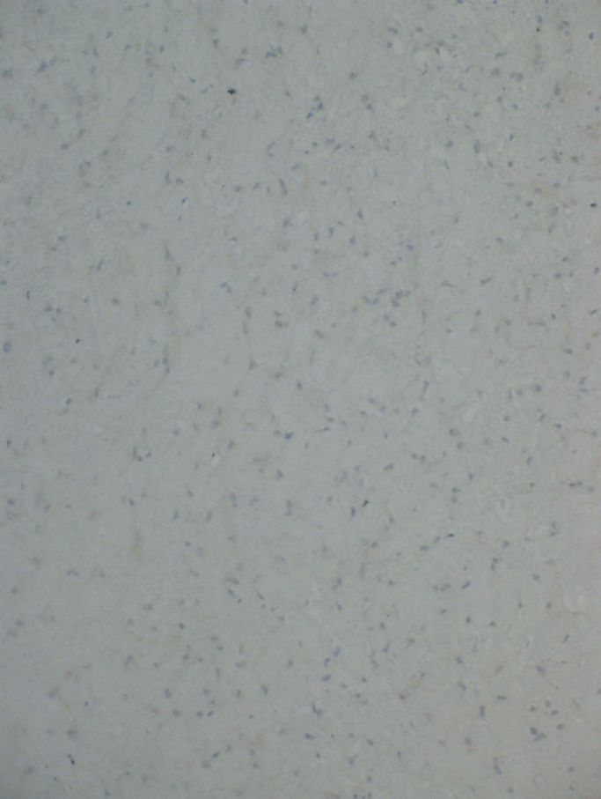
Anterior Orbital Roof Lesion: Immunohistochemistry
Factor VIII (left), Ki67 (center), & S100 (right), all x 200
Factor VIII immunopositivity of blood vessels, Ki67 immunostaining of isolated nuclei consistent with low proliferative index, & absent S100 immunoreactivity

Slide 19
Anterior Orbital Roof Lesion: Diagnosis
SURGICAL PATHOLOGY REPORT Order Number: SU-18-
Date Received: /2018 11:46 PM Date Completed: /2018 1:56 PM
Date Collected: /2018 11:46 PM Diagnosis: A. Left orbit and frontal sinus mass, excision: Myxoma. The benign neoplasm extends to the margins of excision. See COMMENT. B. Left orbit, excision: Fragment of unremarkable lamellar bone. Signing Pathologist: Victor M. Elner, M.D. Comment: This benign neoplasm consists of fusiform, stellate, and rounded cells within a strongly Alcian blue-positive matrix with occasional blood vessels. The cells contain occasional vacuoles, some indenting the nuclei and some within the nuclei. The cells demonstrate strong positivity with vimentin, with a substantial minority of the cells staining strongly for CD34 and Factor XIIIa antigens. The Ki-67 stain is positive in 2-3% of cells. The cells fail to stain for STAT6 and S100. The CD34 and Factor VIII immunostains decorate the occasional blood vessels.
Diagnosis: Sino-orbital myxoma

Slide 20
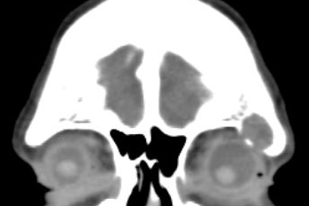
Sino-Orbital Myxoma: Additional Clinical Information- CT Scan 10 years Prior to Biopsy
2008
2018
Insignificant change in sino-orbital myxoma in CT scans taken 10 yr apart

Slide 21
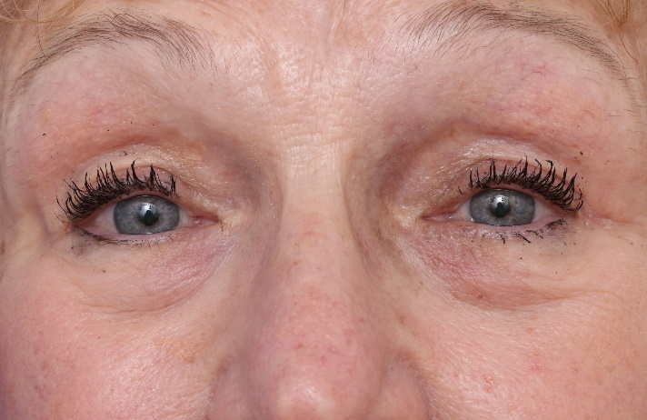
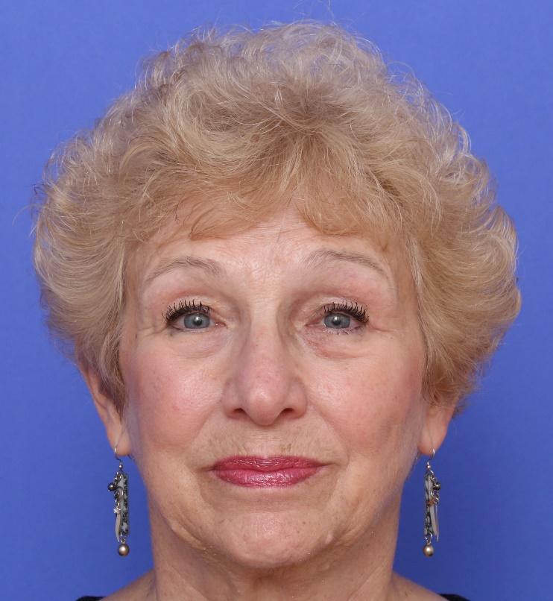
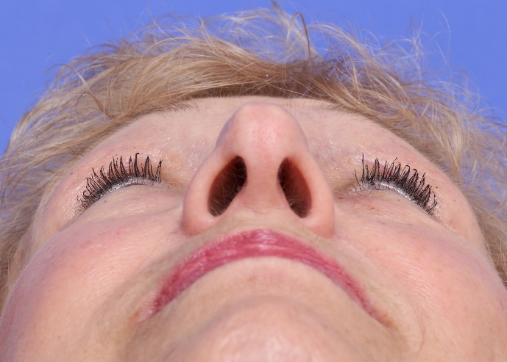
Clinical Course
4 mo after biopsy:
Asymptomatic
Visual acuity: 20/20 OU
1 mm of relative enophthalmos
No ptosis or diplopia

Slide 22
Discussion: Myxoma- History
Virchow (1858):
Coined the term “myxoma” to describe a soft tissue tumor histologically resembling the structure of umbilical cord
Mueller (1838) had named these tumors as “collonema” (Greek for glue) to describe “peculiar gelatinous tumors consisting of remarkably soft gelatiniform tissue, which trembles on being touched”
Stout (1948):
Defined myxoma as “a true neoplasm composed of stellate cells set in a loose mucoid stroma through which course very deliciate reticulin fibers in various directions. In other words, it closely resembles primitive mesenchyme”.
He described various locations including subcutaneous/aponeurotic, bone, genitourinary, and skin as the most common sites, but he listed 4 myxomas of the orbit and eyelids.
Described only 1 myxoma of the heart.

Slide 23
Discussion: Myxoma- Histogenesis & Histopathology
Histogenesis:
Benign neoplasm of primitive mesenchyme with fibrous loose stroma containing undifferentiated cells with fibroblastic differentiation
When dense collagenous stroma is present, the terms fibromyxoma or myxofibroma are used
Histopathology:
Hypocelllular with stellate- and spindle-shaped cells with pale eosinophilic cytoplastm
May have mild pleomorphism which does not predict recurrence
Myxomatous/mucoid stroma with Alcian blue-positive stroma containing hyaluronic acid and acid mucopolysaccharides
Immunopositivity for vimentin and variably for factor XIIIa, CD34, smooth muscle-specific actin, actin, & desmin; S100 and EMA immunopositivity in nerve sheath myxoma (neurothekeoma)

Slide 24
Discussion: Myxoma- Types of Myxoma
Cardiac myxoma: most common primary heart tumor of adults; female predominance in 4th & 5th decades of life; tumor of atria, left >>> than right originating in septum; predisposes to embolism and distant metastases; can cause sudden death; can be part of Carney complex
Cutaneous/superficial myxoma: often poorly circumscribed, may be multilobular; recurrence 20-30%
Intramuscular myxoma: poorly circumscribed
Odontogenic myxoma: locally aggressive with capacity to infiltrate bone.; female predominance in 3rd & 4th decades of life; mandible most affected
Juxta-articular myxoma: poorly circumscribed; May have atypical cells and mitoses; recurrence 35%
Nerve sheath myxoma (neurothekeoma): well circumscribed but may be multilobular; moderately cellular with spindled cells in fasciles and whorls and nests of cells; recurrence 50% if incompletely excised
Aggressive myxoma: Infiltrative; uniformly distributed vessels, some with hyalinization; low to moderate cellularity; focally collagenous; recurrence 35-70%; may occur in orbit

Slide 25
Discussion: Myxoma- Eye & Orbit
Conjunctival myxoma:
Most common eye involvement with > 40 reported cases
Well circumscribed, cystlike, gelatinous, yellow-pink, translucent to solid mass
Vimentin and smooth muscle-specific actin immunopositivity
Treatment is complete excision
Carney complex:
Autosomal dominant mutation of 17q23-24 (PRKARIA tumor suppressor gene) or of 2p16
Pigmentation of face, lips, eyelids, conjunctiva, oral mucosa
Endocrine abnormalities (Cushing’s syndrome)
Myxomas of conjunctiva, heart, skin, breast
Other tumors: blue nevus, neurofibroma; testicular, thyroid, and pancreatic carcinomas

Slide 26
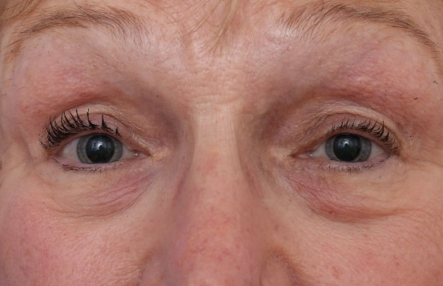
Discussion: Myxoma- Eye & Orbit
Orbital myxoma:
Hidayat AA, Flint A, Marentette L, Torczynski E, Al-Qahtani JM, Ahi NC, Elner VM. Myxomas and angiomyxomas of the orbit: a clinicopathologic study of 6 cases. Ophthalmology. 2007;144:1012-19.
Additional 4 cases of angiomyxoma later described by Bajaj et al. (2011)
Other case reports of myxomas and angiomyxomas also described
Sino-orbital myxoma:
Only 3 previous cases reported: 1) Candy et al., (1991); 2) Hidayat et al. (2007); and 3) Ali et al., (2013).
All 3 in superior orbit. None were angiomyxomas.
All 3 responded to surgical excision
These myxomas appear to have good prognosis

Slide 27
Thank you!

