Slide 1
Eastern Ophthalmic Pathology Society September 13-16, 2018 Washington DC
Eyebrow lesion
Franz Fogt MD Dr med MBA
Bo Jian MD PhD
University of Pennsylvania

Slide 2
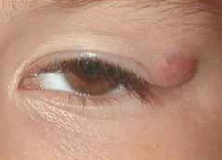
Patient presentation
36 year old patient with a long standing tumor left eyebrow (>4 years)
The lesion was not growing, movable and non painful
Picture of different patient

Slide 3
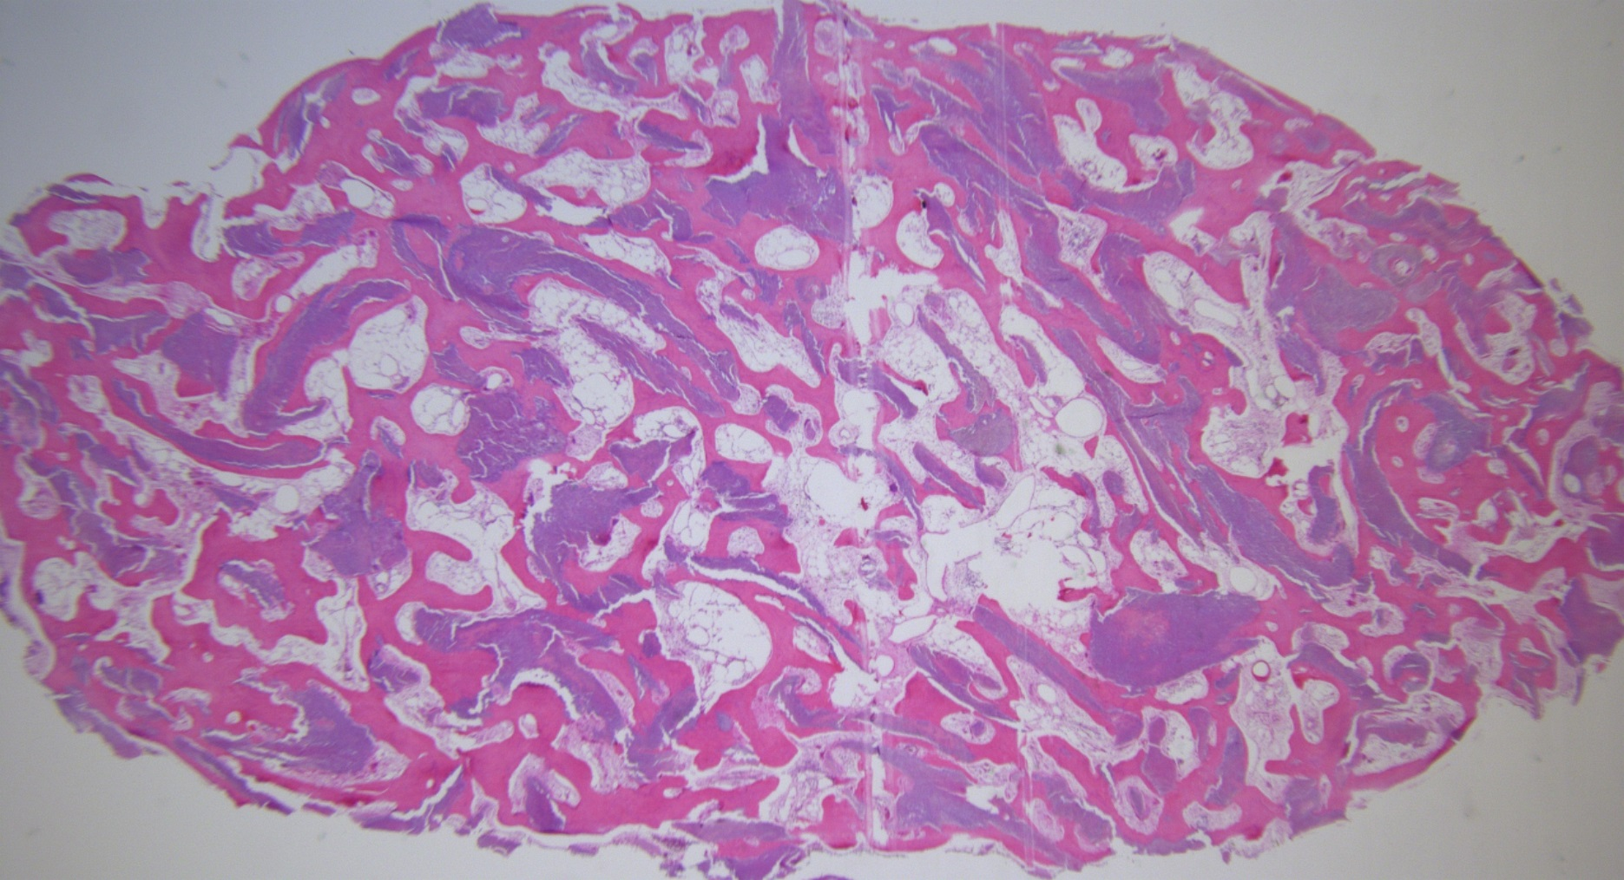

Slide 4
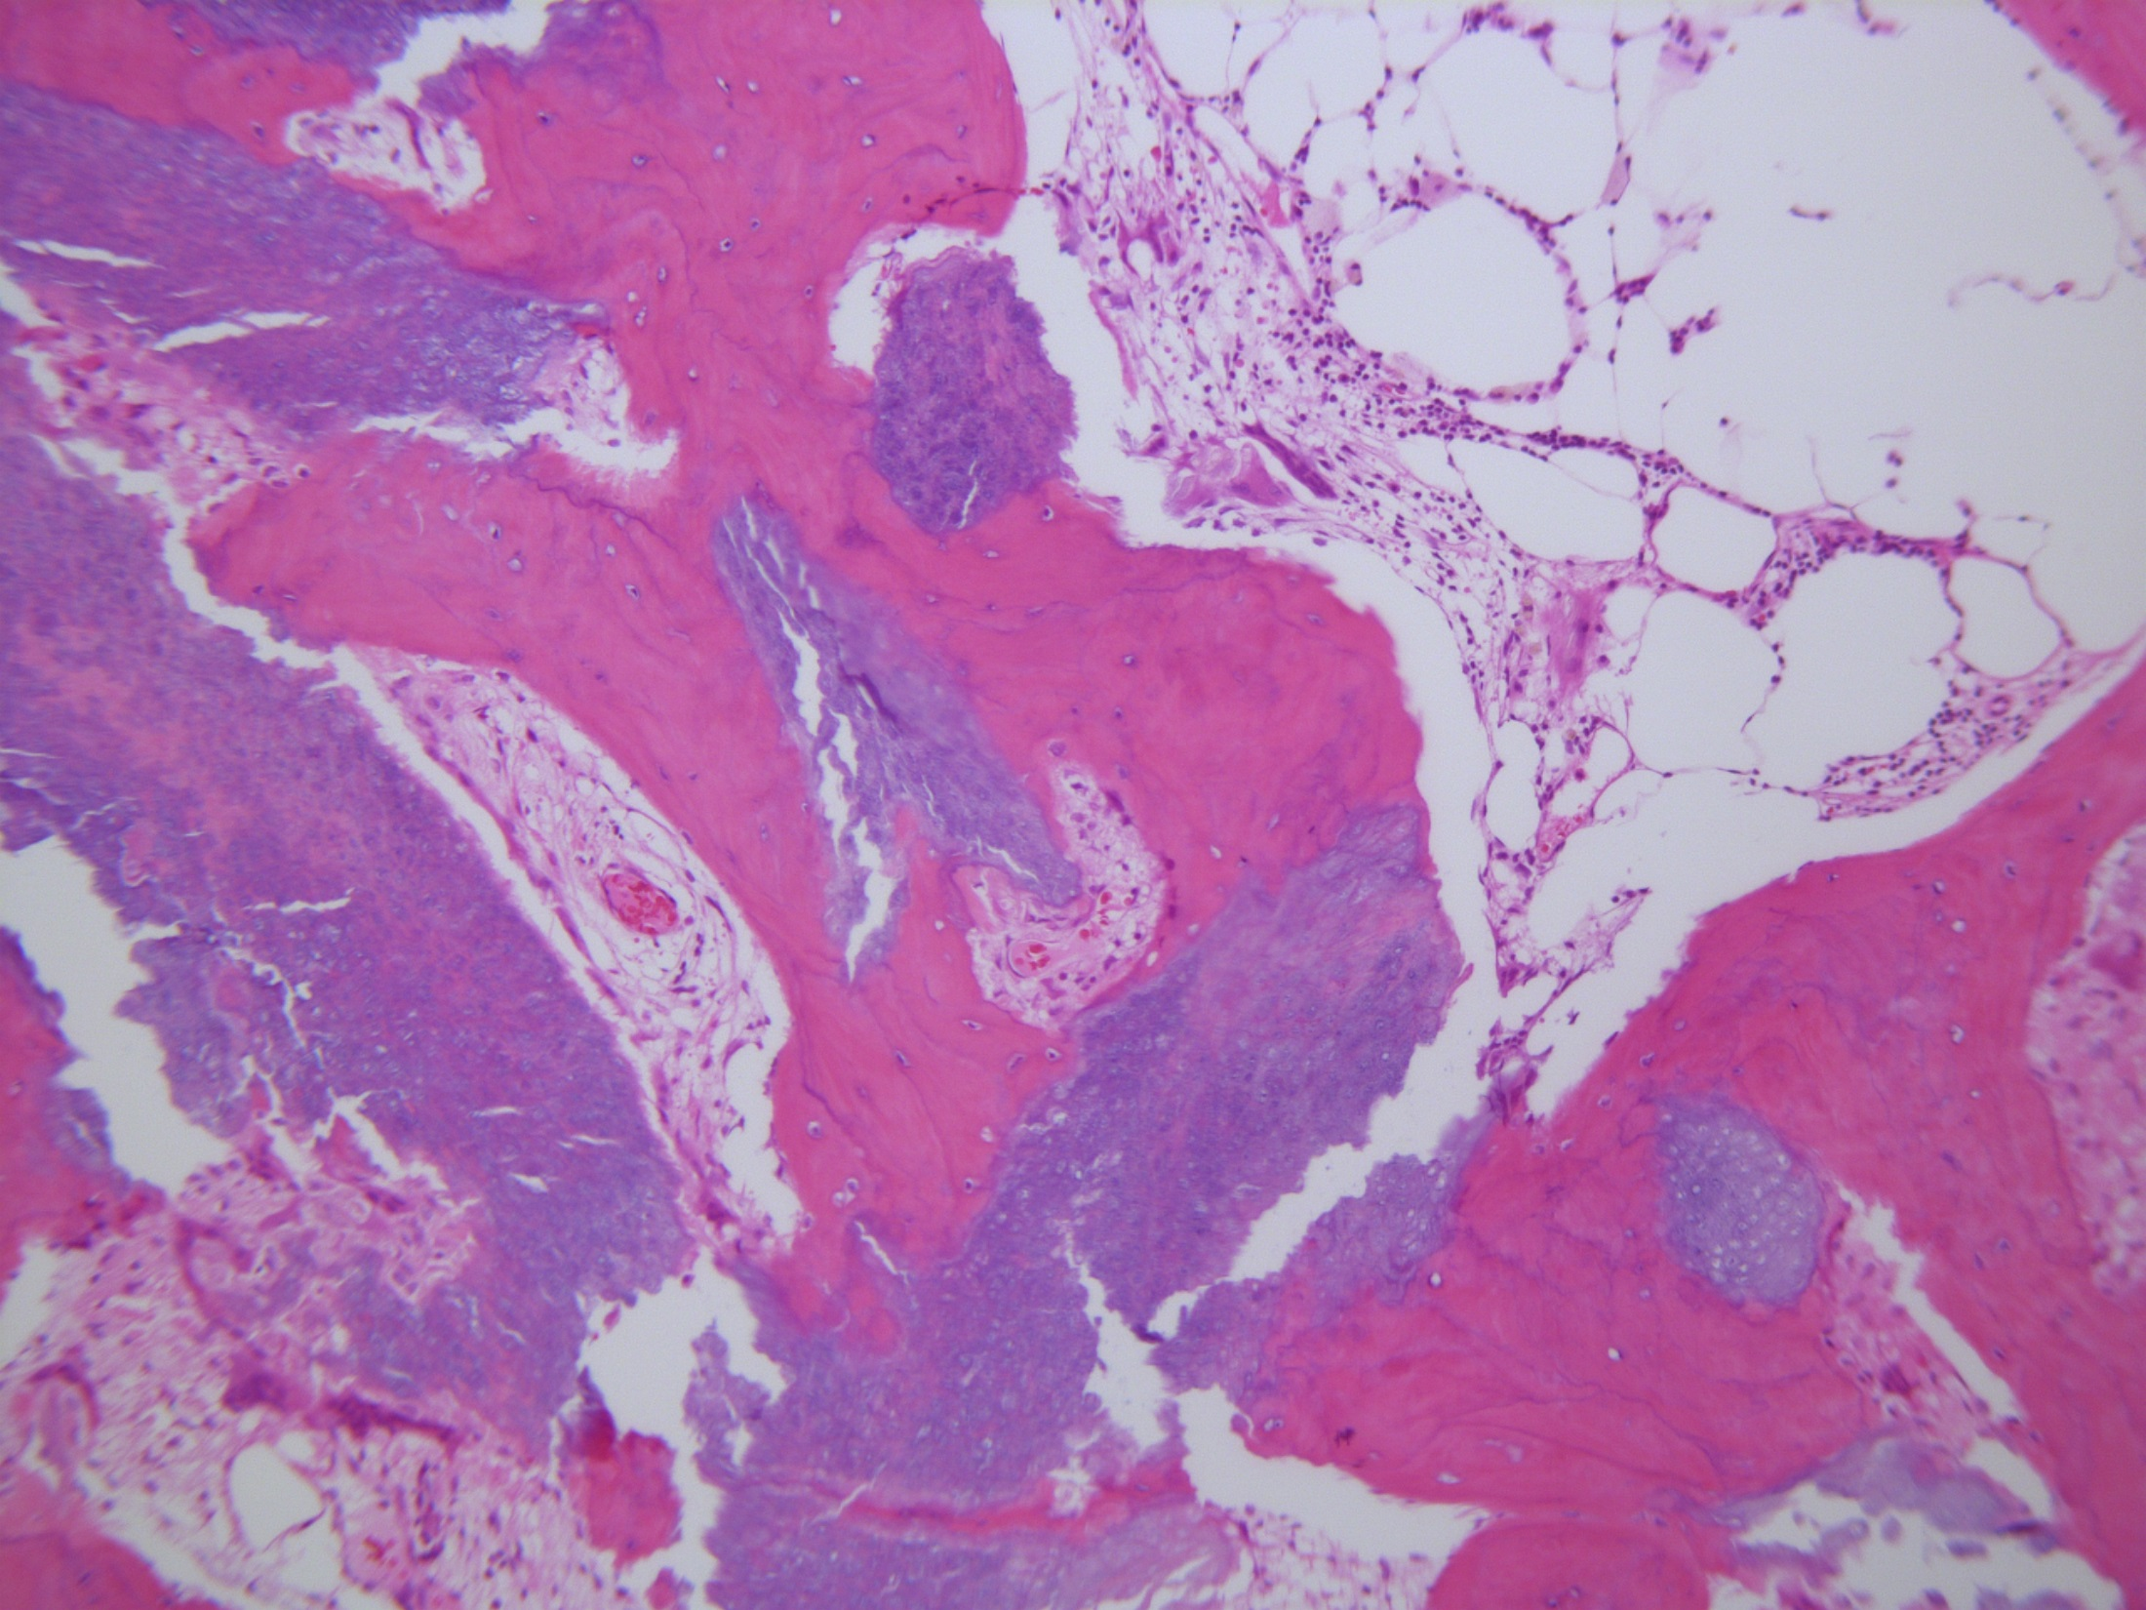

Slide 5
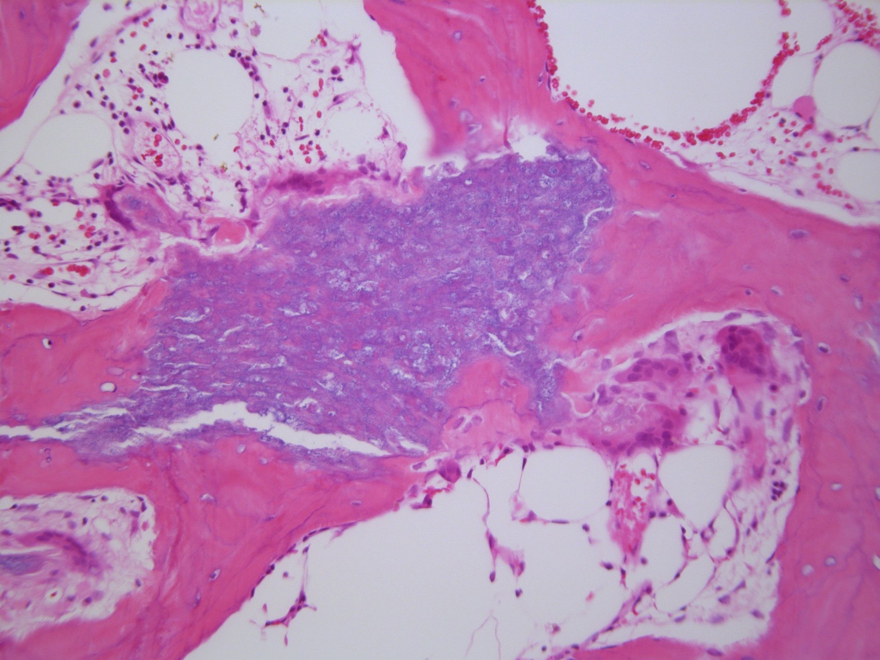

Slide 6
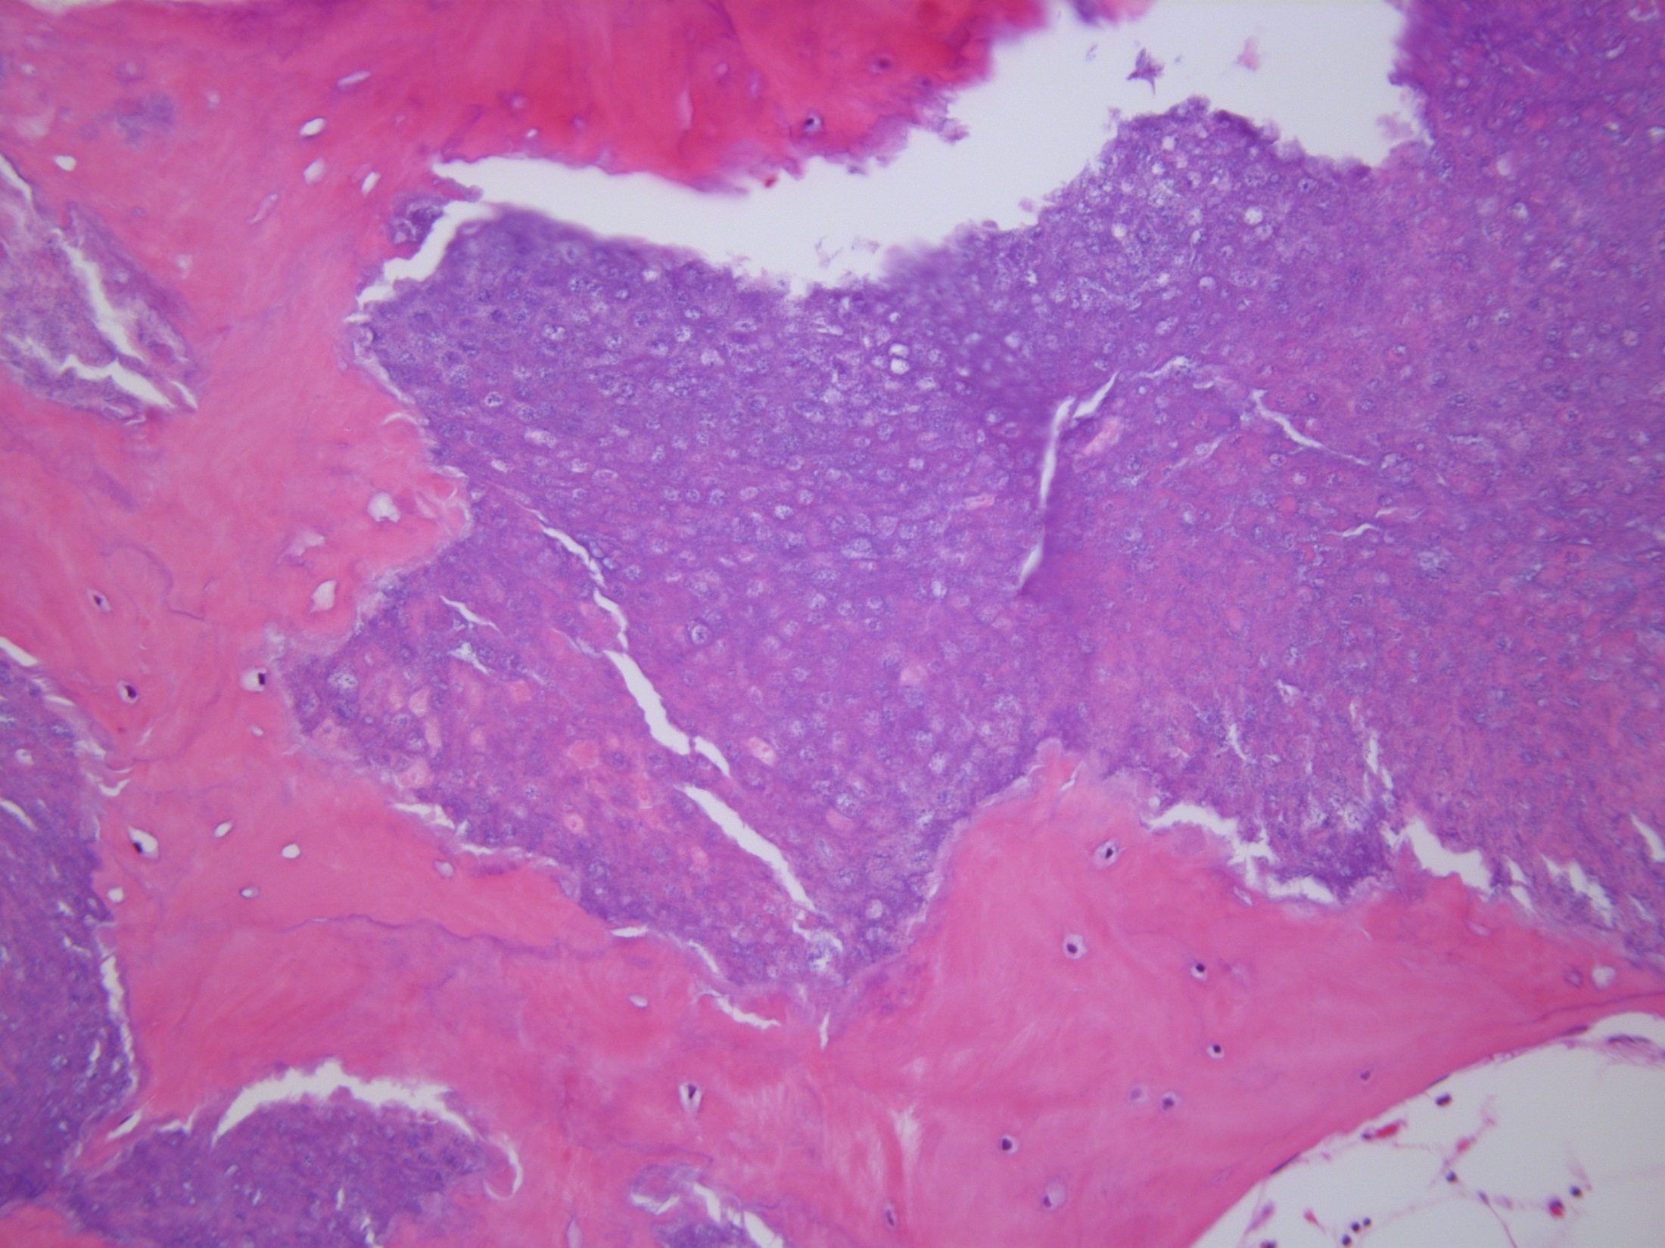

Slide 7
Patient presentation
36 year old patient with a long standing tumor left eyebrow (>4 years)
The lesion was not growing, movable and non painful
A diagnosis of ossifying pilomatrixoma was made
Picture of different patient

Slide 8
Pilomatrixomas
Pilomatrixomas are benign tumors of the hair follicle and represent the most common hair follicle tumor
The tumor was first described in 1881 by Malherbe, but Malherbe quoted in his paper a primary description by M. Wilckens, who presented a larger piece of work under the title ‘about ossifications and calcifications of the skin and so called skin stones’.
As far as the cases reviewed in that paper, it appears that a multitude of lesions, such as cutaneous calcinosis, metaplastic bone formation in long standing wounds and even teratomas (description of hair and tooth-like material) were included. No histologic depictions were available.

Slide 9
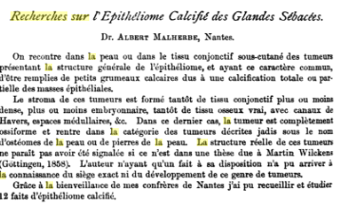
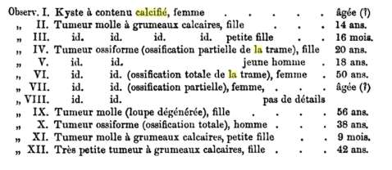

Slide 10
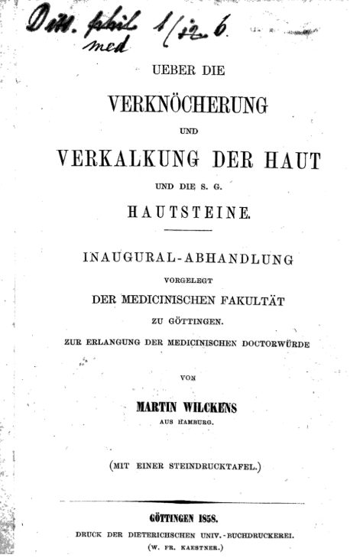

Slide 11
Histology
Pilomatricomas develop from the hair matrix portion of the lower segment (stem) of hair follicles.
Histologically, pilomatricomas show different morphological features, depending on the age of the lesion.
The typical histology is that of a dermal or deep seated epithelial nodule with peripherally located hair matrix type cells with basophilic cytoplasm and small nuclei.
A second cell population towards the inner aspect of the lesion shows a loss of the nucleus and prominent eosinophilic cytoplasm. Those ghost cells represent the terminal differentiated matrix cells.
Juxtaposition between those two cell types is usually abrupt, but transitions can be seen.
In early lesions, basophilic cells may predominate but with time the ghost cell population with predominate the lesion. In addition, later lesions will show multinucleated giant cells and calcification

Slide 12
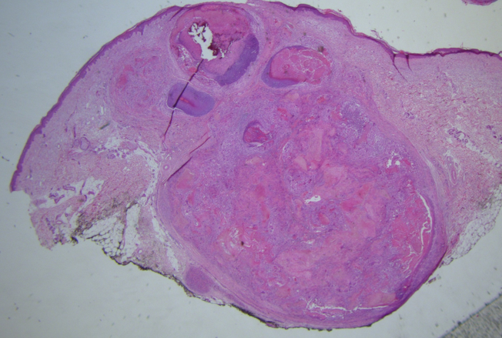

Slide 13
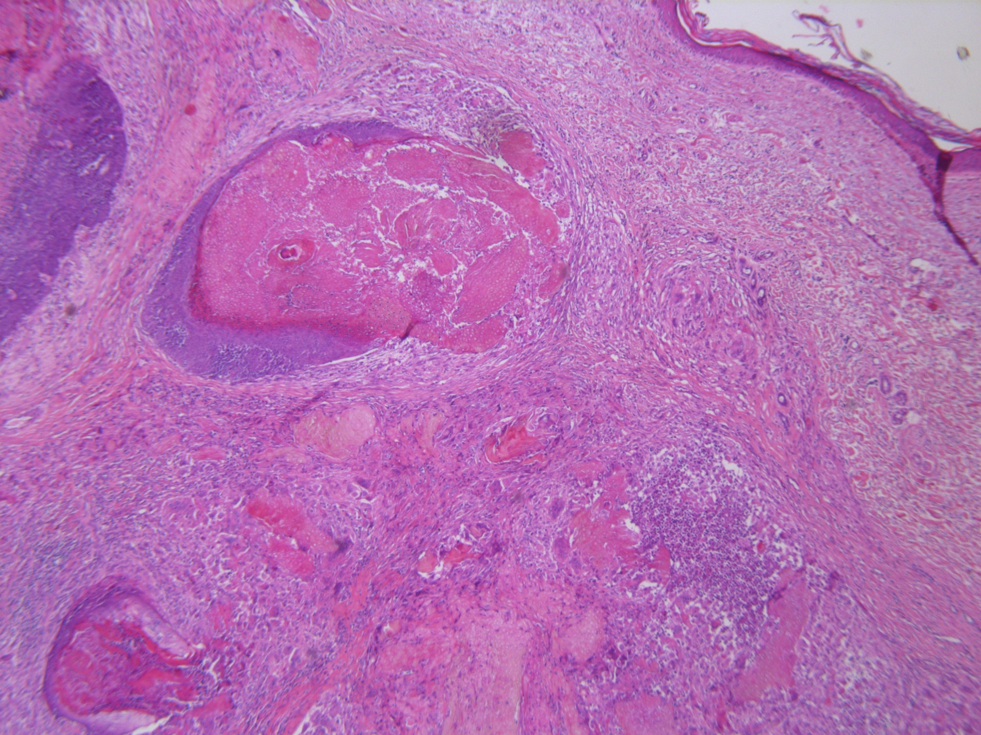

Slide 14
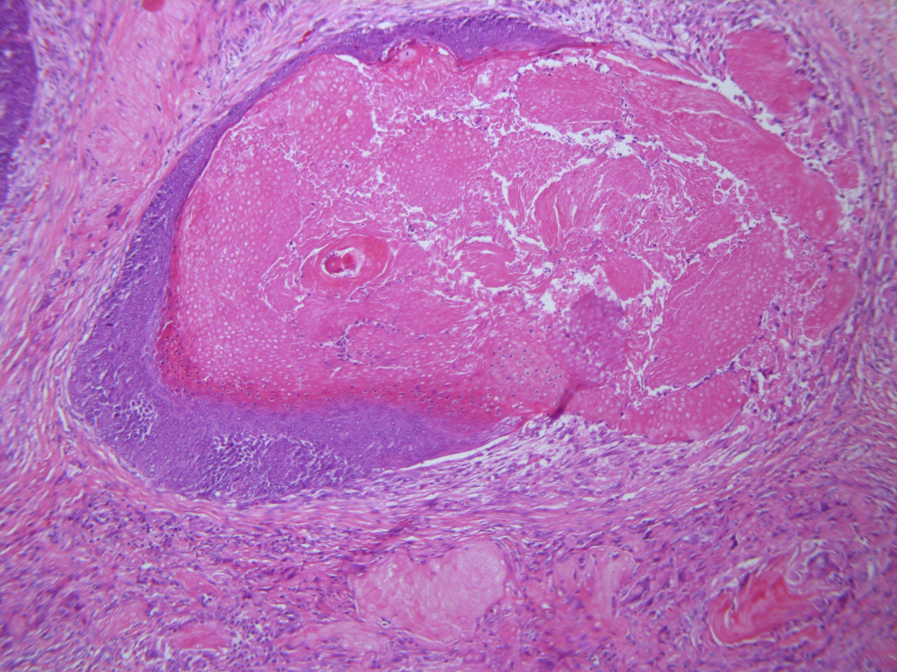

Slide 15
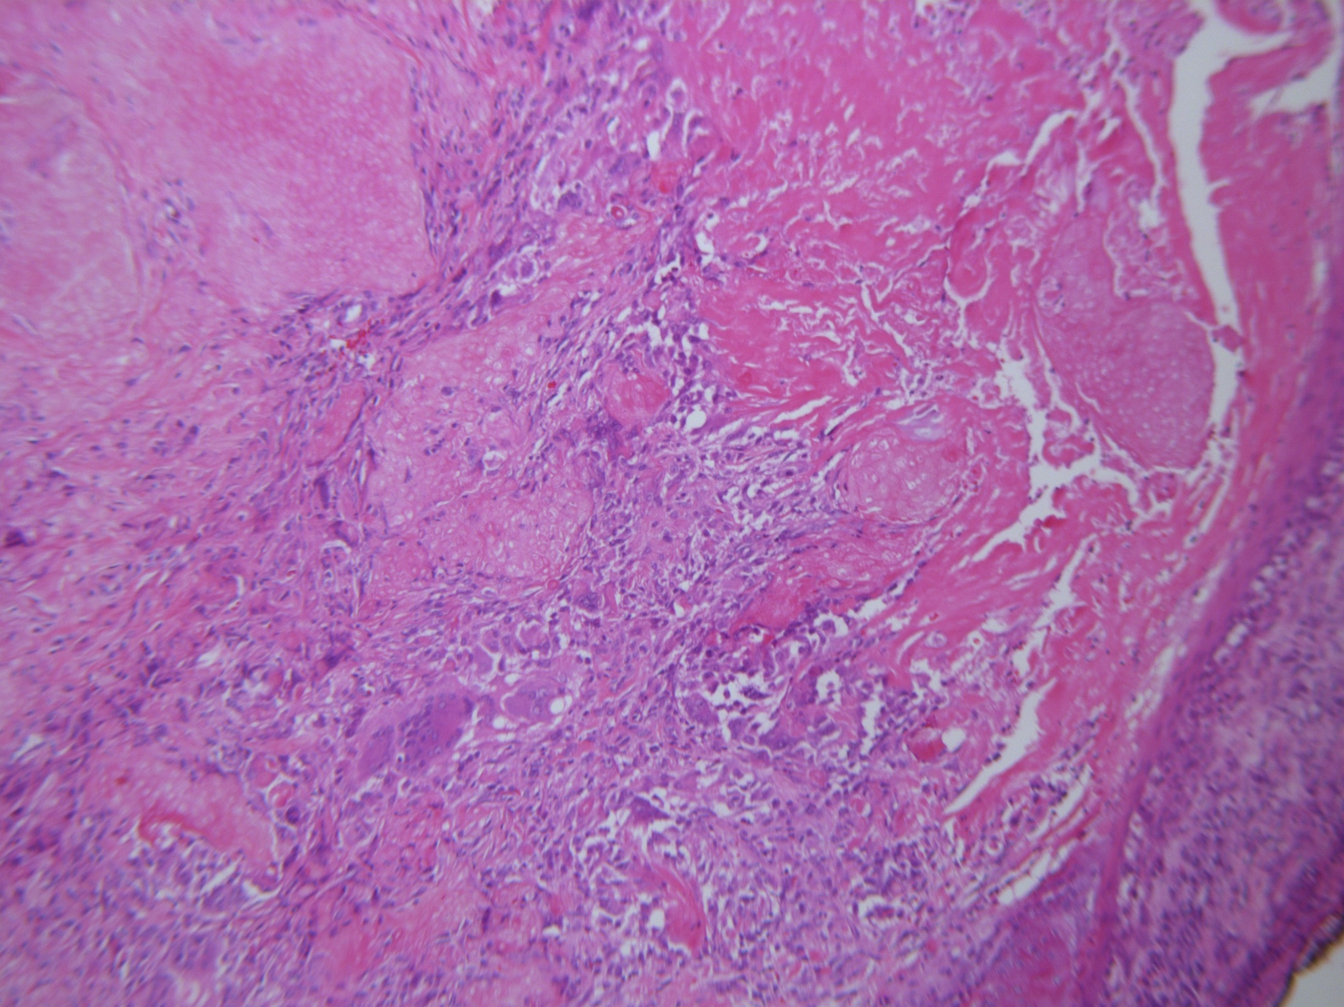

Slide 16
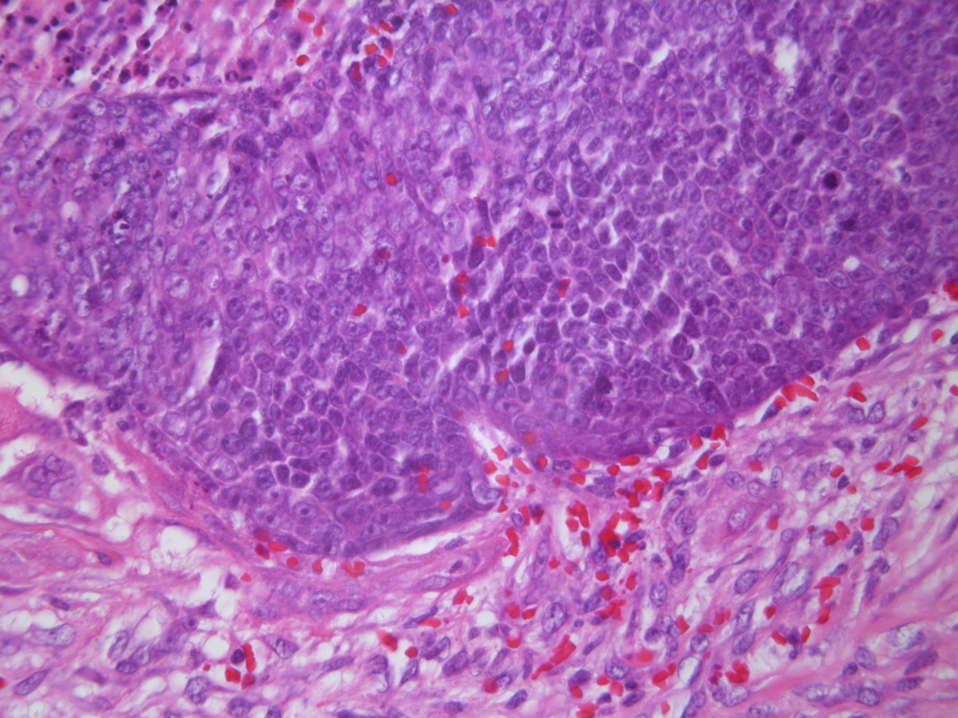

Slide 17
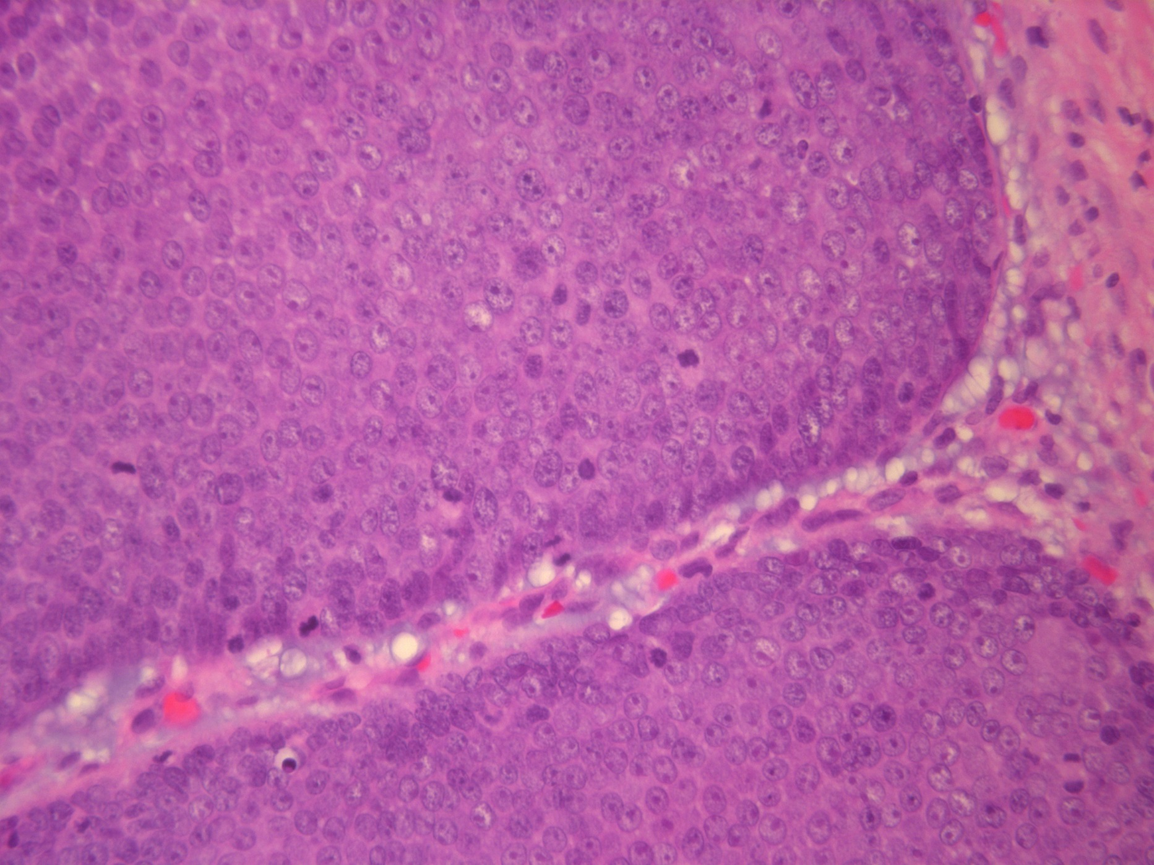

Slide 18
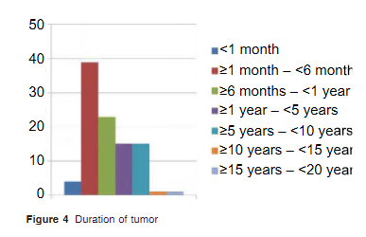
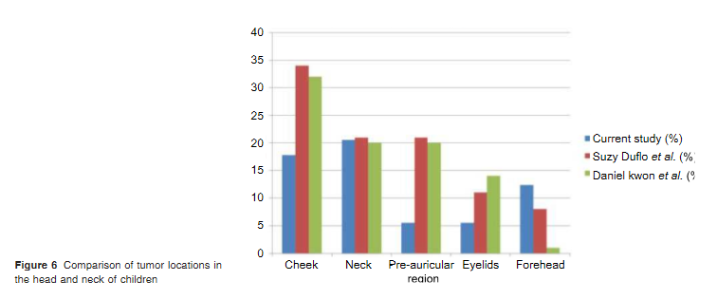

Slide 19
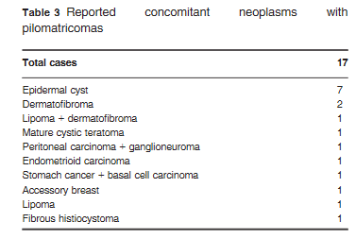

Slide 20
Pilomatrixoma embryology
With pilomatricomas developing from matrix type epithelium, a typical histologic picture can be observed.
Normal hair matrix shows two distinct epithelial cell types are represented:
Basally located, basophilic and, sometimes proliferative, matrix cell layer without features of palisading
Eosinophilic layer which shows typically an abrupt transition from the basophilic cells. Those eosinophilic cells lose their nucleus and represent the terminal differentiation of matrix cells.

Slide 21
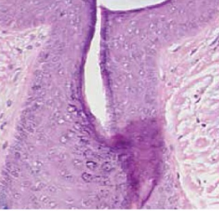
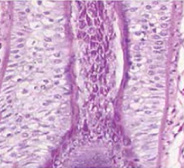
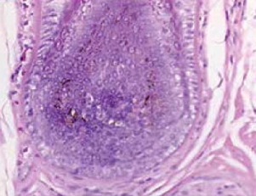
Infundibulum: Keratinization similar to the epidermis, including a granular layer and basket-weave orthokeratosis
Isthmus Trichilemmal keratinization, characterized by absence of granular layer and abrupt compact orthokeratosis
Bulb. Closely packed basophilic keratocytes and interspersed pigmented melanocytes characteristic of the hair matrix
An Bras Dermatol. 2015 Nov-Dec; 90(6): 780–798

Slide 22
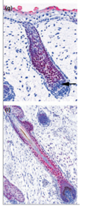
SOX9 expression in developing hair structures
Expression patterns of SOX9 change during human follicular morphogenesis.
At early stages in embryogenesis SOX9 is expressed throughout the evolving hair follicle, with SOX9 showing nuclear stain.
At more advanced stages, the evolving matrix loses its immunoreactivity for SOX9.
Outside the matrix primordium, SOX9 expression is retained
Pregerm stage
(c,) germ stage
(e) hair peg stage
(g) early bulbous hair peg stage
(i) fully advanced bulbous hair peg stage.
British Journal of Dermatology 2010 162, pp1294–1301

Slide 23
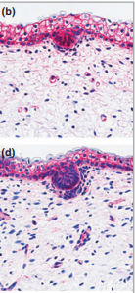
b-catenin expression in developing hair structures
The expression patterns of b-catenin change during human follicular morphogenesis
At early stages in embryogenesis, b-catenin is expressed throughout the evolving hair follicle, showing b-catenin nucleocytoplasmic immunoreactivity
At more advanced stages, the evolving matrix retains its nucleocytoplasmic labelling for bcatenin
Outside the matrix primordium, b-catenin now displays a membranous staining pattern

Slide 24
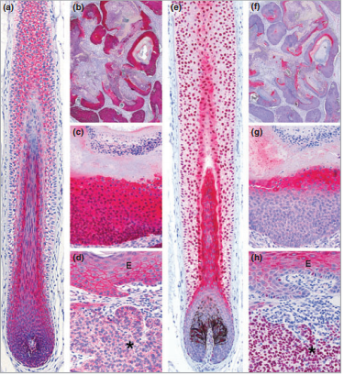
b-catenin and SOX9 expression in pilomatrixoma
b-catenin and SOX9 expression in pilomatrixoma
The spatial expression patterns for b-catenin and SOX9 in postnatal hair follicles (a, e) resemble those in pilomatrixoma.
The basaloid cells of pilomatrixoma show strong nucleocytoplasmic immunoreactivity for b-catenin (b, c) but are SOX9-negative (f, g).
Note that SOX9 also highlights melanocytes; this is shown in (e) depicting the follicular melanocytes interspersed between the bulbar keratinocytes
b-catenin
SOX9
British Journal of Dermatology 2010 162, pp1294–1301

Slide 25
Pilomatrixoma: Differential diagnoses
Pilar sheath acanthoma
Trichoadenoma
Trichilemmoma
Infundibuloma,
Proliferating trichilemmal cyst/tumor
Trichoblastoma and its variants
Pilomatricoma
Trichodiscoma/fibrofolliculoma
Neurofollicular hamartoma
Trichofolliculoma

Slide 26
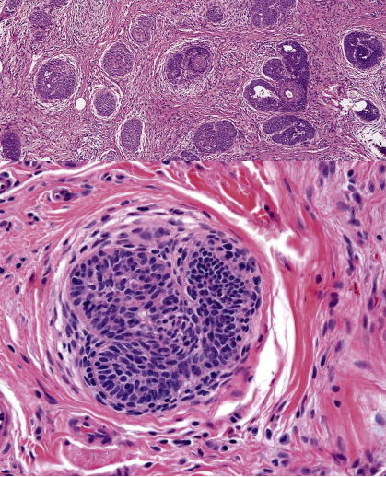
Trichoepithelioma. There are multiple nests of basaloid cells, with some showing abortive hair follicle differentiation.
Early follicular matrix developmentis present.

Slide 27
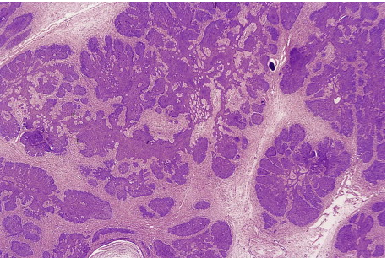
Trichoblastoma
The low-power view shows large, circumscribed basaloid tumor with no epidermal connection within the mid and lower dermis, with extension into the subcutis.
The tumor shows irregular nests of basaloid cells resembling a basal cell carcinoma but with variable stromal condensation and pilar differentiation

Slide 28
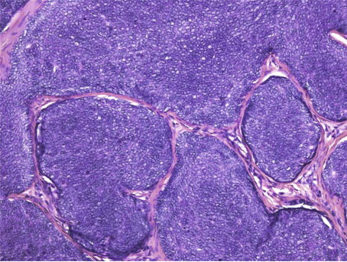
Large nodular trichoblastoma (trichogerminoma)
Composed of closely packed lobules of basaloid cells resembling hair bulbs, with little intervening stroma.

Slide 29
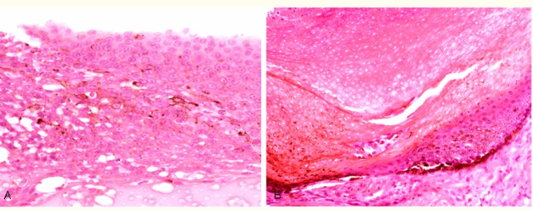
Pigmented pilomatricoma

Slide 30
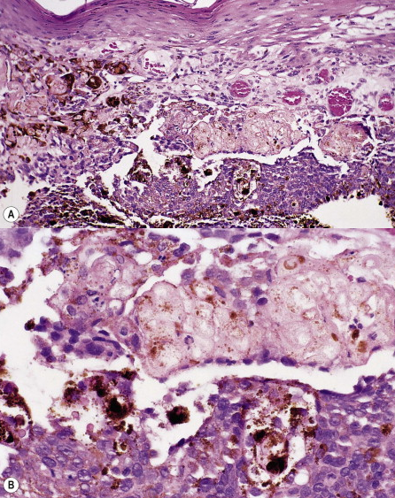
Melanocytic matricoma is a well-circumscribed dermal nodule composed of variably melanized, pleomorphic,
and mitotically active matrical and supramatrical cells with islands of shadow cells
The shadow cells are not always plentiful. Admixed with these cells are numerous dendritic melanocytes containing melanin pigment. There has been no discernible connection with the overlying epidermis or a hair follicle.
An example of melanocytic matricoma has been described with expansile nests as well as single cells, dendritic and epithelioid cell types, and nuclear atypia with mitotic activity; the biologic significance of these changes is unclear, but similar examples of melanocytic colonization have been described in basal cell carcinomas and proliferative squamous lesions

Slide 31
Pilomatricoma: Presentation and Associations
Pilomatricomas present typically as single lesions but may be associated with clinical syndromes.
Myotonic muscular dystrophy
Gardner syndrome which is a soft form of familial adenomatous polyposis
Rubinstein Taybi syndrome, which is a rare genetic disorder characterized by short stature, moderate to severe learning difficulties, distinctive facial features and broad thumbs and 1st toes.
Associated with chromosome 9 trisomy which is characterized by growth deficiency, structural malformations of the heart, changes in the shape of the skull and facial region, musculoskeletal, genital, and renal disorders. Molecularly, pilomatricomas have been associated with β-catenin gene mutations implicating the WNT/β-catenin pathway which is also a genetic pathway associated with Gardner syndrome ()
Chromosome 18 trisomy has been identified in pilomatricoma cells, potentially relevant for growth and differentiation through the anti-apoptotic gene Bcl-2 (13)

Slide 32
Molecular associations
β-catenin gene mutations implicating the WNT/β-catenin pathway which is also a genetic pathway associated with Gardner syndrome
More recently, chromosome 18 trisomy has been identified in pilomatricoma cells, a genetic anomaly that could additionally be pathogenically relevant in growth and differentiation via the the anti-apoptotic geneBcl-2

Slide 33
Patient presentation
36 year old patient with a long standing tumor left eyebrow (>4 years)
The lesion was not growing, movable and non painful
A diagnosis of ossifying pilomatrixoma was made
No additional lesions after 18 months
Picture of different patient

