Slide 1
EASTERN OPHTHALMIC PATHOLOGY SOCIETY
Washington, D.C., 2018
An unusual variant of basal cell carcinoma
J. Godfrey Heathcote, Phillip Moss, Noreen M. Walsh, Curtis W. Archibald
Departments of Pathology and Ophthalmology & Visual Science
Dalhousie University, Halifax, Nova Scotia

Slide 2
Clinical history
M 93
2-year history of a visible fleshy mass on the left lower eyelid
Significant recent growth with occasional spontaneous bleeding
Patient taking warfarin for cardiac arrythmia
6 years previously excision of basal cell carcinoma from left lower lid
On examination:
Elevated lid mass measuring 15 x 15 mm
Mobile and telangiectatic
Involving lower canaliculus
Not adherent to medial canthal tendon

Slide 3
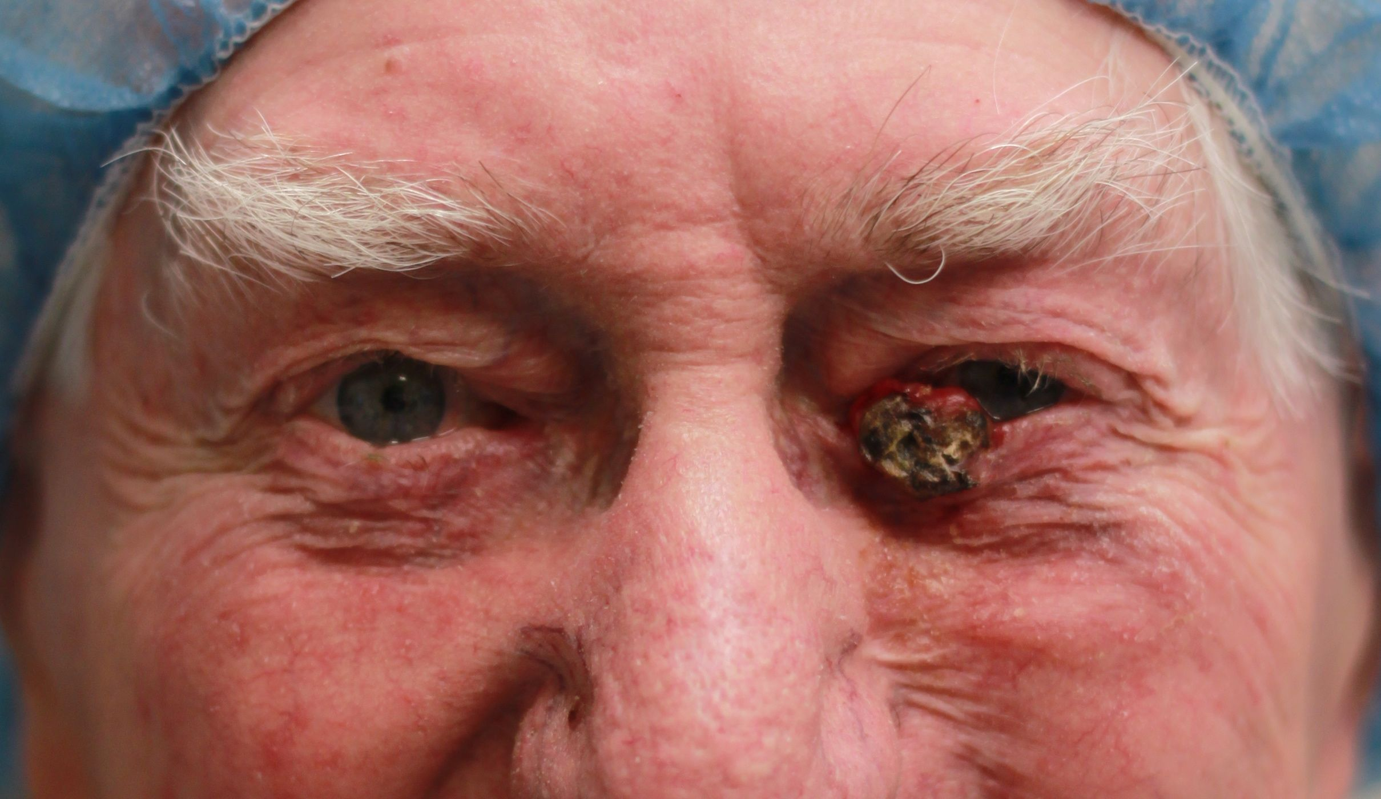
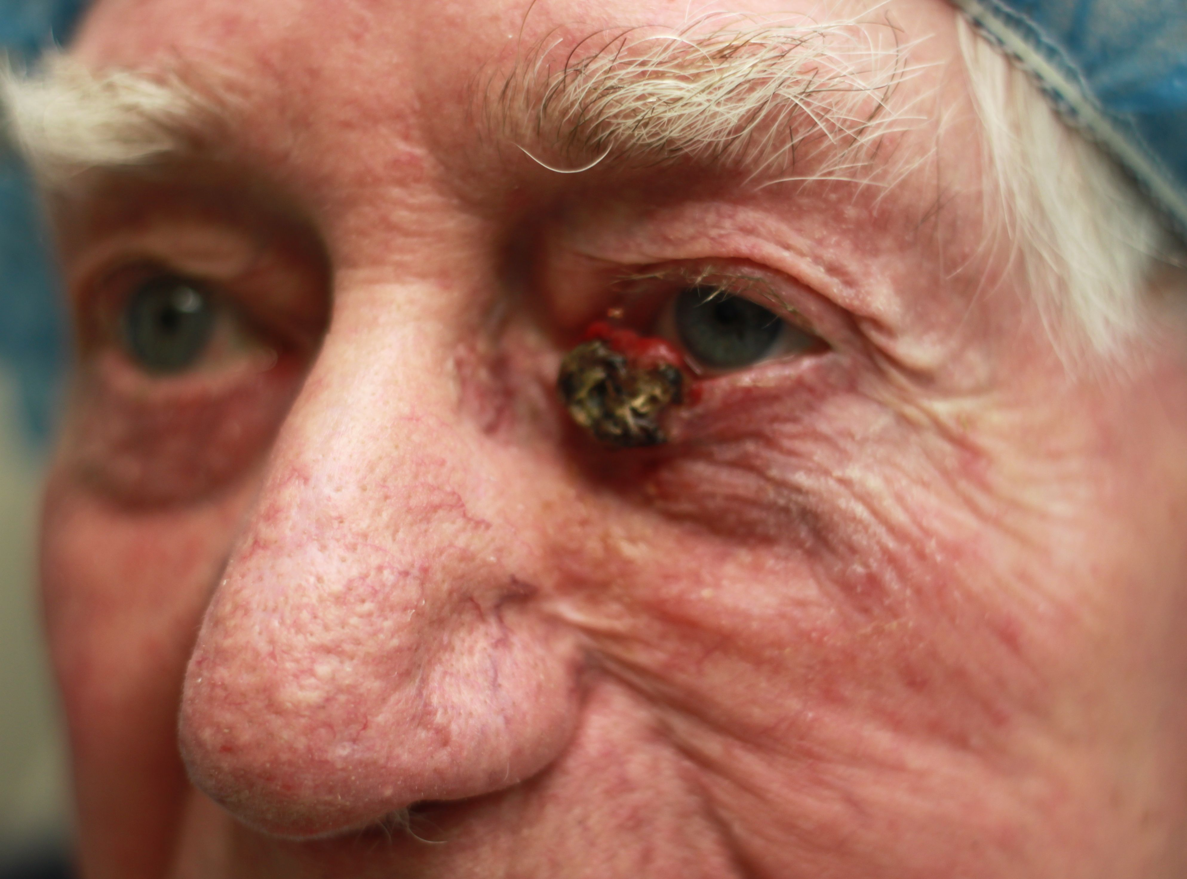
Clinical

Slide 4
Clinical history
Ocular examination
VA: 6/9 OD with 2+ nuclear sclerosis; 6/12 OS with posterior chamber IOL
Hertel exophthalmometry: 18 OD; 17 OS
Posterior pole unremarkable
Past ophthalmic history
Extracapsular cataract extraction 3 years previously
Past medical history
Hypothyroidism, hypertension, (treated)
hip fracture

Slide 5
Clinical diagnosis
Basal cell carcinoma
Excised under frozen section control
Medial, lateral and inferior margins clear
Pathological examination : gross
Full-thickness excision 22 mm (H) x 11 mm (V)
Skin nodule 17 mm x 10 mm x 7 mm in thickness
Medial edge: black eschar and some lashes
Nodule well circumscribed inferiorly but close to resection margin
Central foci of calcification

Slide 6
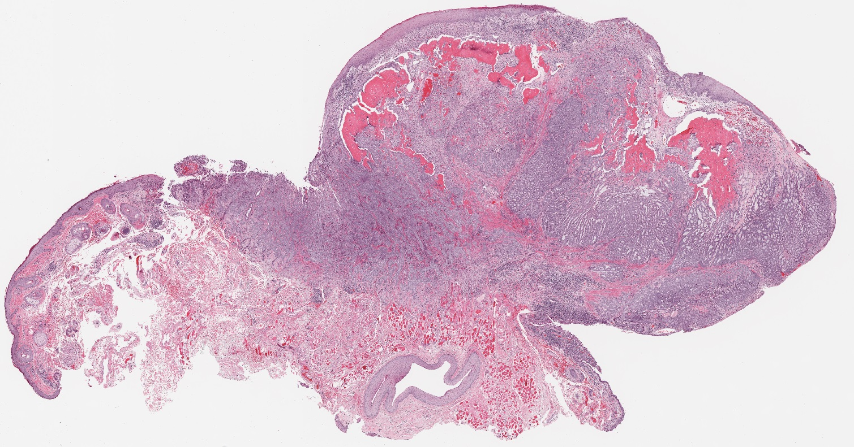
Histopathology

Slide 7
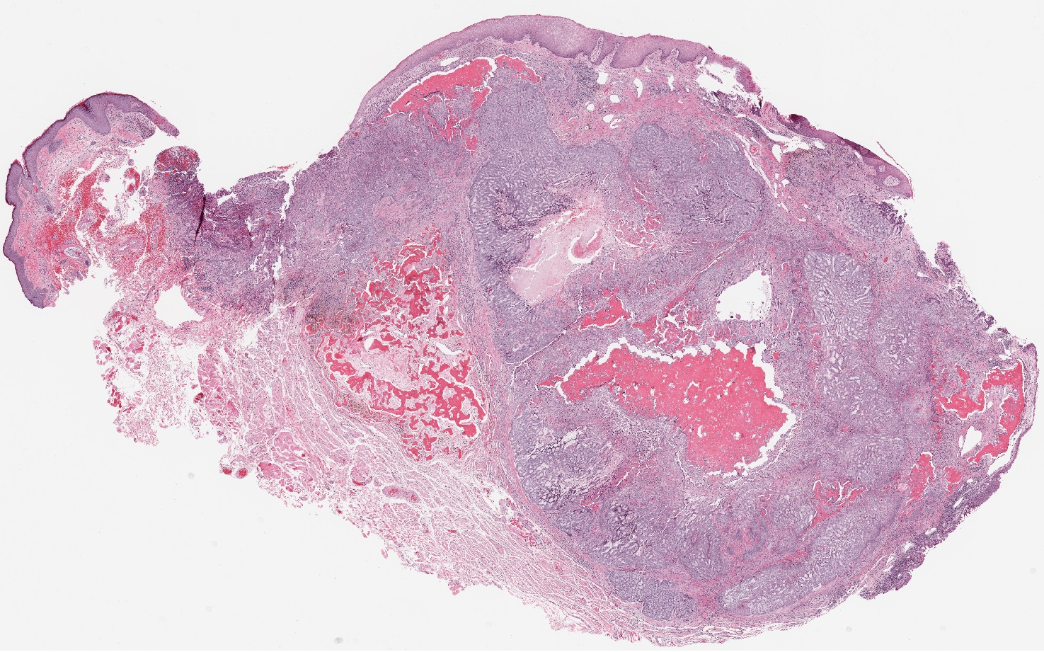
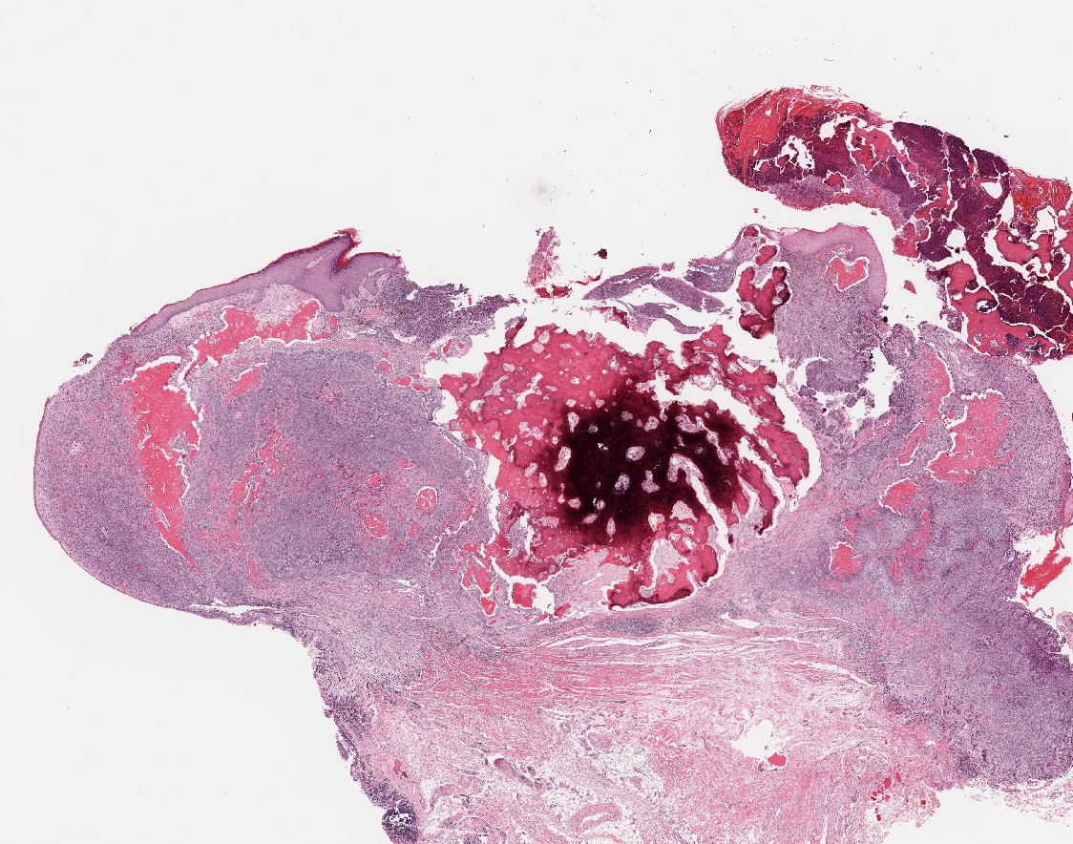
Histopathology

Slide 8
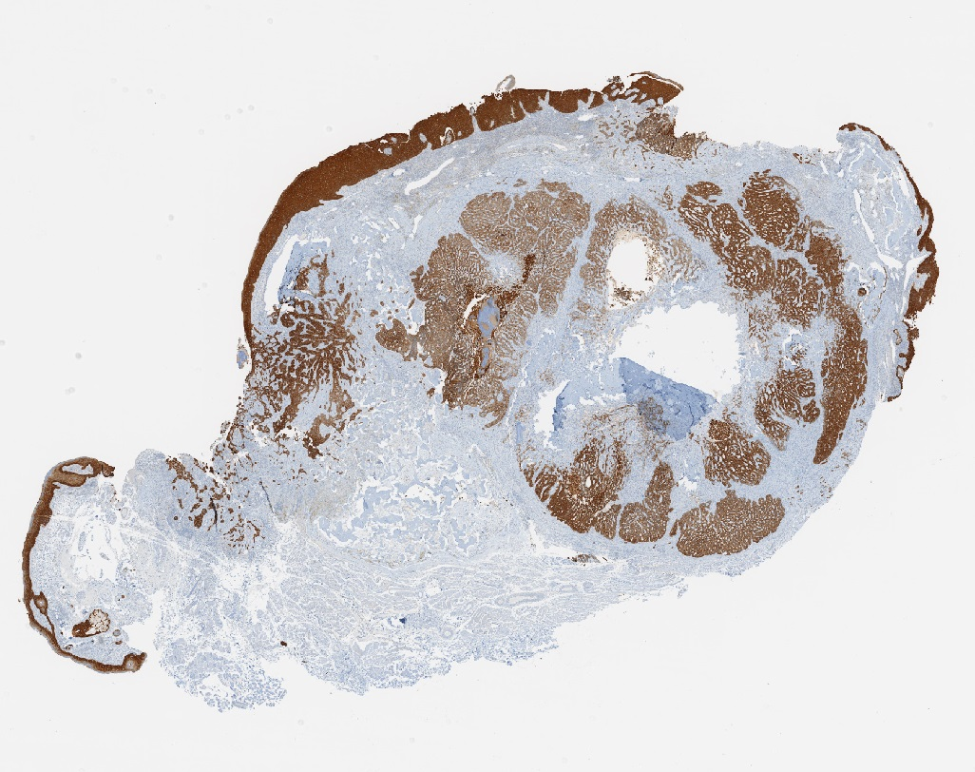
Immunohistochemistry
CK5/6

Slide 9
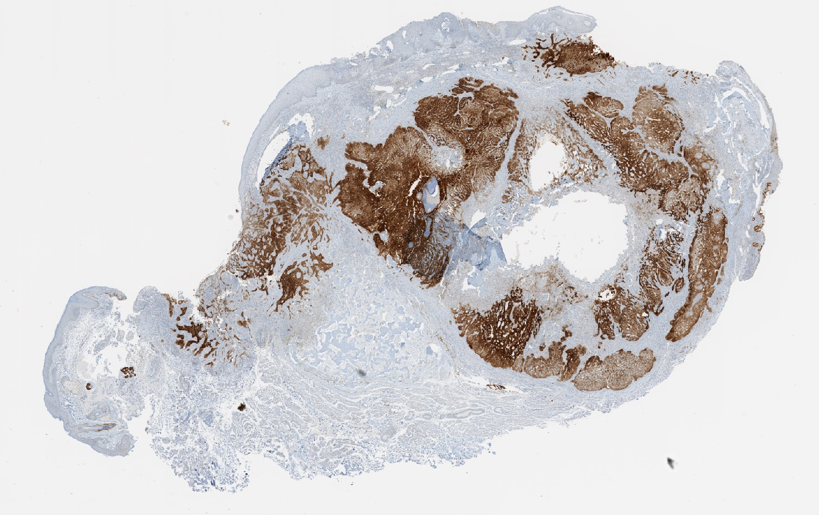
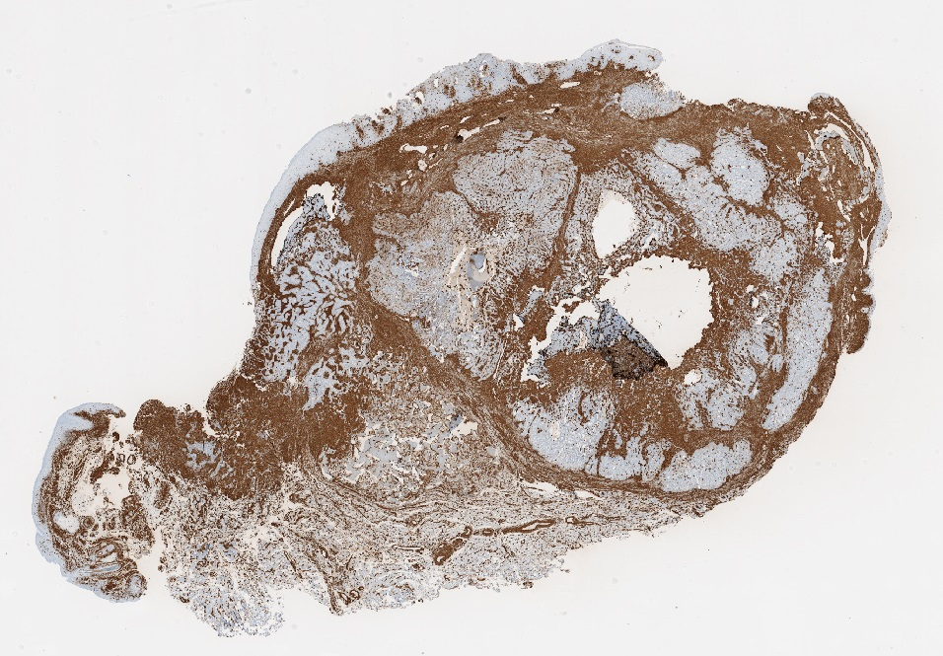
Immunohistochemistry
EpCAM
Vimentin

Slide 10
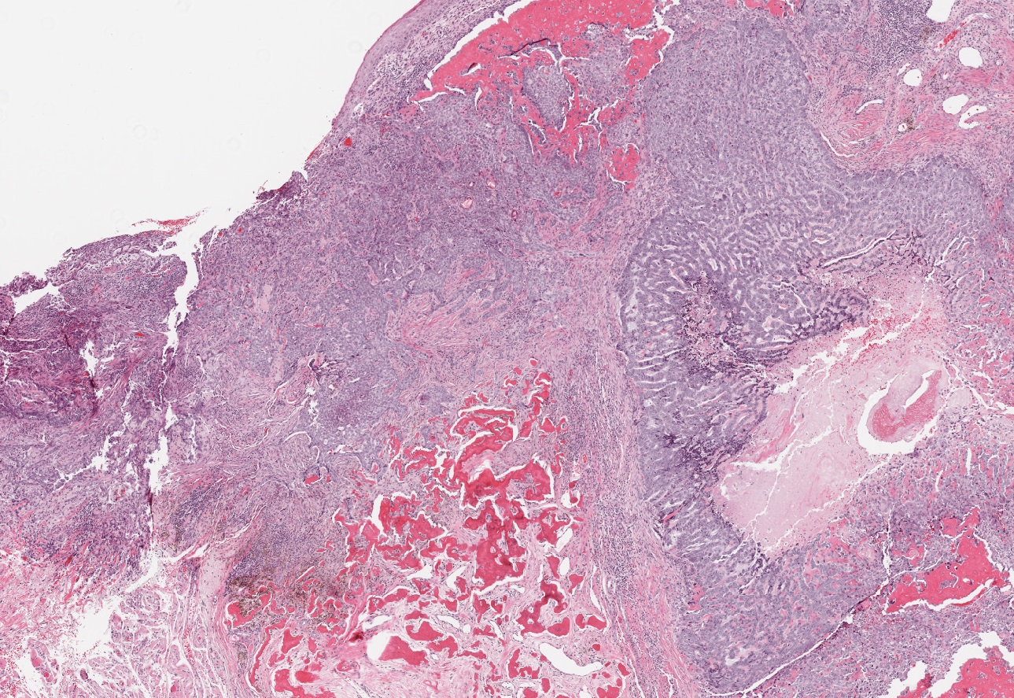
Histopathology

Slide 11
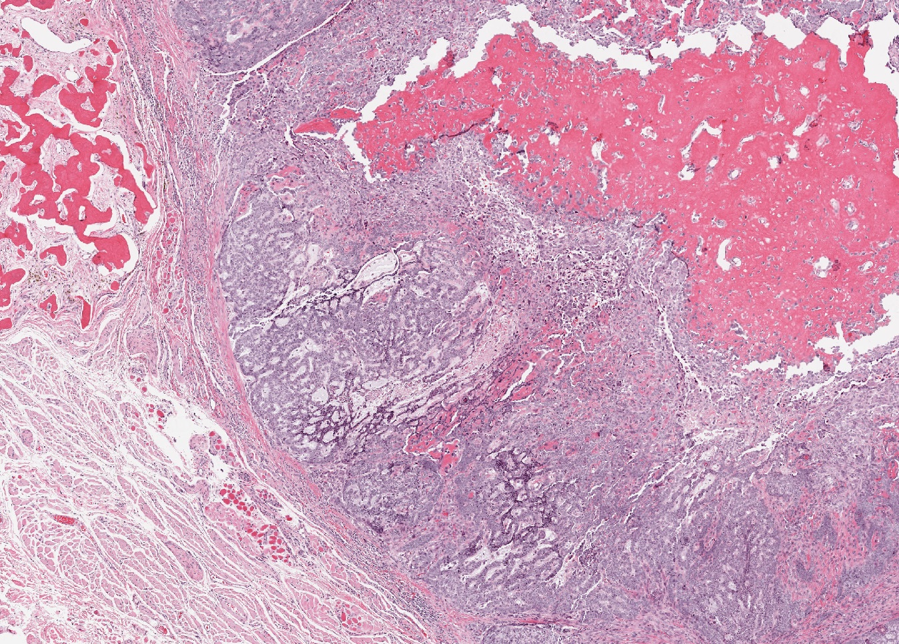
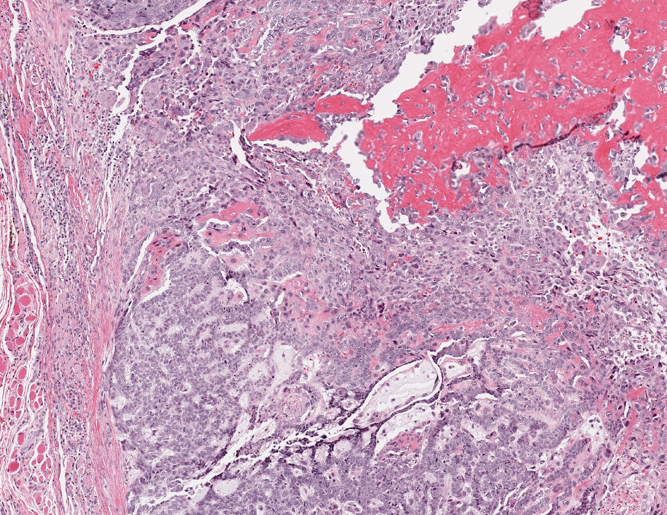
Histopathology

Slide 12
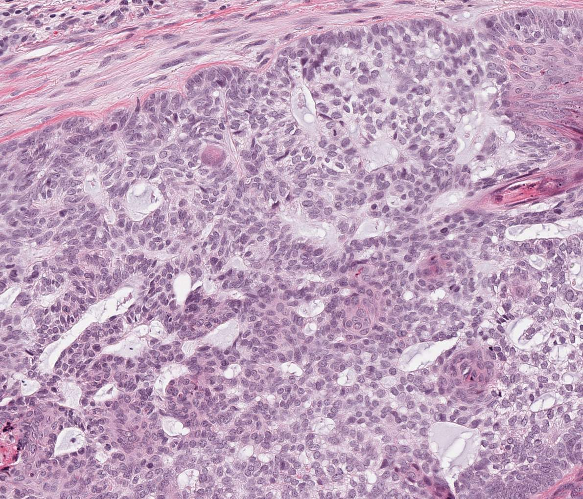
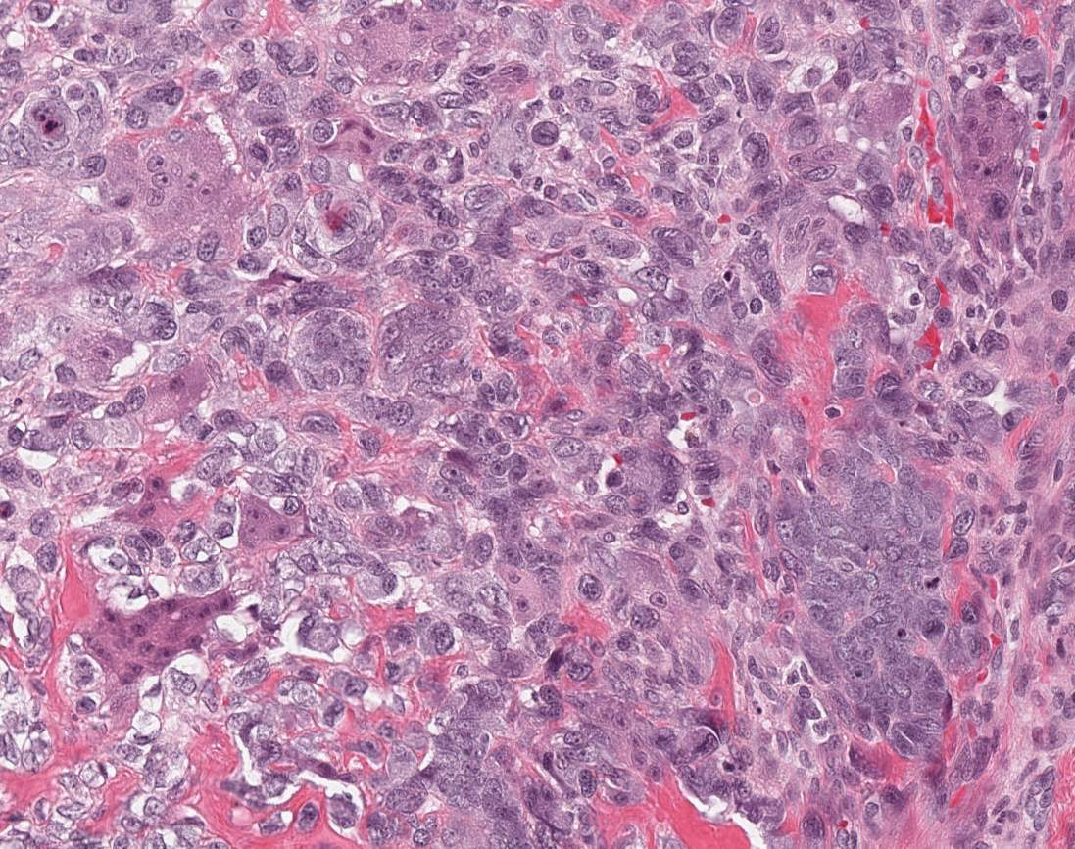
Histopathology
Adenoid BCC
‘Undifferentiated’ BCC

Slide 13
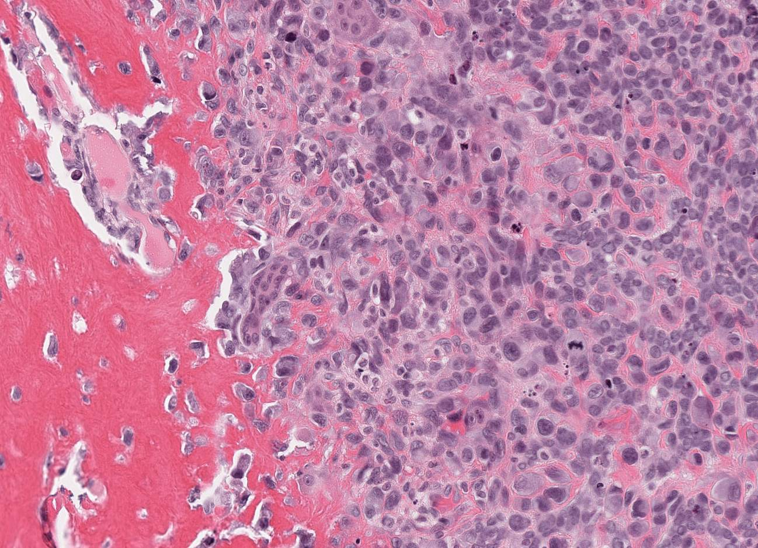
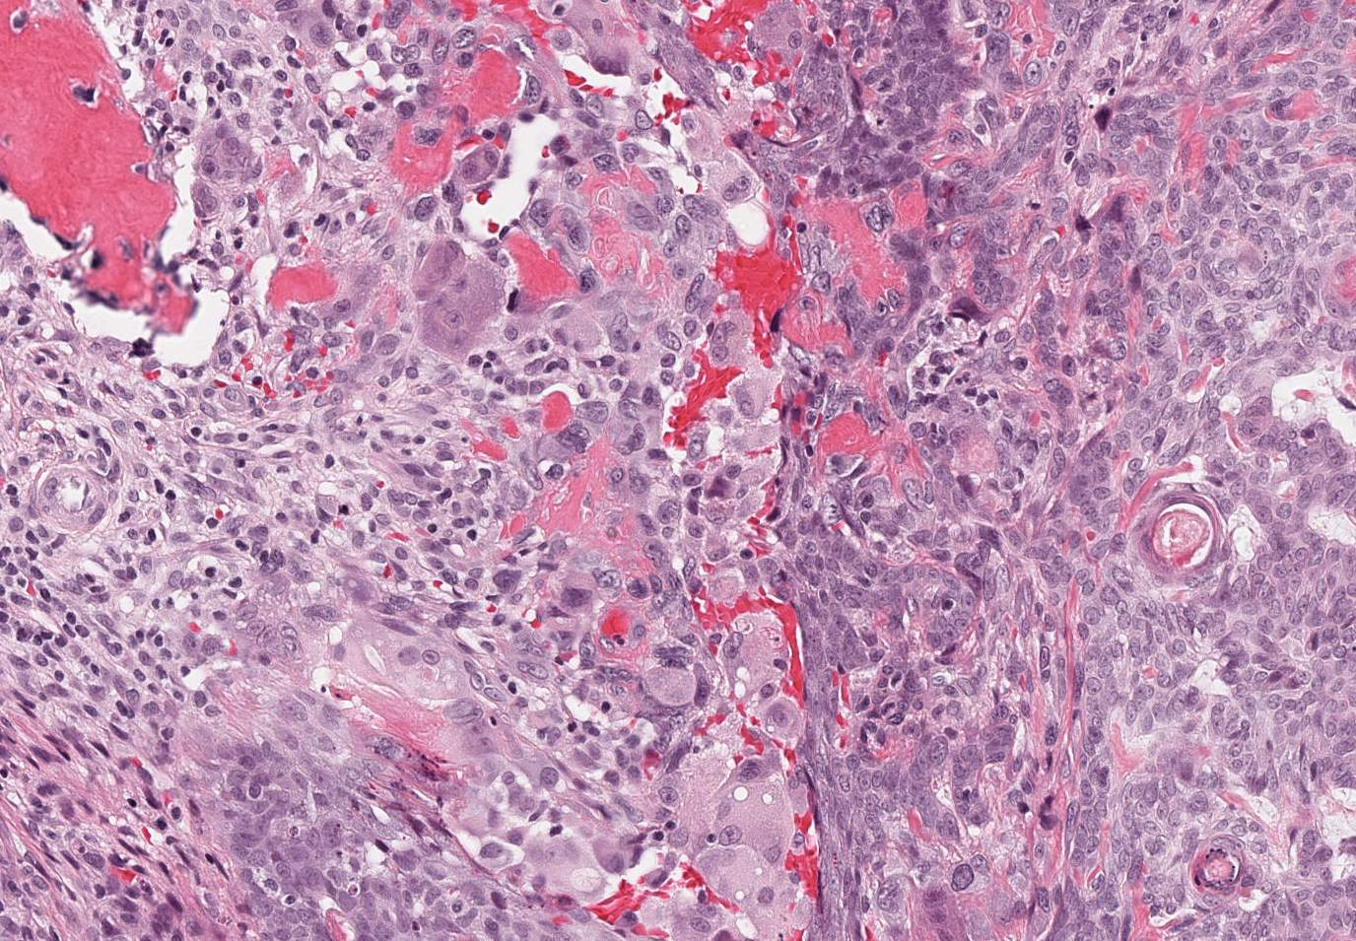
Histopathology
Malignant osteoid
Composite

Slide 14
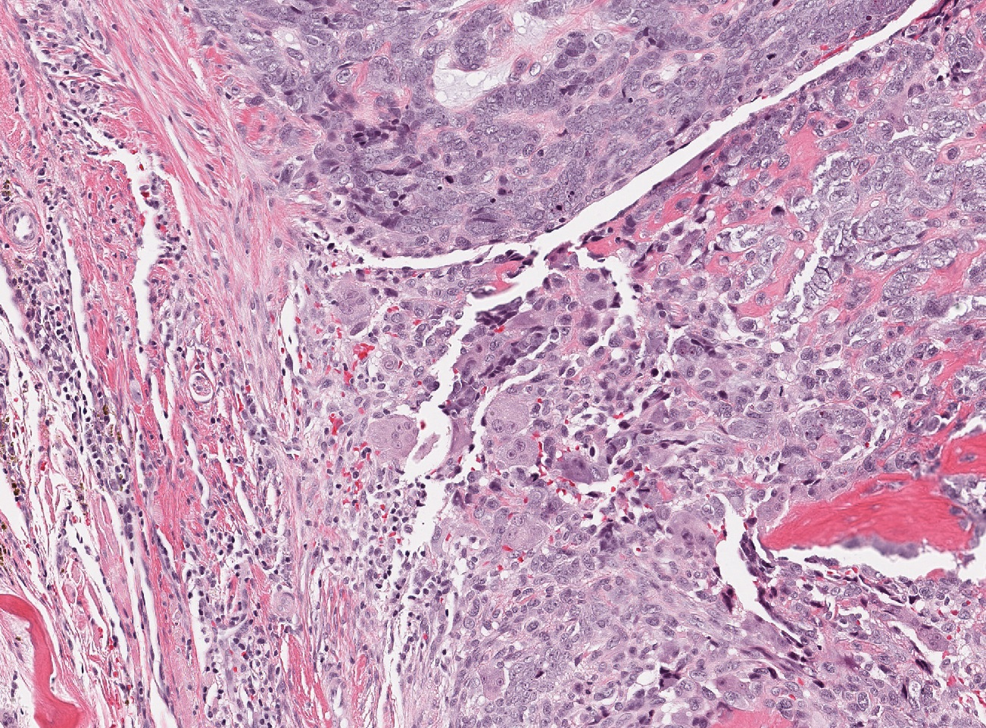
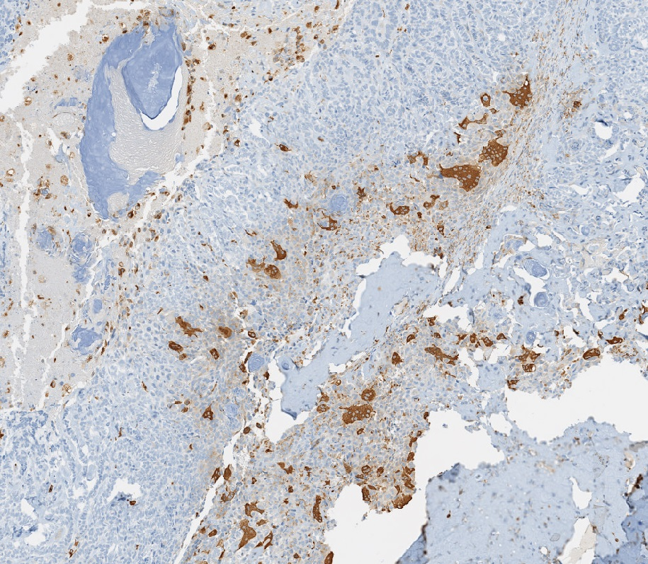
Histopathology
Multinucleated giant cells
CD68

Slide 15
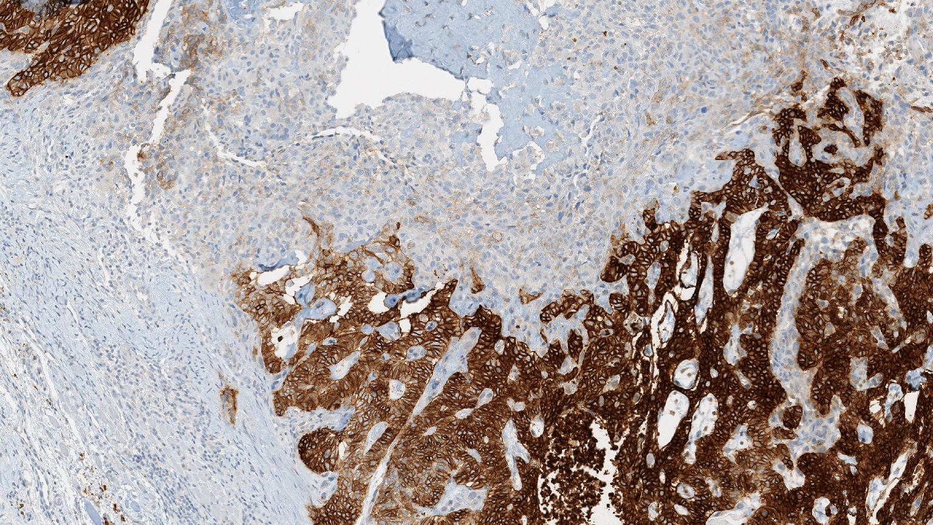
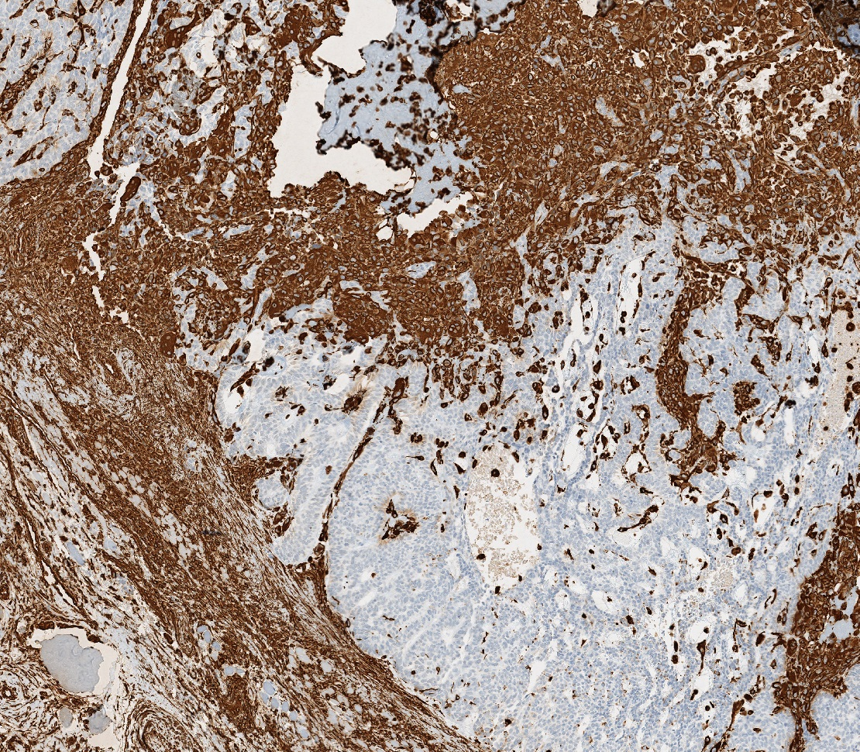
Immunohistochemistry
EpCAM
Vimentin

Slide 16
Pathological diagnosis
Basal cell carcinosarcoma
with
Osteosarcoma
Pleomorphic sarcoma with osteoclastic giant cells

Slide 17
Carcinosarcoma
Concept introduced by Virchow (1864)
Malignant epithelial elements plus malignant mesenchymal elements
More common in viscera than skin
Epithelial component undergoes metaplasia to malignant mesenchyme
Cutaneous carcinosarcoma
Exophytic, ulcerated nodules
Sun-exposed skin
Older men
Often history of recent rapid growth

Slide 18
Cutaneous carcinosarcoma
Epithelial component
Basal cell carcinoma
Squamous cell carcinoma
Other rare cutaneous carcinomas, e.g., eccrine porocarcinoma
Mesenchymal component
Osteosarcoma
Chondrosarcoma
Rhabdomyosarcoma
Leiomyosarcoma
Pleomorphic sarcoma

Slide 19
Cutaneous carcinosarcoma
Zbacnik, et al. 2015
47 reported cases
M : F = 2.5 : 1 and median age 76 years (range: 49-93)
One case with metastasis (2.1%) but 80 mm in maximal dimension
BCC: nodular growth pattern in 16/47
Sarcomatous component
Osteosarcoma …………………………………………………...38%
Atypical fibroxanthoma/pleomorphic sarcoma…………..38%
Fibrosarcoma/spindle cell sarcoma………………………….21%
Mixed ………………………………………………………………13%
Pleomorphic with osteoclastic giant cells…………………....4%

Slide 20
Cutaneous carcinosarcoma
Zbacnik, et al. 2015
47 reported cases
28 (60%) located in head & neck
9 located in auricular/periauricular skin
Harvey et al. (2014): 3/4 unincluded cases involving ear
3/47 involving periocular skin
M69: inner canthus
F77: supraorbital
F 65: infraorbital
? Reflects early presentation and prompt treatment: small size

Slide 21
Pathological diagnosis
Role of immunohistochemistry
Basal cell component
Cytokeratin, BerEP4, BCL2, p63 – positive
Vimentin-negative
Sarcomatous component
Cytokeratin, BerEP4, BCL-negative
Vimentin-positive
p63 may be positive

