Slide 1
Eastern Ophthalmic Pathology Society 13-15 September meeting Washington, D. C
Codrin E. Iacob, M. D.
The New York Eye & Ear Infirmary of Mount Sinai

Slide 2
Granular Corneal Dystrophy type 2
In the late 1880 a German neurologist, Wilhelm Heinrich Erb, coined the term “muscular dystrophy” and characterized this group of diseases as progressive, degenerative primary muscular abnormalities
Erb-Duchenne muscular dystrophy was subsequently named after him
Dystrophy derives from the Greek “dys” meaning wrong, difficult, and from “trophe”, meaning nourishment.

Slide 3
Granular Corneal Dystrophy type 2
In 1890, the German Ophthalmologist Arthur Groenouw (1862 – 1945), working in Breslau, then Germany (currently Wroclaw, Poland), published the first clinical observations about degenerative corneal conditions which he called “Knötchenförmige Hornhauttrübungen”, which were translated into English as “Noduli Corneae”.

Slide 4
Granular Corneal Dystrophy type 2
His description is rather detailed: numerous scattered corneal deposits with round to ragged edges which are stable in time, populate predominantly the central cornea, and do not elicit an accompanying inflammatory reaction. Some larger deposits elevate the overlying epithelium

Slide 5
Granular Corneal Dystrophy type 2
Original drawings of
Knötchenförmige Hornhauttrübungen

Slide 6
Granular Corneal Dystrophy type 2
Early in the twentieth century ophthalmologist observed several types of corneal dystrophies and early descriptions were published of what used to be called Groenouw type I and II, Fleischer familial corneal dystrophy type I and II, or Bücklers corneal dystrophy type I and II
Groenouw, Reis, Fleischer, and Bücklers were just few of classifications attempted

Slide 7
Granular Corneal Dystrophy type 2
Max Bücklers, German Ophthalmologist (1895-1969. Hannover; Mönchen-Gladbach) considered granular dystrophy as the most frequent of the corneal dystrophies (1938)

Slide 8
Granular Corneal Dystrophy type 2
J. Reimer Wolter (trained at the University in Hamburg and emigrated to the US in 1953) and William M. Cutler reported granular corneal dystrophy in the American Medical Literature in 1958.
1961 Sam T. Jones (Chicago, Illinois) and Lorenz E. Zimmerman (from AFIP) published a detailed histopathologic description of granular, macular, and lattice corneal dystrophies

Slide 9
Granular Corneal Dystrophy type 2
1988 the first report of a corneal condition with characteristics of granular and lattice dystrophies was published by Robert Folberg. His study included Italian families in Pennsylvania, USA, which had their origins traced back to the Avellino region in Italy.

Slide 10
Granular Corneal Dystrophy type 2
1997 granular dystrophy Groenouw type I (CDGG1), Reis-Bücklers (CDRB), lattice type I (CDL1) and Avellino (ACD) were all four found to be 5q31-linked human autosomal dominant corneal dystrophies, all implying changes in transforming growth beta-induced gene (TGFBI).
Avellino corneal dystrophy was found to not be restricted to Avellino region in Italy
The nomenclature of these corneal dystrophies was unified to include TGFBI corneal dystrophies as opposed to the Non-TGFBI corneal dystrophies

Slide 11
TGFBI corneal dystrophies
Granular corneal dystrophy type 1 was linked to mutation R555W in exon 12
Granular corneal dystrophy type 2 was linked to mutation R124H in exon 4
Granular corneal dystrophy type 3 (Reis-Bücklers dystrophy)
Thiel-Behnke corneal dystrophy was linked to mutation R555Q in exon 12
Lattice corneal dystrophy type 1 was linked to mutation R124C in exon 4

Slide 12
Granular Corneal Dystrophy type 2
Granular corneal dystrophy type 2 (GCD 2) shows variable clinical expression and onset (as early as age 3 in homozygotes and as early as age 8 in heterozygotes
but most heterozygotes are diagnosed in their second decade or even early adulthood).
Because of this late onset of the disease, some patients undergo corneal surgery (LASIK, LASEK, PTK, or PRK) without being properly diagnosed.
Marked exacerbation of the clinical course was observed in GCD 2 following such corneal surgical procedures.

Slide 13
Granular Corneal Dystrophy type 2
I am presenting here the case of a now 49 year old female who had LASIK performed age 31 while considered to have normal corneas.
Age 42 she had both LASIK flaps removed because of massive interface accumulations of granular hyaline deposits.
Later on, age 48, she had full PK performed on one side due to further exacerbation of her granular deposits.

Slide 14
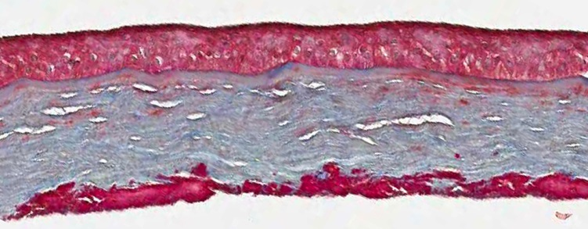
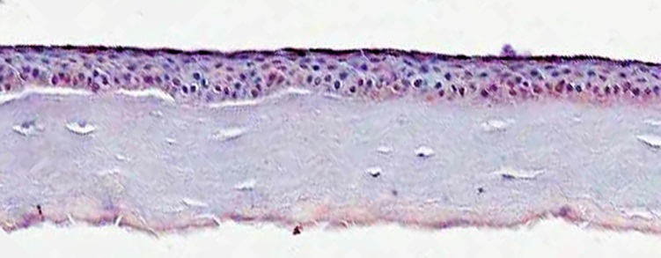
Granular Corneal Dystrophy type 2
After lifting and scraping of LASIK flaps (OD x 2 and OS x 3)
She had amputation of LASIK flap and scraping of corneal bed in April of 2011 in OS December of 2011 in OD.
H&E, trichrome, and Congo red stains from amputated LASIK flap

Slide 15
Granular Corneal Dystrophy type 2
Central thinning of the cornea due to prior amputation of the
LASIK flap
Granular deposits are seen anteriorly

Slide 16
Granular Corneal Dystrophy type 2
Lack of Bowman’s layer
Granular deposits in anterior stroma

Slide 17
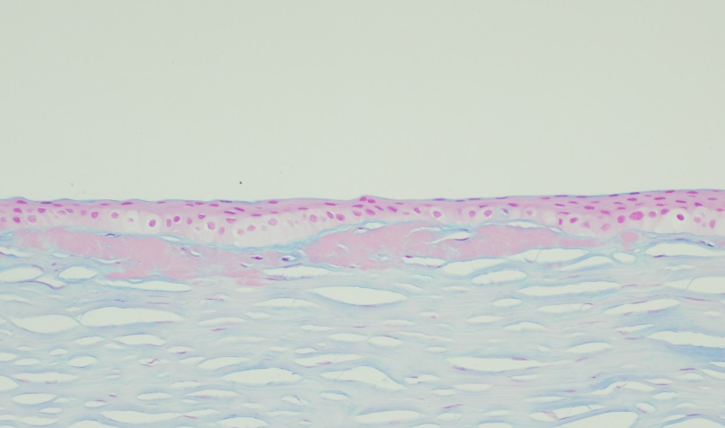
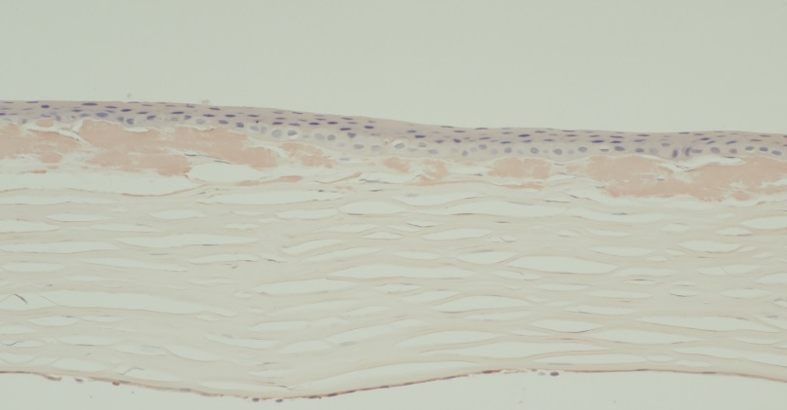
Granular Corneal Dystrophy type 2
Trichrome, PAS, Alcian blue, and Congo red stains
very few amyloid deposits were seen

Slide 18
Granular Corneal Dystrophy type 2
No further genetic testing could be conducted
No detailed familial history is available either
The late onset, which allowed LASIK to be performed on supposed normal corneas, and the exacerbated clinical course after LASIK suggest GCD type 2, supposedly heterozygote genotype

Slide 19
References
Groenouw A. Noduli corneae. Arch. F. Augenheilk., 1890
Buecklers M. Die Erblichen Hornhautdystrophien. Bucherel des Augenarztes. Stuttgart, Enke, 1938
Duke-Elder S. Textbook of Ophthalmology. St. Louis, Mosby, 1938
Jones ST, Zimmerman LE. Histopathologic differentiation of granular, macular, and lattice dystrophies of the cornea. Am J Ophthalmol. 1959 Jan;47(1 Part 1):1-16.
Han KE, Choi SI, Chung WS, Jung SH, Katsanis N, Kim TI, Kim EK. Extremely varied phenotypes in granular corneal dystrophy type 2 heteroztgotes. Mol Vis. 2012;18:1755-62. Epub 2012 Jun 27
Awwad ST, Di Pascuale MA, Hogan RN, Forstot SL, McCulley JP, Cavanagh HD. Avellino corneal dystrophy worsening after laser in situ keratomileusis: further clinicopathologic observations and proposed pathogenesis. Am J Ophthalmol. 2008 Apr;145(4):656-61. doi: 10.1016/j.ajo.2007.12.008. Epub 2008 Feb 19
Konishi M, Yamada M, Nakamura Y, Mashima Y. Immunohistology of kerato-epithelin in corneal stromal dystrophies associated with R124 mutations of the BIGH3 gene. Curr Eye Res. 2000 Nov;21(5):891-6
C3D classification of corneal dystrophies- Edition 2, 2015

