Slide 1
EOPS-2018 Washington D. C. Frederick A. Jakobiec, MD, D.Sc.
Massachusetts Eye and Ear Infirmary
Harvard Medical School
BILATERAL EPIBULBAR PSEUDORHEUMATOID NODULOSIS:
A New Rheumatic Entity

Slide 2
CLINICAL HISTORY
53-year-old man
“Bumps” on the inside corners of both eyes
Itching and burning sensation with redness of both eyes
No systemic disease or arthritis
Rheumatoid factor negative

Slide 3
OCULAR EXAMINATION
Large, circumscribed, yellow, confluent, partially mobile lesions
Normal intraocular evaluation
At surgery, the left epibulbar lesion was adherent to the underlying sclera.

Slide 4
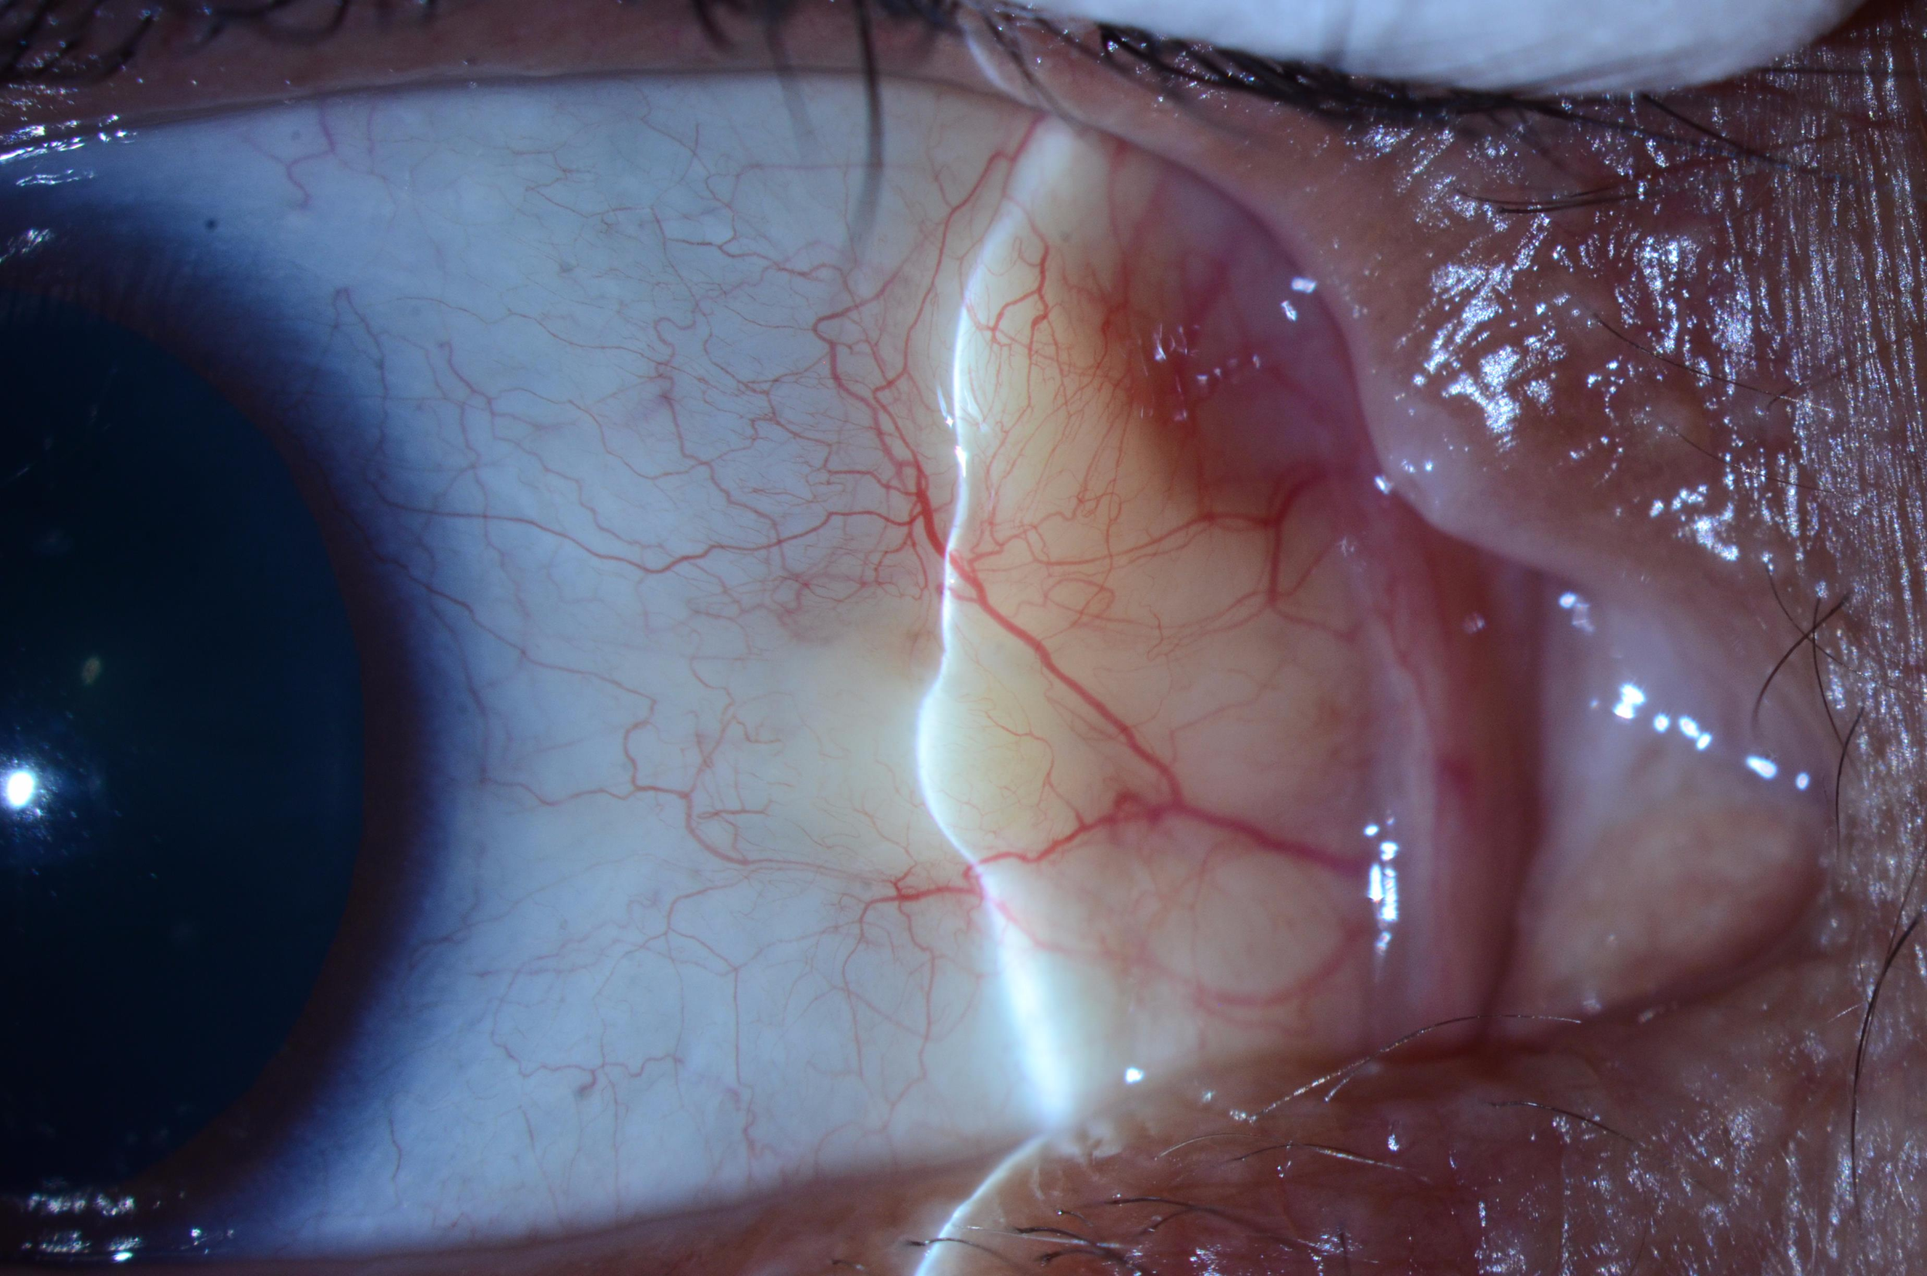
Notes:
OD

Slide 5
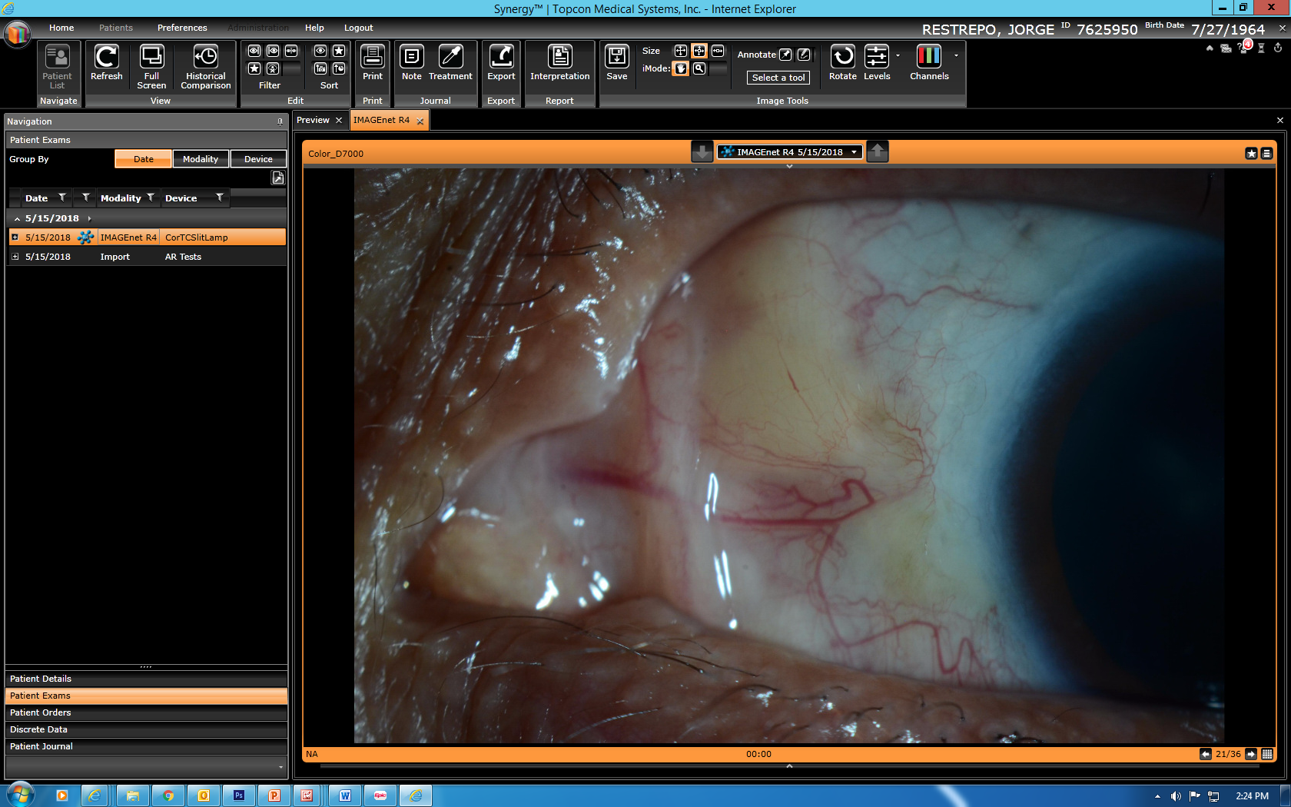
Notes:
OS

Slide 6
TYPE OF NODULES
Rheumatoid nodule (single lesion)
Rheumatoid nodulosis (multiple scattered or grouped lesions)
Rheumatic—term encompassing rheumatoid and pseudorheumatoid lesions

Slide 7
KEY DEFINITIONS
Necrobiosis (not collagen necrosis)
Fibrinoid deposits (not fibrinoid necrosis)
Caseous necrosis (TB)
(Vascularitis usually is associated with fibrinoid deposits: rheumatoid arthritis, polyarteritis nodosa, lupus erythematosus, granulomatosis with polyangiitis [formerly Wegener’s disease])

Slide 8
HISTOPATHOLOGY OF PRESENT LESION
Palisading (picket fence) granulomas of histiocytes + fibroblasts surrounding central necrobiotic collagen
No fibrinoid deposits or mucopolysaccharide deposition
No giant cells or eosinophils
Light mononuclear infiltrate

Slide 12
IMMUNOPATHOLOGY FINDINGS
CD163+ palisading histiocytes
CD3+ T lymphocytes predominate over CD20+ B lymphocytes and CD138+ plasma cells
CD1a+ Langerhans cells generously present within palisades
IgG, IgM, IgA, but not IgE deposition in necrobiotic foci

Slide 13
CD163
Notes:
CD163 10X

Slide 14
CD3
Notes:
CD3 10X

Slide 15
CD20
Notes:
CD20 10X

Slide 16
CD1a
Notes:
CD1a 20X

Slide 17
CD1a
Notes:
CD1a 40X

Slide 18
IgA
Notes:
IgA 5X

Slide 19
IgA
Notes:
IgA 10X

Slide 20
SUMMARY OF SPECTRUM OF EPIBULBAR RHEUMATIC NODULES
Rheumatoid nodules (active disease and RF+)
Rheumatoid nodulosis (active disease, multiple, grouped and scattered nodules, RF+)
Accelerated rheumatoid nodulosis (active disease following introduction of chemotherapy, RF+)
Pseudorheumatoid nodule (no arthritis, RF-)
New entity: Pseudorheumatoid nodulosis (no arthritis, multiple, bilateral nodules, RF-)

