Slide 1
Theresa R Kramer, md, mba Krieger Eye Institute Photomicrographs provided by Gerry Lutty, PhD. Ocular Vasculogenesis and Angiogenesis Laboratory at the Wilmer Eye Institute
Eastern Ophthalmology Pathology Society, 2018
Washington, DC
2018
Pathology of the vasculature in "human specimens of AMD" with
anatomic and functional blood flow measures including OCTA.

Slide 2
Disclosures: Founder and Shareholder OcuFLOW, Inc., Sole owner, OcuFLOW, LLC, Sole Owner “Share the Cells, LLC, Sole owner, Medical Costing, LLC Funding: This work was partially funded by TEDCO-TCF and TEDCO-MD-PACE awards. The development is supported by the Sinai Hospital Bio-incubator and Krieger Eye Institute.
© 2018 OcuFLOW, Inc

Slide 3
Objectives
1. Review the anatomy and physiology of choroidal blood flow and its role in ARMD
2. Describe the available techniques for measuring choroidal blood flow and how they correlate with the pathophysiology ARMD. 3. Discuss how new therapeutic interventions for altering blood flow can modify the progression of ARMD.
© 2018 OcuFLOW, Inc

Slide 4
Pathology of the Choroidal vasculature in armd
© 2018 OcuFLOW, Inc

Slide 5
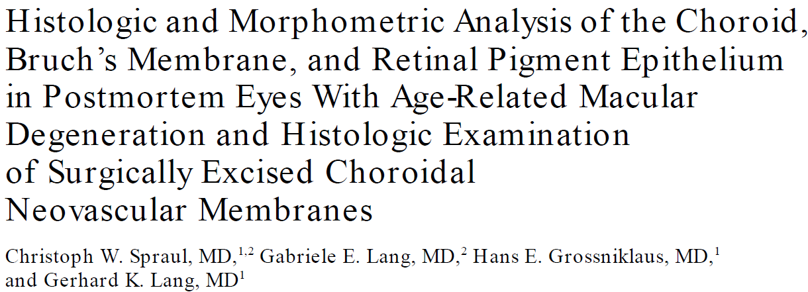
Choroidal Vascular Changes in Age Related Macular degeneration
© 2018 OcuFLOW, Inc

Slide 6
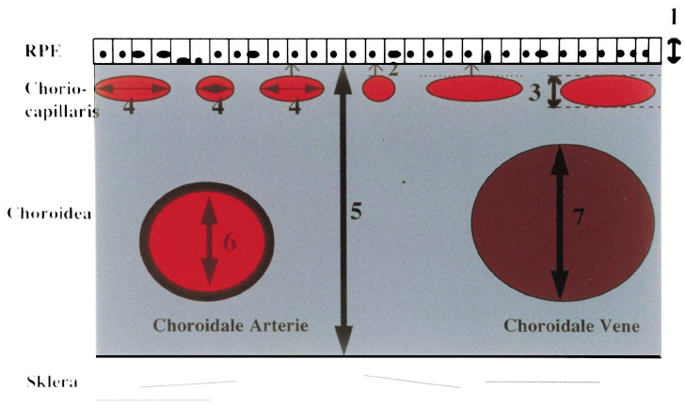
Choroidal Vascular Changes in Age Related Macular degeneration
Analysis of Choroidal Vessels in Neovascular and Nonneovascular Aging Macular Degeneration
 | Submacular Choroid |  |  | Peripheral Choroid
Parameter | NV | Non-NV | Control | NV | Non-NV | Control
Density of large choroidal vessels | Decreased | Decreased | na | No difference | No difference | na
Diameters of arteries and veins | No difference | No difference | na | No difference | No difference | na
Choriocapillaris density | Increased | Increased | na | Increased | Increased | na
Diameter of capillaries | Increased** | Increased | na | No difference | No difference | na
Thickness of choroid | No difference | No difference | na | ?? | ??
Ratio of large choroidal vessels to choroidal thickness | Increased | Increased | na | Increased | Increased | na
Spraul, 1999

Slide 7
Choroidal Vascular Loss in Age Related Macular degeneration
87 yo WF - No AMD
Normal macula
No drusen, RPE loss or
hyperpigmentation
Normal, homogeneous
choriocapillaris
Broad diameter, freely
connecting capillaries
% vascular = 77.8%
Choroid diameter +=12.8
© 2018 OcuFLOW, Inc

Slide 8
Choroidal Vascular Loss in Age Related Macular degeneration
86 yo white female early AMD
Drusen &
Pigment abnormality
Choriocapillaris
pathology
Loss of interconnecting
capillary channels
Thin lumens
Loss of interconnecting
capillary channels
Choroidal neovascular
buds
© 2018 OcuFLOW, Inc

Slide 9
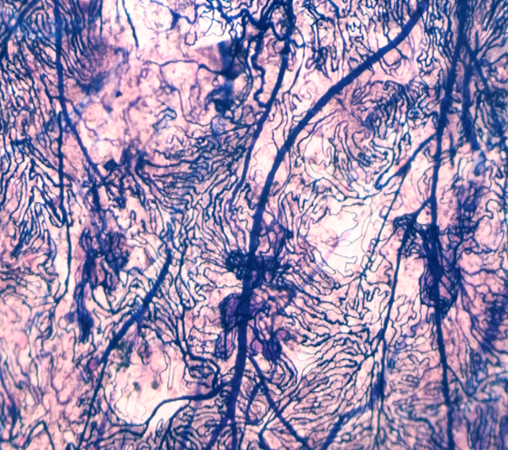
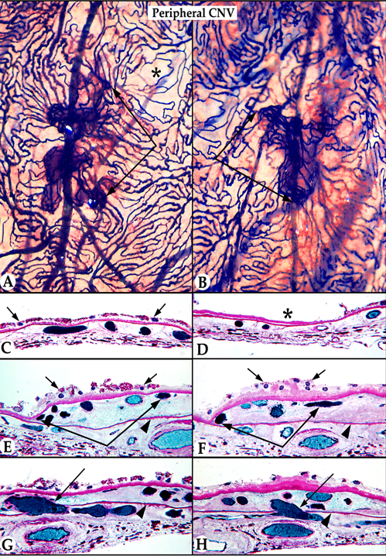
Choroidal Vascular Loss in Age Related Macular degeneration
Far Periphery in GA = GLOBAL diseae
Choroidal NV
Breaks in Bruchs’
© 2018 OcuFLOW, Inc

Slide 10
Anatomic Analysis in AMD Using Clinical Methodologies
© 2018 OcuFLOW, Inc

Slide 11
Peripheral Morphology changes in Age Related Macular Degeneration
Reticular degeneration in periphery
Other peripheral changes
Autofluorescence changes
Drusen but not much RPE
Patchy ICGA in periphery
Peripheral autofluorescence change
Associated with visual change
Notes:
.

Slide 12
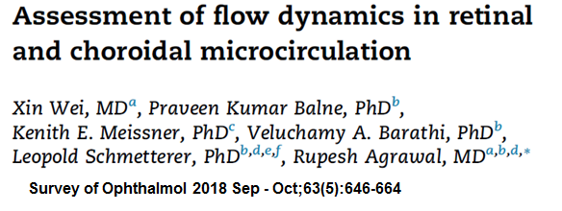
Review of Clinically Useful Ocular Blood Flow Measurement technologies

Slide 13
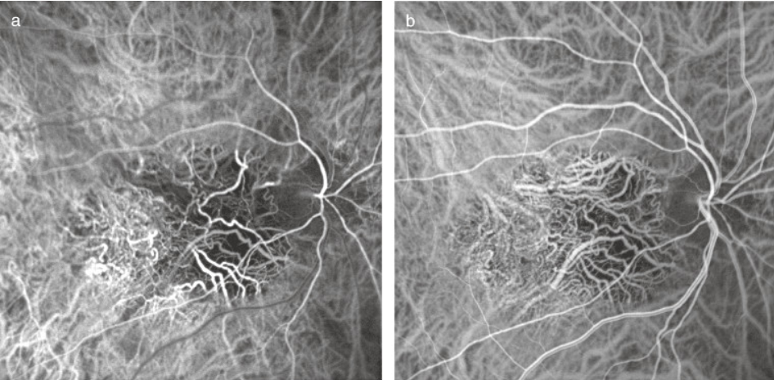
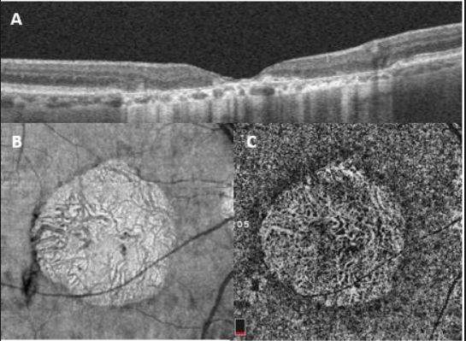
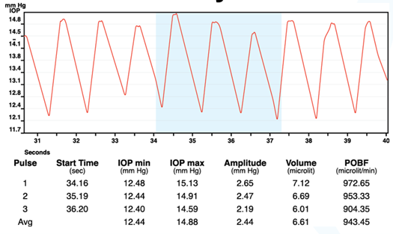
Advances in the Clinical Analysis of Choroidal Vasculature and Choriocapillaris
OCT Anatomic / Minimal Flow Methods
OCT devices
Measure choroidal thickness
OCTA Devices
approved by FDA
OCTA and choroidal thickness, subfoveal
Laser Flowmetry
Subfoveal
Swept source OCT
Only one approved by FDA
Swept source OCT with ultra-wide field
Limited by technology in the periphery
but hopeful
Doppler OCTA
Not in US yet, but 150 degrees of retina
Flow
Quantitative Orbital Doppler Flow Methods
Color Doppler Flow measurements of
orbital vessels (SPCA)
Needs advanced technical expertise
Quantitative Pulsatility Methods
Laser Interference fundus pulsation
amplitude (FPA)
Pulsatile Ocular Blood Flow Analyzer
Pulse amplitude, POBV, POBF
ICG Angiography
ICG Angiography
OCT Angiography
Pulsatile Ocular Blood Flow (POBF)
© 2018 OcuFLOW, Inc

Slide 14
SS-OCT of the Choroid
© 2018 OcuFLOW, Inc

Slide 15
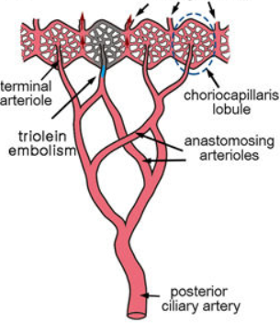
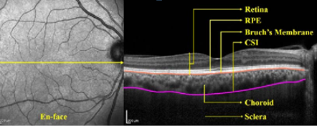
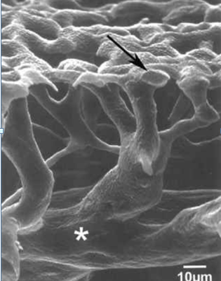
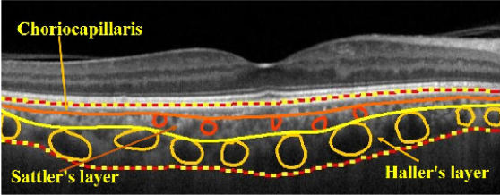
Cross Sectional Structure of Choroid and Choriocapillaris
Swept Source OCT
© 2018 OcuFLOW, Inc

Slide 16
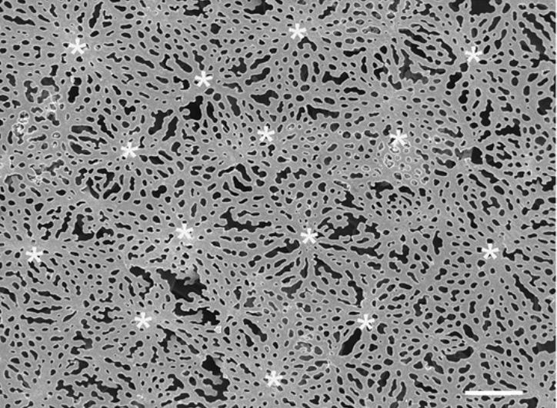
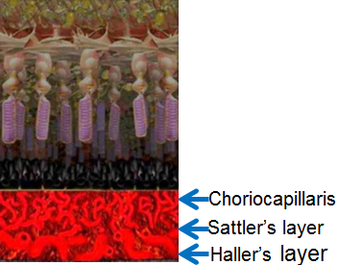
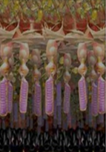
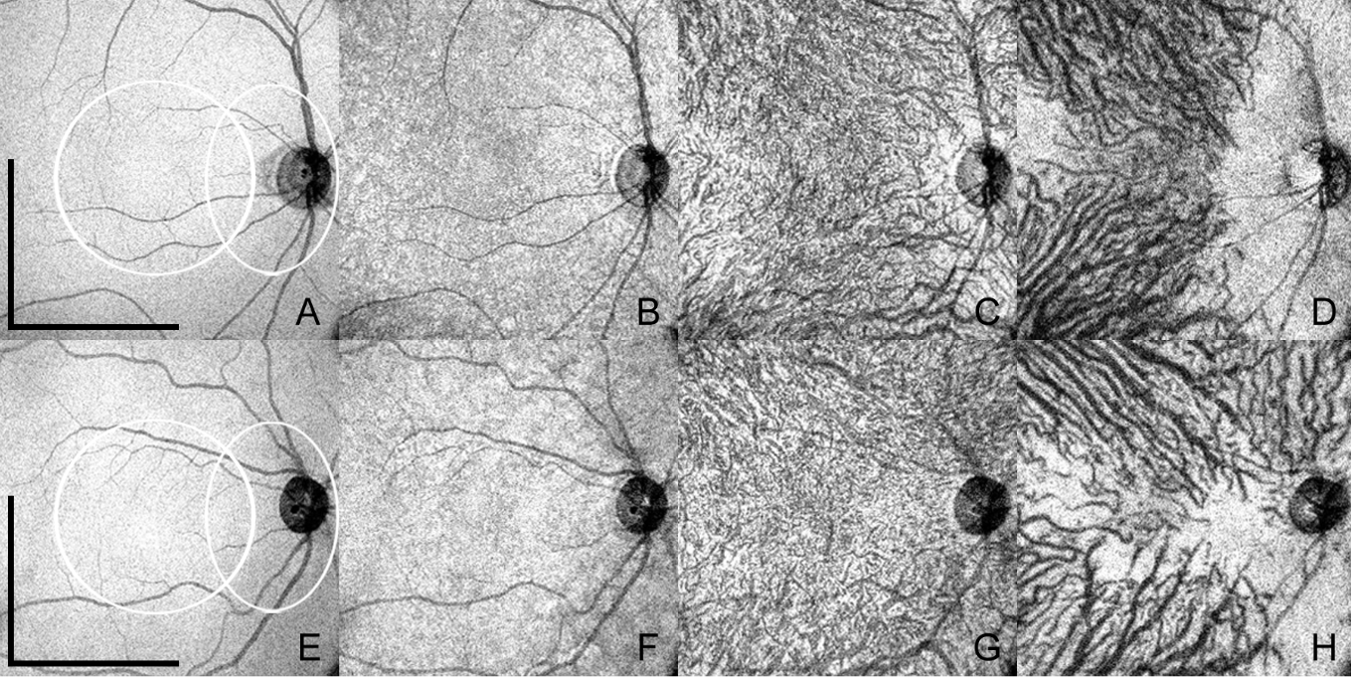
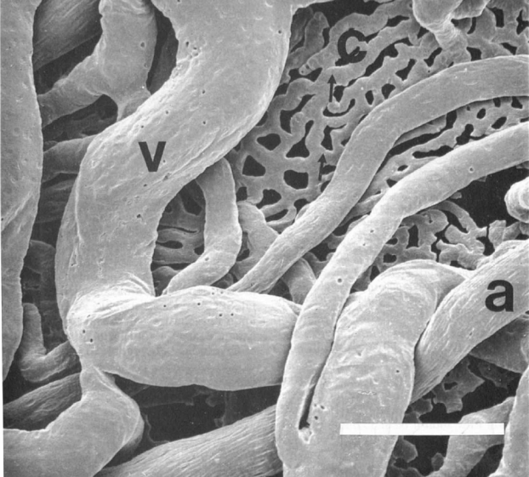
En Face Structure of Choroid and Choriocapillaris
Choriocapillaris
Inner Choroid
26 YO
47 YO
Outer Choroid /
Choroidal arteries and veins
RPE
Swept Source OCT
PlosOne: Adhi, 2015
© 2018 OcuFLOW, Inc

Slide 17
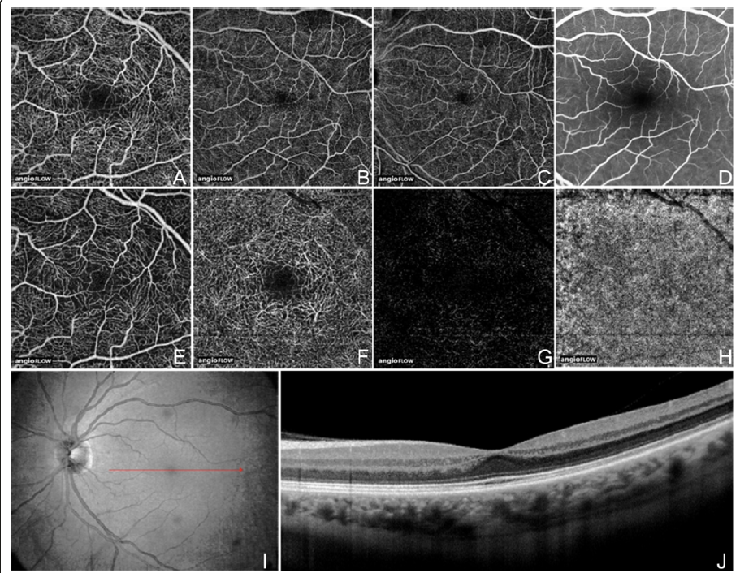
Normal Swept-source OCTA
56 yo male
no ocular disease
6 X 6 mm
8 X 8 mm
8 X 8 mm
Superficial Inner retina
Deep Inner retina
Outer retina
Choriocapillaris
PlosOne: Adhi, 2015
© 2018 OcuFLOW, Inc

Slide 18
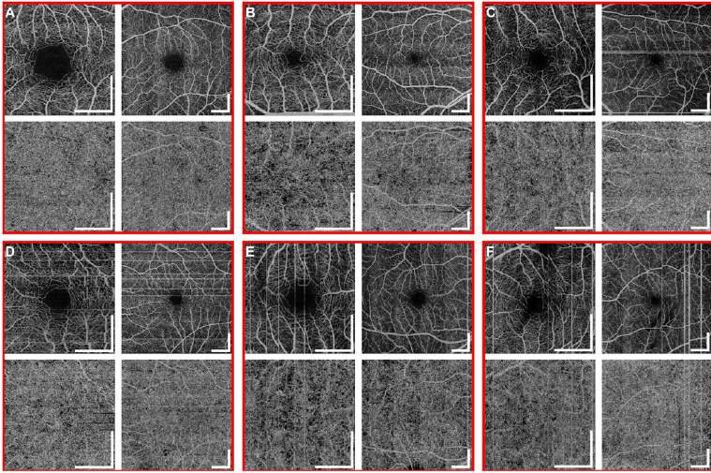
Swept-source OCT of Retinal & Choroidal Vasculature
Age 35
Age 53
Age 58
Aging
change
minimal
Age 68
Age 65
Age 70
Choi, Ophthalmology. 2015 December ; 122(12): 2532–2544
© 2018 OcuFLOW, Inc

Slide 19
Exudative AMD: Swept-source OCT of Choroidal Vasculature
© 2018 OcuFLOW, Inc

Slide 20
Exudative AMD: Swept-source OCT of Choroidal Vasculature
CC depth
CC depth
87 yo Exud-AMD
with occult &
classic CNV
FFA=classic
ICGA= occult
Red = Occult
Yellow= Classic
Shadowing
artifact
Yellow arrow=
CC thickness
White arrow=
RPE atrophy
© 2018 OcuFLOW, Inc

Slide 21
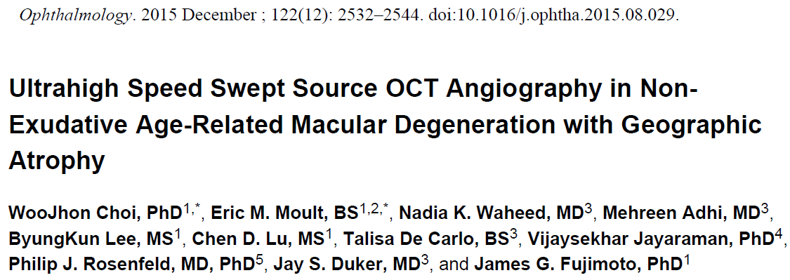
NON-Exudative AMD: Swept-source OCT of Choroidal Vasculature
© 2018 OcuFLOW, Inc

Slide 22
NON-Exudative AMD: Swept-source OCT of Choroidal Vasculature
74 yo NE-AMD
& GA
FAF
En-Face GA
Retinal vessels
OK
Choriocapallaris
loss within and
outside GA
OCT
Red – Blue - Purple
OCTA
Choi, Ophthalmology 2016
© 2018 OcuFLOW, Inc

Slide 23
NON-Exudative AMD: Swept-source OCT of Choroidal Vasculature
75-yo AMD & GA
CNV at edge of GA
Reminiscent of Pathology
© 2018 OcuFLOW, Inc

Slide 24
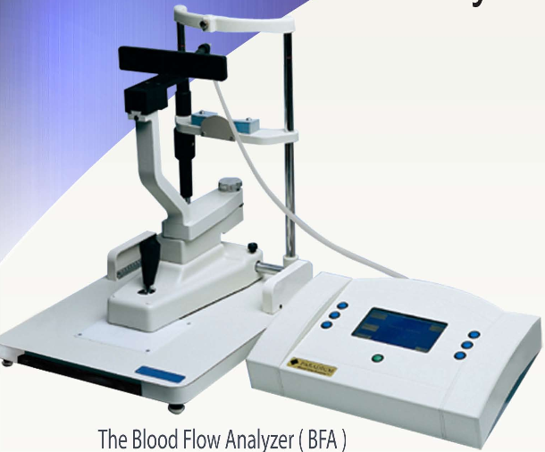
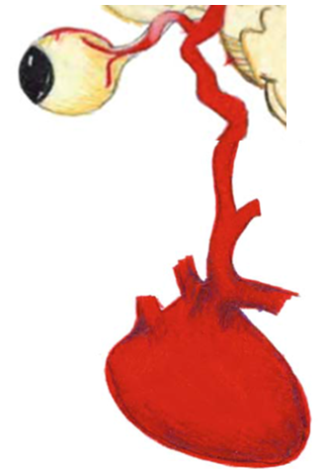
Pulsatility Measurement Devices
Langham and co-workers
adapted the pneumatonometer to measure intraocular pressure every 30 ms
accurate record of the pulsatile change in pressure
using the known relation between ocular pressure and ocular volume
pressure pulse could be converted into a volume pulse
by multiplying this volume by the heart rate
a measure of pulsatile ocular blood flow (POBF) could be obtained.
Easy to Use, Accurate & Reproducible
Schmetterer and co-workers
Laser interferometric fundus pulsation amplitude
comparable to POBF
only used in research
© 2018 OcuFLOW, Inc

Slide 25
Pobf In Aging Macular Degeneration
© 2018 OcuFLOW, Inc

Slide 26
POBF in Exudative AMD
POBF decreases with
progression of disease
POBF in exudative
AMD significantly
lower than non-exudative
© 2018 OcuFLOW, Inc

Slide 27
Pharmacotherapy In Aging Macular Degeneration based on blood flow
© 2018 OcuFLOW, Inc

Slide 28
POBF – TWO HUNDRED References
© 2018 OcuFLOW, Inc

Slide 29
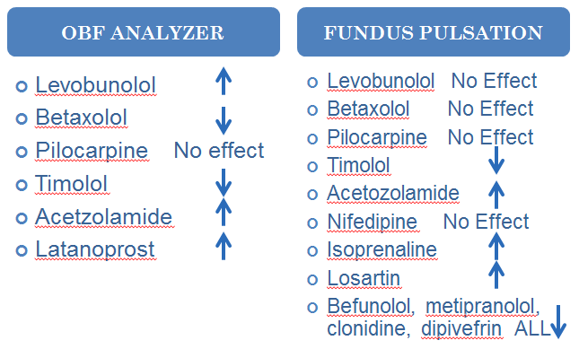
Quantitative Pulsatility Measurement Devices
© 2018 OcuFLOW, Inc

Slide 30
Off Label Pharmaceuticals
Compound | Route | Improves POBF/FPA | Improves Color Doppler Imaging Retrobulbar vessels | Improves Vision | Improves Morphology | Type of AMD Patient | Number of eyes | Mechanism of Action
Dorzolamide | Topical | Yes/Yes | Yes | ?? | Dorzolamide-timolol may reduced central subfield thickness and subretinal fluid |  |  | Carbonic anhydrase inhibitor
Unoprostone | Topical | Yes/Yes | ??? | Yes, AMD, RP and Glaucoma | AMD -Delayed enlargement of macular atrophy and FAF area | Post VEGF/PDT AMD with atrophy | 24 placebo / 24 unoprostone | PGF2-alpa agonist, Activating potassium (BK) and chloride (CIC-2 type) channels, inhibition of endothelin 1 (ET)-dependent mechanisms
High-Dose Statins | Oral | Yes | ?? | Improved 3.3 Letters, p=0.06 | Regression of drusen deposits | AMD patients with large and soft drusen | 10 of 23 | Competitively inhibits HMG-CoA reductase, decreases cholesterol production
 | Cochrane | ND | ?? | Insufficient Evidence | Insufficient Evidence | Range | na | same
Sildanefil | Oral | Yes (glaucoma) | Yes | Yes, CS in AMD HVF in glaucoma | Regression of drusen deposits | AMD and Best's | 4 of 4 but not bilateral | Inhibits cGMP-specific phosphodiesterase type 5 (PFE5/PDE6)
Levo-Dopa | Oral | Yes | Yes | Delays onset and progression of AMD | Clinical trial in recruitment phase | NV and Non-NV AMD | TBD | Dopamine precursor
© 2018 OcuFLOW, Inc

Slide 31
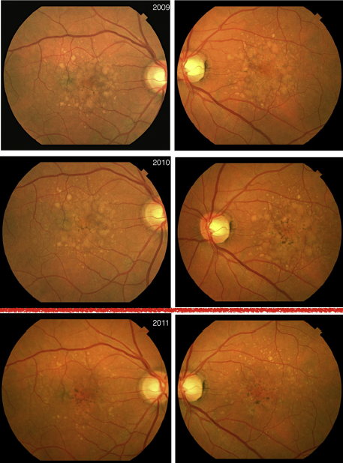
High Dose Statins and AMD Morphology
Cochrane
There is insufficient evidence from RCTs to
justify the use of statins to delay the onset
and progression of AMD or to improve
visual acuity.
Pilot Study =Ten of 23 patients responded:
Responders
Significant regression of drusen deposits,
Eight showed near complete regression
Volume decrease from 0.57 to 0.049 mm3
(p = 0.012)
Gained, on average, 3 letters
Time to resolution 11.7 months (3-22)
Non-responders
volume changed from 0.23 to 0.35 mm3
Lost on average 2.3 letters
None of the patients converted to NV-AMD.
Risk calculator predicted
14% conversion to NV-AMD.
Our alpha error in detecting zero cases is 2.1%.
Gehlbach . PMC 2017 August 04: Vavvas .EBioMedicine 5 (2016) 198–203
http://caseyamdcalc.ohsu.edu

Slide 32
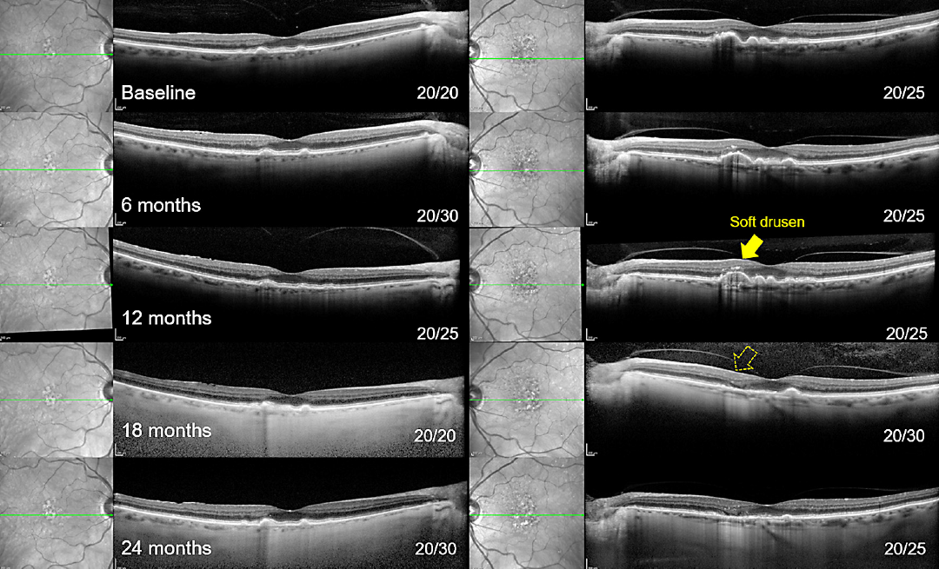
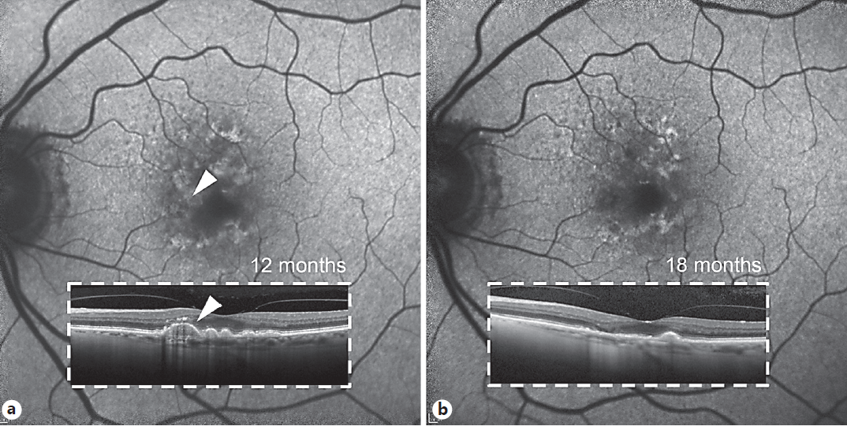
Sildanefil and AMD Morphology
Pilot Study - Coleman, 2018
4 patients who exhibited
AMD
Acquired vitelliform
Best’s (genetic)
Results
All eyes appear to benefit
from PDE6.
Maintenance or improvement
in vision
Coleman, Ophthalmologica. 2018;240(1):45-54.

Slide 33
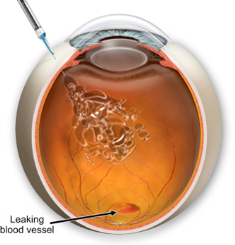
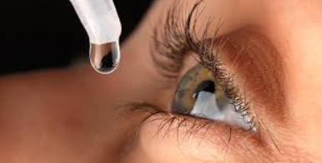
HYPOTHESIS
Now: 24% of Annual Medicare Part-B Pharmacy
Budget is now spent on Anti-VEGF compounds:
$17 billion in 2016!
Future: Delay visual impairment progression
by 1 year and/or a 1% reduction in blindness
& Reduce annual expenditures by $2-4 billion
for treatment and care of visually impaired

Slide 34
Off-Label Pharma for Earlier Treatment
 | Improved POBF | Improved Vision
Topical Pharmaceutical Name |  | AMD | DR |  | Glaucoma
Unoprostone | Yes | Yes | na |  | Yes
Dorzolamide | Yes | Yes | Yes, DME |  | Delays loss
Latanoprost | Yes | na | na |  | Yes
Isoprenaline | Yes | na | na |  | na
Levobunolol | Yes | na | na |  | Delays loss
Systemic Pharmaceutical Name
High Dose Statins | Yes | Yes |  | na | na
Sildenafil | Yes | Yes |  | na | Yes
Levo-Dopa | Yes | Delays loss |  | na | na

Slide 35
Leap of Faith
Can we treat the 90% of early AMD with topical pharmaceuticals already available and delay progression of early AMD to exudative or GA?
Can we delay progression of glaucoma by customizing the management of ocular blood flow AND intraocular pressure concurrently?
Can we initiate treatment of diabetic choroidopathy early and delay the progression to diabetic retinopathy?
© 2018 OcuFLOW, Inc

