Slide 1
Recurrent eyelid lesion
Vivian Lee, MD
Tatyana Milman, MD Ralph C. Eagle, MD
and WEH Ocular Oncology Service
University of Pennsylvania
EOPS 2018
Washington DC

Slide 2
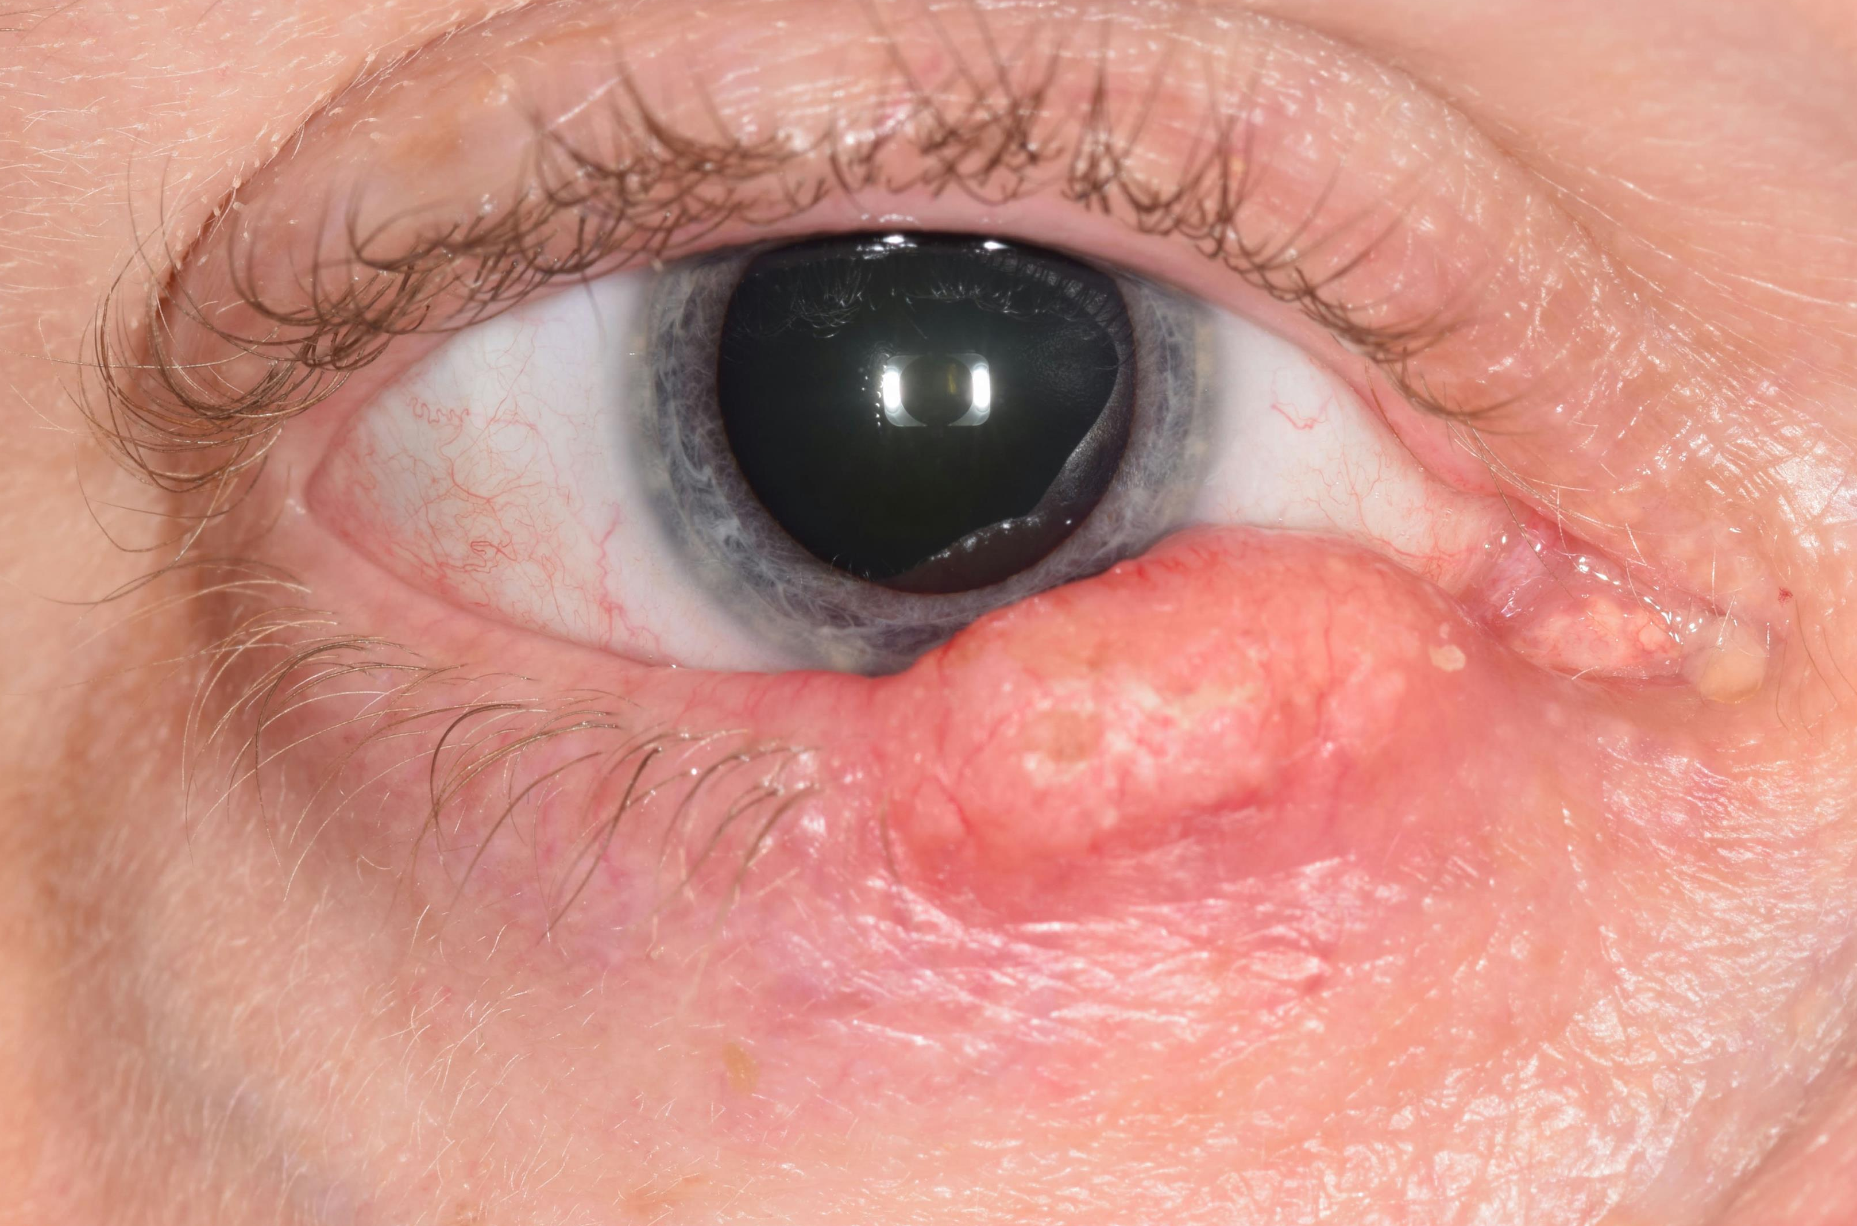
A 56-year-old white male with right lower eyelid mass noted in May 2017

Slide 3
Incisional biopsy was performed, revealing
keratinizing SCC, well- to moderately-differentiated

Slide 4
Excisional biopsy performed subsequently with frozen sections for margin control
Pathology revealed keratinizing SCC,
moderately differentiated,
1 mm from deep margin

Slide 5
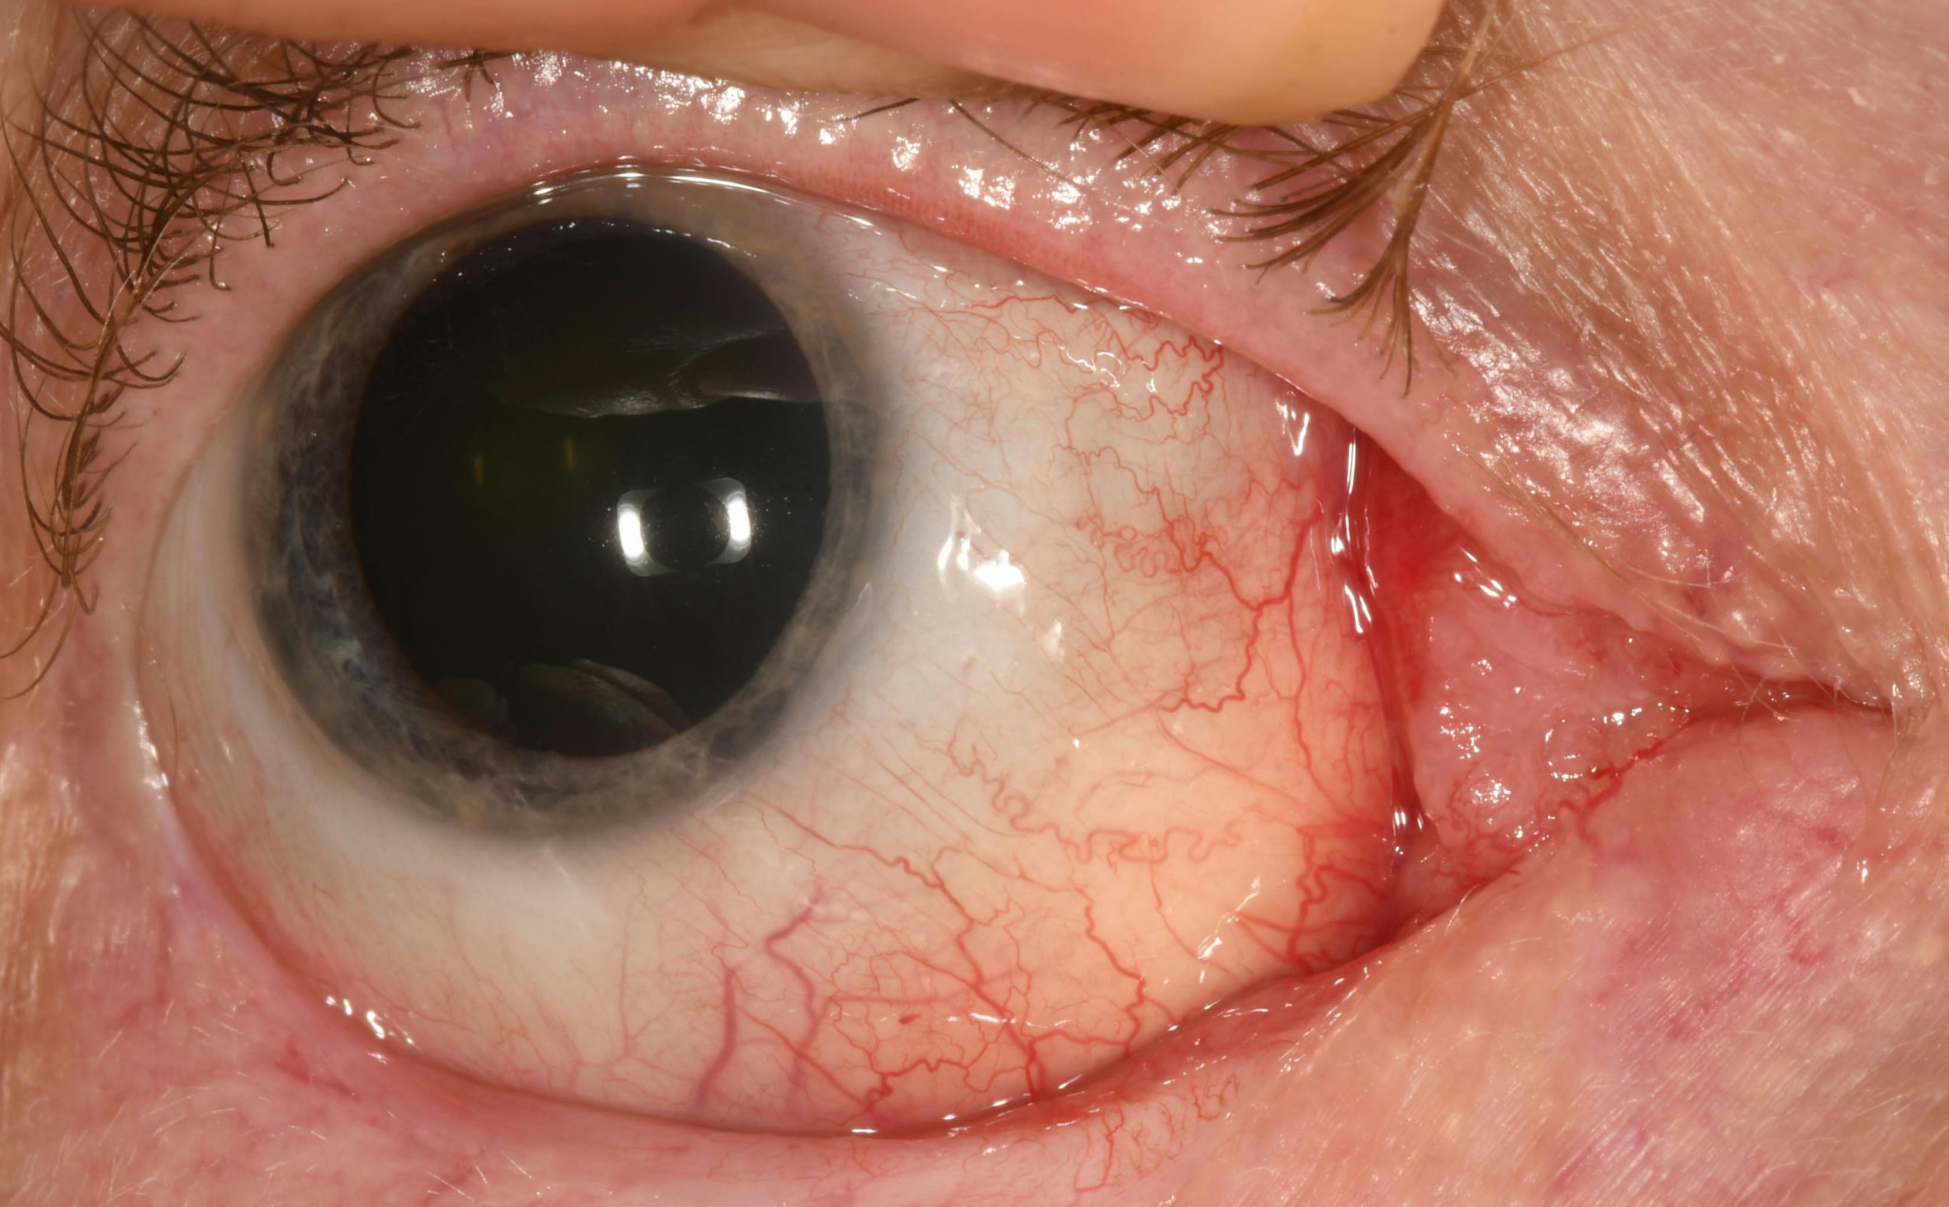
Nine months later, fullness was noted in right caruncle

Slide 6
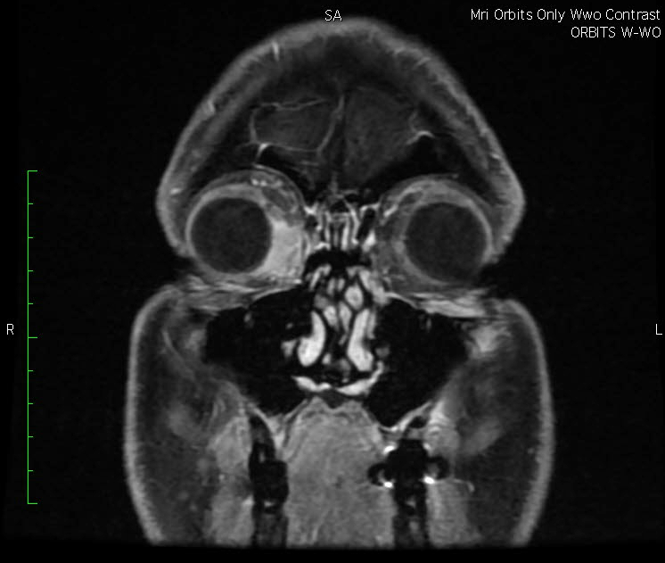

Slide 7
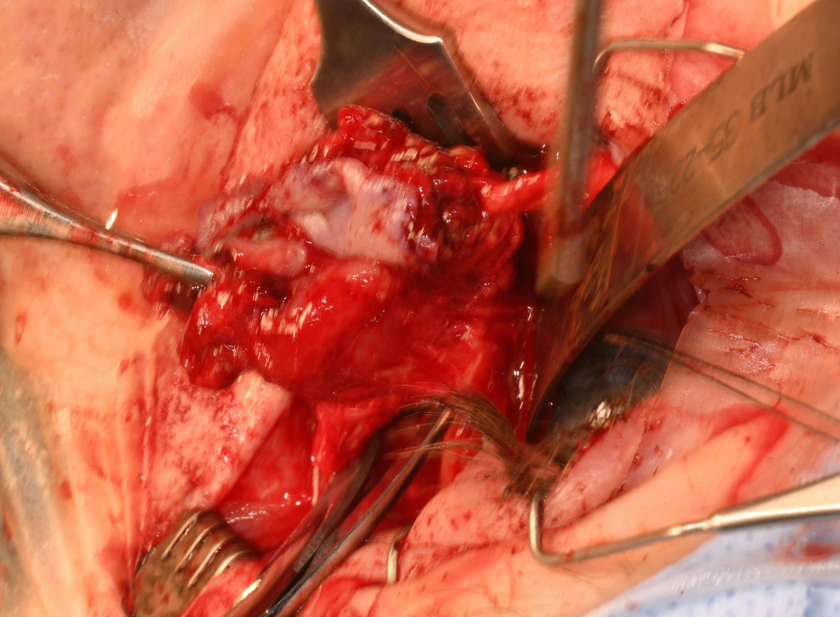
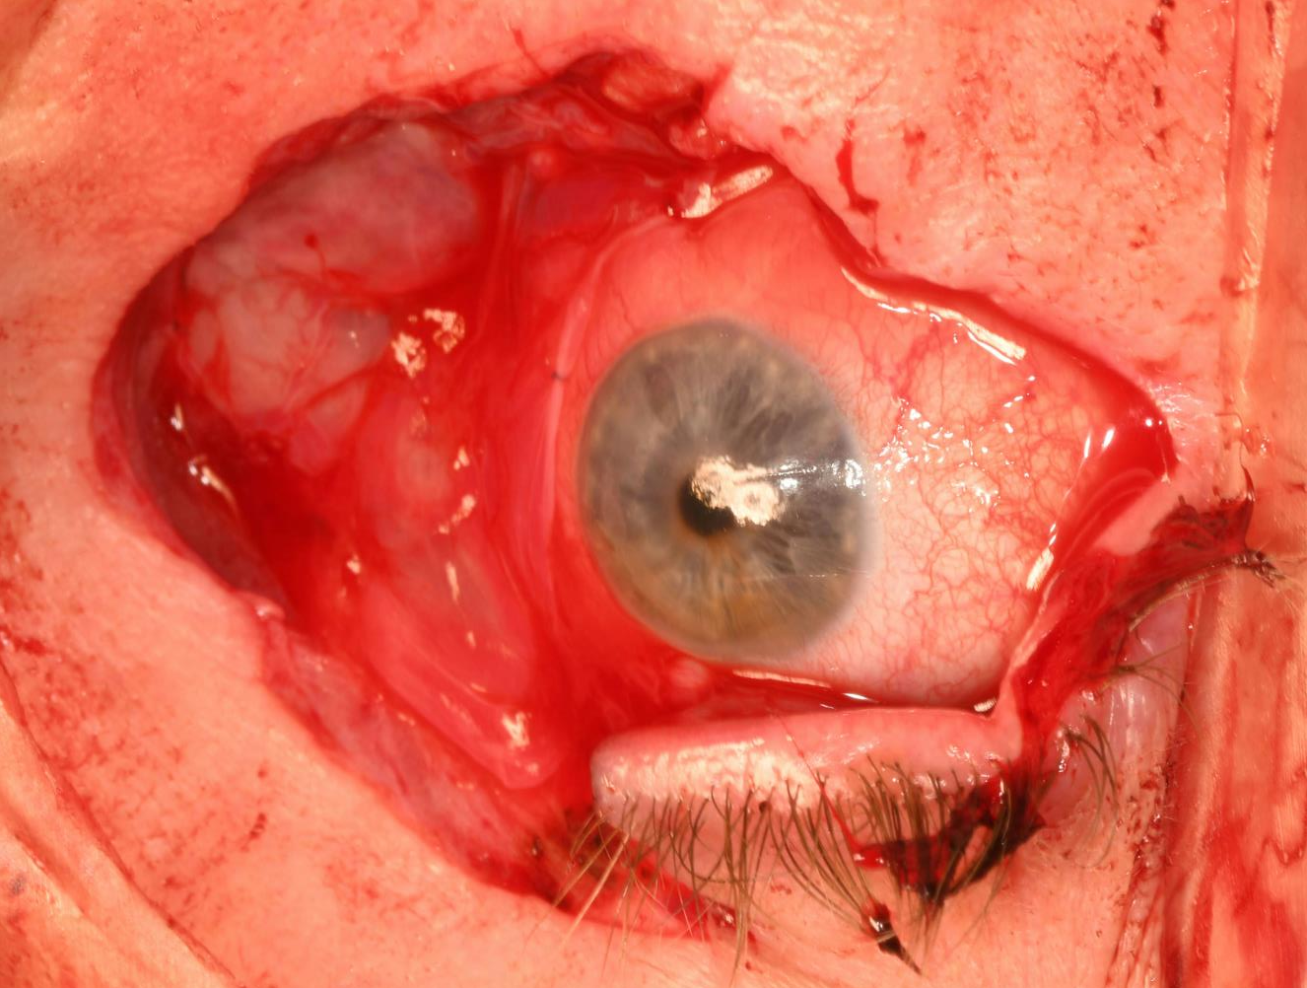

Slide 8
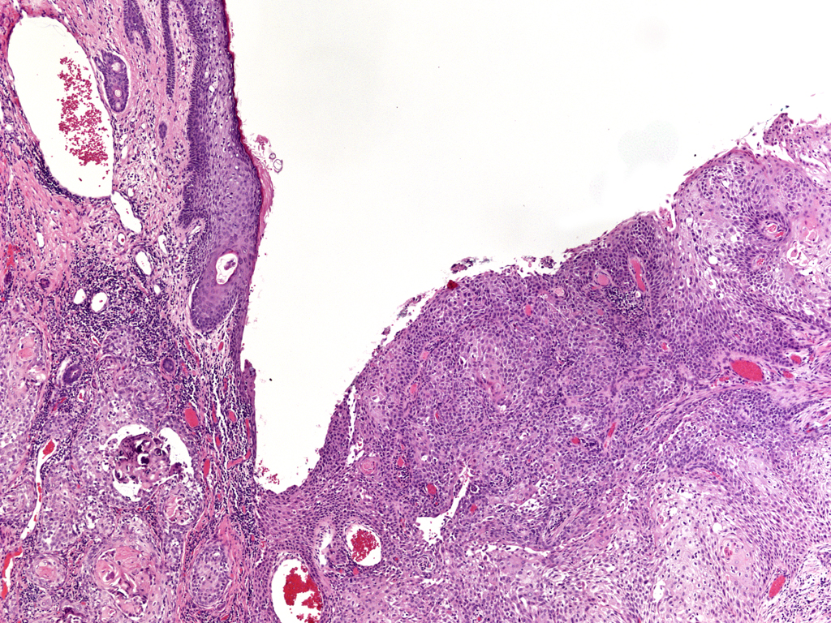
A moderately differentiated, invasive carcinoma is seen arising primarily from the conjunctival surface

Slide 9
Predominantly squamous differentiation and prominent keratinization

Slide 10
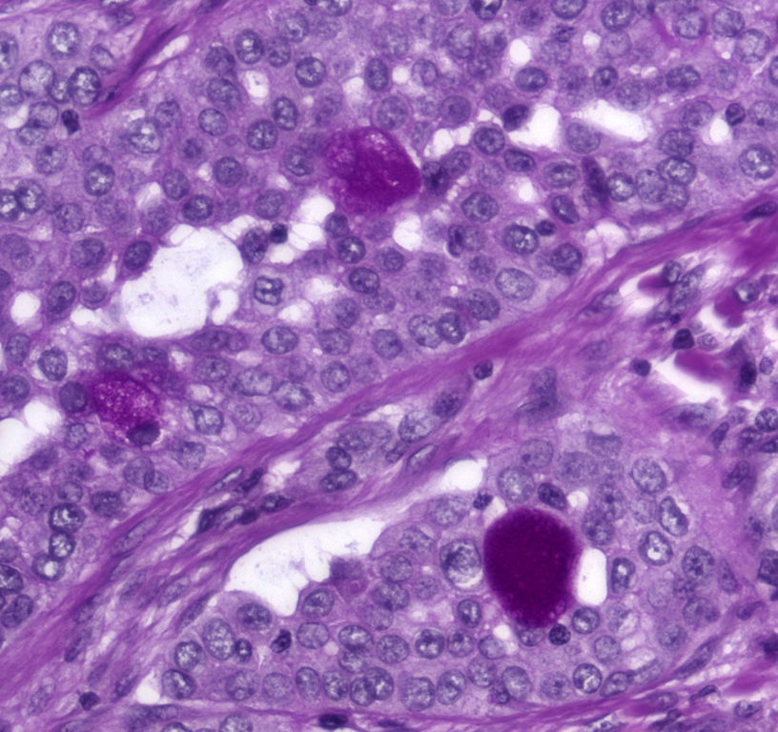
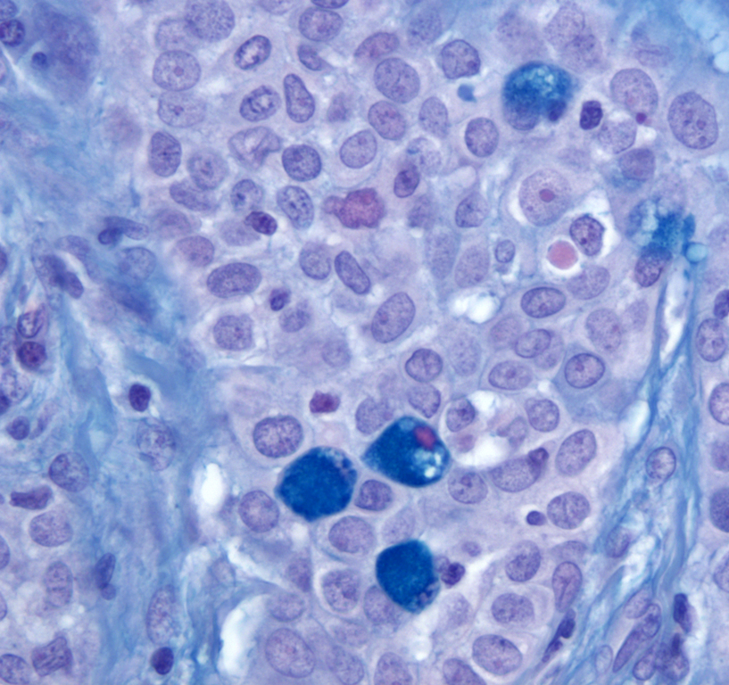
Aggregates, as well as individual, goblet cells are identified
PAS/D
Alcian blue

Slide 11
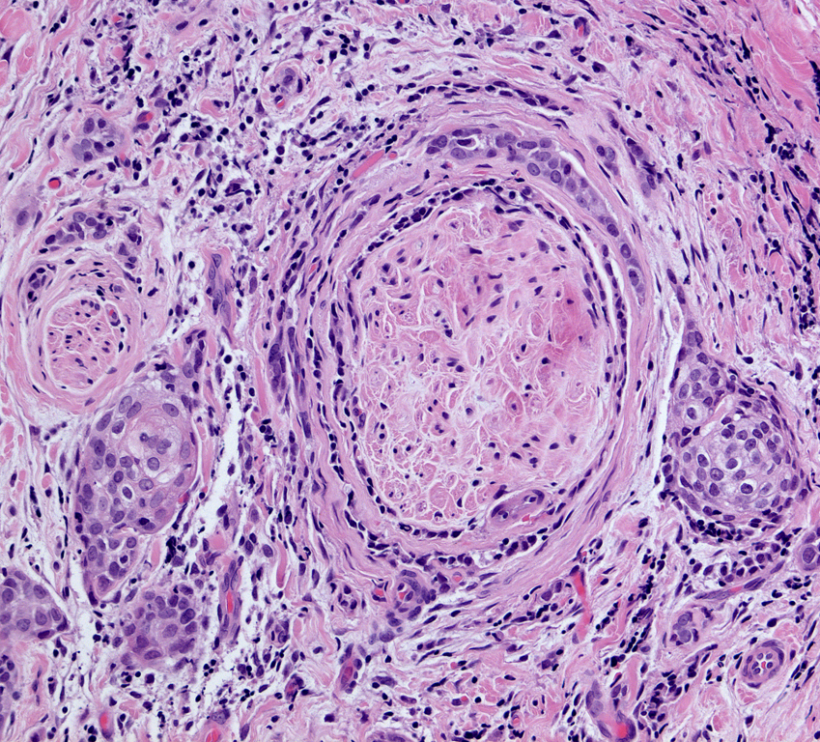
Multiple foci of perineural invasion are identified, but no lymphovascular invasion is seen

Slide 12
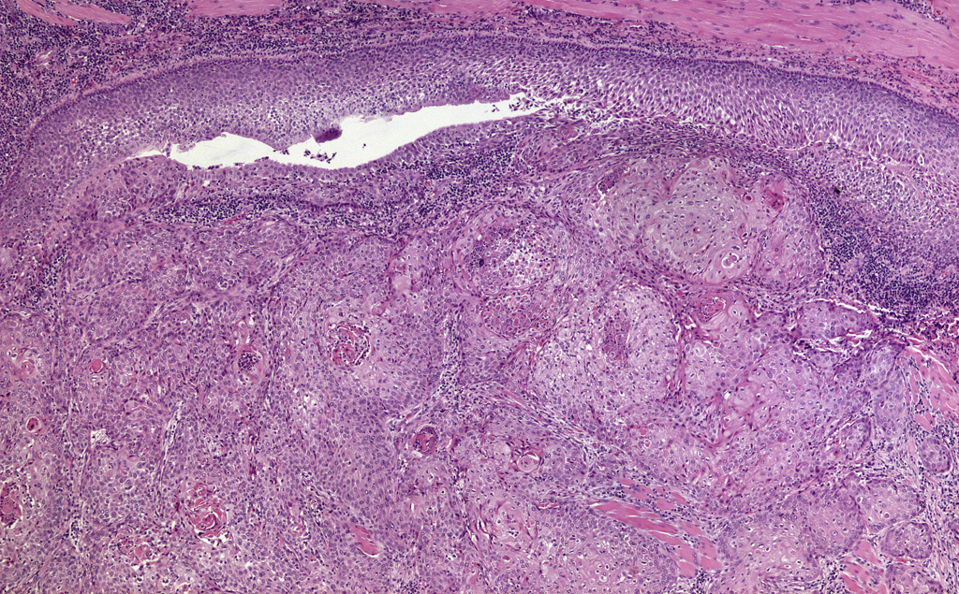
Tumor cells undermine the lacrimal canaliculus with a secondary involvement of canalicular epithelium

Slide 13
Mucoepidermoid carcinoma (MEC)
Most common salivary gland malignancy in adults and children
Term first devised by Stewart, Foot, and Becker in 1945
Histologic criteria includes the presence of:
Epidermoid (squamous) cells without requiring the presence of intercellular bridges and epithelial pearls
Cells containing mucus as proved by mucicarmine staining

Slide 14
Ocular MEC is rare
Twenty-three documented cases in the literature
Has been shown to involve the conjunctiva, eyelid, lacrimal gland, and lacrimal sac
Rao and Font published the first case series of 5 cases in 1976
Brownstein, Albert, Jakobiec, Shields and Eagle have all described cases as well

Slide 15
Clinically, MEC looks like SCC
Difficult to distinguish MEC from SCC clinically
Average age of patients is 52 – 67 years of age
Important to distinguish MEC from SCC since MEC exhibits a much more aggressive course
Locally invasive
High recurrence rate
Can locally metastasize

Slide 16
Need histology to accurately diagnose
Histologically, MEC resembles SCC but with the presence of mucus secreting cells
Mucus-producing goblet cells may have a classic signet ring appearance or appear columnar
Typically, squamous portion lacks keratin pearls or dyskeratosis
Stains are helpful in making the diagnosis
Alcian blue, mucicarmine, PAS, PAS/D
CK7, MUC19

Slide 17
Likely from bi-directional growth
Rao and Font speculated that MEC likely arises from bi-directional neoplastic differentiation
Because normal conjunctiva is made up of stratified squamous epithelial cells and mucus-producing goblet cells
Jakobiec et al. performed electron microscopic studies
Mucus granules within many of squamous cells that were not obvious goblet cells
Moreover, noted focal myofilamentary differentiation in basal cells of areas where tumor formed tubular structures

Slide 18
MEC is assoc with high recurrence
Studies based on salivary gland tumors divide MEC into three categories:
Low grade lesions (92 to 100% 5-year survival), intermediate grade (62 to 92%), high grade (0 to 43%)
Distant metastasis and death common in salivary gland MEC
While ocular MEC usually associated with local invasion and metastasis
However, because of high recurrence rates, enucleation or exenteration may be required for local control
Notes:
Low grade: well circumscribed with gray-white, mucin filled cysts
Cords, sheets and clusters of mucous, squamous, intermediate and clear cells
Low to high grade, although even high grade tumors lack marked nuclear atypia, frequent mitotic figures or extensive necrosis
Occasional focal sebaceous cells, goblet type cells, oncocytic change, inflammatory reaction to extravasated mucin or keratin
No squamous cell carcinoma in situ
Low grade: mucinous and intermediate cells with bland nuclei form glandular spaces
High grade: solid and infiltrative growth pattern of atypical epidermoid and intermediate cells with cytoplasmic clearing and small number of mucinous cells; < 20% intracystic component
Low grade with background mucin, two
types of cells with bland nuclear features
(squamoid with dense cytoplasm and
glandular with vacuolated cytoplasm) High grade with malignant squamous cells
Associated with t(11;19)(q14-21;p12-13) (PathologyOutlines.com)

Slide 19
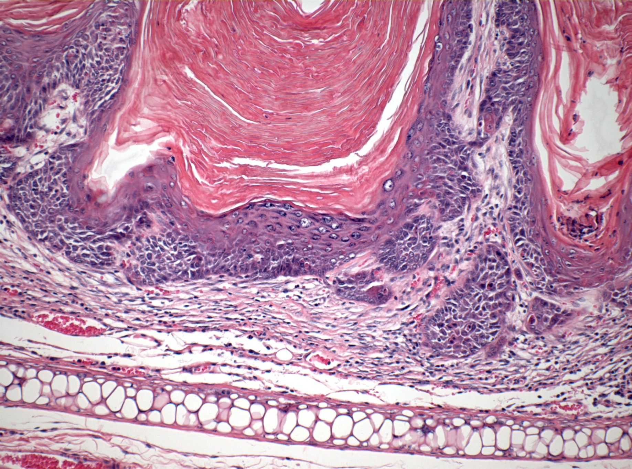
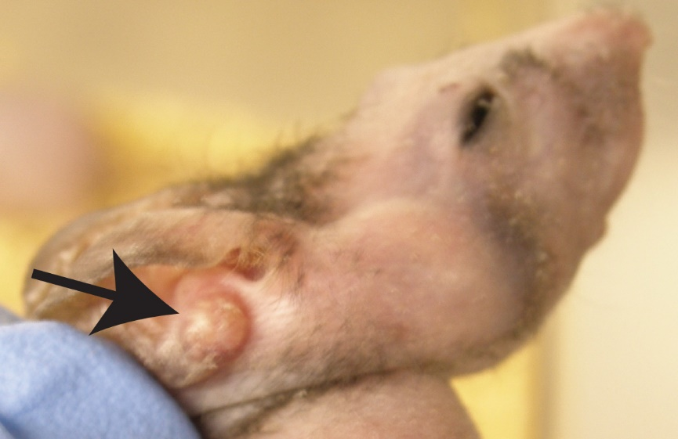
Chromosomal translocation has been found associated with MEC
MECT1-MAML2 has been found in a subset of salivary gland MEC
Translocation produces fusion protein that serves as a transcription activation factor in cAMP/CREB and Notch pathways
May be associated with low grade histopathologic features and a favorable clinical prognosis
However, has also been found in 50% of high grade lesions, which correlated with less high grade features histologically
K14Cre/MAML1 mice develop SCC at 4 to 5 months

Slide 20
Treatment requires accurate diagnosis
Any ‘atypical’ SCC lesion should be re-evaluated for MEC
Requires mucin specific stains and deeper sections
At a minimum, wide local excision is recommended
Ullman et al. did show successful treatment with plaque radiotherapy
Combined therapy with chemotherapy and radiation has been shown to be successful in local control of disease with salivary gland MEC
Close follow up is necessary
Notes:
The Radiation Therapy Oncology Group (RTOG) 9501/Intergroup trial demonstrated increased DFS in the combined therapy group compared with patients who received postoperative radiotherapy alone. Because those researchers observed a similar incidence of distant metastases in both groups, they proposed that the predominant effect of chemotherapy was to potentiate the locoregional effects of radiotherapy.

Slide 21
Thank you
References in protocol

