Slide 1
Orbital abscess in 10 month old immunocompetent male Don Minckler¹, Onyinye Okezie², Khalid Tawansy³, Cassiana Bittencourt¹
¹ University of California, Irvine
² Private Practice Pediatrician, Bakersfield, CA
³ Raymond Renaissance Surgery Center, Pasadena, CA
Relevant Disclosures: None
Don Minckler, MD, MS
Emeritus Professor of Ophthalmology and Glaucoma Service Director
Clinical Professor of Laboratory Medicine (Ophthalmic Pathology)
Gavin Herbert Eye Institute
University of California, Irvine, USA

Slide 2
Minckler EOPS 18
This 11 month old male was brought to a Pediatrician 2/27/18 for a puffy right eye evolving over 3 days. An interval US 3/16/18 suggested an infected + 1.7cm orbital cyst beneath the eye. Keflex was begun. A visiting ophthalmologist from LA examined him 3/22/18 by which time mild proptosis, periorbital inflammation and a palpable orbital mass beneath the right lower lid were noted. An I&D the next day discovered a large mass which when received in formalin was in three pieces the largest of which measured 1.5 x 0.5cm. Serum titer in a local lab for C. immitis was + by complement fixation 4/6/17 for IgM [1:1024 or 9 dilutions]), the highest among other proven cases ever seen by the same Pediatrician’s office per the lab “suggestive of recent infection”. Subsequent titers by the same method dropped to 1:64 by 5/15/17 and again 1:64 8/7/18; CBC normal 4/6/18 except for low Hb and Hct, low platelets, and low segmented neutrophils.
Histology at UCI 3/26-3/29/18 demonstrated fungus consistent with Coccidioidomycosis (C. immitus) in paraffin processed abscess samples stained with H&E, PAS, and GMSf.
Fluconazole 50mg daily X 10 (route not specified probably PO) tolerated well. Birth wt. 8lb 3oz (3.6+Kg)
Via phone communication with the Pediatrician, the child had been a full-term 8lb+ healthy baby. He was never febrile, had no obvious toxicity nor other body site involvement. He was not known to be immunocompromised. He continued to thrive and tolerated Fluconazol in a standard pediatric doses. No other family members were ill or admitted any prior experience with this infection. He continues to do well through the present-last communication from Pediatrician’s office 9/5/18.

Slide 3
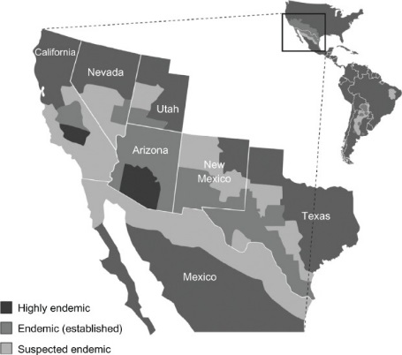
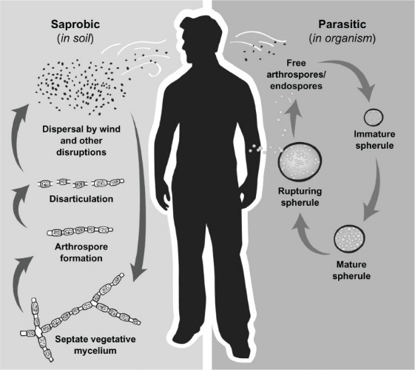
Minckler EOPS 18
The Coccidioides spp. lifecycle is closely intertwined with changes in climate conditions. The fungal mycelia require moisture in the soil to grow.14,15 Hence the fungus is usually recovered in greatest abundance in the spring after the heavy, winter rainfall has ended. The hyphae then need a dry period to promote desiccation and maturation into arthroconidia, which can be aerosolized and inhaled. This requirement partially explains why the rate of Coccidioides infections tends to rise in the drier months of the year.¹
Biphasic organism usually transmitted via respiratory inhalation

Slide 4
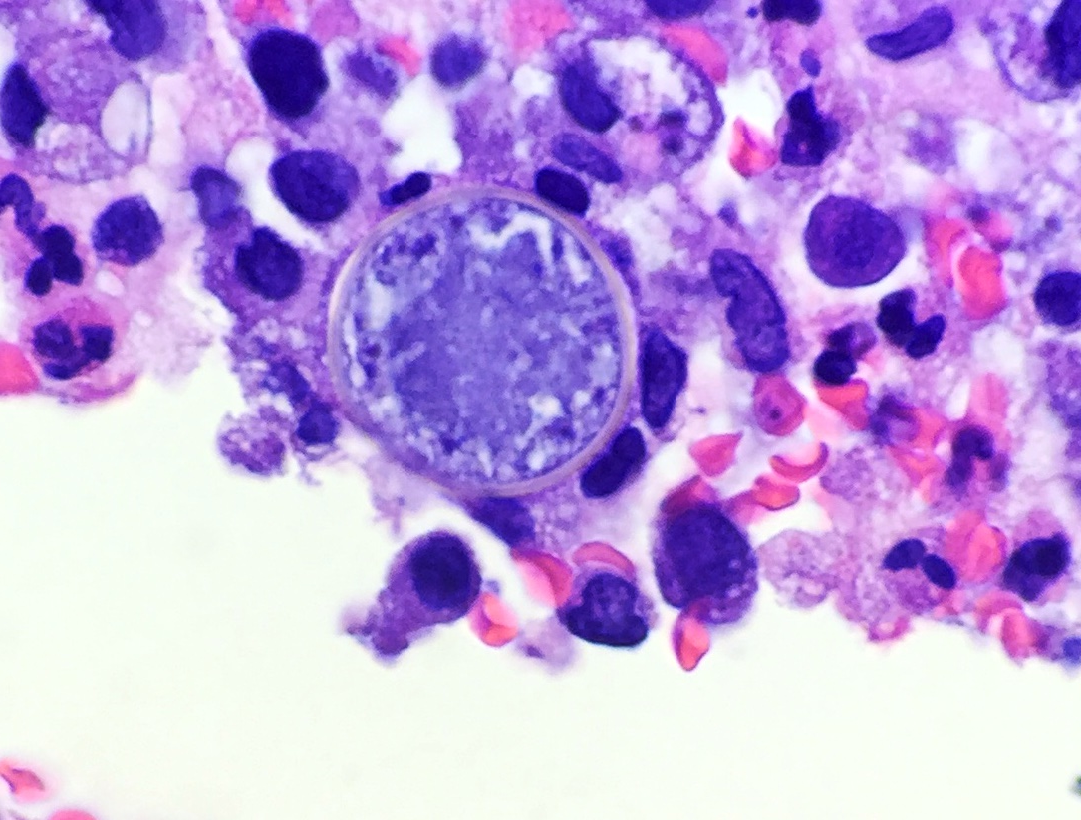
Minckler EOPS 18
PAS original X 500
GMSf original
X 200
H&E original X 400

Slide 5
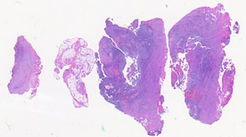
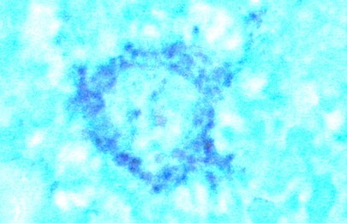
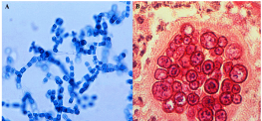
Minckler EOPS 18
GMSf original X 787.5 oil
Original X 500
Arthrospores from Net
Mature sperule from Net
H&E original X 787.5 oil
Notes:
S18-3606; C. immitis; culture + for Coccidioides immitis. Spherules: (30 μm (micrometres) to 60 μm in size)

Slide 6
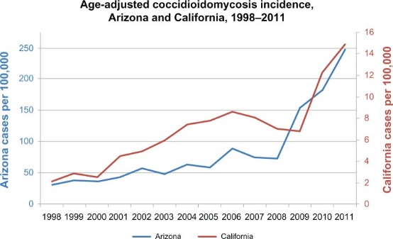
Minckler EOPS 18
The San Joaquin Valley has the highest endemicity. The rate of positive skin tests ranges as high as 50%–70% in Kern County, including the city of Bakersfield, and its neighboring Tulare and Kings Counties. After inhaling Coccidioides spores, 60% of infected persons remain asymptomatic. The rest develop mild-to-severe symptomatic pulmonary infections. 1% of infected persons develop disseminated disease

Slide 7
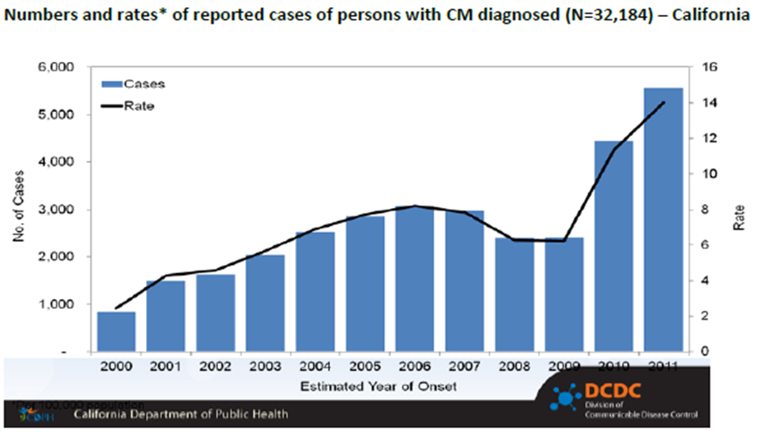
Minckler EOPS 18
Risk factors for severe or disseminated coccidioidomycosis:
Filipino or African ethnicity
HIV/AIDS
Immunosuppressive medications
Prednisone
TNF-α inhibitors
Chemotherapy
Organ transplantation (tacrolimus, etc.)
Diabetes mellitus
Pregnancy
Cardiopulmonary disease
Non-human mammals, including domestic and non-domestic animals in the wild and in captivity. It is especially common among domestic dogs, with an estimated annual incidence of 4% among dogs in Pima and Maricopa Counties.
Some studies have found higher concentrations of the organism around Indian burial sites and in animal burrows.

Slide 8
In summary:
An 11 month old male developed an abscess in the right orbit subsequently proven by serology and histology to contain C. immitis. AKA Valley fever, Desert fever, Desert rheumatism.
Anti-fungal therapy was well tolerated and he remains vigorously healthy per the local Pediatrician.
He has developed no sequelae and tolerated Fluconazole in standard pediatric doses well with reduction of CF titers from a high of 1:1024 to 1:64 over one month after 10 days of oral fluconazole.

