Slide 1
An Unusual Case of Periorbital Swelling
Heather A.D. Potter, MD
Eastern Ophthalmic Pathology Society
September 14-15, 2018
Washington, D.C.

Slide 2
Financial disclosures
None

Slide 3
Objectives
Tell the story of a young patient with LCH
Generate a differential for his orbital swelling
Gather ideas for future directions and management
Notes:
What I would like to do today is to:
Tell the story of a young patient with LCH—it’s a long and complicated story, and if it starts to feel tedious, remember, he lived it.
Generate a differential for his orbital swelling—right now we have settled for a small differential as his diagnosis
Gather ideas for future directions and management—I’ll let you know how he is doing, but I don’t think his story is done…

Slide 4
Presentation
18 y/o male with headache, blurry vision, and swelling of right upper and lower eyelids
Notes:
So this patient is a sweet 19 year old young man who presented a little less than a year ago with some new symptoms.

Slide 5
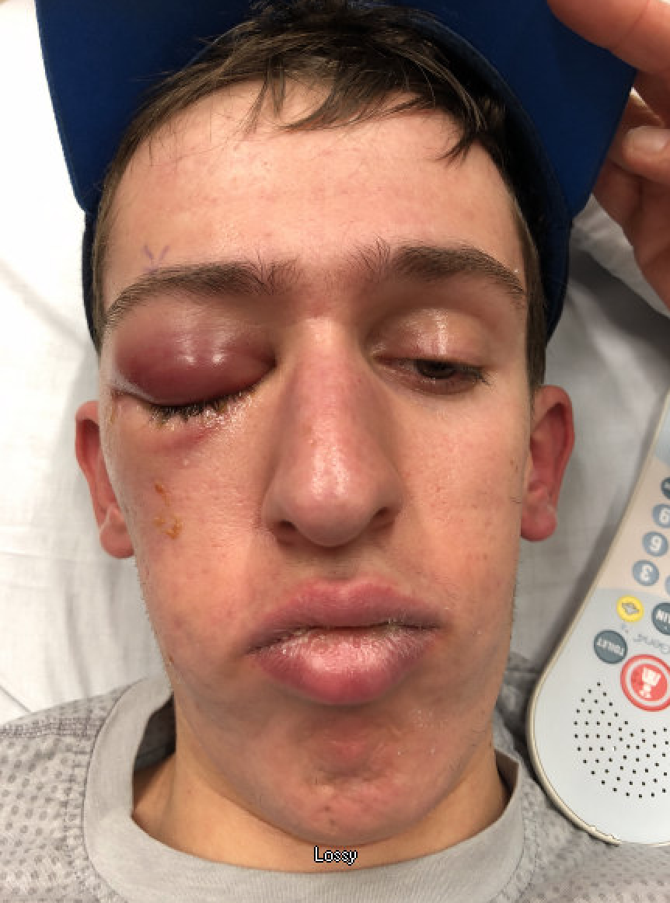

Slide 6
Past Medical History: Langerhans Cell Histiocytosis
Diagnosed August 1999 as a baby (skin involvement)
Radiation in 2000 after bony involvement of external ear canal and zygoma
Neurodegenerative change resulting in diabetes insipidus; started on desmopressin and systemic chemotherapy (vinblastine and prednisone)
More neurodegenerative changes, particularly in the cerebellum; started a regimen of 6-mercaptopurine and pentoxifylline
Further CNS LCH diagnosed; began regimen of vincristine and cytarabine arabinoside

Slide 7
Past Medical History: Langerhans Cell Histiocytosis
Rituximab infusions started in early 2016; discontinued in mid-2016 due to lack of response
In 2016, skin tissue from 1999 skin biopsy tested positive for BRAFV600 mutation
Due to clinical worsening, started on BRAF inhibitor Dabrafenib 11/1/17

Slide 8
Langerhans cell histiocytosis (LCH)
Rare disorder of histiocyte proliferation
1 or more osteolytic bone lesions
May also involve infiltration of organs (brain, liver, lung, etc)
Usually children 1-3 years old
Incidence ~1/3-5 million children
No definite heritability
McClain, 2018
Notes:
LCH was named because the cells resemble Langerhans cells on path – specialized dendritic cells in skin and mucosa
Actually derived from myeloid progenitor cells from the bone marrow
[histiocyte is a stationary phagocytic cell present in connective tissue – type of macrophage]
[dendritic cells are antigen-presenting immune cells]
Adults may have “pulmonary LCH” – rare, associated with cigarette smoking
Inflammatory versus neoplastic

Slide 9
Past Medical History: Langerhans cell histiocytosis
Noted right eye pain and right headache 11/14/18
ER on 11/20/17 for vision changes
MRI showed right orbital lesion in area of lateral rectus muscle
Stopped dabrafenib
Eye pain and headache resolved
Notes:
Right headache was centered around the orbit
In the ER, there was no swelling, but the MRI was done because of the vision changes and his history.

Slide 10
11/29/18 Oculoplastics pre-operative evaluation

Slide 11
11/29/18 Oculoplastics pre-operative evaluation
Va: 20/20 OD, 20/20 OS
Pupils: 4→3 mm OU, no APD
IOP: 18/15
EOM: -1 supraduction, otherwise full OD; OS full with L beating nystagmus in left gaze (present previously)
CVF: Full/Full

Slide 12
11/29/18 Oculoplastics pre-operative evaluation
LLL: OD erythematous with 3+ edema; OS WNL
C/S: W/Q OU
K: Clear OU
AC: D/Q OU
Iris: R/F OU
Lens: Clear OU
Vitreous: Clear OU
Optic nerve: 0.2 c/d OU, sharp, pink, flat OU

Slide 13
Historical MR imaging (2016)

Slide 14
MR imaging (2017)

Slide 15
Summary
Skin, neurodegenerative, and bone disease
History of radiation to right orbit
Treated with multiple rounds of chemotherapy, desmopressin, rituximab, BRAF inhibitor
Mass developed acutely while on BRAF inhibitor

Slide 16
Management
Biopsy 12/1
The mass was best visualized at the superior aspect of the lateral rectus, so this location was selected for biopsy. The muscle was noted to be reddish orange and bulbous in this area. Several pieces of the muscle measuring a total of 6mm x 8 mm x 4 mm total were removed from the mass using Westcott scissors. The mass was friable and yellow-ish on the inside, with a fairly distinct capsule.

Slide 17
Pathology—H&E 4x

Slide 18
Pathology—H&E 20x

Slide 19
Pathology—H&E 40x

Slide 20
Pathology—S100

Slide 21
Pathology—CD1a

Slide 22
Pathology—CD3

Slide 23
Pathology—CD20

Slide 24
Pathology CD68

Slide 25
Pathology--Myogenin

Slide 26
Pathology--Desmin

Slide 27
Pathology--SMA

Slide 28
Pathology--BRAF

Slide 29
Summary of Pathology
Proliferation of spindle to pleomorphic cells infiltrating skeletal muscle
Many large anaplastic cells with marked atypia.
Negative CD 20, S100, CD1a, SMA, myogenin and BRAF.
Positivity for CD 3, CD68 in background
Some large cells appear to be positive for desmin.

Slide 30
Pathology—H&E 40x

Slide 31
Differential diagnosis
Langerhans cell histiocytosis with malignant transformation to Langerhans cell sarcoma
Post radiation sarcoma (rhabdomyosarcoma?)
Soft tissue sarcoma
BRAF inhibitor-associated sarcoma

Slide 32
May 2018—continued q 3 months imaging

Slide 33
What does the future hold? Further work-up/treatment recommendations?

Slide 34
Thank you
Dr. Mark Lucarelli
Dr. Diane Pucceti
Dr. Suzanne Van Landingham
Dr. Shilpa Reddy
Dr. Chandana Papudesu
Dr. Meghana Agni

Slide 35
Thank you
Dr. Mark Lucarelli
Dr. Diane Pucceti
Dr. Suzanne Van Landingham
Dr. Shilpa Reddy
Dr. Chandana Papudesu
Dr. Meghana Agni

Slide 36
References
Esmaili N, Harris GJ. Langerhans Cell Histiocytosis of the Orbit: Spectrum of Disease and Risk of Central Nervous System Sequelae in Unifocal Cases. Ophthal Plast Reconstr Surg 2016;32:28–34.
Margo CE, Goldman DR. Langerhans cell histiocytosis. Surv Ophthalmol 2008;53:332–58.
Brockstein B, Mundt A, Haraf D, Ferguson M, Montag A; Radiation-Induced Leiomyosarcoma: Does Antimetabolite Chemotherapy Contribute? A Report of Three Cases; Sarcoma. Volume 7, Issue 3-4, Pages 167-172
Brockstein B, et al. Radiation-Induced Leiomyosarcoma: Does Antimetabolite Chemotherapy Contribute? A Report of Three Cases; Sarcoma; Volume 7, Issue 3-4, Pages 167-172
Grimer R, et al; Guidelines for the Management of Soft Tissue Sarcomas; Sarcoma Guidelines (15 pages), Volume 2010 (2010)
Fernebro J, et al; Genetic Profiling Differentiates Second Primary Tumors from Metastases in Adult Metachronous Soft Tissue Sarcoma; Sarcoma; Research Article (7 pages), Volume 2008 (2008)
Roberts F, Macduff EM; An update on mesenchymal tumours of the orbit with an emphasis on the value of molecular/cytogenetic testing; Saudi journal of ophthalmology; 2018, Vol.32(1), p.3-12
Szymanski LJ, et al; Quadruple Neoplasms following Radiation Therapy for Congenital Bilateral Retinoblastoma. Ocular Oncology and Pathology. 2017 Dec; 4 (1); 33-37.
Adesina OO, et al; Undifferentiated Nonrhabdomyosarcoma Soft Tissue Sarcoma of the Orbit. Ophthalmic Plast Reconstr Surg. 2017 May/Jun;33(3):e57-e60.
Malka-Mahieu H, et al; Synergistic effects of eIF4A and MEK inhibitors on proliferation of NRAS-mutant melanoma cell lines.Cell Cycle. 2016 Sep 16;15(18):2405-9.
Ciccarelli C, et al. p21WAF1 expression induced by MEK/ERK pathway activation or inhibition correlates with growth arrest, myogenic differentiation and onco-phenotype reversal in rhabdomyosarcoma cells. Mol Cancer. 2005 Dec 13;4:41.

