Slide 1
Eastern Ophthalmic Pathology 2018 Meeting – Washington, DC
Diva R Salomão, MD
Professor of Laboratory Medicine and Pathology
Mayo Clinic – Rochester - MN

Slide 2
Case History
8-year old boy, developmentally delayed
Persistent bilateral eye redness and rubbing
Heart transplant at age 3 years
Primary graft dysfunction – initial post-op
Cerebral vascular accidents
EBV-mismatch transplant
Low-grade EBV viremia – after first year
EBV hepatitis – resolved with reduction of immunosuppression

Slide 3
Case History
5 years after transplant
Persistent bilateral eye redness and rubbing
Seen by primary care physician
Erythromycin ointment
Temporary relief
Symptoms returned after 2 weeks (x3)
Referred to ophthalmology

Slide 4
Case History
Ophthalmic exam
Visual acuity – 20/40 (bilateral)
IOP – 14 mmHg (bilateral)
Pupils - 4 mm
Anterior segment
Bilateral conjunctival injection
Bilateral anterior chamber cellular reaction
Small keratic precipitates – OD
Large mutton-fat keratic precipitates – OS

Slide 5
L
Notes:
9/08/2016 - iris nodules – more prominent in the left than in the right eye

Slide 6
Case History
Anterior granulomatous iritis – L>R
No posterior involvement
Suspected infectious etiology
Systemic work-up
Started Prednisone forte 1% - 6x day
Re-evaluation after a week

Slide 7
Case History
Redness and itching improved
Extensive systemic work-up – negative
RF, ANA, HSV, TB, Lyme ELISA, Toxo, West Nile virus
Normal CBC
EBV positive
Suspected post transplant lymphoproliferative disorder

Slide 8
R
L
L

Slide 9
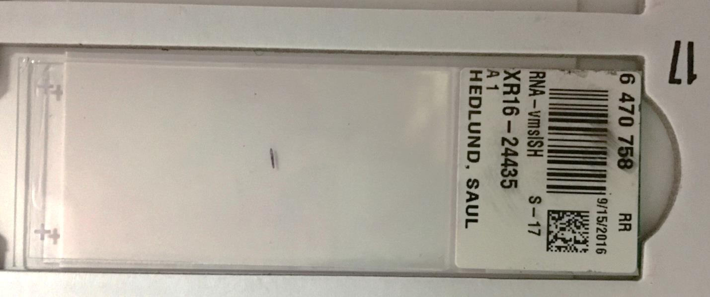

Slide 10
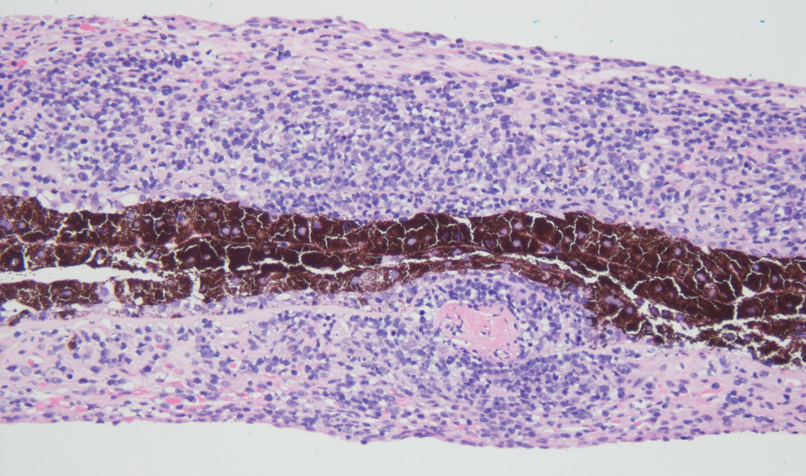
HE x100

Slide 12
CD3
CD20
Notes:
CD3 and CD20

Slide 13
Kappa ISH
Lambda ISH
EBV ISH

Slide 14
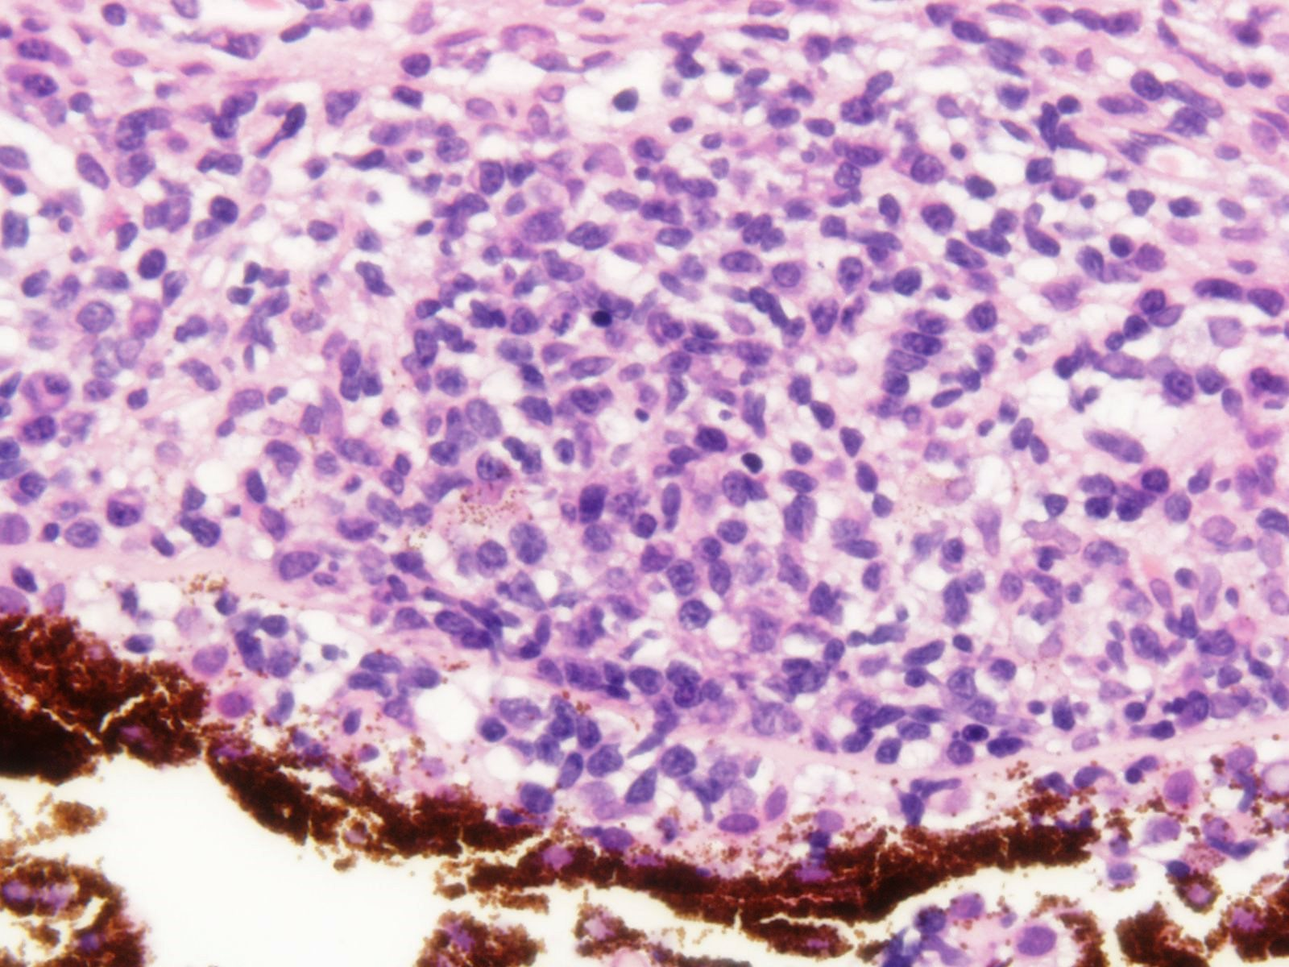
Case History
CD20+ B cells and CD3+ T cells
Numerous intermixed plasma cells
Kappa immunoglobulin light chain restriction
EBV+ by in situ hybridization
Proliferating cells – small lymphocytes
Post transplant lymphoproliferative disorder (PTLD) with marginal zone lymphoma like features

Slide 15
Post Transplant Lymphoproliferative Disorder (PTLD)
Complication of prolonged usage of immunosuppression
Majority EBV-related
Three general types of PTLD
Non-destructive (early) lesions
Polymorphic PTLD
Monomorphic PTLD
Continuum of disease
Dierickx D and Habermann TM. N Engl J Med 2018; 378:549-562
Swerdlow SH et al. WHO Classification 2017

Slide 16
Post Transplant Lymphoproliferative Disorder (PTLD)
Variable incidence – <1% to 20%
Highest incidence –first year after transplant
Cumulative risk over 5 years – allograft type
Eye is uncommonly involved
Approximately 20 cases reported
Risk factors
EBV seronegativity at time of transplant
Intensity and type of immunosuppression
Young age
Iu LP et al. Pediatr Blood Cancer 2015; 62:169-172
Opelz G et al. Am J Transplant 2004; 4:222-230
Smith JM et al. Transplantation 2006;81:175-80

Slide 17
Post Transplant Lymphoproliferative Disorder (PTLD)
EBV-positive and EBV-negative PTLD
EBV-positive cases
Pathogenesis well established
Decrease in T-cell immune surveillance
EBV-negative cases
Two thirds of T-cell PTLD; adults; late onset
Pathogenesis less clear (non viral, hit-and run EBV infection, other virus)
Share genomic alterations- non-tx lymphoma
Fink SE et al. Am J Transplant 2014; 14:2577-2587
Luskin MR et al. Am J Transplant 2015;15:2665-2673

Slide 18
PTLD - WHO Classification – up to 2017
Non-destructive PTLDs
Plasmacytic hyperplasia
Infectious mononucleosis
Florid follicular hyperplasia
Polymorphic PTLD
Monomorphic PTLDs
B-cell neoplasms
T-cell neoplasms
Classic Hodgkin lymphoma PTLD
Small B-cell neoplasms
not designated as PTLD

Slide 19
PTLD and Small B-cell neoplasms
Indolent B-cell lymphomas
Designated as for immunocompetent patients
Not considered a type of PTLD
Incidence ratio solid organ transplant pts
Not increased - CLL/SLL, follicular, mantle cell and splenic marginal zone lymphomas
Moderately increased – Marginal zone, lymphoplasmacytic and MALT lymphomas
EBV-positive extranodal marginal zone lymphoma in posttransplant setting
Gibson SE, Swerdlow SH et al. Am J Surg Pathol 2011; 35:807-815

Slide 20
PTLD – New WHO Classification -2017
Non-destructive PTLDs
Plasmacytic hyperplasia
Infectious mononucleosis
Florid follicular hyperplasia
Polymorphic PTLD
Monomorphic PTLDs
B-cell neoplasms
T-cell neoplasms
Classic Hodgkin lymphoma PTLD
Small B-cell neoplasms
not designated as PTLD -
except for MALT lymphoma

Slide 21
Ocular PTLD
Predominance of pediatric patients
15 patients ages 2-14 years (mean age 7)
5 adults – 58-68 years (5M;2F)
Liver (9), heart (6), kidney (3), lung (1) and bone marrow (1)
Time from transplant to ocular disease
3 to 120 months; average 41 months
Chan SM et al. Ophthalmology 2000;107:1479-1482
Cook T et al. Arch Ophthalmol. 2001; 119:768-770
Cho AS et al. Arch Ophthalmol 2001; 119:183-189
Fujita S et al. Transplantation 2006; 81:3:493-495
Cheung D et al. Eye 2006; 20:972-974

Slide 22
Ocular PTLD
Bilateral ocular involvement - 50% cases
Iris involvement - 14 cases
3 cases concomitant involvement of retina (3), choroid, vitreous, optic disk
Optic disk (4), vitreous (4), conjunctiva (1)
Majority of patients (12) – eye only site
Immunosuppression – cyclosporine (15)
Brodsky MC et al. Surv Ophthalmol 1991; 26:217-222
Demols PF et al. Br J Ophthalmol 2001; 85:93-95
Walton RC et al. Am J Ophthalmol 2007; 143:1050-1051
Chen YW et al. Tawain J Ophthalmol 2015; 5:140-142

Slide 23
Ocular PTLD
Treatment modalities
Reduction of immunosuppression (15)
Radiation (4), antiviral (6), chemo (2)
Systemic rituximab (1)
Outcomes – most patients in remission (12)
3 patients deceased (systemic PTLD)
Recurrence (1), no change (1)
No follow-up (2)
Iu LP et al. Pediatr Blood Cancer 2015; 62:169-172

Slide 24
Ocular PTLD
Our patient’s treatment
Mycophenolate mofetil - stopped
Systemic rituximab – 4x (325mg/m²)
Intraocular rituximab injections - 5x (1 mg in 0.1 ml)
Reduction of iris lesions, keratic precipitates and AC cellular reaction
Intraocular rituximab and methotrexate – 1x
Resolved with no signs of ocular toxicity
Bata BM et al. Journal of AAPOS 2018; 22:159-161

Slide 25
Summary
8 year-old boy, heart transplant at age 3
Developed PTLD, 5 years post transplant
Monomorphic PTLD with extranodal marginal zone lymphoma (MALT) – like morphology
Good response to reduction in immunosuppression and rituximab therapy (intravenous and intraocular)

Slide 26
QUESTIONS?
Notes:
Charles and Will Mayo

