Slide 1
Eastern Ophthalmic Pathology Society 2018 Meeting
Washington DC
Diva R Salomão, MD
Ophthalmic Pathology Section
Department of Laboratory Medicine and Pathology
Mayo Clinic – Rochester - MN

Slide 2
Clinical History
8 year-old boy
Post orthotopic heart transplant at age 3 yrs
Presented to the pediatric eye clinic for persistent bilateral eye redness and rubbing
Anterior segment examination showed bilateral conjunctival injection, small keratic precipitates OD and larger mutton-fat keratic precipitates OS
Biopsy of left iris nodule

Slide 3
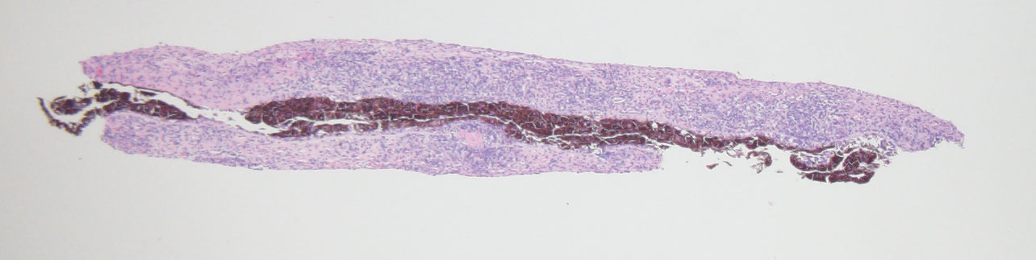
HE X 100

Slide 4
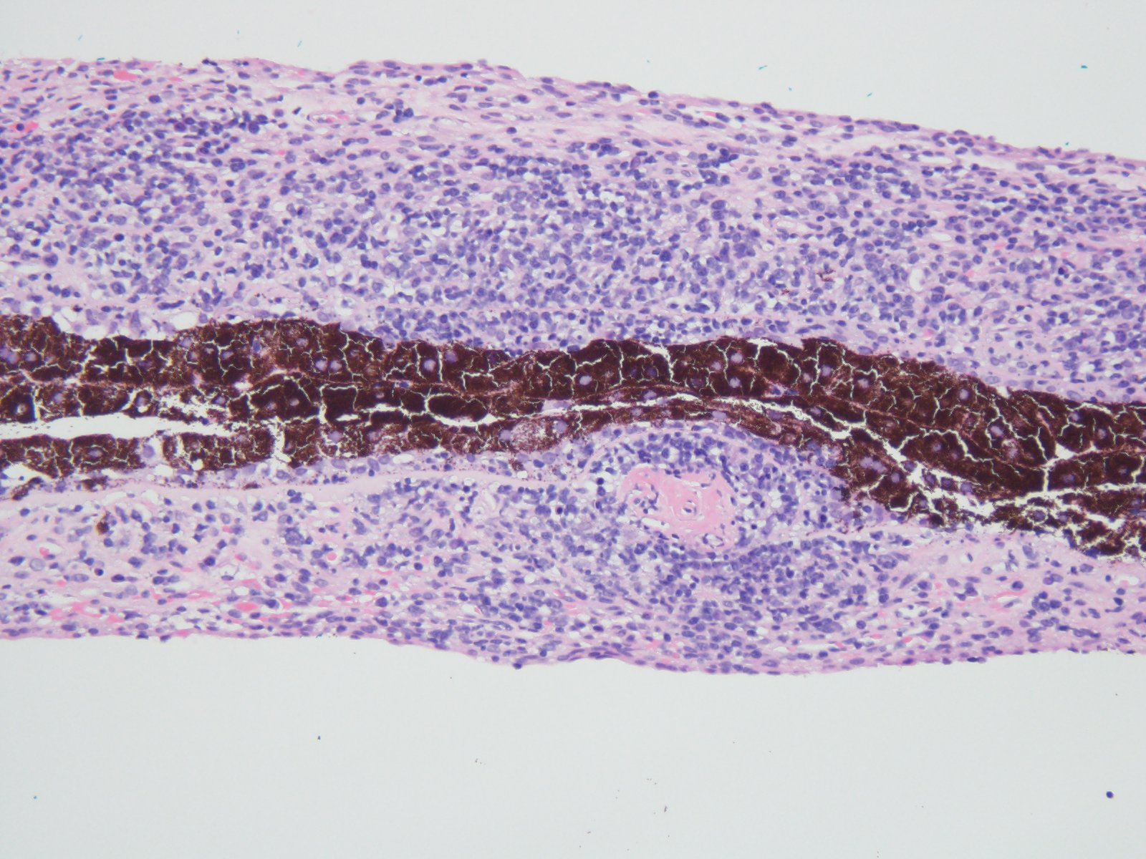
HE X 200

Slide 5
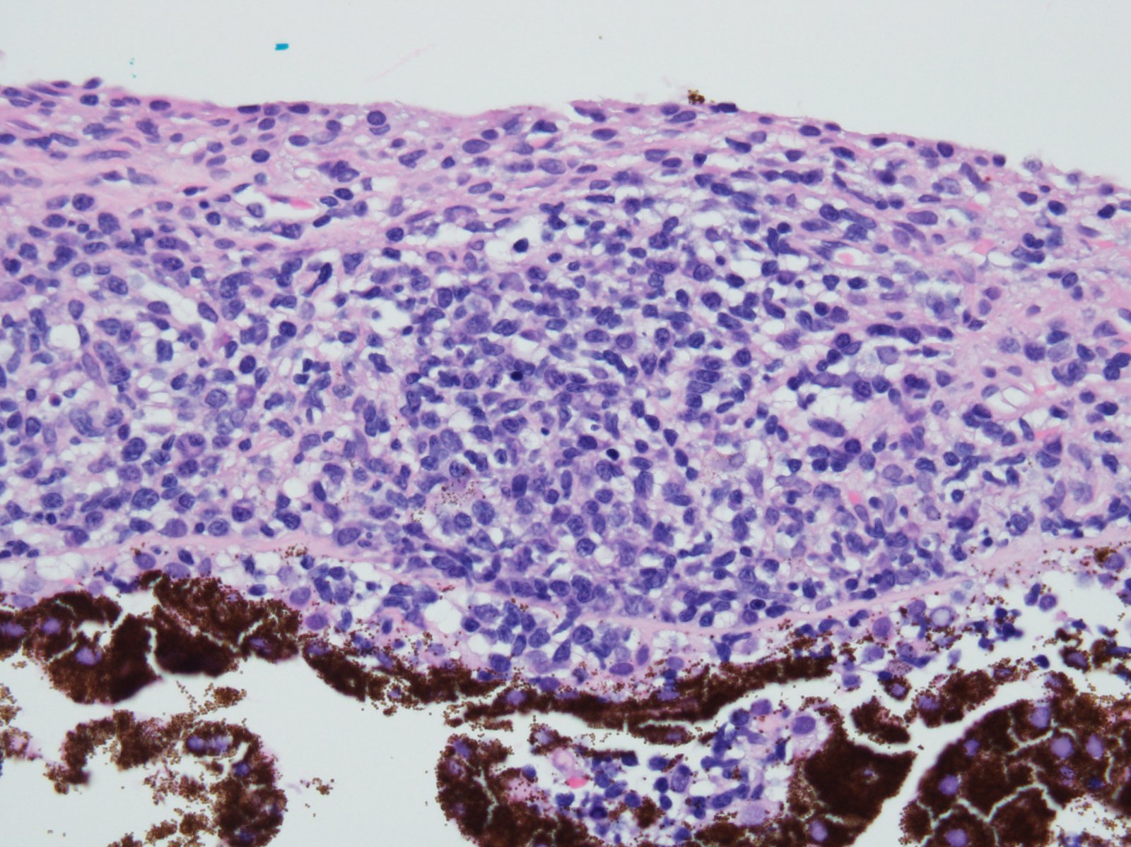
HE X 400

Slide 6
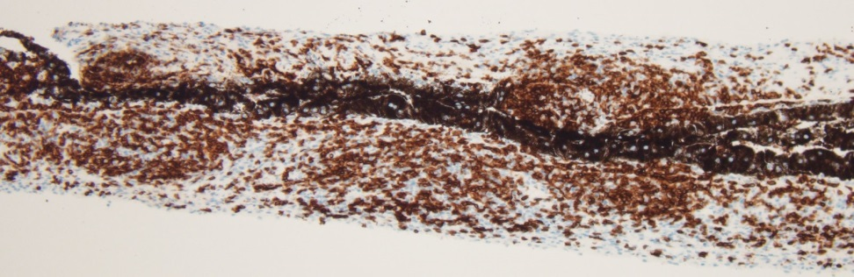
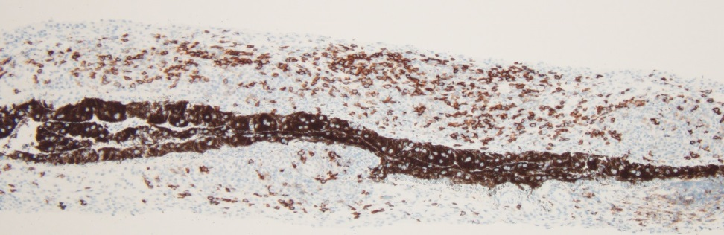
CD3
CD20

Slide 7
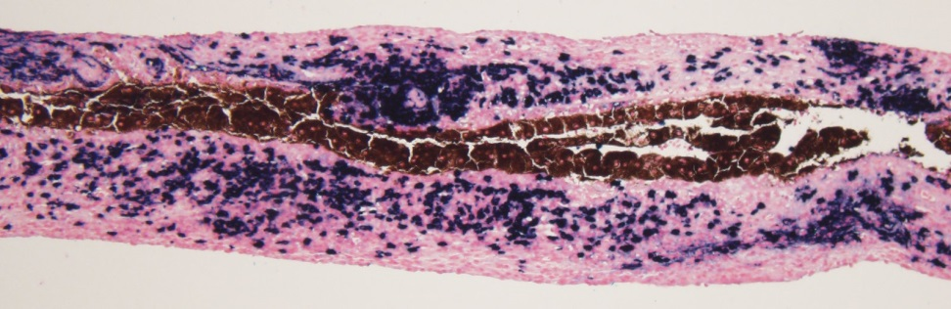
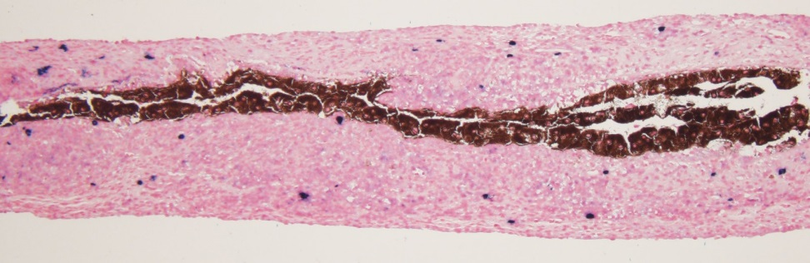
Kappa-ISH
Lambda-ISH

Slide 8
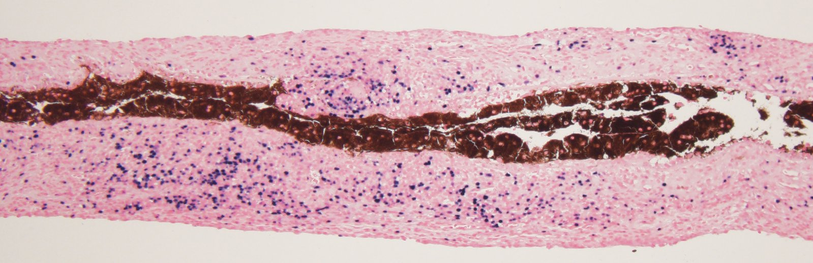
EBV-ISH

