Slide 1
Orbital Fibrous Dysplasia in an Older Than Average Patient
Joseph W. Sassani, MD, MHA
The Departments of Ophthalmology and Pathology
The Milton S. Hershey Medical Center
Hershey, PA 17033

Slide 2
Co-authors
Pathology Co-Authors:
Elizabeth E. Frauenhoffer, MD
Charles S. Specht, M.D.
Clinical Co-authors:
Christopher Weller, M.D.
Ingrid U. Scott, MD, MPH

Slide 3
Clinical History
76 y.o. man
3/28/18: Examined by Dr. Christopher Weller
Referred for possible biopsy of left supraorbital mass
Concern lesion represented a metastasis previous lung cancer

Slide 4
Ocular History
Hx LP vision OD secondary to old CRVO treated with PRP
HX mild BDR
Hx epiretinal membrane OU
Previous cataract surgery each eye
Ongoing retinal care provided by Dr. Ingrid Scott of our Retinal Service

Slide 5
Past Medical History
Left upper lobectomy in 2011 for lung cancer
no evidence of recurrence to date
Type 2 diabetes
Emphysema
Hypertension
Hyperlipidemia

Slide 6
Ophthalmic History
VA: R: LP; L: 20/25, PH 20/20
2+ APD right eye OD
Motility: full
Hertel: 16 R; 14 L/ base of 100
left enophthalmos by “worms eye view”
VF: Normal by confrontation OS; unable, OD
SLE: WNL except for bilateral PC IOLs

Slide 7
CT Head
Expansile lesion in the lateral wall of the left orbit measuring 2.3 x 1.6 x 1.7 cm in vertical, transverse and anteroposterior dimensions
Areas of cortical discontinuity in the posterior aspect
Mucosal thickening was noted in the right maxillary sinus
Developmental venous anomaly in the right anterior frontal lobe also was noted
Radiologist:
No images available for direct comparison
MRI report from 5/9/2002 did not comment on the lesion
Suggested that the lesion likely represented a metastasis

Slide 8
CT Head

Slide 9
CT Head

Slide 10
Clinical Course
4/16/18: Left lateral orbitotomy with bone window and biopsy performed without complication
Mass in the region of the left orbit/frontal process of the zygoma

Slide 11
Histopathology

Slide 12
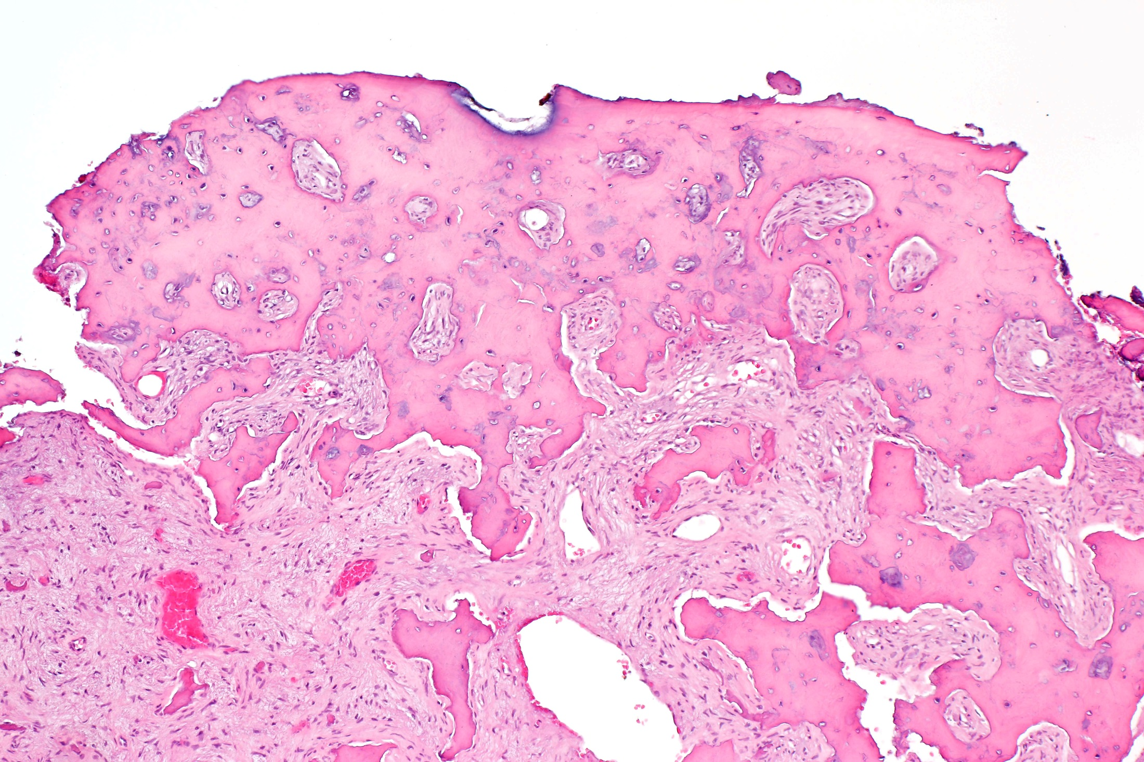

Slide 13
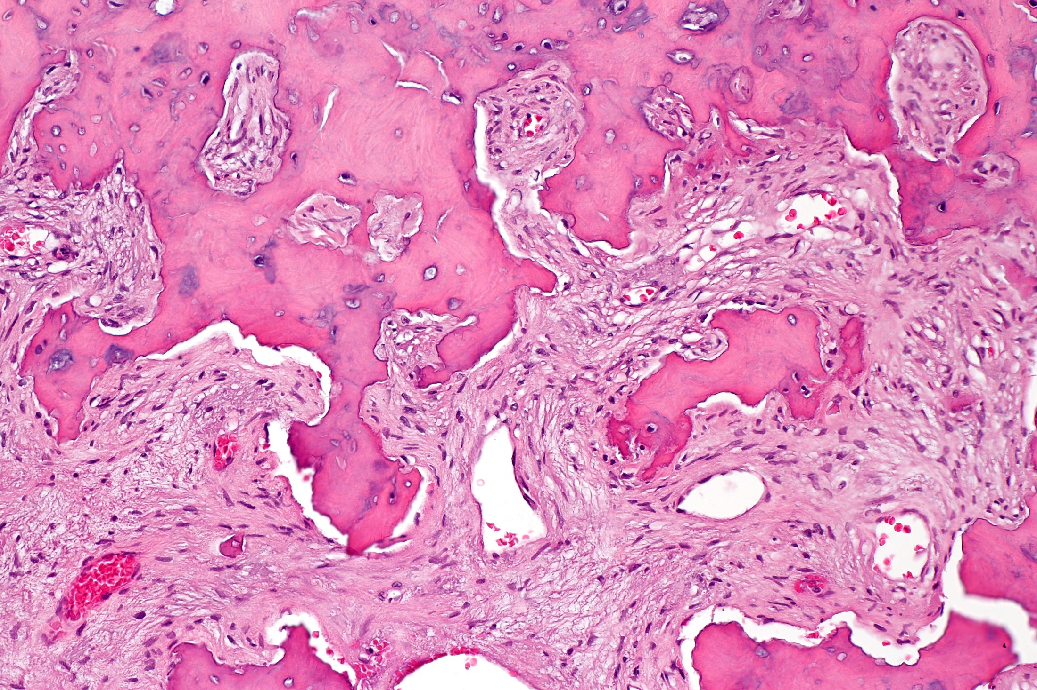

Slide 14
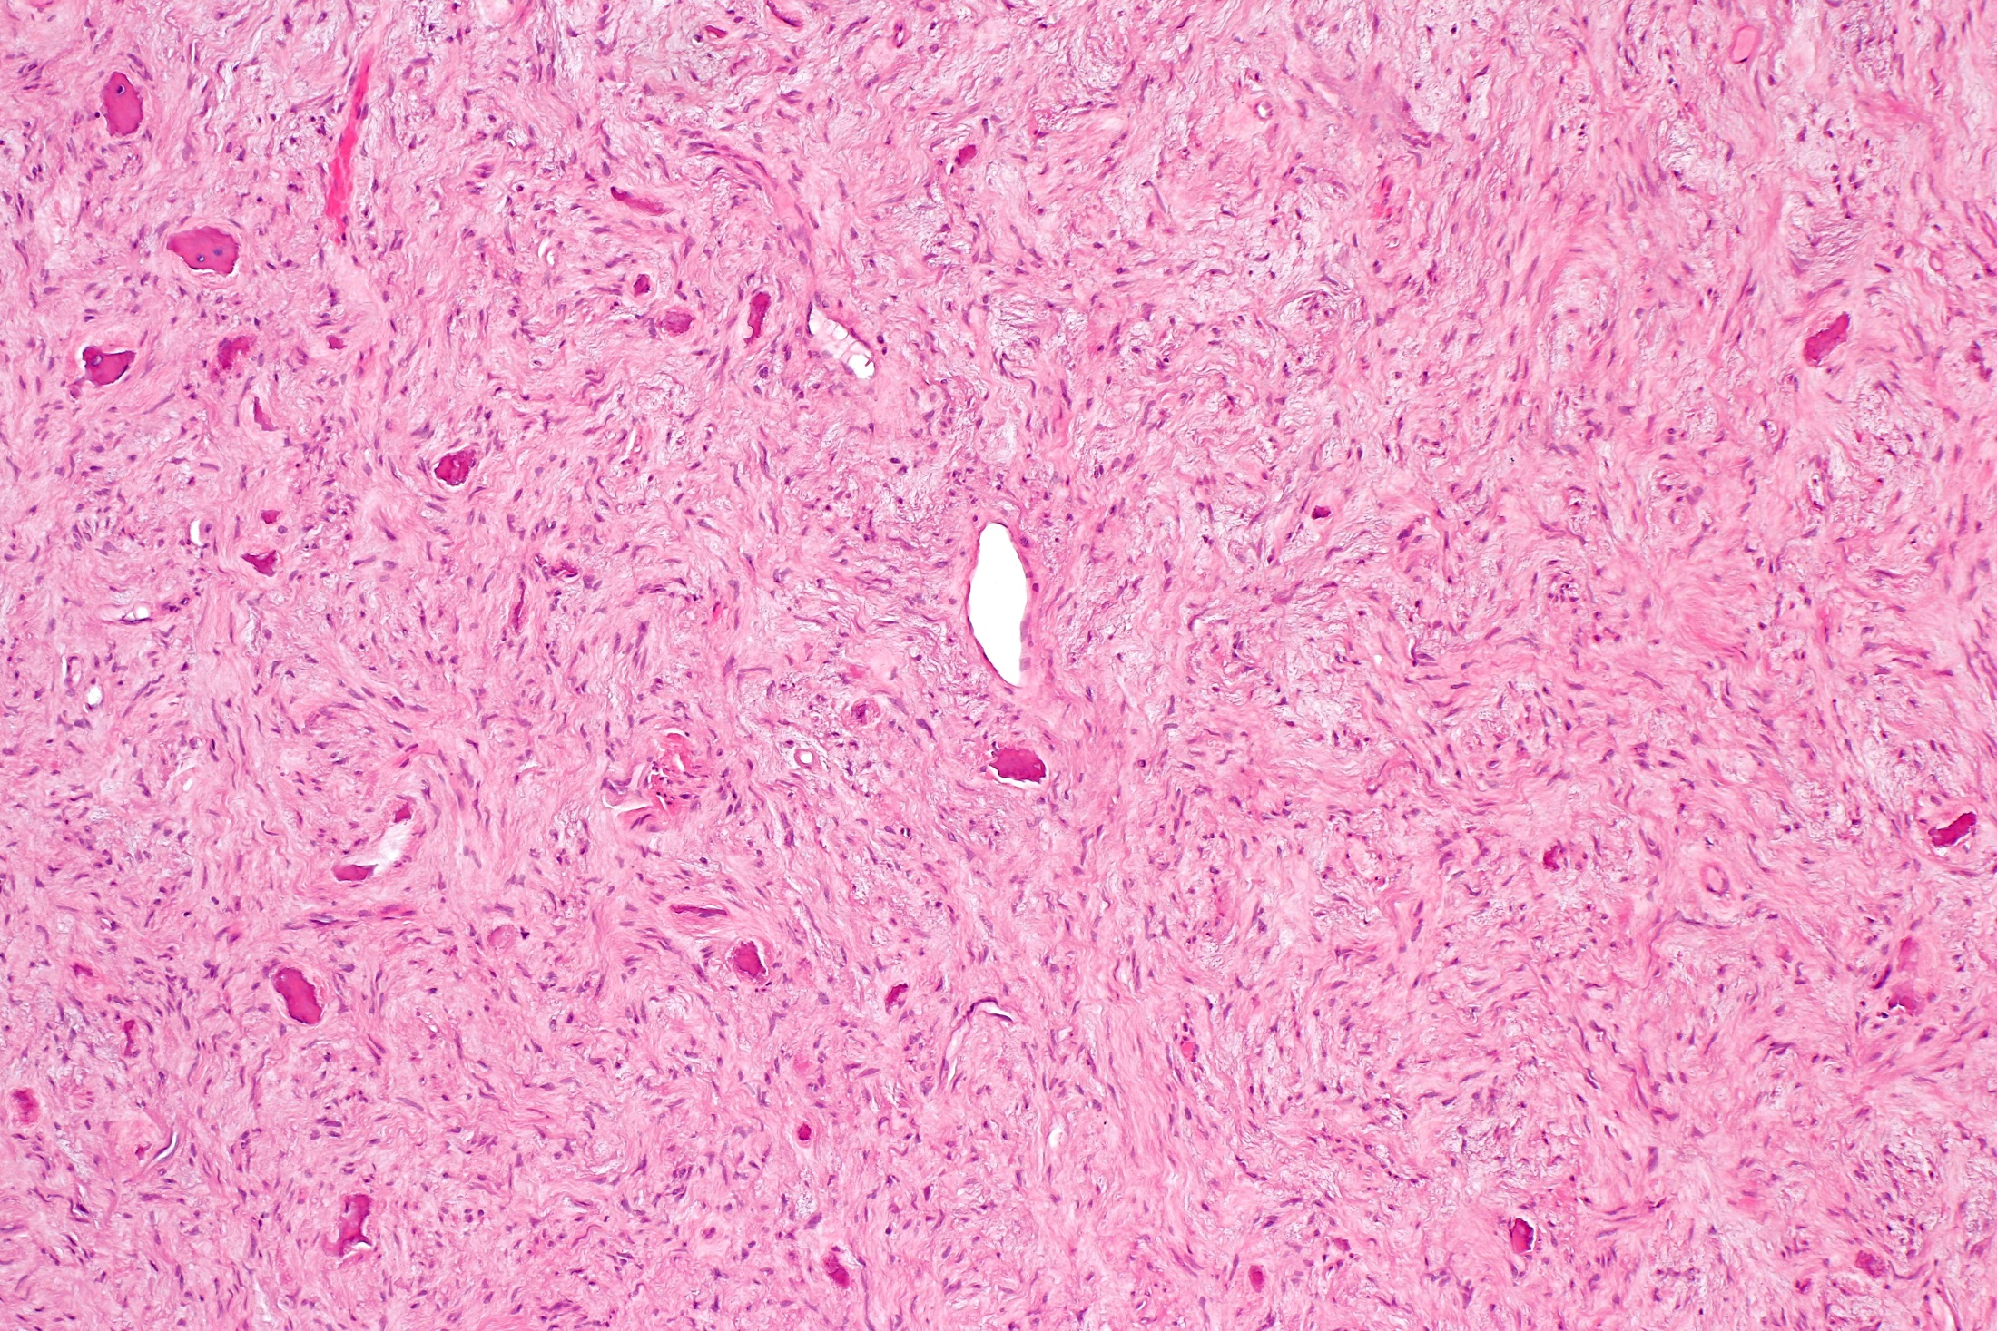

Slide 15
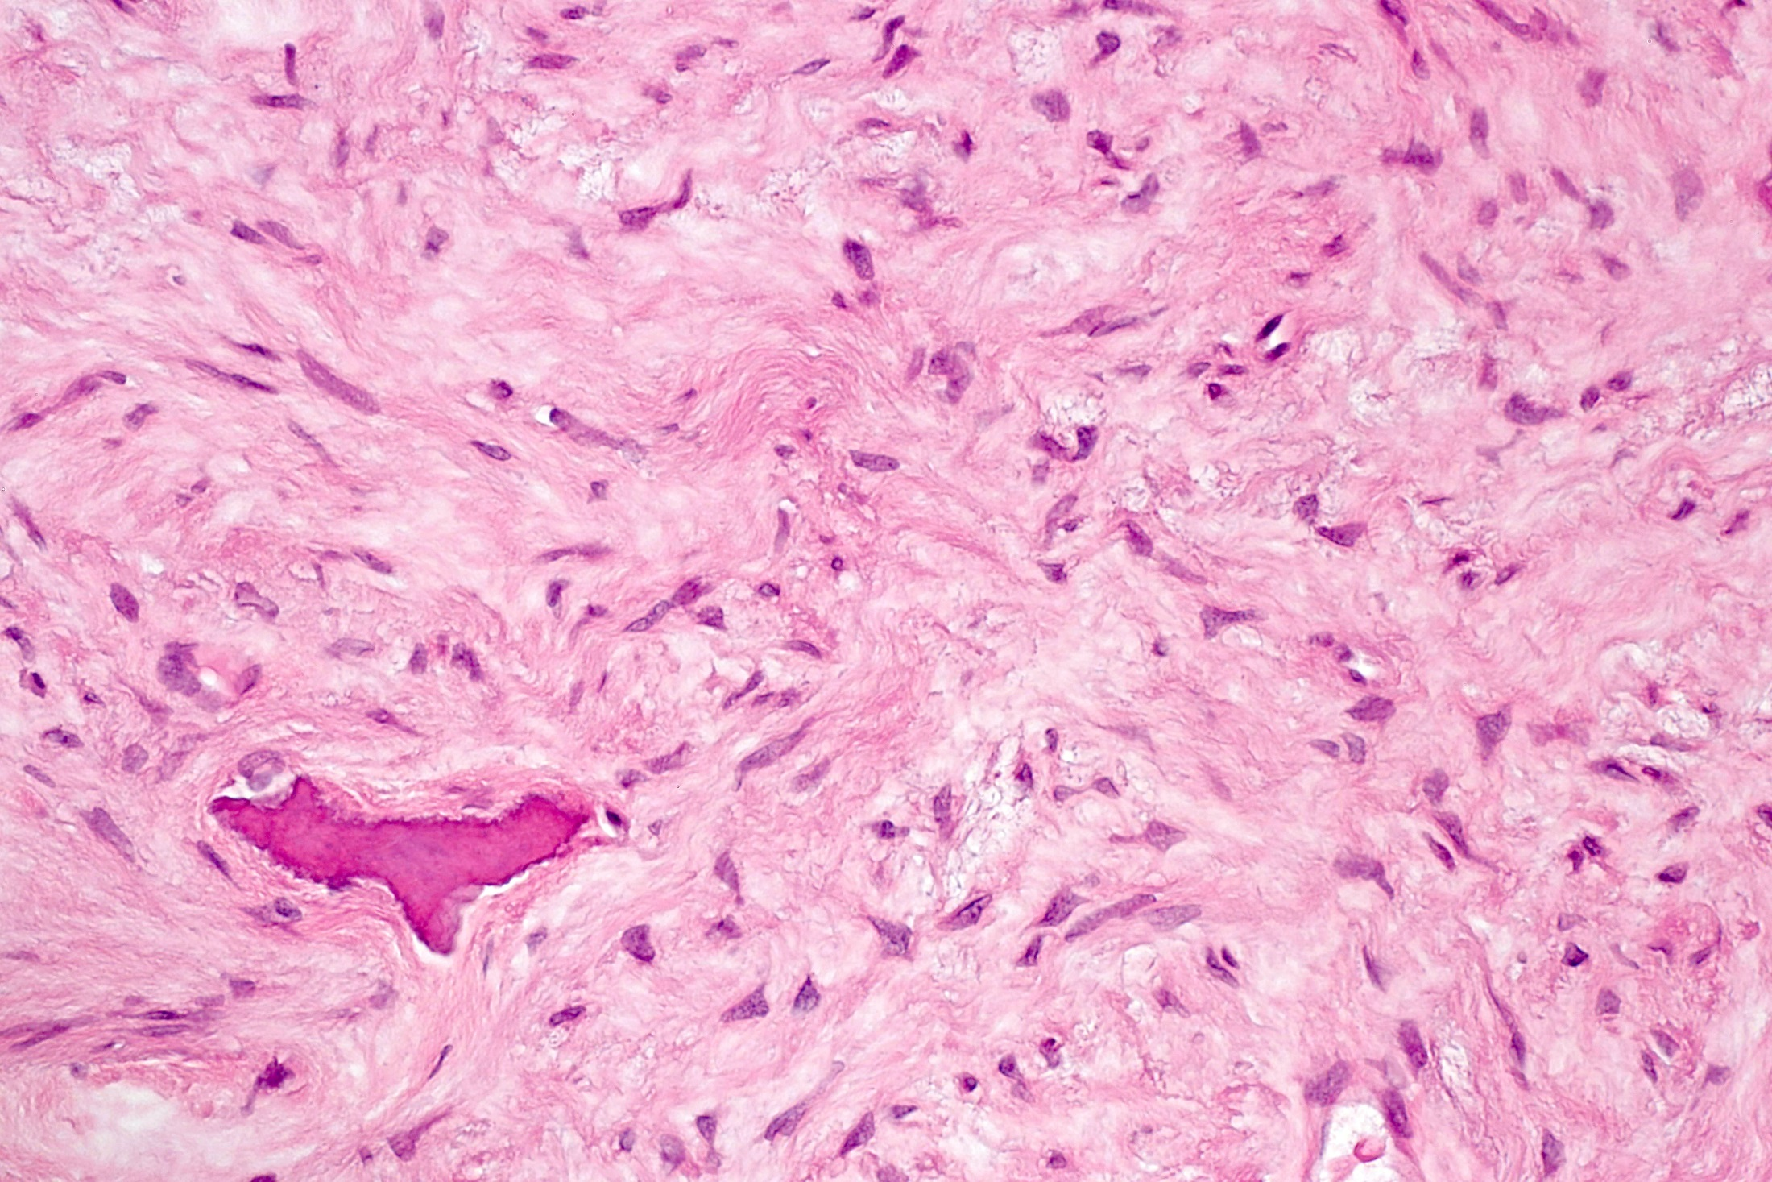

Slide 16
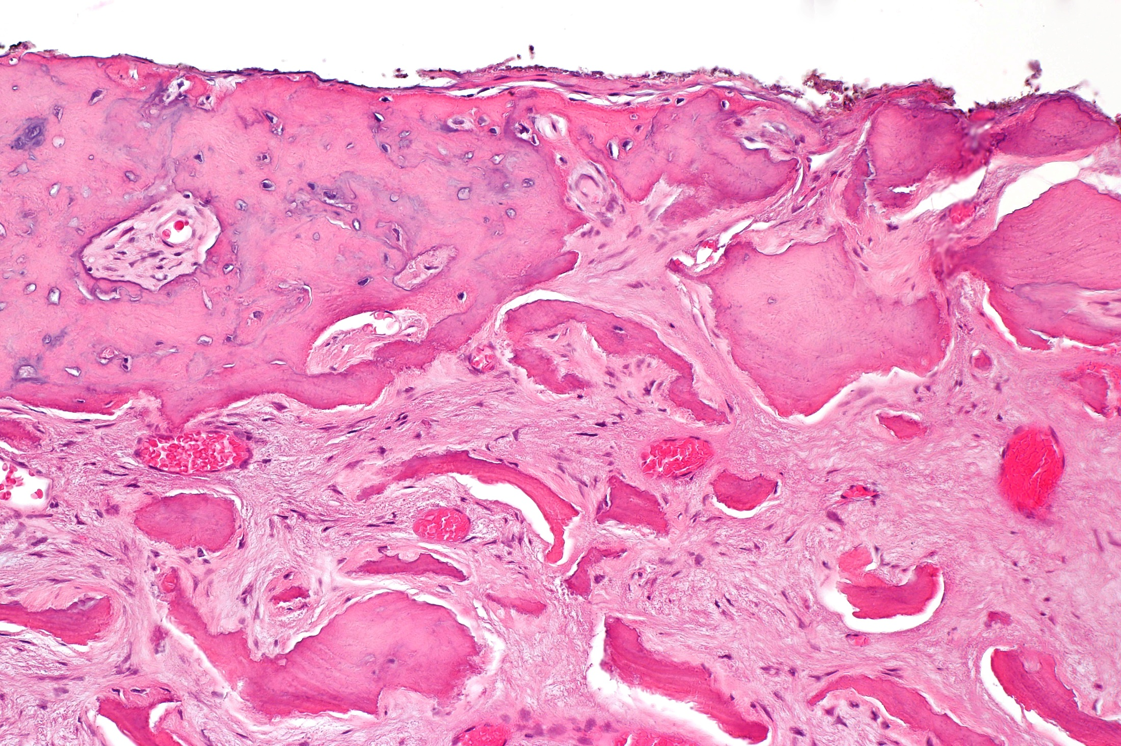

Slide 17
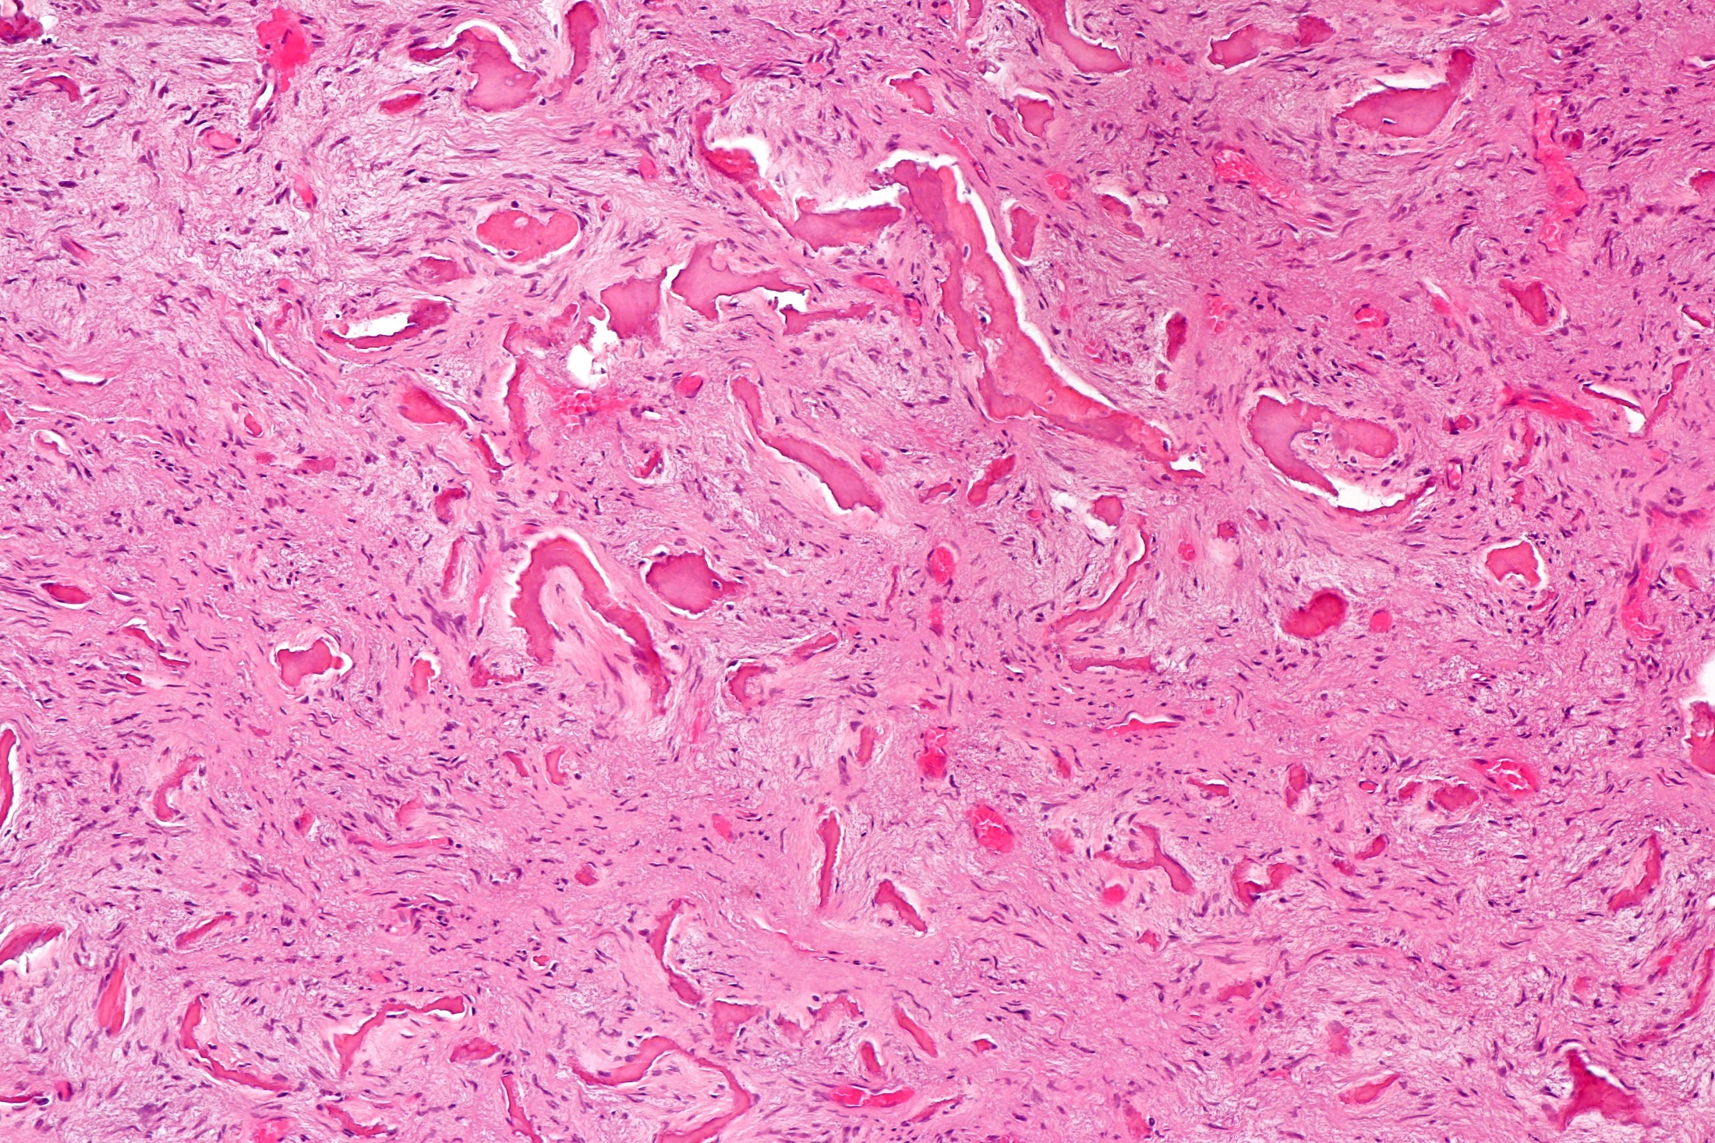

Slide 18
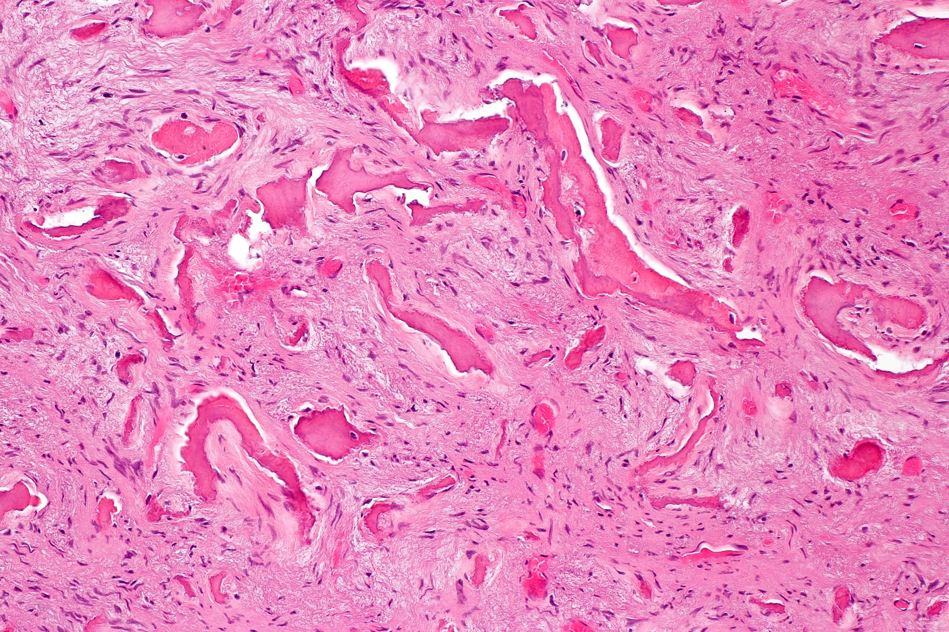

Slide 19
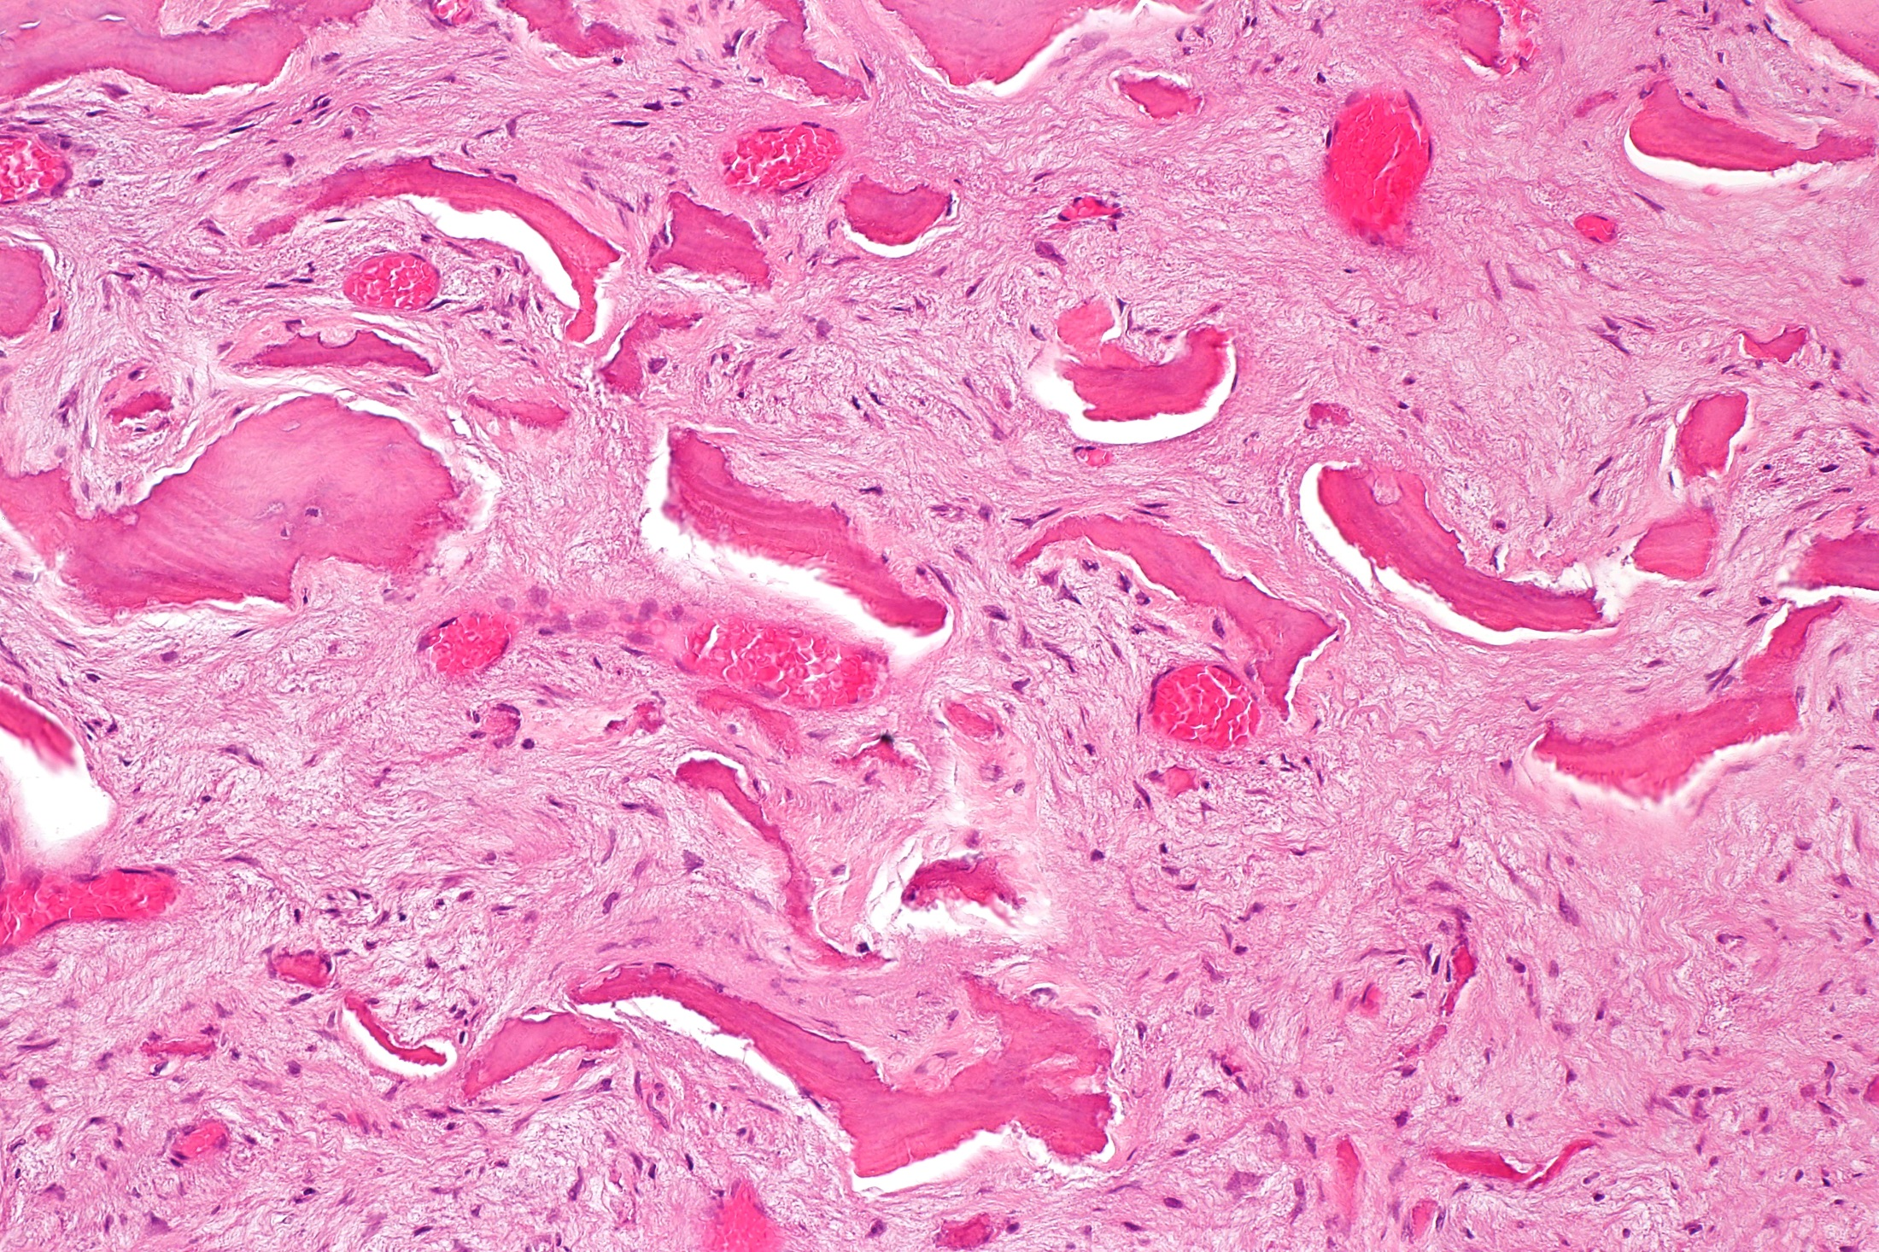

Slide 20
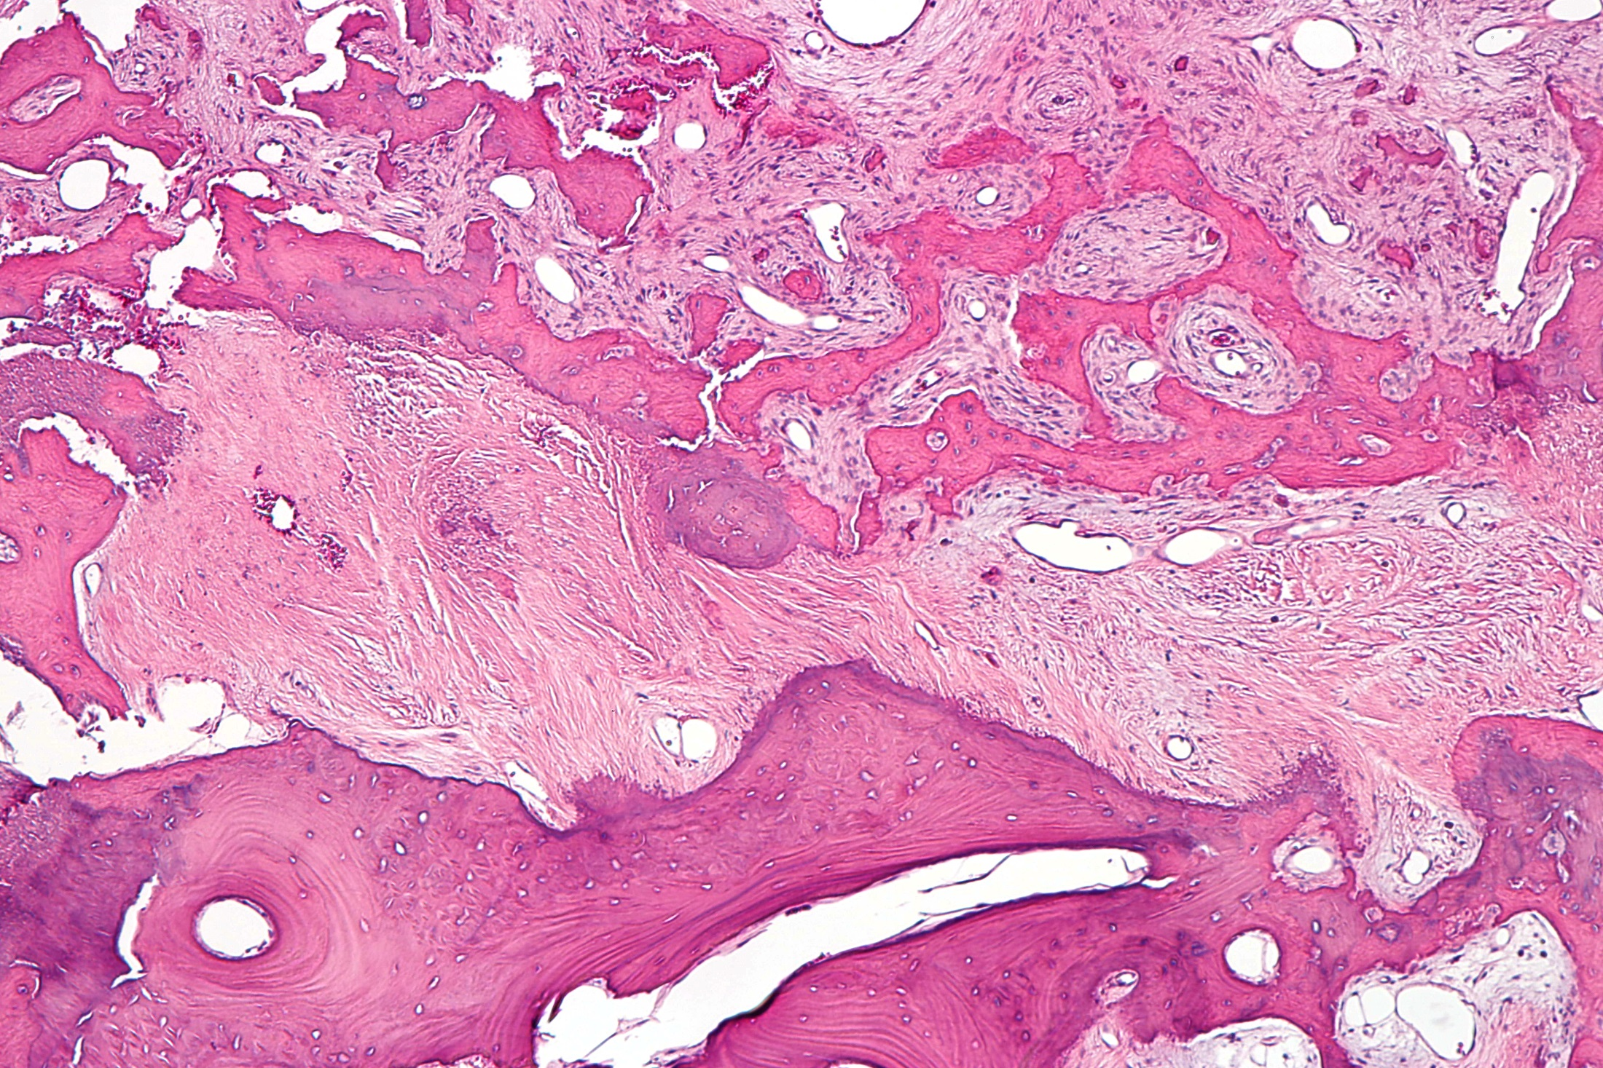

Slide 21
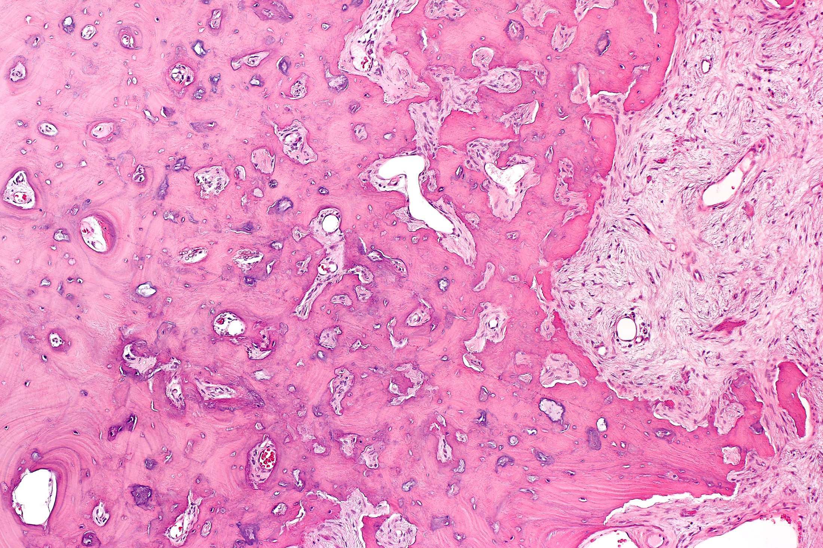

Slide 22
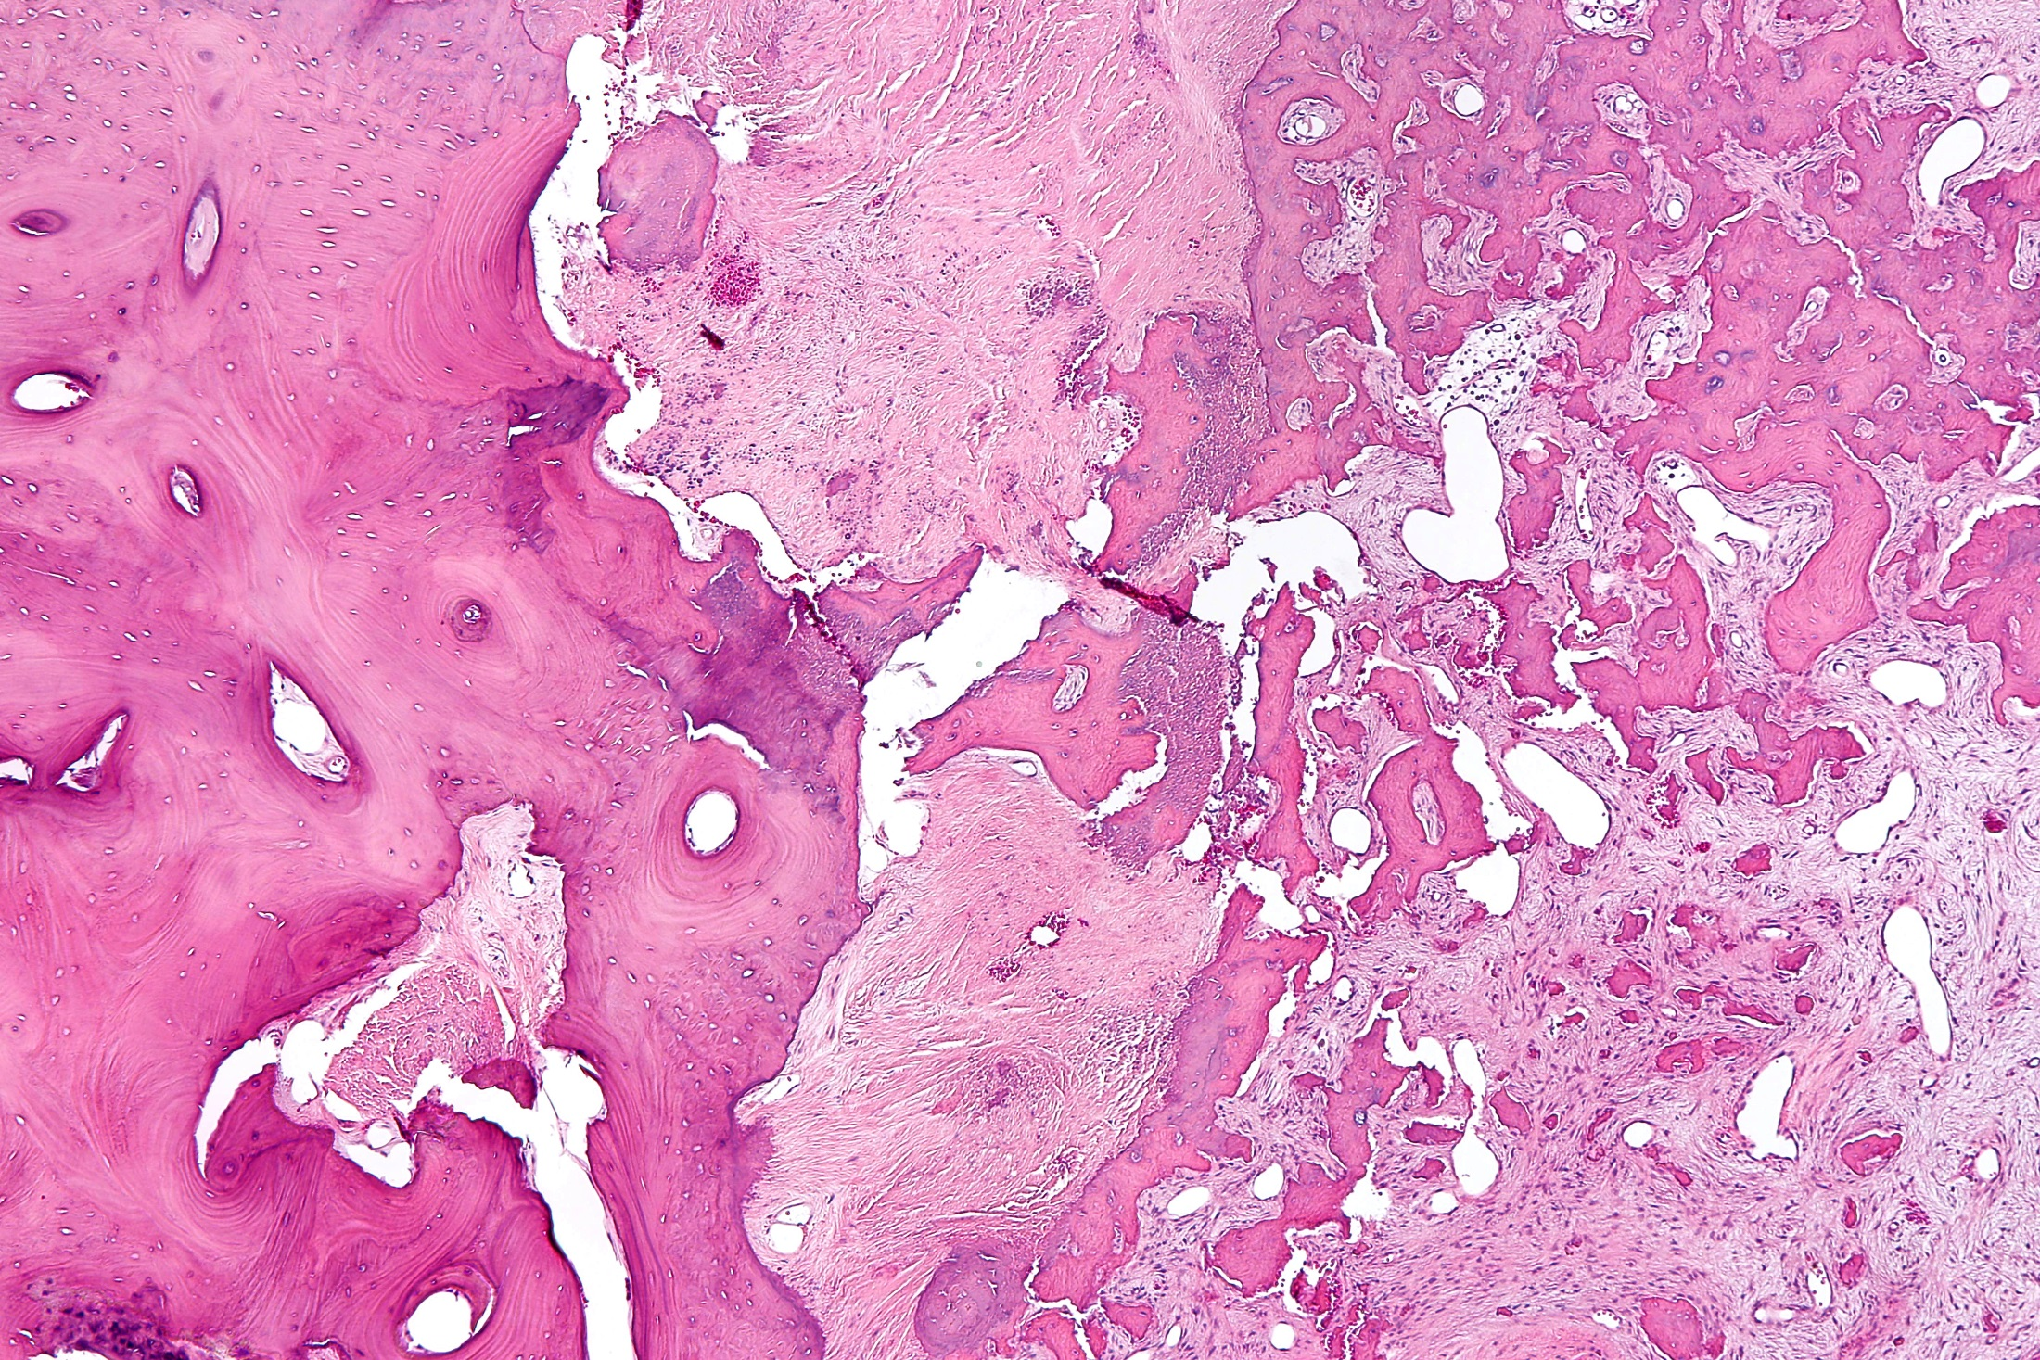

Slide 23
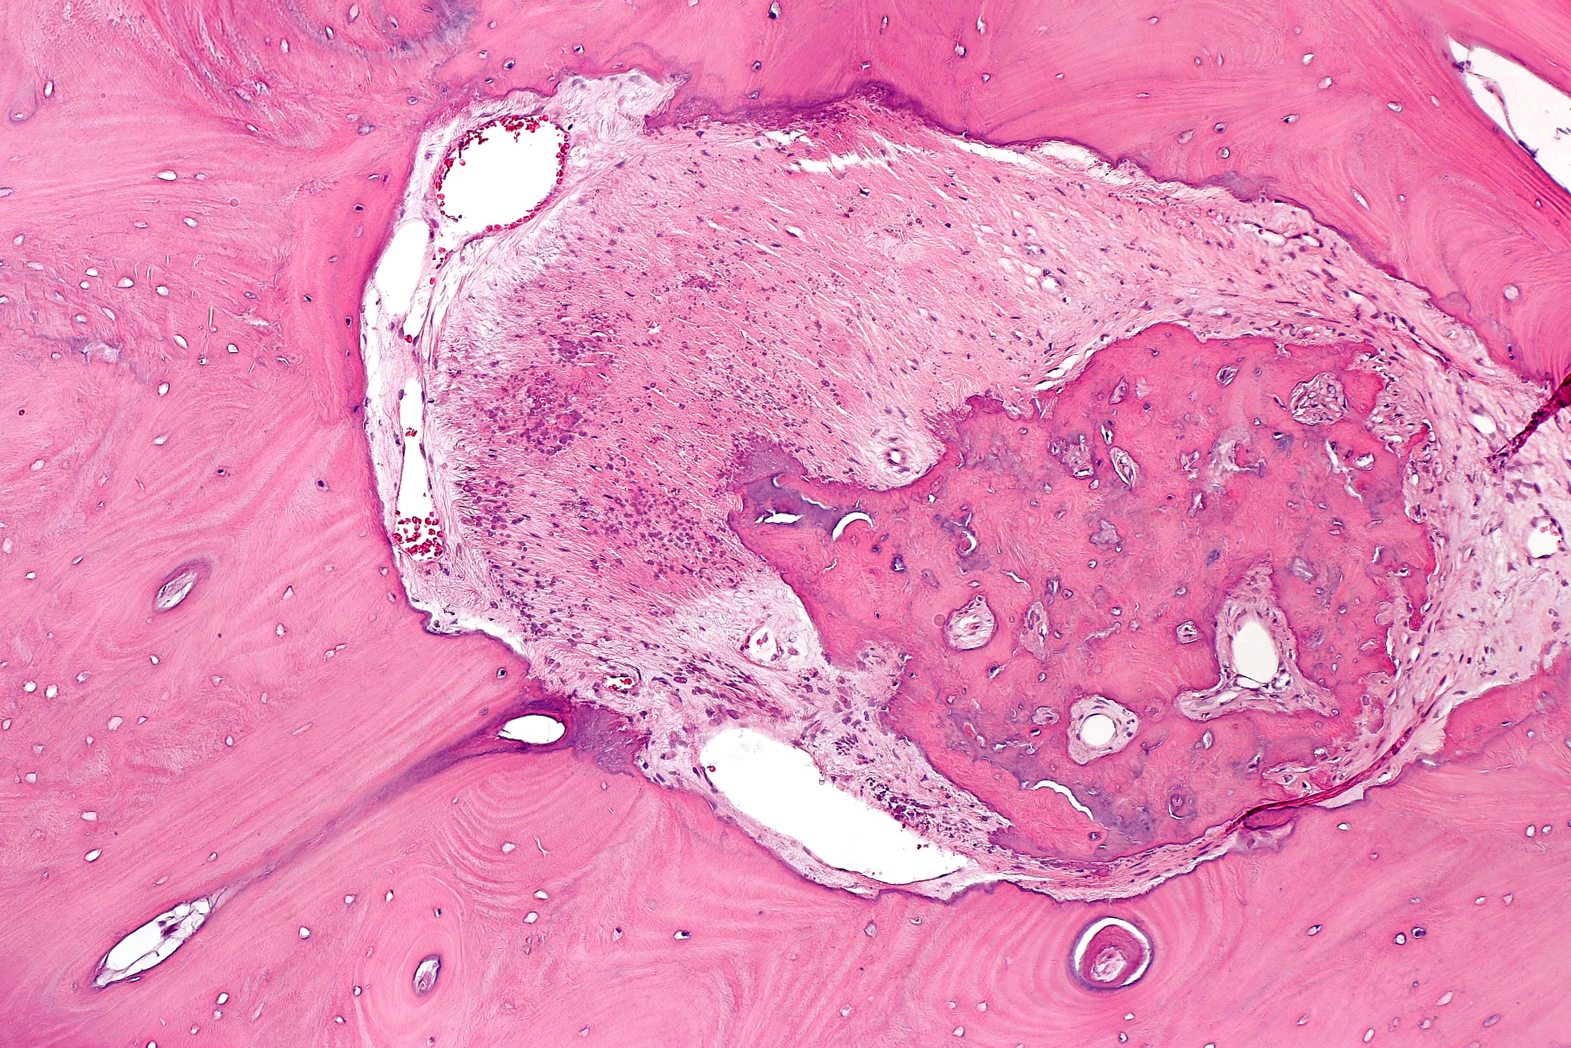

Slide 24
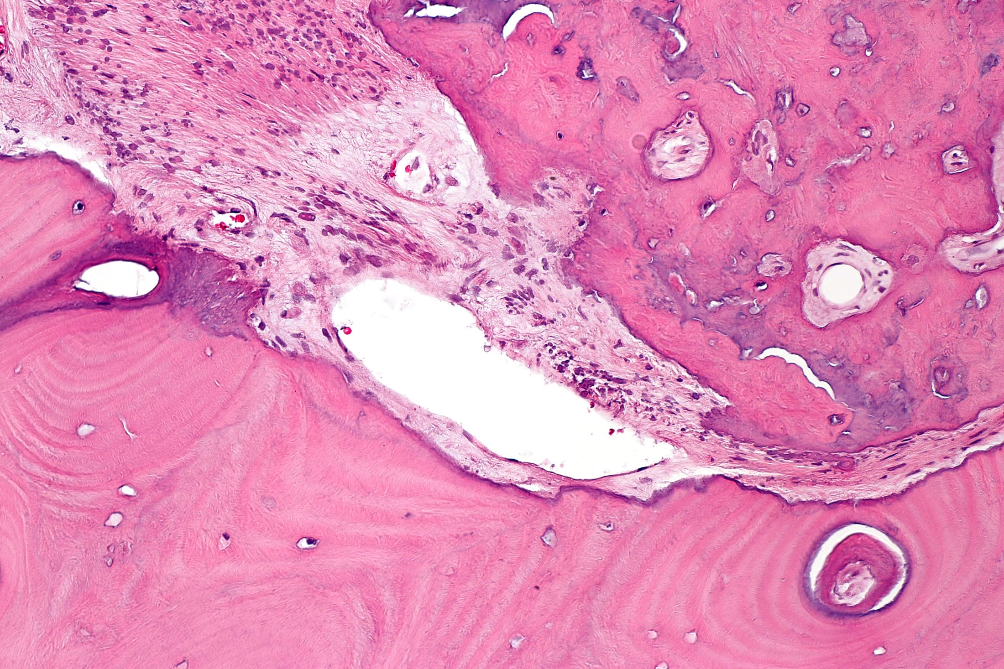

Slide 25
Discussion
Clinical entity consistent with fibrous dysplasia (FD) was first described by von Recklinghausen in 1891
Term “polyostotic fibrous dysplasia” was first used by Liechtenstein in 1938
In that paper he credits Dr. Henry L. Jaffe for calling his attention to cases of the disorder
1942, Lichtenstein and Jaffe called attention to the multiple patterns of bony involvement in FD

Slide 26
Characteristics
Characterized by skeletal lesions with replacement of normal bone by abnormal fibrous tissue within which irregular trabeculae of woven bone are haphazardly arranged
Bland spindle cells predominate as the background for the bony elements of the lesion

Slide 27
Histopathologic Patterns
Most common pattern is “Chinese writing”
thin bony trabeculae characteristic feature
resorption of the interior of bony trabeculae (dissecting resorption) is see frequently
Pagetoid pattern:
dense sclerotic trabecular bone predominates
Hypercellular pattern:
significant amounts of bone as in the pagetoid variant
bony trabeculae are discontinuous
distributed in a very orderly pattern that often contains a parallel arrangement

Slide 28
Differential Diagnosis
Molecular pathology diagnostic techniques of limited value in this lesion, but may be helpful in unusual cases
Main differential diagnosis primarily includes low grade central osteosarcoma, and ossifying fibroma (jaw)
Cemento-ossifying fibroma and juvenile psammomatoid ossifying fibroma also are considerations

Slide 29
Anatomic Classification
Based on its skeletal distribution
Monostotic: involves a single bone
70% to 80% of patients
Polyostotic: involves multiple bones
Note: With craniofacial involvement, the disease is considered monostotic even if several bones are involved as there is said to be only one disease focus

Slide 30
Associated Syndromes: McCune-Albright Syndrome MAS)
Comprises <5% of patients with FD
Classically associated with polyostotic FD
Accompanied by abnormal skin pigmentation, and precocious puberty
Other associated endocrine abnormalities:
Hyperthyroidism
growth hormone excess
FGF23-mediated phosphate wasting
Hypercortisolism
Jaffe-Lichtenstein type: lacks precocious puberty

Slide 31
Associated Syndromes: Mazabraud Syndrome and Encephalocraniocutaneous Lipomatosis
MS: Consists of monostotic or polyostotic FD in association with single or multiple intramuscular myxomas
Encephalocraniocutaneous lipomatosis: Involves tissues of ectodermal and mesodermal origin such as skin, eye, adipose tissue, and brain, has been reported

Slide 32
FD Epidemiology
FD = 7% of all nonmalignant bone tumors
May progress even after puberty
Nevertheless, usually been considered a disease of childhood
Importance of the disease in adulthood has gained increasing recognition
Review of 31 reports including 788 cases of FD:
mean age at presentation = 24 years
no male patients were observed over the fifth decade
Patient we present, therefore, was much older that the majority of FD patients at the time of presentation

Slide 33
Presentation of Craniofacial FD
Most common: facial asymmetry in 86%, followed by an orbital or facial mass in 60%
Most common ocular presenting complaint is blurred vision in 24%, followed by eyelid position abnormalities in 10%
Most common ophthalmic complications of FD:
visual loss
exophthalmos
dysesthesias in the distribution of the trigeminal nerve
epiphora
headaches
diplopia
visual field defects
even blindness if the optic canal is involved

Slide 34
Imaging Characteristics
Radiologically:
translucent if fibrous tissue predominates
“ground glass” appearance if there is more calcification
CT scanning of craniofacial FD demonstrates sclerotic involvement in 50%, and pagetoid findings in 15.6%
MRI helps characterize internal lesion structure
helps determine extent of intraosseous and any extraosseous involvement
may also be helpful in distinguishing FD from other fibro-osseous lesions, meningioma, Langerhans’ cell histiocytosis, and Paget’s disease

Slide 35
Genetics
Caused by activating mutations of the GNAS gene that encodes the cAMP-regulating transcript stimulatory protein G𝞪s
Results in up-regulation of Wnt/β-catenin signaling
Activation of adenyl cyclase and dysregulation in cAMP production
Expression of an active G𝞪s mutation in skeletal stem cells is both sufficient and necessary for FD initiation and maintenance
Hosalkar RM, Mohanty N: Pagetoid polyostotic fibrous dysplasia. BMJ Case Rep 2015, 2015

Slide 36
Genetics (continued)
Enhanced G𝞪s signaling and cAMP generation accelerate the osteogenic commitment of the stromal cells
however, they inhibit their further differentiation into osteoblasts thereby resulting in the formation of fibrous dysplastic lesions that
nevertheless, express early osteoblastic markers such as alkaline phosphatase

Slide 37
Genetics (continued)
Mutation located on the q arm of chromosome 20 at position 13.3.26
Mutations are found in early embryonic somatic cells resulting in a somatic mosaic state
Lack of inheritance of FD attributed to probable embryonic lethality of germ-line transmitted activating GNAS mutations, which are said to only survive through mosaicism
Clinical manifestations are related to how small or large the cell mass is during embryogenesis when the mutation occurs, and where in the cell mass the somatic mutation occurs

Slide 38
Genetics (continued)
G𝞪s and its coupled receptors, G protein-coupled receptors (GPCRs), important in endocrine gland function
Sporadic, mosaic activating G𝞪s mutations can result in autonomous endocrine gland hormone overproduction, which is associated with MAS
One theory as to why FD tends to stabilize (normalization) with increasing age is that there is an age-dependent demise of GNAS-mutated cells in these lesions through apoptosis

Slide 39
Malignant Transformation
Uncommon in FD
Generally is considered a cytologically benign disorder
Occurs in approximately 1% of cases
Associated with previous radiation therapy in 46% of cases in one large series
Nevertheless, in a systematic review of 31 reports including 788 cases of FD in which 18% of cases recurred or reactivated no cases of sarcomatous change were found

Slide 40
Malignant Transformation (continued)
Malignancy is more frequent in polyostotic disease, particularly when associated with MAS or MS
May occur even in monostotic fibrous dysplasia
Associated malignancies are osteosarcoma, fibrosarcoma, chondrosarcoma, and malignant fibrohistiocytoma

Slide 41
Worrisome Subset of Cases
Conversely, FD can be confused with an osseous neoplasm
5% of cases of FD may even exhibit aggressive growth pattern simulating malignancy, but have benign histopathologic findings
Craniofacial lesions, in MAS should be monitored closely, particularly in childhood, to provide early detection of optic nerve compression

Slide 42
Rare Association with Other Tumors
Rarely, associated with other tumors including: atypical lymphoplasmacyte-rich meningioma, and one with multiple globoid meningiomas.
Additionally, other lesions may mimic FD.
Considerable discussion regarding the surgical management of FD particularly when there is optic canal involvement
In one study, even the authors differed among themselves as to the indications for surgical intervention in these patients

Slide 43
Treatment, Regrowth and Complications
May be greater risk of post-surgical regrowth when FD is associated with the MAS
Intravenous bisphosphonate is a current non-surgical treatment for FD aimed at reducing pain and strengthening bone
Therapy targeted at the abnormal pathways resulting from the genetic defect may hold promise in the future
Rapid progression of exophthalmos has been seen in FD complicated by aneurysmal bone cyst, hemorrhage, or mucocele within the dysplastic tissue

Slide 44
Summary
Orbital FD reported in a 76 yo man
No lesion noted on MRI 16 years previously
Surgically excised
Characteristic histopathologic findings
No worrisome characteristics

Slide 45
Co-authors
Pathology Co-Authors:
Elizabeth E. Frauenhoffer, MD
Charles S. Specht, M.D.
Clinical Co-authors:
Christopher Weller, M.D.
Ingrid U. Scott, MD, MPH

Slide 46
Co-authors
Pathology Co-Authors:
Elizabeth E. Frauenhoffer, MD
Charles S. Specht, M.D.
Clinical Co-authors:
Christopher Weller, M.D.
Ingrid U. Scott, MD, MPH

Slide 47
Orbital Fibrous Dysplasia in an Older Than Average Patient
Joseph W. Sassani, MD, MHA
The Departments of Ophthalmology and Pathology
The Milton S. Hershey Medical Center
Hershey, PA 17033

