Slide 1
Bad News on the Horizon
Eastern Ophthalmic Pathology Society
September 13, 2018
Washington D.C.
Jerry A. Shields MD
Ocular Oncology Service
Wills Eye Hospital
Philadelphia PA USA

Slide 2
83 yowm
Dry eye symptoms OD
June 2017 - ophthalmologist noted hyperkeratosis
advised observation and lubricating eyedrops
Oct 2017 - ophthalmologist noted growth of lesion suspicious for neoplasm
Nov 2017 - referred to our Oncology Service

Slide 3
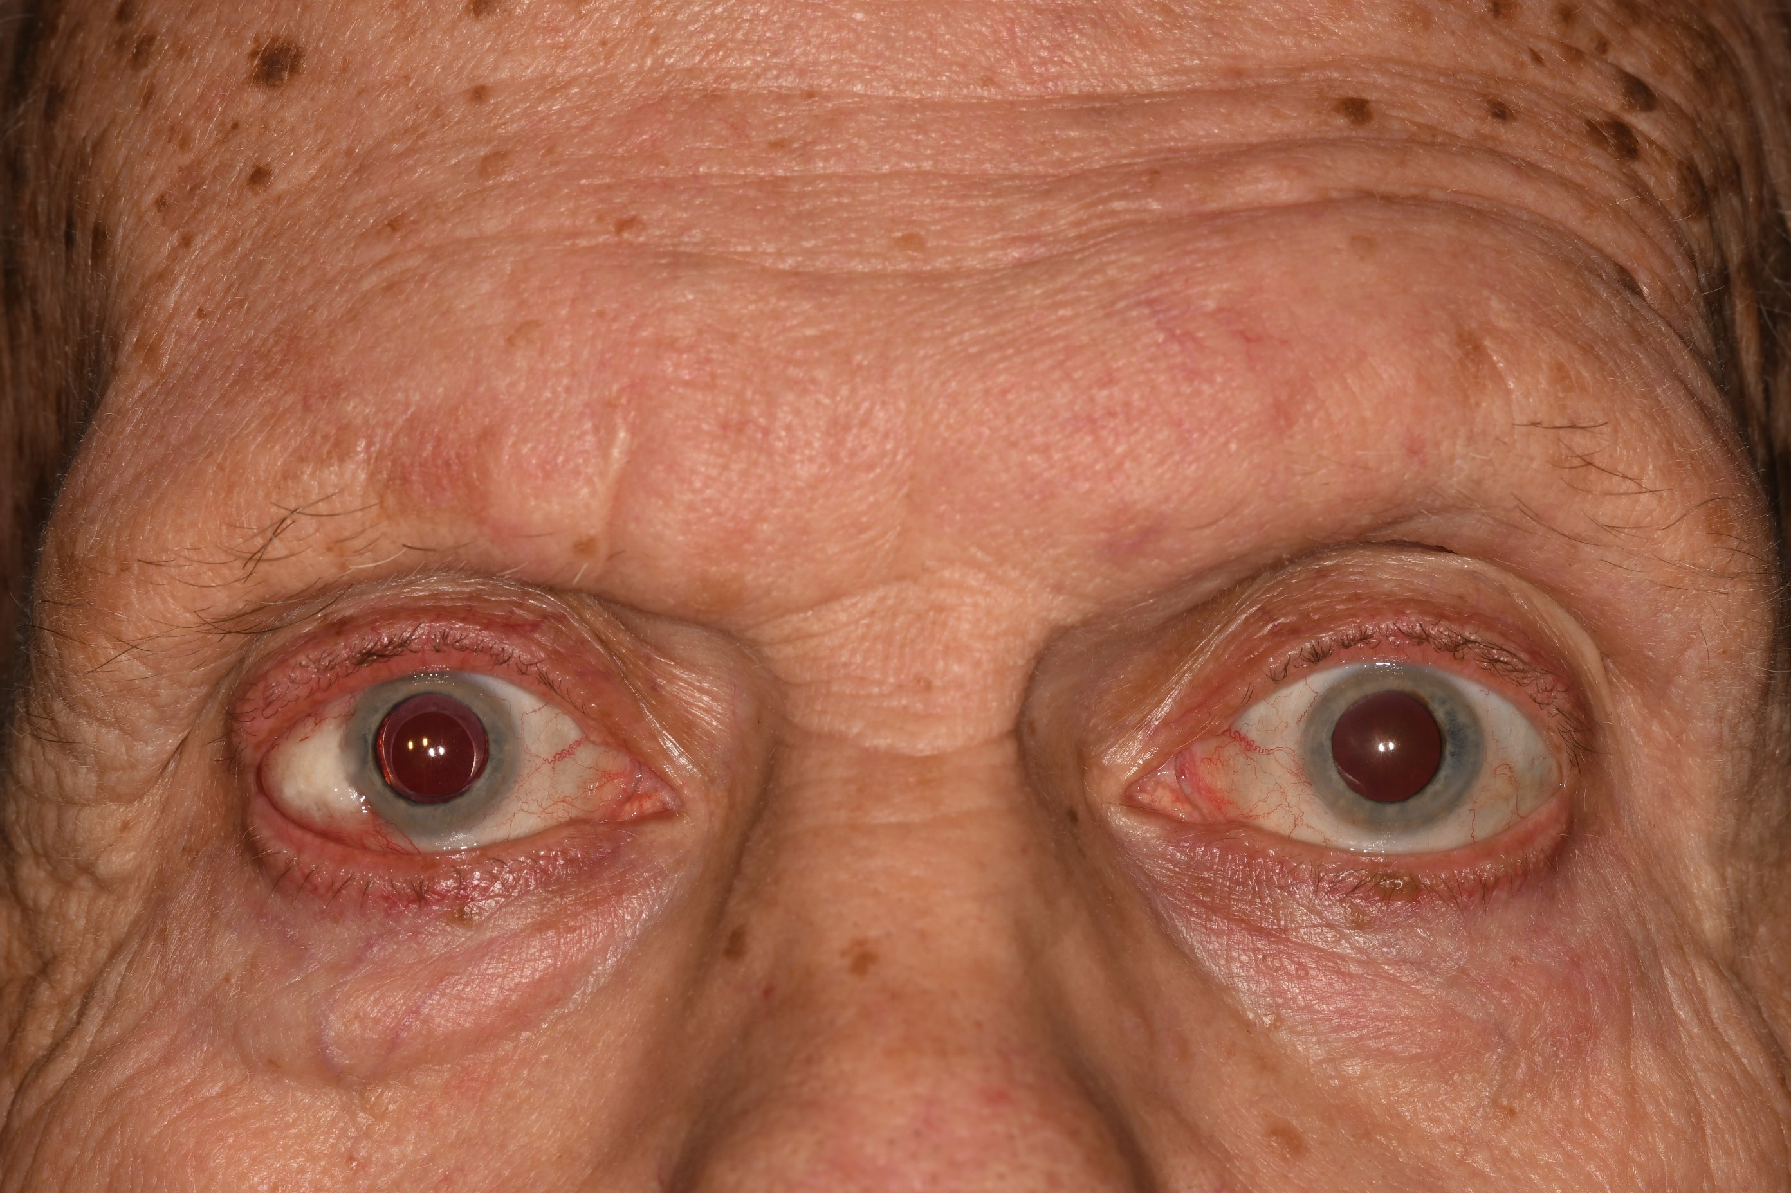
Painless white scar on right eye

Slide 4
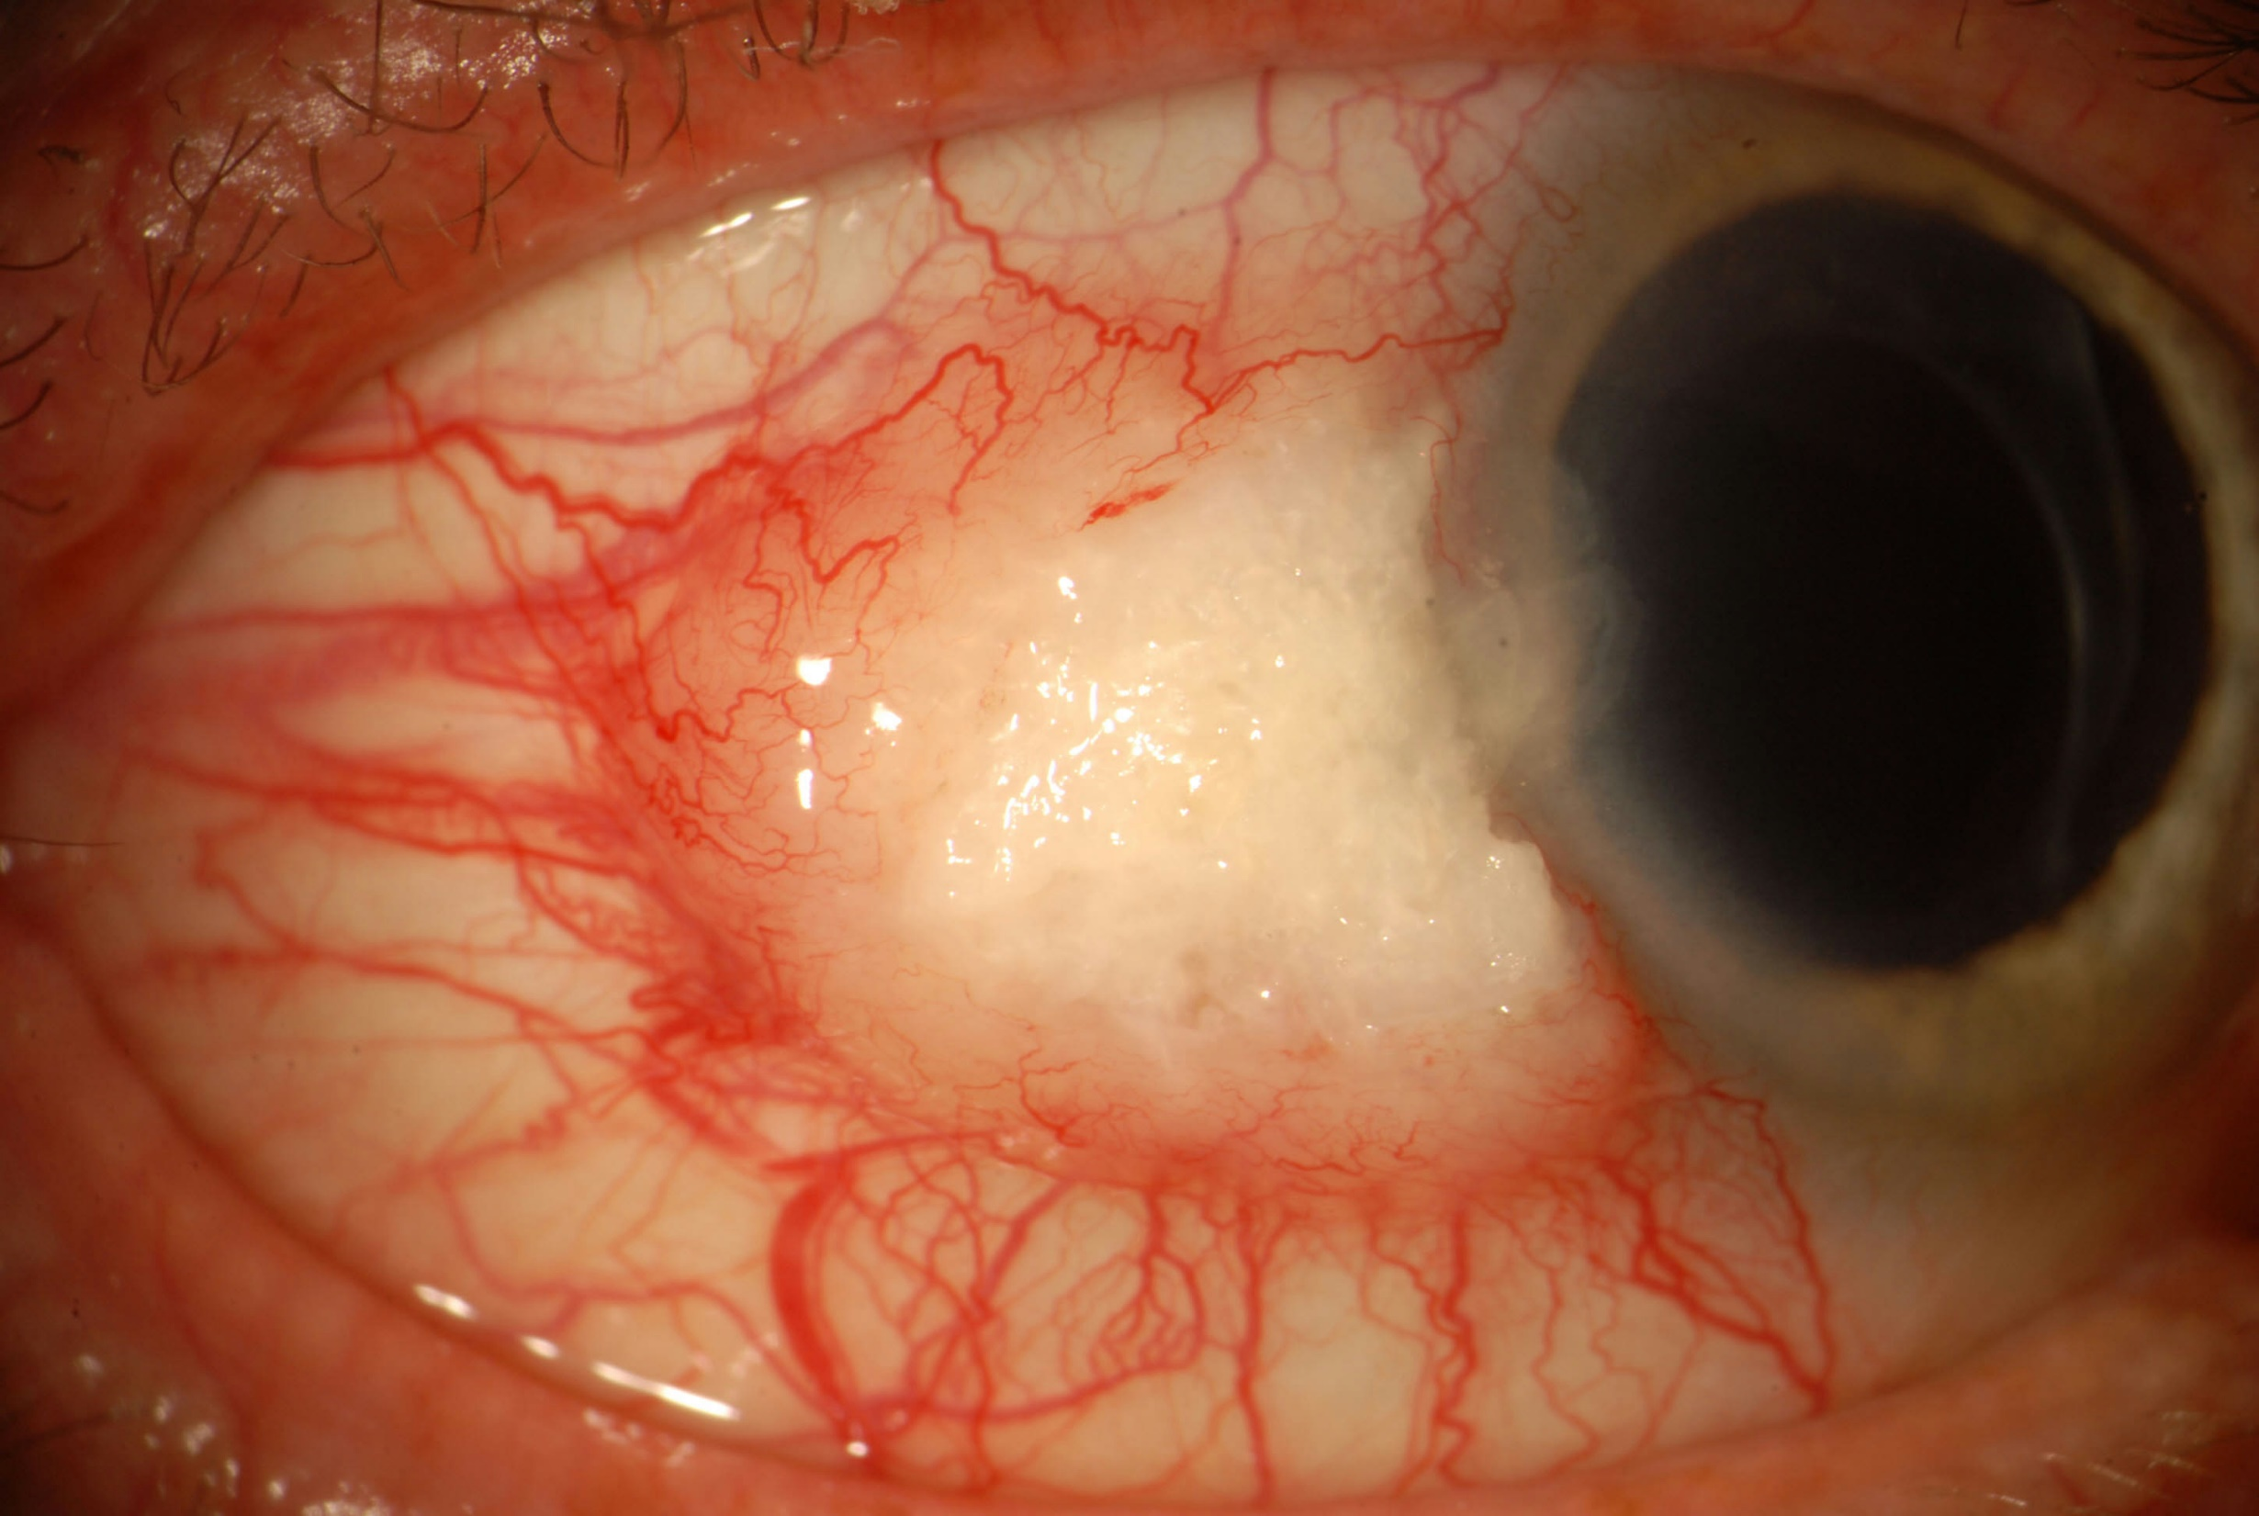
White mass
10 x 10 x 3 mm
Corneal extension
Leukoplakia with dryness
Extensive feeder vessels

Slide 5
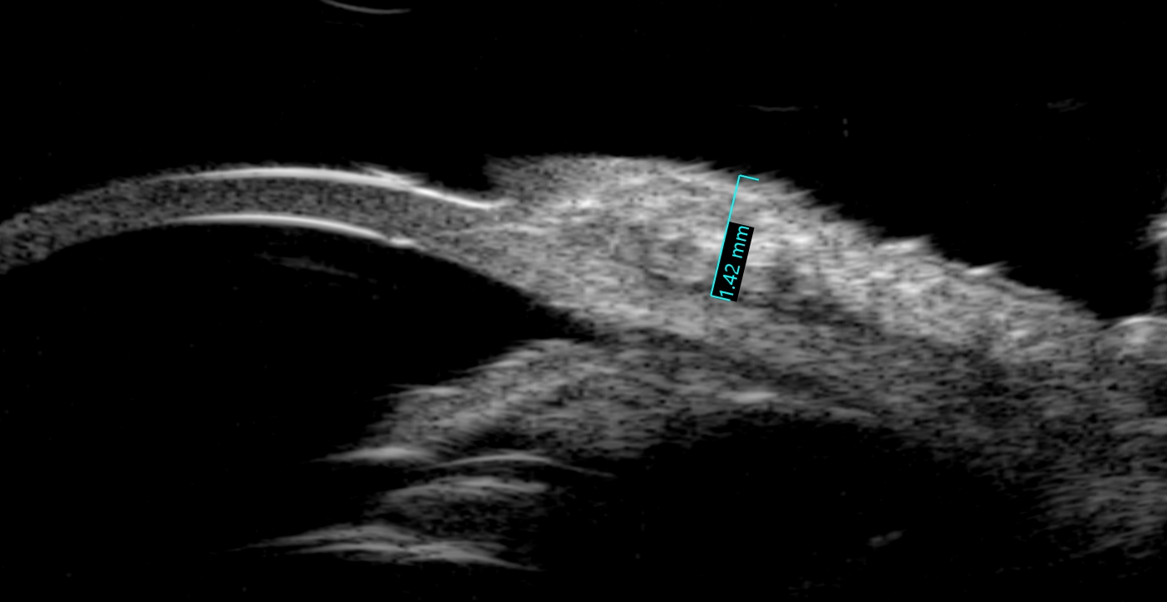
UBM
Epibulbar mass without scleral invasion.
Tumor thickness = 1.42 mm

Slide 6
Our differential diagnosis
Conjunctiva lesion
Squamous cell carcinoma
Mucoepidermoid carcinoma
Rule out metastasis
Doubt melanoma

Slide 7
Surgical procedure
Cryotherapy
No touch removal of the mass
At surgery
sclera was boggy
worried about invasive tumor
Etoh
Keratectomy
Cryo

Slide 8
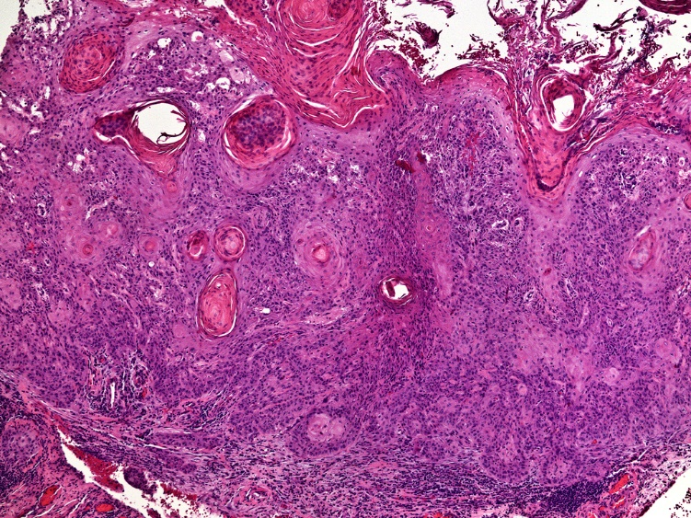
Pathology
Squamous epithelium showed :
Acanthosis
Dysplasia
Parakeratosis
Notes:
The conjunctival epithelium is markedly hyperkeratotic, parakeratotic and acanthotic, with full thickness dysplasia, and keratinizing nests of invasive squamous cells in the underlying substantia propria.

Slide 9
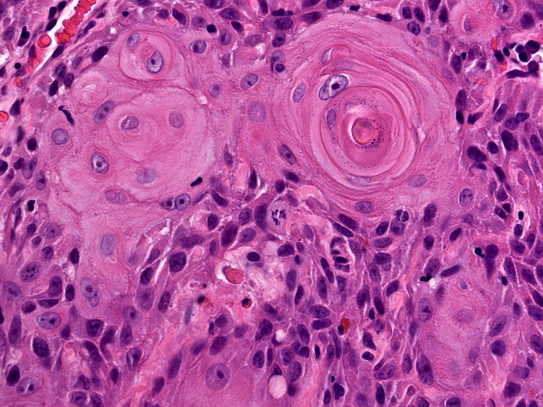
Nests of atypical squamous epithelial cells in substantial propria with keratin pearl formation and intercellular bridges

Slide 10
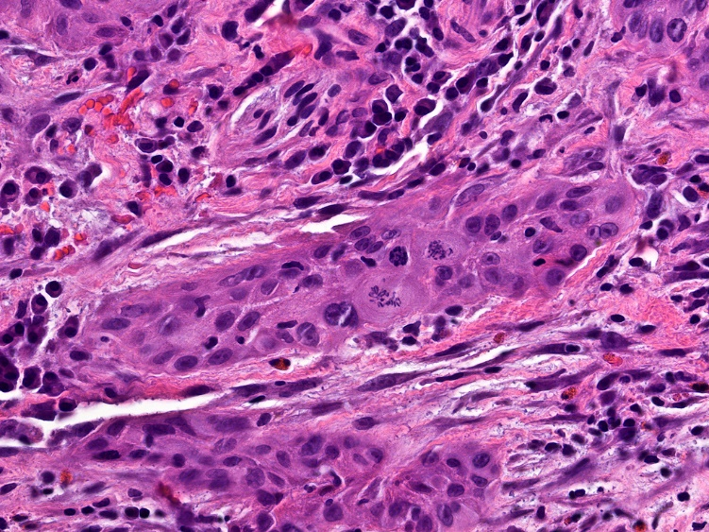
Mitotic activity
Peripheral margins clean
Tumor base positive
Notes:
In the leading edge of the lesion, the neoplastic cells were less well-differentiated, with more prominent nuclear atypia and frequent mitotic figures.
The neoplastic cells involved the deep scleral surgical margin.

Slide 11
Final Pathology Diagnosis
Keratinizing squamous cell carcinoma, conjunctiva
Well to moderately differentiated
Deep resection margin positive for tumor
Advised plaque radiotherapy

Slide 12
Nov 2017 Advised plaque radiotherapy
Dec 2017 No show for plaque
Poor follow up, tough guy and family issues
April 2018 finally returned for follow up

Slide 13
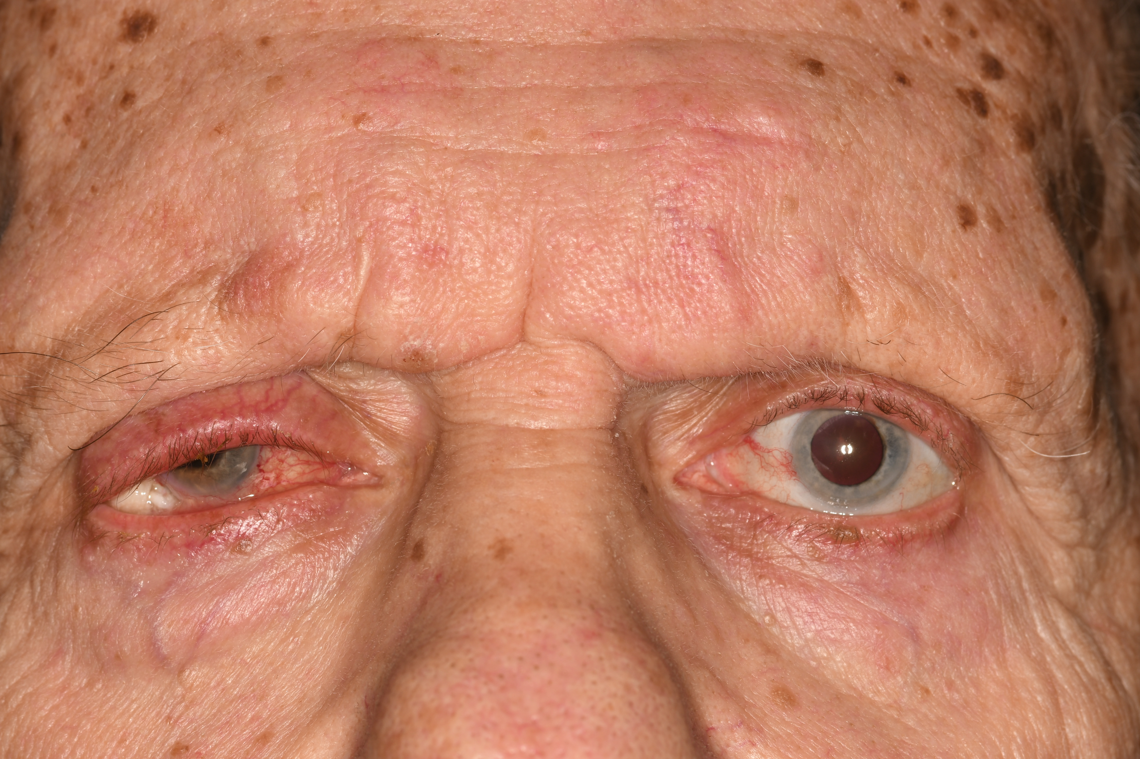
April 2018 Follow up
Swollen OD with RUL ptosis
White epibulbar mass

Slide 14
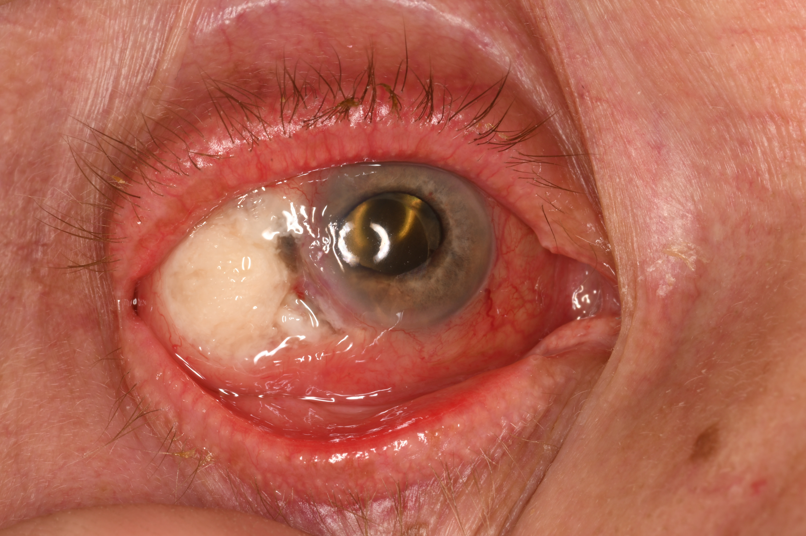
April 2018 – had severe pain
White epibulblar mass
Brown tissue - ? uveal prolapse

Slide 15
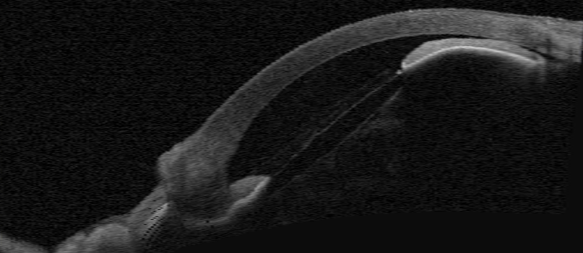
Anterior segment OCT
April 2018
Flattened anterior chamber
Hypotony

Slide 16
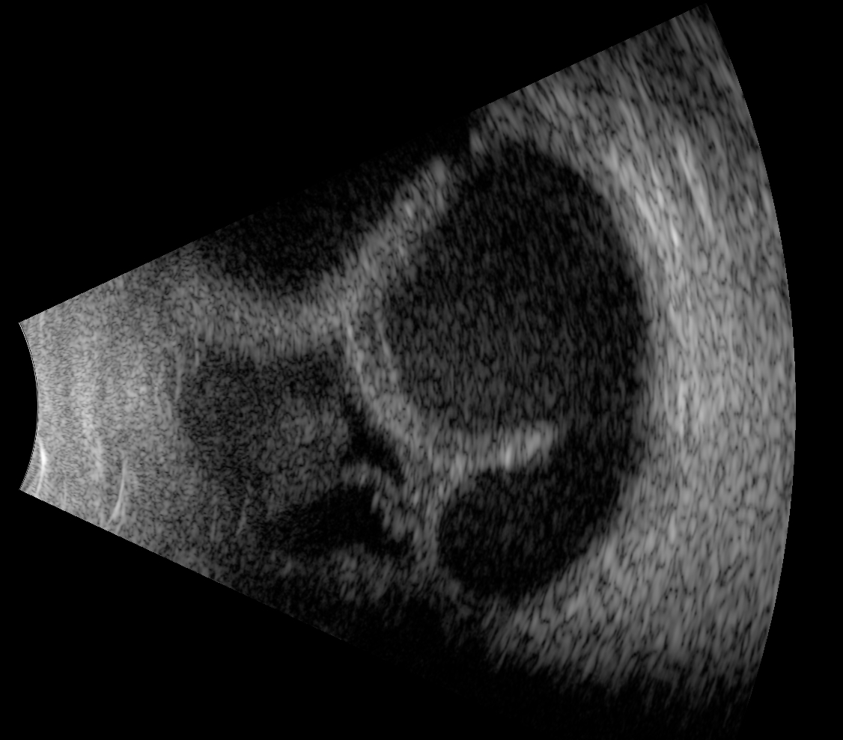
Ultrasound
April 2018
Uveal effusion
Hypotony

Slide 17
April 2018
Worry about intraocular invasion of conj SCC
Advised enucleation – patient agreed

Slide 18
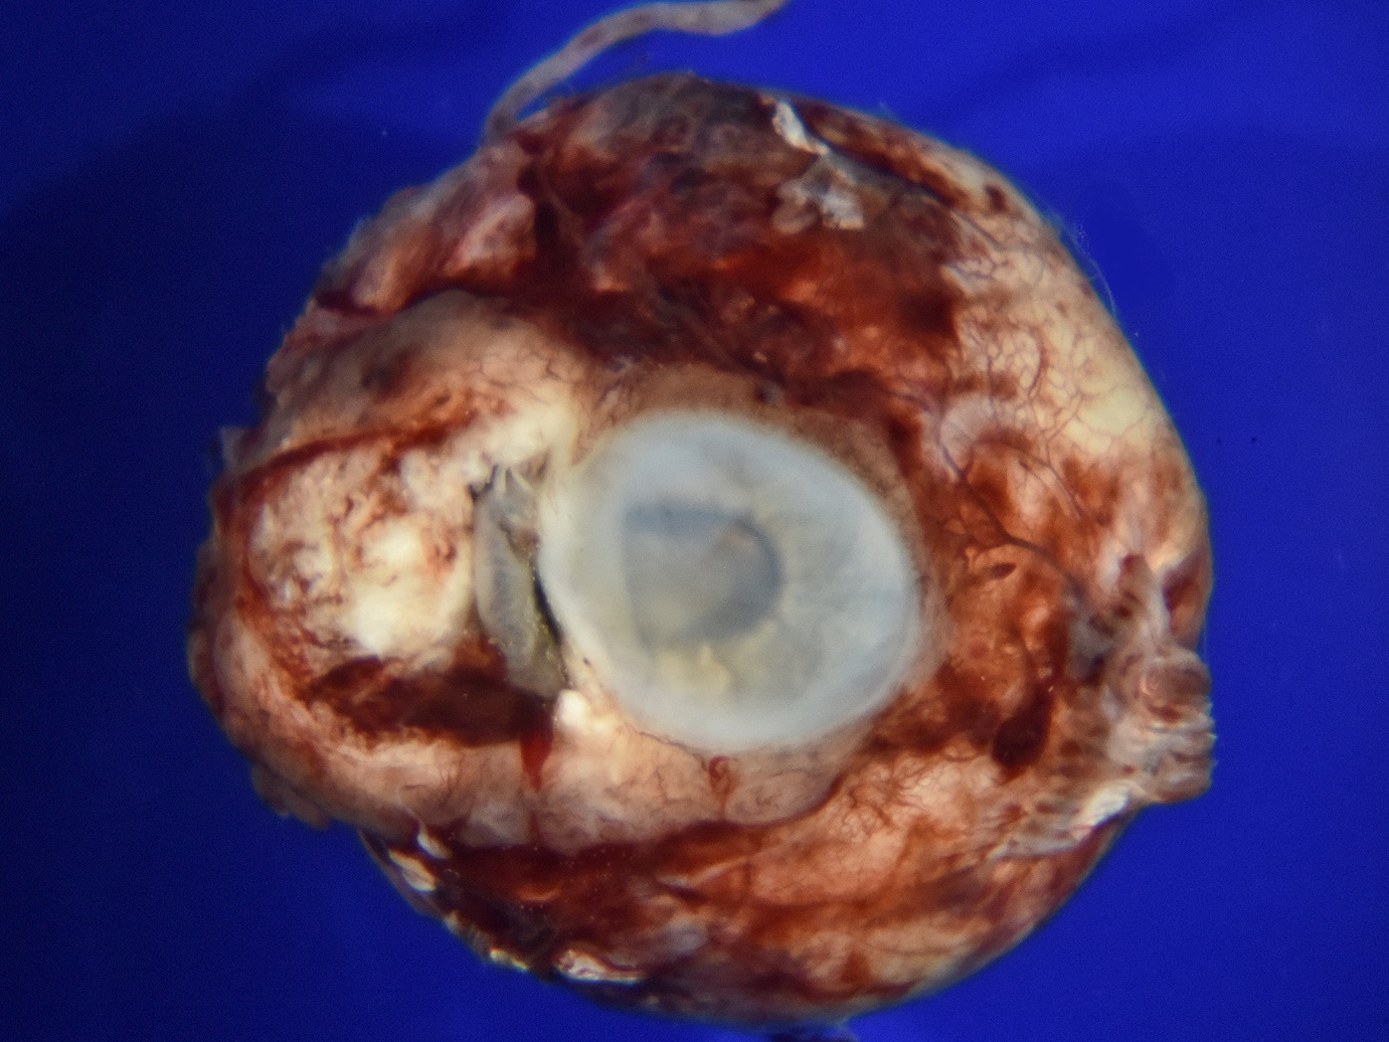
Enucleation, 2018

Slide 19
White nasal epibulbar mass
Iris prolapse
Flocculent material in anterior chamber
Notes:
External evaluation of the enucleated eye demonstrated a white nasal epibulbar mass, associated with corneoscleral limbal wound and iris prolapse. White flocculent material was present in the anterior chamber.

Slide 20
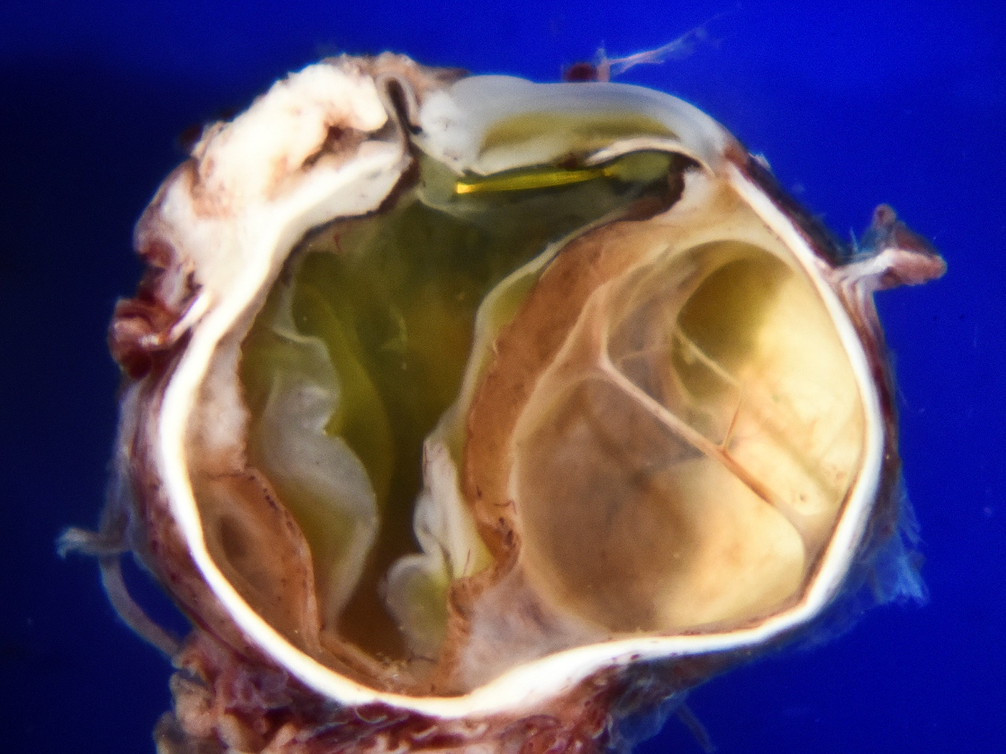
Iris prolapse
Epibulbar mass
Full-thickness corneoscleral perforation
Serous retinal
detachment
Cystic spaces in choroid
Notes:
Evaluation of the intraocular contents similarly demonstrated a white, focally necrotic mass involving the conjunctiva, episclera and sclera, associated with a full-thickness corneoscleral limbal wound with iris prolapse.

Slide 21
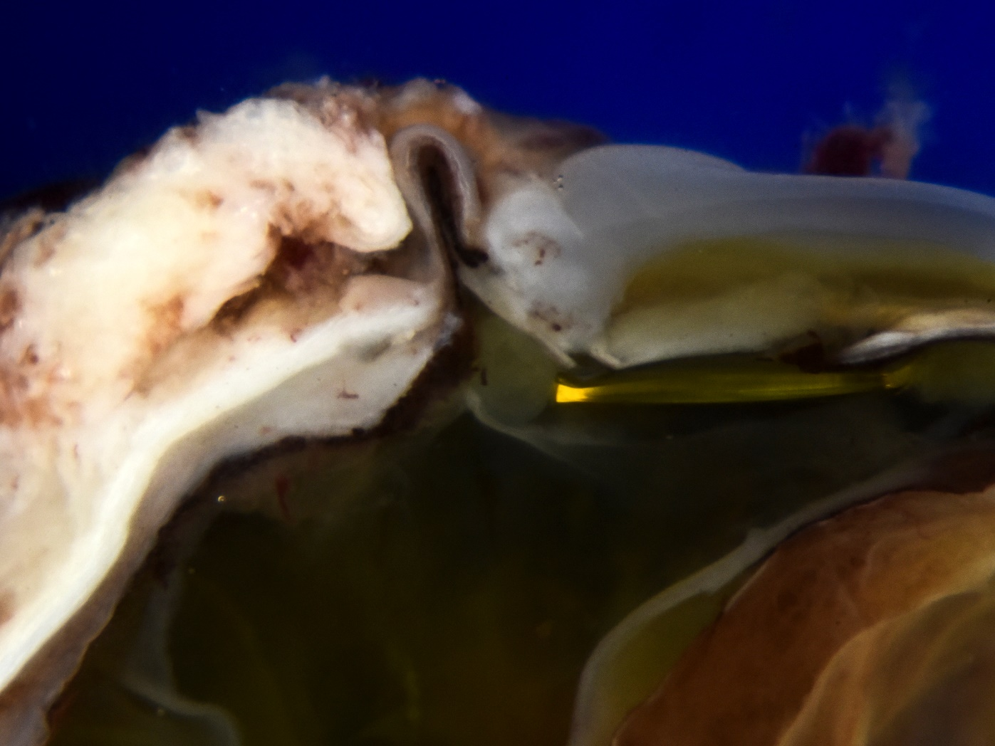
Iris prolapse
Corneal infiltration
Membrane on the iris
PCIOL
Ciliary body infiltration
Closer view

Slide 22
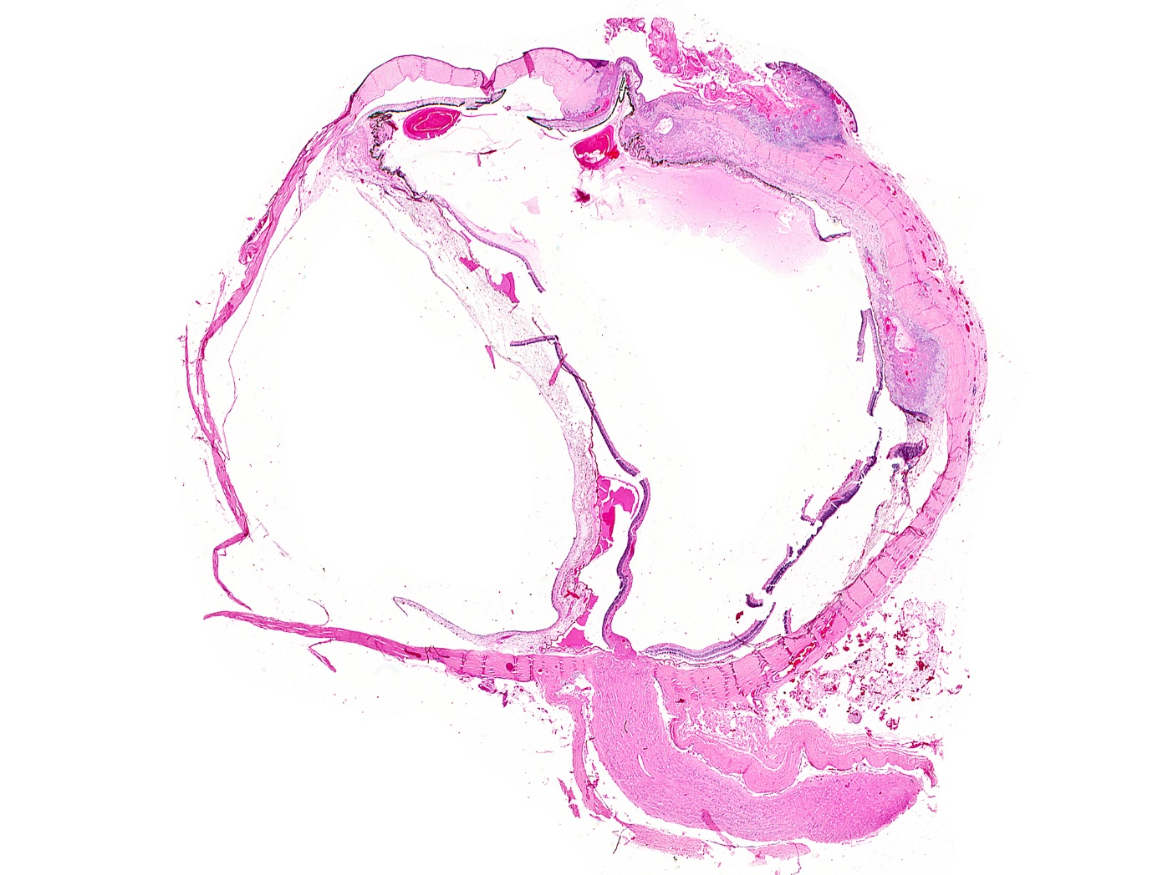
Iris prolapse
Corneal and ciliary body infiltration
Choroid infiltration
Notes:
This slide is a fade-through from gross photo animation – please take a look with a “view mode”
Microscopic evaluation of the eye confirmed the presence of corneoscleral limbal perforation with iris prolapse.

Slide 23
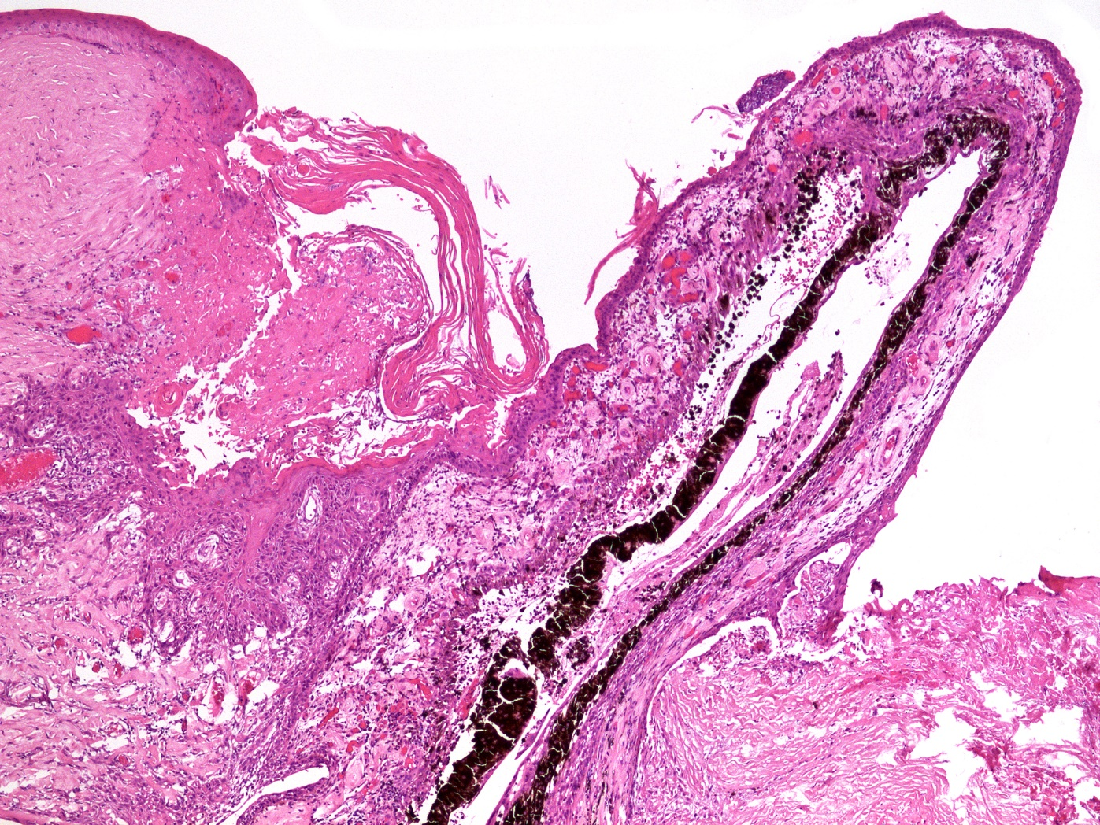
Neoplastic membrane on surface of prolapse
Corneal invasion
Notes:
The neoplastic cells lined the surface of the iris, growing as a neoplastic membrane on its anterior surface and posterior surface and invaded the adjacent cornea.

Slide 24
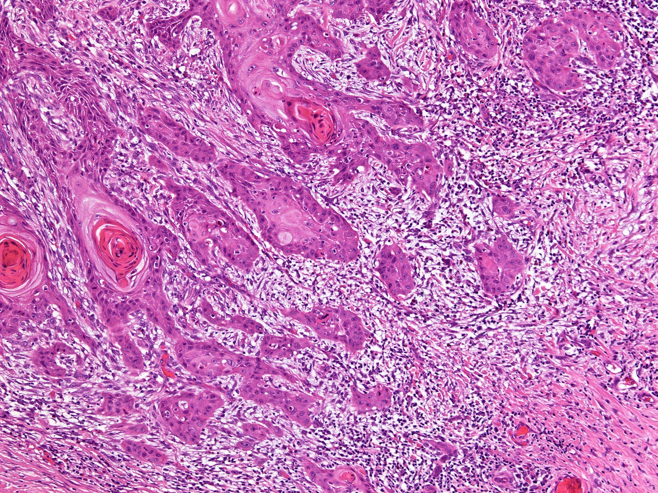
Infiltrating keratinizing moderately differentiated carcinoma invading sclera
Notes:
In most areas, the neoplasm was morphologically similar to the initial excisional biopsy, composed of nests and bands of keratinizing squamous cells with prominent keratin pearl formation.

Slide 25
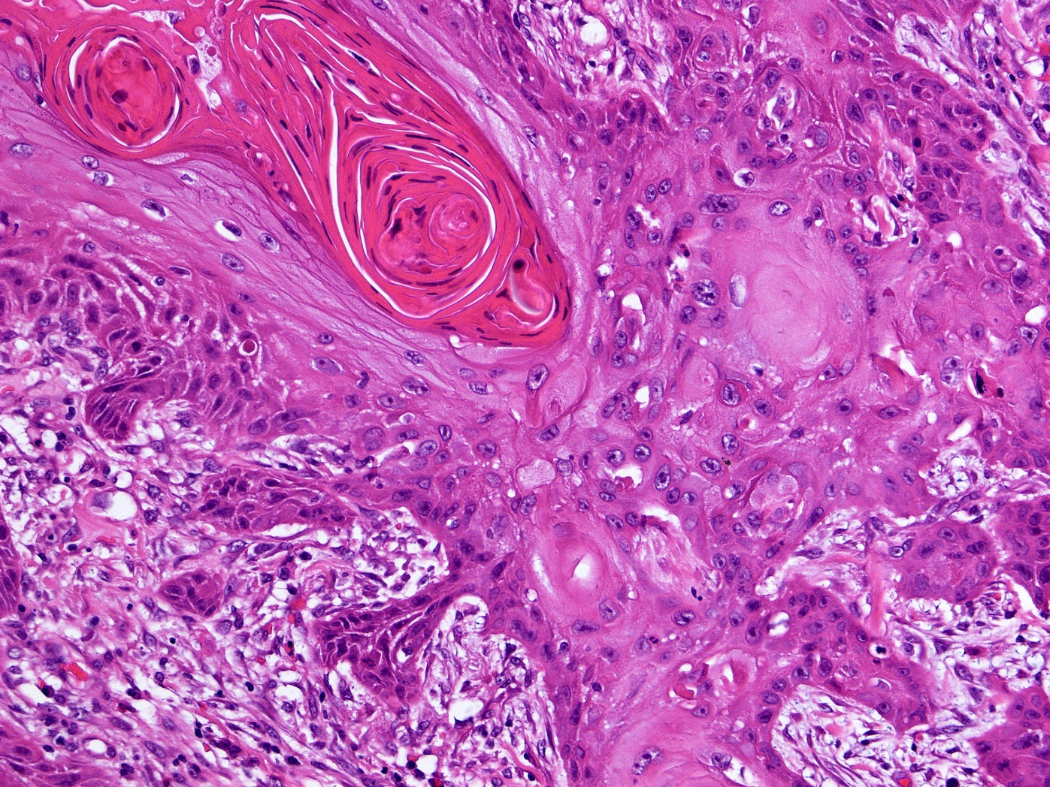
Keratin pearls and intercellular bridges

Slide 26
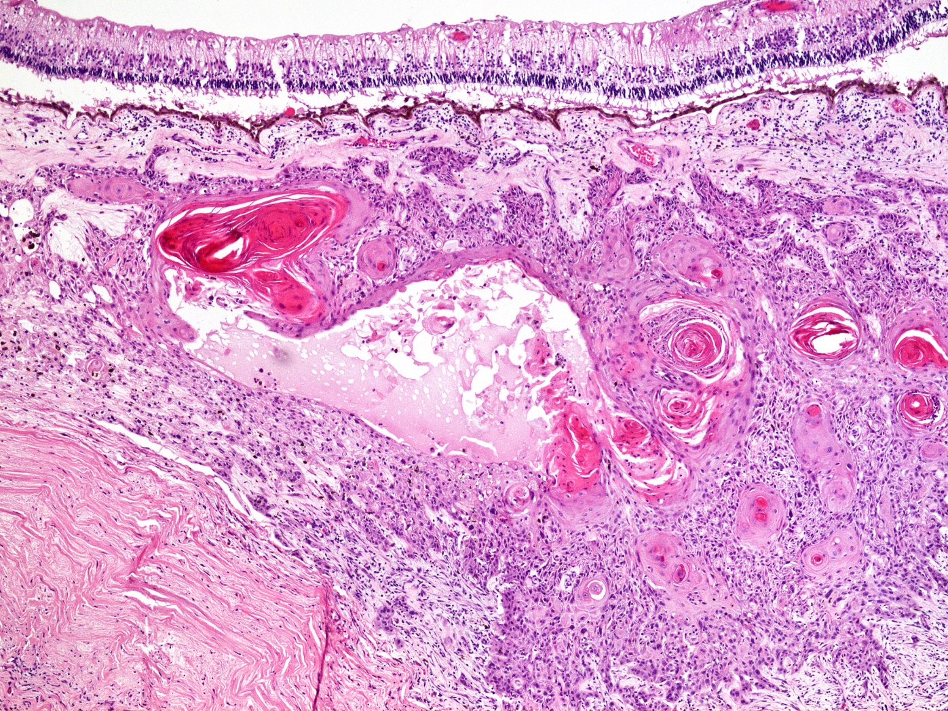
Keratinizing carcinoma infiltrates choroid
Notes:
and the choroid, where they formed neoplastic cysts filled with the keratinizing debris.

Slide 27
Invasive tumor in the ciliary body:
Less distinct squamous differentiation
Goblet cells
Notes:
In the region of the ciliary body, the tumor had less distinct squamous differentiation with clusters of goblet cells identified.
THIS SLIDE HAS AN ANIMATION – PLEASE VIEW WITH VIEW MODE

Slide 28
Goblet cells
Notes:
THIS SLIDE HAS AN ANIMATION – PLEASE VIEW WITH VIEW MODE

Slide 29
Goblet cells
with PAS-positive, diastase resistant mucin
Notes:
The goblet cells with intracytoplasmic mucin were highlighted with PAS and Alcian blue stains.

Slide 30
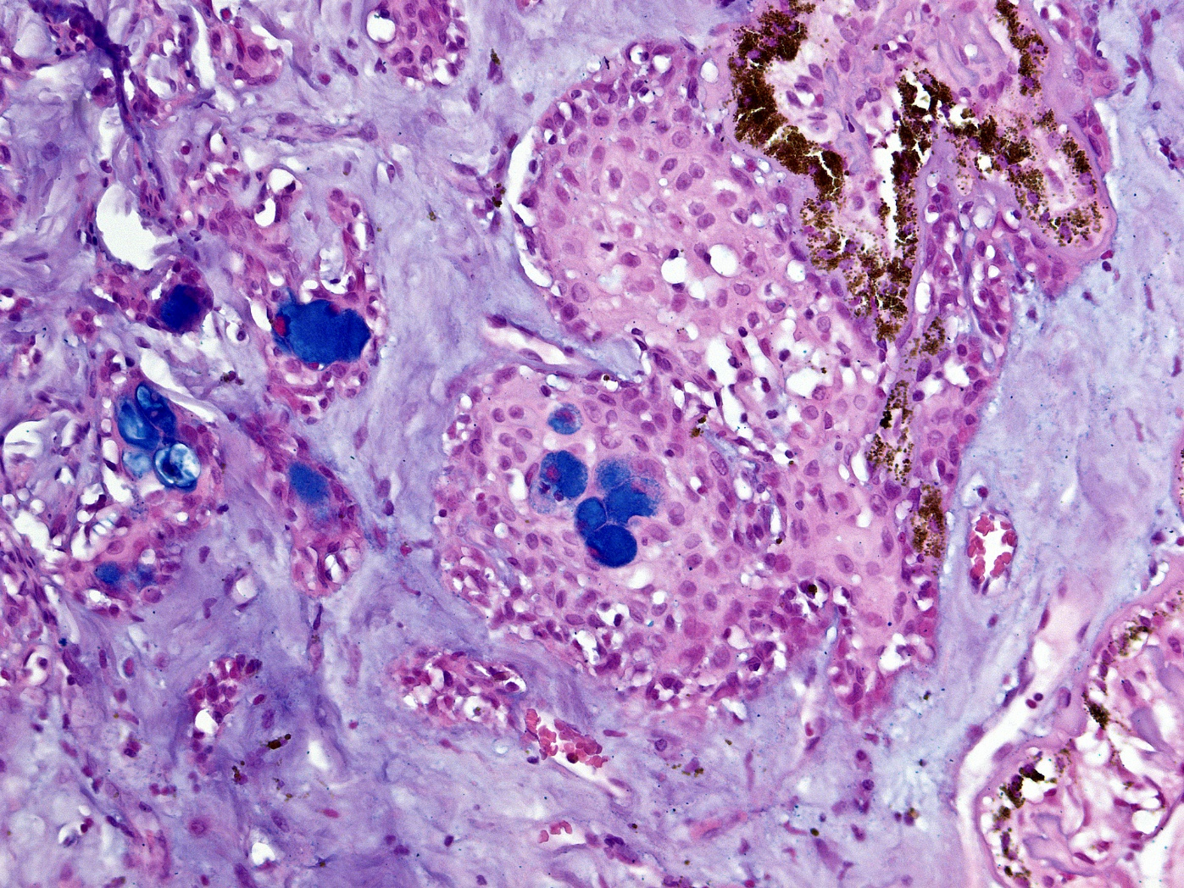
Goblet cells with Alcian blue-positive mucin
Suggests mucoepidermoid carcinoma

Slide 31
PATHOLOGY DIAGNOSIS
ADENOSQUAMOUS
(FORMERLY CALLED MUCOEPIDERMOID) CARCINOMA WITH INTRAOCULAR INVASION

Slide 32
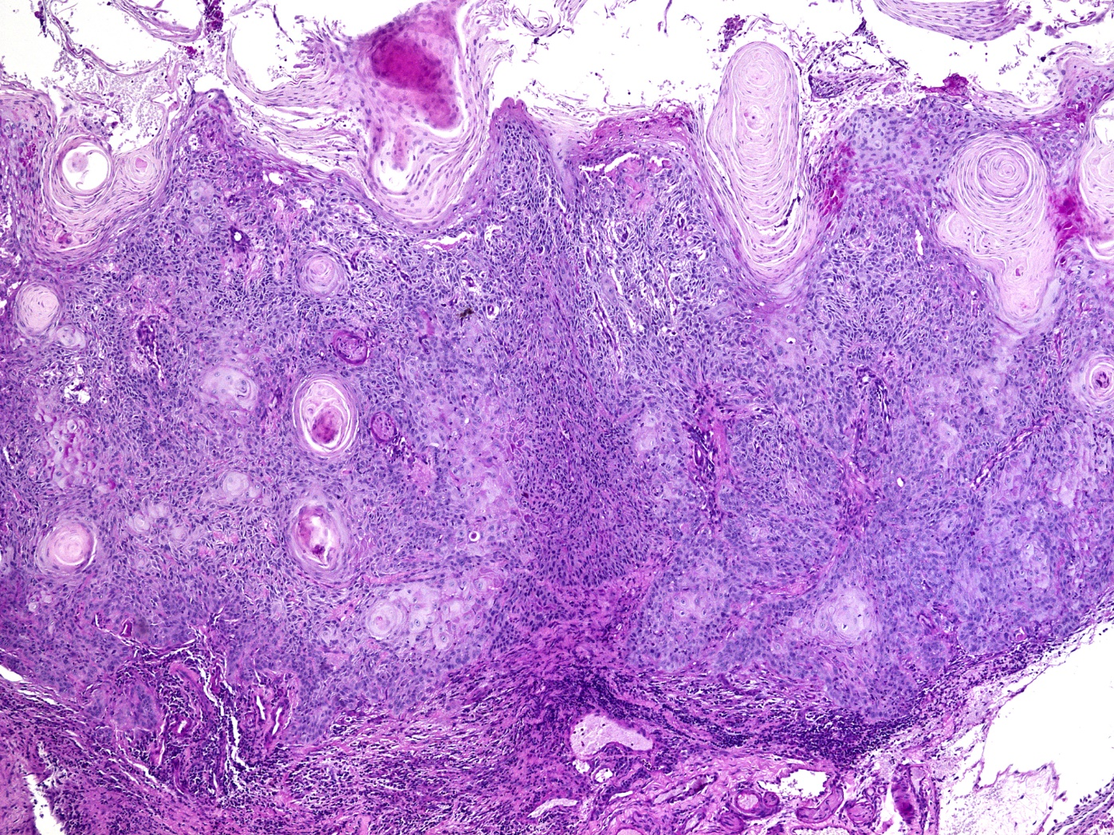
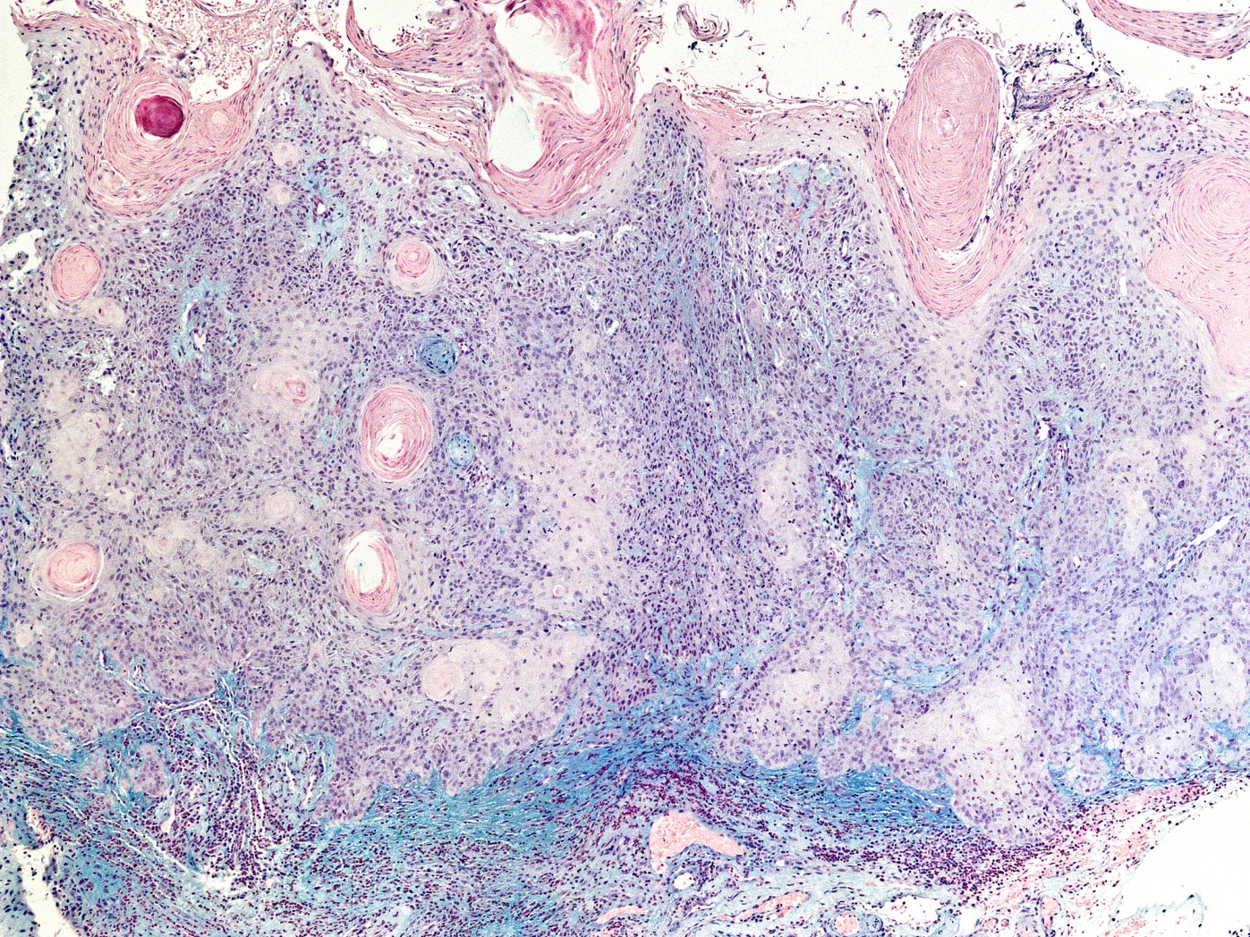
Re-review original excision
from Nov 2017
No evidence of intracellular mucin
PAS
negative
Alcian blue
negative
Notes:
We re-reviewed the pathology from the original excision and performed additional PAS and Alcian blue stains and could not find evidence of goblet cells or mucin production in the sections examined.

Slide 33
Discussion

Slide 34
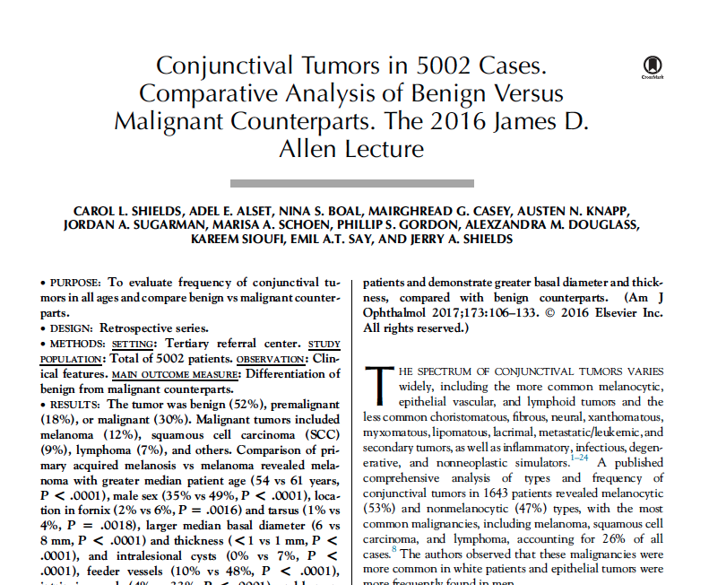
Malignant squamous neoplasms 14%
Conjunctival intraepithelial neoplasia 5%
Squamous cell carcinoma 9%
Mucoepidermoid carcinoma <1%

Slide 35
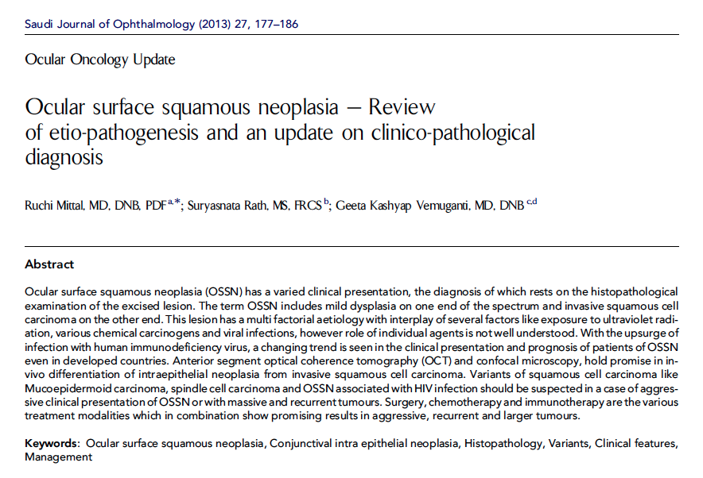
2013
Mucoepidermoid carcinoma
Rare neoplasm
Mucin producing SCC
Mucin producing cells are
large, pale
stain with PAS, mucicarmine, colloidal iron,
alcian blue

Slide 36
2013
Mucoepidermoid carcinoma
Aggressive tumor
High rate of recurrence
Metastasis uncommon
Our patient will likely need exenteration

Slide 37
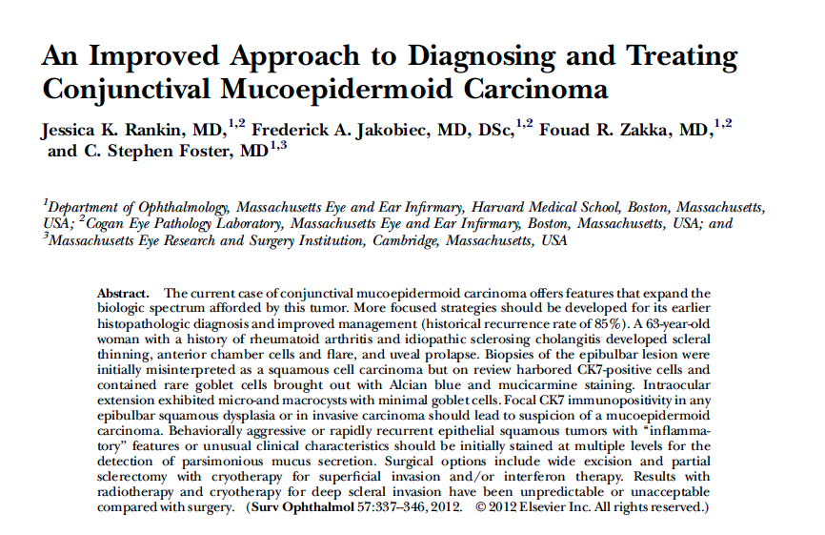
`
Surv Ophthalmol 2012
Important points
“CK7+ staining in any epibulbar squamous dysplasia or invasive carcinoma should lead to suspicion of a mucoepidermoid carcinoma.”
“one needs to search for sparse amounts of intracellular mucin demonstrable with Alcian blue and mucicarmine staining”
Standard conj SCC is mucin negative
Mucoepidermoid SCC is mucin positive

Slide 38
Discussion: Take Home Points
There is a rare variant of conjunctival squamous cell carcinoma,
termed mucoepidermoid carcinoma, that has a more aggressive
clinical course and worse prognosis. Mucoepidermoid
carcinoma usually appears as a gelatinous conjunctival mass,
occasionally with intralesional cysts. It is believed to arise
from a conjunctival stem cell that differentiates toward goblet cells.
The goblet cells are the key to diagnosis although they can be sparse. Special stains. such as
alcian blue, mucicarmine, and CK7+ can detect the goblet cells. This malignancy can
show aggressive behavior and invasion of the adjacent structures, and can even
destroy the eye. Although locally aggressive, metastasis to distant organs is surprisingly rare.

Slide 39
N
Summary
83 yowm
Conjunctival keratinized mass
Surgically resected
Poor follow up
Recurrent 5 months later with massive intraocular invasion requiring enucleation
Dx: Mucoepidermoid Carcinoma
(now called adenosquamous carcinoma)
Follow up: May 30, 2018, No recurrence.

Slide 40
Thanks to:
Tatyana Milman
Ralph Eagle
Sara Lally
Carol ShieldS

Slide 41
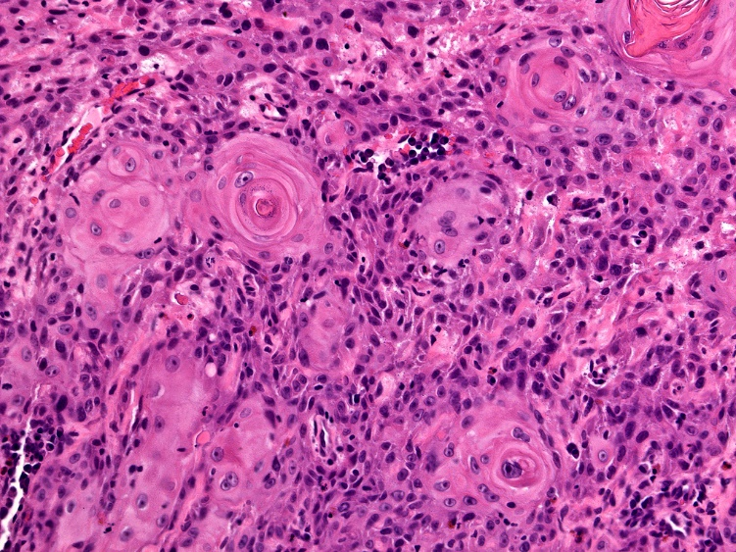
Nests of atypical keratinizing squamous epithelial cells in substantial propria
No lymphovascular or perineural invasion
Notes:
The neoplastic cells demonstrated prominent squamous differentiation, with easily identifiable intercellular bridges and abundant keratin pearls.

Slide 42
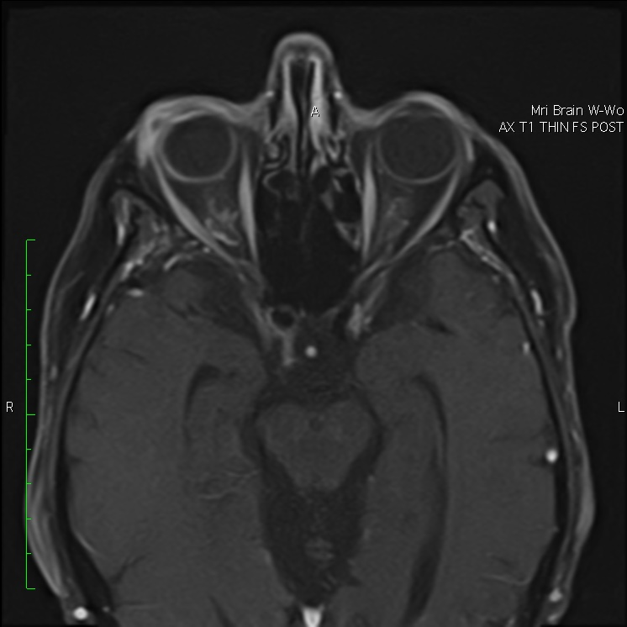
Returned for follow up in April 2018
MRI
Epibulbar mass on right eye with enhancement

Slide 43
Shallow anterior chamber with closed angle
Epibulbar mass
Uveal Prolapse
PCIOL
dislocation
Notes:
Additional findings associated with limbal perforation included shallow anterior chamber with focal anterior chamber angle closure and a dislocation of the posterior chamber intraocular lens implant with its capsular bag.

Slide 44
Iris prolapse
Corneal and ciliary body infiltration
Choroid infiltration
Notes:
This slide is a fade-through from gross photo animation – please take a look with a “view mode”
Microscopic evaluation of the eye confirmed the presence of corneoscleral limbal perforation with iris prolapse.

Slide 45
Infiltration of the cornea
Epibulbar mass
Infiltration of ciliary body and choroid
Cystic spaces in choroid
Notes:
The adjacent cornea, ciliary body and choroid by contained a white infiltrate, grossly compatible with involvement by the tumor. Cystic spaces were present in the choroid, suggestive of neoplastic cysts.

Slide 46
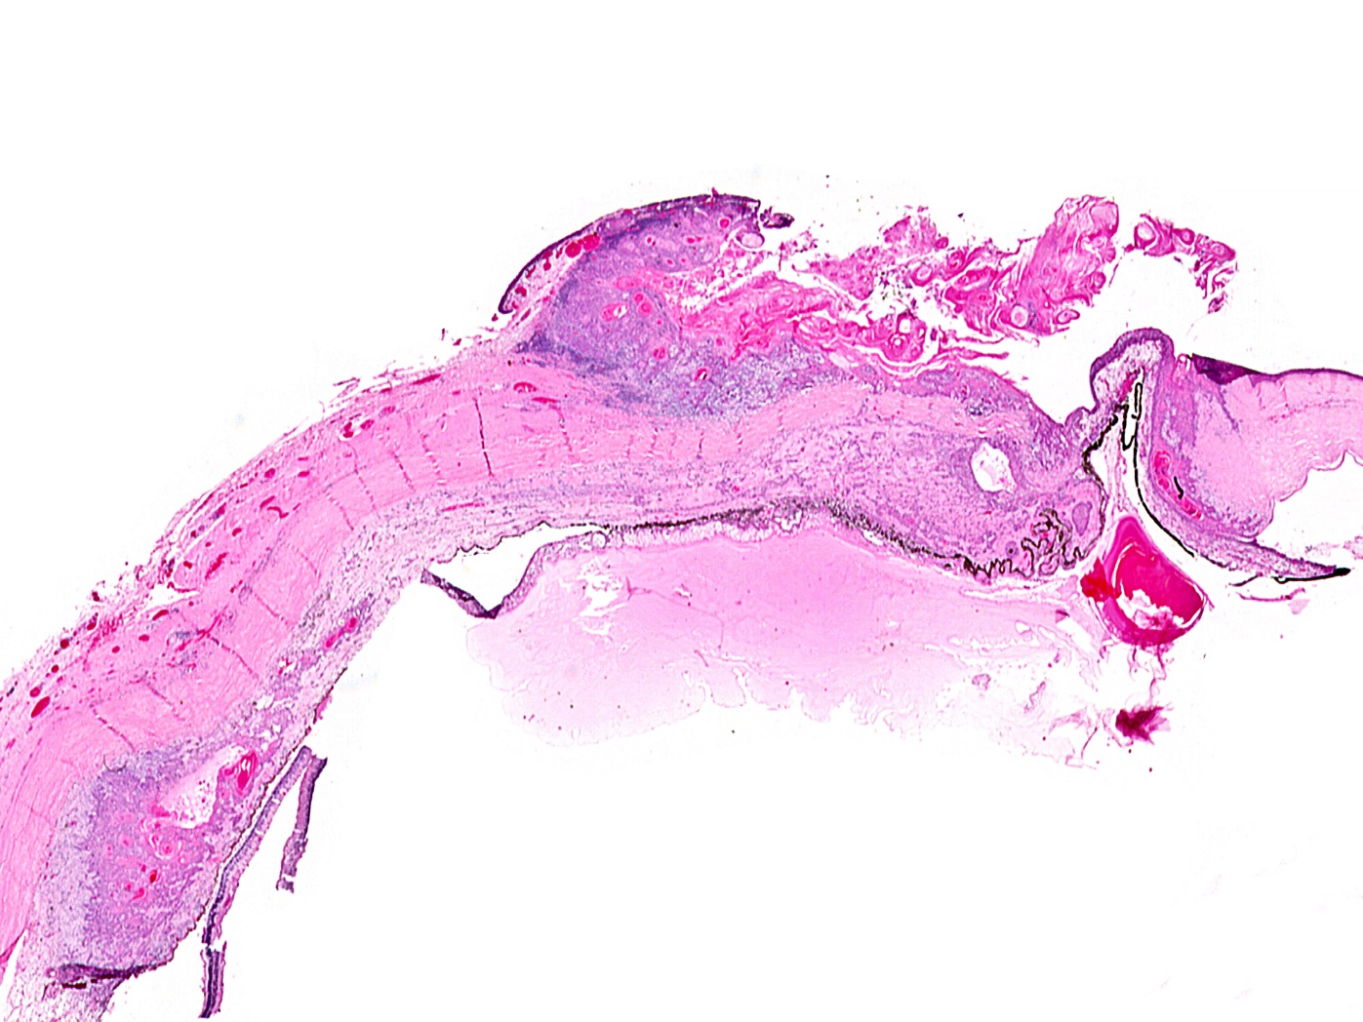
Iris prolapse
Close up
Notes:
The limbal conjunctiva, episclera, sclera, and the adjacent cornea and uvea were involved by keratinizing carcinoma, corresponding to the white tumor noted grossly.

Slide 47
2012
Two important points
Point #1
“CK7+ staining in any epibulbar squamous dysplasia or invasive carcinoma should lead to suspicion of a mucoepidermoid carcinoma.”
Standard conj SCC is CK7 negative
Mucoepidermoid SCC is CK7 positive

Slide 48
2012
Case of mucoepidermoid carcinoma
Presented with scleral invasion
Biopsy showed SCC
Review of biopsies found
CK7+ staining
Alcian blue and mucicarmine+
Suggested mucoepidermoid carcinoma

Slide 49
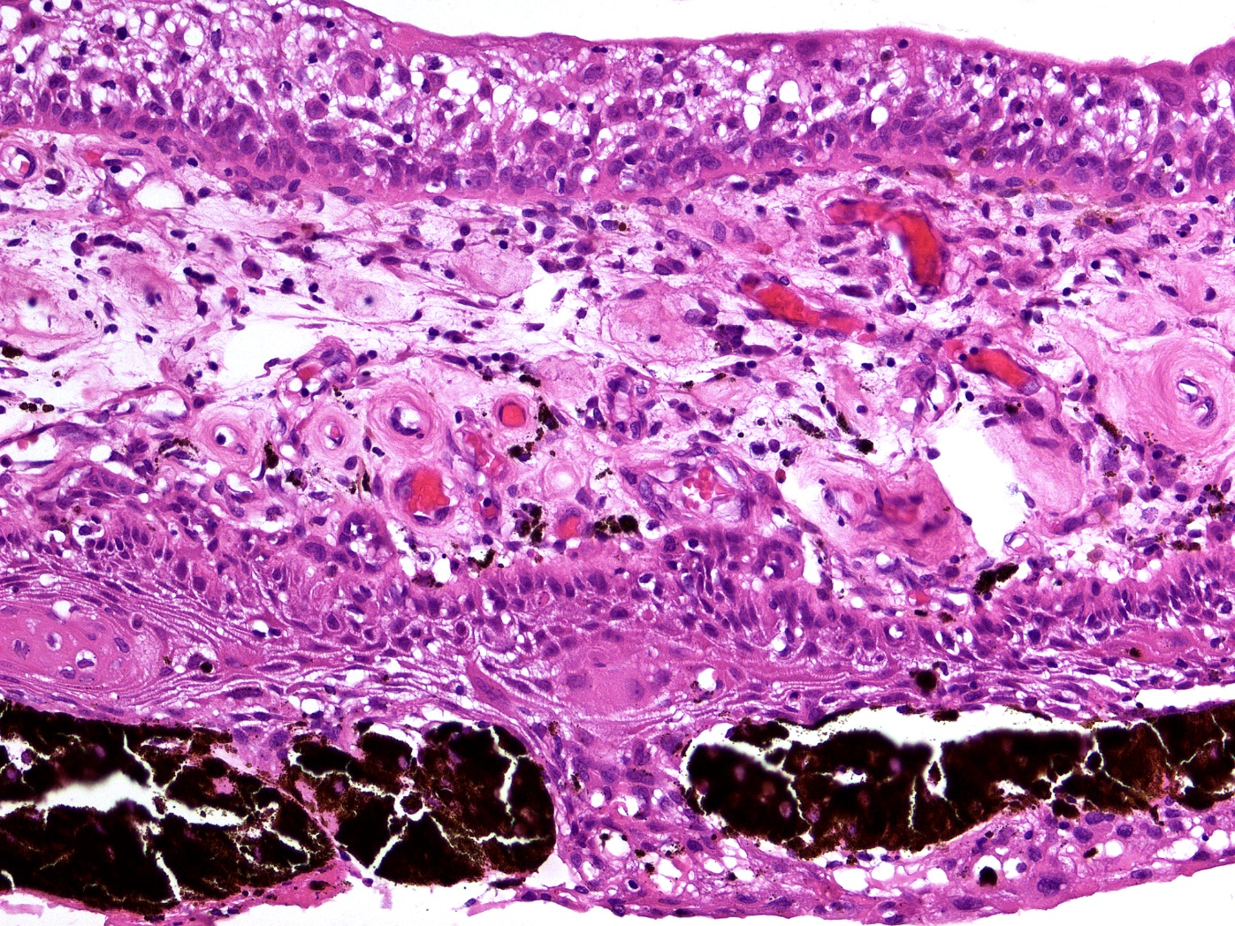
1
Neoplastic epithelial membrane on the surface of the iris
Notes:
Higher magnification photomicrograph highlights the malignant cells on the anterior and posterior surfaces of the iris and invading the iris stroma.

