Slide 1
Clear Cell Sarcoma of the Orbit
ANNA STAGNER, MD
Eastern ophthalmic pathology society annual meeting
September 13-15, 2018
No financial disclosures

Slide 2
Initial Presentation
29-year-old woman with left eyelid swelling and occasional diplopia

Slide 3
History
At least several months of eyelid swelling and intermittent double vision
At initial presentation MRI with gadolinium showed a cystic/solid orbital floor mass
Initial biopsy: skeletal muscle and fibrosis

Slide 4
Initial Examination: 1 year PTD
Visual acuity 20/20-1 OU
Normal pupils with no RAPD
1-2 mm of left proptosis with upward displacement of the globe
1-2 mm left upper eyelid ptosis
Anterior segment and DFE unremarkable

Slide 5
Past Medical and Social History
Patient originally from Haiti
History of travel to multiple developing countries
Treated for infectious diseases encountered in her travels: malaria, giardia, cholera and amebiasis
Mild asthma (on albuterol/fluticasone inhalers)
Hypothyroidism on levothyroxine

Slide 6
Referral
Interval growth over two subsequent MR scans spanning 6 months’ time (from 19 to 24 mm)
Patient now 19 weeks pregnant
20/40 OS with severely limited up- and downgaze
Left relative afferent pupillary defect

Slide 7
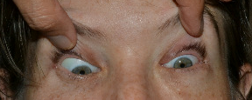

Slide 8
Notes:
T2 Axial non-contrast
There is redemonstration of an intraconal mass within the left orbit, measuring
24 x 21 x 22 mm (AP by TV by CC). The mass is isointense to faintly hyperintense
to gray matter on T1-weighted images, and isointense to gray matter on
T2-weighted images, with a central 8mm focus of T2 hyperintensity which may
reflect central necrosis or sequelae of prior surgery. There is restricted
diffusion within the mass, which may reflect dense cell packing.
Superiorly, the mass displaces the left optic nerve with preservation of a thin
intervening fat plane.
Medially, the mass abuts the medial rectus muscle and inferior aspect of the
lamina papyracea, with loss of the intervening fat planes. The mass bulges
approximately 3 mm into the right posterior ethmoid air cells (axial bravo image
43), which may reflect focal dehiscence of the posteroinferior aspect of the
lamina papyracea.
Inferiorly, the mass is inseparable from the inferior rectus muscle, which is
likely encased/invaded. The mass protrudes approximately 3 mm into the left
maxillary sinus in the region of the infraorbital foramen/infraorbital nerve,
with suspected focal dehiscence of the left orbital floor (coronal STIR image
13). There is adjacent mild mucosal thickening in the left maxillary sinus.
Susceptibility artifact in the region of the lower eyelid likely reflects
postoperative change.
Laterally, the mass abuts the lateral rectus muscle with loss of the intervening
fat plane.
Anteriorly, the mass appears to just contact the posterior margin of the globe.
There is stable proptosis.
Posteriorly, the mass extends to the orbital apex. There is no evidence of
cavernous sinus extension, noting that evaluation for cavernous sinus invasion
and perineural spread is limited in the absence of intravenous contrast.
There is curvilinear STIR hyperintensity within the left anterior orbit
extending into the periorbital soft tissues, which may reflect venous
congestion.
Compared to 4/18/2018 and 10/17/2017, the lesion has marginally decreased in AP
diameter, with slightly less mass effect on the posterior globe. This apparent
decrease may reflect the reported history of interval left orbitotomy and
excision on 6/11/2018.
Compared to 5/23/2017, the lesion has significantly increased in size,
remeasured as approximately 19 x 18 x 16 mm on the 5/23/2017 MRI.
The right orbit is unremarkable.
BRAIN:
There is no evidence of intracranial mass, hemorrhage or acute infarction.
The ventricles, sulci, and cisterns are normal in size and configuration.
The flow voids of the major intracranial vessels appear intact.
IMPRESSION:
Redemonstration of a left intraconal mass lesion encasing the inferior rectus
muscle, with relations to adjacent structures as described in detail above,
compatible with the reported pathological diagnosis of malignant melanoma.
The mass has significantly increased in size compared to 5/23/2017.
No evidence of intracranial metastatic disease, noting that sensitivity for this
evaluation is reduced in the absence of intravenous contrast.

Slide 9
Notes:
T1 coronal fat sat

Slide 10
Repeat orbitotomy was preformed due to progressive optic neuropathy.

Slide 11
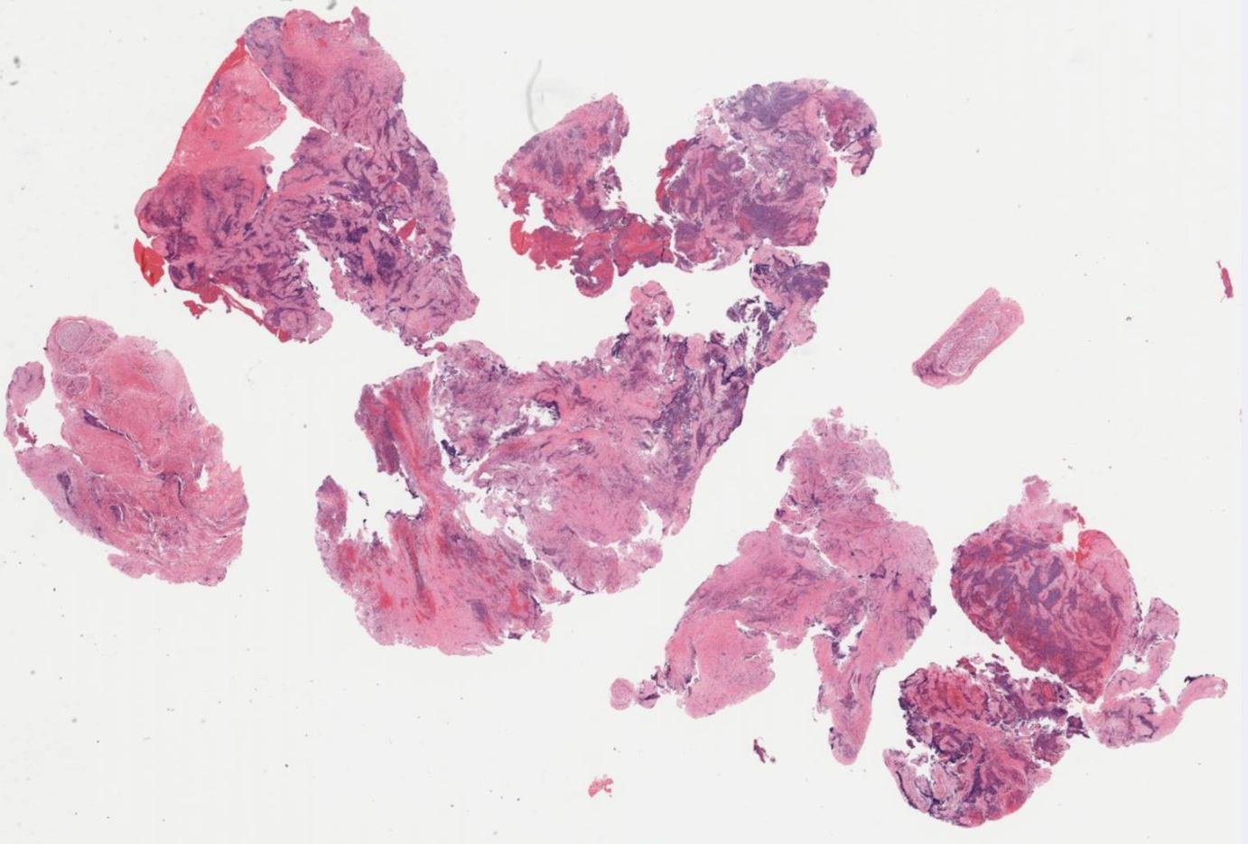
H&E x 10

Slide 12
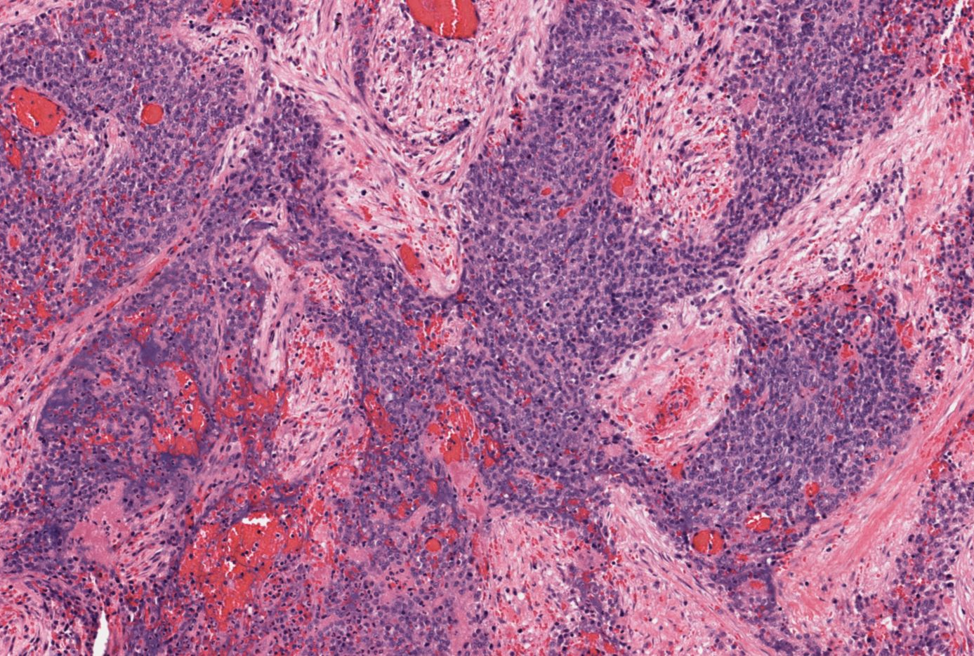
H&E x100

Slide 13
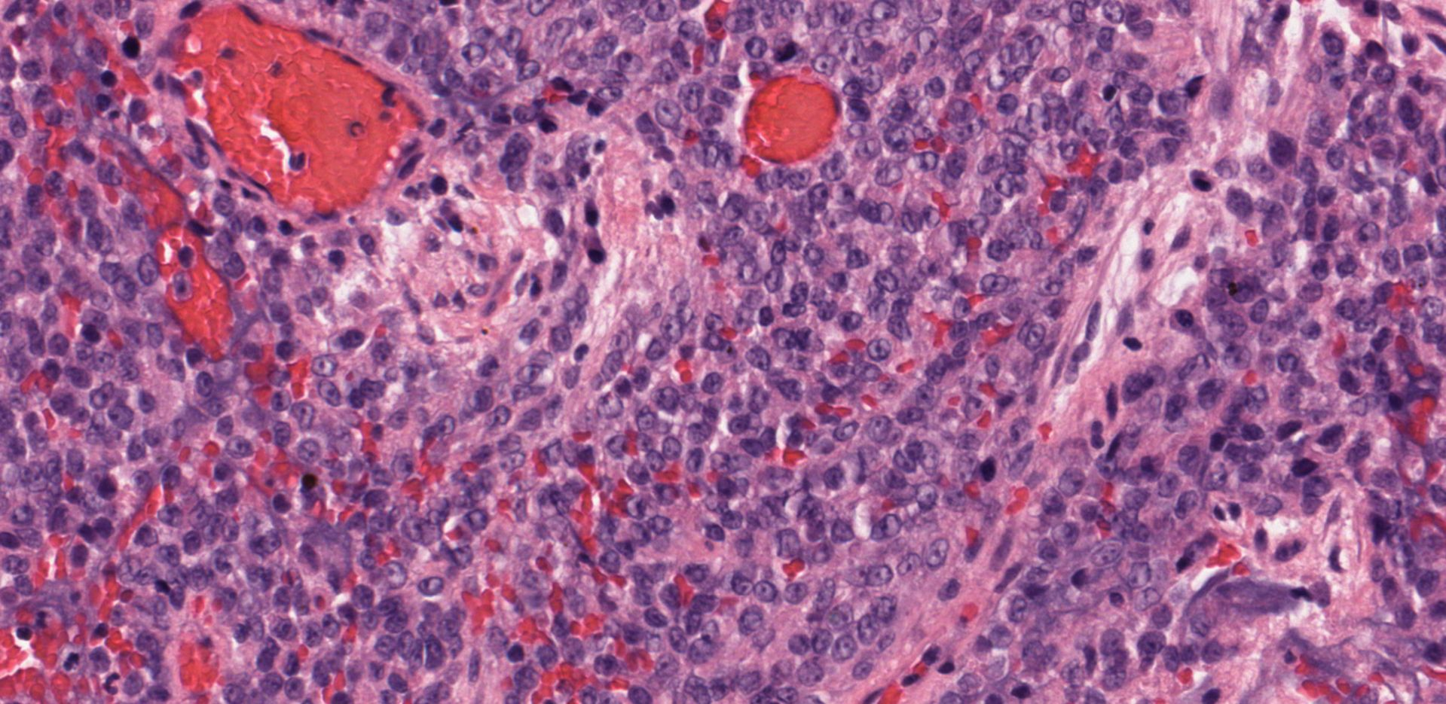
Pathology
Trichrome, x 200
H&E x400
Notes:
Composed of monotonous round to ovoid cells with small prominent nucleoli
Mitotic figures are not conspicuous.

Slide 14
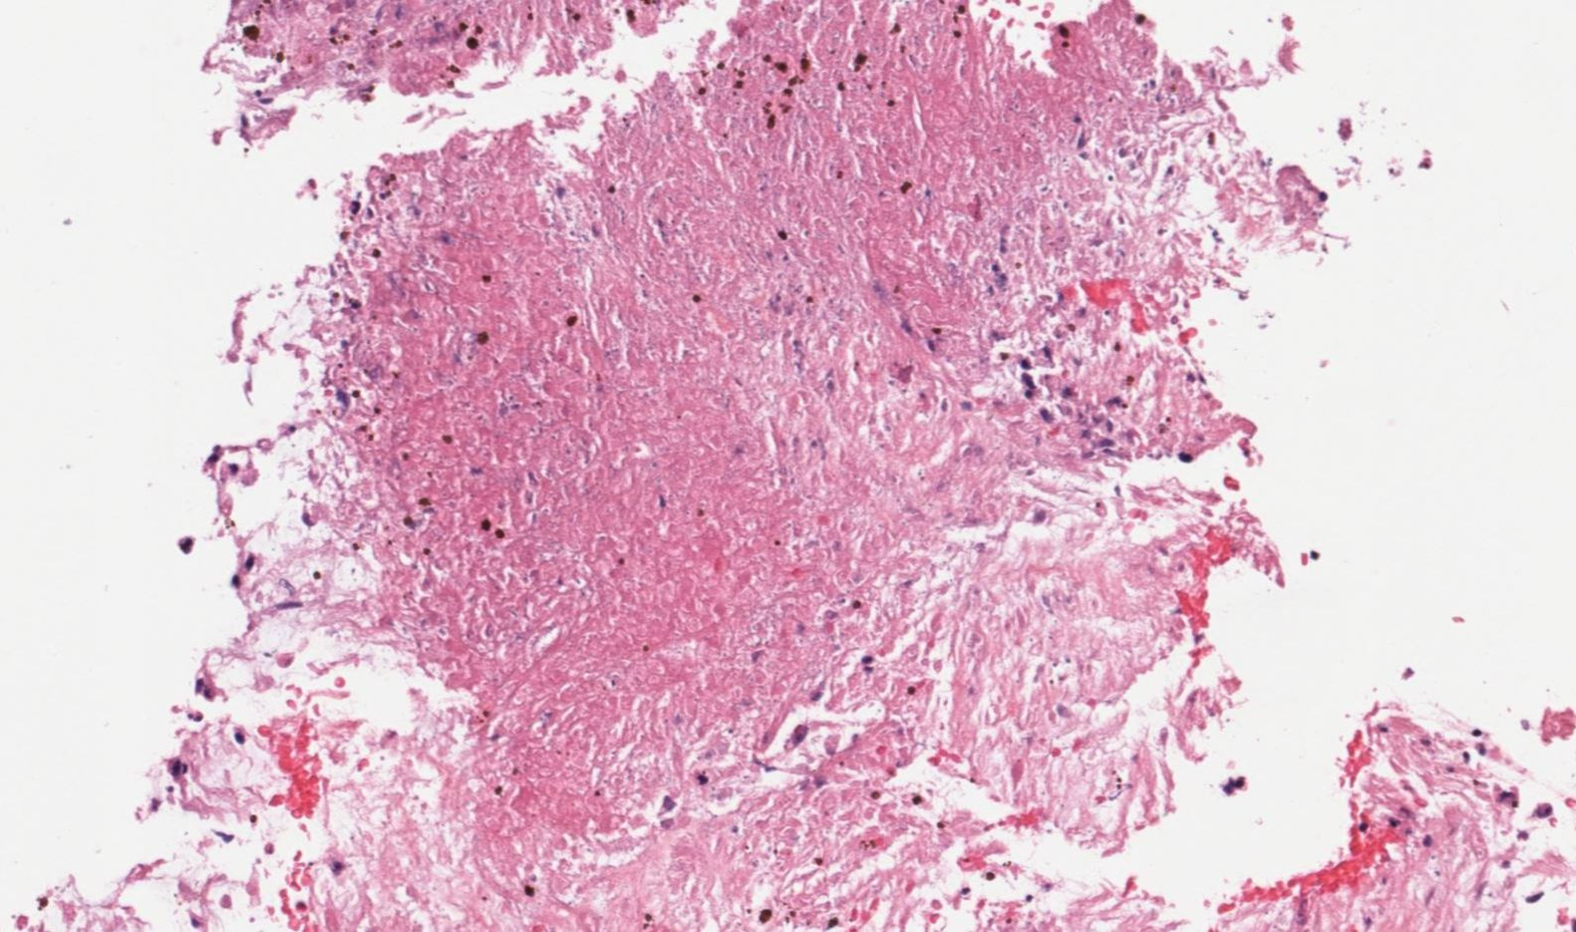
H&E x 200

Slide 15
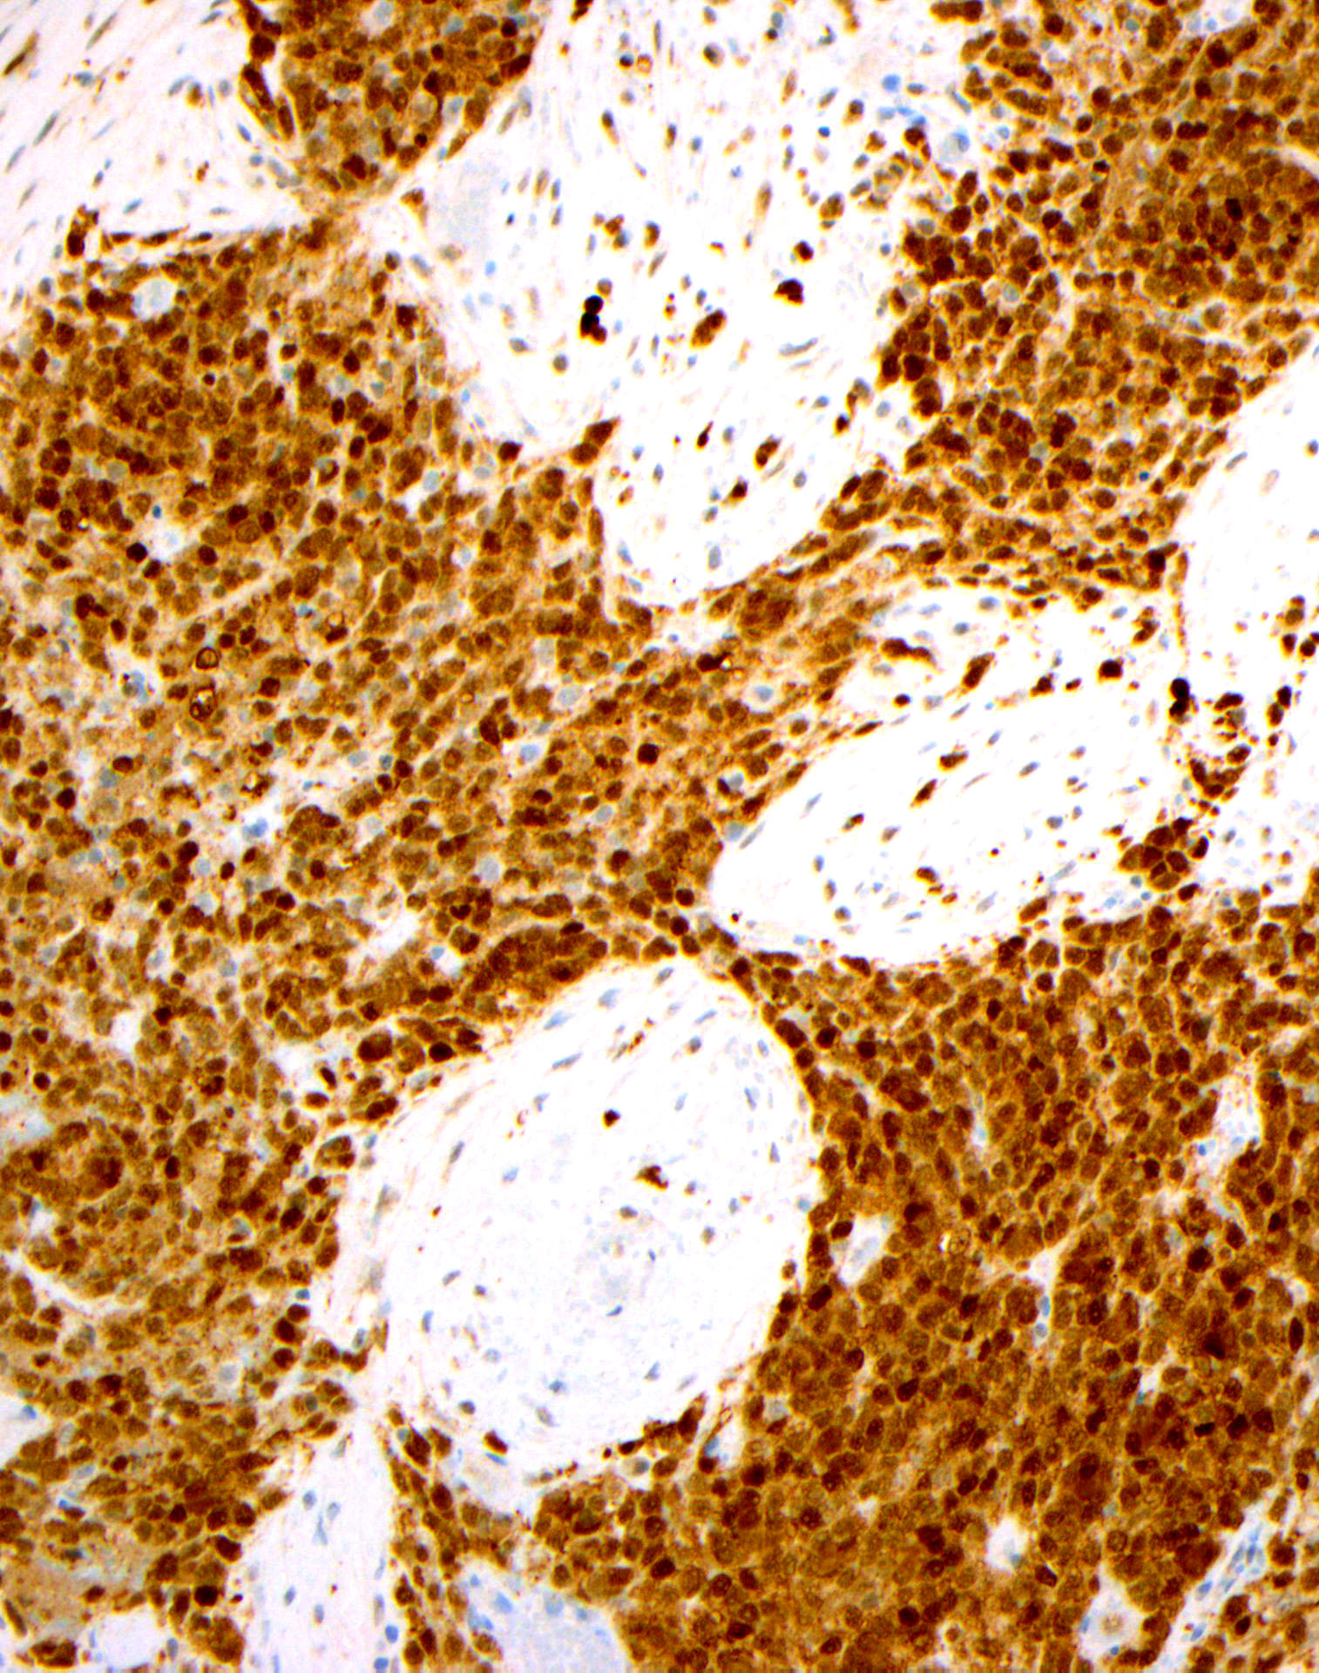
Sox10, x200
S100, x200

Slide 16
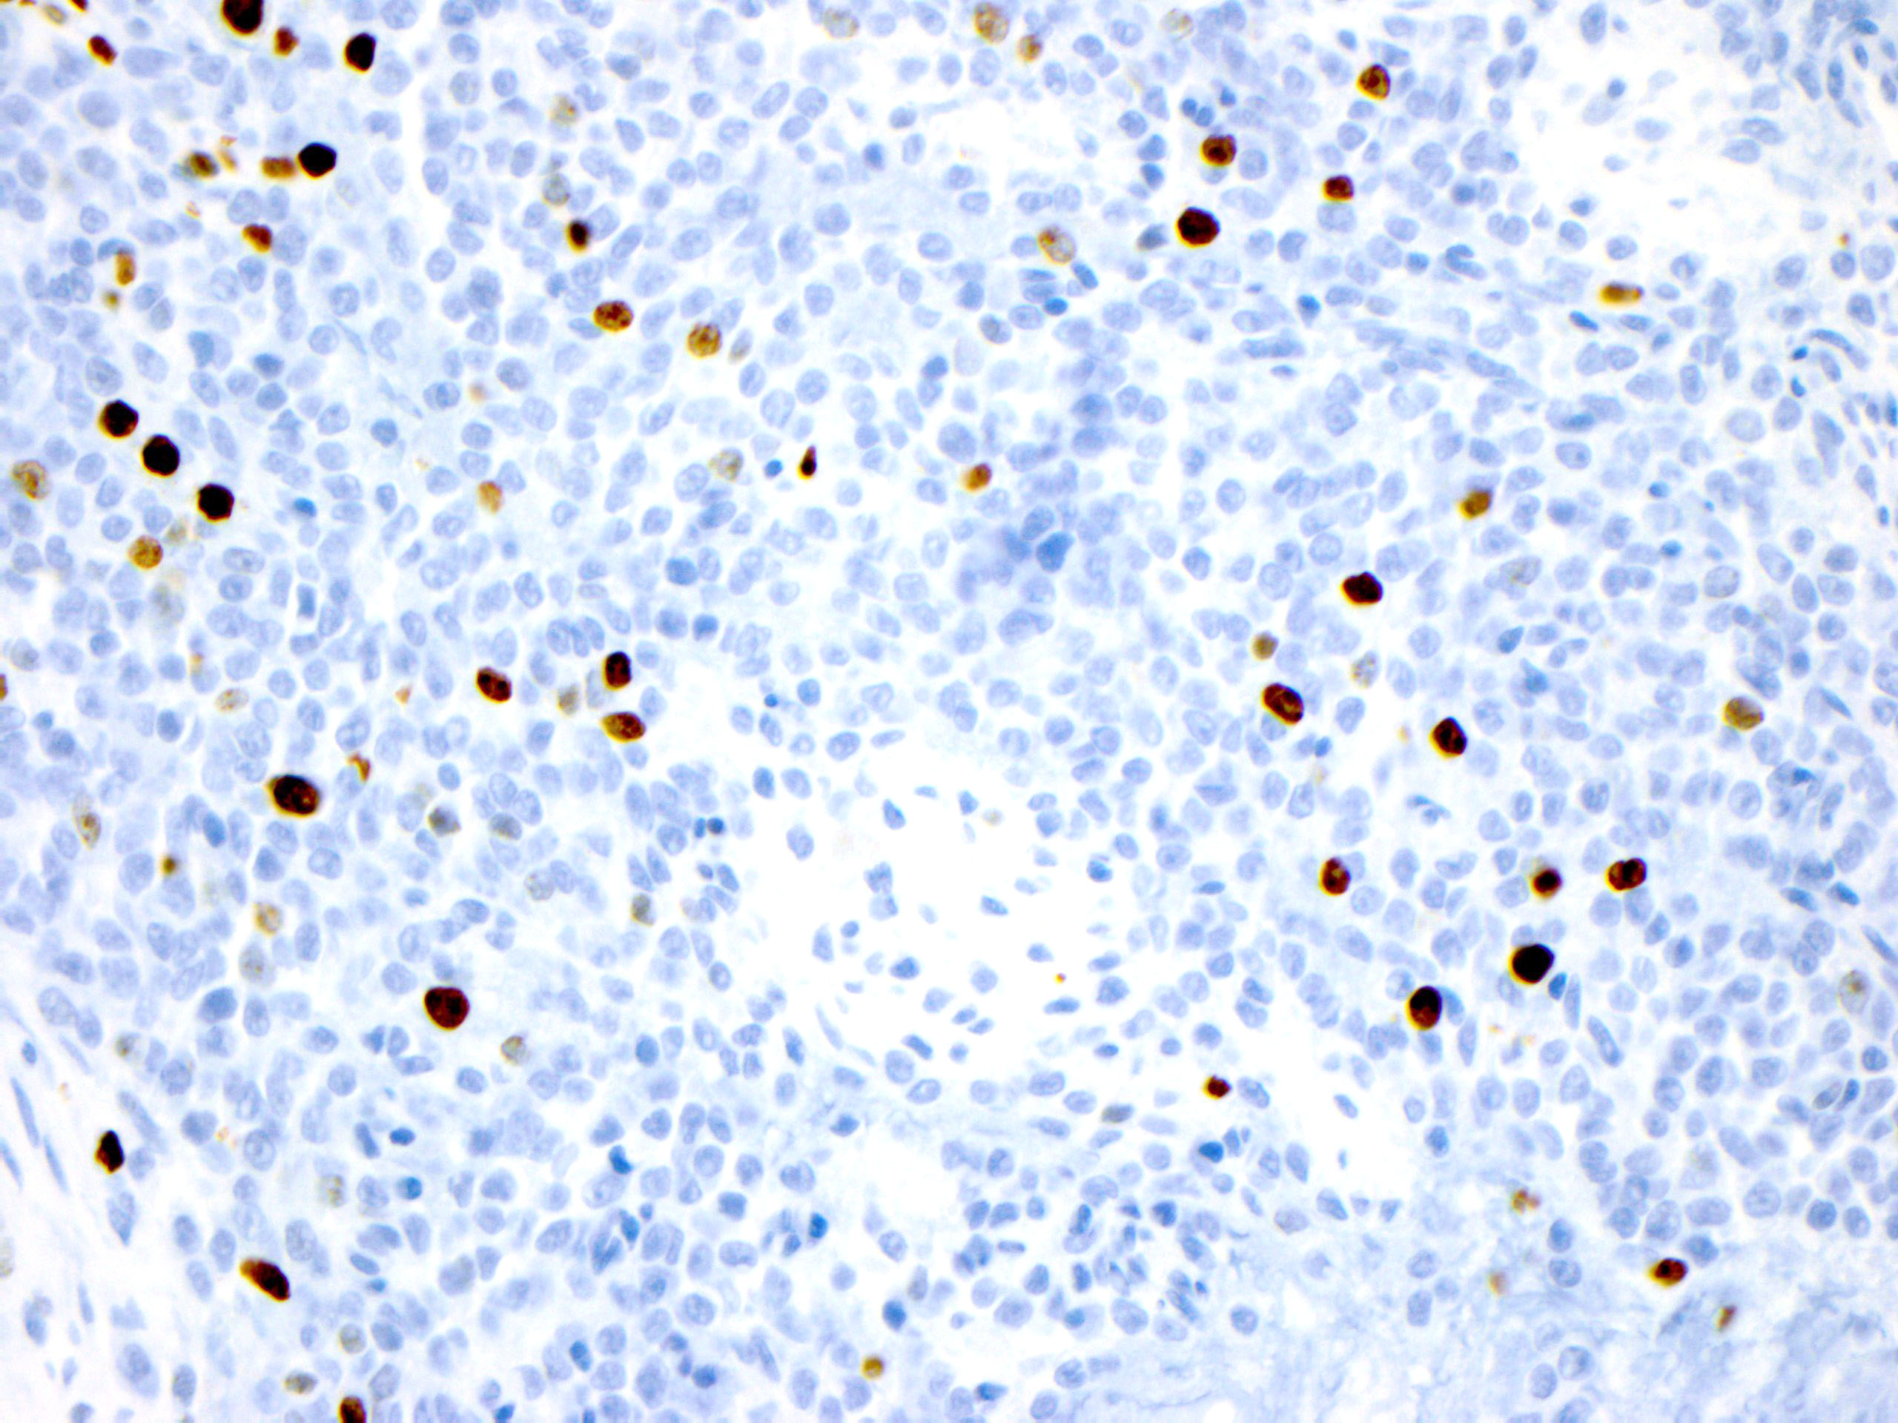
Ki67, x 400

Slide 17
Diagnosis
Orbital melanoma…
or is it?

Slide 18
Molecular Diagnostics
No BRAF or NRAS variants identified
BUT:
Solid Fusion Assay POSITIVE for EWSR1-ATF1 gene fusion
Clear cell sarcoma

Slide 19
Clear Cell Sarcoma
Clear cell sarcoma of tendon and aponeurosis
Melanoma of soft parts (formerly)
Translocation-associated sarcomas of soft tissues showing melanocytic differentiation

Slide 20
Clinical Features
Rare, occurs in young adults (3rd-4th decades) with slight female predominance
90% in extremities (esp foot; head/neck/trunk rare) and often attached to tendon/aponeurosis
Deep (subcutis or deeper); painful in half of cases

Slide 21
Histopathology
Cells with characteristically uniform/monotonous appearance
Spindled to ovoid/round cells in nests and fascicles
Clear to pale eosinophilic cytoplasm
Prominent central nucleoli
Average 4 mits/10 HPF
Intervening collagen bands
Notes:
As with most translocation sarcomas, nuclei are monotonous not pleomorphic- Pleomorphism may be seen in recurrence or metastasis

Slide 22
IHC/Molecular Genetics
Immunohistochemistry
Essentially identical to melanoma
Positive: S100, SOX10, +/- MART-1/Melan-A, HMB-45, MITF
Molecular Genetics
EWSR1-ATF1 fusion resulting from t(12;22) (>90% of cases)
EWSR1-CREB1 alternate fusion resulting from t(2;22)
No BRAF/NRAS variants
Identical gene fusions have been found in variety of tumors, including angiomatoid fibrous histiocytoma

Slide 23
CCS Versus Melanoma
Similar presentation: Dermal/subcutaneous/deep nodule
Immunophenotype may be identical to CCS
Metastatic melanoma usually more pleomorphic and mitotically active
Melanoma often has BRAF or NRAS mutations and lacks EWSR1-ATF1 and EWSR1-CREB1 fusions
Better prognosis than melanoma for size/depth
Notes:
CCS should always be considered in differential diagnosis of skin/soft tissue metastatic melanoma, especially in extremities of young patients who lack known history of primary melanoma

Slide 24
Treatment/Prognosis
Usually treated with surgery only; usually chemotherapy resistant
Poor prognosis but often prolonged clinical course (70% 5- and 10% 20-year survival)
Late metastases or recurrence (lymph nodes, unlike most sarcomas; lung)
Local recurrence, size >5cm, and necrosis most important poor prognostic factors

Slide 25
Orbital tumor | Chromosomal alteration | Affected gene | Prevalence
Alveolar rhabdomyosarcoma | t(2;13)(q35;q14) or t(1;13)(p36;q14) | PAX3-FKHR or PAX7-FKHR fusions (FKHR gene is now known as FOXO1) | 60-70% t(2;13) and 20% t(1;13)
Desmoplastic small round cell tumor | t(11;22)(p13;q12) | EWS-WT1 gene fusion | >95%
Ewing sarcoma/ primitive neuroectodermal tumor (PNET) | t(11;22)(q24;q12) or t(21;22)(q22;q12) | EWSR1-FLI1 fusion or EWS-ERG fusion | 85% t(11;22) and 10% t(21;22)
Inflammatory myofibroblastic tumor | Various rearrangements involving 2p23 | ALK rearrangement | About 50%
Liposarcoma | Myxoid: t(12;16)(q13;p11) Well-differentiated: amplification of 12q13-15 | Myxoid: FUS–DDIT3 fusion Well-differentiated: MDM2 amplification | Myxoid: >90% Well-differentiated: ~90%
Mesenchymal chondrosarcoma^{10,45} | Fusion of 8q21.13and 8q13.3 | HEY1-NCOA2 gene fusion | At least 66%
Rhabdoid tumor^{13,20} | Mutation or deletion at 22q11 | Loss of SMARCB1/ hSNF5/INI-1 gene | >90%
Solitary fibrous tumor^{17,42} | inv12(q13q13) | NAB2-STAT6 | >90%
Synovial sarcoma^{16,18,29,43} | t(X;18)(p11;q11) | SYT-SSX1 (or SSX2) fusion | >90%

Slide 26
Our Patient
Patching for diplopia after surgery
Staging MRI showed no evidence of regional or distant metastases (T2N0M0)
Plan for definitive proton beam therapy (74 Gy in 31 fractions)

Slide 27
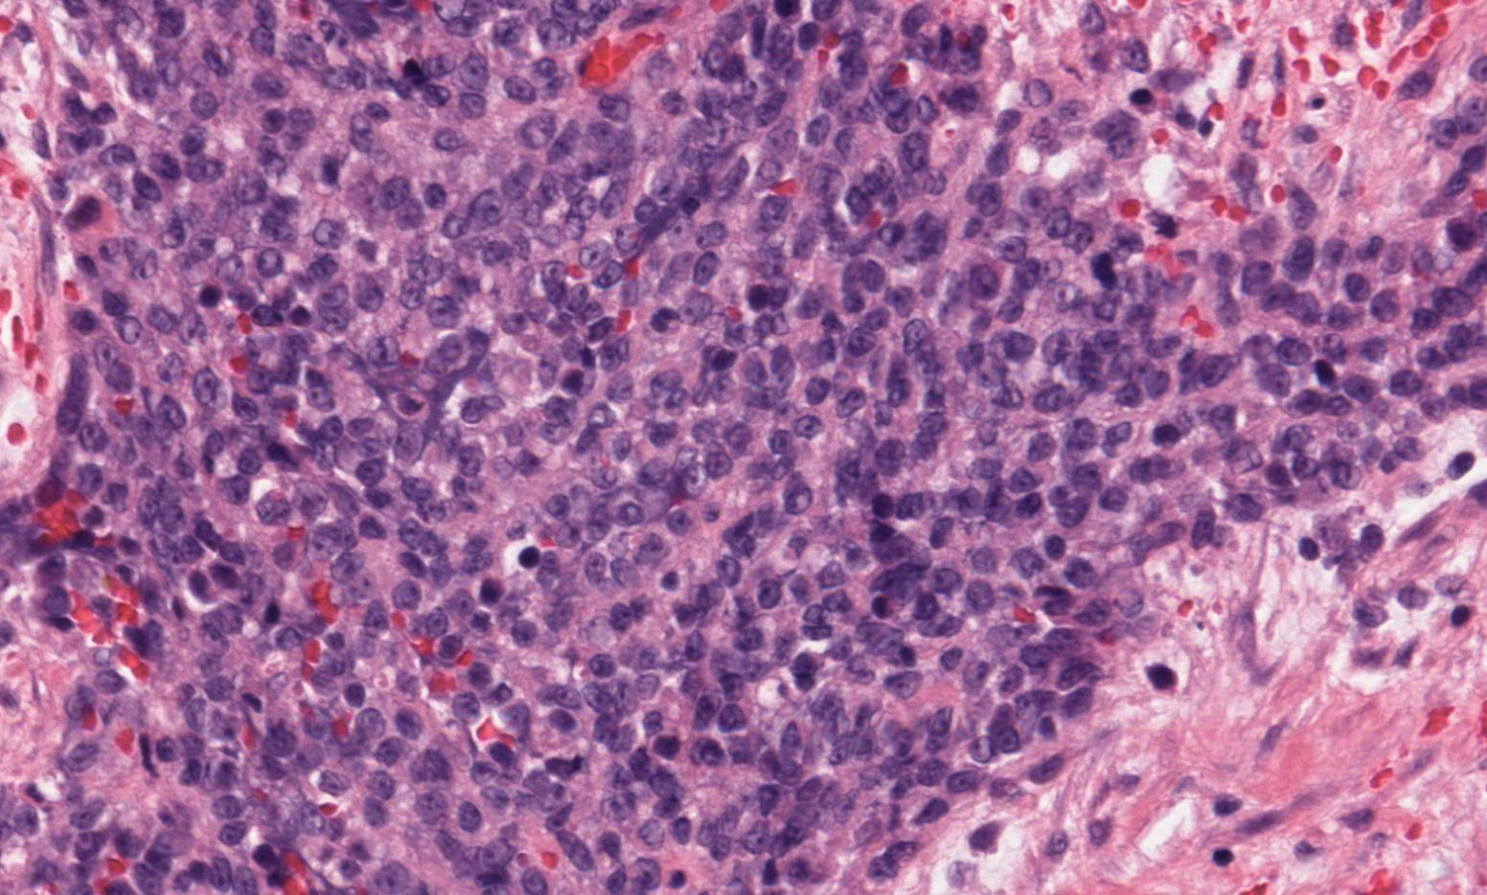
Thank you! G. Petur Nielsen, MD Rosalynn Nazarian, MD
H&E, x 200

Slide 28
References
Chung EB, Enzinger FM. Malignant melanoma of soft parts. A reassessment of clear cell sarcoma. Am J Surg Pathol. 1983 Jul;7(5):405-13.
Gardner, JM. Clear Cell Sarcoma. Expertpath.com.
Hisaoka M, et al. Clear cell sarcoma of soft tissue: a clinicopathologic, immunohistochemical, and molecular analysis of 33 cases. Am J Surg Pathol. 2008 Mar;32(3):452-60.
Hocar O, et al. Clear cell sarcoma (malignant melanoma) of soft parts: a clinicopathologic study of 52 cases. Dermatol Res Pract. 2012;2012:984096. Epub 2012 May 30.
Thway K, Fisher C. Tumors with EWSR1-CREB1 and EWSR1-ATF1 fusions: the current status. Am J Surg Pathol. 2012 Jul;36(7):e1-e11.

