Slide 1
Conjunctival Complex Choristoma
Nasreen A. Syed, MD
F.C. Blodi Eye Pathology Laboratory
University of Iowa

Slide 2
Conjunctival Complex Choristoma
Acknowledgements
Francisca Zuazo Echinique, MD
Patricia Kirby, MD

Slide 3
Conjunctival Complex Choristoma Clinical Presentation
3 month old Caucasian female
Pedunculated mass in the left lateral canthus
Present since about 1 month of age
Medical history: unremarkable
Exam appropriate for age other than the mass

Slide 4
Conjunctival Complex Choristoma Clinical Presentation

Slide 5
Conjunctival Complex Choristoma Management
Resection delayed until 6 months of age due to risks of general anesthesia
Patient returned at age 6 months, lesion slightly larger
Observation recommended
Excisional biopsy performed at age 10 months

Slide 6
Conjunctival Complex Choristoma Gross Examination
Tan-white, solid, rubbery irregular piece of tissue
4 mm x 3.5 mm x 3 mm
Notes:
CD138 – plasma cell marker
Claudin 1 = meningioma, BPH
Claudin 4 = lung adenoCA

Slide 7
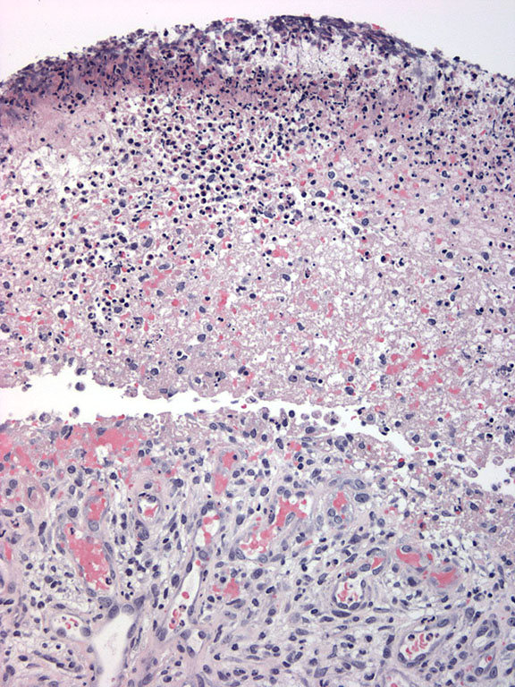
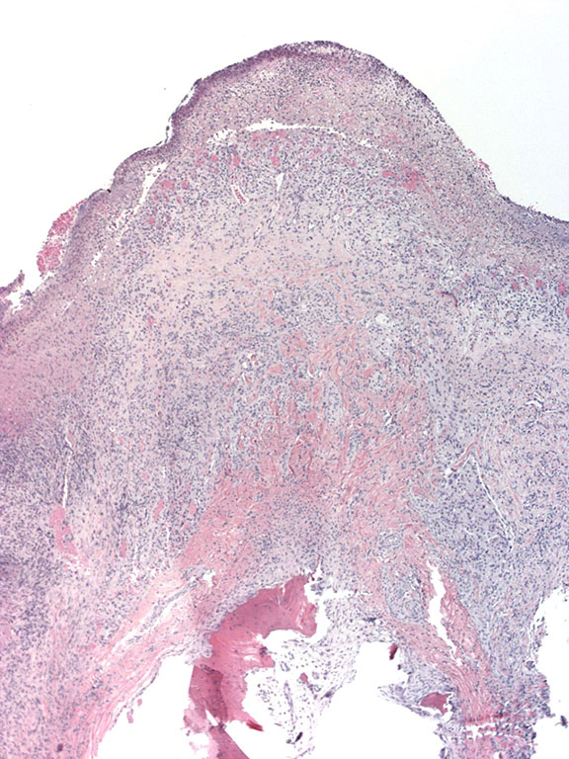
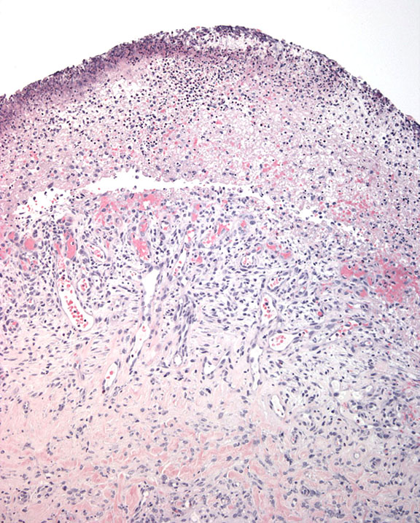
Conjunctival Complex Choristoma Histopathology

Slide 8
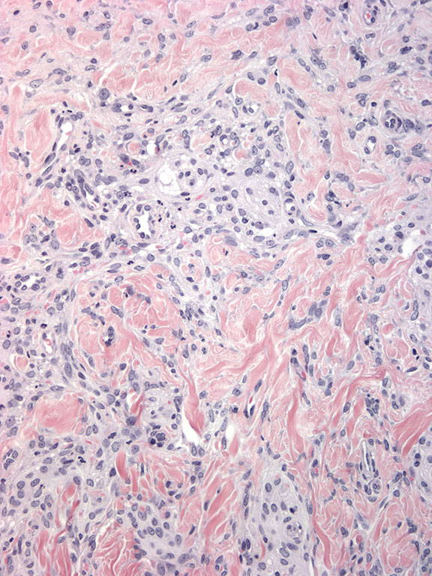
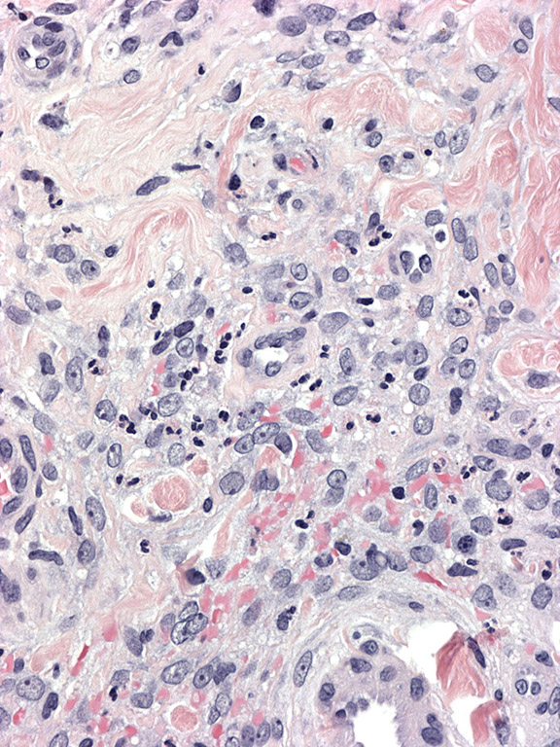
Conjunctival Complex Choristoma Histopathology

Slide 9
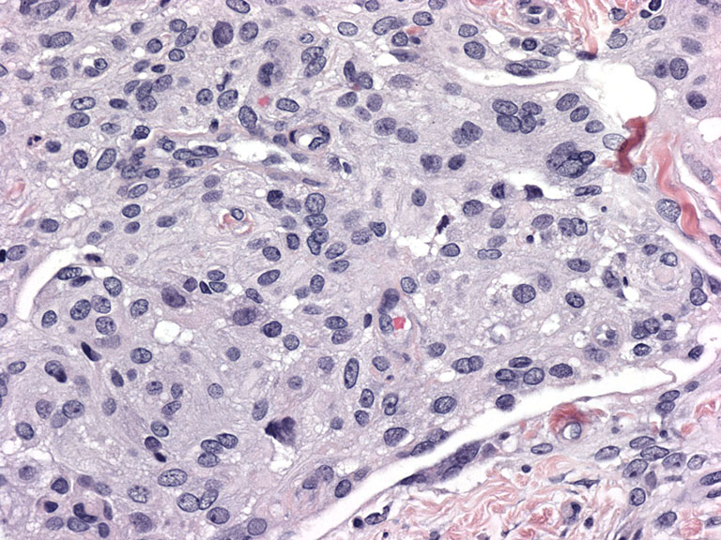
Conjunctival Complex Choristoma Histopathology

Slide 10
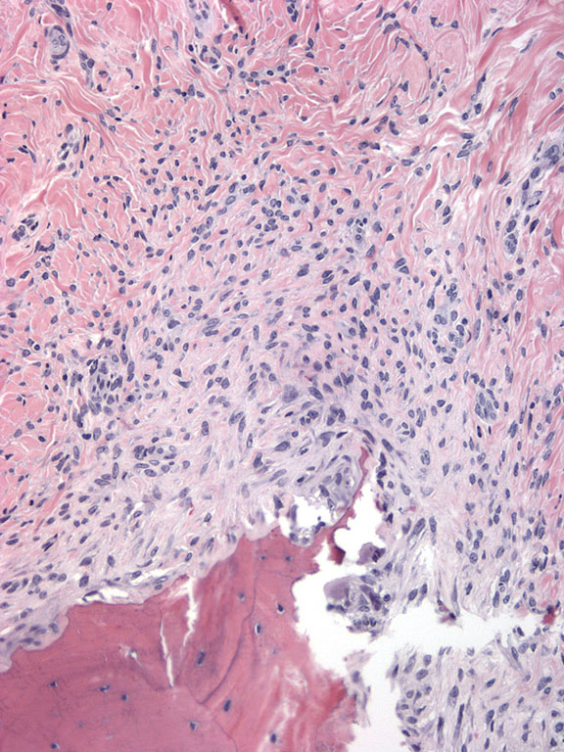
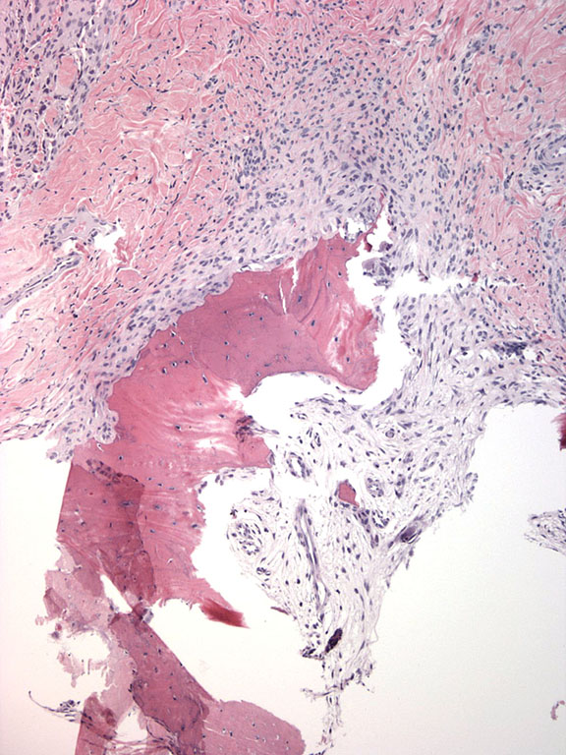
Conjunctival Complex Choristoma Histopathology

Slide 11
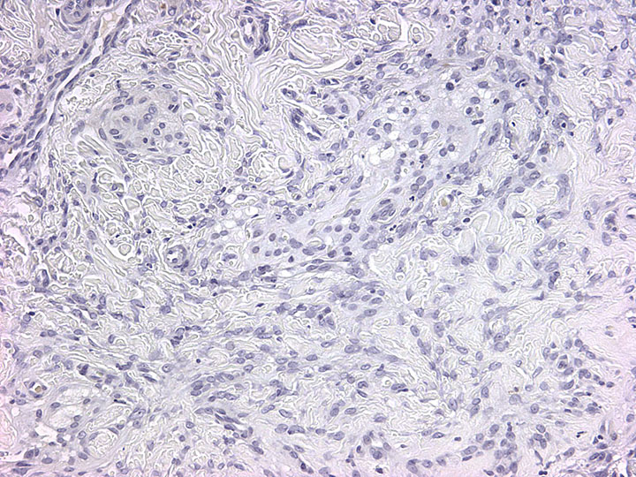
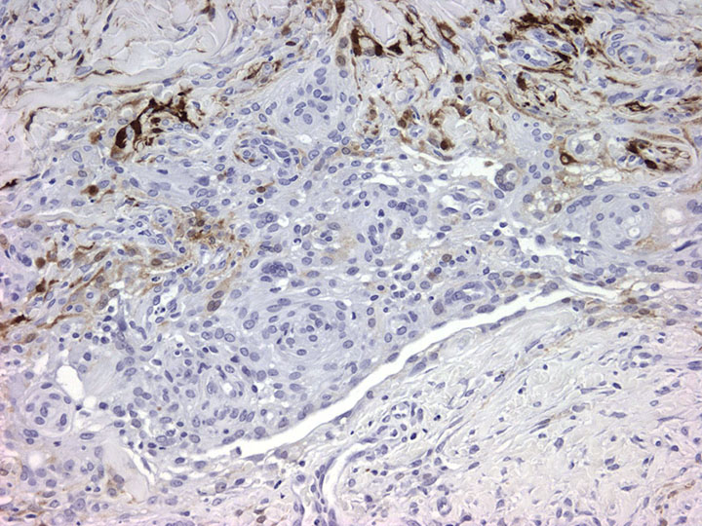
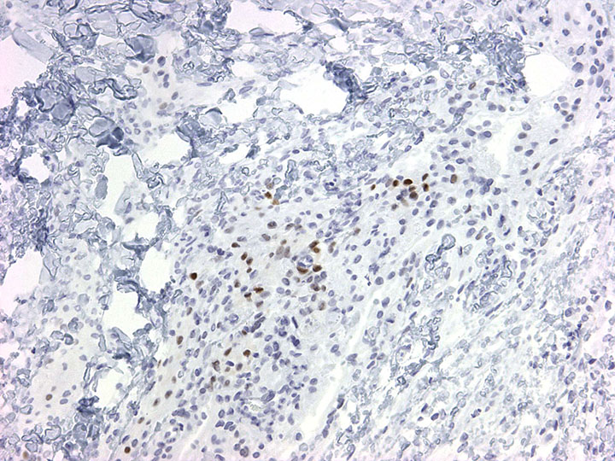
Conjunctival Complex Choristoma Immunohistochemistry
EMA
SSTR2
S100
PR

Slide 12
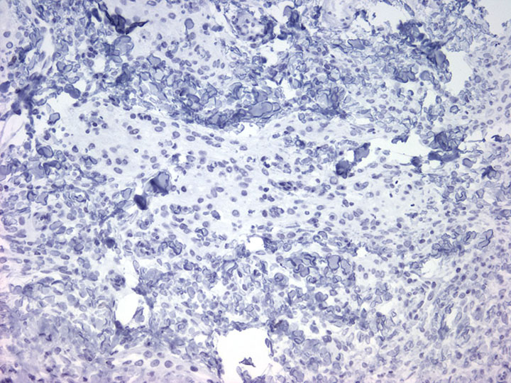
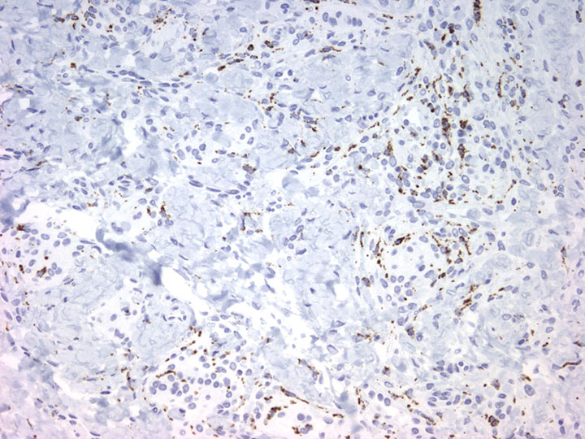
Conjunctival Complex Choristoma Immunohistochemistry
AE1/3
p63
CD68

Slide 13
Conjunctival Complex Choristoma Diagnosis
Conjunctival complex choristoma
Osseous component
Meningothelial component

Slide 14
Conjunctival Complex Choristoma Discussion
Ocular surface choristomatous lesions are uncommon
Typically present in childhood or as young adult
Can occasionally occur in older adults
Usually occur as a dermoid or lipodermoid
Occasionally can have other tissues (complex choristoma)
Smooth muscle, lacrimal gland, bone, cartilage, tooth, brain

Slide 15
Conjunctival Complex Choristoma Discussion
? Cutaneous choristomatous analog
Cutaneous meningioma
3 categories
Type I – primary cutaneous
Type II – deep soft tissue ectopic meningiomas extending into skin
Type III – CNS meningiomas extending into the skin (not choristomatous)
Also may be related to previous trauma with skull fracture

Slide 16
Conjunctival Complex Choristoma Discussion
Cutaneous meningioma
Type 1 cases
Tend to occur on the scalp or paraspinal skin
Childhood or early adulthood
Tend to be of the meningothelial type
Almost all have psammoma bodies
Can express vimentin, EMA, S100, p63
Rarely associated with genetic syndromes such as NF1
Postulated to be on a spectrum with rudimentary meningoceles

Slide 17
Conjunctival Complex Choristoma Discussion
No reports of ocular surface meningothelial choristomas in humans in literature identified
Is this the first case?
Rare reports of type II cutaneous meningiomas in the eyelid
Type I cutaneous meningioma of eyelid has been reported in dogs

Slide 18
Conjunctival Complex Choristoma Discussion
Our case – we recommended imaging of head to exclude a deeper lesion or any anomalies of the CNS
MRI of head and orbits was normal

