Slide 1
Necrotic Sinonasal Neuroendocrine Carcinoma(SNEC)
Keith James Wroblewski MD No financial disclosures to report
Frank Chin, MD (PGY3)
Rim Abdallah, MD (Resident)Pathology)
Sana Tabbara MD Pathology

Slide 2
Which of the following US President shown in his skulling attire at Harvard had a traumatic loss of vision in one of his eyes while boxing in the White House?
A. Aaron Burr
B. Herbert Hoover
C. Alexander Hamilton
D. Teddy Roosevelt
E. Andrew Jackson

Slide 4
Chief Complaint
47 year old female who presented with:
Gradual, progressive loss of vision in the left eye
Binocular diplopia in all directions of gaze
Proptosis of the left eye

Slide 5
History of Present Illness
Late September/early October ’17: Symptoms began with sinonasal pressure, tenderness, and nasal congestion.
No improvement with a course of antibiotics and steroids.
10/11/17: Developed blurred vision OS and binocular diplopia.
10/17/17: Noticed slight proptosis OS along with mild pain/discomfort with extraocular movements.
10/23/17: CT maxillofacial showed a large sinonasal mass.
Admitted to ENT service at GW Hospital.

Slide 6
Past Medical/Ocular/Family History
Past Ocular History:
None reported
Past Medical History:
None reported
Family History:
Unknown, patient was adopted.
Social History:
Occasional alcohol use, denies tobacco or recreational drug use.

Slide 7
Visual Acuity:
OD: 20/20
OS: 20/200, PH NI.
Color Plates:
OD: 24/24
OS: 0/24
Confrontational Visual Fields:
OU: Full
IOP: (tonopen)
OD: 19
OS: 21
EOM Motility:
OD OS
+4 +1
+4 +4 +1-2 0
+4 +1

Slide 8
External Exam:
OS: Grossly proptotic. + APD.
Slit Lamp Exam:
OU: Unremarkable
Dilated Fundus Exam:
OD: Unremarkable
OS: +1 disc elevation with blurred margins and mild hyperemia.

Slide 9
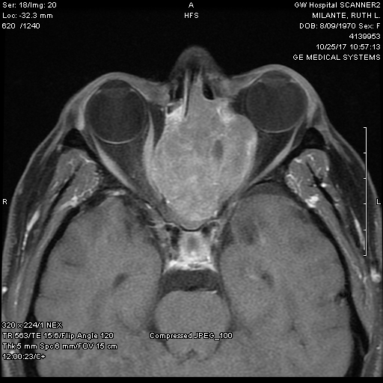
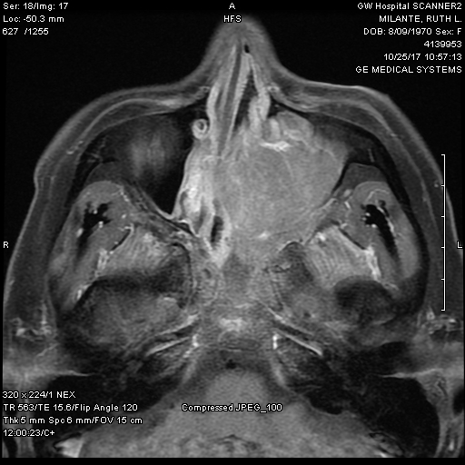
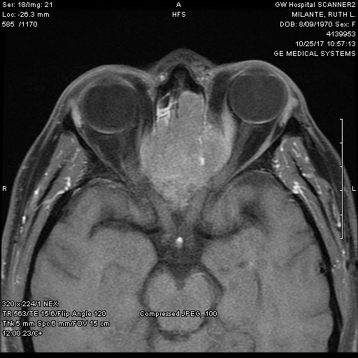
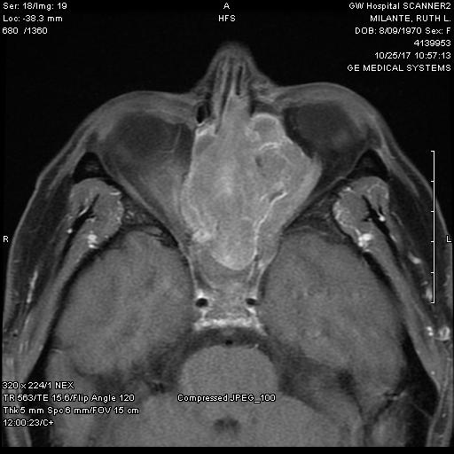
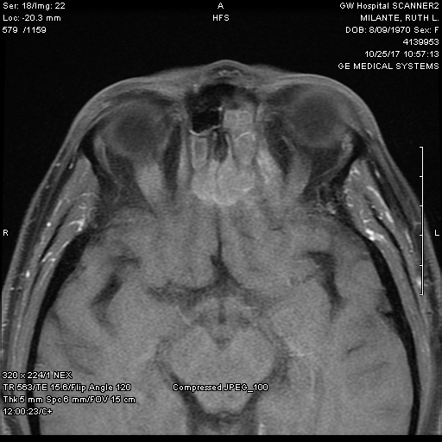
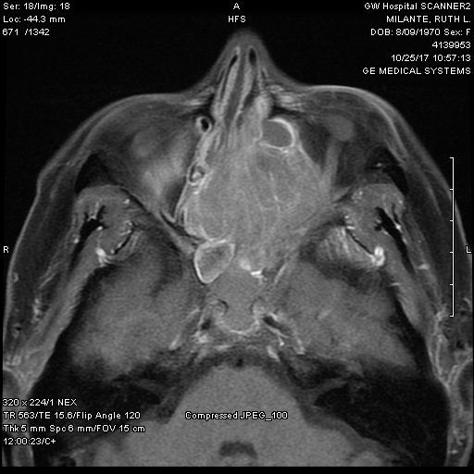
MRI Face/Neck/Orbits

Slide 10
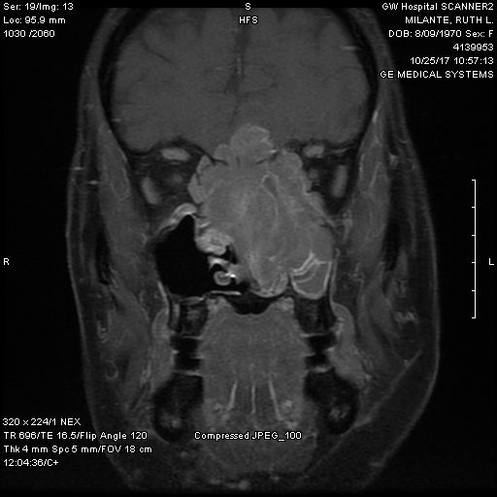
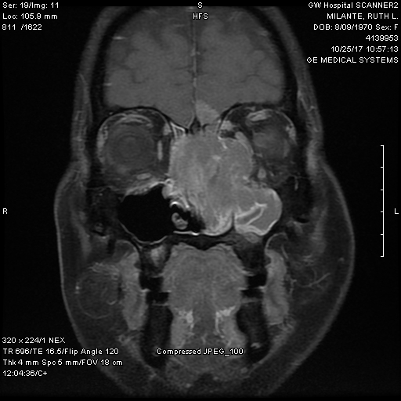
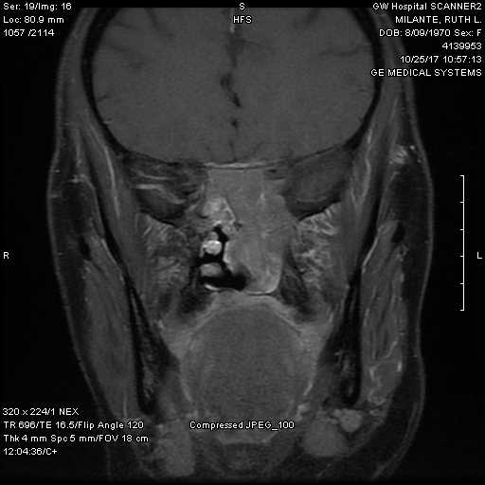
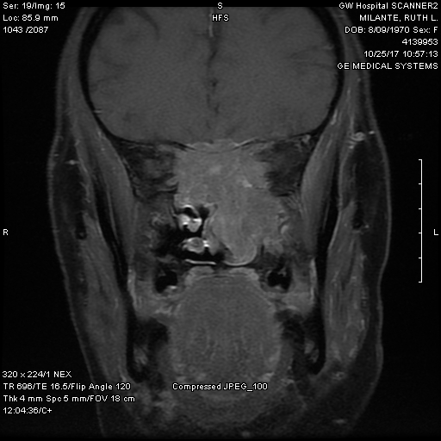
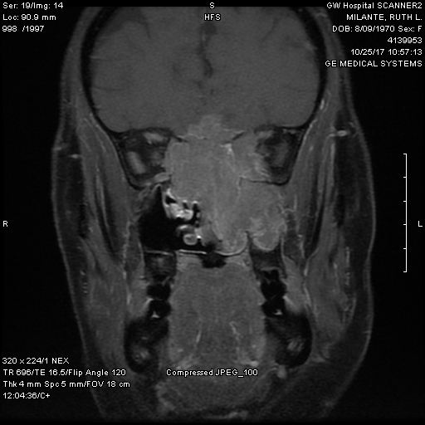
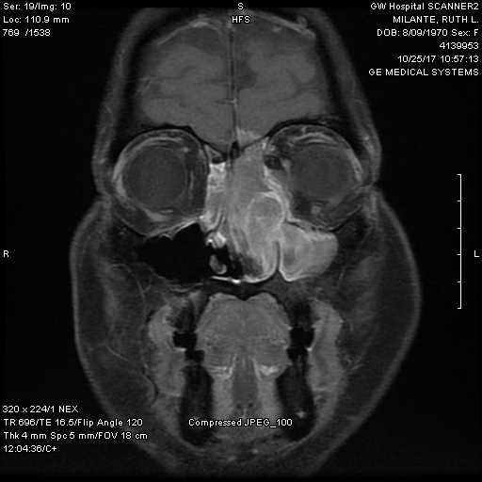
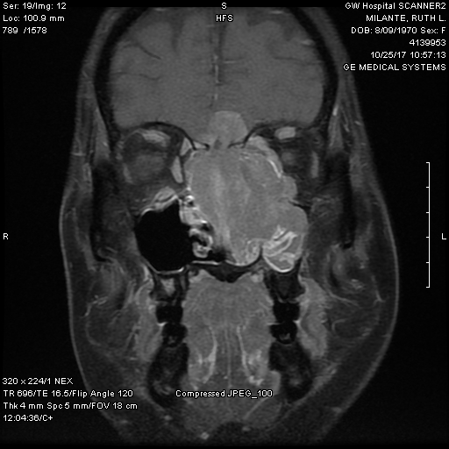
MRI Face/Neck/Orbits

Slide 11
Assessment:
Compressive optic neuropathy and EOM restriction OS secondary to orbital extension of a large sinonasal mass.
Plan:
Exam under anesthesia and nasal endoscopy with biopsy with ENT.
IV Decadron for compressive optic neuropathy.

Slide 12
Hospital Course
10/23/17:
Admitted to GW Hospital.
10/24/17:
Underwent biopsy by ENT.
Frozen section concerning for high grade malignant neoplasm.
10/25/17- 10/27/17:
Eye exam stable/unchanged.
PET scan obtained 10/27/17, showed an extensively hypermetabolic mass (Max SUV = 46.6) in left nasopharynx with extension into bilateral orbits and left maxillary sinus. No other areas of hypermetabolism noted.
Heme/Onc consulted.
Discharged on 10/27/17 with PO prednisone with follow up with ENT, Oncology, and Ophthalmology.

Slide 13
SP-17-17396
01/5/2017

Slide 14
LEFT NASAL CAVITY, MASS, BIOPSY
Multiple fragments of pink-tan soft tissue

Slide 15
Biopsy

Slide 17
Small round cell tumor types: small cell neuroendocrine carcinoma, sinonasal undifferentiated carcinoma, squamous cell carcinoma, Ewing sarcoma-primitive neuroectodermal tumor (PNET), mucosal malignant melanoma, olfactory neuroblastoma (esthesioneuroblastoma), desmoplastic small round cell tumor, rhabdomyosarcoma, etc.

Slide 19
Cytokeratin CAM5.2 and MAK6

Slide 20
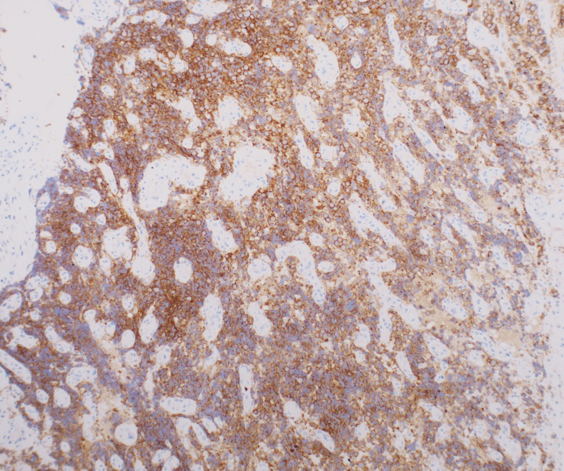
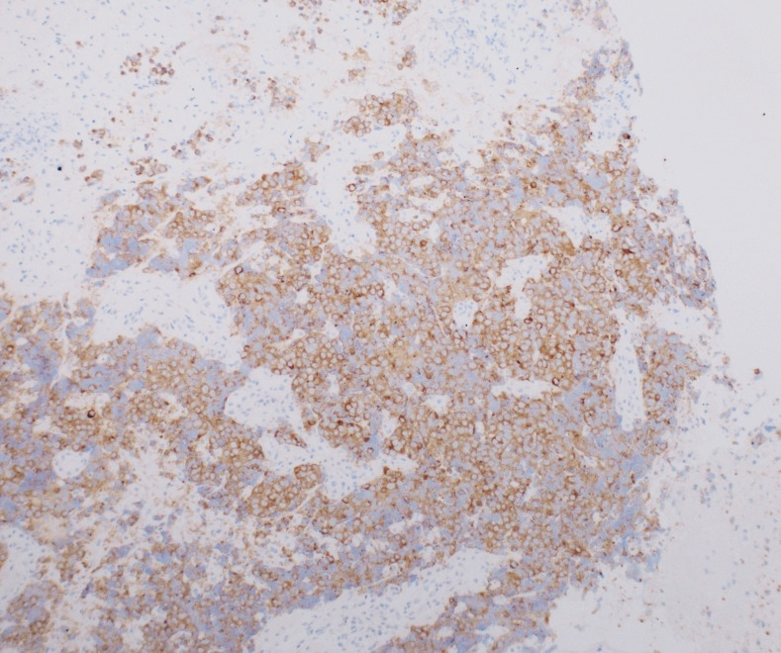
CD56
synaptophysin
Negative for Ck5/6, p40, p63, vimentin, desmin, myogenin, S100, HMB45 and lymphoid markers, EBV negative
Diagnosis: Small cell undifferentiated neuroendocrine carcinoma
AKA poorly differentiated neuroendocrine carcinoma

Slide 21
CD 56

Slide 22
Synatophysin

Slide 23
Outpatient Course
11/1/17:
Oncology:
Induction chemotherapy with Cisplatin (75 mg/m2) and Etoposide (100 mg/m2) x 3-4 cycles.
Further imaging followed by radiation therapy or possible surgical resection upon completion of chemotherapy.
Ophthalmology:
VA OS down to CF @ 2ft. EOM motility restriction stable/no change. No change on DFE.
11/8/17:
First round of chemotherapy with Cisplatin and Etoposide.

Slide 24
Outpatient Course
11/15/17:
VA: OS 20/40-, Full color vision
Resolution of APD
Improvement of proptosis
Improvement in diplopia and EOMs: OS
+3
+3 +2-3
+3-4
However, patient was noted to have developed CSR OS, likely secondary to high dose steroids. Follow up scheduled with retina.

Slide 25
Outpatient Course
12/14/17:
VA OS 20/25
Resolution of diplopia, full EOMs.
CSR OS much improved, OCT mac showed resolution of SRF, mild IS/OS distortion nasal to fovea, and a resolving PED superonasal to fovea.

Slide 26
Small Cell Neuroendocrine Carcinoma
Extra-pulmonary primary small cell neuroendocrine carcinomas are uncommon neoplasms.
Comprises only 2.5-5% of all small cell carcinomas.
11-16% of extra-pulmonary small cell neuroendocrine carcinomas are of primary head and neck origin.
30% of head and neck small cell carcinomas originated from the nasal cavity and the paranasal sinuses.

Slide 27
Small Cell Neuroendocrine Carcinoma
Can initially present with nasal obstruction, nasal discharge, and epistaxis.
Decreased vision, diplopia, proptosis can occur with orbital involvement.
Aggressive tumors with many cases presenting in Stages III, IVA, or IVB
However, small cell neuroendocrine carcinomas of the nasal cavity and paranasal sinuses exhibited the longest overall survival (median survival 36.4 months) and 5 year overall survival of 45%.

Slide 28
Small Cell Neuroendocrine Carcinoma
Current management favors chemotherapy followed by high dose proton-photon radiotherapy, with surgery reserved for non-responders
Cisplatin and etoposide is usually preferred as first line chemotherapy treatment
Ocular toxicities of cisplatin include nonspecific blurred vision, unilateral or bilateral retrobulbar optic neuritis, macular pigmentary changes, and other retinal toxicity.

Slide 29
Questions/Comments?
Special thanks to:
Dr. Craig Geist
Dr. Keith Wroblewski
Dr. Rim Abdallah

Slide 30
References
Barker, Jerry L., et al. “Management of Nonsinonasal Neuroendocrine Carcinomas of the Head and Neck.” Cancer, Wiley Subscription Services, Inc., A Wiley Company, 22 Oct. 2003, onlinelibrary.wiley.com/doi/10.1002/cncr.11795/full.
Fitzek, Markus M., et al. “Neuroendocrine Tumors of the Sinonasal Tract.” Cancer, Wiley Subscription Services, Inc., A Wiley Company, 14 May 2002, onlinelibrary.wiley.com/doi/10.1002/cncr.10537/full.
Krishnamurthy, Arvind, et al. “Small Cell Neuroendocrine Carcinoma of the Paranasal Sinus.”National Journal of Maxillofacial Surgery, Medknow Publications & Media Pvt Ltd, 2013, www.ncbi.nlm.nih.gov/pmc/articles/PMC3800372/.
Pointer, Kelli B., et al. “Small Cell Carcinoma of the Head and Neck: An Analysis of the National Cancer Database.” Oral Oncology, U.S. National Library of Medicine, June 2017, www.ncbi.nlm.nih.gov/pmc/articles/PMC5553627/.
Singh, Parul. Ocular Adverse Effects of Anti-Cancer Chemotherapy. Herbert Publications, 16 Feb. 2012, www.hoajonline.com/jctr/2049-7962/1/5.

