Slide 1
Macular Corneal Dystrophy
Matthew Kaufman, MD
Ophthalmic Pathology CPC
NP Fellow: Ken Clark, MD
Attending: Charleen T. Chu, MD, PhD

Slide 2
Initial Presentation
50 year-old male with a chief complaint of blurred vision and glare from both eyes
Diagnosed with corneal dystrophy 6 years prior
No significant past medical history
Visual Acuity:
20/40 OD
20/30 OS
Pupils, EOMS, Visual Fields, and IOPs Normal

Slide 3
Exam
Slit lamp exam revealed large nummular stromal opacities in the cornea with hazy intervening stroma
Opacities were more superficial centrally and more posterior peripherally
No epithelial staining with fluorescein

Slide 4
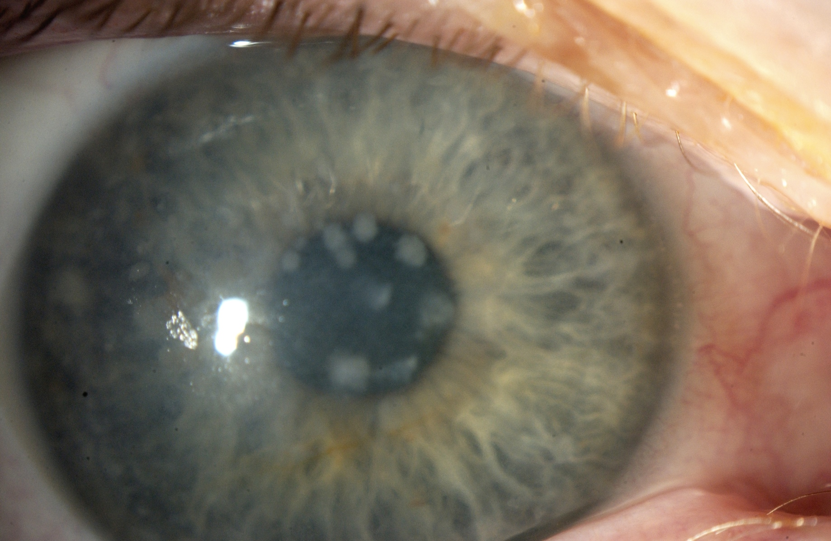
Slit Lamp Photo OD

Slide 5
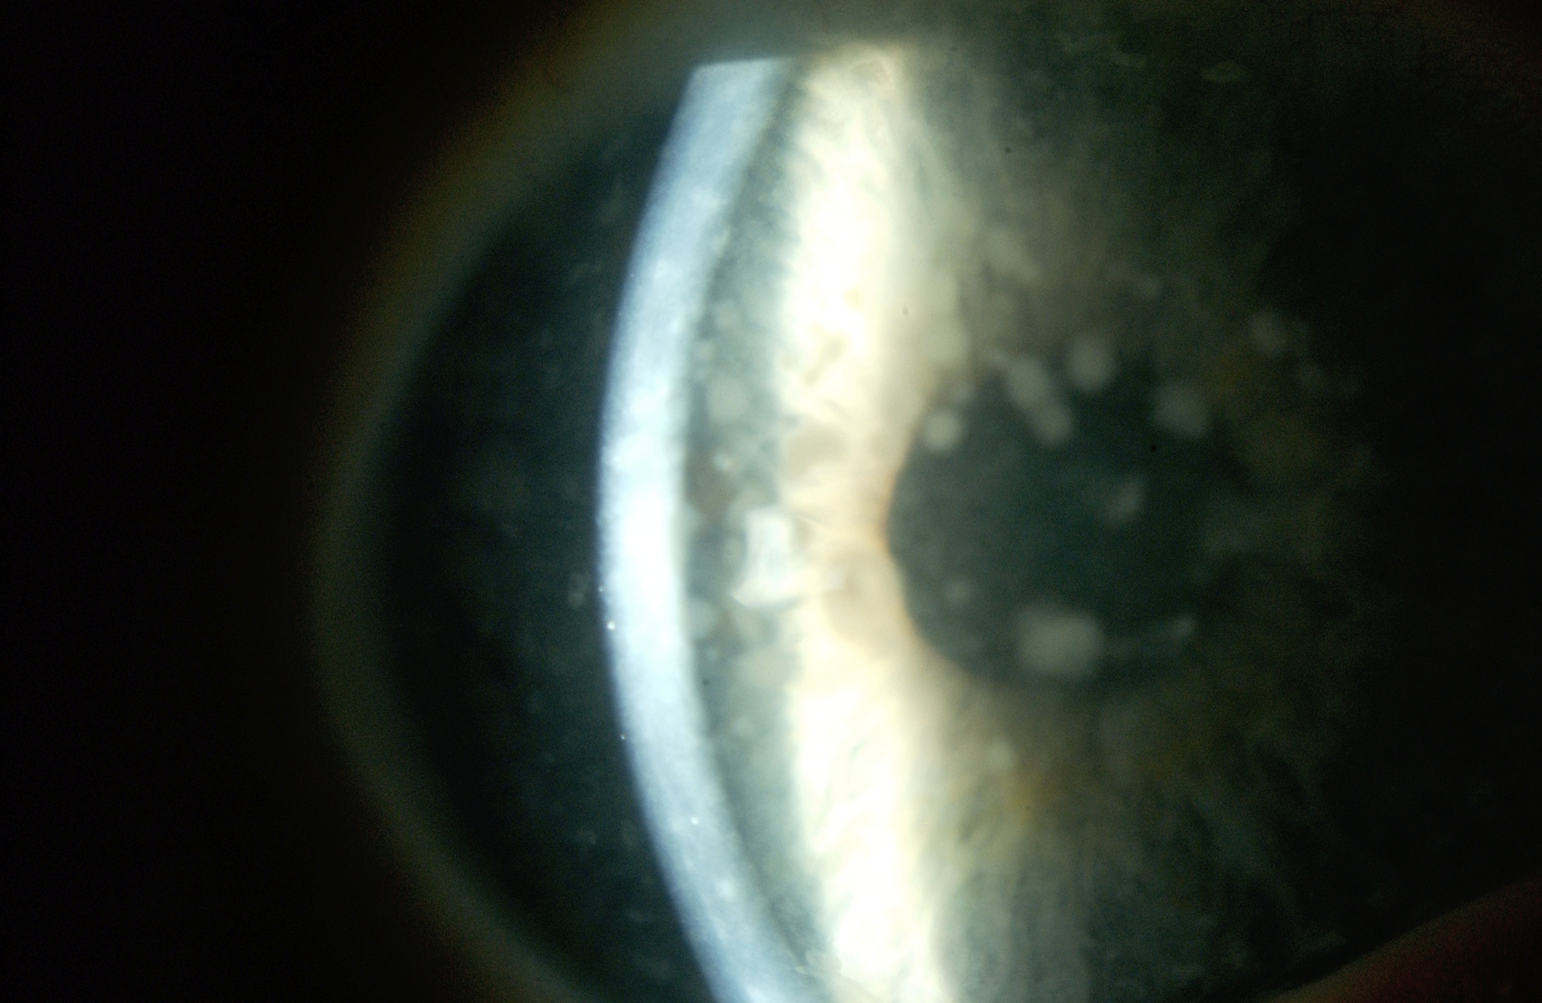
Slit Lamp Photo OD

Slide 6
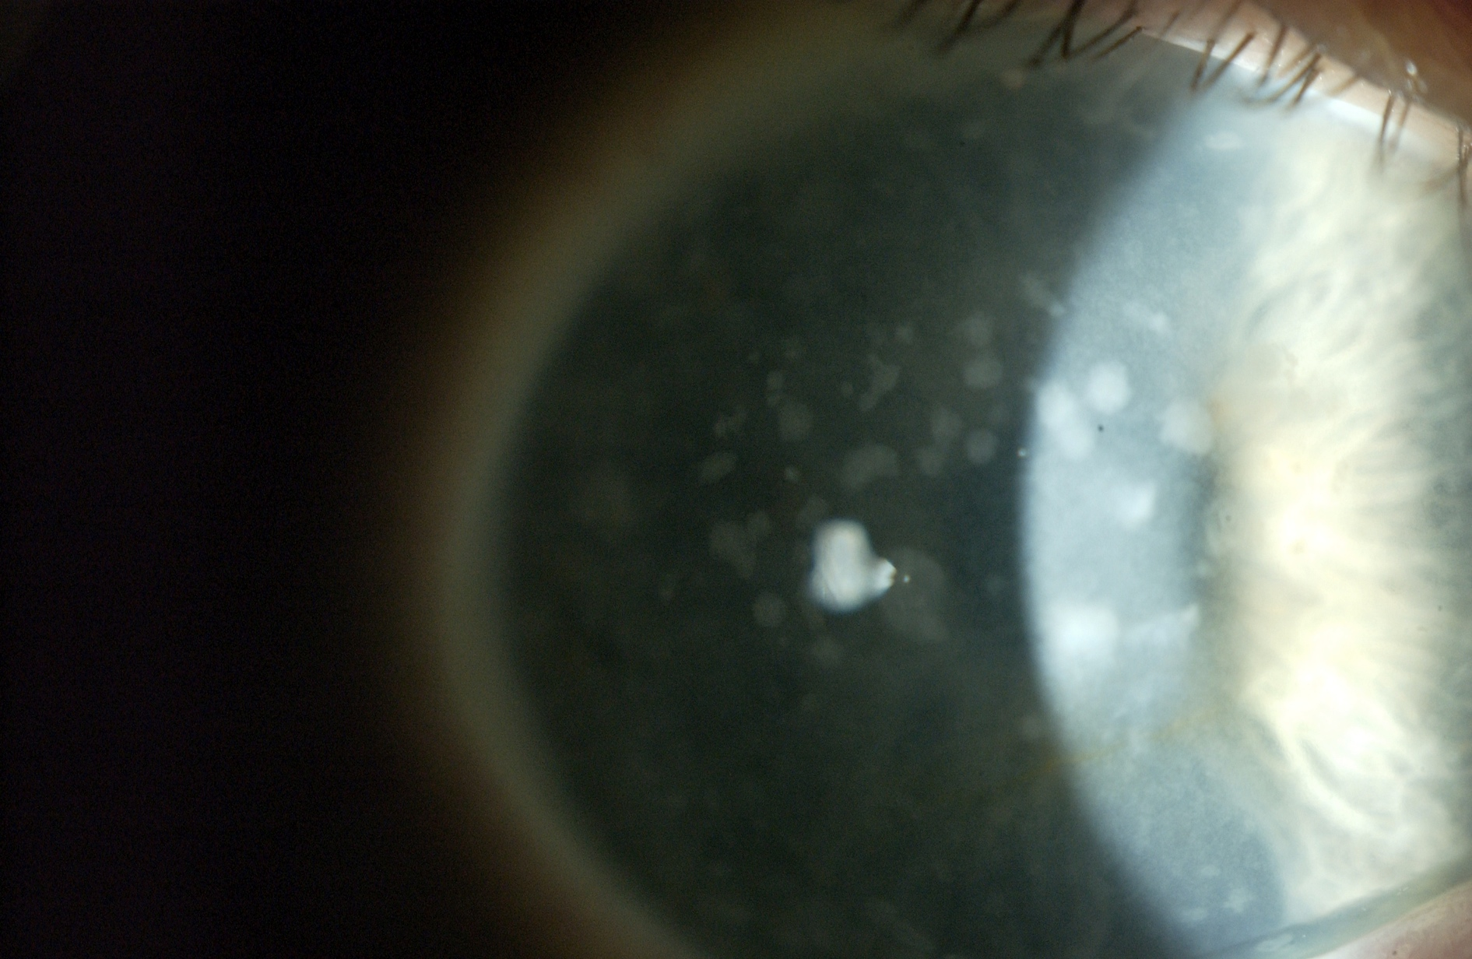
Slit Lamp Photo OD

Slide 7
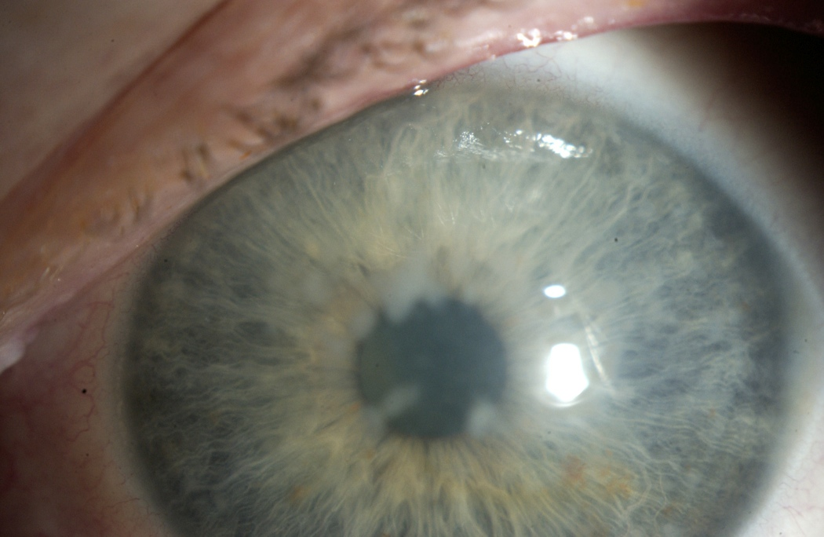
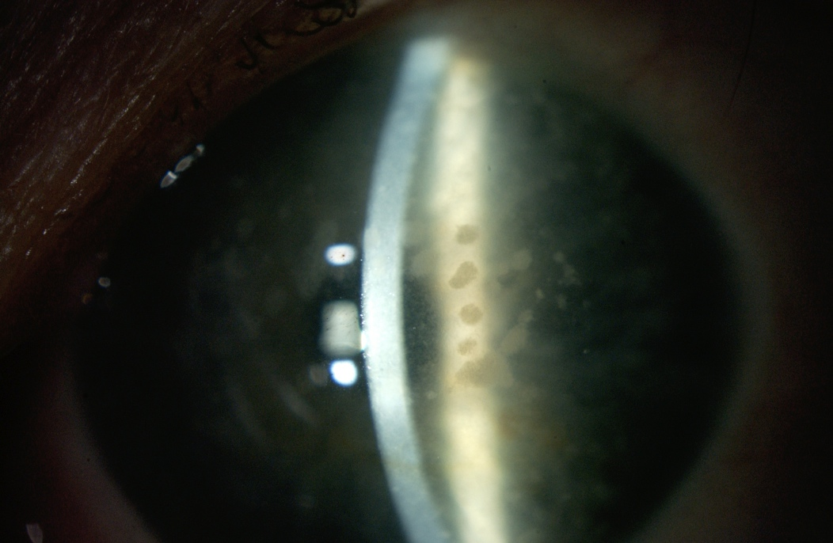
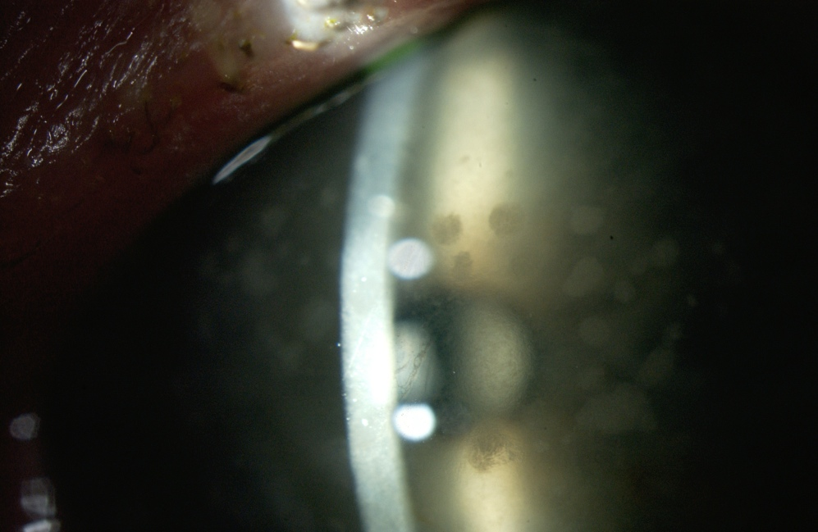
Slit Lamp Photos OS

Slide 8
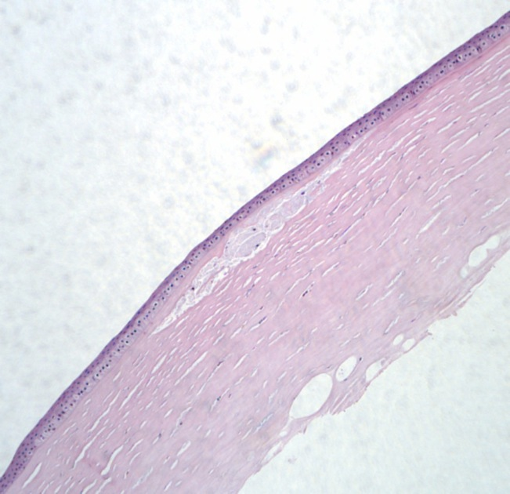
Pathology – Cornea OS (H&E)
Epithelium
Mucopolysaccharide deposits
Stroma

Slide 9
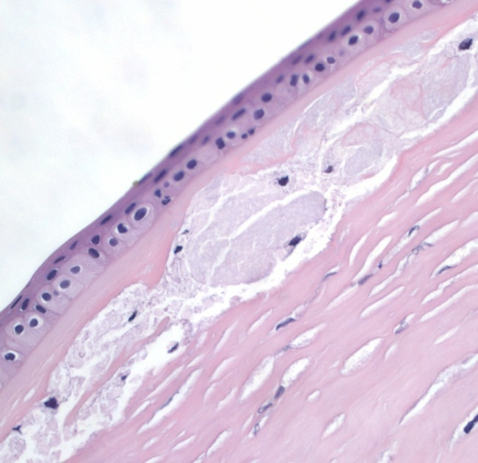
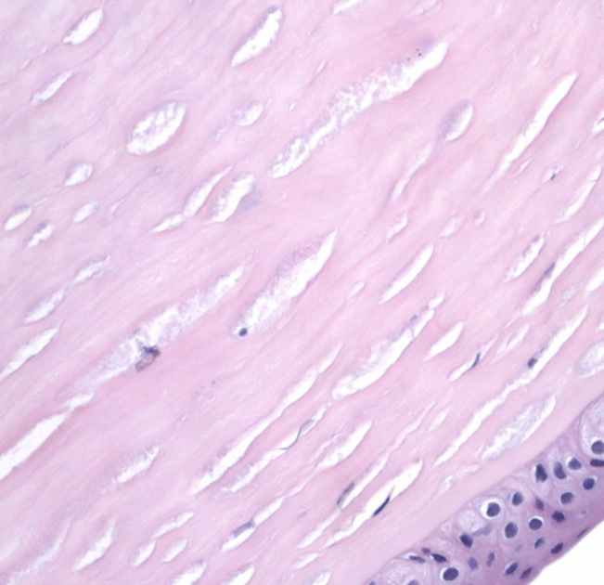
H&E
Mucopolysaccharide

Slide 10
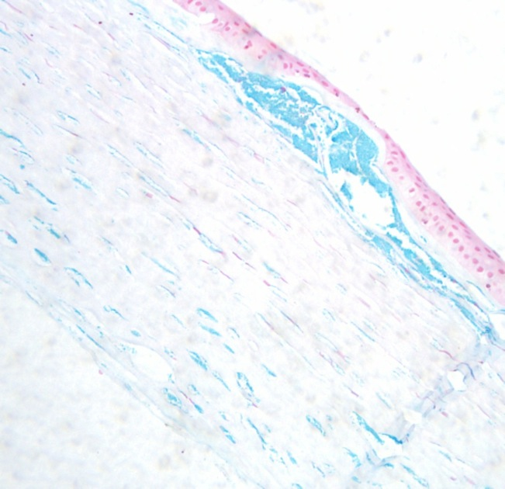
Alcian Blue (pH 2.5)
Mucopolysaccharide

Slide 11
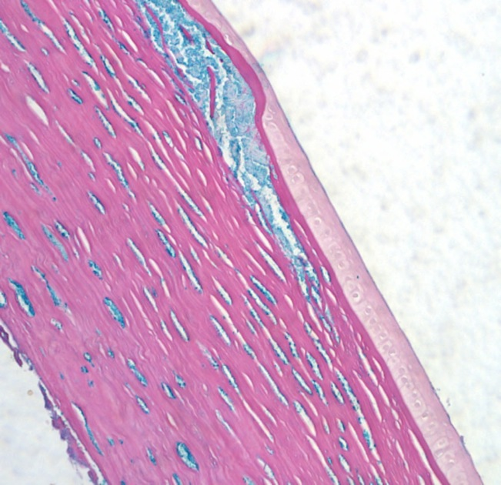
Colloidal Iron
Mucopolysaccaride

Slide 12
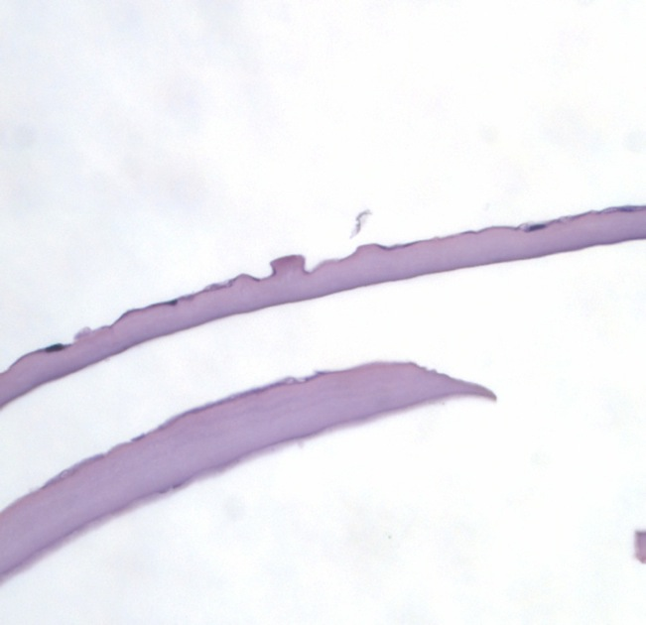
Descemet’s Membrane H&E
Gutta

Slide 13
Diagnosis and Plan
Macular Corneal Dystrophy
Patient was offered phototherapeutic keratectomy (PTK) with plan for lamellar keratoplasty or penetrating keratoplasty if PTK was ineffective
Given minimal symptoms, patient chose to defer treatment

Slide 14
Two Years Later…
Patient complains of increased difficulty driving and reading
Reports significant glare symptoms
Visually acuity 20/50 OU
Proceeds with PTK OD
Post-op visual acuity 20/30 with improved symptoms

Slide 15
One year post-PTK
Patient feels vision worsening again
Difficulty reading, seeing a golf ball, and driving. Still having significant glare/haze.
Slit lamp exam shows the dystrophy affecting all levels of the corneal stroma
Patient elected to proceed with penetrating keratoplasty (PKP) in the left eye

Slide 16
Case
PKP performed in patient’s left eye
Pathology showed corneal stroma with glycosaminoglycan/mucopolysaccharide deposits
Stained positively for for alcian blue and colloidal iron
Guttata were present on Descemet’s membrane

Slide 17
Conclusion of Case
Nine months following PKP in the left eye, vision improved to 20/30
Right eye vision remains 20/40
Improvement in glare

Slide 18
Macular Corneal Dystrophy
Autosomal recessive inheritance
Mutation in chromosome 16q22
Less common than lattice and granular dystrophies
Most prevalent in India, Saudi Arabia, Iceland, and parts of the USA
Corneas clear at birth
Clouding usually begins in the first decade
Earlier onset than lattice and granular
Progressive decrease in vision usually resulting in severe visual impairment

Slide 19
Clinical Appearance
Bilateral
Ill-defined gray-white stromal opacities with hazy surrounding stroma
As disease progresses, hazy areas of stroma merge leaving no intervening clear zones
Progressive extension through entire thickness of central and peripheral corneas
Endothelium and Descemet’s may be involved and show guttata
Rarely, recurrent erosions develop

Slide 20
Three Subtypes
Type I
No detectable keratan sulfate (KS) in the serum or cornea. Normal dermatan sulfate-proteoglycan (DS)
Type II
Normal ratio of KS to DS, but 30% lower production than normal with DS chains 40% shorter than normal
Type IA
No KS in the serum, but KS present in keratocytes

Slide 21
Workup
ELISA to measure sulfated keratan sulfate in preclinical forms or carriers

Slide 22
Histopathology
Intracytoplasmic inclusions in keratocytes and endothelial cells of acid mucopolysaccharide (glycosaminoglycans)
Stain positively for the following:
Alcian blue
Colloidal iron
Sometimes Periodic acid-Schiff
May have guttata of Descemet’s membrane

Slide 23
Classic Corneal Stromal Dystrophies
Macular Corneal Dystrophy
Lattice Corneal Dystrophy
Granular Corneal Dystrophy
Avelino Dystrophy

Slide 24
Lattice Corneal Dystrophy
Type I: TGFBI gene, mutation in locus 5q31
Autosomal dominant
Clinical:
Glasslike branching lines in stroma
Pathology:
Amyloid deposits in anterior stroma extending to subepithelial area with possible disruption of epithelium
Stains with Congo red dye
Recurs in PKP more frequently than granular or macular

Slide 25
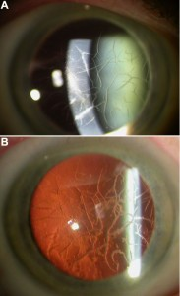
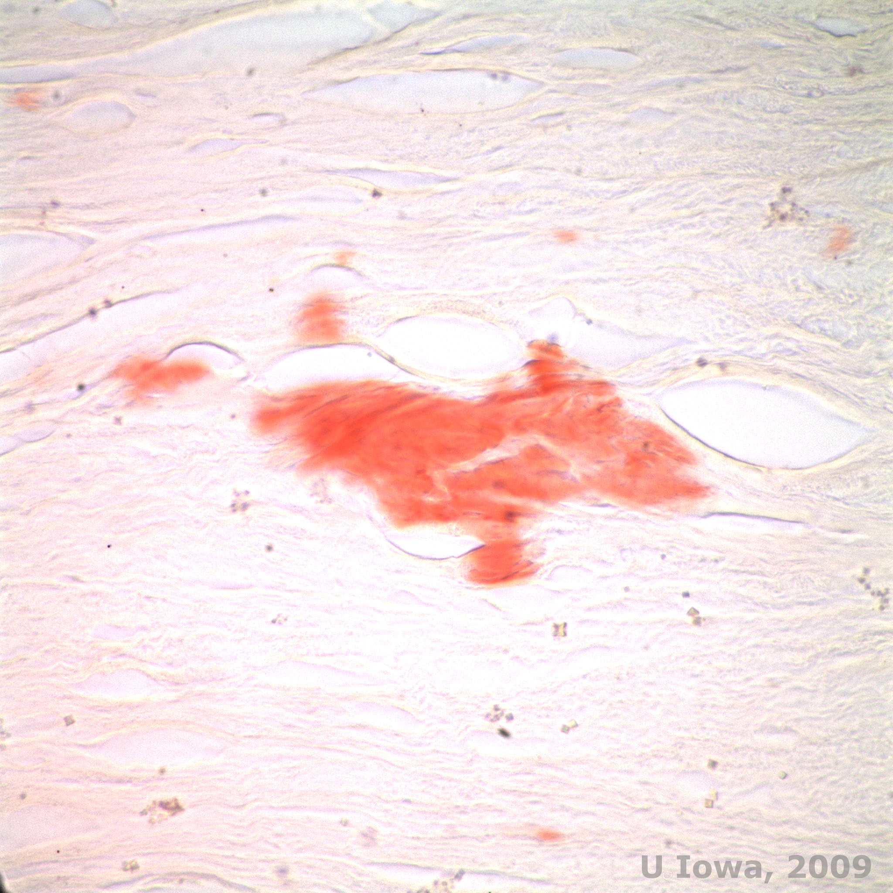
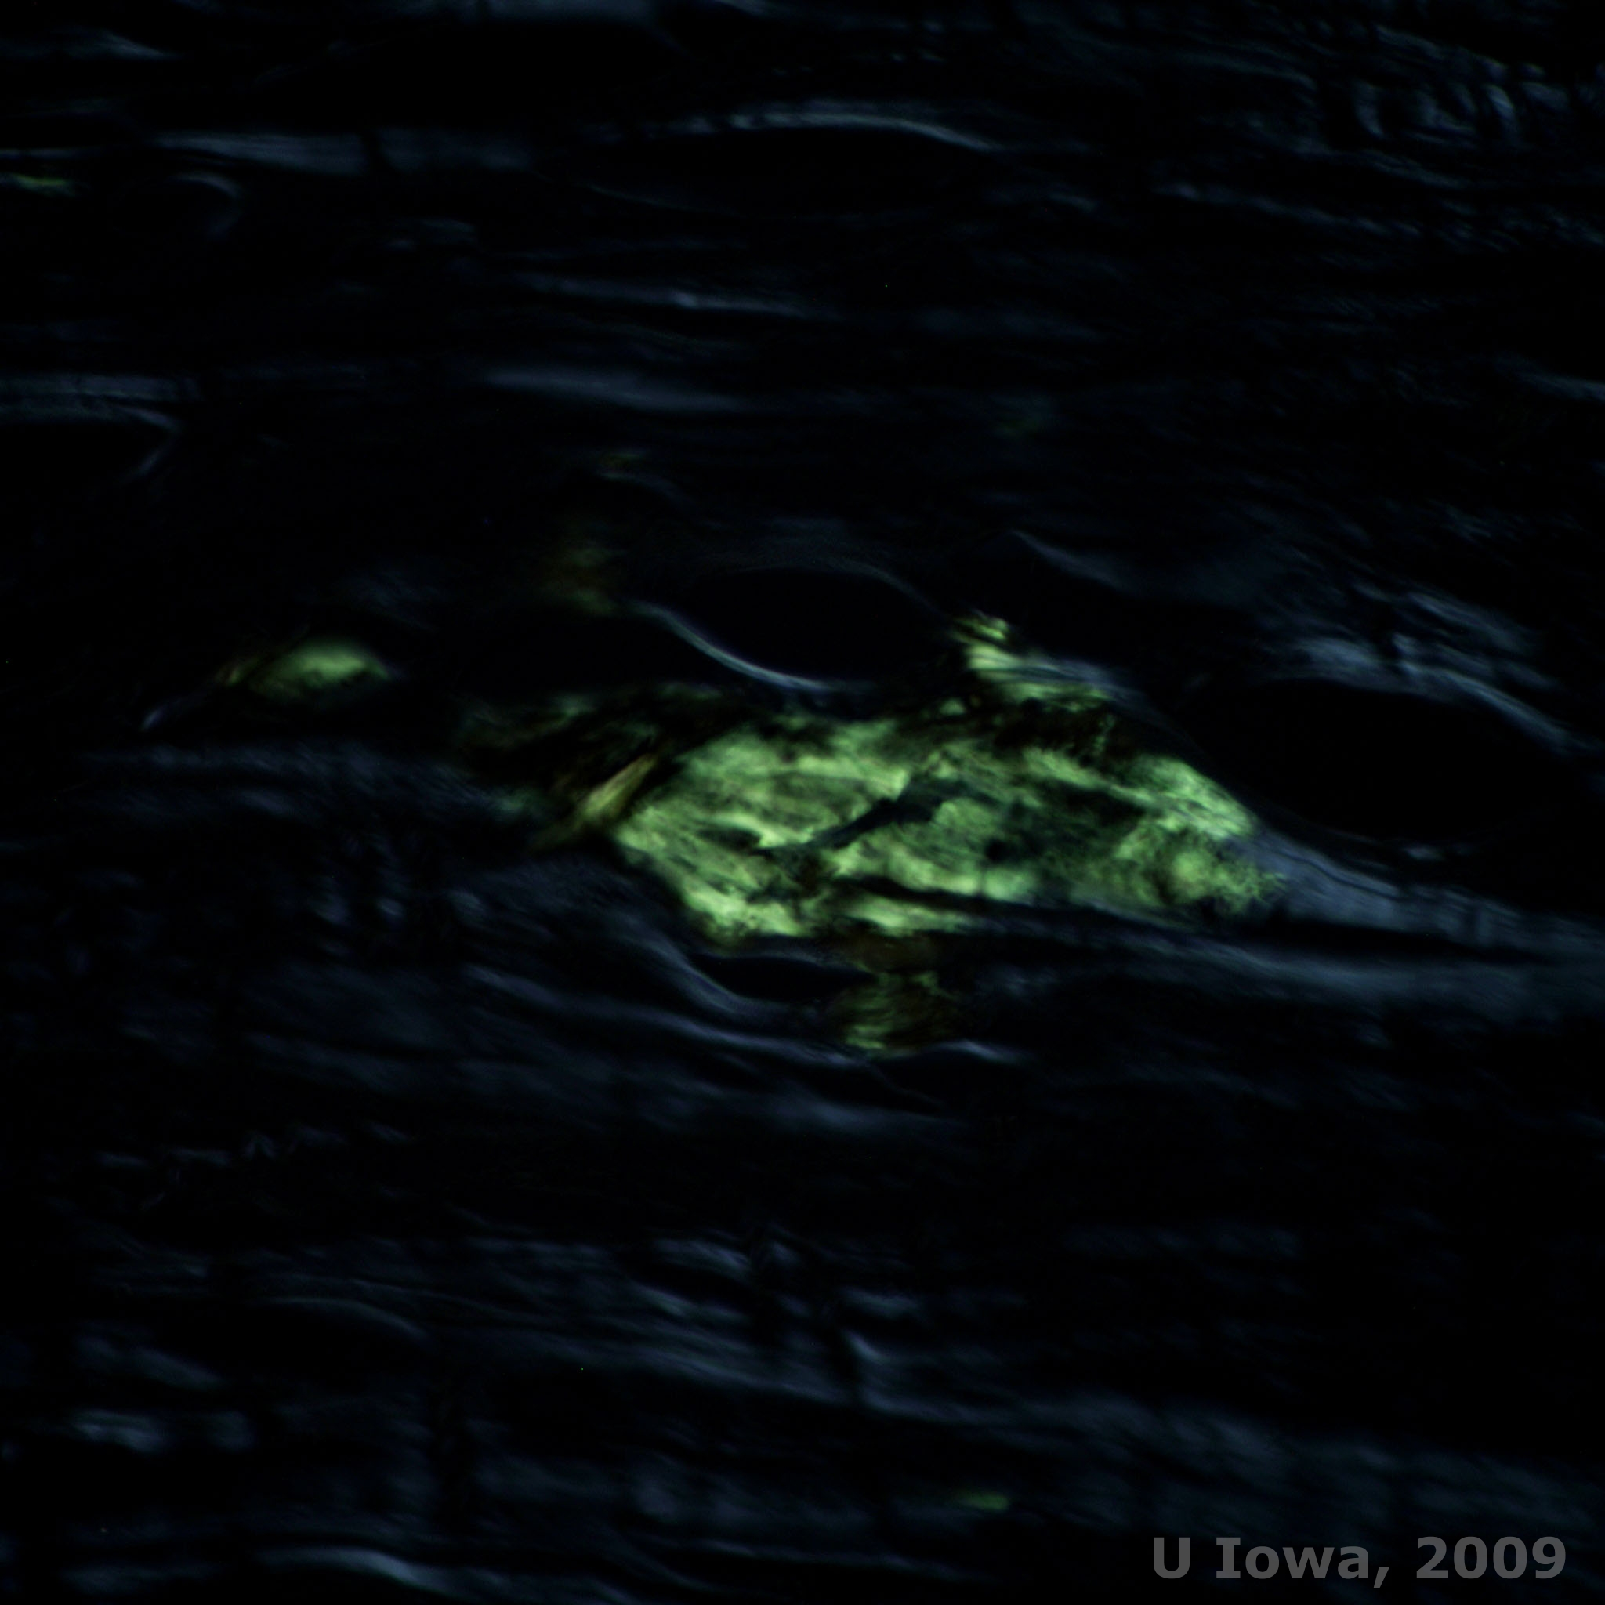
Lattice Dystrophy
Congo red staining amyloid
Apple-green birefringence under polarized light
Source: odlarmed.com/?p=3684
Source: webeye.ophth.uiowa.edu

Slide 26
Granular Corneal Dystrophy
TGFBI gene, mutation in locus 5q31
Autosomal dominant
Clinical:
Crumblike stromal opacities with intervening clear spaces
Pathology:
Hyaline rod-shaped deposits in stroma that can extend anteriorly through focal breaks in Bowman’s layer
Stains with Masson trichrome

Slide 27
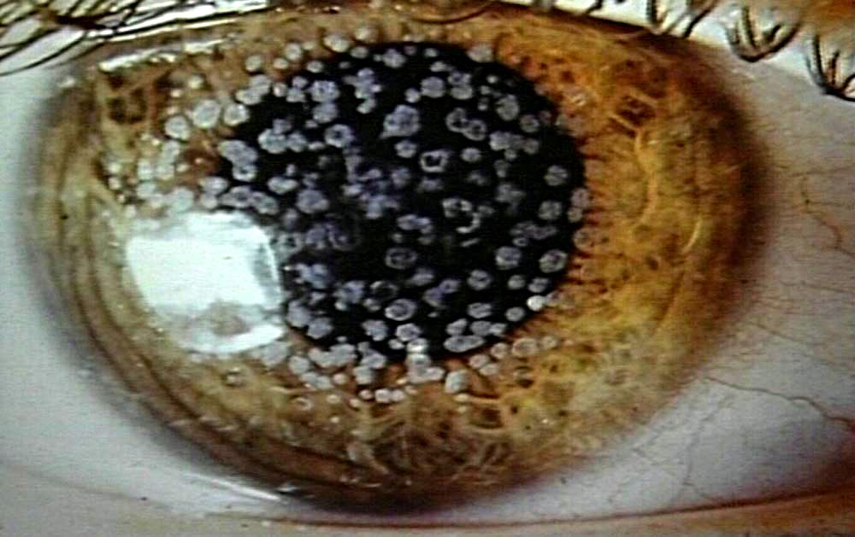
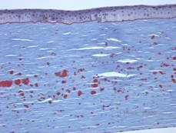
Granular Dystrophy
Source: odlarmed.com/?p=3680
Masson trichrome staining hyaline
Source: webeye.ophth.uiowa.edu

Slide 28
Avellino Dystrophy
TGFBI gene, locus 5q31
Autosomal dominant
Combination of lattice and granular dystrophies
Named for 4 early patients who traced their family to Italian province of Avellino
Clinically and pathologically shows granular and lattice lesions
Stains with both Masson trichrome and Congo red dye

Slide 29
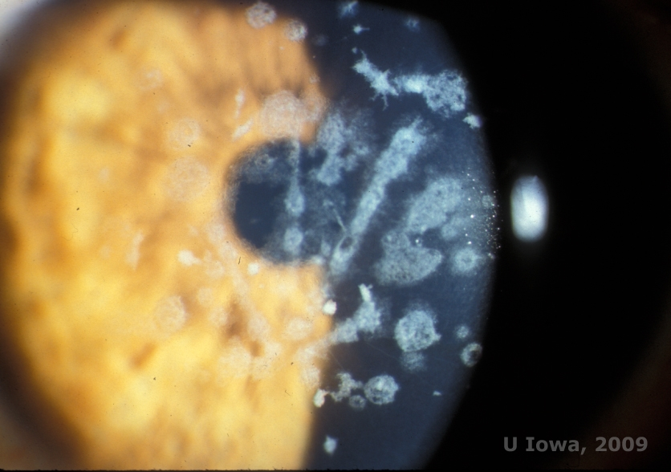
Avellino Dystrophy
Source: webeye.ophth.uiowa.edu

Slide 30
References
Case ID: PHS11-34882
Clinical Approach to Corneal Dystrophies and Metabolic Disorders. In: Basic and clinical science course (BCSC) Section 8: External disease and cornea. San Francisco, CA. American Academy of Ophthalmology; 2009:319-20.
Klintworth, GK. Corneal dystrophies. Orphanet J Rare Dis. 2009 Feb 23; 4:7. Review.

